Slide 1
Zomato Restaurant Analysis
-OVERVIEW
-ORDERS & RATINGS

Slide 2
Agenda
Introduction
Overview Page Insights
Orders & Ratings Page Insights
Key Findings
Recommendations
Q&A

Slide 3
Project Objective
Goal: To understand customer preferences, restaurant performance, and ordering patterns using Zomato data, and extract actionable insights for business decisions.

Slide 4
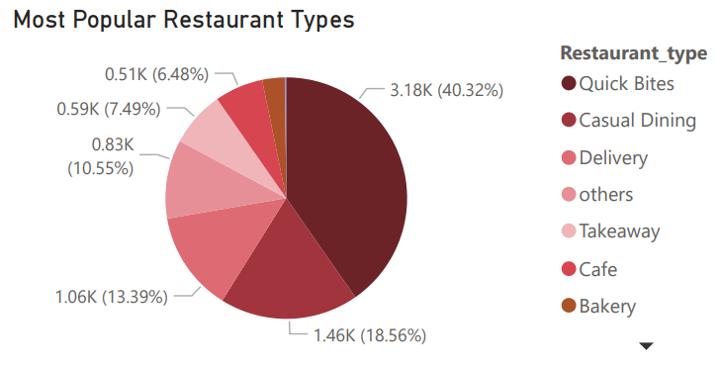
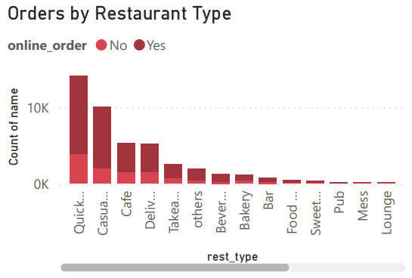
Restaurant Types & Ordering Trends
Casual Dining leads as the most common restaurant type.
Cafes and Quick Bites also show high presence, catering to younger and working crowds.
These three formats dominate the food scene, showing Bangalore’s affinity toward accessible, casual spots.
Most orders for Quick Bites and Cafes are p-laced online.
Fine Dining and Lounges rely more on offline (walk-in) customers.
Zomato can tailor offers or boost app features based on these patterns

Slide 5
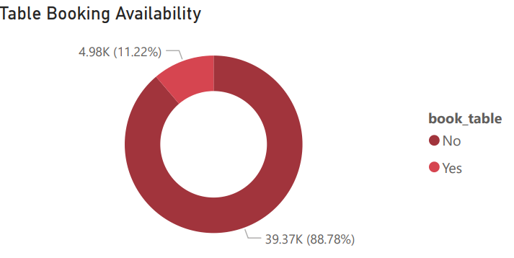
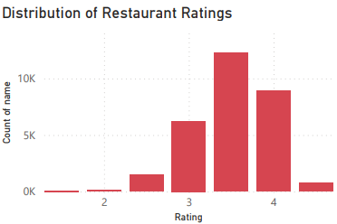
Table Bookings & Restaurant Ratings
A significant number of restaurants do not provide table booking.
Booking options are more common in upscale or Fine Dining establishments.
Zomato can expand its booking service in underutilized categories.
Most restaurants have ratings between 3.5 and 4.2, indicating good but not exceptional performance.
Very few are rated below 3 or above 4.5.
This helps customers set realistic expectations and allows Zomato to feature top-rated places.

Slide 6
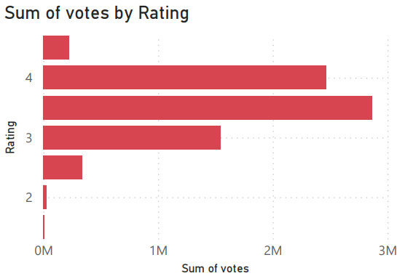
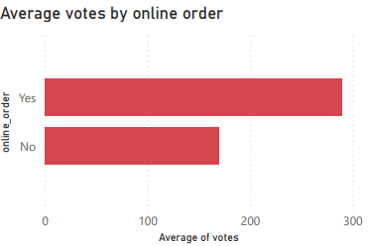
Customer Engagement & Votes
Restaurants rated 4.0 and above receive the highest customer votes.
Indicates that users are more likely to
engage with highly rated establishments
Restaurants that support online ordering receive more votes on average than offline-only.
Shows digital ordering boosts visibility and interaction.

Slide 7
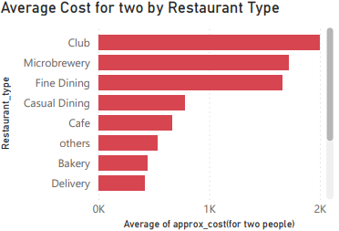
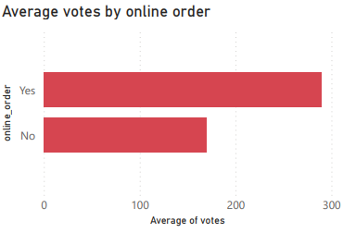
Ratings vs Cost & Restaurant Type Performance
Clubs and Microbreweries have the highest average spend (₹1700–₹2000+).
Cafes and Casual Dining are more budget-friendly.
Zomato can use this to segment customers and design cost-sensitive offers.
Restaurants that accept online orders receive a higher average number of customer votes compared to those that don’t.
This indicates that online ordering enhances customer engagement and visibility, encouraging users to leave feedback.

Slide 8
Conclusion:
Casual Dining and Quick Bites are the most dominant and preferred restaurant types.
Online ordering enhances customer engagement, shown by higher votes and reach.
Average ratings cluster around 3.5–4.2, indicating consistent quality.
Premium restaurants like Clubs and Microbreweries attract higher spenders.
Strategic use of this data can help Zomato refine its marketing, partnerships, and service offerings.

