Slide 1

ArchAI
The Business Case for ArchAI
The AI Cloud Architect for SMBs — pitch, moat, ROI, comparison, and architecture
Prepared for CTO / CIO evaluation
ArchAI — A product from nexplanit.com · info@nexplan.io

Slide 2

THE PROBLEM
Cloud architecture is slow, expensive, and reviewed after the fact.
$500/hour
Typical enterprise cloud consulting rate
2–6 weeks
Time from kickoff to a usable architecture
After the fact
When security & compliance usually get reviewed
ArchAI — A product from nexplanit.com · info@nexplan.io

Slide 3
THE PITCH
Cloud architecture, at software speed and software cost.
ArchAI replaces manual consulting and hand-written Terraform with a validated, multi-agent AI pipeline. Describe a system in plain English — or point it at infrastructure you already have — and get production-ready, audited Terraform for AWS, Azure, and GCP in minutes. Starting free.
ArchAI — A product from nexplanit.com · info@nexplan.io

Slide 4
HOW IT WORKS
Four specialised AI agents. One validated blueprint.
Gatekeeper
Architect
Engineer
Auditor
01
→
02
→
03
→
04
Validates the request is genuine infra work
Designs the resource plan as structured JSON
Writes production Terraform (HCL)
Checks syntax & security — retries on failure
Same pattern for Brownfield: Scanner → Auditor → Planner → Engineer, plus an auto-generated Architectural Decision Record.
ArchAI — A product from nexplanit.com · info@nexplan.io

Slide 5
THE MOAT
Why this is defensible, not just a wrapper on an LLM.
01
02
Validated output, not raw generation
Compounding switching cost
A dedicated Auditor checks every blueprint before you see it — retrying automatically on failure.
Your standards, encoded once in the Knowledge Base, enforced on every future blueprint automatically.
03
04
Full lifecycle, not a point solution
SMB-priced, enterprise-capable
Design, security, cost, DR, and brownfield migration — in one platform, not five stitched together.
Comparable platforms price $349–$1,500+/mo for platform teams. ArchAI starts free, full capability at $199/mo.
ArchAI — A product from nexplanit.com · info@nexplan.io

Slide 6
COST & ROI
What this actually saves you.
Time to result
2–6 weeks → under 2 minutes
Compliance review
Manual, extra cost → automatic, every blueprint
Entry cost
$0 to start, full platform at $199/mo
ArchAI — A product from nexplanit.com · info@nexplan.io

Slide 7
FEATURES
One platform, the full lifecycle.
Greenfield design
Brownfield migration
Security & compliance
Plain-English input → validated Terraform in under 2 minutes.
Scan existing infra, get an audited phased migration plan.
SOC 2, GDPR, HIPAA, CIS Benchmark — applied automatically.
Multi-cloud cost comparison
Disaster recovery planning
Knowledge Base enforcement
Side-by-side AWS/Azure/GCP estimates, built in.
RTO/RPO targets generated with every architecture.
Your standards, enforced on every future blueprint.
ArchAI — A product from nexplanit.com · info@nexplan.io

Slide 8
HOW IT COMPARES
Against the platforms you're probably already evaluating.
Capability | ArchAI | Spacelift / env0 | Pulumi | StackGen | Generic AI
Natural-language generation | ✓ | ✗ | ✗ | ✓ | Partial
Validates before you see it | ✓ | Post-deploy | ✗ | ✓ | ✗
Brownfield migration plan | ✓ | ✗ | ✗ | Limited | ✗
Built-in cost comparison | ✓ | Needs add-on | ✗ | Unclear | ✗
Transparent SMB pricing | Free → $199/mo | $349–1,500+/mo | Free (self-run) | Quote-only | N/A
Reflects each platform's publicly stated capabilities as of 2026 — verify current details directly with each vendor.
ArchAI — A product from nexplanit.com · info@nexplan.io

Slide 9
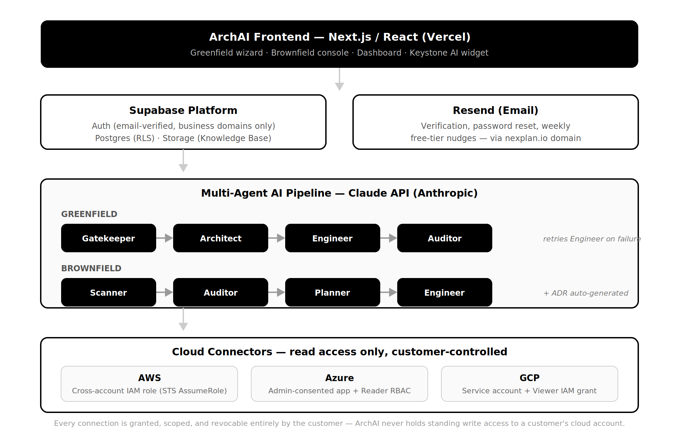
TECHNICAL ARCHITECTURE
How it actually works under the hood.
ArchAI — A product from nexplanit.com · info@nexplan.io

Slide 10
PRICING
Start free. Scale as you grow.
Scout
Pro
Team
Enterprise
$0
$49/mo
$199/mo
$1,500/mo
3 blueprints/mo · AWS only
25 blueprints/mo · All clouds
150 blueprints/mo · Brownfield included
Unlimited · SSO · Dedicated support
ArchAI — A product from nexplanit.com · info@nexplan.io

Slide 11
Ready to see it on your infrastructure?
arch.nexplan.io · info@nexplan.io
A product from nexplanit.com

