Slide 1
CreditOne - Credit Analysis
Sandia Pattabiraman

Slide 2
GOALS
As the current way of finding credit score to someone is not that effective, I define the below 2 goals for this project :
Is there a better way in figuring out if a loan can be approved to someone or not ?
Is there a better way in figuring out how much credit can be made available to someone ?

Slide 3
Framework to be applied - Zumel and Mount
Reason
Since we are trying to optimize the solution at hand, I am proposing this solution. Jain and Sharma would have been ideal if we are trying to find something new.

Slide 4
Source - MYSQL Database
Attributes
Amount of the given credit
Gender
Education
Marital status
Age
Repayment status for a 6 months period (april to september 2005)
Bill statement for a 6 months period
Payment for a 6 months period
Defaulter Status

Slide 5
Managing the Data
Perform EDA on the data and try to find some insights.
Use part of the data for training Machine Learning Models.
Use part of the data for validating/testing the Machine Learning Models.

Slide 6
Known Issues
There is a title column in the Rows - Planning to make it as the actual column.
There is one empty entry in the data set - Planning to remove the empty entries.

Slide 7
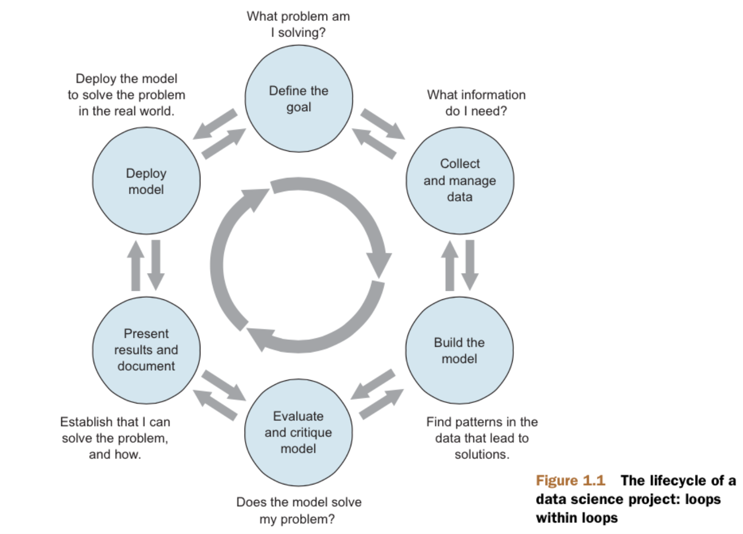
Process Flowchart

Slide 8
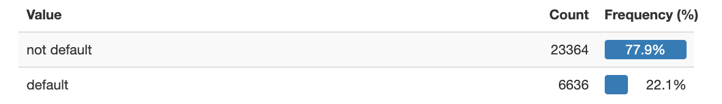
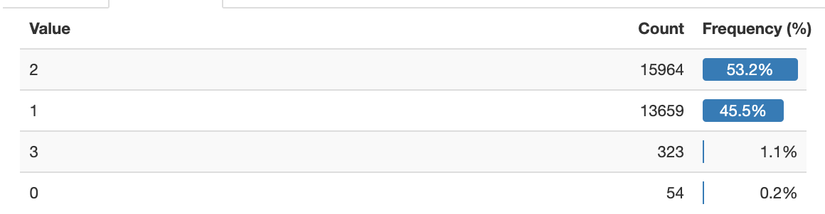
Initial Glance of Data
Defaulter / Non-defaulter count
1 - Married; 2 - Single; 3 - Divorce; 0 - Others

Slide 9
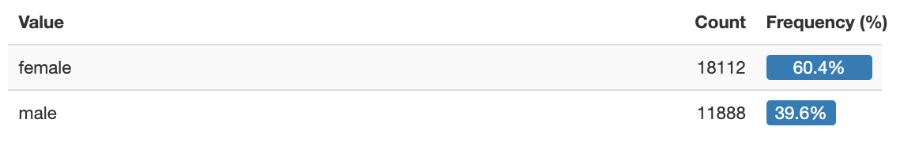
Gender count

