Slide 1
Thoughts on Fugu…

Slide 2
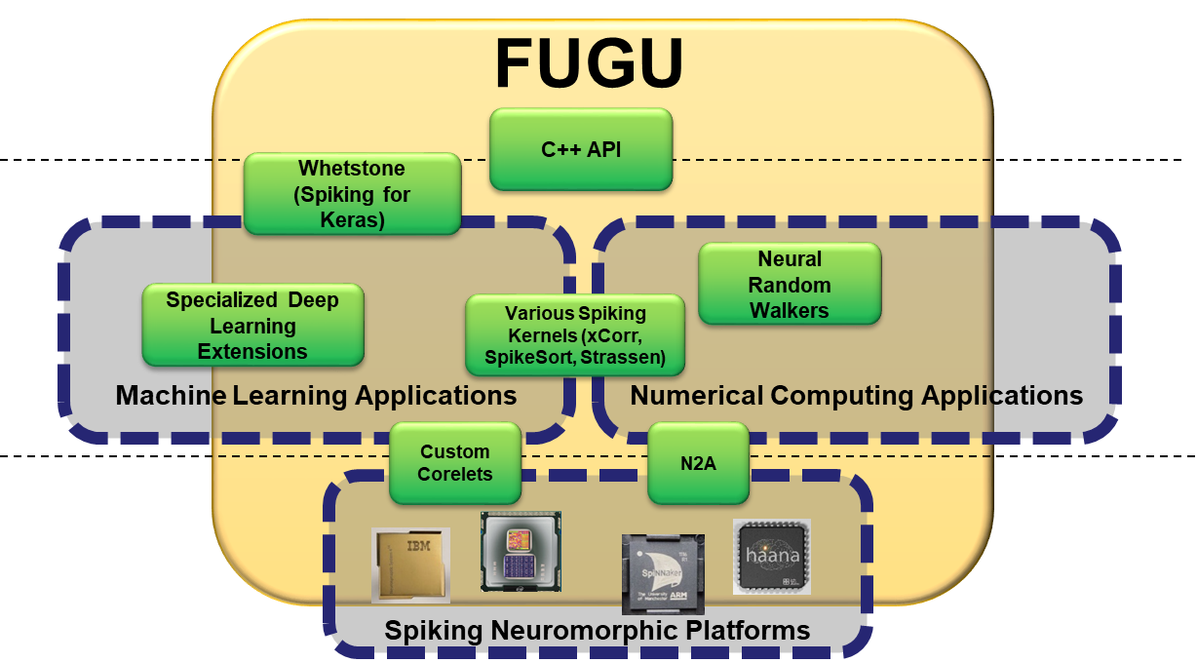
Spiking algorithms are weird and spiking hardware is weirder
Fugu aims to abstract the task of using spiking neuromorphic hardware for the general CS user
High-level access
Program in C++ or Python
Enable heterogeneous solutions
Mid-level algorithms
Leverage growing library of spiking neural algorithms to
Link neural algorithms together
Low-level mapping
Pass application specific neural algorithm to hardware
Handle I/O between neural and non-neural task components

Slide 3
Mid-level requirements
What do modules and output algorithms look like?
How do we link SNAs?

Slide 4
Defining a Fugu Module
Inputs
Needs to match output of upstream module(s)
Size (# neurons)
Does algorithm scale to input size?
Input time
Is input all single step? (T_{in}=1)
Is input structured over some time range?
x_{in}
T_{in}

Slide 5
Defining a Fugu Module
Outputs
Needs to match input of downstream module(s)
Size (# neurons)
How does algorithm scale to output size?
Output time
Is output all single step? (T_{out}=1)
Is output structured over some time range?
Delay time – depth of algorithm
How many time steps does output arise after corresponding input?
Delay and Input/Output Time are not the same!!!
x_{out}
x_{in}
T_{in}
D_{out}
T_{out}

Slide 6
Examples
SpikeSort
x_{in} = x_{out}
T_{in} = 1
T_{out} = max(x_{in})
D_{out} = 1 (2? if buffer holds input?)
x_{in}
x_{out}
SpikeSort begins output relevant information as soon as input arrives; but outputs are temporally extended as network expands input data into time dimension
T_{in}
D_{out}
T_{out}

Slide 7
Examples
(Strassen) Matrix Multiplication
x_{in} = 2 (NxN matrices, unfolded) – 1x 2N²
x_{out} = 1 x N²
T_{in} = 1
T_{out} = 1
D_{out} = ~7 (depends on version)
x_{in}
x_{out}
Strassen matrix multiply network takes in two input matrices and outputs one output matrix. Inputs and outputs are a single time-step vector. Algorithm takes several time steps to compute through layers, so depth is >1. Depth is related to algorithm size
T_{in}
D_{out}
T_{out}

Slide 8
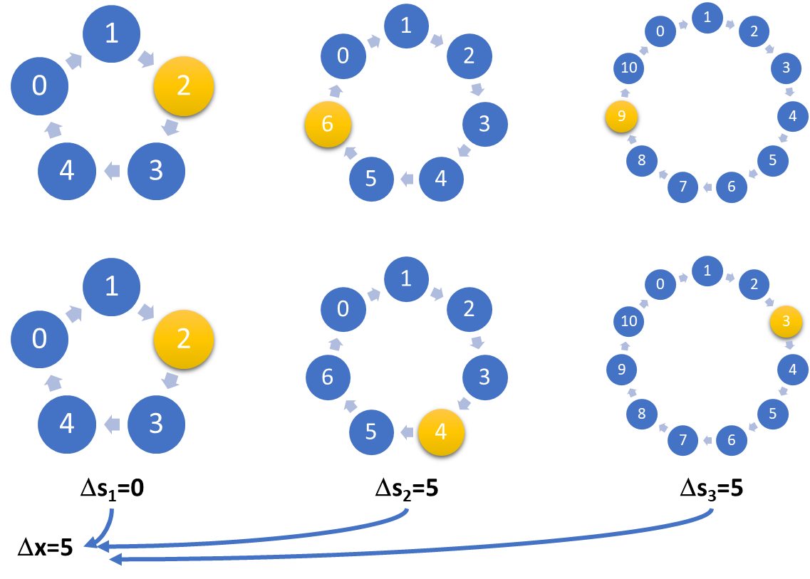
Examples
Particle Random Walk Code
x_{in} = k, where k is number of ring neurons, to initialize position
x_{out} = k (output position)
T_{in} = 1
T_{out} = 1
D_{out} = 2*Length of simulation
x_{in}
x_{out}
Particle RW algorithm is entirely parallel – each walker circuit can operate independently of all others. The length of the simulation equates to the depth of the circuit (though the circuit uses feedback). Input and output are just start and final positions
T_{in}
D_{out}
T_{out}

Slide 9
Examples
…
x_{in} = 2 (NxN matrices, unfolded) – 1x 2N²
x_{out} = 1 x N²
T_{in} = 1
T_{out} = 1
D_{out} = ~7 (depends on version)
x_{in}
x_{out}
Strassen matrix multiply network takes in two input matrices and outputs one output matrix. Inputs and outputs are a single time-step vector. Algorithm takes several time steps to compute through layers, so depth is >1
T_{in}
D_{out}
T_{out}

Slide 10
Implications
Modules have to match input and output structures
Size and Time of a module’s outputs must equal the downstream input
Delay has to be accounted for globally
If information is being processed in parallel, then delays must match

Slide 11
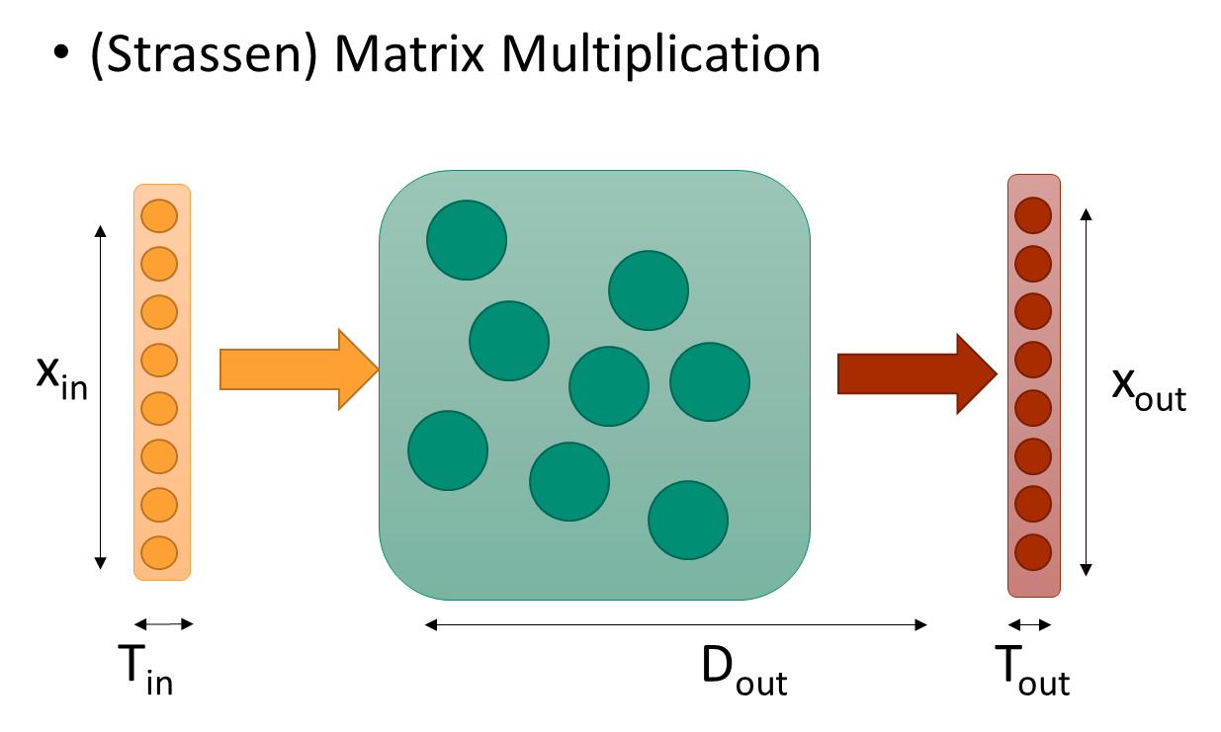
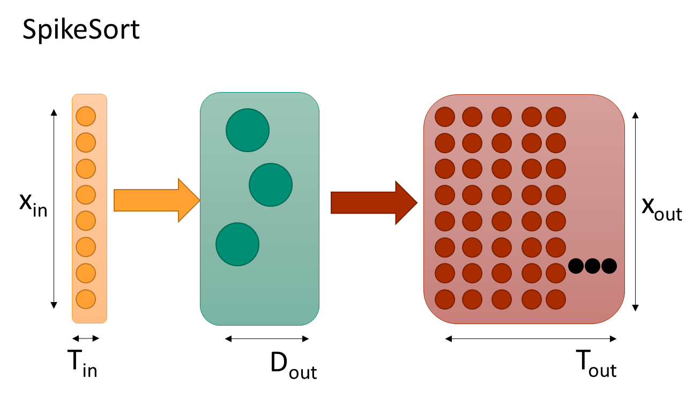
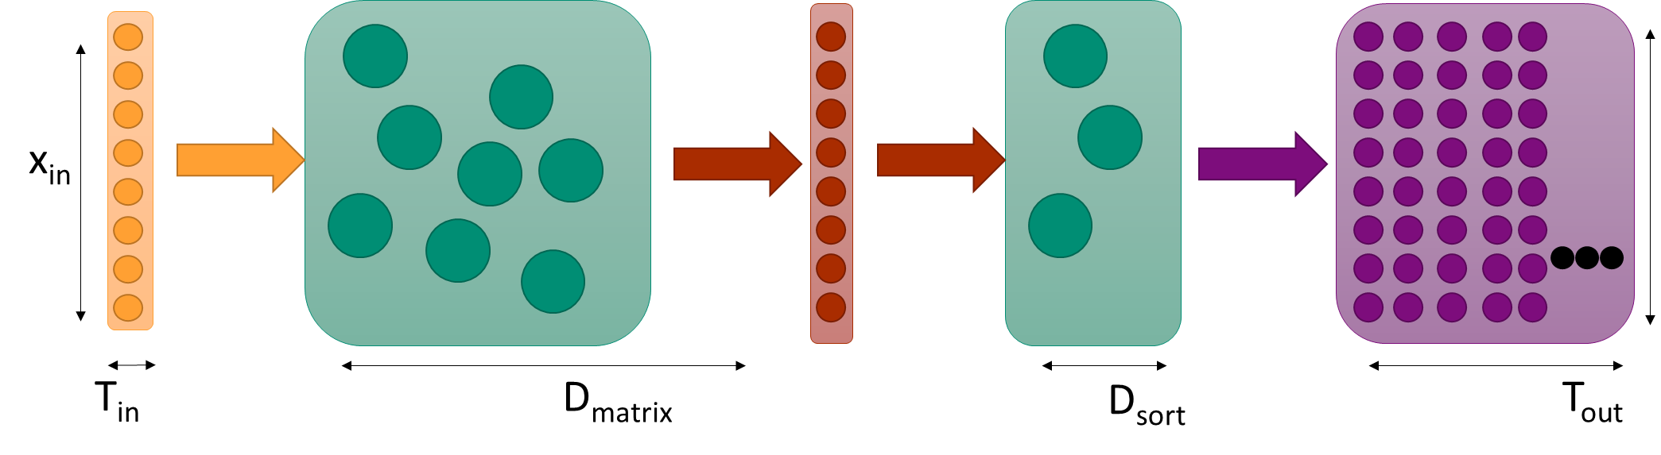
We can take put SpikeSort at the back-end of Strassen, but not the other way around…
x_{in} = 2 (NxN matrices, unfolded) – 1x 2N²
x_{out} = 1 x N²
T_{in} = 1
T_{out} = N² (?)
D_{out} = ~7 (Strassen) + 2 (sort)
x_{out}

Slide 12
Delays need to be accounted for in parallel computation
t=0
1
t=5
t=10
2
3
t=15
t=20
This mismatch will cause a failure, as module 4 won’t be processing temporally corresponding information as coming out of module 3
t=25
4
t=30

Slide 13
Delays need to be accounted for in parallel computation
t=0
1
t=5
t=10
2
3
t=15
Delay
t=20
t=25
Adding a repeater / delay circuit will help coordinate timing of right and left parallel pathways
4
t=30

Slide 14
Important to consider control knobs as well - perhaps these are distinct class of I/O
Control knobs for:
Context modulation
Timing / synchronization
Verification of progress / checkpointing?
Mid-compute visualization
…
x_{in}
x_{out}
D_{out}
T_{in}
T_{out}

Slide 15
Examples
Random Walk graph vertex
Start signal from supervisor
x_{in} = d, where d = # vertex connections
x_{out} = d
T_{in} = N_{d} – max number of walkers from input vertices
T_{out} = N – number of walkers on vertex
D_{out} = log₂d
x_{in}
x_{out}
Certain algorithms, such as this RW algorithm, will have a non-predetermined output length (it runs until it stops). The use of a supervisor circuit through control connections can help sync components
T_{in}
D_{out}
T_{out}
Finished signal to supervisor

Slide 16
To do
We should go through all of our SNAs and identify what this structure looks like
Is the above description sufficient at a mid-level to facilitate plug-and-play?
Obviously this lacks some description of coding scheme, but that will be very algorithm dependent.

