Slide 2
Thank you for attending NIWeek 2017.
Notes:
As a speaker of NIWeek, begin your session by welcoming attendees.
Convey these points:
Your time is valuable, thank you for being at NIWeek 2017.
We aim to make this as valuable as possible, from sharing best practices to helping connect you to fellow engineers and NI experts.

Slide 4
Notes:
Update the color palette to map the old template
Check text box

Slide 5
A software-centric platform that accelerates the development and increases the productivity of test, measurement, and control systems.
Notes:
Our approach is to accelerate productivity, innovation, and discovery through a software-centric platform for developing any system that needs test, measurement, and control.
When spending time and energy making technology work gets in the way of focusing on a solution, we know that’s a big problem. So, our goal is to enable engineers to get their job done faster regardless of their application or industry.

Slide 6
Tim Vargo
Ravi Beniwal
Sandia National Laboratories
Binary Palette
Instrumentation Engineer
tdvargo@sandia.gov
Owner
ravi@binarypalette.com

Slide 8
Tried & True, Conventional Debugging Tools
… which still work very well, but with limitations
Built-in Debug Tool | Pros | Cons
Execution Highlighting | Visualizes data flow | Slows execution speed
Breakpoints | Pause execution at this exact point | Persistent
Default Probes | Peek at wire values | Difficult to place in clones, Non-persistent
Custom Probes | + custom view and/or actions | Per LV version

Slide 9
Probes
Review of Generic Probes
Retain Wire Values
Custom Probes
Custom Probes Controls (look Mom, no code!)
Custom Probes NI (native)
Conditional
Custom Probes Saphir (3rd party, ViBox – Probes)
Custom Probes New (roll your own)
Variant Probe (by Ton Plomp)

Slide 10
Often forgotten, overlooked, or just plain ol’ “never-knew-about-that”
Suspend When Called
Access this from “SubVI Node Setup”
Video Demo: https://youtu.be/AgXcyf2Ta_A

Slide 11
Often forgotten, overlooked, or just plain ol’ “never-knew-about-that”
WinDebugLogging
DebugView (from Sysinternals [Microsoft])

Slide 21
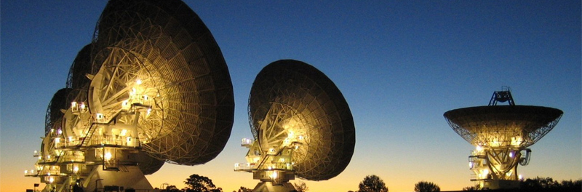
We must avoid “drawing vast conclusions from half-vast data”
— Jerry R. Ehman, SETI Astronomer

Slide 22
Notes:
We want your feedback. Please take one minute to complete the session survey.

Slide 23
LabVIEW Task Manager

Slide 24
Notes:
Convey these points:
Thank you for attending NIWeek 2017.
There’s many ways to stay connected.
You can download the session materials through the mobile app or at ni.com/niweekcommunity.
If you’re interested, you can reach me at [share your email]

