Slide 1


#OurGiantsAreFemale - Reshma Saujani
A lawyer, politician, non-profit executive
Founder and CEO of Girls Who Code with an aim to
  inspire, educate, and equip young women with the computing skills
  increase the number of women in computer science
  close the gender gap in technology
  change the image of what a programmer looks like and does
Girls Who Code has served about 450K girls through in-person computing programs and reached 500M online
Author of the Books
  Brave, Not Perfect: Fear Less, Fail More, and Live Bolder
  Women Who Don't Wait in Line: Break the Mold, Lead the Way

Slide 2



Tim Vargo
LabVIEW Task Manager
Ravi Beniwal
Christoph Brauers
CLA, MSME
ravi@binarypalette.com
Instrumentation Engineer
tim.g.vargo@gmail.com
CLA, MS Autonomous Systems
christoph.brauers@gmail.com
Contributors from the LabVIEW Community
Aristos Queue
James Powell
Darren Nattinger
ohiofudu
Neil Pate

Slide 3
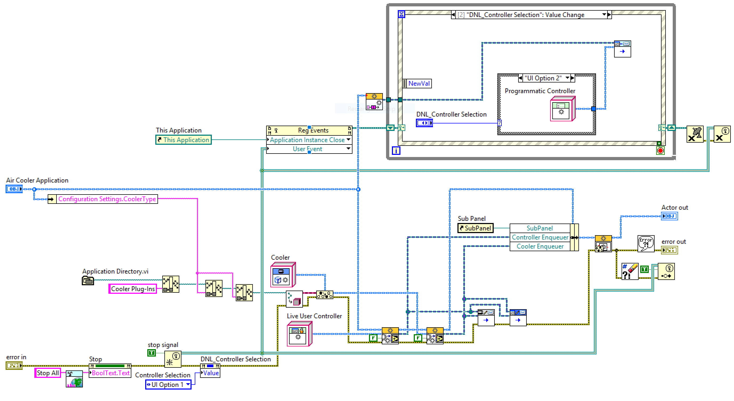
As LabVIEW enthusiasts, we all love visuals
Nicely laid out block diagrams, happily flowing data and messages, …

Slide 4
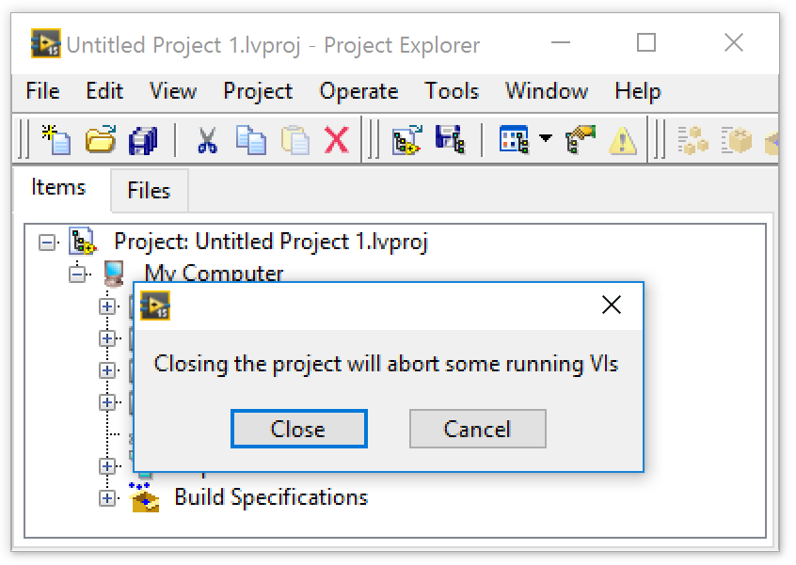
But There Are Visuals That Make Our Faces Cringe
WHAT?!
There are still VIs running?!
Which ones?!
I thought, I got ‘em all ☹

Slide 5
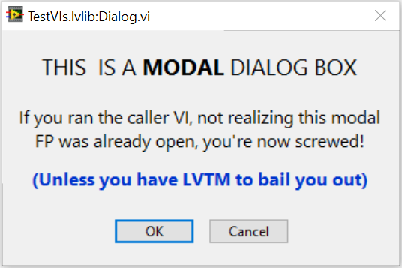
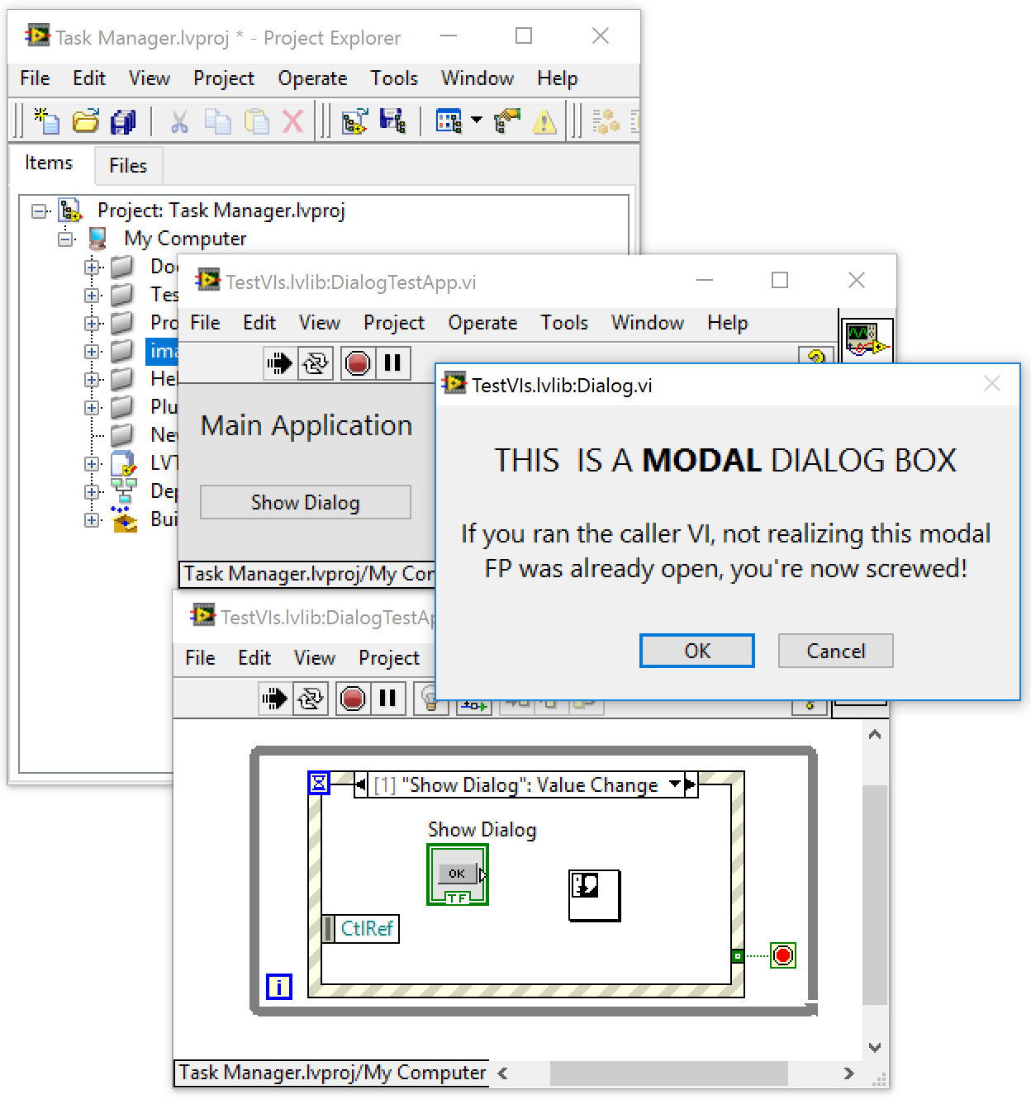
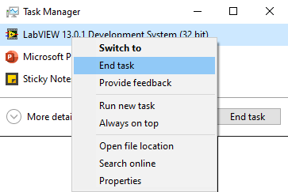
And then there is the stale·mate
/ˈstālˌmāt/, noun, a position counting as a draw, in which a player is not in check but cannot move except into check.
These buttons only laugh at you when clicked
(actually, not even that)
<sigh> I guess the only way out of this is to kill LabVIEW – but I have unsaved VIs! #%$!@#$

Slide 6
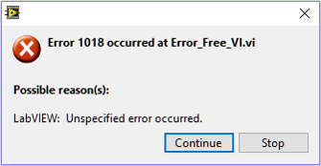
Random VIs Throwing Random Errors
… and no easy way to get to them
Oh THAT’s helpful!

Slide 7



Tried & True, Conventional Debugging Tools
… which still work very well, but with limitations
Built-in Debug Tool | Pros | Cons
Execution Highlighting | Visualizes data flow | Slows execution speed (impedes discovery of timing problems)
Single Stepping | One operation at a time | Slows execution speed (impedes discovery of timing problems)
Breakpoints | Pause execution at this exact point (useful for beginning execution highlighting and single stepping) | Persistent (must remember to remove them before deployment)
Notes:
Persistence is both a Pro and a Con

Slide 8
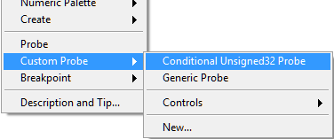

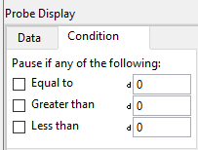

Probes !!!
Generic (default) Probes
  Retain Wire Values
Custom Probes
  Custom Probes Conditional (native)
  Custom Probes Controls (look Mom, no code!)
  Custom Probes New… (roll your own)
  VI Box Probes (Saphir, Free, NI Tools Network)
    Shows value history, value and time delta, etc.
  Variant Probe (Ton Plomp, LAVA Code Repository)
    Shows data in a variant as a tree, with values and attributes
Notes:
Retain Wire Values keeps wire values in memory so that a probe placed AFTER running the VI can still view the value!
Also enables hovering over any wire to glimpse its value.
Saphir probes are available for free download on the LabVIEW Tools Network
Variant Probe is available for free download from LAVAg.org

Slide 9
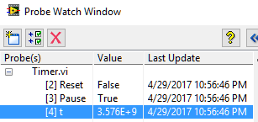
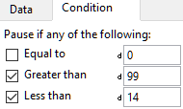

Tried & True, Conventional Debugging Tools
… which still work very well, but with limitations
Built-in Debug Tool | Pros | Cons
Default Probes | Peek at wire values throughout execution | Difficult to place in clones, Non-persistent
Conditional Probes | + “pause if value” logic | + Not available for all datatypes
Custom Probes | + custom view and/or actions | + Per LabVIEW version
Notes:
Probes are commonly called "Watchpoints" in other languages
Conditional Probes are commonly called "Watch Variables" in other languages
Persistence is both a Pro and a Con

Slide 10
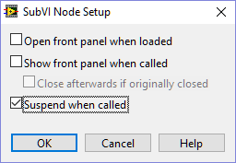

Often forgotten, overlooked
or just plain ol’ “huh, I-never-knew-about-that”
Suspend when called
Access this from “SubVI Node Setup”
Suspends a SubVI when called and waits for user interaction
  Allows changes to input values, then re-execute
  Allows changing the output, then return to caller
A poor-man’s (yet extremely effective) unit testing
Video Demo: https://youtu.be/AgXcyf2Ta_A

Slide 11



There are many Free, 3rd-party Debugging Tools
These will retain information even if LabVIEW crashes!
WinDebugLogging
  Write debug strings to the Windows debug interface
  Dr. Damien (DFGray), Nov-2008
  DebugView (from Sysinternals [Microsoft])
WinDebugLogProbe
  Tim Vargo
Notes:
Using the Windows debug interface retains information even if LabVIEW crashes!
Also works for deployed executables, and has very low overhead
View the results with DebugView by Sysinternals [now Microsoft]

Slide 12
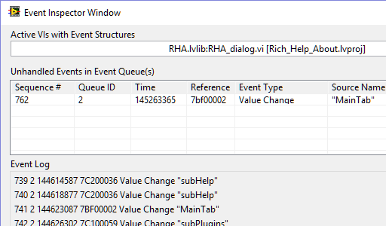
More NI debugging tools
Built-in to LabVIEW
Event Inspector
  Introduced with LabVIEW 2013
  Gains new understandings into the inner workings of our event structures

Slide 13
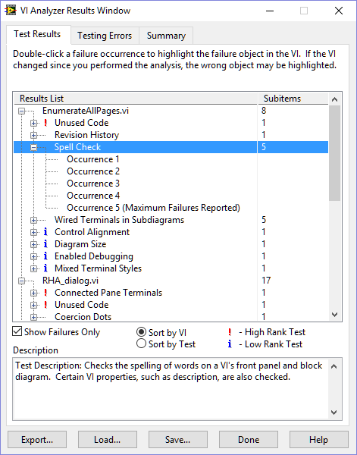
More NI debugging tools
Toolkits for extra cost (but worth it, IMHO)
VI Analyzer
  VI Analyzer does its job well, but it intends to perform a static analysis of VIs, not a dynamic analysis of code while running

Slide 14

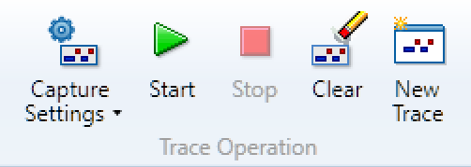
More NI debugging tools
Toolkits for extra cost (but worth it, IMHO)
Desktop Execution Trace Toolkit (DETT)
  The DETT product is very good at what it was designed to do
    dynamic execution traces provide a fantastic wealth of evidence when event timing and/or sequence information is critical
    … but they don’t provide non-event related information, such as state

Slide 15
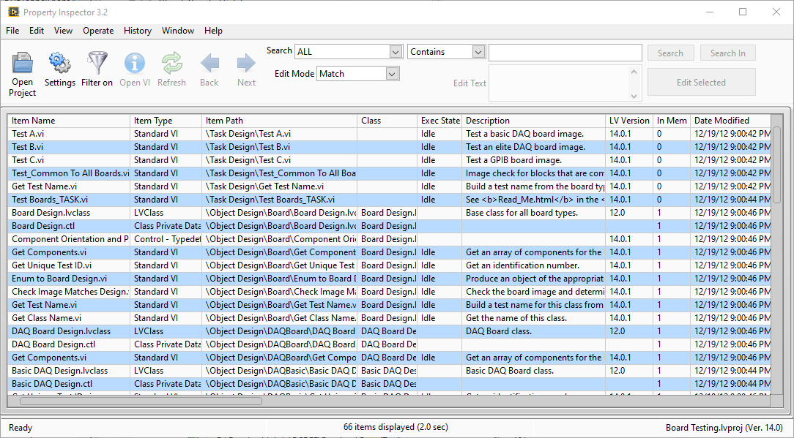
Property Inspector - Paid LabVIEW Add-On Tool
Search, sort, and edit properties of multiple VIs, individually or simultaneously.
Sort VIs to find highest data usage, code size, clone instances, or edit date.
Isolate and update binary settings, audit by data size, clean up old or unused code by LabVIEW version, sort by date modified for latest, locate undocumented code, and edit or download shortcuts.
Unlike Find and Replace, editing is not limited to just the searched text; the add-on features string manipulation functions that you can use to edit or remove the entire field.
Available from LabVIEW Tools Network

Slide 16
Some impediments to advanced troubleshooting …
All of the built-in tools are extremely useful during troubleshooting of individual VIs or small collections of VIs
  particularly when we already know which VIs are the troublesome ones
The LabVIEW IDE still lacks a debugging tool to provide insights with a "bigger picture" view of an entire project

Slide 17
Some impediments to advanced troubleshooting …
Using only the native troubleshooting tools
  reentrant VIs are especially difficult to debug, since each preallocated clone will have its own data space in memory
  shared clones can be even more complex, since they may or may not share a common data space
Dynamically launched VIs, even if not reentrant, present their own particular frustrations while debugging, since it is difficult to place probes BEFORE executing the code.

Slide 18
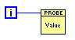


Placing probes BEFORE executing Call By Reference VIs …
Simply place a probe in the reentrant master, right?
  No! Clones will not get probes
Create on ordinary VI with a single control of that type
  place it
  wire it
  watch its FP
    NOT a probe, but rather a workaround
    Will appear in ALL clones of its caller (a true probe would not)

Slide 19
Placing probes BEFORE executing Call By Reference VIs …
Right-click on SubVI, select SubVI Node Setup >> Show front panel when called
  Just for this call
VI Properties >> Window Appearance >> Customize >> Show front panel when called
  All calls
Problems:
  Persistent
  Interrupts execution

Slide 20
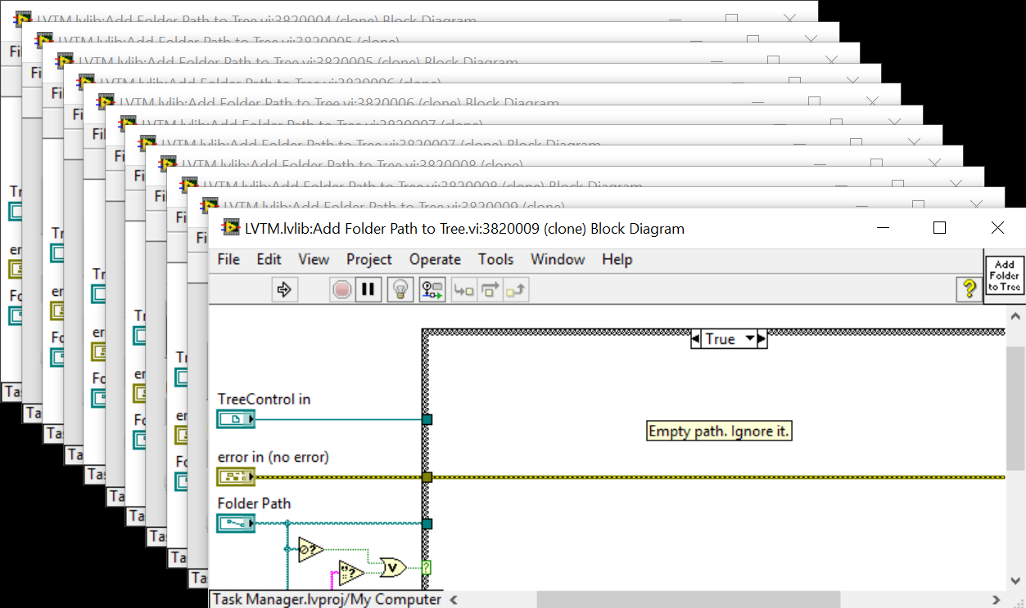
Placing probes BEFORE executing CBR VIs …
Place a breakpoint in the reentrant master. Awesome: all clones will also get breakpoints, opening their FPs & BDs
  Problem: all clones will also get breakpoints, opening their FPs & BDs!
Sometimes, things just get way to complex
Notes:
Sometimes, things just get way to complex

Slide 21

What to do when debugging becomes too complex ???
How to defeat these shortcomings, and many other debugging related challenges …
  have long been the topics of many user community discussions
  several ad-hoc solutions and processes, usually quite limited in scope, have been developed over the years by the user community
  but they lack the coherence of a unified tool
Introducing the

Slide 22

LabVIEW Task Manager
The LabVIEW Task Manager seeks to be that missing unified debugging tool
Providing a dynamic & big-picture view of all VIs currently in memory
  by delivering new comprehensions into your running code
Conquering those difficulties concerning reentrancy, clones, dynamic launching, finding & aborting hung VIs, and other sticky complications
  by enabling interaction with individual or groups of VIs in many various ways

Slide 23
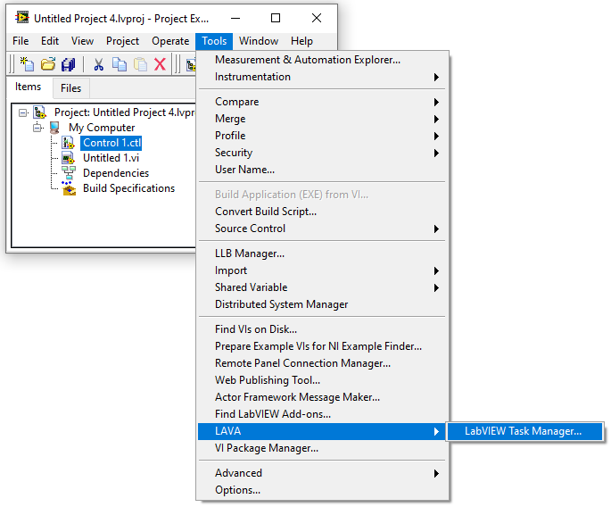
Launching LabVIEW Task Manager (LVTM)
Menu>>Tools>>LAVA>>LabVIEW Task Manager…

Slide 24
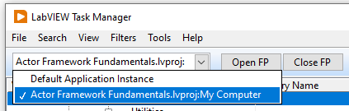
Application Instance
LVTM detects all open LabVIEW application instances,
but discovers and displays VIs for only the selected instance

Slide 25
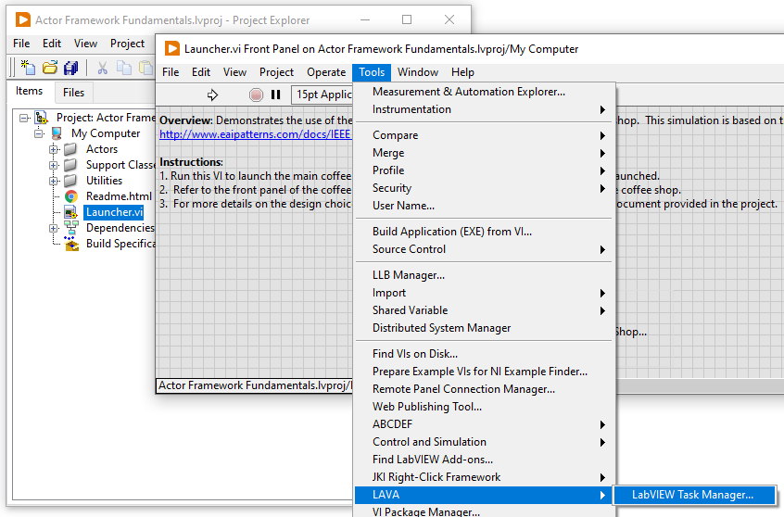
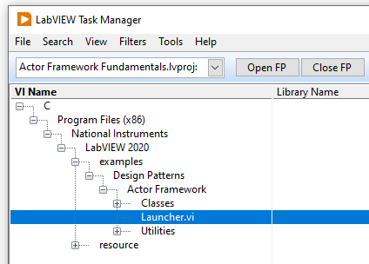
Auto-Detect Application Instance and Host VI
When LVTM is launched from
the menu of any VI in any project,
it opens up with
that project instance selected and
that VI selected in the list of VIs in memory
to provide a convenient starting point.

Slide 26
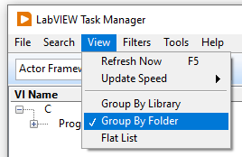
Menu: View
The View menu provides options for
setting an update speed for refreshing the view
grouping VIs

Slide 27
Menu: View>>Group By Library
Group By Library displays all VIs in the selected application instance grouped by the library they belong to. All VIs that are not part of any library are shown under <no parent library>.

Slide 28
Menu: View>>Group By Folder
Group By Folder displays all VIs in the selected application instance with their folder hierarchy on disk. This view makes it easy to see where all the project dependencies live on disk.
Notes:
It is in this view where items can be excluded from being displayed, which we will see in a few slides later.

Slide 29
Menu: View>>Flat List
Flat List displays all VIs in the selected application instance as a list. This view can help sorting the view by different properties of the VIs, by clicking on the column headers.
Notes:
In particular, sorting the flat list view by State will help distinguish between Idle, Running, and RunTop (top-level) VIs; which can be very useful when looking for VIs that are still running that you thought should not be. VIs with a State of RunTop can then be aborted!

Slide 30
Menu: Filters
The Filters menu items provide several settings for
filtering out items from view
  Filtering out VIs that you don’t currently care about can tremendously improve performance of the LVTM
    Certain dynamic properties of all VIs are occasionally checked and updated. The more VIs that need to be checked, the more resources are tied up, and the longer each update cycle takes.
  Also helps the user to de-clutter the view

Slide 31

Menu: Filters>>Extensions
Select (√) the file extensions that you want to filter out of the view. All files with the selected extensions will be ignored.

Slide 32
Menu: Filters>>Types
Select (√) the VI types that you want to filter out of the view. All VIs of the selected type will be ignored.

Slide 33

Shortcut Menu: Filter Out …
While in the Group By Folder view, right click any folder and select Filter Out This Folder, adding that folder to an exclusion list
Or you can select Filter Out All But This Folder, which will add all remaining folders to the exclusion list
Any VIs in these filtered out folders will no longer show up in the tree
Although filtered paths can only be added or removed while in the Group By Folder view, the hidden paths will also persist in other views. This helps the user to de-clutter the view, and can also greatly improve performance.

Slide 34
Menu: Filters>>Paths
If one or more paths have been filtered out, they will show up under the Filters>>Paths menu. Clicking any of these paths will remove it from the exclusion list.
Selecting Remove All will remove all filtered out paths, effectively disabling path based filtering.

Slide 35
Progress Update
Any time changes are made to the filters or to the view, the view is refreshed
A progress bar, in the status bar at bottom right, shows the discovery and update progress

Slide 36
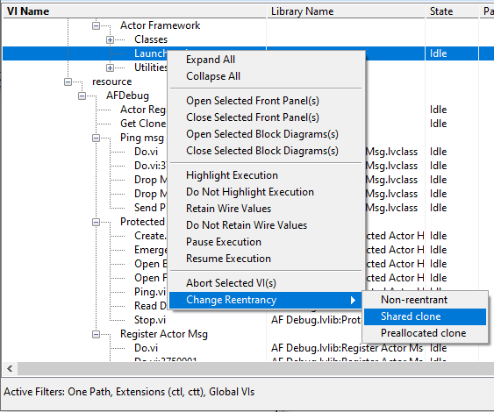
Toolbar
LVTM provides several operations that can be performed on one or more selected VIs in the tree. These operations may be invoked from the toolbar buttons near the top of the screen.
These same operations may also be invoked from the right click shortcut menu.

Slide 37
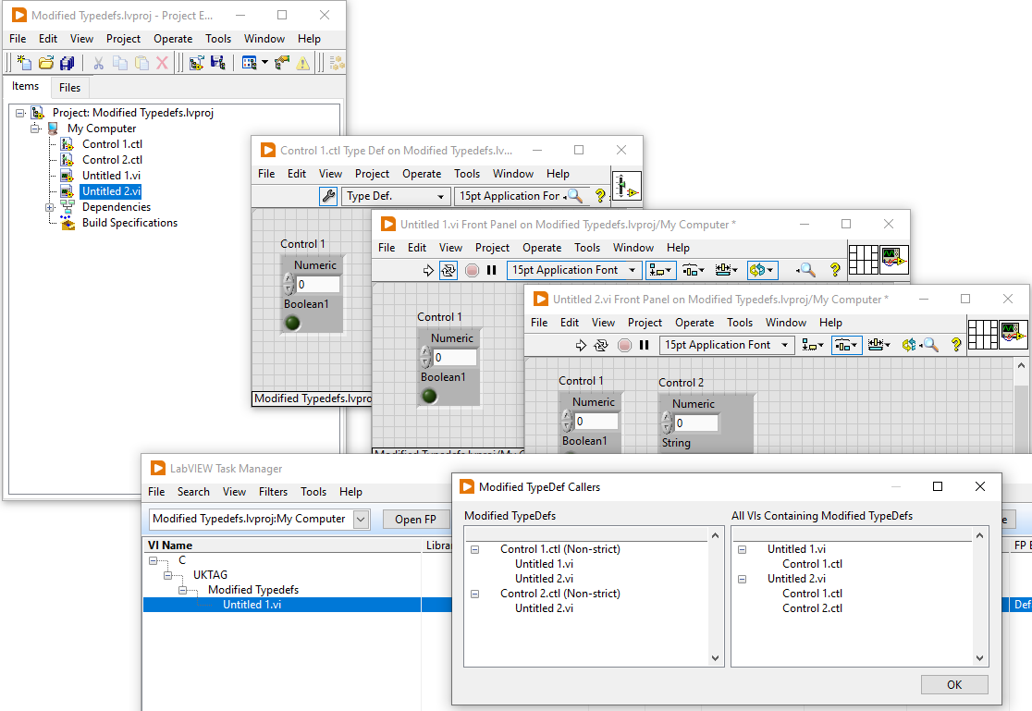
Discover Vis Affected by a Modified Typedef
LVTM provides several operations that can be performed on one or more selected VIs in the tree. These operations may be invoked from the toolbar buttons near the top of the screen.

Slide 38


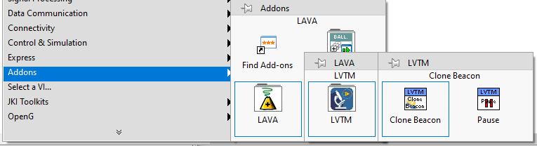
Helper Functions
Available from the Functions Palette
These functions are available to assist with your debugging efforts
LVTM Pause – Drop this function into any VI you wish to pause
  If the pause request is generated from a clone of a reentrant VI, it will pause all clones of that VI
  Works only if the LabVIEW Task Manager is running, in the same application instance
Clone Beacon – Drop this VI into any asynchronously called reentrant VI, to force it to be seen by LabVIEW Task Manager
Notes:
If the pause request is generated from a clone of a reentrant VI, it will pause all clones of that VI

Slide 39
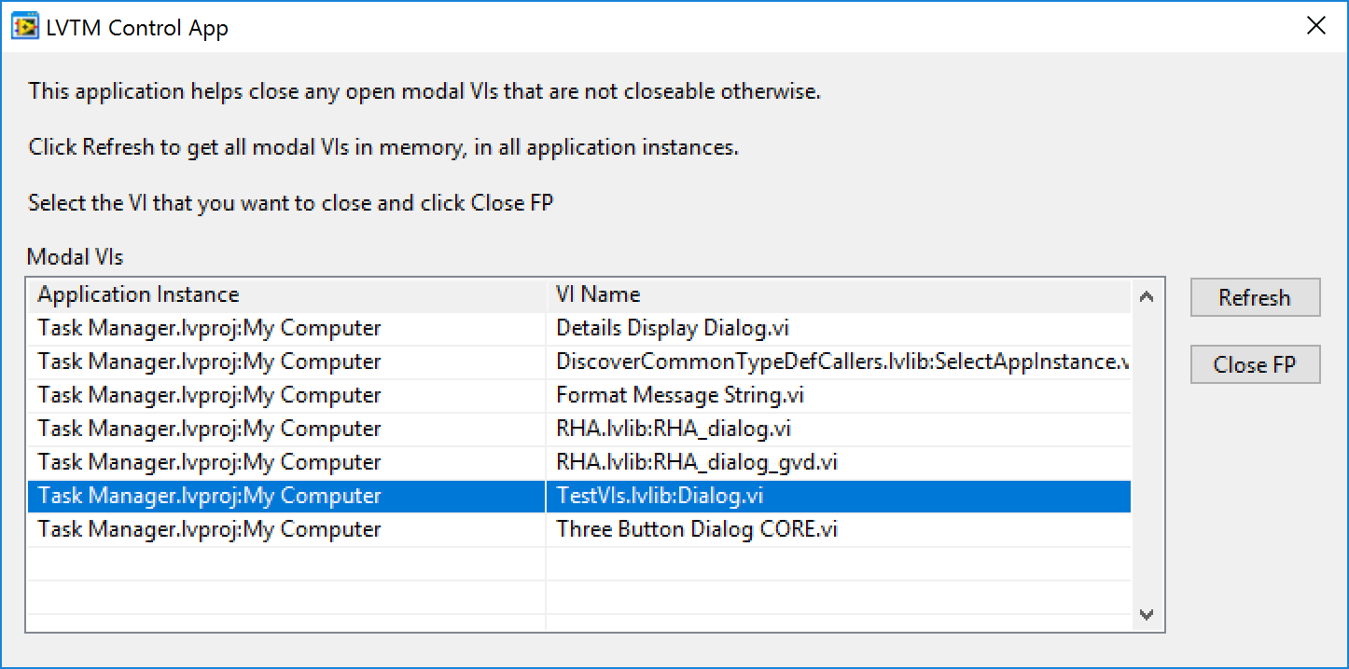
LVTM Control App
Remember the stalemate?
This is an executable that works with LabVIEW Task Manager
It queries LVTM for all modal Vis, in all application instances
Let’s you close the FP of any of these VIs

Slide 40
LVTM Control App
Remember the stalemate?
But this requires LVTM to be running in the LabVIEW development environment because it depends on a TCP Server launched by LVTM.
So you might want to always keep it open in the background
(anticipating a stalemate?).

Slide 41
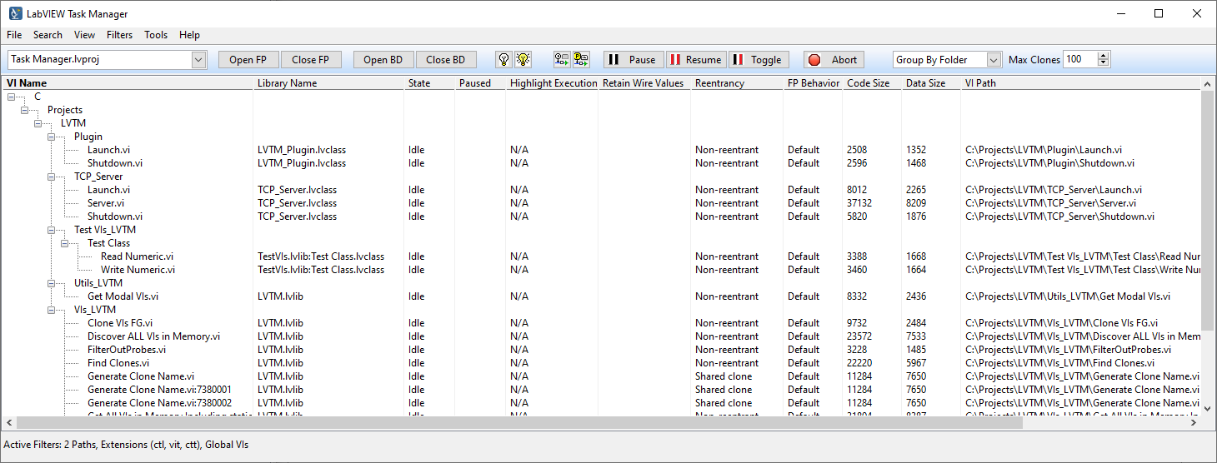
LVTM Executable
Connect to any LabVIEW version via VI Server
This is where Christoph Brauers’ efforts shine
He took LVTM and made the necessary changes to run it as an executable that connects to LabVIEW IDE, or even executables using VI Server.

Slide 42
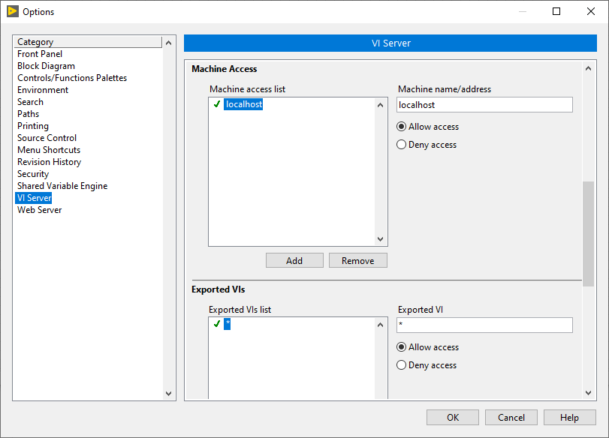
LVTM Executable
Uses “Exported VIs”, rather than “All VIs in Memory”
For this to work, you need to set your LabVIEW IDE VI Server properties to allow Machine Access, as well as Export All VIs (Exported VI = *)
Can connect to and control VIs within LabVIEW executables
A few functions are not accessible from the runtime environment

Slide 43
LIVE
DEMO

Slide 44
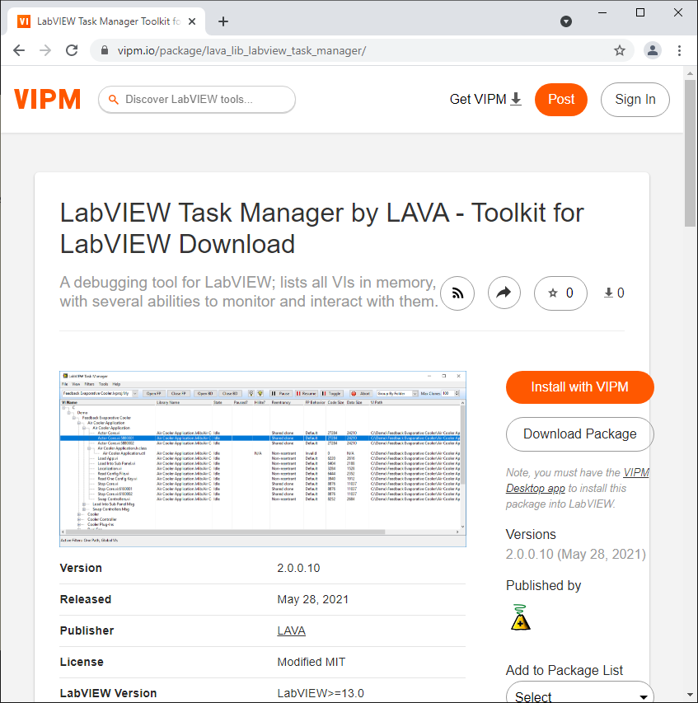
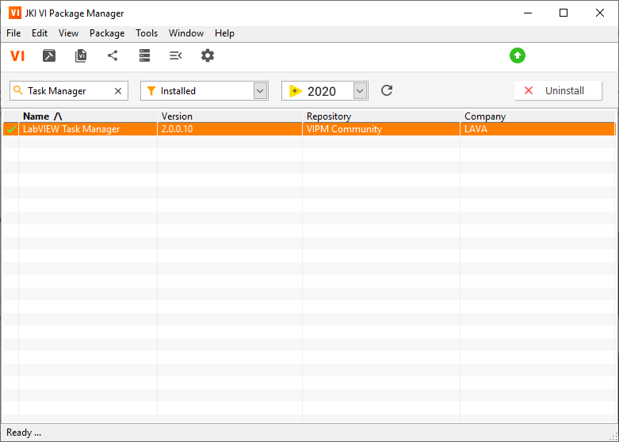
How to GET the tool … VIPM
https://www.vipm.io/package/lava_lib_labview_task_manager/

Slide 45
How to CONTRIBUTE to the tool …
https://bitbucket.org/lavag/labview-task-manager

