Slide 2
Thank you for attending NIWeek 2017.
Notes:
As a speaker of NIWeek, begin your session by welcoming attendees.
Convey these points:
Your time is valuable, thank you for being at NIWeek 2017.
We aim to make this as valuable as possible, from sharing best practices to helping connect you to fellow engineers and NI experts.

Slide 4
Notes:
Update the color palette to map the old template
Check text box

Slide 5
A software-centric platform that accelerates the development and increases the productivity of test, measurement, and control systems.
Notes:
Our approach is to accelerate productivity, innovation, and discovery through a software-centric platform for developing any system that needs test, measurement, and control.
When spending time and energy making technology work gets in the way of focusing on a solution, we know that’s a big problem. So, our goal is to enable engineers to get their job done faster regardless of their application or industry.

Slide 6
Tim Vargo
Ravi Beniwal
Sandia National Laboratories
Binary Palette
Instrumentation Engineer
tdvargo@sandia.gov
Owner
ravi@binarypalette.com

Slide 8



Tried & True, Conventional Debugging Tools
… which still work very well, but with limitations
Built-in Debug Tool | Pros | Cons
Execution Highlighting | Visualizes data flow | Slows execution speed (impedes discovery of timing problems)
Single Stepping | One operation at a time | Slows execution speed (impedes discovery of timing problems)
Breakpoints | Pause execution at this exact point (useful for beginning execution highlighting and single stepping) | Persistent (must remember to remove them before deployment)
Notes:
Persistence is both a Pro and a Con

Slide 9
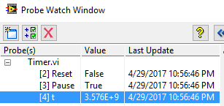
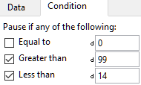
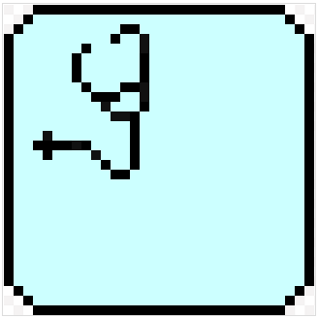
Tried & True, Conventional Debugging Tools
… which still work very well, but with limitations
Built-in Debug Tool | Pros | Cons
Default Probes | Peek at wire values throughout execution | Difficult to place in clones, Non-persistent
Conditional Probes | + “pause if value” logic | Not available for all datatypes
Custom Probes | + custom view and/or actions | Per LV version
Notes:
Probes are commonly called "Watchpoints" in other languages
Conditional Probes are commonly called "Watch Variables" in other languages
Persistence is both a Pro and a Con

Slide 10
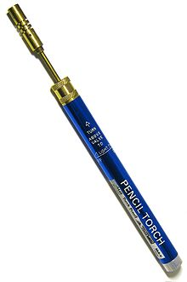

Probes !!!
Review of Generic Probes
Retain Wire Values
Custom Probes
Custom Probes Controls (look Mom, no code!)
Custom Probes NI (native)
Conditional
Custom Probes Saphir (3rd party, ViBox – Probes)
Custom Probes New (roll your own)
Variant Probe (by Ton Plomp)
Notes:
Retain Wire Values keeps wire values in memory so that a probe placed AFTER running the VI can still view the value!

Slide 11
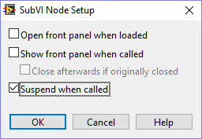

Often forgotten, overlooked, or just plain ol’ “huh, I-never-knew-about-that”
Suspend when called
Access this from “SubVI Node Setup”
Suspends a subVI when called and waits for user interaction
Allows changes to input values, then re-execute
Allows changing the output, then return to caller
A poor-man’s (yet extremely effective) unit testing
Video Demo: https://youtu.be/AgXcyf2Ta_A

Slide 12



There are many Free, 3rd-party Debugging Tools These two will retain information even if LabVIEW crashes!
WinDebugLogging
Write debug strings to the Windows debug interface
Dr. Damien (DFGray), Nov-2008
DebugView (from Sysinternals [Microsoft])
WinDebugLogProbe
Tim Vargo
Notes:
Using the Windows debug interface retains information even if LabVIEW crashes!

Slide 13
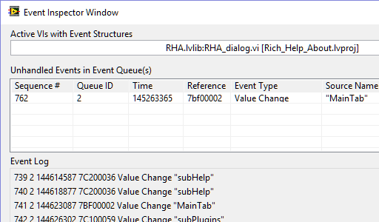
NI debugging tools
Built-in to LabVIEW
Event Inspector
Introduced with LabVIEW 2013, the Event Inspector added an ability to gain new understandings into the inner workings of our event structures

Slide 14
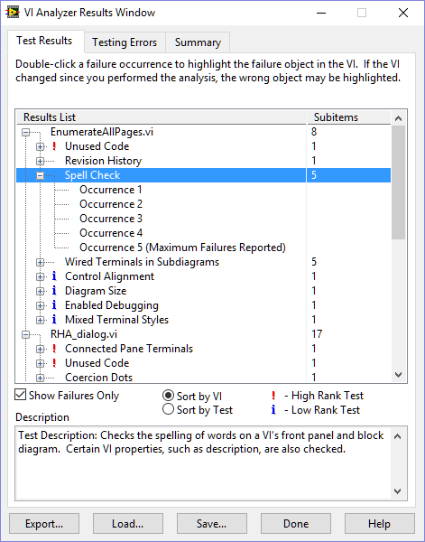
NI debugging tools
Toolkits for extra cost (but worth it)
VI Analyzer
VI Analyzer does its job well, but it intends to perform a static analysis of VIs, not a dynamic analysis of code while running

Slide 15
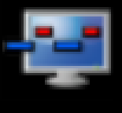
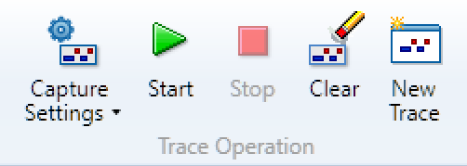
NI debugging tools
Toolkits for extra cost (but worth it)
Desktop Execution Trace Toolkit (DETT)
The DETT product is very good at what it was designed to do
dynamic execution traces provide a fantastic wealth of evidence when event timing and/or sequence information is critical
… but they don’t provide non-event related information

Slide 16
Some impediments to advanced troubleshooting …
All of these built-in tools are extremely useful during troubleshooting of individual VIs or small collections of Vis
particularly when we already know which VIs are the troublesome ones
but the LabVIEW IDE still lacks a debugging tool to provide insights with a "bigger picture" view of an entire project
Using only the native troubleshooting tools
reentrant VIs are especially difficult to debug, since each preallocated clone will have its own data space in memory
shared clones are even more complex since they share data space
Dynamically launched VIs, even if not reentrant, present their own particular frustrations during a debug session, since the developer is unable to place probes BEFORE executing the code.

Slide 17
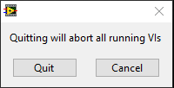
As LabVIEW enthusiasts, we all love visuals
… but THESE visuals make our faces cringe, and our sphincters tighten

Slide 18

What to do when debugging becomes too complex ???
How to defeat these shortcomings, and many other debugging related challenges …
have long been the topics of many user community discussions
several ad-hoc solutions and processes, although usually quite limited in scope, have been developed over the years by the user community
but they lack the coherence of a unified tool
Introducing the

Slide 19

The LabVIEW Task Manager
The LabVIEW Task Manager seeks to be that missing unified debugging tool
Provides a dynamic & big-picture view of all VIs currently in memory
Conquers those difficulties concerning reentrancy, clones, dynamic launching, finding & aborting hung VIs, and other sticky complications
LabVIEW Task Manager delivers new comprehensions into your running code, and enables interacting with individual or groups of VIs in many various ways, providing significant benefits while troubleshooting

Slide 29

We must avoid “drawing vast conclusions from half-vast data”
— Jerry R. Ehman, SETI Astronomer

Slide 30
Notes:
We want your feedback. Please take one minute to complete the session survey.

Slide 31
LabVIEW Task Manager

Slide 32
Notes:
Convey these points:
Thank you for attending NIWeek 2017.
There’s many ways to stay connected.
You can download the session materials through the mobile app or at ni.com/niweekcommunity.
If you’re interested, you can reach me at [share your email]

