Slide 1
Multi-scenario Extreme Weather Simulator (MEWS)
Energy Resilience Mission Assurance Task 4.5
Daniel Villa
May 4th, 2021
This presentation has been released as Unclassified Unlimited Release Material per SAND2021-6836 PE

Slide 2
Objectives
1. Provide extreme weather files that increases in severity and frequency to be used by stochastic resilience analysis
Hurricanes
Increased wind, humidity, precipitation, cloud cover
Decreased solar radiation
Flooding?
Extreme temperature (heat waves and winter storms)
Increased temperature
Corresponding long-term effects on humidity?
Gradual climate change trends
2. Quickly generate files with reasonable output with a data-driven approach
Data here includes climate model outputs
Fuse historical data and climate projections into “best-guess” sampling distributions and Markov processes

Slide 3
Python
The first version of MEWS has been programmed as a python package
The API is only ready for demonstration purposes but has unit testing for the core classes
mews.stats.markov
mews.stats.extreme.DiscreteMarkov → determine when alterations in weather occur
mews.stats.extreme.Extremes
mews.weather.alter.Alter → This is the generic class to introduce alterations
mews.graphics.plot_realization

Slide 4
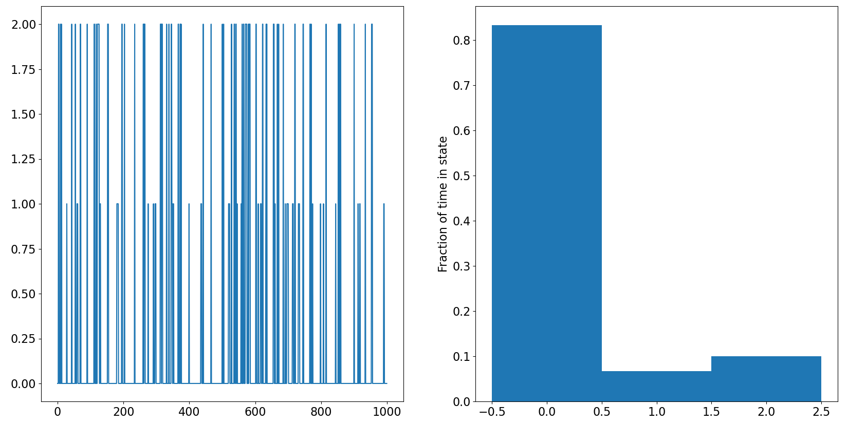
Multi-state Markov chains
Unit testing has verified several benchmark cases work correctly
Cython C implementation 10-100 times faster than native Python

Slide 5
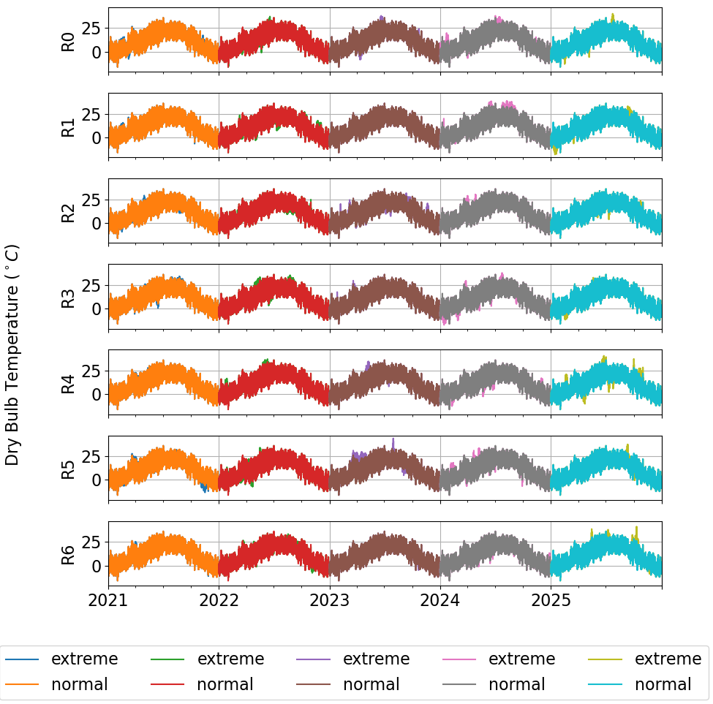
Hot/Cold extreme simulation
Linearly increasing probability of heat waves or winter storms
7 realizations
The statistics are made up for now. Further development can provide algorithms for making them as realistic as possible with historical weather and climate inputs
Energy Plus files output
Eventually MEWS should support output file needs for several programs
Files to be used for ERMA Task 4.5 Energy Plus runs
Weather shown here is TMY3 for Santa Fe Municipal Airport

Slide 6
Conclusion
The MEWS tool has a demonstration version working
Resilience analysis will need MEWS capabilities to provide stochastic estimates for boundary conditions variations. Timing with infrastructure failures like power-outages will be strongly correlated to MEWS output
Climate variations need to be included for long-term planning resilience analysis

