Slide 1
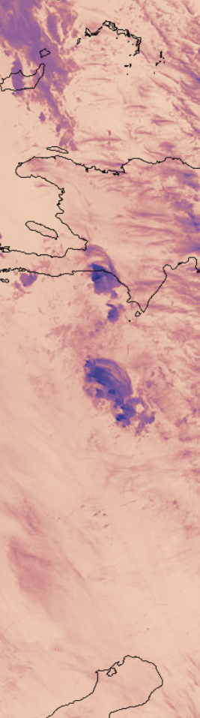
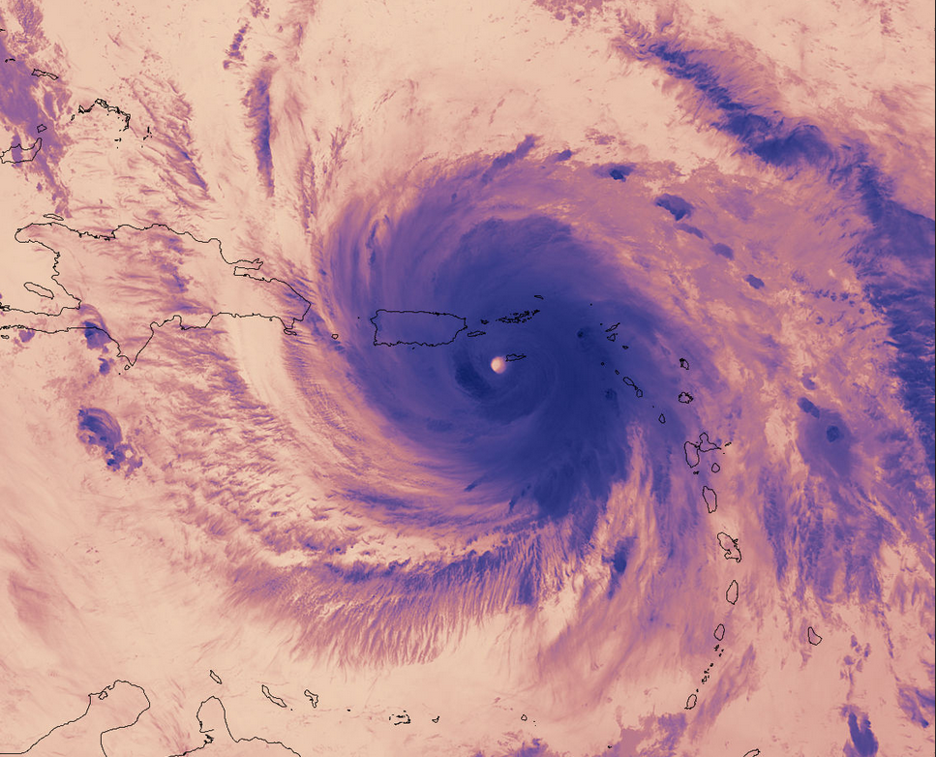
MEWS
Multi-scenario Extreme
Weather Simulator
NASA public domain image
https://www.nasa.gov/sites/default/files/thumbnails/image/maria.a2017263.0612.bt5_.1500m.jpg

