Slide 1
Credibility Framework in SAW
What: Accurate and version controlled credibility information infrastructure for any engineering discipline; configurable by non-programmers
Current state: Several spreadsheets (PIRT, PCMM, Exp.); evidence may be “hearsay”; Final peer review team may spend considerable time collecting/organizing evidence
Future state: Reviewable tightly linked (each statement has backing) evidence package
Stakeholders: High consequence programs (weapons system qualification) need defensible credibility communication
Approach:
Involve V&V practitioners, ModSim team members and UI/UX experiments early
Leverage SAW RRP framework
Risks: Lack of adoption (need analysis management support), software architecture not reusing existing SAW capabilities
Investment: 2 FTE in two years.
Deliverables:
FY19: extendable software architecture with one instantiation for weapon qualification
FY20: instantiations for preliminary design, full system design and refinements to weapon qualification credibility, ARG document generation

Slide 2
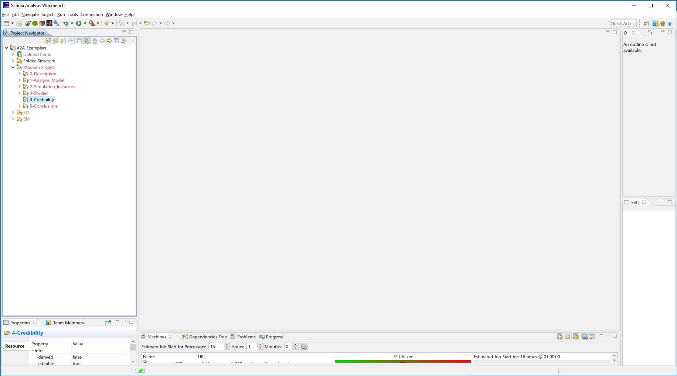
Click
Note: In reality right-click -> New Credibility Structure Here

Slide 3
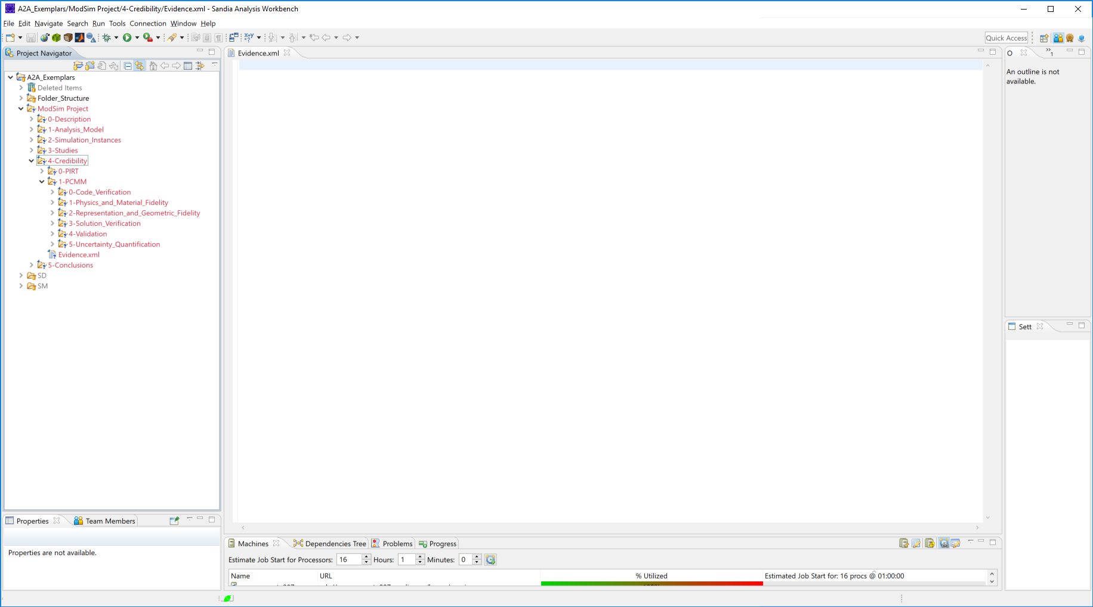

CompSim Credibility Process
Note: Dakota studies recommended to be done here
Phenomena, PIRT
Assess, PCMM
Communicate
Communicate
Click
Defining key physical phenomena and ranking importance is the primary function of a PIRT (Phenomena Identification and Ranking Table). A secondary function is to further assess the adequacy and gaps in the simulation capabilities, and available experimental data in an expanded PIRT
The Predictive Capability Maturity Model is an expert elicitation process designed to characterize and communicate the completeness and rigor of the approaches used in computational model definition, code and solution verification, validation, and uncertainty quantification for an application prediction.
References to documents with details of
ModSim limitations and risks
Peer reviews
PCMM assessment
Documentation structure
Plausible prediction bounds
Note: Credibility evidence container
Links to artifacts
States of tools (PIRT, PCMM)
Reference
Reference
Generate Credibility Report from Current State

Slide 4
CompSim Credibility Process
Phenomena
Click
Back
Add Phenomena Group
Add Phenomenon
Reset
Done

Slide 5
CompSim Credibility Process
Phenomena, PIRT
Assess, PCMM
Communicate
Click
Defining key physical phenomena and ranking importance is the primary function of a PIRT (Phenomena Identification and Ranking Table). A secondary function is to further assess the adequacy and gaps in the simulation capabilities, and available experimental data in an expanded PIRT
The Predictive Capability Maturity Model is an expert elicitation process designed to characterize and communicate the completeness and rigor of the approaches used in computational model definition, code and solution verification, validation, and uncertainty quantification for an application prediction.
References to documents with details of
ModSim limitations and risks
Peer reviews
PCMM assessment
Documentation structure
Plausible prediction bounds
Note: Need graphical indication that an element has been touched – no progress bar
Reference
Reference
Generate Credibility Report from Current State

Slide 6
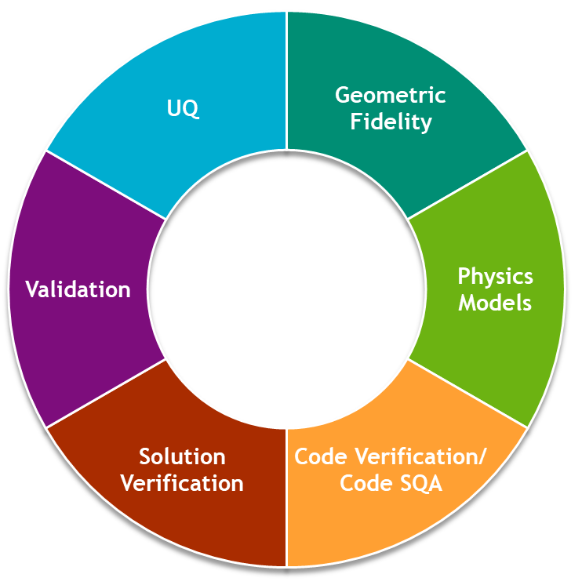
CompSim Credibility Process
Assess, PCMM
Click
Back

Slide 7
CompSim Credibility Process
Assess, PCMM
Click
Evidence
Assess
Aggregate
Back

Slide 8
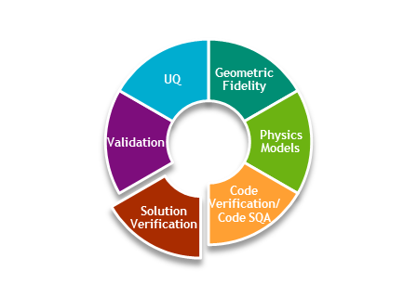
CompSim Credibility Process
Assess, PCMM -> Solution Verification -> Evidence
Click
Add Evidence
Done

Slide 9
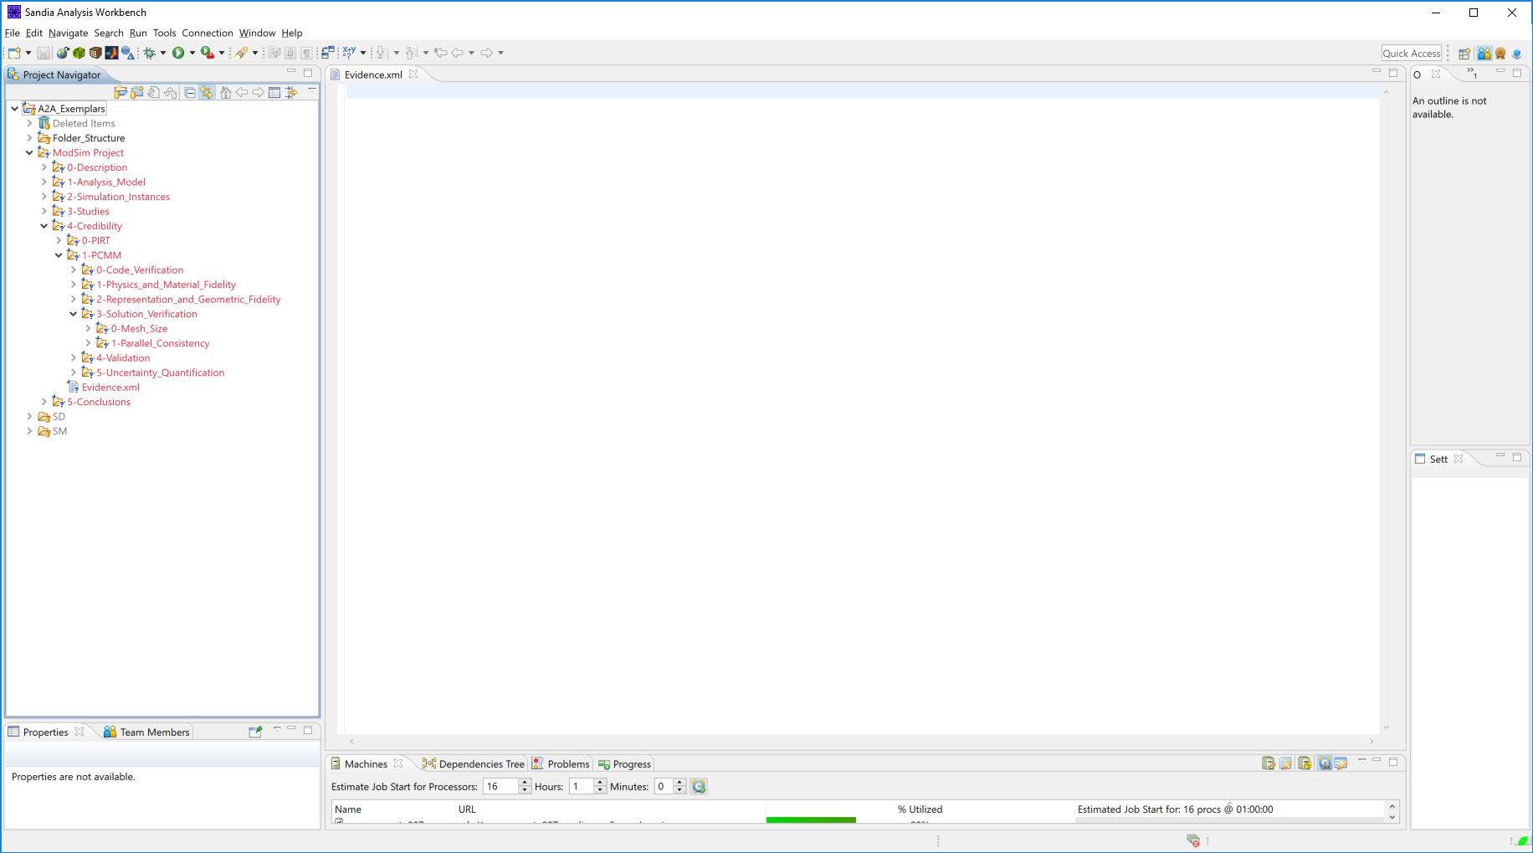
CompSim Credibility Process
Assess, PCMM -> Solution Verification -> Evidence
Click
Add Evidence
Done

Slide 10
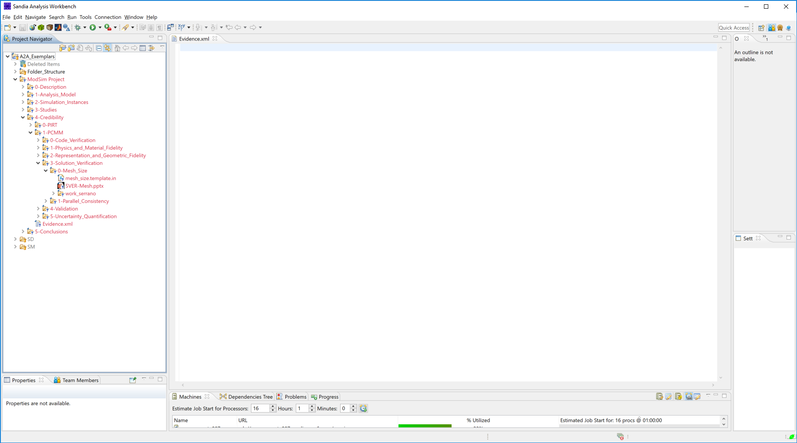
CompSim Credibility Process
Assess, PCMM -> Solution Verification -> Evidence
Click
Add Evidence
Done

Slide 11
CompSim Credibility Process
Assess, PCMM -> Solution Verification -> Evidence
WARNING: Document is not under configuration control. Commit now?
Yes
No
Cancel
Click
Note: Evidence not under configuration control not accepted for assessment
Add Evidence
Done

Slide 12
CompSim Credibility Process
ModSim Project
Assess, PCMM -> Solution Verification -> Evidence
4-Credibility
1-PCMM
3-Solution_Verification
SVER-Mesh.pptx
Click
Add Evidence
Done

Slide 13
CompSim Credibility Process
ModSim Project
Assess, PCMM -> Solution Verification -> Evidence
4-Credibility
1-PCMM
File Name | Description
SVER_Mesh.pptx | Solution verification with respect to me
3-Solution_Verification
Click
SVER-Mesh.pptx
Note: Typing
Add Evidence
Done

Slide 14
CompSim Credibility Process
ModSim Project
Assess, PCMM -> Solution Verification -> Evidence
4-Credibility
1-PCMM
File Name | Description
SVER_Mesh.pptx | Solution verification with respect to mesh size
3-Solution_Verification
Click
SVER-Mesh.pptx
Add Evidence
Done

Slide 15
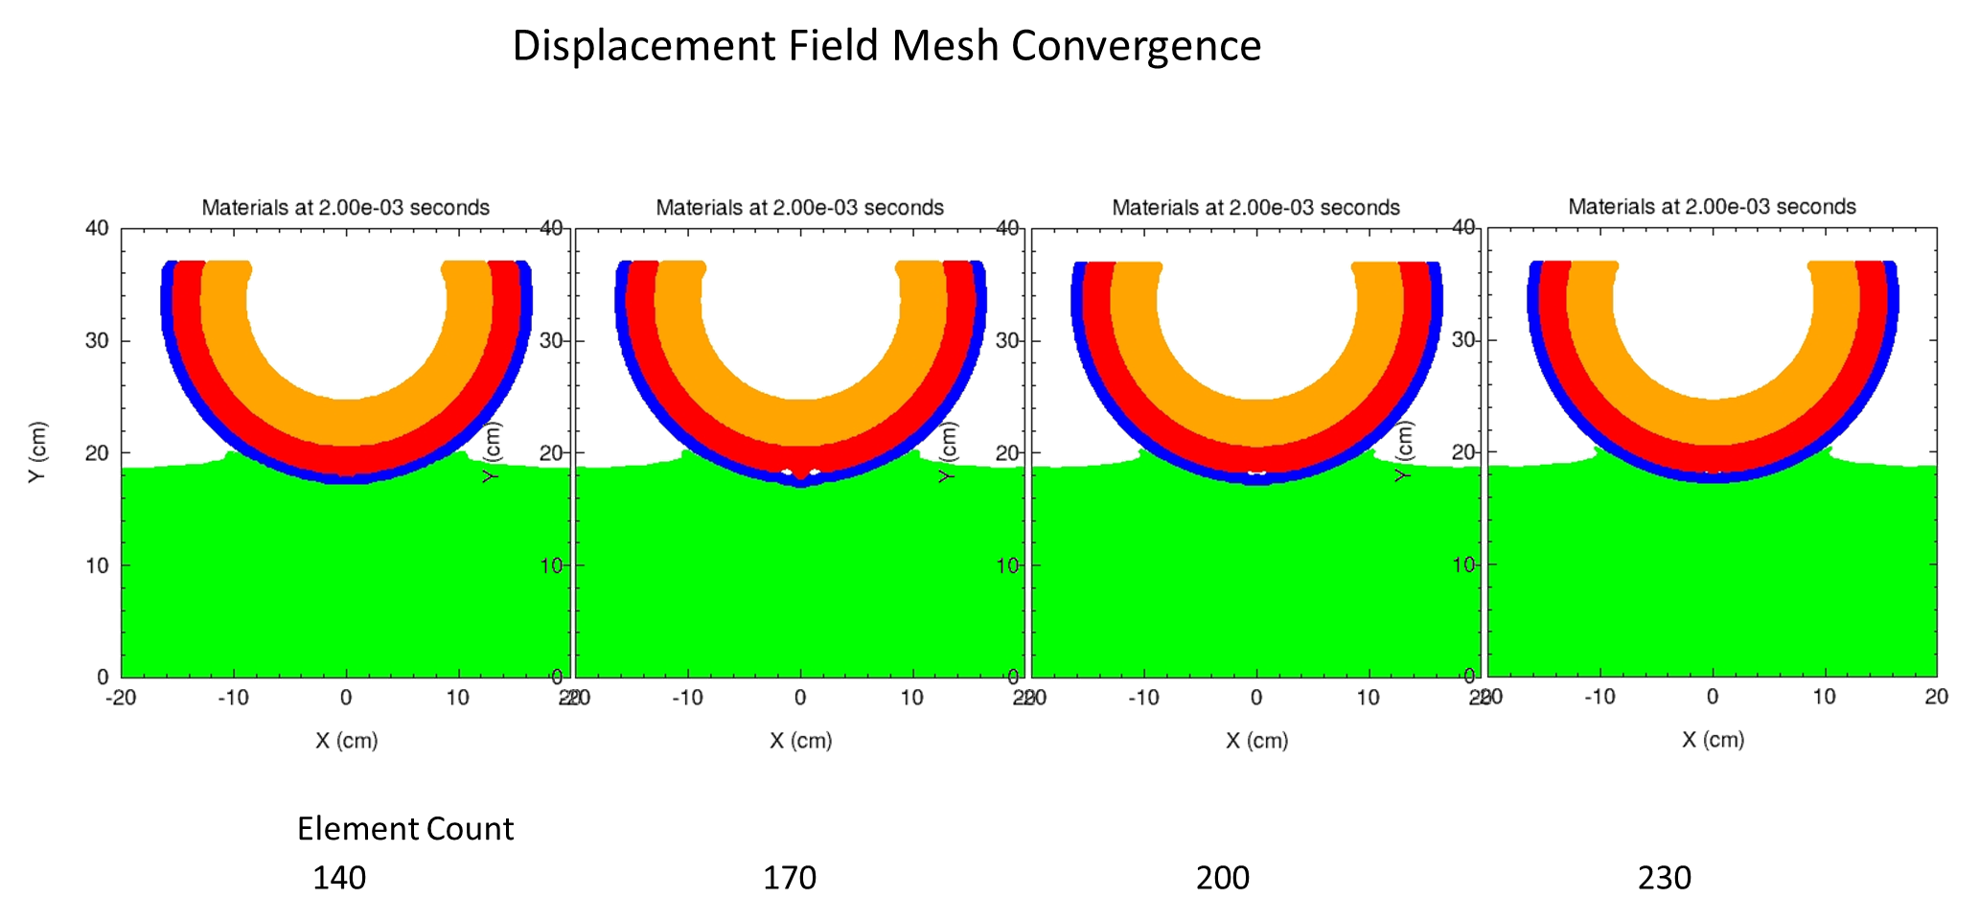
CompSim Credibility Process
ModSim Project
Assess, PCMM -> Solution Verification -> Evidence
4-Credibility
1-PCMM
File Name | Description
SVER_Mesh.pptx | Solution verification with respect to mesh size
3-Solution_Verification
SVER-Mesh.pptx
Click
Add Evidence
Done

Slide 16
CompSim Credibility Process
ModSim Project
Assess, PCMM
4-Credibility
1-PCMM
3-Solution_Verification
SVER-Mesh.pptx
Click
Evidence
Assess
Aggregate
Back

Slide 17
CompSim Credibility Process
ModSim Project
Assess, PCMM -> Solution Verification -> Assess
4-Credibility
Consequence
Click
1-PCMM
Assessor Role
3-Solution_Verification
SVER-Mesh.pptx
Back

Slide 18
CompSim Credibility Process
ModSim Project
Assess, PCMM -> Solution Verification -> Assess
4-Credibility
Consequence
1-PCMM
Scoping
Assessor Role
3-Solution_Verification
Design
Qualification
Click
SVER-Mesh.pptx
Back

Slide 19
CompSim Credibility Process
ModSim Project
Assess, PCMM -> Solution Verification -> Assess
4-Credibility
Consequence
Qual
1-PCMM
Click
Assessor Role
3-Solution_Verification
SVER-Mesh.pptx
Back

Slide 20
CompSim Credibility Process
ModSim Project
Assess, PCMM -> Solution Verification -> Assess
4-Credibility
Consequence
Qual
1-PCMM
Assessor Role
3-Solution_Verification
Customer
Analyst
Click
SVER-Mesh.pptx
Experimentalist
Code Developer
V&V Partner
Back

Slide 21
CompSim Credibility Process
ModSim Project
Assess, PCMM -> Solution Verification -> Assess
4-Credibility
Consequence
Qual
1-PCMM
Role
Analyst
3-Solution_Verification
SVER-Mesh.pptx
Click
PCMM Tool
Back

Slide 22
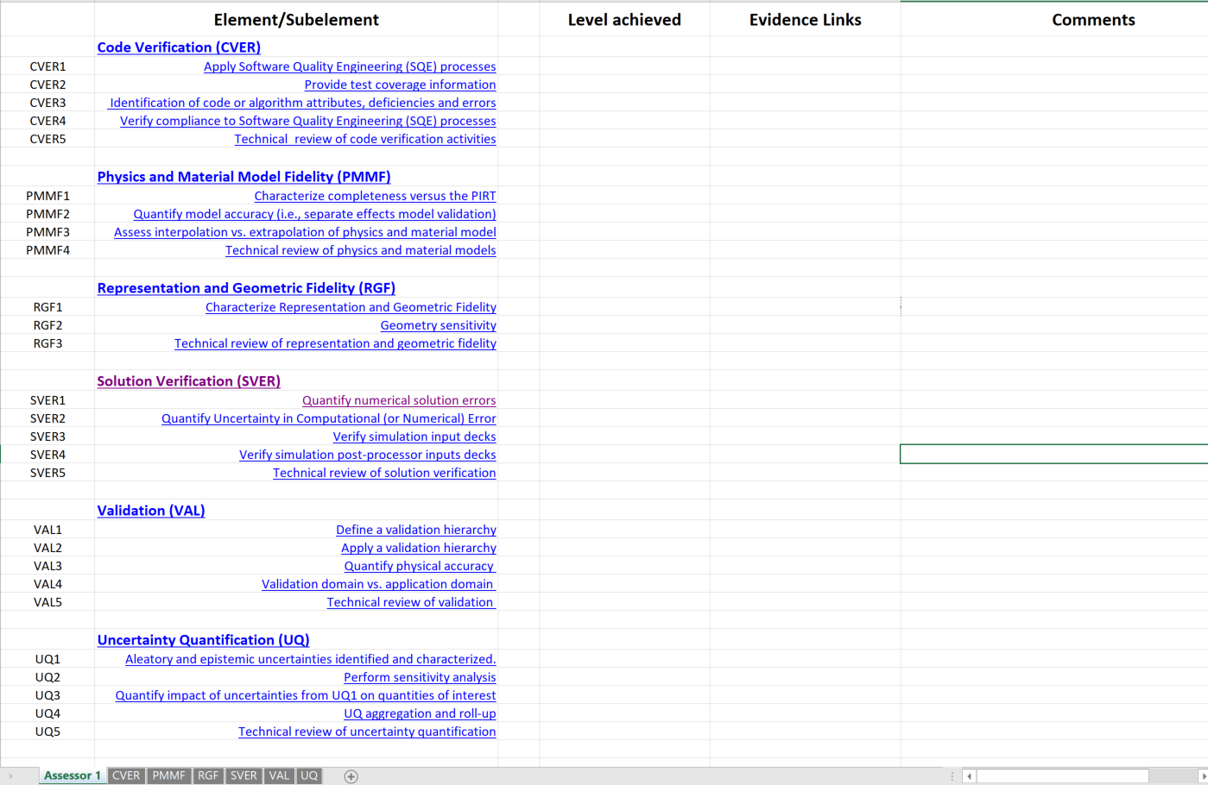
CompSim Credibility Process
ModSim Project
Assess, PCMM -> Solution Verification -> Assess
4-Credibility
Consequence
Qual
1-PCMM
Role
Analyst
3-Solution_Verification
SVER-Mesh.pptx
Click
Back
Done

Slide 23
CompSim Credibility Process
ModSim Project
Assess, PCMM -> Solution Verification -> Assess
4-Credibility
Consequence
Qual
1-PCMM
Role
Analyst
3-Solution_Verification
SVER-Mesh.pptx
Not Assessed
Click
High
Medium
Low
Back
Done

Slide 24
CompSim Credibility Process
ModSim Project
Assess, PCMM -> Solution Verification -> Assess
4-Credibility
Consequence
Qual
1-PCMM
Role
Analyst
3-Solution_Verification
Visual evidence only
Note: Comment added
Click
Back
Done

Slide 25
CompSim Credibility Process
ModSim Project
Assess, PCMM
4-Credibility
1-PCMM
3-Solution_Verification
Click
Back

Slide 26
CompSim Credibility Process
ModSim Project
Assess, PCMM
4-Credibility
1-PCMM
3-Solution_Verification
SVER-Mesh.pptx
Evidence
Assess
Click
Aggregate
Back

Slide 27
CompSim Credibility Process
Assess, PCMM -> Solution Verification -> Aggregate
Consequence
Qual
Click
Back
Done

Slide 28
CompSim Credibility Process
ModSim Project
Assess, PCMM -> Solution Verification -> Aggregate
4-Credibility
Consequence
Qual
1-PCMM
3-Solution_Verification
Customer
Click
Analyst
Experimentalist
Code Developer
V&V Partner
Back
Done

Slide 29
CompSim Credibility Process
ModSim Project
Assess, PCMM -> Solution Verification -> Aggregate
4-Credibility
Consequence
Qual
1-PCMM
Comments
3-Solution_Verification
Customer Could we use less accurate model for studies?
Analyst Visual evidence only
Experimentalist
Code Developer We have similar regression problems in test suite
V&V Partner Field based comparator metrics under development
Click
Back
Done

Slide 30
CompSim Credibility Process
ModSim Project
Click
Assess, PCMM
4-Credibility
1-PCMM
3-Solution_Verification
Back

Slide 31
CompSim Credibility Process
ModSim Project
Phenomena, PIRT
Assess, PCMM
Communicate
4-Credibility
Click
1-PCMM
Defining key physical phenomena and ranking importance is the primary function of a PIRT (Phenomena Identification and Ranking Table). A secondary function is to further assess the adequacy and gaps in the simulation capabilities, and available experimental data in an expanded PIRT
The Predictive Capability Maturity Model is an expert elicitation process designed to characterize and communicate the completeness and rigor of the approaches used in computational model definition, code and solution verification, validation, and uncertainty quantification for an application prediction.
References to documents with details of
ModSim limitations and risks
Peer reviews
PCMM assessment
Documentation structure
Plausible prediction bounds
3-Solution_Verification
Reference
Reference
Generate Credibility Report from Current State

Slide 32
CompSim Credibility Process
ModSim Project
Communicate
4-Credibility
ModSim limitations and risks
Peer reviews
PCMM assessment
Documentation structure
Plausible prediction bounds
1-PCMM
Click
3-Solution_Verification
Back

Slide 33
CompSim Credibility Process
ModSim Project
Communicate -> Peer Reviews
4-Credibility
1-PCMM
3-Solution_Verification
Click
Add Peer Review
Back

Slide 34
CompSim Credibility Process
Click
ModSim Project
Communicate -> Peer Reviews
4-Credibility
1-PCMM
Peer Review Date | Panel Memo | ModSim Team Response
2020 Dec 3 | Peer_Review_Panel_memo.doc | Peer_Review_Repsponse.doc
3-Solution_Verification
Note: Links to documents
Add Peer Review
Back

Slide 35
CompSim Credibility Process
ModSim Project
Phenomena, PIRT
Assess, PCMM
Communicate
1-PCMM
Defining key physical phenomena and ranking importance is the primary function of a PIRT (Phenomena Identification and Ranking Table). A secondary function is to further assess the adequacy and gaps in the simulation capabilities, and available experimental data in an expanded PIRT
The Predictive Capability Maturity Model is an expert elicitation process designed to characterize and communicate the completeness and rigor of the approaches used in computational model definition, code and solution verification, validation, and uncertainty quantification for an application prediction.
References to documents with details of
ModSim limitations and risks
Peer reviews
PCMM assessment
Documentation structure
Plausible prediction bounds
3-Solution_Verification
Reference
Reference
Click
Generate Credibility Report from Current State

Slide 36
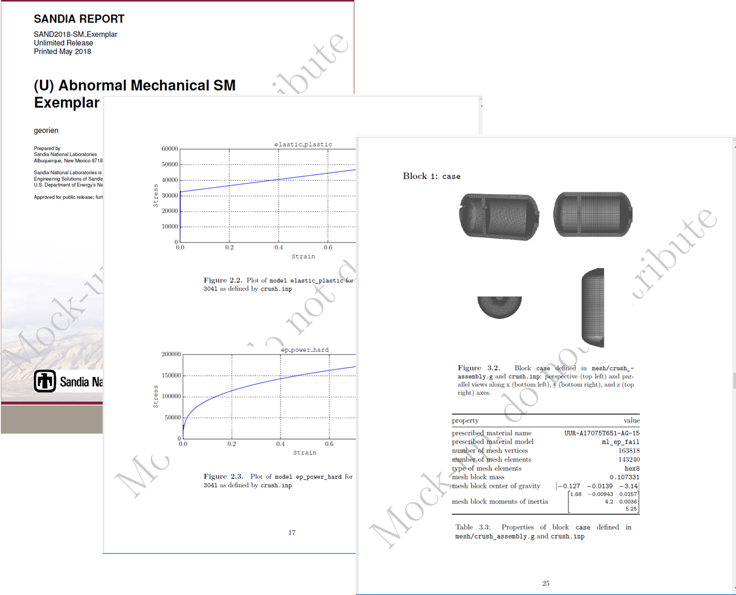
CompSim Credibility Process
ModSim Project
Note: Detailed document; source material for credibility briefings (customer, peer review, etc.)
1-PCMM
3-Solution_Verification
Back

