Slide 1
Effective Heart Disease Prediction Using Hybrid Machine Learning Techniques
PRESENTED BY: P. RITEESH -2103A51206 -CSE
K.VENKATA SAINADH -2103A51422 -CSE
M.SANDEEP -2103A51583 -CSE
BATCH NO. : 01

Slide 2
PROBLEM STATEMENT
Heart diseases can be managed effectively with a combination of lifestyle changes, medicines and even food habits. With the right treatment, the symptoms of the heart disease can be reduced and the functioning of the heart also becomes improved. The predicted results can be used to prevent and also reduce the cost for surgical treatment and other expensives and even the side effects are also reduced.
Due to the disease is related to the heart and also it is the most sensitive part the disease has to be handled carefully and also more faster way with a greater accuracy. So, we propose a model called HRFLM which is better in some of the parameters such as accuracy, specificity and in error control.

Slide 3
AIMS AND OBJECTIVES
AIM : Prediction of Heart Disease using proposed HRFLM(Hybrid Random Forest with Linear Model)
Objectives :
To identify the null values in the dataset and pre-process the data by removing the rows that contain the null values.
To convert the target variable into binary classification where 0 represents the absence of heart disease and 1 represents the presence of heart disease.
Training the dataset using Logistic Regression , Naive Bayes , Random Forest , Gradient boosted trees , Decision trees, SVM(Support Vector Machine) and calculating the performance metrices.
Identifying the best model based on the calculated performance metrices.
Using the best predicted model proposing a hybrid model to improve the accuracy and other performance metrices.
Plotting a graph for the performance metrices of various models and proving the hybrid model is the best.

Slide 4
ABSTRACT
Heart disease has become common cause for death in the modern world. This disease is caused irrespective of age in these days and if not controlled or predicted at the earlier stage then this can cause a great damage and even fatality of the person.
There are many techniques which are used to predict the heart diseases such as Genetic Algorithm, Decision Trees, Naive Bayes and even Neural Networks which gave valuable results. Since the disease is related to the heart it is more complex and more sensitive part, so the disease has to be handled very carefully and if the severity is more then the treatment has to be done immediately. So, this lead to implement an algorithm that is even more efficient than the above algorithms with such as accuracy etc., parameters.
So, the main objective of the current proposed model uses all the features without any restrictions on using the feature selection. The technique we used here is the hybrid model named HRFLM (Hybrid Random Forest with Linear Model) which is better than the above algorithms in some of the parameters such as accuracy, specificity and in error control.

Slide 5
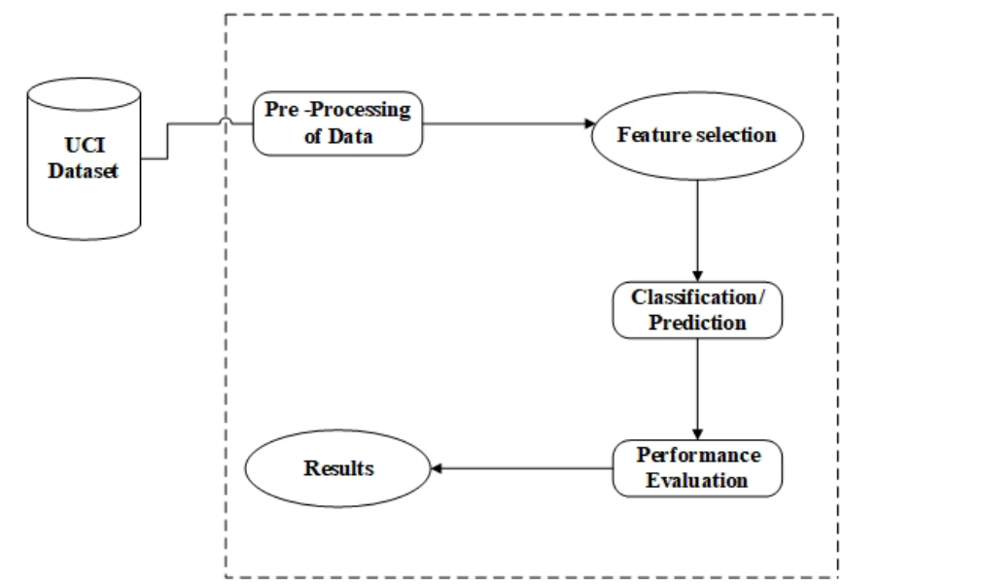
WORKFLOW

Slide 6
Proposed Methodology
Initially the UCI dataset is preprocessed by removing the rows which contain the null values.
Converting the target variable into binary classification where 0 represents the absence of heart disease and 1 represents the presence of heart disease.
Then the pre-processed dataset is then split into test and train data where the testing data is 15% of the whole pre-processed data.
Now the train data is trained to the model using various classification algorithms such as using Logistic Regression , Naive Bayes , Random Forest , Gradient boosted trees , Decision trees , SVM.
Now after training, the test data is given to the model and the result is predicted by the model.
Based on the results, the performance metrices are calculated such as classification error , accuracy, precision , F-measure , specificity and sensitivity.
The best model among these is taken for proposing the hybrid model.

Slide 7
EXPECTED OUTCOME
To detect the heart disease with high accuracy and low computational time.
Identifying the algorithms which are helpful in the hybrid prediction model.
SOFTWARE TOOLS REQUIRED
Anaconda(Jupyter notebook)
Streamlit

Slide 8
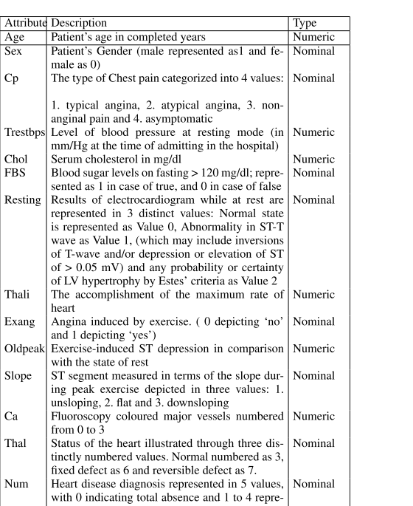
MODULE-1
The UCI dataset is used for training and testing the model.
Dataset Link: https://archive.ics.uci.edu/ml/datasets/heart+disease
Dataset attributes :

Slide 9
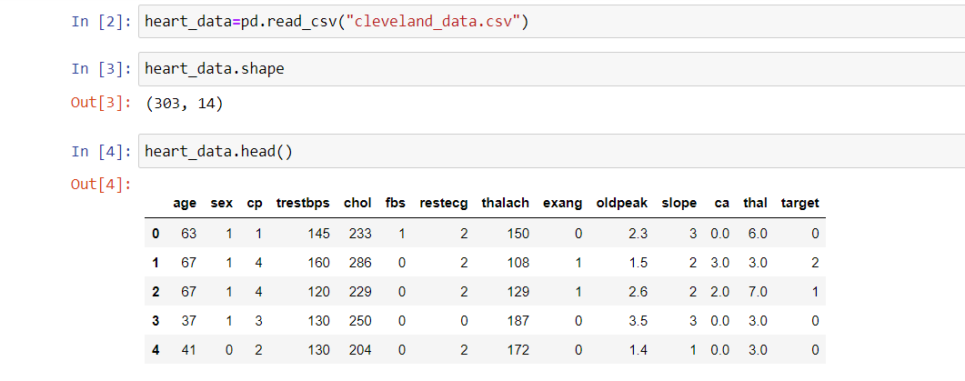
MODULE-2
This module forms the basis for the entire implementation part.
Data preprocessing for the UCI dataset is done.
The UCI dataset contains some null values in some rows. So all the rows that contain the null values are removed from the dataset.
First five records of UCI dataset before preprocessing

Slide 10
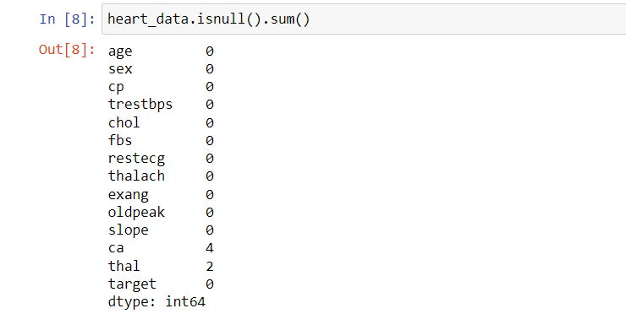
Null values are checked before deleting them
UCI dataset contains null values in 4 rows of ca and two rows of thal

Slide 11
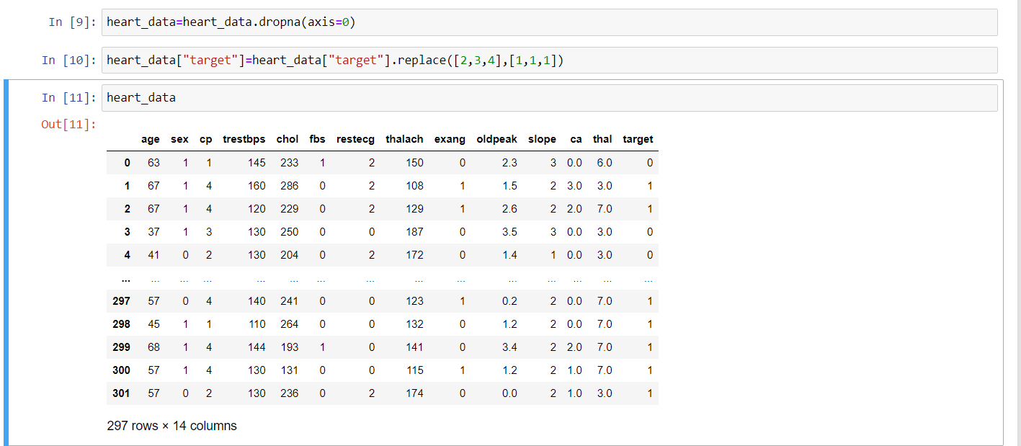
As a part of preprocessing rows containing null values are removed and target variable is converted to the range of(0,1)

Slide 12
Module-3
Now, the UCI dataset is splitted into training and testing data, the training data is taken as 85% of the whole data and testing data is 15% of whole data.
This training and test data is now used for training the model using Logistic Regression , Naive Bayes , Random Forest , Gradient boosted trees.
Now based on the results predicted by the model performance metrices such as classification error , accuracy, precision , F-measure , specificity and sensitivity are calculated.

Slide 13
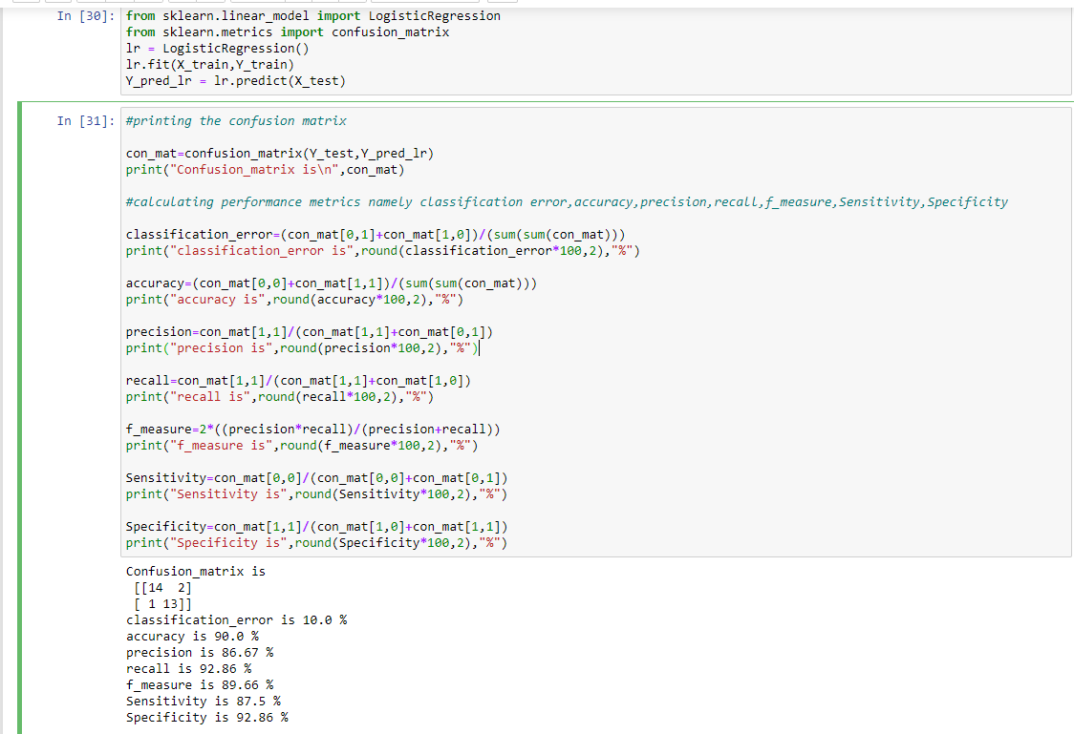
Logistic Regression

Slide 14
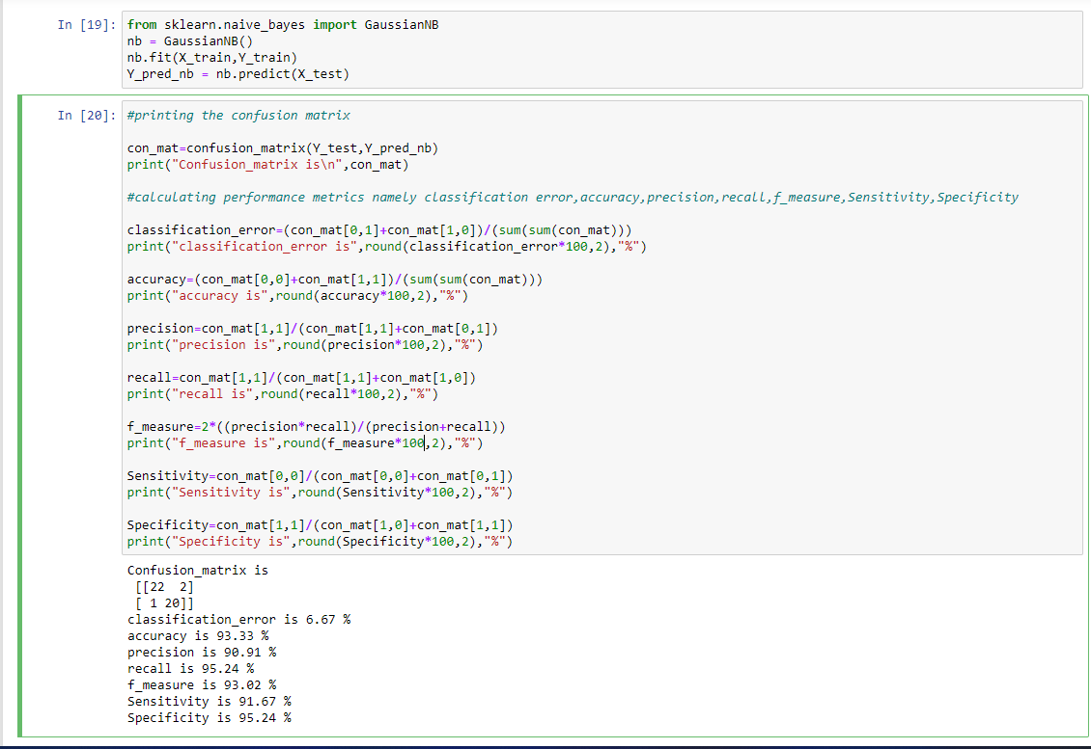
Naive Bayes

Slide 15
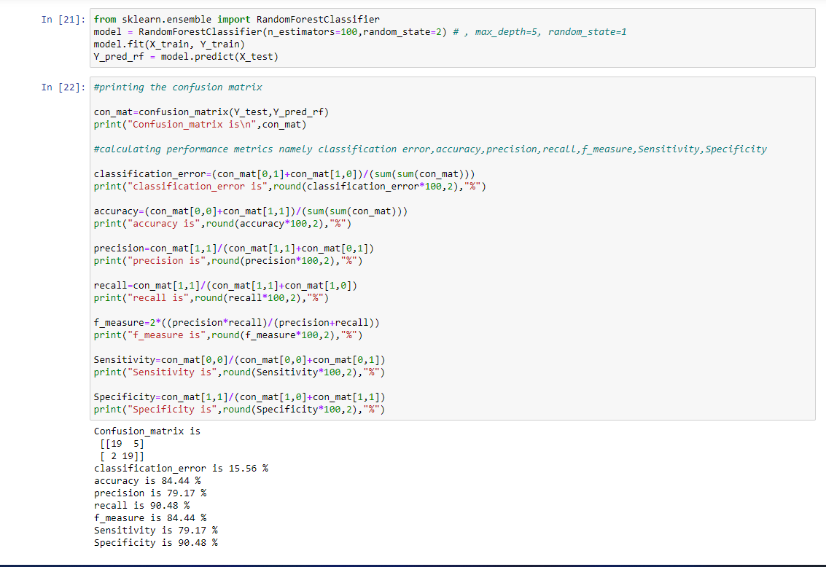
Random Forest

Slide 16
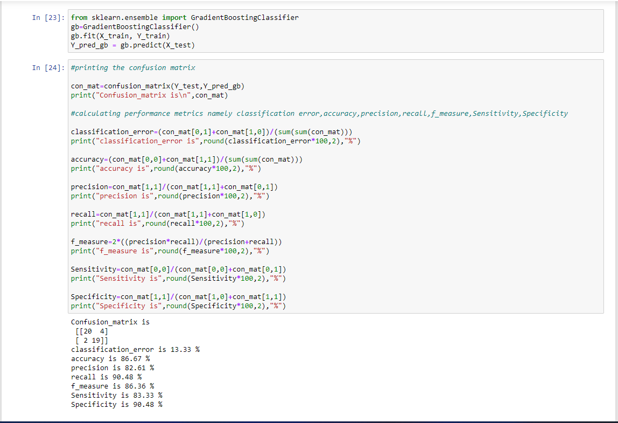
Gradient Boosted Trees

Slide 17
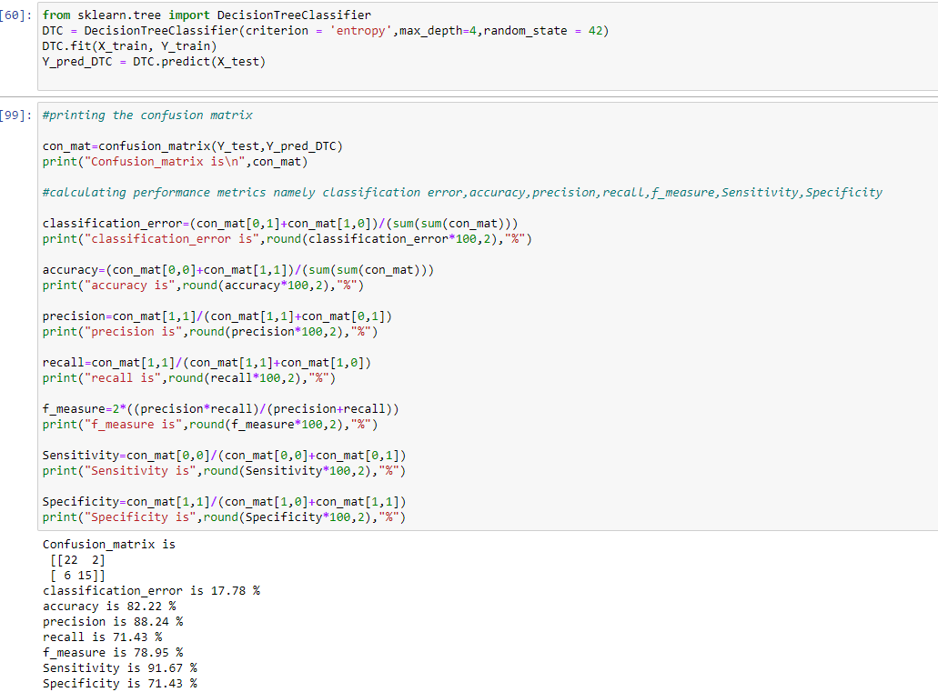
Decision Tree Algorithm

Slide 18
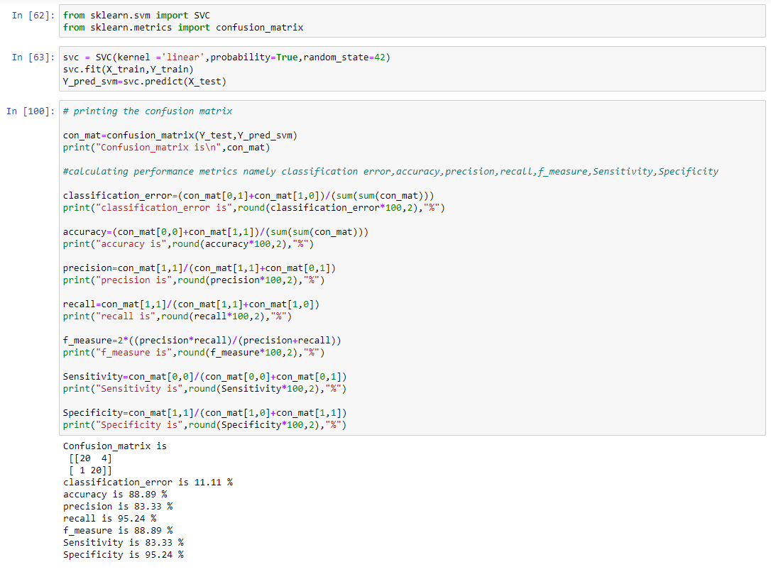
Linear Support Vector Machine(LSVM)

Slide 19
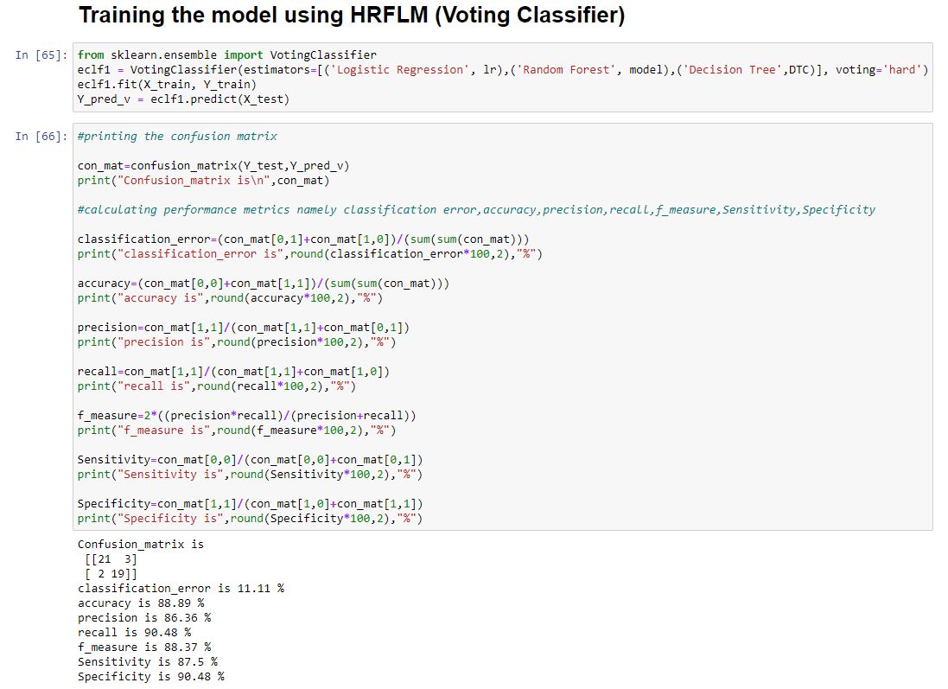

Slide 20
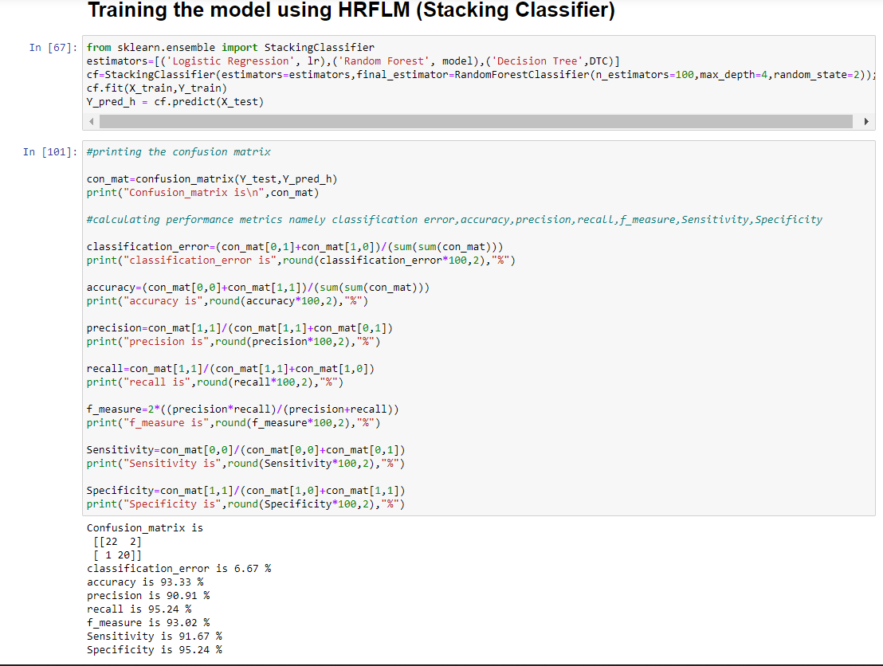

Slide 21
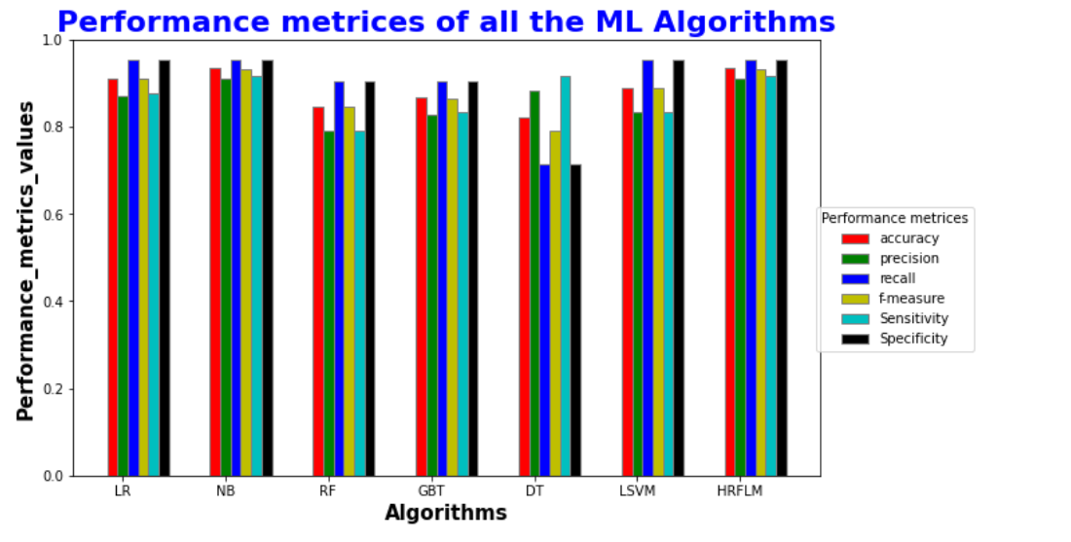
Graph of ML basic models with the hybrid model

Slide 22
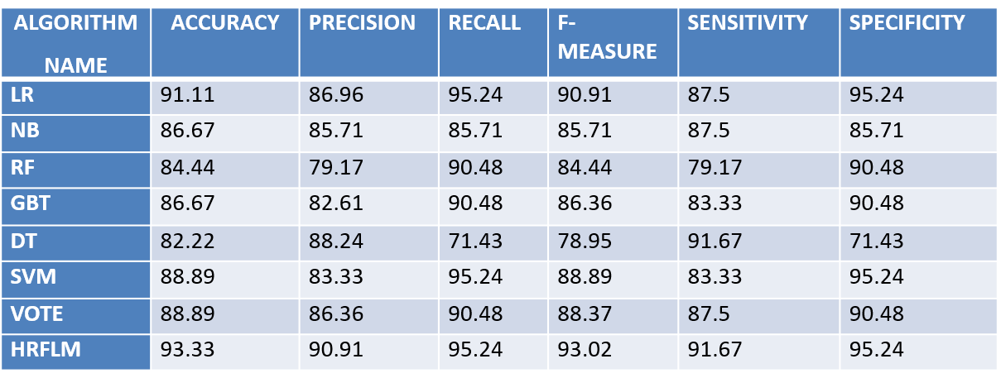
Results:

Slide 23
Conclusion
The number of heart disease cases are increasing steadily with the increased number of aged population
So, early detection of the disease is necessary
So , from the algorithms that we trained the data combined together that has highest accuracy and other performance metrices is taken into consideration for building the hybrid model(HRFLM)

Slide 24
THANK YOU

