Slide 1

Life is easy with Mobile App Technologies
By Sandila Sujayana – Grade 09
17th Nov 2022

Slide 2

Agenda
Theme or Field that app facilitate
purpose of the app?
Name of the app.
GUIs.
Features
Technologies and procedures.
How problem/scenario solved?
Future improvements
End

Slide 3
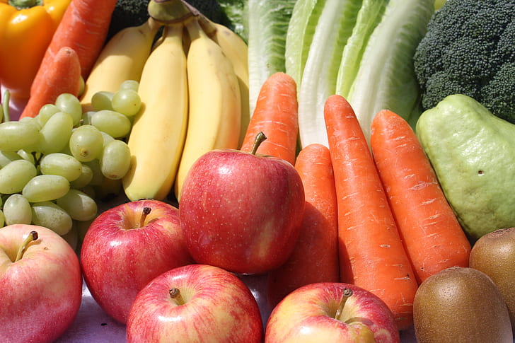
Theme or Field & Purpose of the app
Fruits and Vegetable
Due to Covid19 and Economic Crisis, Sri Lanka is facing a food crisis!
Vegetable and Food prices increased rapidly
Low production
High wastage / damage
Third party involvement
BEST SOLUTION is effective distribution of Fruits and Vegetables without third parties
Fresh Items
Low cost
Less wastage
Save Food

Slide 4
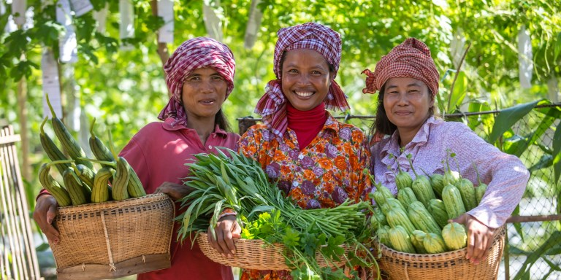
Name of the app??.
ගොවි සවිය - GOVI SAVIYA
Support the farmers
They get more money
Sync with latest technologies
Contribute minimize the economic crisis!!
Save Food

Slide 5
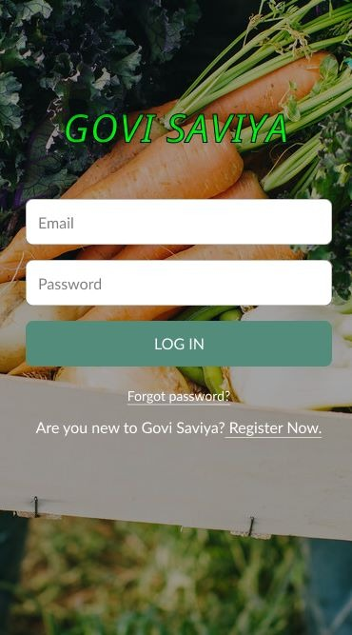
GUIs… / User Interfaces…??
Login / Registration Windows for
Farmers
Clients/Buyers
Super / admin user
Stock Monitor
Market Place
Order / Check out
Payment window
Notification / Alerts about news

Slide 6
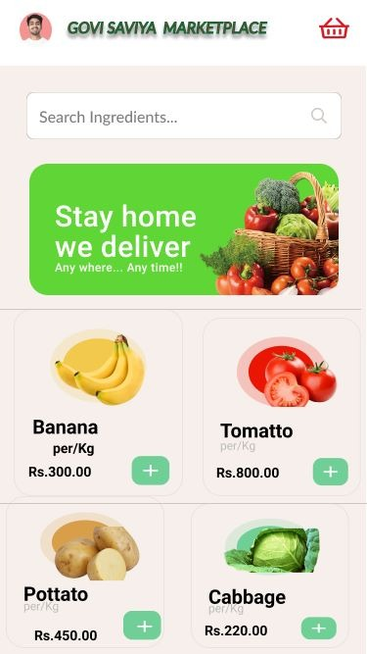
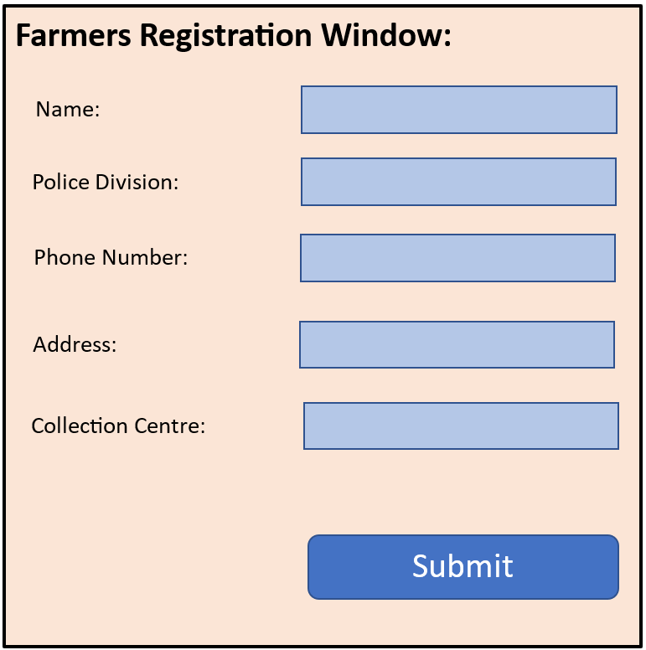
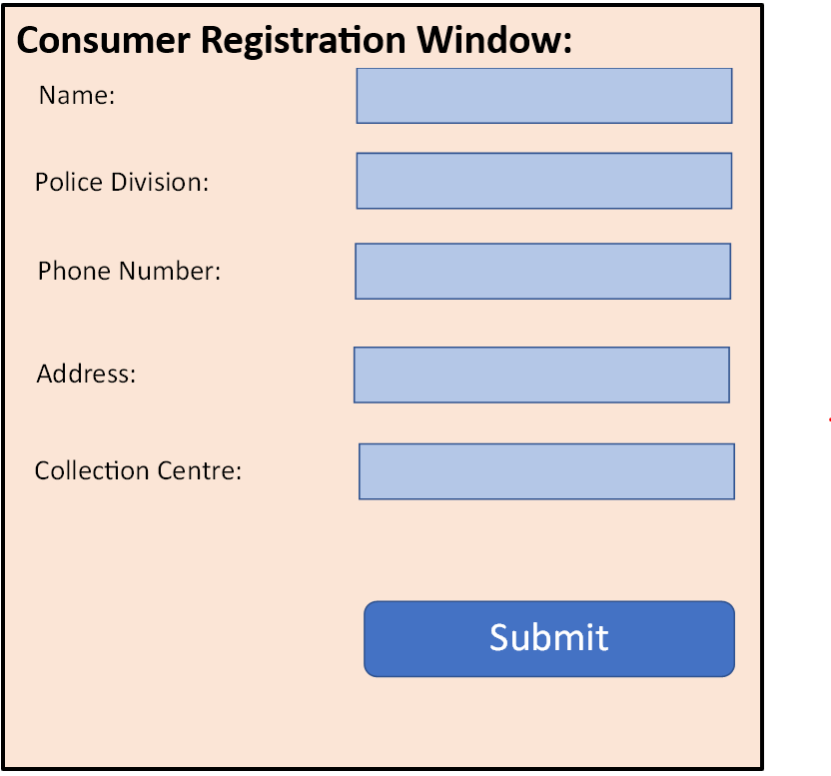
GUIs continue…??

Slide 7
Features
Searching facility
View sample items
Quick and simple registration
Ability order small quantity to large
Technologies
Java / Kotlin / CSS/HTML
Need further learning…
Procedures
Identify requirement
Interview /discussion with farmers
Design concept
Prototype
FIGMA UI Designer
development

Slide 8
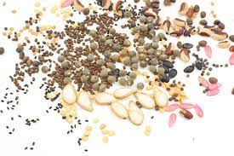
How problem/scenario solved?
Island wide farmers can involve without cost
Fruits/Vegetables from Farm itself can be sold directly for any clients
Future improvements
Expand for selling plants
For Vegetable / fruits seeds
Knowledge sharing / Training
Farmers can share experiences / stories each other

Slide 9

Q & A ?
Let's help each other and uplift my mother, Sri Lanka.!!
Thank you !!

