Slide 1
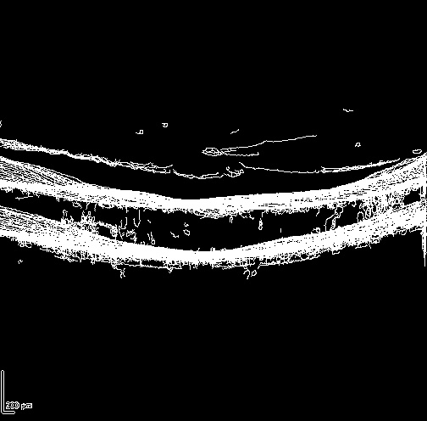
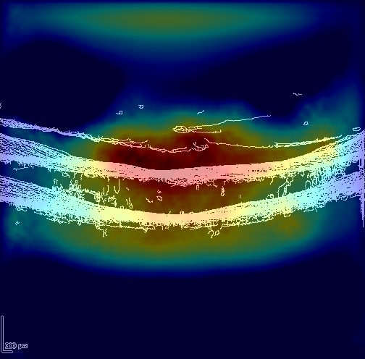
DRSS Severity Classification on OCT Images
SANTHANA BHARATHI NARASIMMACHARI (903607412)
VENKATA HANUMA SANDILYA BALEMARTHY (903482005)

Slide 2
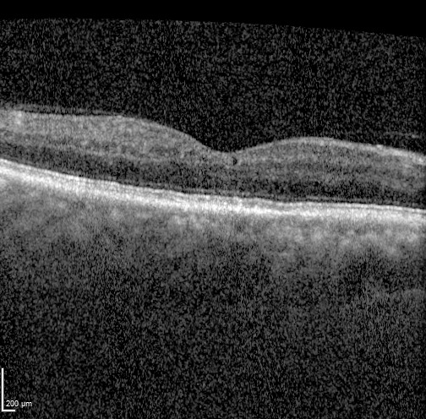
Problem Statement
Develop a classifier that reads OCT images from the OLIVES dataset and categorizes them into 3 output DRSS Severity level.
Classifier
DRSS Severity Level (0,1 &2)

Slide 3
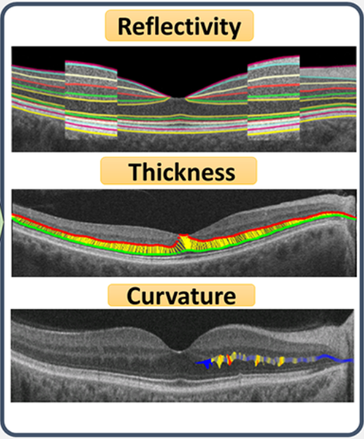
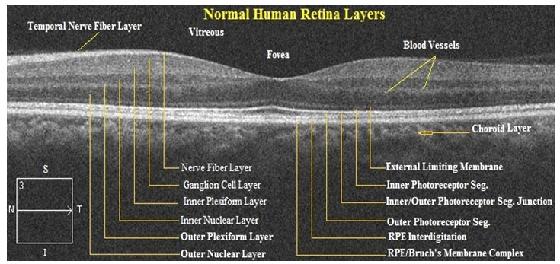
Critical Features
Extract retinal layers to obtain the three core metrics to diagnose Diabetic Retinopathy.

Slide 4
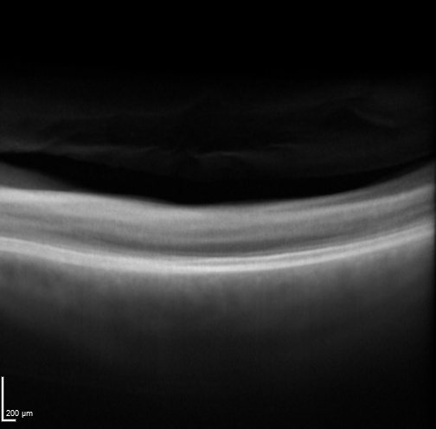
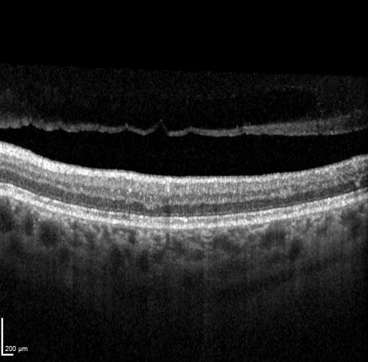
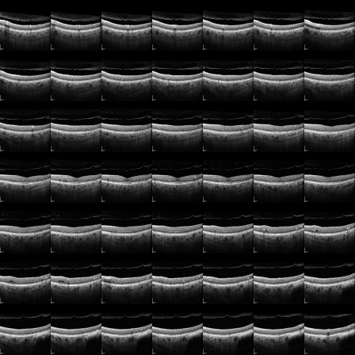
Pre-processing Techniques
Employed techniques to extract the relevant features and operate at lower dimensionality.
Laplacian Pyramid Fusion
Alpha Blending
Canny Edge Image
Grid image

Slide 5
Chosen Classifiers
Support Vector Machine (SVM)
K-Nearest Neighbors (KNN)
Naive Bayes
U-Net Classifier (CNN)

Slide 6
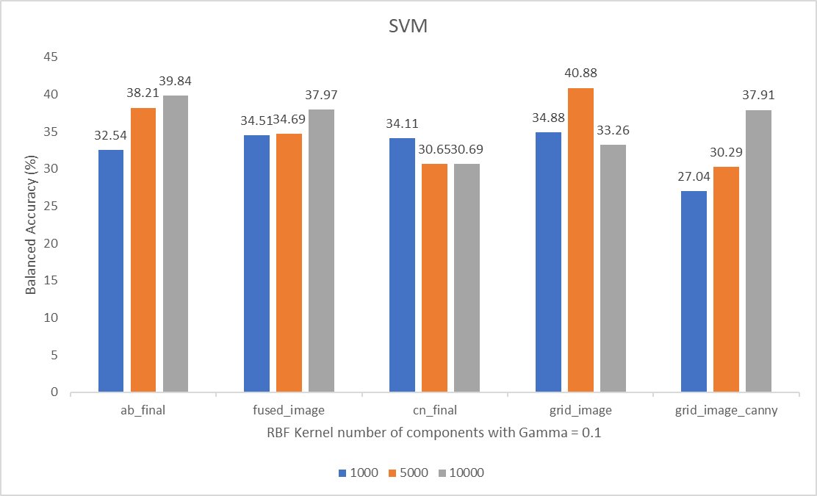
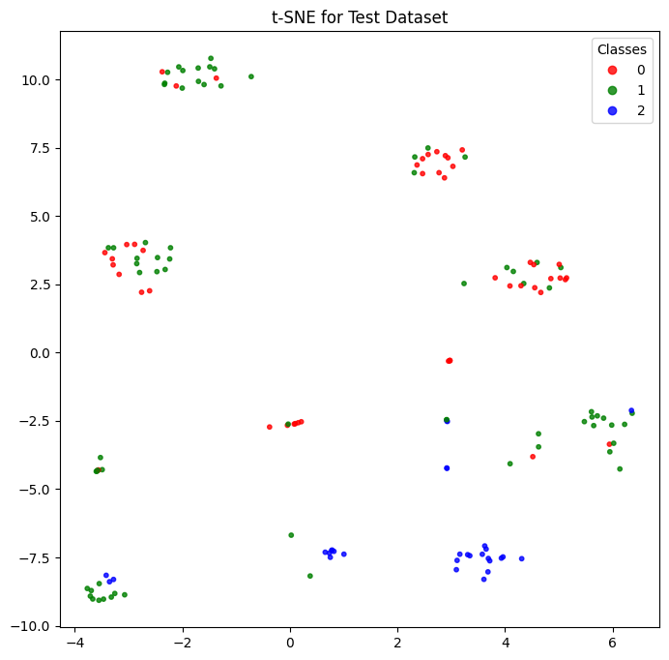
Support Vector Machine (SVM)
t-SNE shows high separability of class-2. Translates to increase in accuracy of predicting class-2 correctly. Employed RBF kernel.
Grid images show high accuracy due to retention of information and spatial context.
Notes:
Employed RBF non-linear kernel to navigate non linearity in feature space. Grid images show high accuracy due to retention of information and spatial context even after dimensionality reduction.

Slide 7
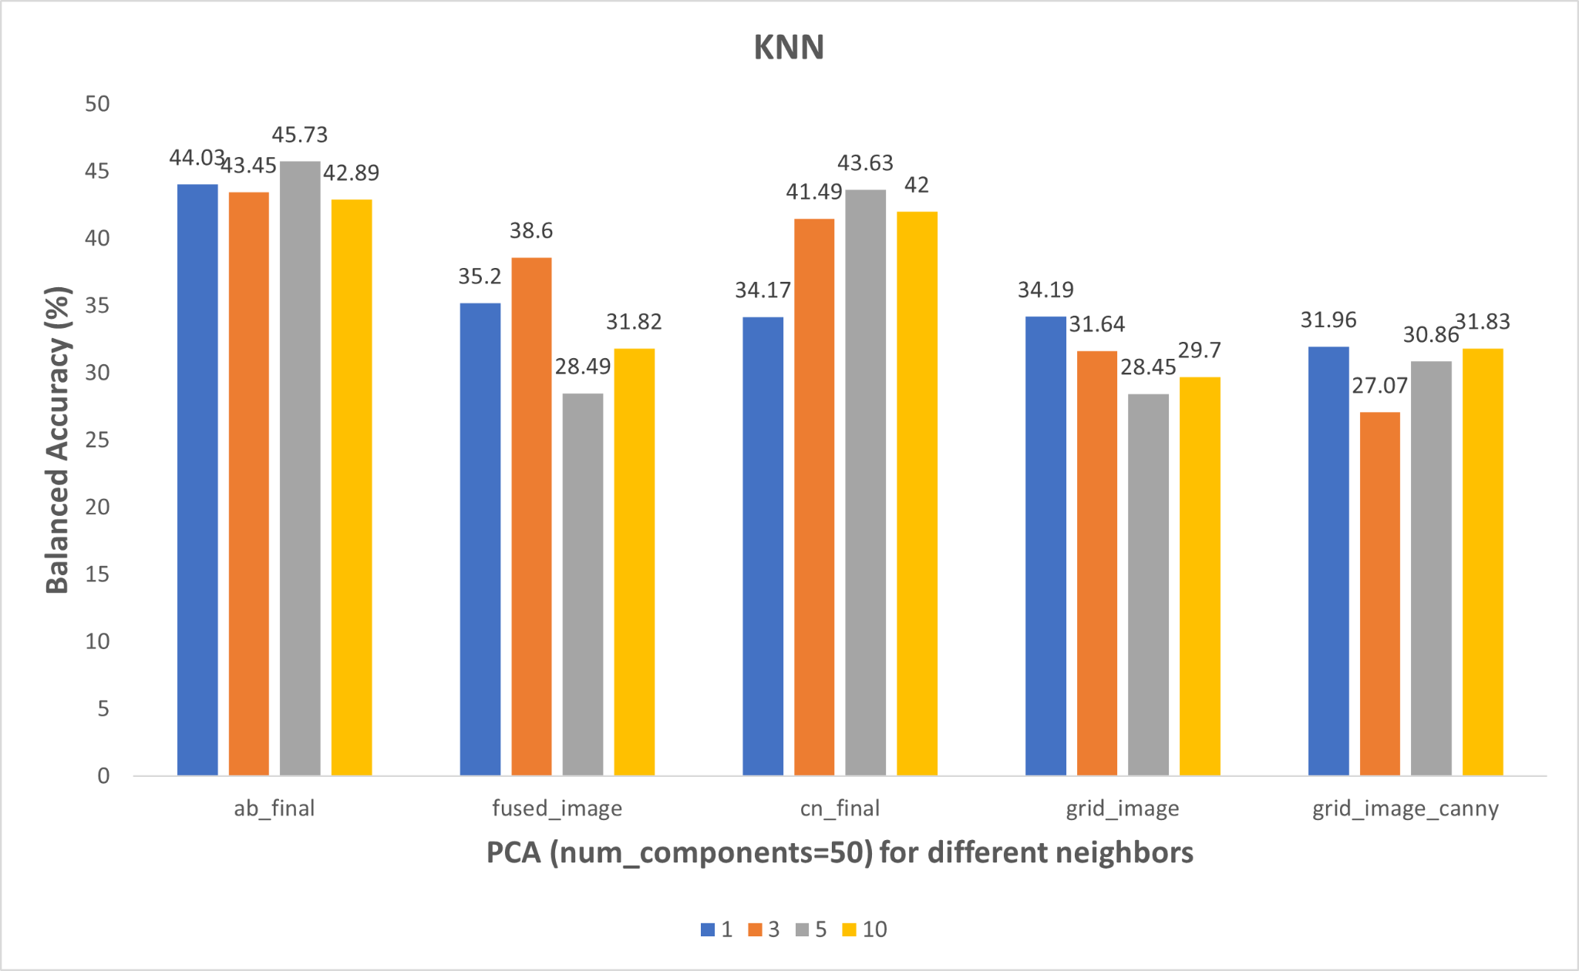
K-Nearest Neighbors (KNN)
Alpha Blended images yield the highest accuracy, followed by Canny Edge images.
A nearest neighbor value of '5' demonstrates the peak accuracy.

Slide 8
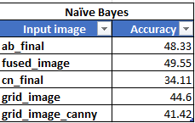
Naive Bayes(NB)
Naive Bayes scales well to handle multi-class classification problems,
Peak accuracy seen in Laplacian Pyramid Fusion image. This can be attributed to noise reduction and feature independence
Notes:
NB requires only one model to be trained, while SVM and KNN may require multiple models

Slide 9
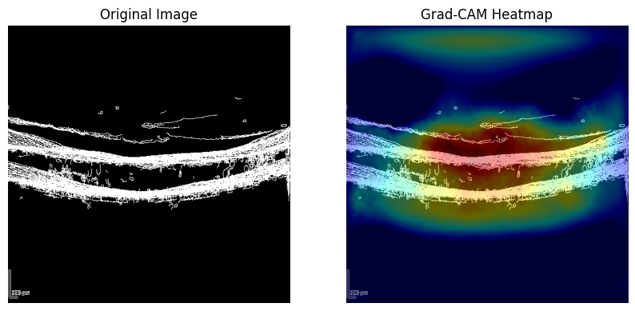
U-Net Classifier
A type of semantic segmentation technique. Contracting and Expanding structure effective in capturing hierarchical organizations such as retinal layers.

Slide 10
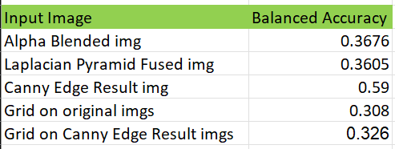
U-Net Classifier

Slide 11
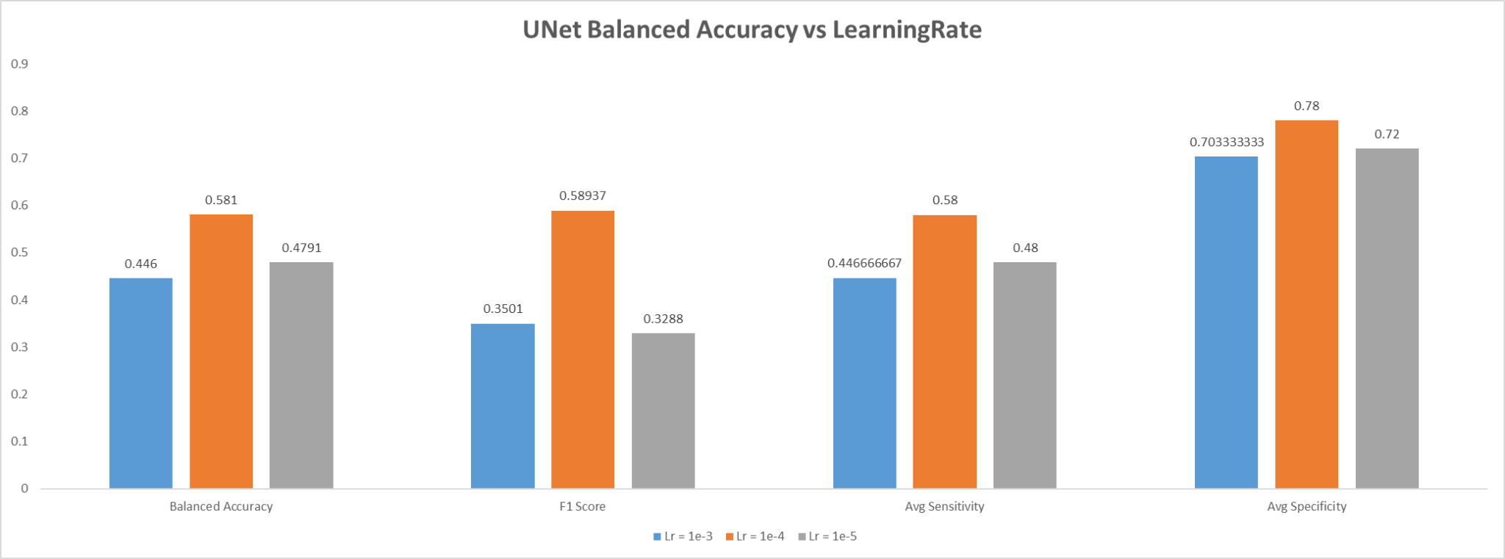
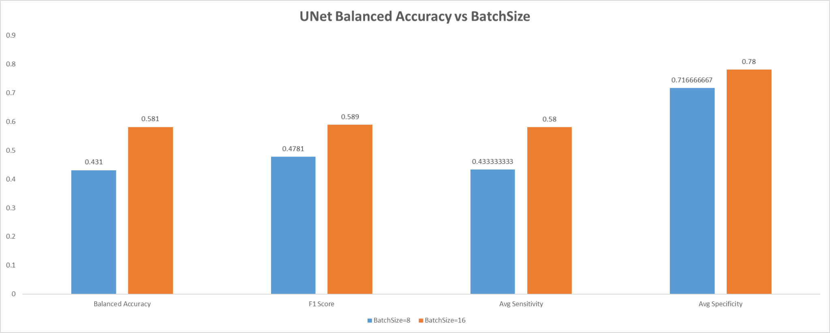
U-Net Classifier - Grid search

Slide 12
Summary
OCT DRSS Classification Accuracy
Feature Extraction Techniques | SVM | KNN | Naïve Bayes | U-Net
Alpha Blended image | 38.21 | 45.73 | 48.33 | 36.76
Laplacian Pyramid Fused image | 34.69 | 28.49 | 49.55 | 36.05
Canny Edge Result image | 30.65 | 43.63 | 34.11 | 59
Grid on orig image | 40.88 | 28.45 | 44.6 | 30.8
Grid on Canny Edge Result image | 30.29 | 30.86 | 41.42 | 32.6

Slide 13
Thank you

