Slide 1

Smriti Anand
Software Engineer

Slide 2
About me
Software developer with six years of experience, passionate about building products that simplify people's lives.
Born and raised in Ranchi, Jharkhand.
Earned a Bachelor's degree in Computer Science from Birla Institute of Technology, Mesra.
Started IT career as a Graduate Engineer Trainee (GET) with Vodafone India, later promoted to Senior Executive.
After 2.5 years at Vodafone, moved to NICE Interactive Solution India Pvt Ltd as a Software Engineer.
Currently a Member of Technical Staff 2 at VMware, working with the Clearsky team.
In my personal time, I enjoy upcycling and sketching.

Slide 3
Problem Statement
Design and implement a competitor to Stack Overflow Website.
Use Cases:
Top questions are to be shown in home page.
Users can create profile.
User can post a question, tag a question
User can answer to a question. Rich media content (photos/videos) can be added as an answer.
Users can answer to an answer.
Users can vote to and an answer or question
User can search the tags and browse the questions by tags
User can search questions/answers by text.

Slide 4
Assumptions
A question can have multiple answers.
An answer can have multiple comments.
No authentication for the user to access the APIs.
Top questions can be filter on the basis of vote.
Considering there is only one persona associate with the system.
Votes can be UPVOTE or DOWNVOTE.
In memory cache has been used.

Slide 5
Tech Stack
1. Java
2. Springboot
3. MySql
4. Elastic Search
5. S3 storage

Slide 6
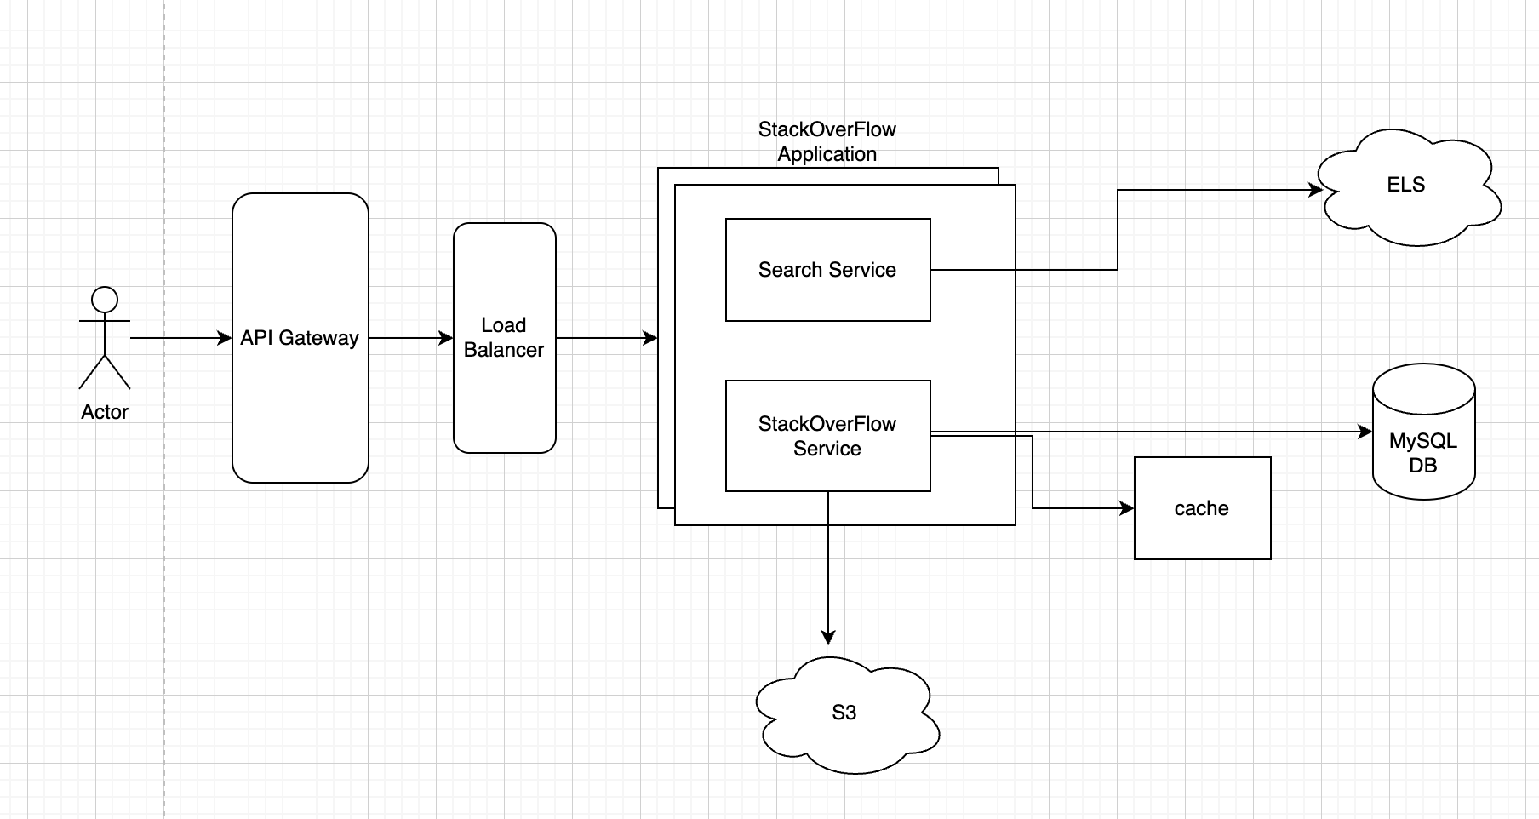
HLD

Slide 7
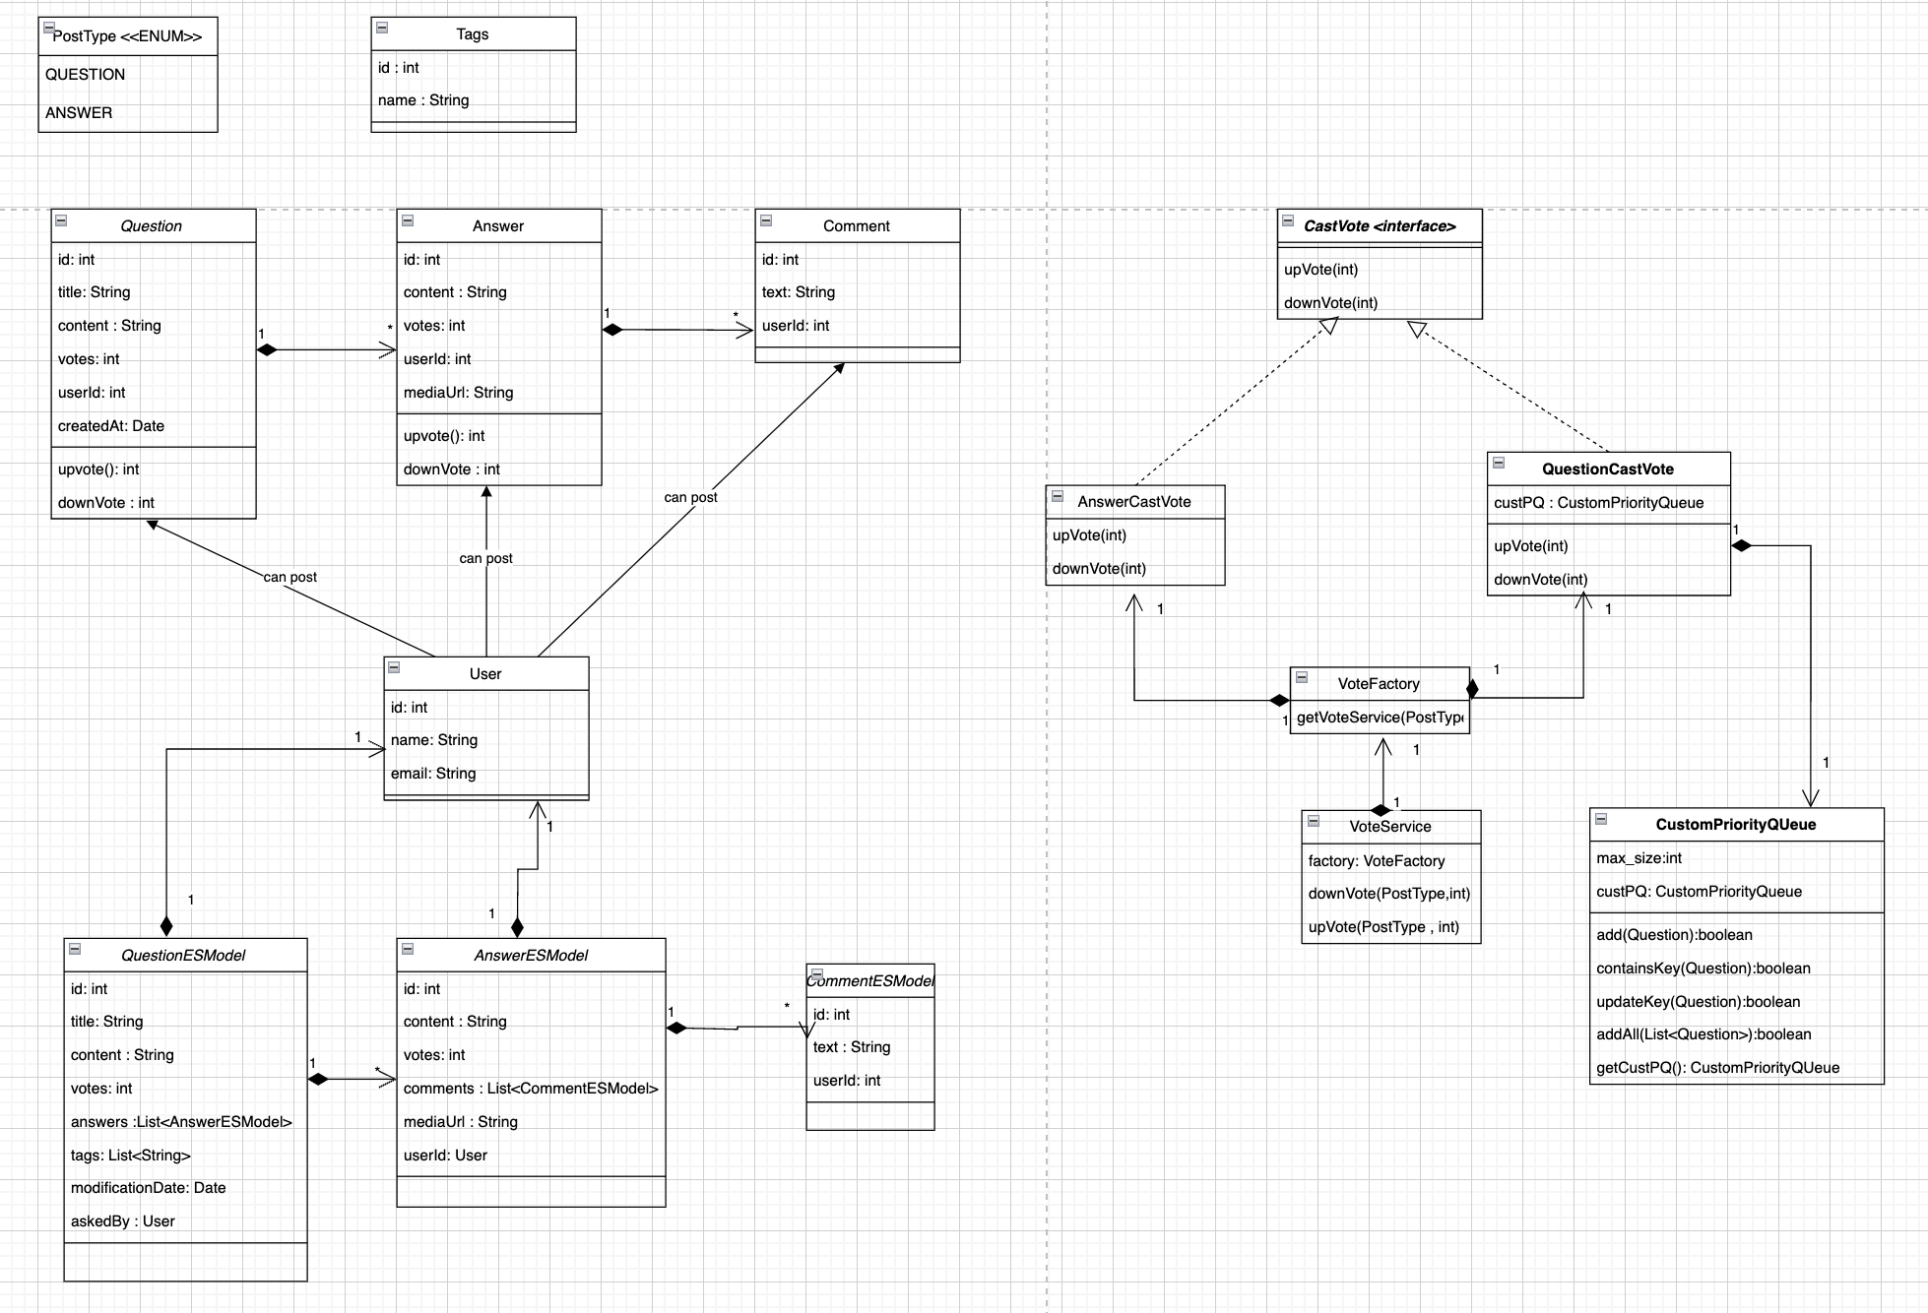
Class Diagram

Slide 8
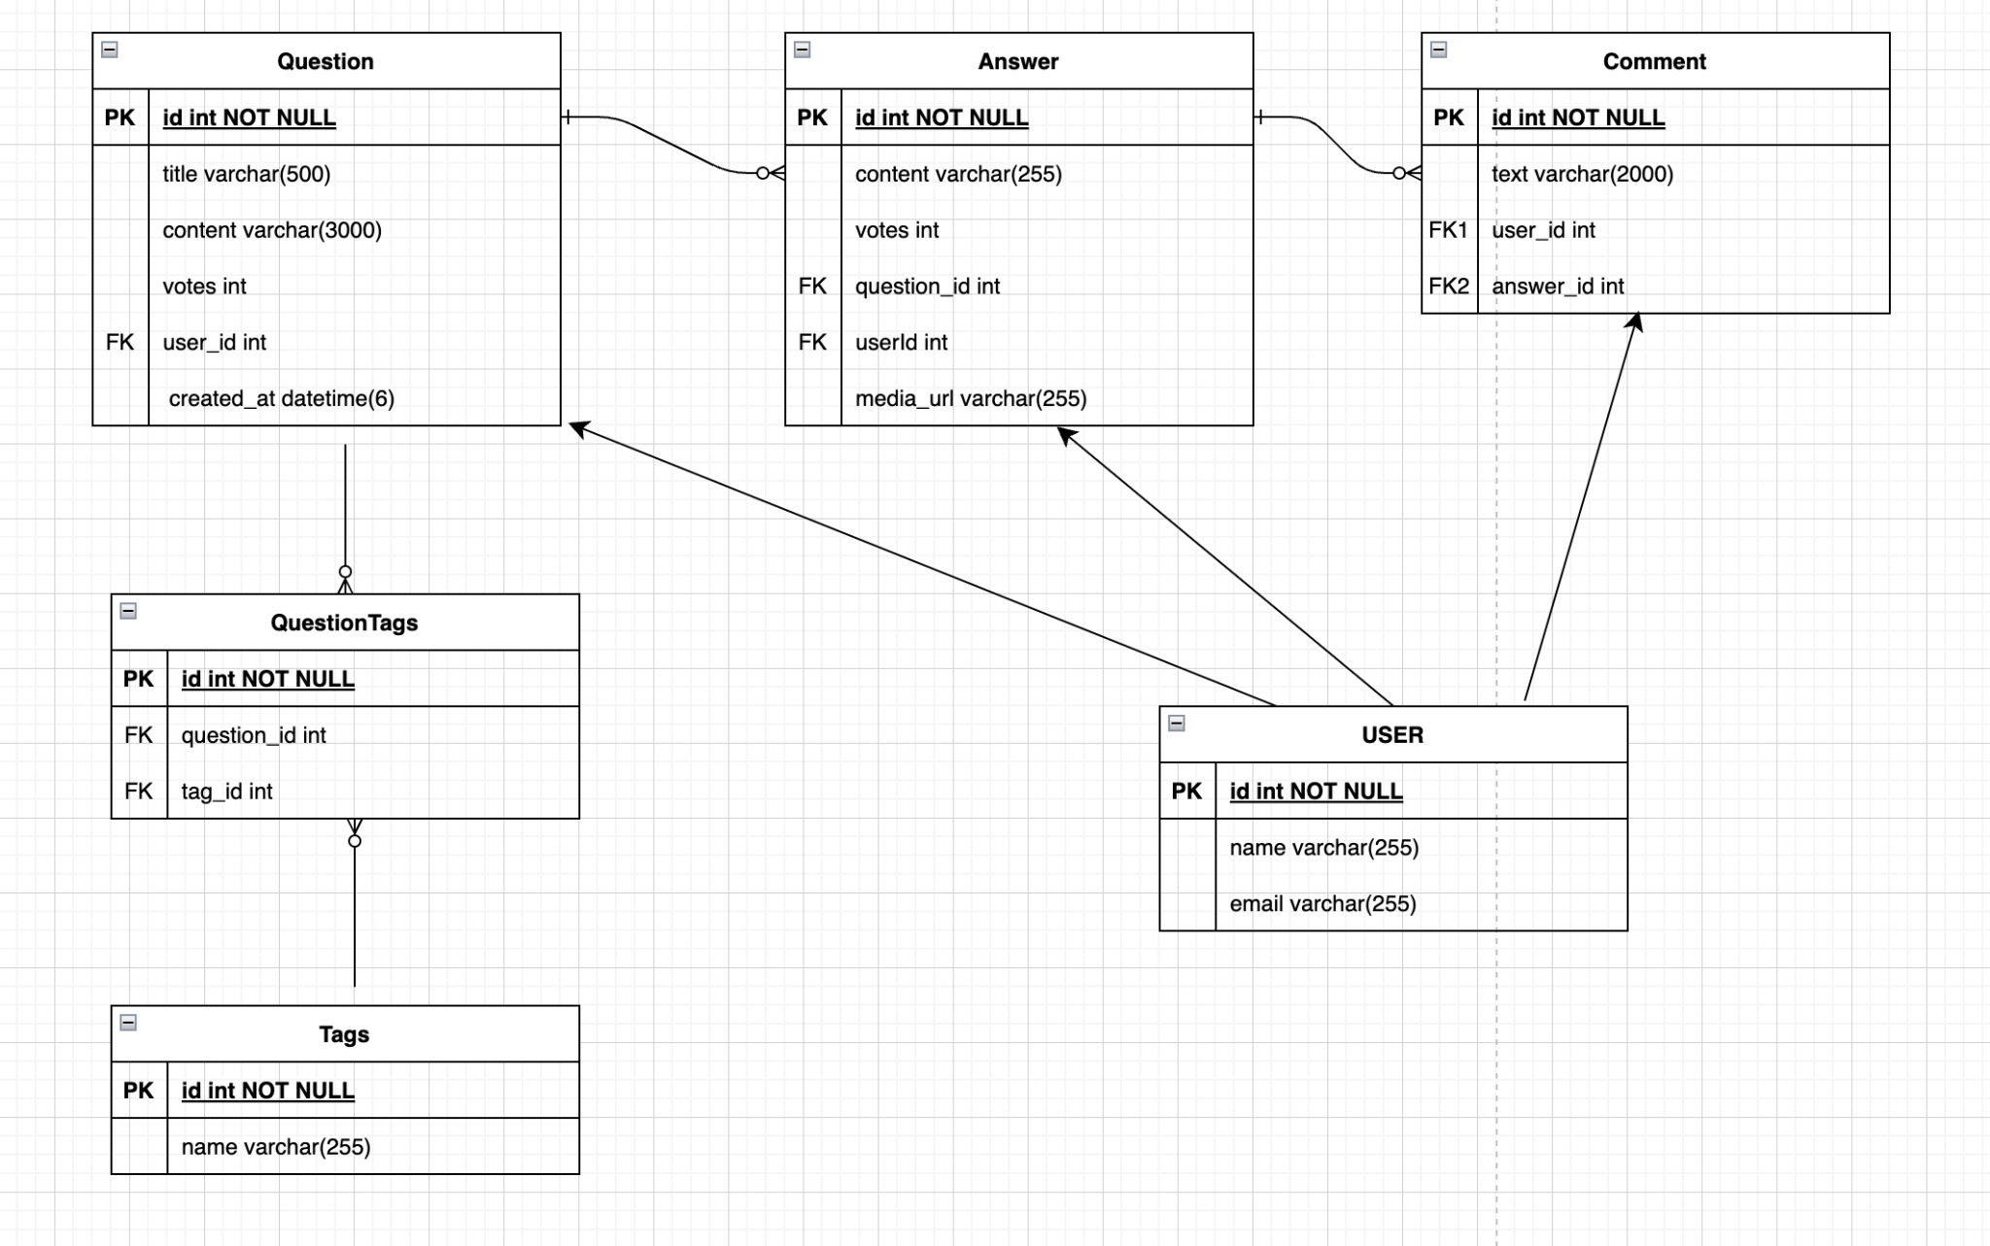
Entity relationship Diagram

Slide 9
Future Scope
1. Comment on question can be made available for user
2. Different type of Roles can be added - Guest, Member, Admin.
3. Delete/ Close/ Undelete question by admin role.
4. Notification System can be added.
5. Redis cache can be used in place of in memory cache.
6. Kafka can be used to sync ELS.
7. Different filter can be implemented for fetching top questions.
8. Recommendation system to show top questions for that user.
9. Authentication and Authorization can be implemented.
10. Payment service integraionn for bounty.

Slide 10

Thank you
Smriti Anand
smriti0921@gmail.com
+91 9128118868
LinkedIn : SmritiAnand

