Slide 1
Experiment 8
Matched Filtering, ISI and Eye Diagrams
Simulation focus
BPSK → RRC pulse shaping → AWGN → RRC matched filter → delay compensation → sampling → decision
Experiment 8 • Matched Filtering, ISI and Eye Diagrams

Slide 2
1. Objectives, tasks and required visualizations
Objectives
• Demonstrate matched-filter reception.
• Use eye diagrams to identify noise, ISI and timing sensitivity.
Implementation tasks
28. BPSK through RRC pulse shaping + AWGN.
29. Matched RRC filtering + delay compensation.
30. Vary SNR, roll-off, span and sampling offset.
31. Introduce a multipath ISI channel.
Required visualizations
Transmit/matched-filter output • Eye diagrams • Eye height vs SNR • BER vs sampling offset
Mandatory validation
Confirm total cascade delay and show that detected symbols are taken only after delay removal.
Experiment 8 • Matched Filtering, ISI and Eye Diagrams

Slide 3
2. Theory: BPSK, RRC and matched filtering
• BPSK maps bit 1 to +1 and bit 0 to −1.
• RRC pulse shaping controls bandwidth and provides a zero-ISI design when paired with a matched RRC filter.
• AWGN introduces random amplitude/phase-free noise in this real-valued BPSK model.
• The receiver uses a matched filter, maximizing output SNR at the symbol decision instant.
• Eye diagrams visualize vertical noise margin, horizontal timing margin and ISI-induced closure.
Decision rule
ŷ[k] = 1 if y[nk] ≥ 0; otherwise ŷ[k] = 0.
Overall pulse
RRC at Tx × RRC at Rx → Raised-Cosine response.
Experiment 8 • Matched Filtering, ISI and Eye Diagrams

Slide 4
3. Core equations and delay calculation
BPSK mapping
a[k] = 2b[k] − 1, b[k] ∈ {0,1}
Matched-filter output
y[n] = Σ r[m] hMF[n − m]
BER
BER = Nerror / Nbits
Sampling index
nk = Dtotal + k·sps + Δ
One RRC group delay
Dfilter = span·sps / 2
Cascade delay
Dtotal = 2Dfilter = span·sps
Example used in this PPT
span = 8 symbols, sps = 8 samples/symbol → Dfilter = 32 samples → Dtotal = 64 samples.
Experiment 8 • Matched Filtering, ISI and Eye Diagrams

Slide 5
4. BPSK matched-filter receiver block diagram
Random
bits
BPSK
mapper
RRC
shaper
AWGN
RRC matched
filter
Delay
remove
Sampler +
decision
Delay checkpoint
Tx RRC delay = 32 samples; Rx matched RRC delay = 32 samples; total = 64 samples. The first valid decision is taken after this 64-sample delay.
Experiment 8 • Matched Filtering, ISI and Eye Diagrams

Slide 6
5. Python implementation: the essential receiver logic
symbols = 2*bits.astype(float) - 1
up = np.zeros(len(symbols)*sps)
up[::sps] = symbols
h = rrc_filter(beta, span, sps)
tx = np.convolve(up, h)
rx = add_awgn(tx, snr_db, rng)
mf = np.convolve(rx, h)
D_total = span*sps
sample_index = D_total + np.arange(len(symbols))*sps
detected = (mf[sample_index] >= 0).astype(int)
ber = np.mean(detected != bits[:len(detected)])
Reusable parameters
beta, span, sps, snr_db and sampling offset Δ are exposed as parameters, so the same functions can be reused for the complete experiment.
Experiment 8 • Matched Filtering, ISI and Eye Diagrams

Slide 7
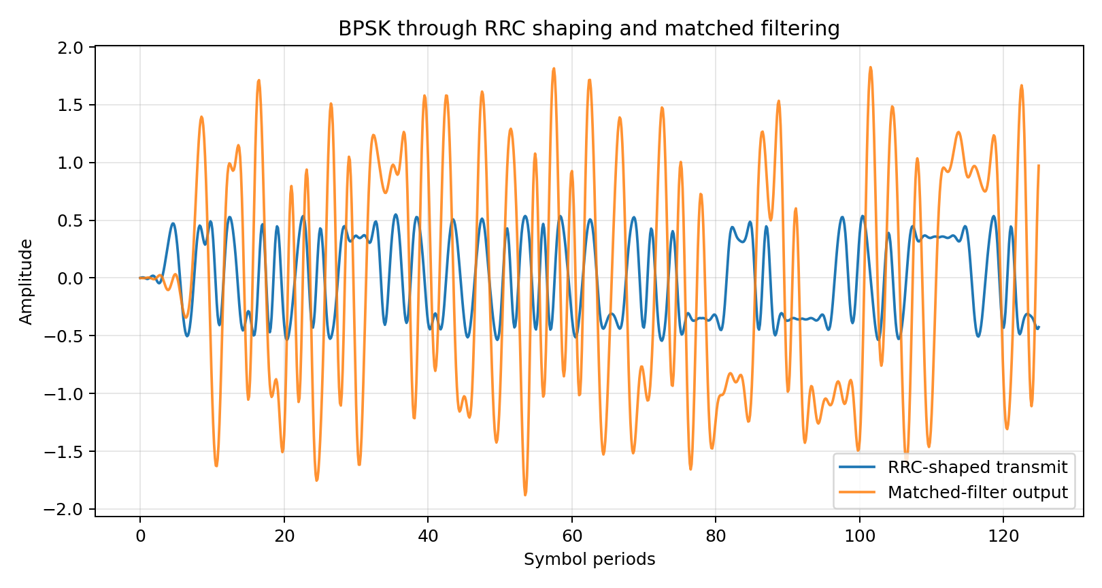
6. Transmit waveform and matched-filter output
Observation
The matched-filter output concentrates pulse energy at the correct symbol instants, improving the reliability of threshold decisions.
Experiment 8 • Matched Filtering, ISI and Eye Diagrams

Slide 8
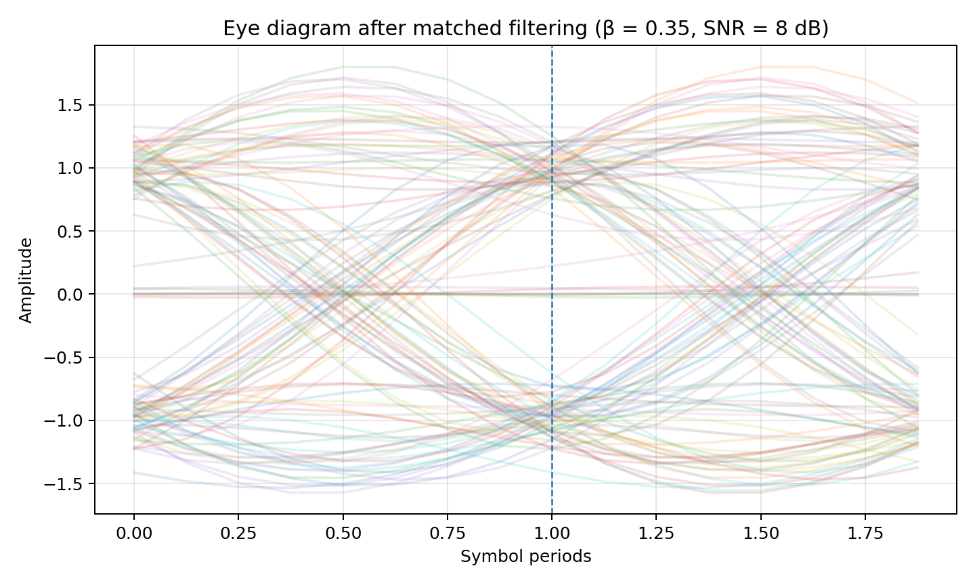
7. Eye diagram after matched filtering
• Vertical opening → noise margin.
• Horizontal opening → timing tolerance.
• Eye closure → stronger noise, ISI or timing error.
• Center dashed line → nominal symbol sampling phase.
AI-ready prompt connection
The eye function should operate on the matched-filter output and use the compensated delay when selecting symbol-centered traces.
Experiment 8 • Matched Filtering, ISI and Eye Diagrams

Slide 9
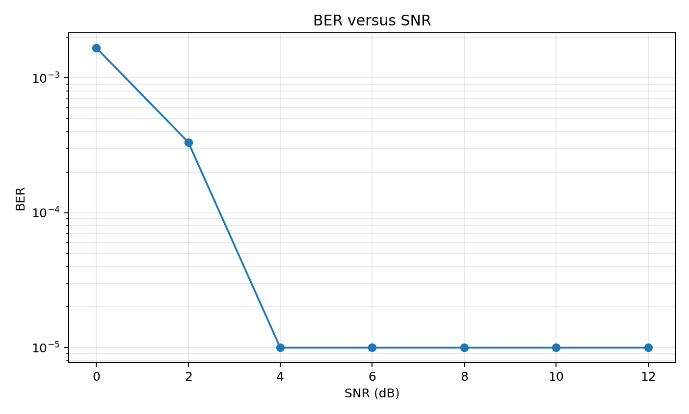
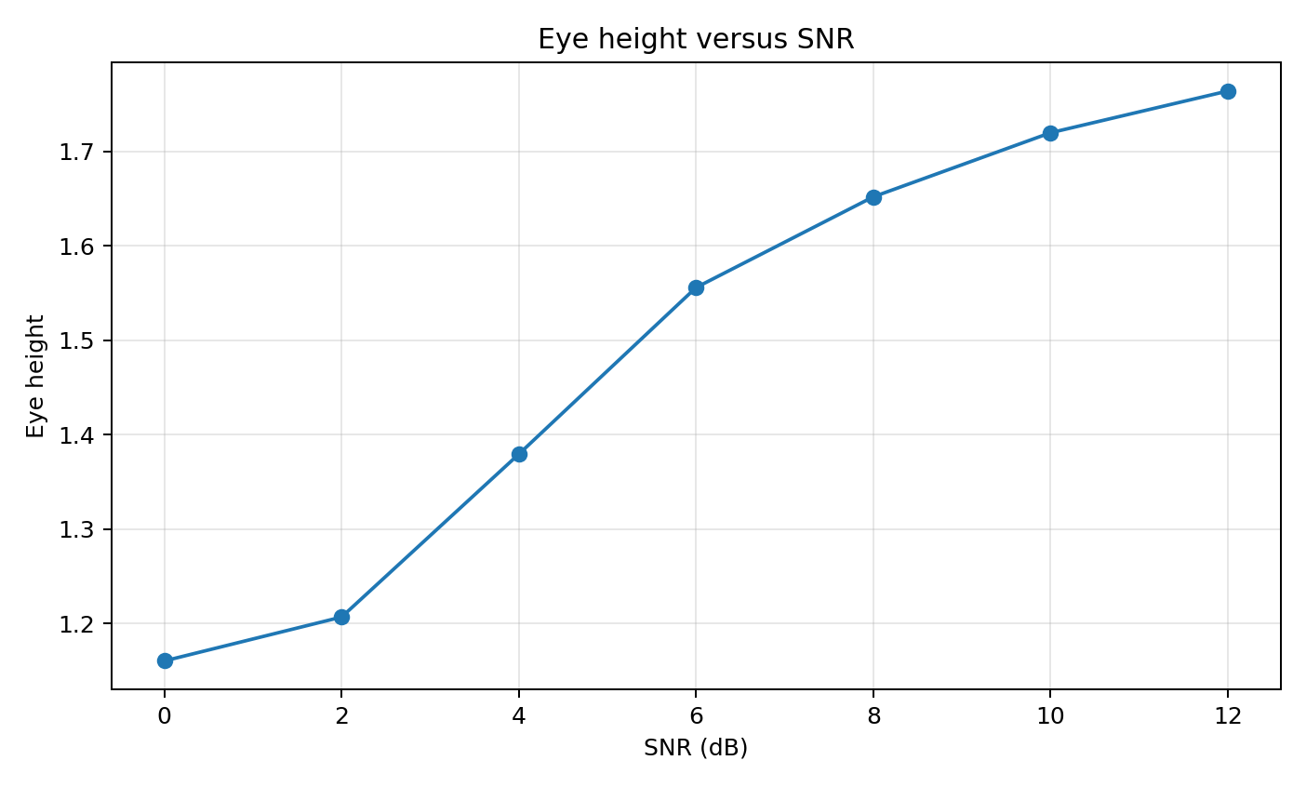
8. Performance: BER and eye height versus SNR
Physical interpretation
Higher SNR reduces random decision errors and generally increases the visible eye opening. The exact numerical curve depends on the finite simulation length and random seed.
Experiment 8 • Matched Filtering, ISI and Eye Diagrams

Slide 10
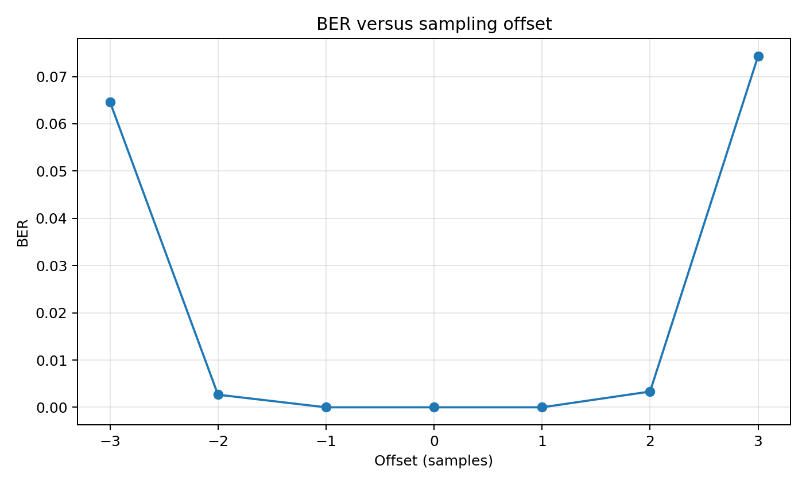
9. Timing sensitivity: BER versus sampling offset
Expected trend
BER is normally lowest near the optimum eye-center sampling phase. Moving the sample by ±1, ±2, … samples reduces timing margin.
Diagnostic test
Compare Δ = 0 against positive and negative offsets at the same SNR. A sharp BER increase indicates timing sensitivity rather than a change in channel noise.
Experiment 8 • Matched Filtering, ISI and Eye Diagrams

Slide 11
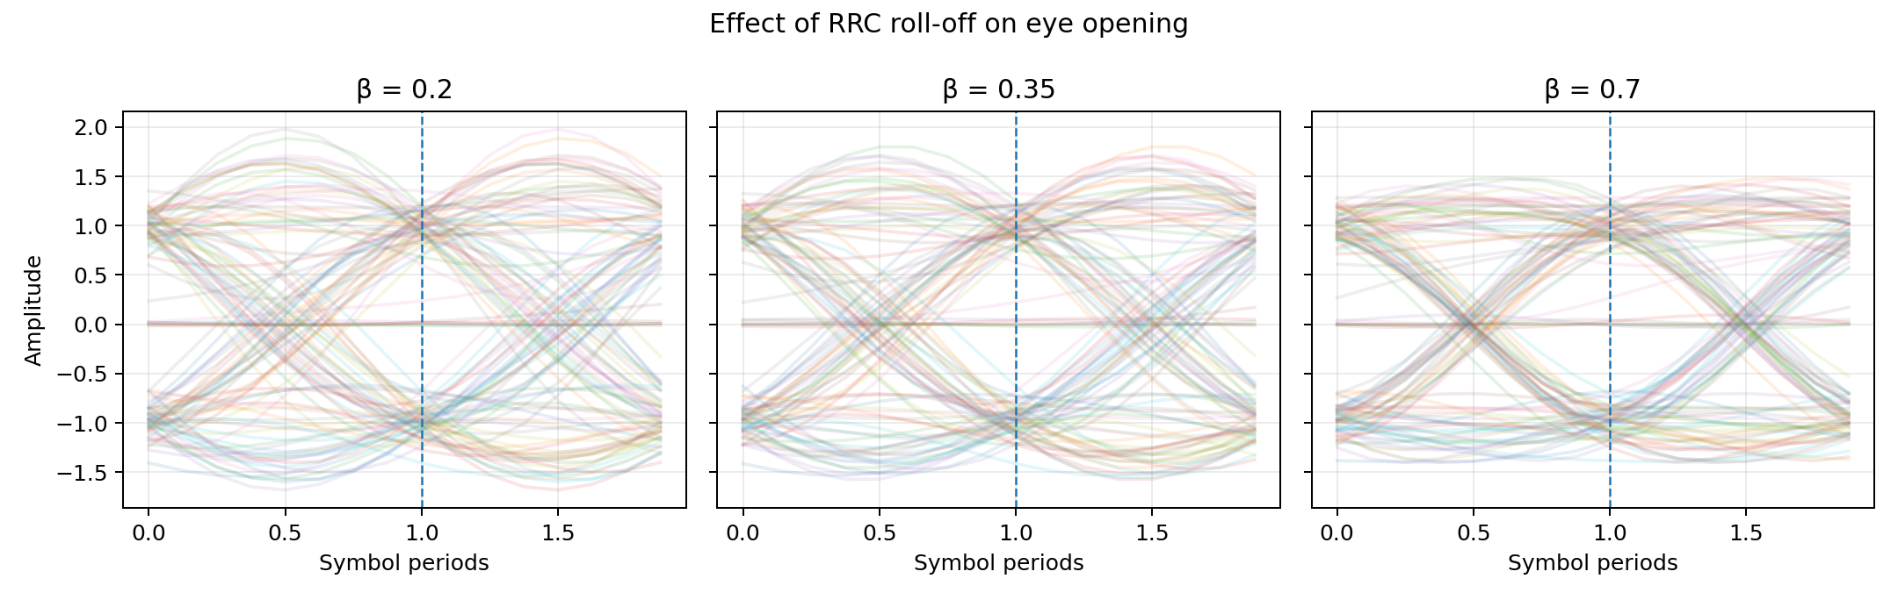
10. Roll-off factor β: pulse shape and eye diagram
• β determines excess bandwidth.
• Changing β changes the time-domain pulse shape and transition behavior.
• Compare eye opening at equal SNR, span, sps and sampling phase.
• Use the same matched-filter design at the transmitter and receiver.
Experiment 8 • Matched Filtering, ISI and Eye Diagrams

Slide 12
11. Multipath ISI extension
Channel model
r[n] = s[n] + αs[n−d] + w[n]
α = echo amplitude, d = echo delay.
Effect on eye
A delayed copy of a previous symbol overlaps the current pulse. The resulting symbol-dependent distortion can close the eye even when AWGN is unchanged.
Suggested experiment
Fix SNR and sweep α = 0, 0.2, 0.4, 0.6. For each value, compare eye diagrams and BER. This separates multipath ISI from noise effects.
Diagnosis
Noise → vertical spread. Timing error → horizontal closure. Multipath → deterministic, symbol-dependent distortion and eye closure.
Experiment 8 • Matched Filtering, ISI and Eye Diagrams

Slide 13
12. AI-ready prompt from the experiment sheet
Implement a reusable eye-diagram function without a communication toolbox.
Show BPSK after matched filtering for several SNR values and identify the optimum
sampling instant after compensating total filter delay.
• Generate eye diagrams from matched-filter output.
• Calculate and display total cascade delay explicitly.
• Take symbol decisions only after delay compensation.
• Repeat for several SNR values and compare eye opening and BER.
• Expose β, span, sps, SNR and sampling offset as reusable parameters.
Experiment 8 • Matched Filtering, ISI and Eye Diagrams

Slide 14
13. Observation and interpretation
The simulation demonstrates reliable BPSK reception using RRC pulse shaping and matched filtering. AWGN produces random amplitude fluctuations; increasing SNR reduces BER and normally makes the eye opening clearer. The matched-filter pair gives a raised-cosine overall response with an optimum symbol sampling instant. Sampling away from the eye centre reduces timing margin and increases BER. Changing the roll-off factor changes the pulse shape and bandwidth trade-off. The delay check is essential: for span = 8 symbols and sps = 8, each RRC filter contributes 32 samples, so the Tx + Rx cascade delay is 64 samples. Therefore, the receiver must compensate 64 samples before taking symbol decisions. Multipath extension can then be used to demonstrate ISI and diagnose eye closure.
Conclusion
Eye diagrams provide an intuitive view of noise, ISI and timing sensitivity, while BER provides a quantitative performance measure.
Experiment 8 • Matched Filtering, ISI and Eye Diagrams

Slide 15
14. GitHub-ready project structure
experiment8_github_repo/
├── experiment8_bpsk_simulation.py
├── requirements.txt
├── README.md
├── results.txt
├── 01_tx_matched_filter.png
├── 02_eye_diagram.png
├── 03_ber_vs_snr.png
├── 04_eye_height_vs_snr.png
├── 05_ber_vs_sampling_offset.png
└── 06_rolloff_eye_comparison.png
• Create a GitHub repository and upload the folder contents.
• Install dependencies with pip install -r requirements.txt.
• Run python experiment8_bpsk_simulation.py.
• The generated PNG files can be used directly in the lab report.
• The README documents the delay-validation rule.
Experiment 8 • Matched Filtering, ISI and Eye Diagrams

Slide 16
15. Reproducibility and result record
Experiment 8 simulation summary
RRC roll-off beta = 0.35
Span = 8 symbols
Samples/symbol = 8
Each RRC filter group delay = span*sps/2 = 32 samples
Total cascade delay = span*sps = 64 samples
Detection uses samples only after total delay compensation.
BER vs SNR:
0 dB : 0.00166667
2 dB : 0.000333333
4 dB : 0
6 dB : 0
8 dB : 0
10 dB : 0
12 dB : 0
BER vs sampling offset at 6 dB:
Reproducibility
The script uses fixed random seeds for the demonstration and sweeps, so the included plots are reproducible on the same Python/NumPy/SciPy environment.
Experiment 8 • Matched Filtering, ISI and Eye Diagrams

