Slide 1
EXPERIMENT 7
Pulse Shaping and the Nyquist Criterion
Digital Communication Laboratory
Raised-Cosine (RC) and Root-Raised-Cosine (RRC) filters
Python simulation + graphical validation
NAME : SANDIP SINGHA DEPT: ECE YEAR: 3 RD ROLL NO: 34900324050
Digital Communication Laboratory | Experiment 7 | 1

Slide 2
1. Objectives
Compare rectangular, sinc, raised-cosine and root-raised-cosine pulse shapes.
Study the bandwidth–time-domain trade-off controlled by roll-off factor α.
Verify Nyquist zero crossings at integer symbol intervals.
Observe pulse shaping of a binary symbol stream.
Understand why RRC filters are commonly split between transmitter and receiver.
Digital Communication Laboratory | Experiment 7 | 2

Slide 3
2. Implementation Tasks
Create an upsampled symbol impulse train.
Generate RC filters for α = 0.25, 0.5 and 1.0.
Generate RRC filters directly from the mathematical definition.
Plot pulse and frequency responses.
Sample the overall RC response at integer symbol intervals and tabulate the values.
Compare RRC transmitter + receiver cascade with the RC response.
Digital Communication Laboratory | Experiment 7 | 3

Slide 4
3. Pulse Shaping — Basic Idea
Pulse shaping controls the spectrum of transmitted symbols and limits inter-symbol interference (ISI).
A symbol impulse train is convolved with a pulse h(t).
At the receiver, the sampled pulse should ideally be 1 at the desired symbol and 0 at all other symbol times.
Different pulse shapes offer different compromises between bandwidth, time-domain duration and implementation complexity.
Digital Communication Laboratory | Experiment 7 | 4

Slide 5
4. Pulse-Shaping Communication Chain
Binary symbols
Upsampler
(↑SPS)
Tx filter
RRC / RC
Channel
Rx filter
RRC
Sampler
at kT
Key condition: the combined Tx–Rx response should satisfy the Nyquist zero-ISI criterion.
Digital Communication Laboratory | Experiment 7 | 5

Slide 6
5. Raised-Cosine (RC) Pulse
h_RC(t) = sinc(t/T) · cos(παt/T) / [1 − (2αt/T)²] where sinc(x) = sin(πx)/(πx) T = symbol period α = roll-off factor, 0 ≤ α ≤ 1 Special case at t = ±T/(2α): use the analytical limit instead of direct division.
Increasing α makes the transition band wider and the time-domain pulse more compact.
Digital Communication Laboratory | Experiment 7 | 6

Slide 7
6. Root-Raised-Cosine (RRC) Pulse
h_RRC(t) = [ sin(π(1−α)t/T) + 4α(t/T)cos(π(1+α)t/T) ] / [ π(t/T){1 − (4αt/T)²} ] Special points: t = 0 and t = ±T/(4α) are removable singularities. The implementation explicitly evaluates their analytical limits.
The RRC filter has a square-root spectrum; two matched RRC filters cascade to an RC response.
Digital Communication Laboratory | Experiment 7 | 7

Slide 8
7. Nyquist Zero-ISI Criterion
At the decision instants t = kT: h(0) = 1 h(kT) = 0, k = ±1, ±2, ±3, ... Therefore, when symbols are sampled at the correct symbol times, all neighbouring pulses contribute zero at the decision instant. Result: ideal sampling can recover the intended symbol without ISI.
Digital Communication Laboratory | Experiment 7 | 8

Slide 9
8. Bandwidth and Roll-Off
For symbol rate Rs = 1/T, the one-sided baseband bandwidth of an RC spectrum is:
B = (1 + α) Rs / 2
α = 0 gives the minimum Nyquist bandwidth but a slow-decaying sinc-like time response.
Larger α increases bandwidth but improves time-domain localization and eases timing/filter implementation.
For α = 0.25, 0.5, 1.0: B/Rs = 0.625, 0.75, 1.0.
Digital Communication Laboratory | Experiment 7 | 9

Slide 10
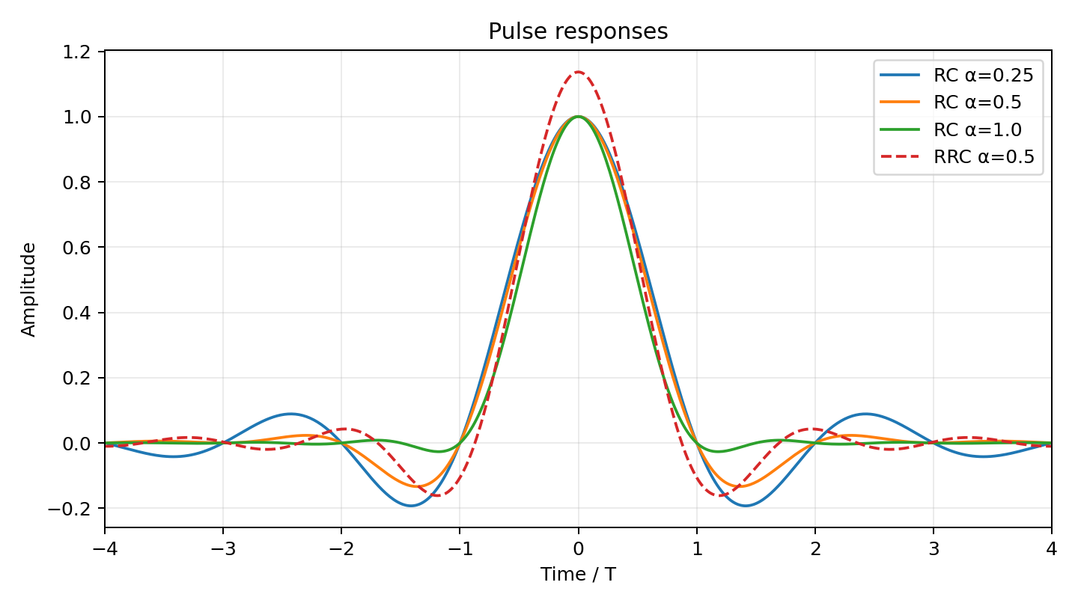
9. Pulse Responses — RC and RRC
Digital Communication Laboratory | Experiment 7 | 10

Slide 11
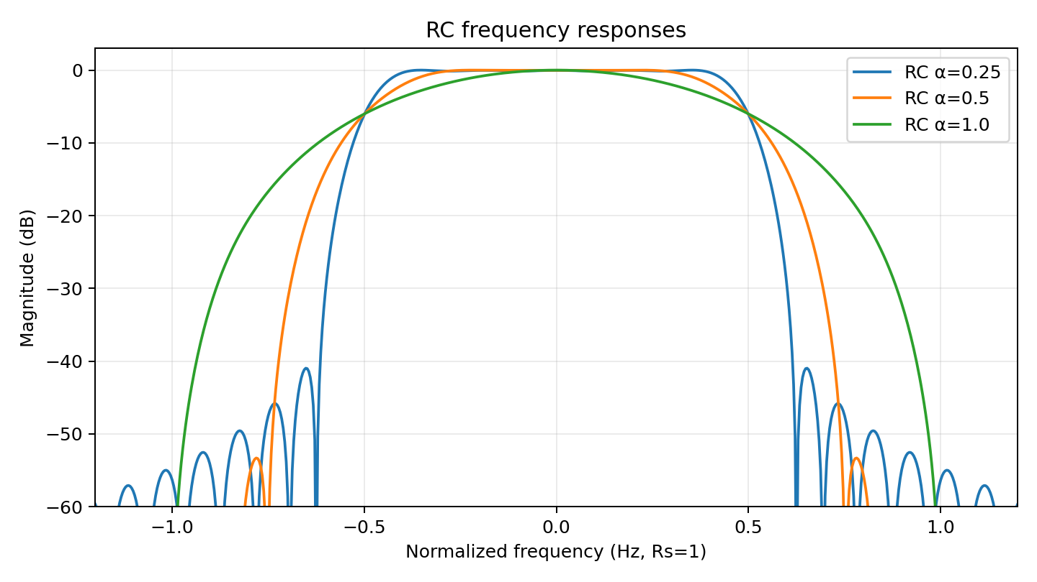
10. Frequency Responses
Digital Communication Laboratory | Experiment 7 | 11

Slide 12
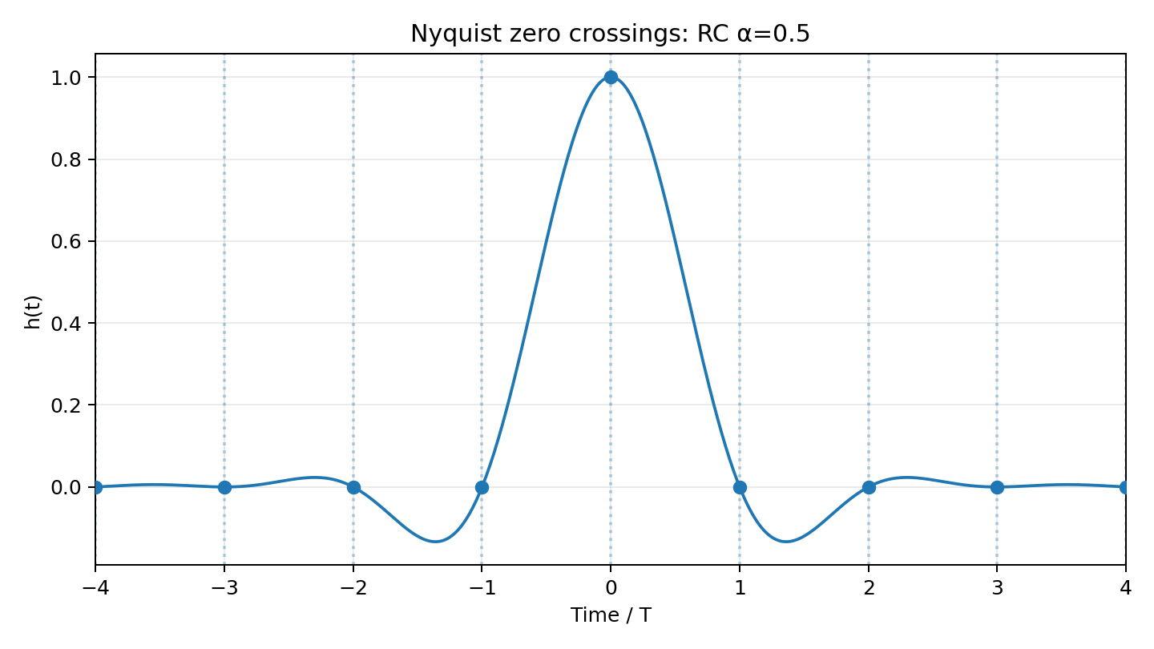
11. Nyquist Zero Crossings (RC, α = 0.5)
Digital Communication Laboratory | Experiment 7 | 12

Slide 13
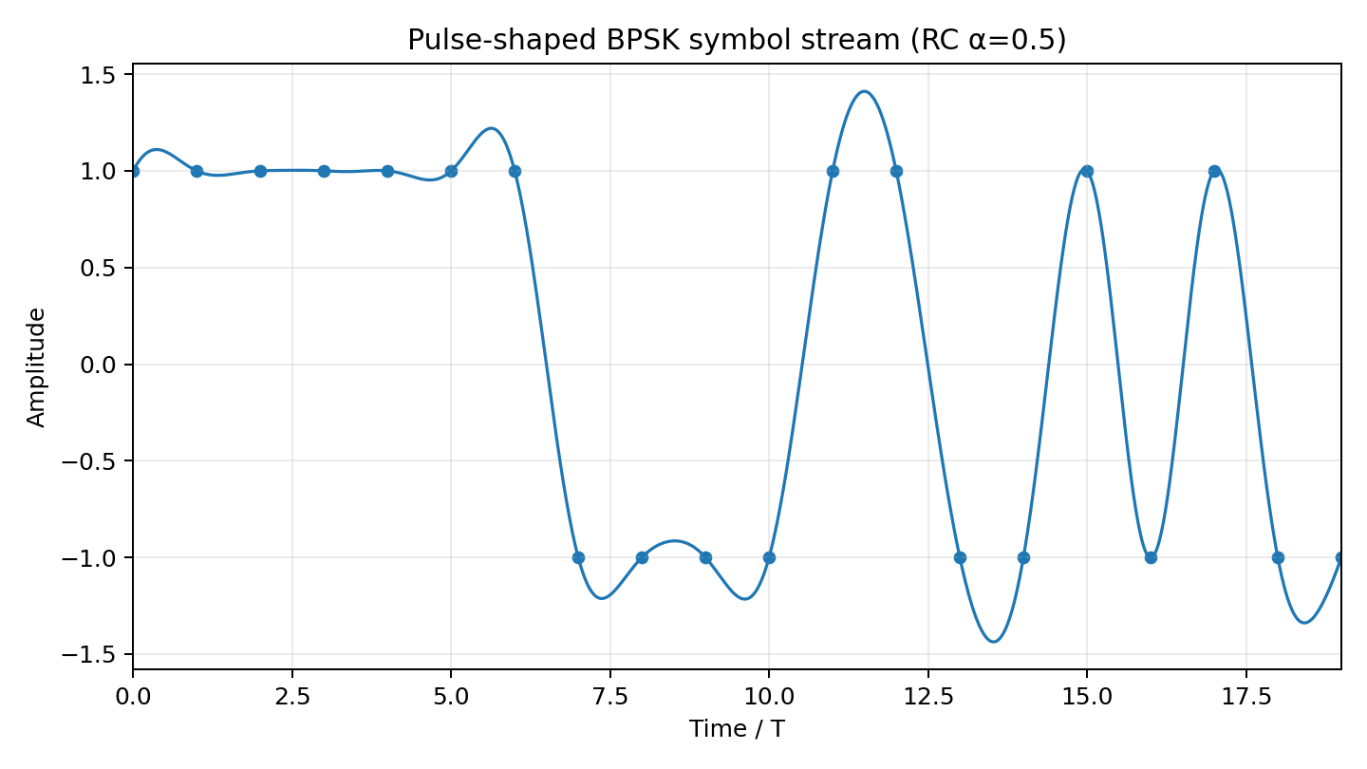
12. Pulse-Shaped Symbol Stream
Digital Communication Laboratory | Experiment 7 | 13

Slide 14
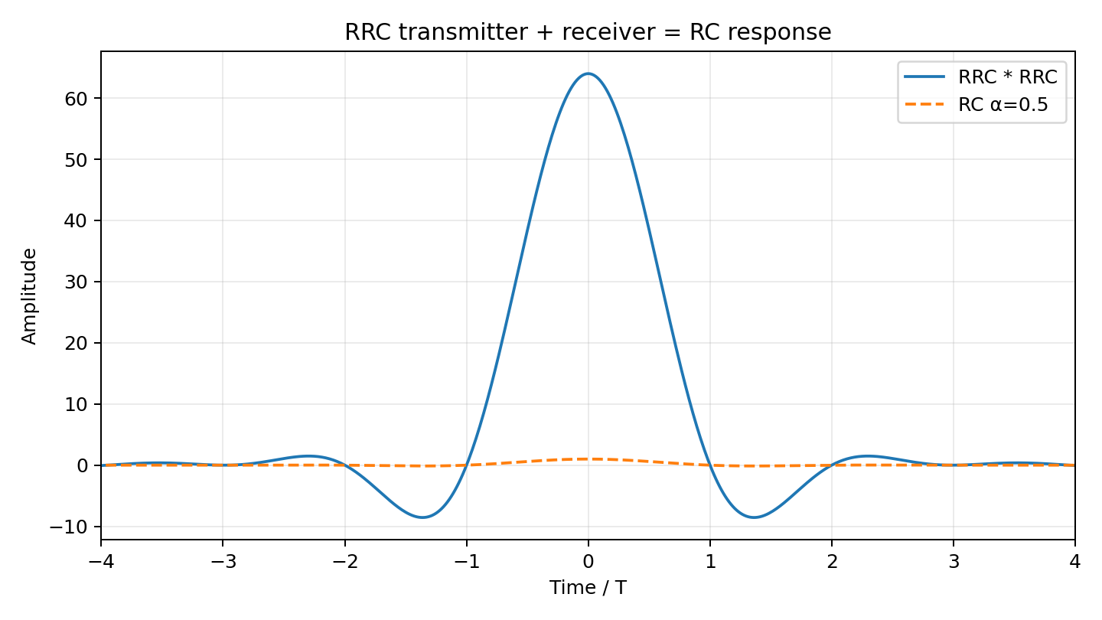
13. RRC Transmitter + Receiver
Digital Communication Laboratory | Experiment 7 | 14

Slide 15
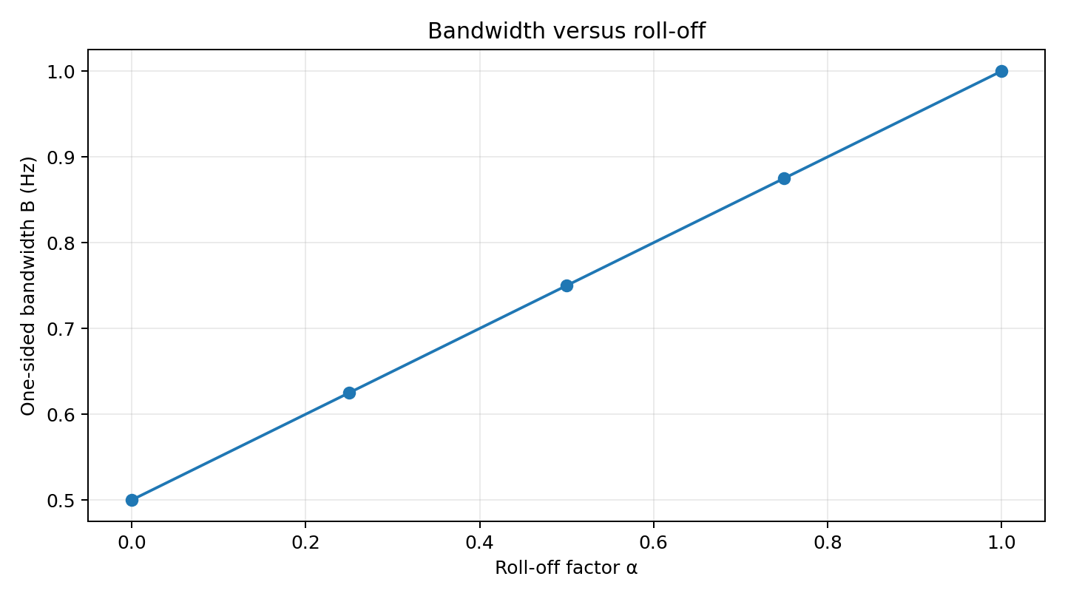
14. Bandwidth versus Roll-Off Factor
Digital Communication Laboratory | Experiment 7 | 15

Slide 16
15. Mandatory Validation — Integer Symbol Intervals
k | t/T | RC h(kT), α=0.5
-5 | -5.0 | -0.000000
-4 | -4.0 | +0.000000
-3 | -3.0 | +0.000000
-2 | -2.0 | -0.000000
-1 | -1.0 | +0.000000
+0 | +0.0 | +1.000000
+1 | +1.0 | +0.000000
+2 | +2.0 | -0.000000
+3 | +3.0 | +0.000000
+4 | +4.0 | +0.000000
+5 | +5.0 | -0.000000
Digital Communication Laboratory | Experiment 7 | 16

Slide 17
16. Python Implementation — Core Structure
1. Define time vector and symbol period T 2. rc_pulse(t, α): implement RC formula + singularity limits 3. rrc_pulse(t, α): implement RRC formula + special points 4. Use FFT to obtain normalized frequency response 5. Upsample random ±1 symbols and convolve with RC pulse 6. Cascade RRC with RRC and compare against RC 7. Sample RC at kT and print validation table 8. Save all plots to results/ for GitHub
Digital Communication Laboratory | Experiment 7 | 17

Slide 18
17. Python Code — RC Function
def rc_pulse(t, alpha, T=1.0): x = t / T h = np.sinc(x) if alpha == 0: return h den = 1 - (2*alpha*x)**2 h = h * np.cos(np.pi*alpha*x) / den # removable singularities: t = ±T/(2α) singular = np.isclose( np.abs(x), 1/(2*alpha), atol=1e-12 ) h[singular] = (np.pi/4) * np.sinc(1/(2*alpha)) return h
Digital Communication Laboratory | Experiment 7 | 18

Slide 19
18. Python Code — RRC Function
def rrc_pulse(t, alpha, T=1.0): x = t / T h = np.zeros_like(x, dtype=float) if alpha == 0: return np.sinc(x) for i, xi in enumerate(x): if abs(xi) < 1e-12: h[i] = 1 + alpha*(4/np.pi - 1) elif abs(abs(xi)-1/(4*alpha)) < 1e-10: h[i] = (alpha/np.sqrt(2))*( (1+2/np.pi)*np.sin(np.pi/(4*alpha)) + (1-2/np.pi)*np.cos(np.pi/(4*alpha)) ) else: num = np.sin(np.pi*(1-alpha)*xi) + 4*alpha*xi*np.cos(np.pi*(1+alpha)*xi) den = np.pi*xi*(1-(4*alpha*xi)**2) h[i] = num/den return h
Digital Communication Laboratory | Experiment 7 | 19

Slide 20
19. Observation and Interpretation
Expected effect: increasing α widens the occupied bandwidth and shortens the pulse's effective time-domain spread.
Expected effect: RC pulses cross zero at integer multiples of T, preventing ISI at ideal decision instants.
RRC alone is not the final Nyquist response; the cascade of matched Tx/Rx RRC filters gives the RC response.
The validation table should show h(0) ≈ 1 and h(kT) ≈ 0 for every non-zero integer k.
Any small residual values are due to finite truncation and numerical sampling, not a failure of the Nyquist theory.
Digital Communication Laboratory | Experiment 7 | 20

Slide 21
20. Results Summary
RC and RRC pulse responses were generated directly from their mathematical definitions.
Frequency responses showed the expected roll-off transition controlled by α.
Integer-symbol sampling confirmed the zero-crossing property of the RC pulse.
An upsampled binary symbol stream was pulse-shaped successfully.
Two RRC filters cascaded to an RC-like overall response.
Bandwidth increased linearly with roll-off according to B = (1+α)Rs/2.
Digital Communication Laboratory | Experiment 7 | 21

Slide 22
21. Viva / Exam Questions
1. What is pulse shaping and why is it required?
2. State the Nyquist criterion for zero ISI.
3. What does the roll-off factor α represent?
4. Compare RC and RRC filters.
5. Why are RRC filters split between transmitter and receiver?
6. What happens to bandwidth when α increases?
7. Why must removable singularities be handled in numerical code?
Digital Communication Laboratory | Experiment 7 | 22

Slide 23
22. AI-Ready Prompt for Reproducing the Experiment
Generate raised-cosine (RC) and root-raised-cosine (RRC) filters directly from their mathematical definitions. Use T=1, SPS=64 and a finite span of 10 symbols. Handle the removable singularities explicitly. Generate RC for α = 0.25, 0.5 and 1.0; plot impulse and frequency responses. Create an upsampled ±1 symbol impulse train and pulse-shape it with RC. Verify the Nyquist criterion by sampling the overall RC response at integer symbol intervals and tabulating h(kT). Generate an RRC transmitter and receiver, convolve them, and compare the cascade with the RC response. Finally plot bandwidth B=(1+α)Rs/2 versus α. Explain the expected physical effect before each parameter sweep and interpret any discrepancy caused by finite
truncation or numerical precision.
Digital Communication Laboratory | Experiment 7 | 23

Slide 24
23. GitHub Submission Structure
experiment-7-pulse-shaping/ ├── experiment_7_pulse_shaping.py ├── README.md ├── requirements.txt └── results/ ├── 01_pulse_responses.png ├── 02_frequency_responses.png ├── 03_zero_crossings.png ├── 04_pulse_shaped_stream.png ├── 05_rrc_cascade.png └── 06_bandwidth_vs_rolloff.png Recommended commit message: "Add Experiment 7 pulse shaping and Nyquist validation"
Digital Communication Laboratory | Experiment 7 | 24

Slide 25
24. Conclusion
Pulse shaping provides controlled bandwidth and limits inter-symbol interference.
Raised-cosine filtering satisfies the Nyquist zero-ISI criterion at symbol decision times.
Roll-off factor α controls the bandwidth–time-domain trade-off.
RRC filters are practical matched Tx/Rx components whose cascade forms the RC response.
Python simulation and mandatory sampling validation confirm the theoretical behavior.
Digital Communication Laboratory | Experiment 7 | 25

