Slide 1
LeadFlow CRM
Production-oriented Lead Management & Assignment System
Sandipan Das
Notes:
Introduce the project in 30 seconds: roles, reliability, audit history, and the focus on business rules rather than CRUD.

Slide 2
Problem and solution
What the system needed to guarantee
• Capture and deduplicate enquiries
• Assign leads without concurrency corruption
• Restrict sales users to their own leads
• Preserve who did what, when and why
• Operate as a real deployed application
Notes:
LeadFlow addresses business rules, edge cases and data consistency in addition to the user interface.

Slide 3
Architecture
A modular monolith with clear responsibility boundaries
• React + Vite frontend behind Nginx
• Express: route → controller → service → repository
• MySQL is the authoritative transactional database
• Redis supports rate limits, cache and BullMQ
• Separate worker sends email; Socket.IO pushes live notifications
Notes:
Walk left to right through the system. Emphasize that business logic belongs in services and SQL belongs in repositories.

Slide 4
Duplicate handling
Normalize early; let the database arbitrate races
• Matching normalized phone OR email means duplicate
• Phone/email pointing to different leads means CONTACT_CONFLICT
• Never merge conflicting customer data silently
• Application pre-check provides a useful error
• Unique indexes prevent simultaneous duplicate inserts
Notes:
Use the example Sandipan@Gmail.com versus sandipan@gmail.com. Mention the final unique index race protection.

Slide 5
Idempotent creation
Safe retries are not the same as contact deduplication
• Client supplies Idempotency-Key
• SHA-256 binds the key to normalized payload
• Unique user + operation + key reservation
• Completed request replays the saved response
• Different payload with the same key returns 409
Notes:
Explain a mobile timeout: the client retries; the server returns the first response instead of creating twice.

Slide 6
Concurrency-safe assignment
Row locks + optimistic versions + one transaction
• SELECT ... FOR UPDATE locks the lead
• Validate an active sales target
• Update current owner and version
• Close previous assignment and insert new history
• Insert activity; commit all or roll back all
Notes:
Explain two admins clicking assign. The first wins; the second gets a 409 and reloads.

Slide 7
Authorization
Security is enforced in backend queries
• Admin sees organization-wide data
• Sales query includes assigned_user_id = authenticated user
• Changing a URL ID cannot bypass ownership
• Other owner's lead returns 404 to avoid disclosure
• Strict validation and prepared SQL protect inputs
Notes:
Call this defense against IDOR. The frontend is not a security boundary.

Slide 8
Why Redis?
Shared temporary state—not business truth
• Atomic login-attempt counters with TTL
• One limit across multiple API containers
• Short-lived dashboard cache
• BullMQ job storage
• MySQL remains the durable source of truth
Notes:
Contrast Redis with the default in-memory express-rate-limit store, especially multiple processes and restarts.

Slide 9
Why BullMQ?
SMTP should not delay or break a business request
• API commits assignment before email work
• Worker processes email asynchronously
• Three attempts with exponential backoff
• Controlled concurrency of five jobs
• Future upgrade: transactional outbox
Notes:
State that email is a side effect. Mention the outbox limitation honestly if asked about guaranteed delivery.

Slide 10
Auditability
Current state and historical truth serve different queries
• leads.assigned_user_id answers who owns it now
• assignments records every ownership period
• activities records actor, type, time and changes
• reassignment_requests preserves approval workflow
• Transactions prevent state/history divergence
Notes:
Show why a single owner column cannot answer who owned the lead last week.

Slide 11
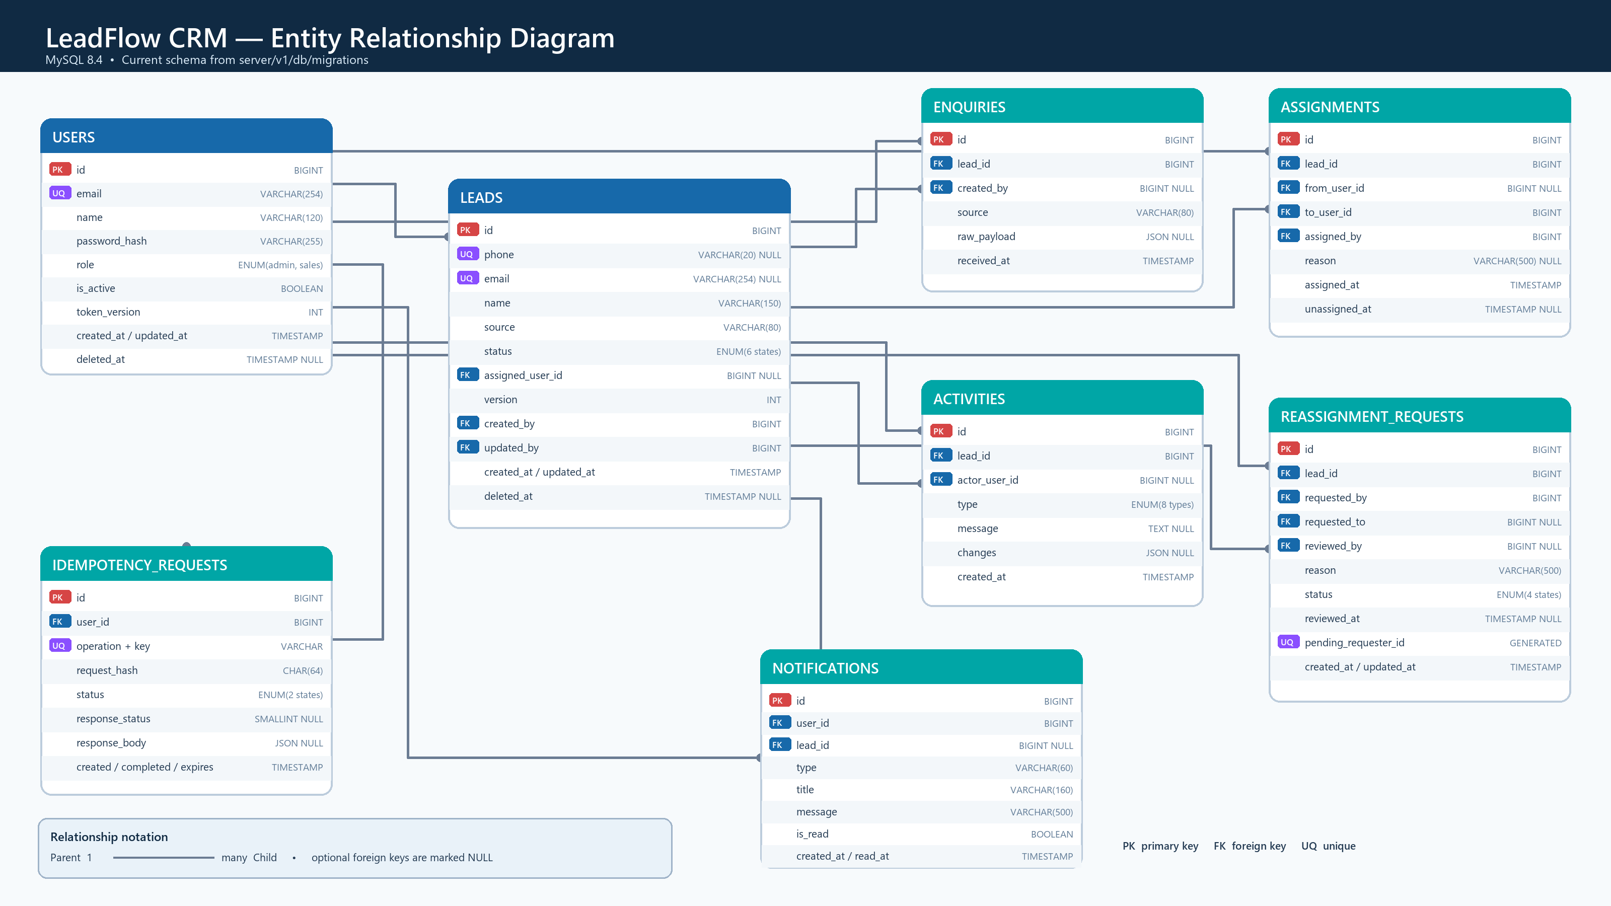
Database design

Slide 12
Business edge cases
Explicit rules replace silent assumptions
• Converted and lost are terminal
• Assigned users must be active salespeople
• User with active leads must be reassigned before deactivation
• Unassigned leads are valid before triage
• One pending reassignment request per lead/requester
Notes:
Explain that each ambiguity from the brief became an explicit policy and API error.

Slide 13
Scale and performance
Indexes follow actual access patterns
• Bounded cursor/page pagination
• Composite indexes for assignee/status/date/source
• Redis caches repeated dashboard aggregates
• EXPLAIN ANALYZE before adding more indexes
• At larger scale: full-text search, replicas, pre-aggregation
Notes:
Do not claim indexes solve every search problem. Say that query plans and measured workload guide optimization.

Slide 14
Production deployment
One reproducible service topology
• Docker: API, worker, MySQL and Redis
• Nginx: HTTPS, static frontend and reverse proxy
• Database and Redis have no public ports
• Volumes persist data; health checks detect failure
• Swagger UI exposes the API contract—not credentials
Notes:
Explain why PM2 is unnecessary inside Docker. Nginx is public; data services remain private.

Slide 15
Testing
Focus on rules that can damage integrity
• Unit: normalization and status transitions
• Authorization: prevent access to another owner's lead
• Integration: creation, duplicates and history
• Concurrency: competing creations and assignments
• Rollback: mutation is undone if history fails
Notes:
Mention disposable database containers so tests use real MySQL behavior without production risk.

Slide 16
Trade-offs and next steps
Simple today, clear evolution path
• Modular monolith instead of premature microservices
• No automatic merge or hard lead deletion
• Add transactional outbox for guaranteed job publication
• Add Playwright E2E and production observability
• Adopt dedicated search only when measurements justify it
Notes:
The limitations are documented together with the conditions and designs for addressing them.

Slide 17
Closing
Every important change is authorized, consistent and auditable
• MySQL guarantees business integrity
• Redis accelerates shared temporary workloads
• BullMQ isolates unreliable external email
• Socket.IO adds immediacy while MySQL retains notifications
• The design is explainable, testable and production-oriented
Notes:
Finish with the main design principle, then invite questions or open Swagger for a live demonstration.

