Slide 1
Liner Regression ,Logistic Regression , SVM, Naïve Bayes, Random Forest

Slide 2
Outline
Supervised Learning
Linear Regression
R-squared
Logistic Regression
SVMs
Gradient-based optimization
Decision Trees and Random Forests

Slide 3
Machine Learning
Supervised: We are given input samples (X) and output samples (y) of a function y = f(X). We would like to “learn” f, and evaluate it on new data. Types:
Classification: y is discrete (class labels).
Regression: y is continuous, e.g. linear regression.

Slide 4
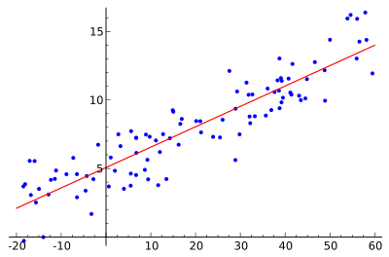
Linear Regression
We want to find the “best” line (linear function y=f(X)) to explain the data.
y
X

Slide 5

Linear Regression
The predicted value of y is given by:
$$\hat{y}= {\hat{β}}_{0}+ \sum_{j=1}^{p}{X_{j}{\hat{β}}_{j}}$$
The vector of coefficients $\hat{β}$ is the regression model.

Slide 6
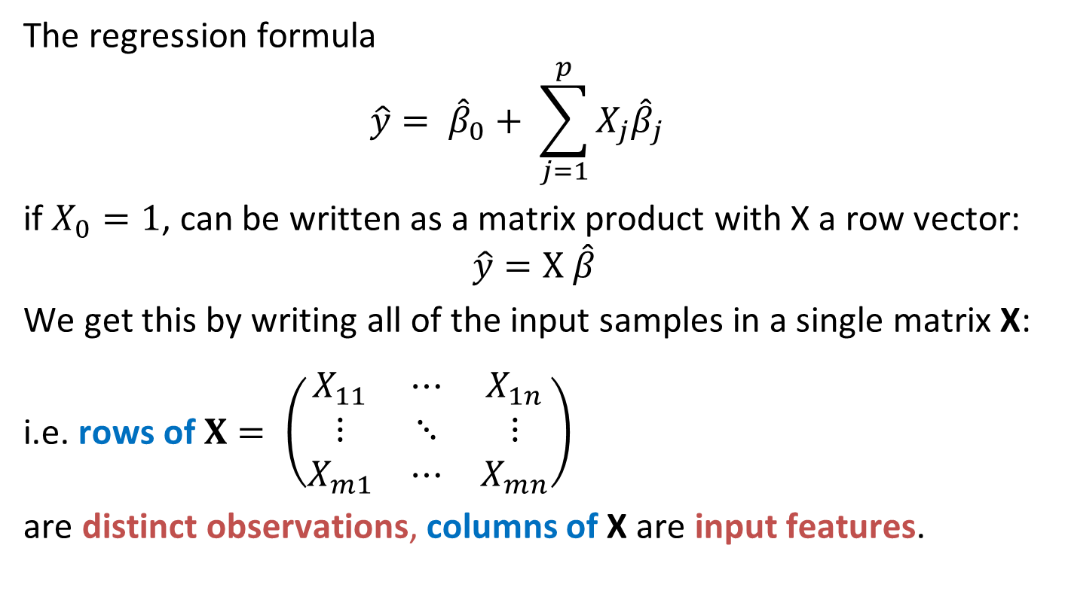
Linear Regression
The regression formula
$$\hat{y}= {\hat{β}}_{0}+ \sum_{j=1}^{p}{X_{j}{\hat{β}}_{j}}$$
if $X_{0}=1$, can be written as a matrix product with X a row vector:
$$\hat{y}=X \hat{β}$$
We get this by writing all of the input samples in a single matrix X:
i.e. rows of $X= \left(\begin{matrix}X_{11} & ⋯ & X_{1n} \\ ⋮ & ⋱ & ⋮ \\ X_{m1} & ⋯ & X_{mn}\end{matrix}\right)$
are distinct observations, columns of X are input features.

Slide 7
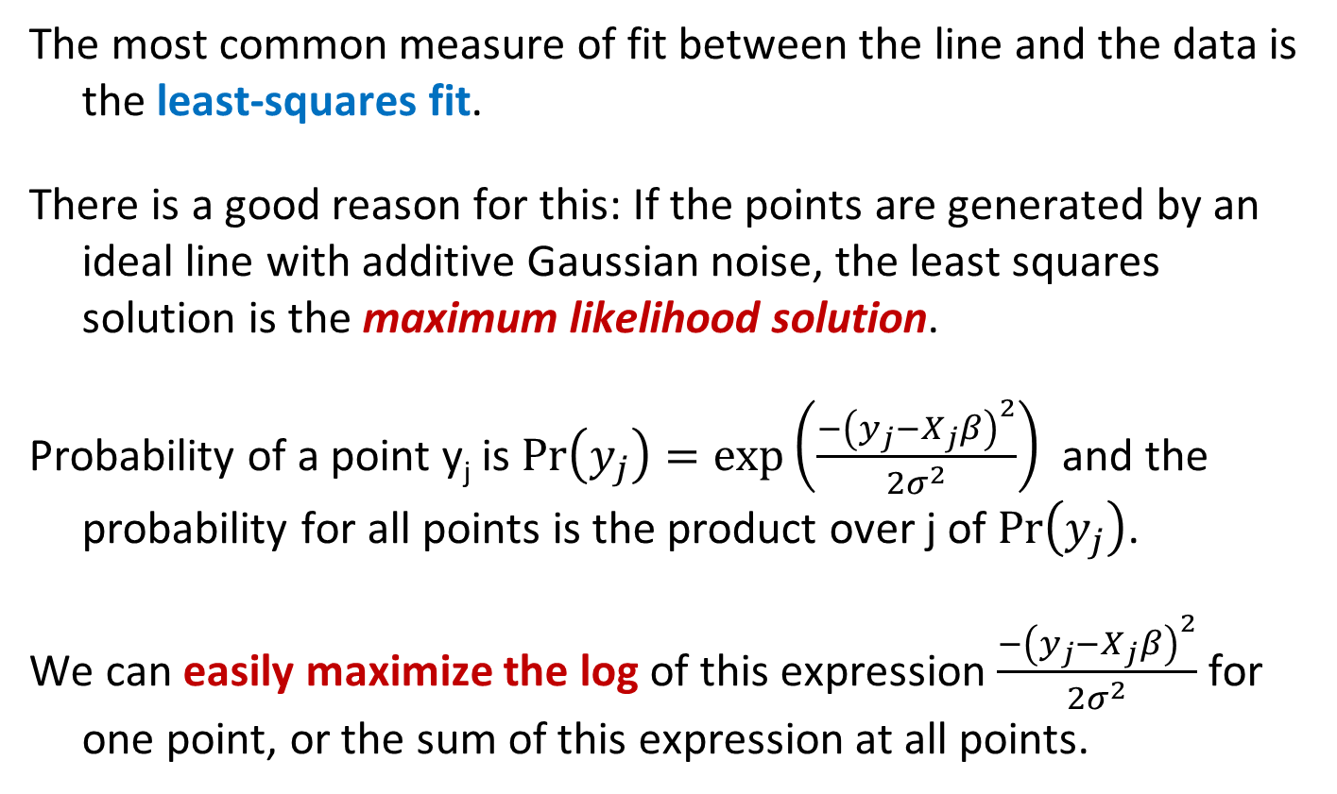
Least Squares Solution
The most common measure of fit between the line and the data is the least-squares fit.
There is a good reason for this: If the points are generated by an ideal line with additive Gaussian noise, the least squares solution is the maximum likelihood solution.
Probability of a point y_{j} is $Pr\left(y_{j}\right)=exp⁡\left(\frac{−{\left(y_{j}−X_{j}β\right)}^{2}}{{2σ}^{2}}\right)$ and the probability for all points is the product over j of $Pr\left(y_{j}\right)$.
We can easily maximize the log of this expression $\frac{−{\left(y_{j}−X_{j}β\right)}^{2}}{{2σ}^{2}}$ for one point, or the sum of this expression at all points.

Slide 8
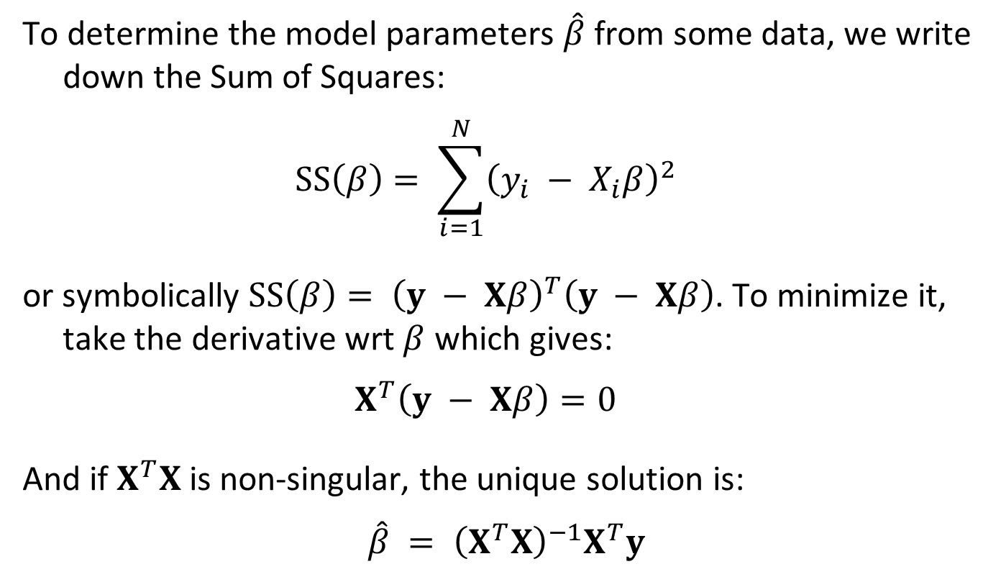
Least Squares Solution
To determine the model parameters $\hat{β}$ from some data, we write down the Sum of Squares:
$$SS\left(β\right)= \sum_{i=1}^{N}{{\left(y_{i} − X_{i}β\right)}^{2}}$$
or symbolically $SS\left(β\right)= {\left(y − Xβ\right)}^{T}\left(y − Xβ\right)$. To minimize it, take the derivative wrt $β$ which gives:
$$X^{T}\left(y − Xβ\right)=0$$
And if $X^{T}X$ is non-singular, the unique solution is:
$$\hat{β} = {\left(X^{T}X\right)}^{−1}X^{T}y$$

Slide 9
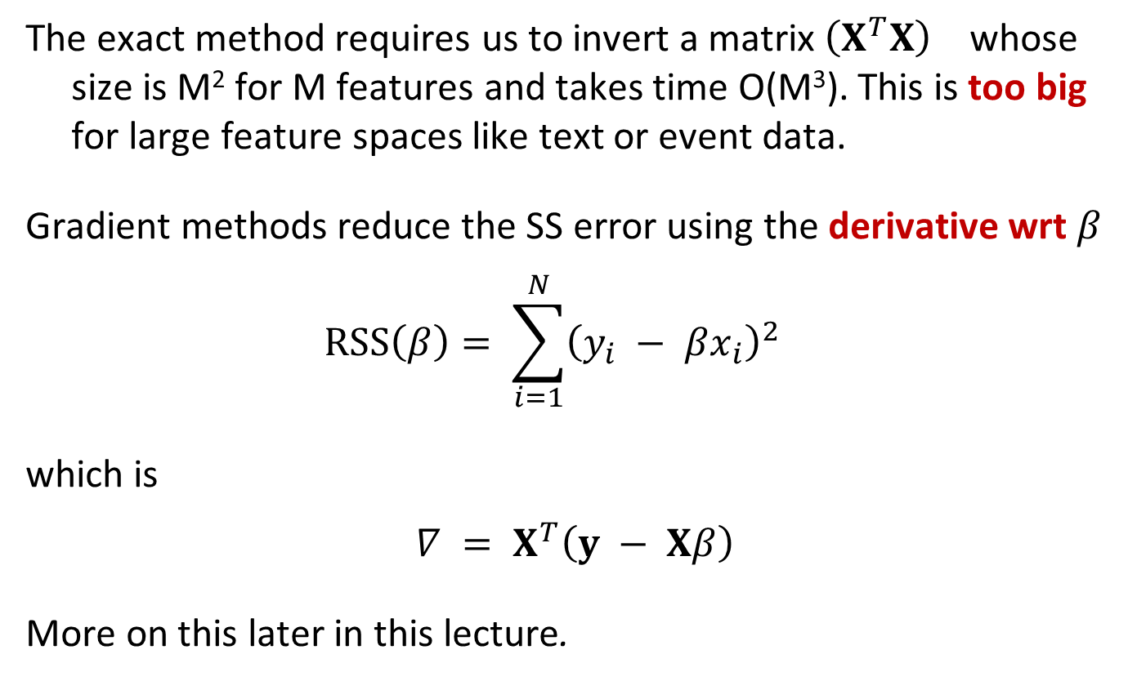
Iterative Least Squares
The exact method requires us to invert a matrix ${\left(X^{T}X\right)}^{}$ whose size is M² for M features and takes time O(M³). This is too big for large feature spaces like text or event data.
Gradient methods reduce the SS error using the derivative wrt $β$
$$RSS\left(β\right)= \sum_{i=1}^{N}{{\left(y_{i} − βx_{i}\right)}^{2}}$$
which is
$$∇ = X^{T}\left(y − Xβ\right)$$
More on this later in this lecture.

Slide 10
Outline
Supervised Learning
Linear Regression
R-squared
Logistic Regression
SVMs
Gradient-based optimization
Decision Trees and Random Forests

Slide 11
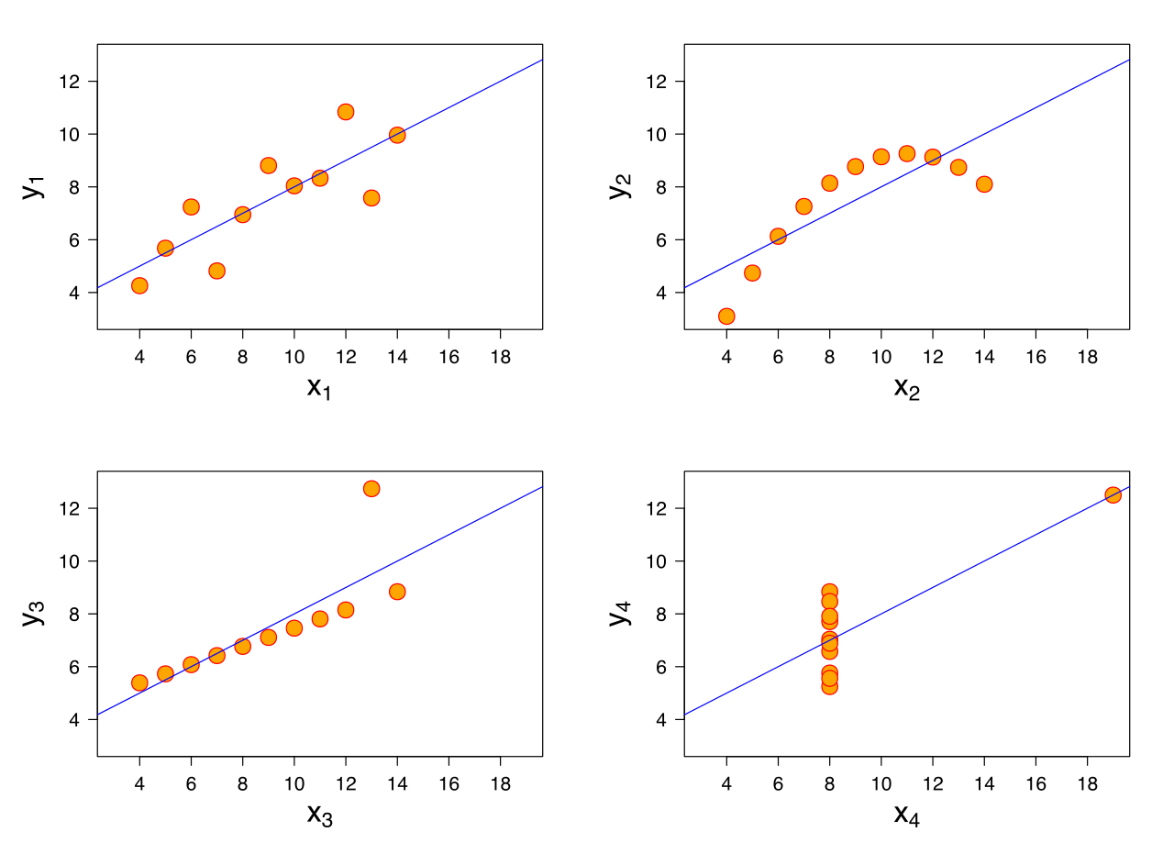
R²-values and P-values
We can always fit a linear model to any dataset, but how do we know if there is a real linear relationship?

Slide 12
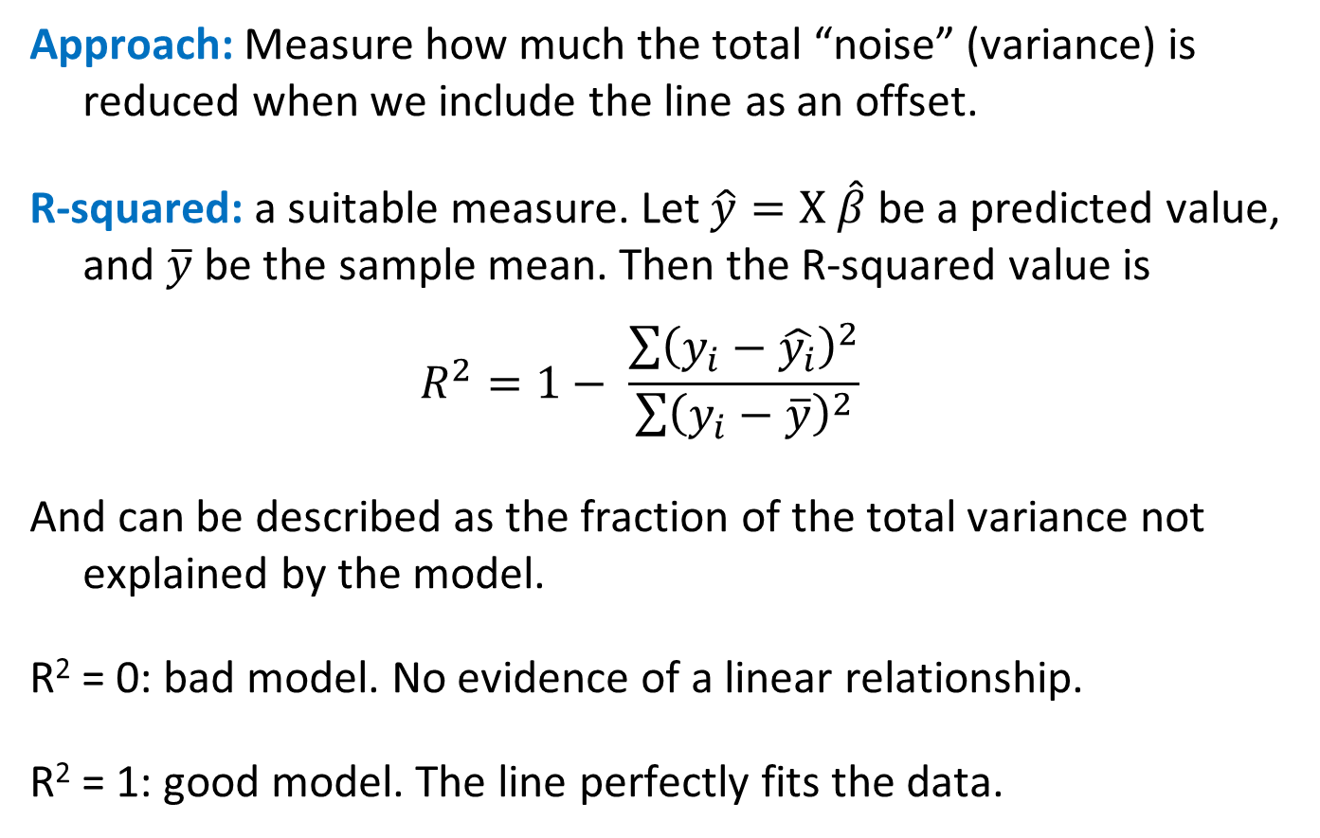
R²-values
Approach: Measure how much the total “noise” (variance) is reduced when we include the line as an offset.
R-squared: a suitable measure. Let $\hat{y}=X \hat{β}$ be a predicted value, and $\overline{y}$ be the sample mean. Then the R-squared value is
$$R^{2}=1− \frac{\sum{{\left(y_{i}−\hat{y_{i}}\right)}^{2}}}{\sum{{\left(y_{i}−\overline{y}\right)}^{2}}}$$
And can be described as the fraction of the total variance not explained by the model.
R² = 0: bad model. No evidence of a linear relationship.
R² = 1: good model. The line perfectly fits the data.

Slide 13

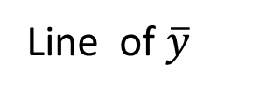

R-squared
Small if good fit
$$R^{2}=1− \frac{\sum{{\left(y_{i}−\hat{y_{i}}\right)}^{2}}}{\sum{{\left(y_{i}−\overline{y}\right)}^{2}}}$$
y
Line of $\hat{y}$
Line of $\overline{y}$
X
Notes:
What R-squared value would you expect under the null hypothesis ?

Slide 14
R²-values and P-values
Statistic: From R-squared we can derive another statistic (using degrees of freedom) that has a standard distribution called an F-distribution.
From the CDF for the F-distribution, we can derive a P-value for the data.
The P-value is, as usual, the probability of observing the data under the null hypothesis of no linear relationship.
If p is small, say less than 0.05, we conclude that there is a linear relationship.

Slide 15
Outline
Supervised Learning
Linear Regression
R-squared
Logistic Regression
SVMs
Gradient-based optimization
Decision Trees and Random Forests

Slide 16
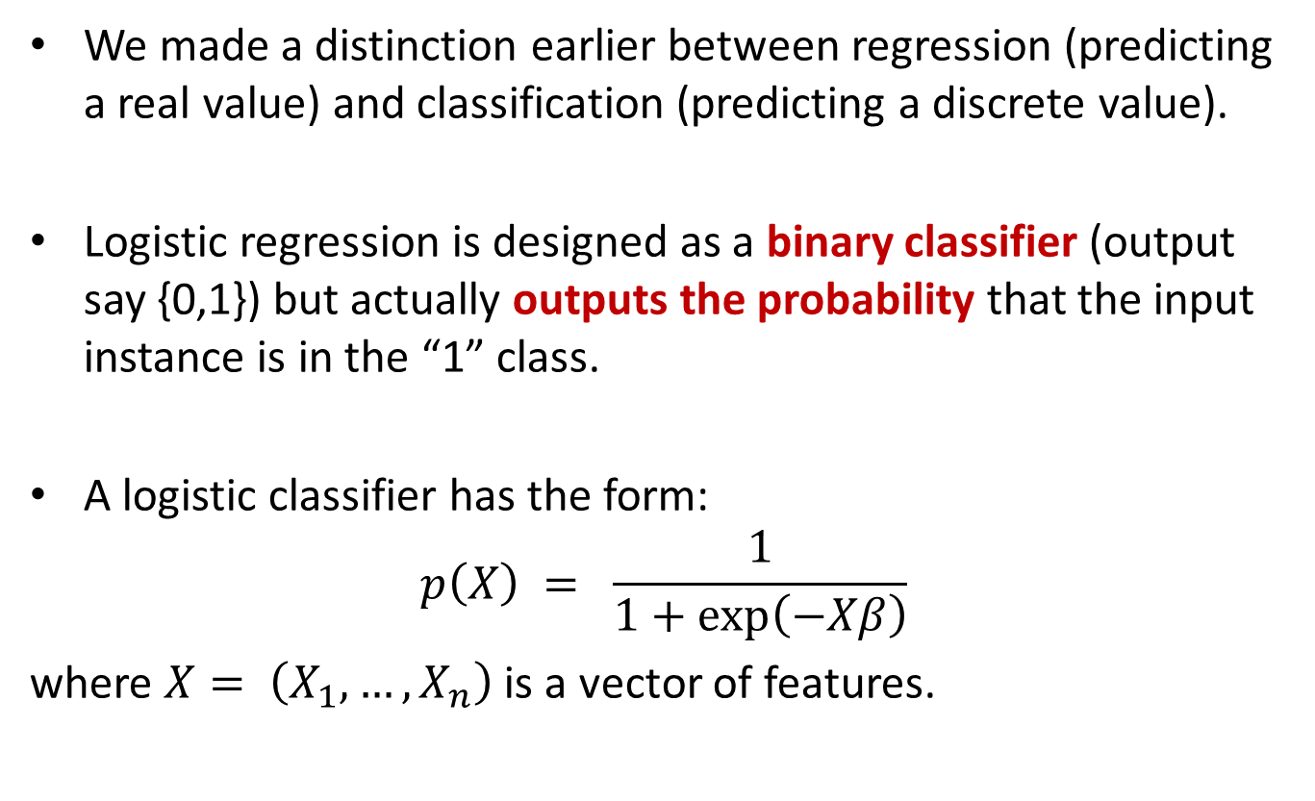
Logistic Regression
We made a distinction earlier between regression (predicting a real value) and classification (predicting a discrete value).
Logistic regression is designed as a binary classifier (output say {0,1}) but actually outputs the probability that the input instance is in the “1” class.
A logistic classifier has the form:
$$p\left(X\right) = \frac{1}{1+exp⁡\left(−Xβ\right)}$$
where $X= \left(X_{1},…,X_{n}\right)$ is a vector of features.

Slide 17
Logistic Regression
Logistic regression is probably the most widely used general-purpose classifier.
Its very scalable and can be very fast to train. It’s used for
Spam filtering
News message classification
Web site classification
Product classification
Most classification problems with large, sparse feature sets.
The only caveat is that it can overfit on very sparse data, so its often used with Regularization

Slide 18
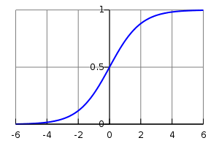

Logistic Regression
Logistic regression maps the “regression” value $−Xβ$ in (-∞,∞) to the range [0,1] using a “logistic” function:
$$p\left(X\right) = \frac{1}{1+exp⁡\left(−Xβ\right)}$$
i.e. the logistic function maps any value on the real line to a probability in the range [0,1]

Slide 19

Logistic Regression
Where did the logistic function come from?

Slide 20
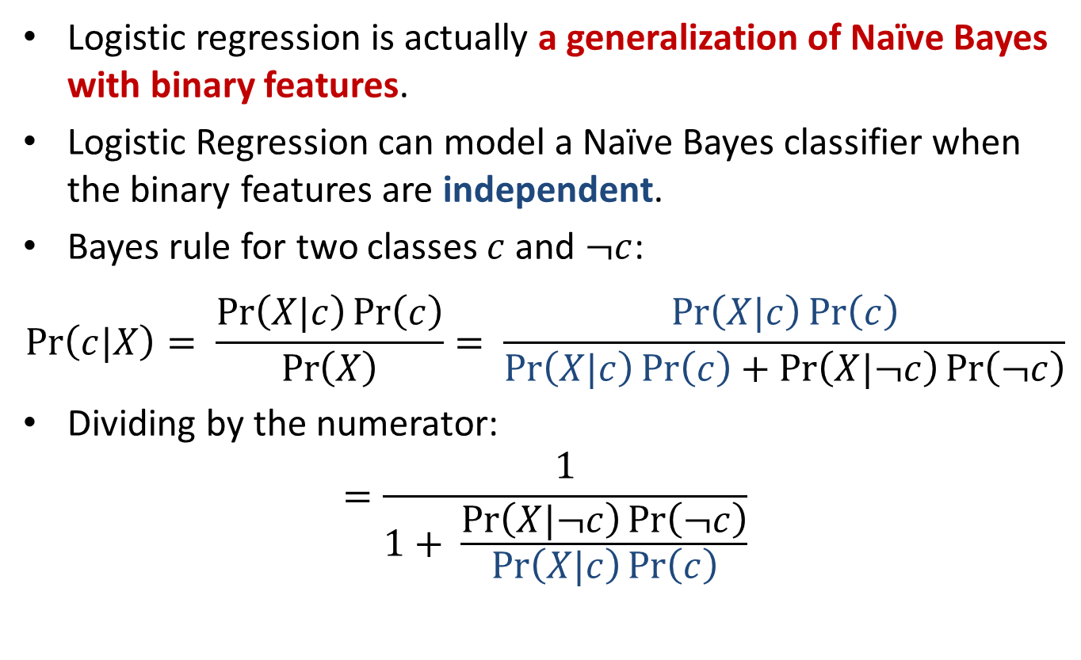
Logistic Regression and Naïve Bayes
Logistic regression is actually a generalization of Naïve Bayes with binary features.
Logistic Regression can model a Naïve Bayes classifier when the binary features are independent.
Bayes rule for two classes $c$ and $¬c$:
$$\operatorname{Pr}\left(c|X\right)= \frac{\operatorname{Pr}\left(X|c\right)\operatorname{Pr}\left(c\right)}{\operatorname{Pr}\left(X\right)}= \frac{\operatorname{Pr}\left(X|c\right)\operatorname{Pr}\left(c\right)}{\operatorname{Pr}\left(X|c\right)\operatorname{Pr}\left(c\right)+\operatorname{Pr}\left(X|¬c\right)\operatorname{Pr}\left(¬c\right)}$$
Dividing by the numerator:
$$=\frac{1}{1+ \frac{\operatorname{Pr}\left(X|¬c\right)\operatorname{Pr}\left(¬c\right)}{\operatorname{Pr}\left(X|c\right)\operatorname{Pr}\left(c\right)}}$$

Slide 21
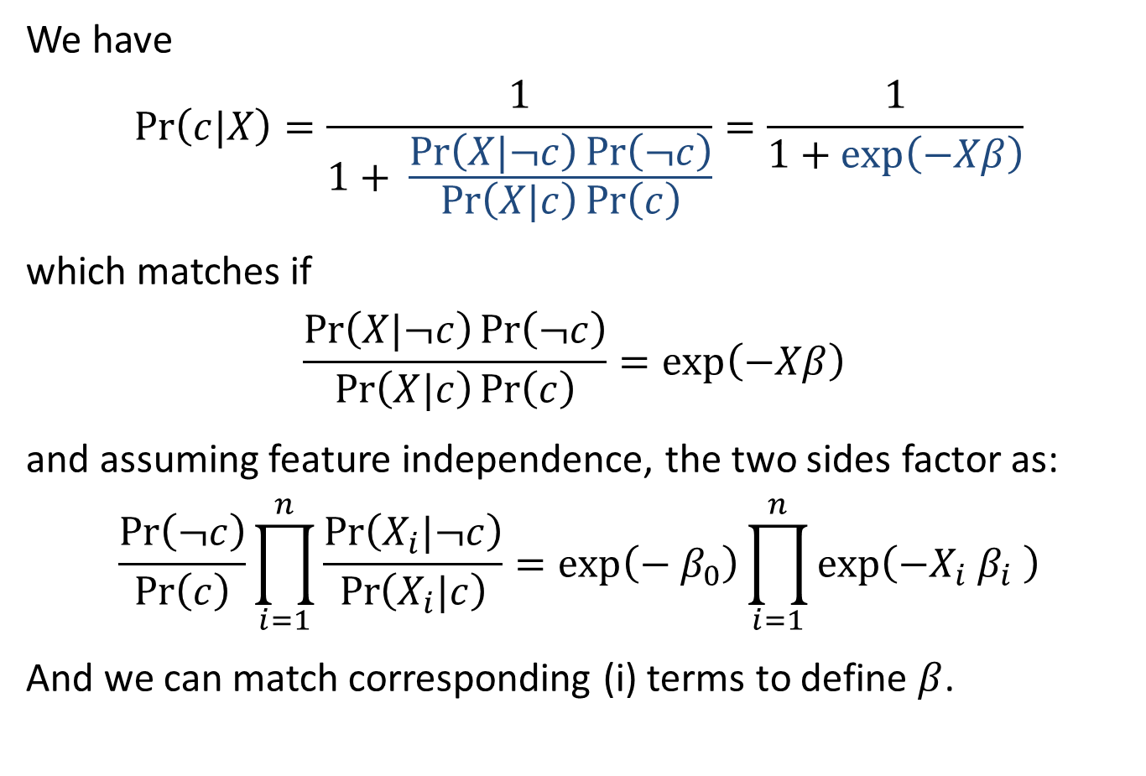
Logistic Regression and Naïve Bayes
We have
$$\operatorname{Pr}\left(c|X\right)=\frac{1}{1+ \frac{\operatorname{Pr}\left(X|¬c\right)\operatorname{Pr}\left(¬c\right)}{\operatorname{Pr}\left(X|c\right)\operatorname{Pr}\left(c\right)}}=\frac{1}{1+exp⁡\left(−Xβ\right)}$$
which matches if
$$\frac{\operatorname{Pr}\left(X|¬c\right)\operatorname{Pr}\left(¬c\right)}{\operatorname{Pr}\left(X|c\right)\operatorname{Pr}\left(c\right)}=exp\left(−Xβ\right)$$
and assuming feature independence, the two sides factor as:
$$\frac{\operatorname{Pr}\left(¬c\right)}{\operatorname{Pr}\left(c\right)}\prod_{i=1}^{n}{\frac{\operatorname{Pr}\left(X_{i}|¬c\right)}{\operatorname{Pr}\left(X_{i}|c\right)}}=\exp\left(−{ β}_{0}\right)\prod_{i=1}^{n}{exp\left(−X_{i}{ β}_{i} \right)}$$
And we can match corresponding (i) terms to define $β$.

Slide 22

Logistic Regression and Naïve Bayes
Summary: Logistic regression has this form:
$$\operatorname{Pr}\left(c|X\right)=\frac{1}{1+exp⁡\left(−Xβ\right)}$$
Models Naïve Bayes formula with two classes
after dividing through by one of them
Models product of contributions from different (independent) features

Slide 23
Logistic Regression and Naïve Bayes
Because it can always learn an NB model but is more general, Logistic regression should do at least as well as naïve Bayes*
Logistic regression typically does better though because it can deal with dependencies between features, whereas Naïve Bayes cannot.
- true if we have sufficient data to reduce variance in the models.
Naive Bayes generally has higher bias due to the independence assumption, but also lower variance than logistic regression.

Slide 24
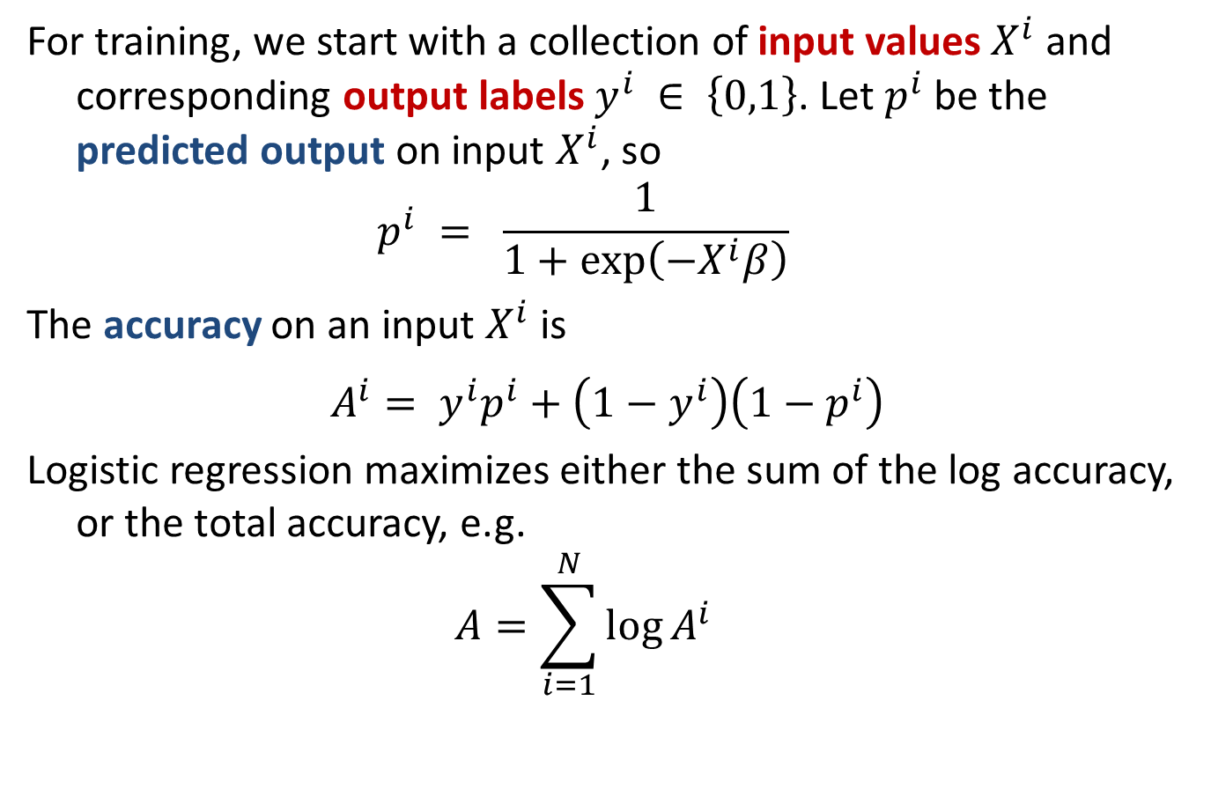
Logistic Training
For training, we start with a collection of input values $X^{i}$ and corresponding output labels $y^{i} ∈ \left\{0,1\right\}$. Let $p^{i}$ be the predicted output on input $X^{i}$, so
$$p^{i} = \frac{1}{1+exp⁡\left(−X^{i}β\right)}$$
The accuracy on an input $X^{i}$ is
$$A^{i}= y^{i}p^{i}+\left(1−y^{i}\right)\left(1−p^{i}\right)$$
Logistic regression maximizes either the sum of the log accuracy, or the total accuracy, e.g.
$$A=\sum_{i=1}^{N}{\log{A^{i}}}$$

Slide 25
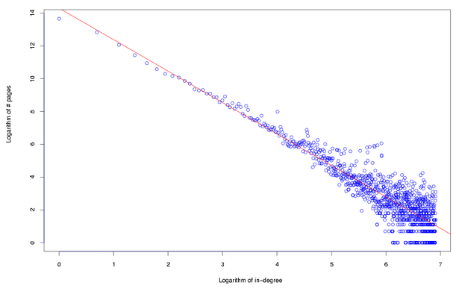
Logistic Regression Training - SGD
A very efficient way to train logistic models is with Stochastic Gradient Descent (SGD) – we keep updating the model with gradients from small blocks (mini-batches) of input data.
One challenge with training on power law data (i.e. most data) is that the terms in the gradient can have very different strengths (because of the power law distribution). We’ll discuess this soon…

Slide 26
Outline
Supervised Learning
Linear Regression
R-squared
Logistic Regression
SVMs
Gradient-based optimization
Decision Trees and Random Forests

Slide 27
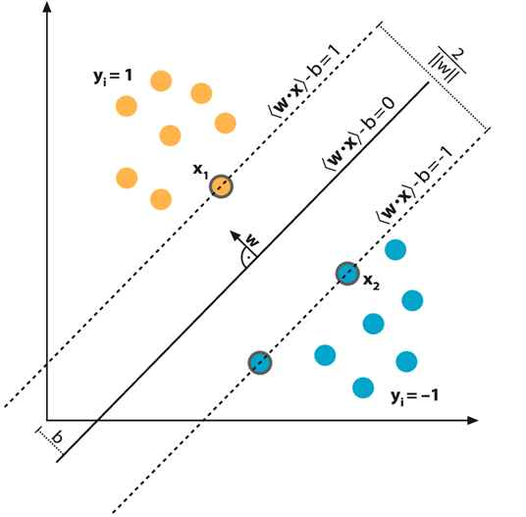

Support Vector Machines
A Support Vector Machine (SVM) is a classifier that tries to maximize the margin between training data and the classification boundary (the plane defined by $Xβ=0$)

Slide 28
Support Vector Machines
The idea is that maximizing the margin maximizes the chance that classification will be correct on new data. We assume the new data of each class is near the training data of that type.

Slide 29
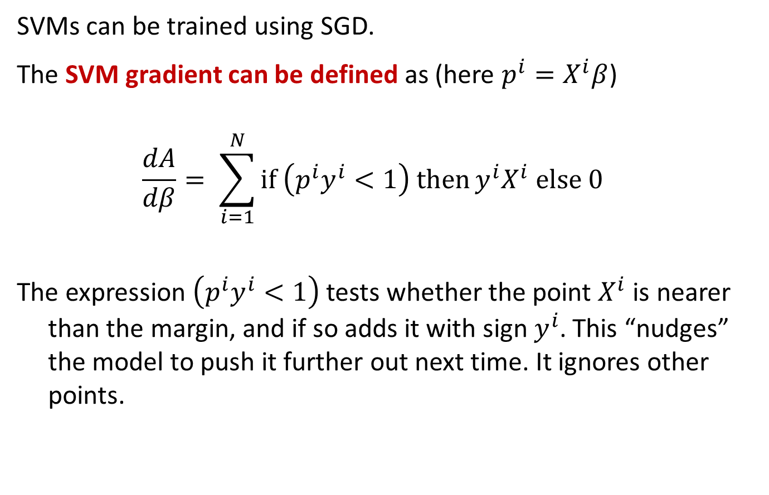
SVM Training
SVMs can be trained using SGD.
The SVM gradient can be defined as (here $p^{i}=X^{i}β$)
$$\frac{dA}{dβ}= \sum_{i=1}^{N}{\text{if} \left(p^{i}y^{i}<1\right) \text{then}}{y^{i}X}^{i} \text{else} 0$$
The expression $\left(p^{i}y^{i}<1\right)$ tests whether the point $X^{i}$ is nearer than the margin, and if so adds it with sign $y^{i}$. This “nudges” the model to push it further out next time. It ignores other points.

Slide 30
SVM Training
This SGD training method (called Pegasos) is much faster than previous methods, and competitive with Logistic Regression.
Its also capable of training in less than one pass over a dataset.

Slide 31
Outline
Supervised Learning
Linear Regression
R-squared
Logistic Regression
SVMs
Gradient-based optimization
Decision Trees and Random Forests

Slide 32
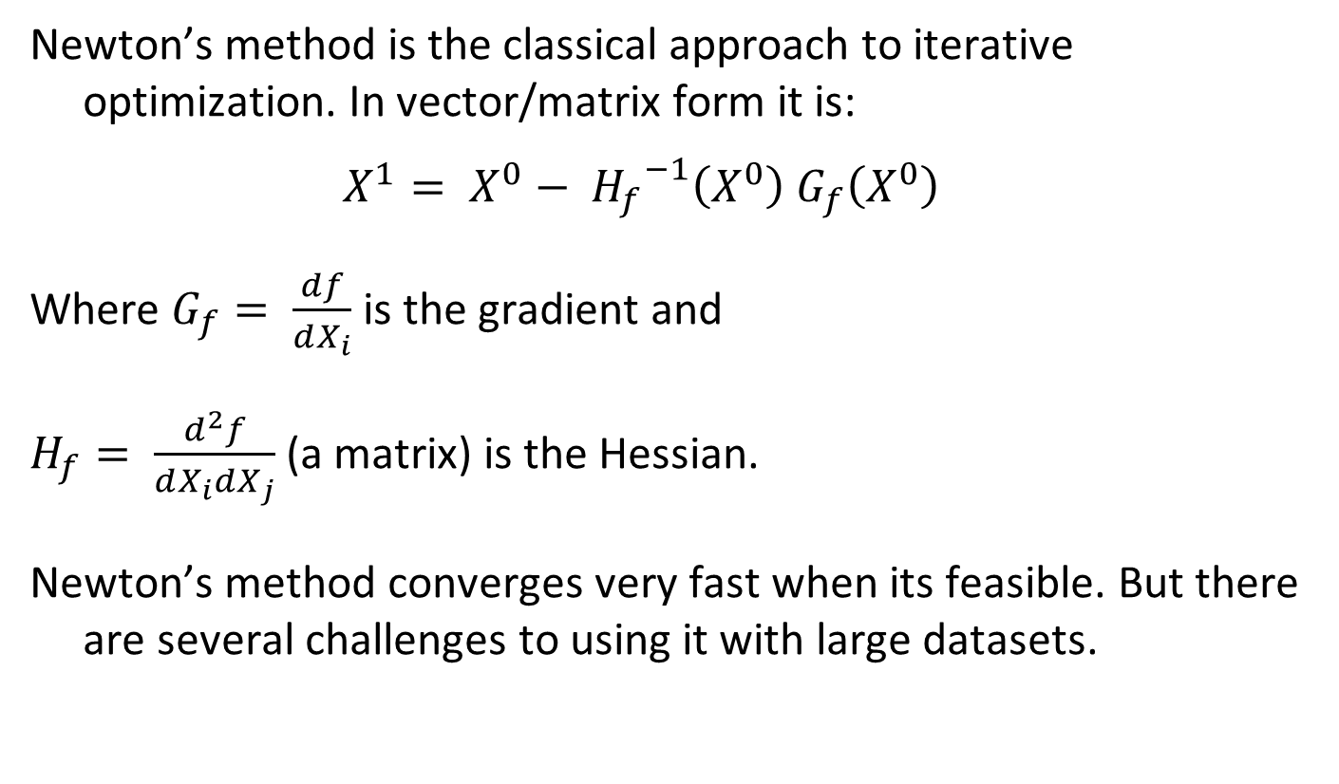
Newton’s Method
Newton’s method is the classical approach to iterative optimization. In vector/matrix form it is:
$$X^{1}= X^{0}− {H_{f}}^{−1}\left(X^{0}\right) G_{f}\left(X^{0}\right)$$
Where $G_{f}= \frac{df}{dX_{i}}$ is the gradient and
$H_{f}= \frac{d^{2}f}{dX_{i}dX_{j}}$ (a matrix) is the Hessian.
Newton’s method converges very fast when its feasible. But there are several challenges to using it with large datasets.

Slide 33
Challenges for Newton’s Method
Both the gradient and Hessian are normally computed on the entire dataset. This means many passes over the data to complete a series of Newton steps.
The Hessian has size O(M²) if there are M features. This is impractical for large feature spaces, e.g. text or event data.
One Solution is L-BFGS, which stands for “Limited Memory Broyden-Fletcher-Goldfarb-Shanno”. It’s a Newton-like algorithm that use an approximation to the Hessian with only a few rows.
L-BFGS still requires full passes over the dataset however.

Slide 34
Stochastic Gradient
A very important set of iterative algorithms use stochastic gradient updates.
They use a small subset or mini-batch X of the data, and use it to compute a gradient which is added to the model
$$β^{′}=β+ α ∇$$
Where $α$is called the learning rate.
These updates happen many times in one pass over the dataset.
Its possible to compute high-quality models with very few passes, sometime with less than one pass over a large dataset.

Slide 35
Challenges for Stochastic Gradient
Stochastic gradient has some serious limitations however, especially if the gradients vary widely in magnitude. Some coefficients change very fast, others very slowly. (The Hessian corrects for this in Newton’s method).
This happens for text, user activity and social media data (and other power-law data), because gradient magnitudes scale with feature frequency, i.e. over several orders of magnitude.
Its not possible to set a single learning rate that trains the frequent and infrequent features at the same time.

Slide 36
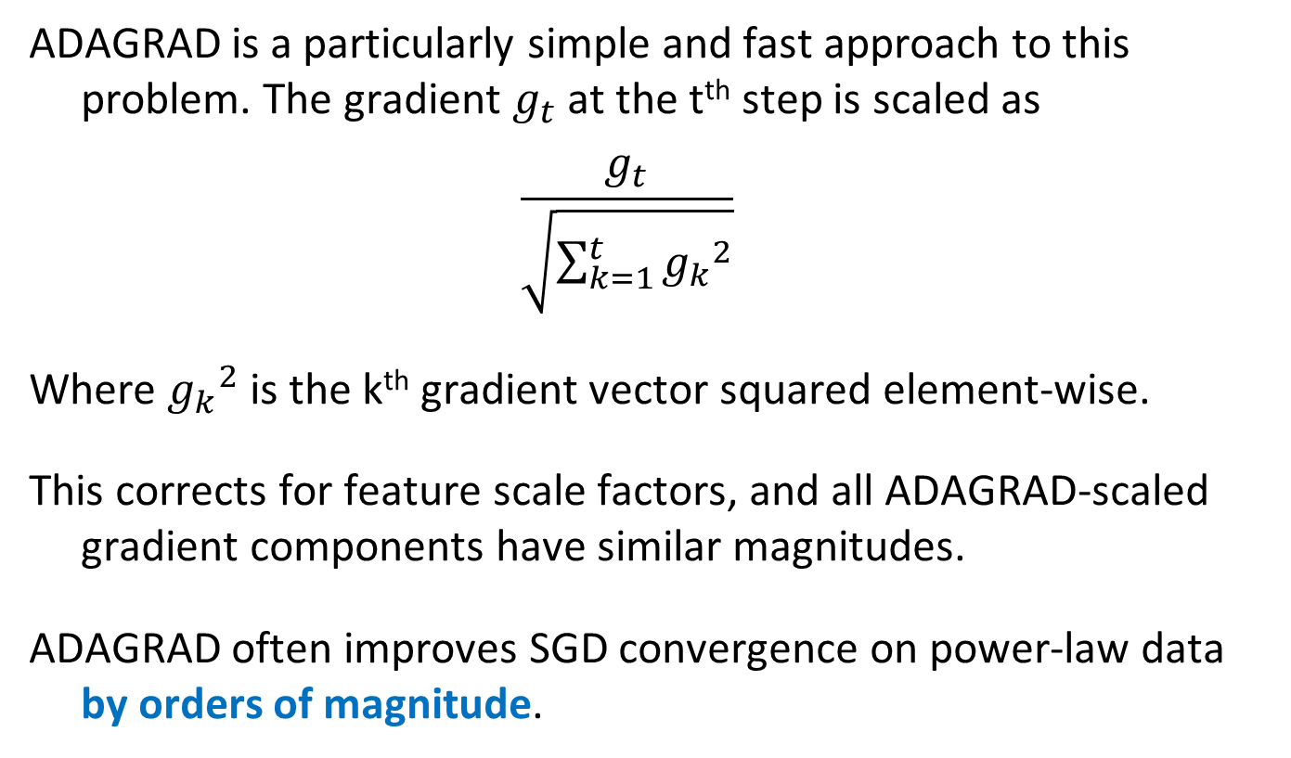
ADAGRAD – Adaptive-rate SGD
ADAGRAD is a particularly simple and fast approach to this problem. The gradient $g_{t}$ at the t^{th} step is scaled as
$$\frac{g_{t}}{\sqrt{\sum_{k=1}^{t}{{g_{k}}^{2}}}}$$
Where ${g_{k}}^{2}$ is the k^{th} gradient vector squared element-wise.
This corrects for feature scale factors, and all ADAGRAD-scaled gradient components have similar magnitudes.
ADAGRAD often improves SGD convergence on power-law data by orders of magnitude.

Slide 37
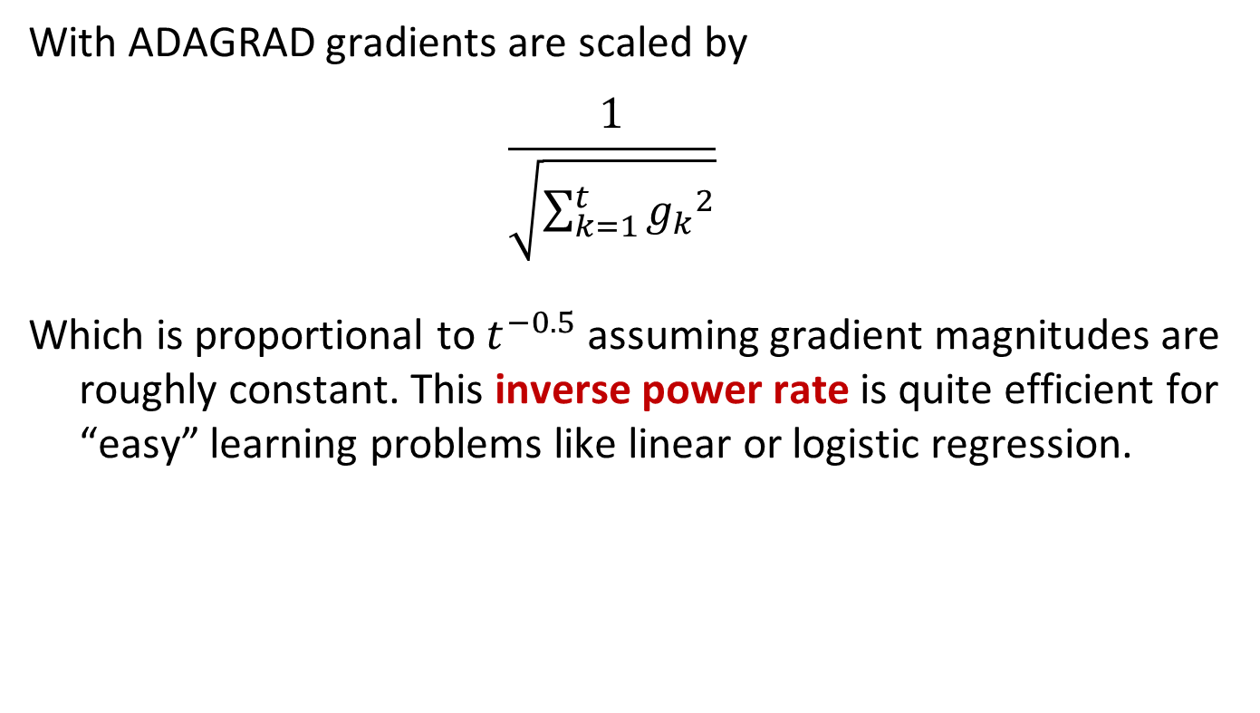
SGD learning rate schedules
With ADAGRAD gradients are scaled by
$$\frac{1}{\sqrt{\sum_{k=1}^{t}{{g_{k}}^{2}}}}$$
Which is proportional to $t^{−0.5}$ assuming gradient magnitudes are roughly constant. This inverse power rate is quite efficient for “easy” learning problems like linear or logistic regression.

Slide 38
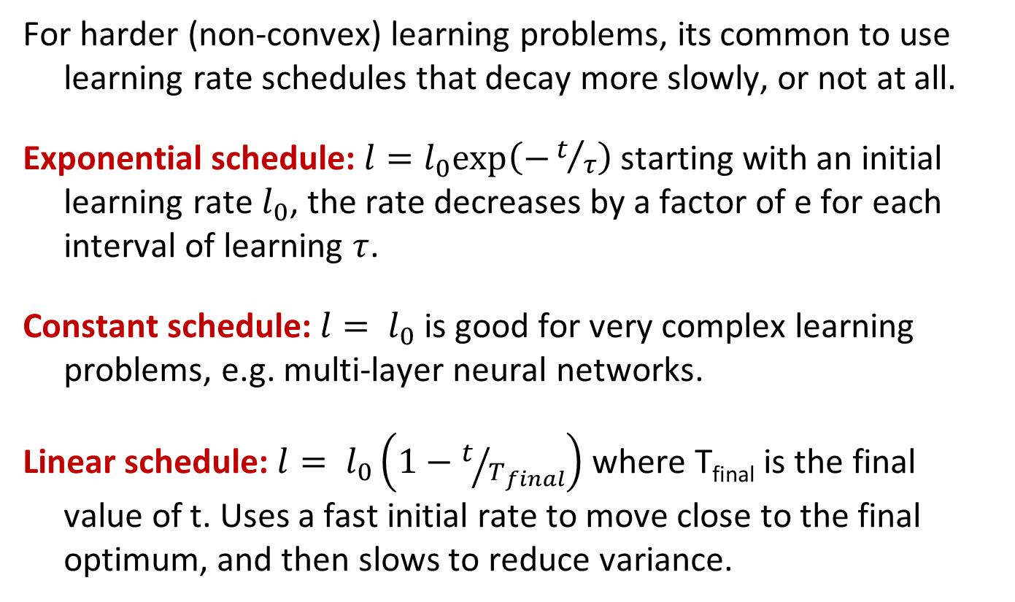
SGD learning rate schedules
For harder (non-convex) learning problems, its common to use learning rate schedules that decay more slowly, or not at all.
Exponential schedule: $l=l_{0}exp\left(−t/τ\right)$ starting with an initial learning rate $l_{0}$, the rate decreases by a factor of e for each interval of learning $τ$.
Constant schedule: $l= l_{0}$ is good for very complex learning problems, e.g. multi-layer neural networks.
Linear schedule: $l= l_{0}\left(1−t/{T_{final}}\right)$ where T_{final} is the final value of t. Uses a fast initial rate to move close to the final optimum, and then slows to reduce variance.

Slide 39
5-minute break

Slide 40
Outline
Supervised Learning
Linear Regression
R-squared
Logistic Regression
SVMs
Gradient-based optimization
Decision Trees and Random Forests

Slide 41
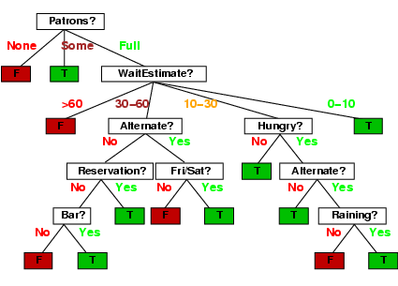
Decision trees
Walk from root to a class-labeled leaf.
At each node, branch based on the value of some feature.
Ex: Should we wait for a table at this restaurant?
Note you can use the same
attribute more than once.

Slide 42
Decision tree learning
If there are k features, a decision tree might have up to 2^{k} nodes. This is usually much too big in practice.
We want to find “efficient” (smaller) trees.
We can do this in a greedy manner by recursively choosing a best split feature at each node.

Slide 43
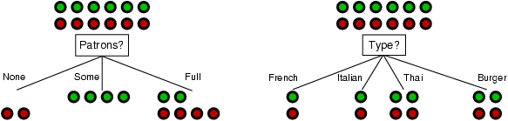
Choosing an attribute
Idea: a good features splits the examples into subsets that are (ideally) "all positive" or "all negative"
Patrons or type?
To wait or not to wait is still at 50%.

Slide 44
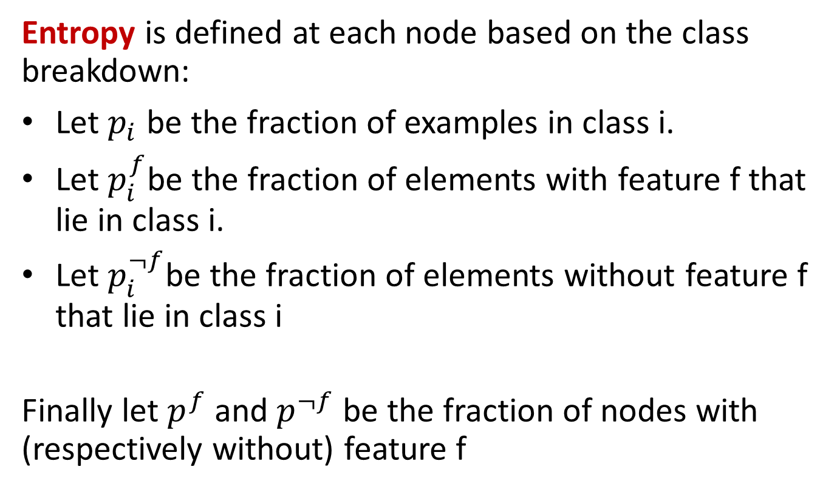
Using Information Theory
Entropy is defined at each node based on the class breakdown:
Let $p_{i}$ be the fraction of examples in class i.
Let $p_{i}^{f}$be the fraction of elements with feature f that lie in class i.
Let $p_{i}^{¬f}$be the fraction of elements without feature f that lie in class i
Finally let $p^{f}$ and $p^{¬f}$ be the fraction of nodes with (respectively without) feature f

Slide 45
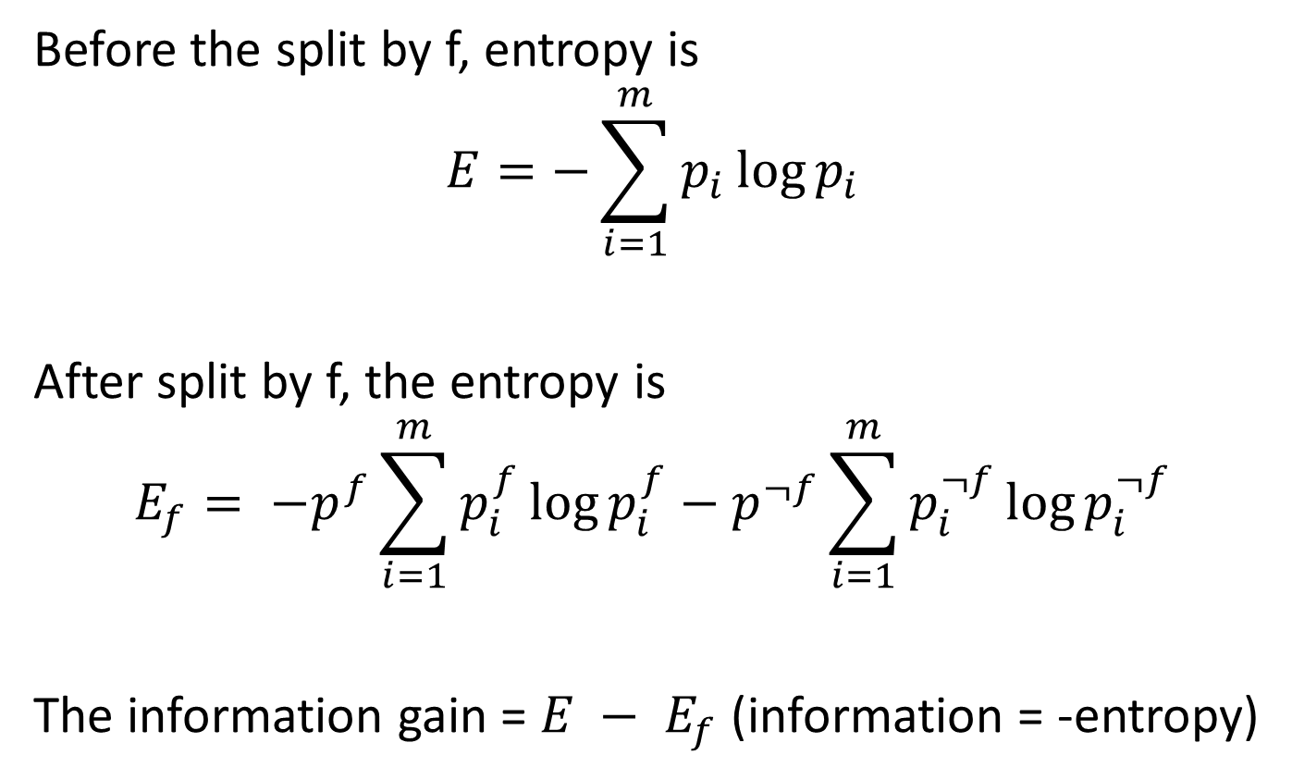
Information Gain
Before the split by f, entropy is
$$E=−\sum_{i=1}^{m}{p_{i}\log{p_{i}}}$$
After split by f, the entropy is
$$E_{f}= {−p}^{f}\sum_{i=1}^{m}{p_{i}^{f}\log{p_{i}^{f}}}−p^{¬f}\sum_{i=1}^{m}{p_{i}^{¬f}\log{p_{i}^{¬f}}}$$
The information gain = $E − E_{f}$ (information = -entropy)

Slide 46
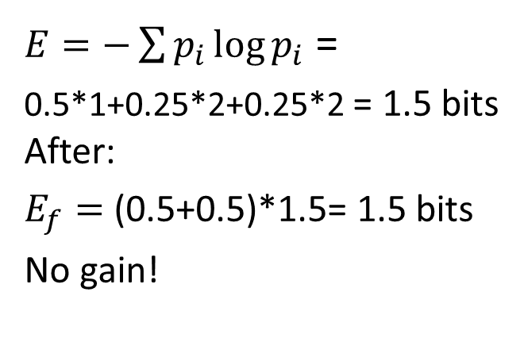
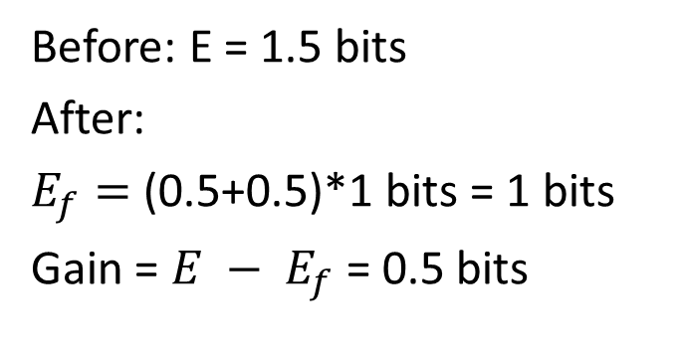
Example
P = (0.5,0.25,0.25)
P = (0.5,0.25,0.25)
AAAA
BB
CC
Classes A, B, C
AAAA
BB
CC
Split by Patrons feature
Split by Type feature
AA
B
C
AA
B
C
AA
CC
AA
BB
(0.5,0.25,0.25)
(0.5,0.25,0.25)
(0.5,0,0.5)
(0.5,0.5,0)
$E=−\sum{p_{i}\log{p_{i}}}$ =
0.5*1+0.25*2+0.25*2 = 1.5 bits After:
$E_{f}=$ (0.5+0.5)*1.5= 1.5 bits
No gain!
Before: E = 1.5 bits
After:
$E_{f}=$ (0.5+0.5)*1 bits = 1 bits
Gain = $E − E_{f}$ = 0.5 bits

Slide 47
Choosing best features
At each node, we choose the feature f which maximizes the information gain.
This tends to be produce mixtures of classes at each node that are more and more “pure” as you go down the tree.
If a node has examples all of one class c, we make it a leaf and output “c”. Otherwise, when we hit the depth limit, we output the most popular class at that node.

Slide 48
Decision Tree Models
As tree depth increases, bias decreases and variance generally increases. Why? (Hint: think about k-NN)
Bias decreases with tree depth
Variance increases with tree depth

Slide 49
Ensemble Methods
Are like Crowdsourced machine learning algorithms:
Take a collection of simple or weak learners
Combine their results to make a single, better learner
Types:
Bagging: train learners in parallel on different samples of the data, then combine by voting (discrete output) or by averaging (continuous output).
Stacking: combine model outputs using a second-stage learner like linear regression.
Boosting: train learners on the filtered output of other learners.

Slide 50
Random Forests
Grow K trees on datasets sampled from the original dataset with replacement (bootstrap samples), p = number of features.
Draw K bootstrap samples of size N
Grow each Decision Tree, by selecting a random set of m out of p features at each node, and choosing the best feature to split on.
Aggregate the predictions of the trees (most popular vote) to produce the final class.
Typically m might be e.g. sqrt(p) but can be smaller.

Slide 51
Random Forests
Principles: we want to take a vote between different learners so we don’t want the models to be too similar. These two criteria ensure diversity in the individual trees:
Draw K bootstrap samples of size N:
Each tree is trained on different data.
Grow a Decision Tree, by selecting a random set of m out of p features at each node, and choosing the best feature to split on.
Corresponding nodes in different trees (usually) cant use the same feature to split.

Slide 52
Random Forests
Very popular in practice, probably the most popular classifier for dense data (<= a few thousand features)
Easy to implement (train a lot of trees). Good match for MapReduce.
Parallelizes easily (but not necessarily efficiently).
Not quite state-of-the-art accuracy – DNNs generally do better, and sometimes gradient boosted trees.
Needs many passes over the data – at least the max depth of the trees. (<< boosted trees though)
Easy to overfit – hard to balance accuracy/fit tradeoff.

Slide 53
Boosted Decision Trees
A recently-developed alternative to random Forests:
In contrast to RFs whose trees are trained independently, BDT trees are trained sequentially by boosting: Each tree is trained on weighted data which emphasizes incorrectly-labeled instances by the previous trees.
Both methods can produce very high-quality models. Superiority of one method or the other is very dataset-dependent.
Resource requirements are very different as well, so its actually non-trivial to compare the methods (what resources do you fix during the experiment?).

Slide 54
Random Forests vs Boosted Trees
The “geometry” of the methods is very different (MNIST data):
Random forest use 10’s of deep, large trees:
Depth 20-30
…
100k’s of nodes
Bias reduction
through depth
10’s of trees
Variance reduction through the ensemble aggregate

Slide 55
Random Forests vs Boosted Trees
The “geometry” of the methods is very different (MNIST data):
Boosted decision trees use 1000’s of shallow, small trees:
…
Depth 10-15
1k’s of nodes
1000’s of trees
Bias reduction through boosting – variance already low

Slide 56
Random Forests vs Boosted Trees
RF training embarrassingly parallel, can be very fast
Evaluation of trees (runtime) also much faster for RFs
Depth 20-30
…
100k’s of nodes
10’s of trees
…
Depth 10-15
1k’s of nodes
1000’s of trees

Slide 57
Take-aways
Beware HiPPOs and folklore about ML methods – especially those that consider one dimension of performance:
Naïve Bayes vs. Logistic Regression
Random Forests vs. Boosted Decision Trees
Always try out all the plausible methods whenever possible.
Make sure you understand the principles and characteristics of the methods you are using. And make sure to tune each method thoroughly - it can make a huge difference to performance.

