Slide 1


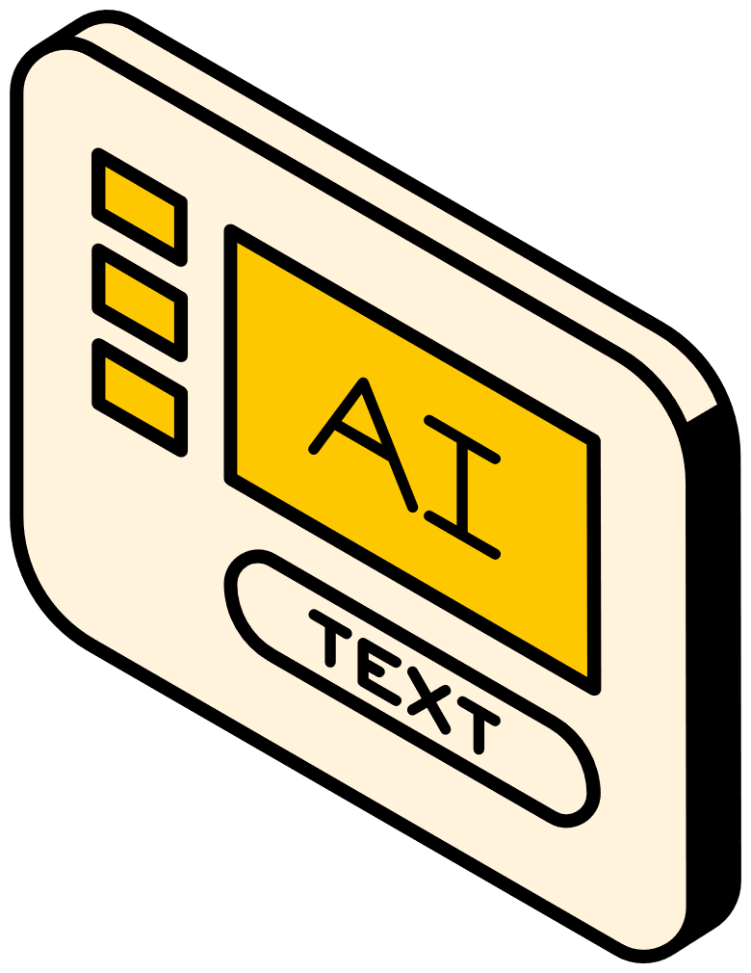
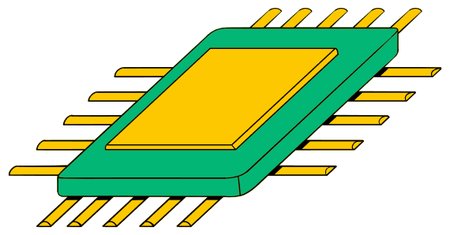
Department of Computer Science & Engineering MCKV Institute of Engineering
AI-POWERED FORM FILLING ASSISTANT FOR INDIAN CITIZENS
Intel Unnati Industrial Training 2025
PRESENTED BY:
  SANDIPAN RAKSHIT
  CHINMOY DAS
  SOURANGSHU KUNDU

Slide 2

PRESENTATION OUTLINE
Introduction Problem Statement Proposed solution System Architecture Implementation workflow Tech Stack User Interfaces Future scope and further enhancements Conclusion Acknowledgement

Slide 3


INTRODUCTION
Millionsofcitizens visit Seva Kendras centers to
apply for essential services such as birth certificates, PAN cards, income certificates, and various welfare schemes. Although most citizens carry valid identification documents like Aadhaar, PAN, or voter IDs, the information printed on these documents must still be manually typed into multiple forms for each application.
This project introduces an AI-Powered Form Filling Assistant, a web based system designed to automatically extract personal information from identity documents and intelligently populate multiple government forms within seconds. The solution leverages recent advancements in Optical Character Recognition (OCR), Natural Language Processing (NLP), and Large Language Models (LLMs) to deliver a fast, accurate, and scalable automation tool.

Slide 4

PROBLEM STATEMENT
Citizens often need to fill in multiple government service forms at Seva Kendras (e.g., for certificates, licenses, and welfare schemes). This project aims to build an AI tool that auto-fills these forms based on uploaded documents (Aadhaar, PAN, voter ID, etc.), reducing manual effort and errors.

Slide 5



PROPOSED SOLUTION
The solution leverages the combined power of Optical Character Recognition (OCR), Large Language Models (LLMs), and intelligent field- mapping algorithms to transform a traditionally manual workflow into a fast, automated, and error-resistant process.
The system is designed as a web-based application with a clean separation between frontend, backend, and AI modules, ensuring scalability, modularity.

Slide 6
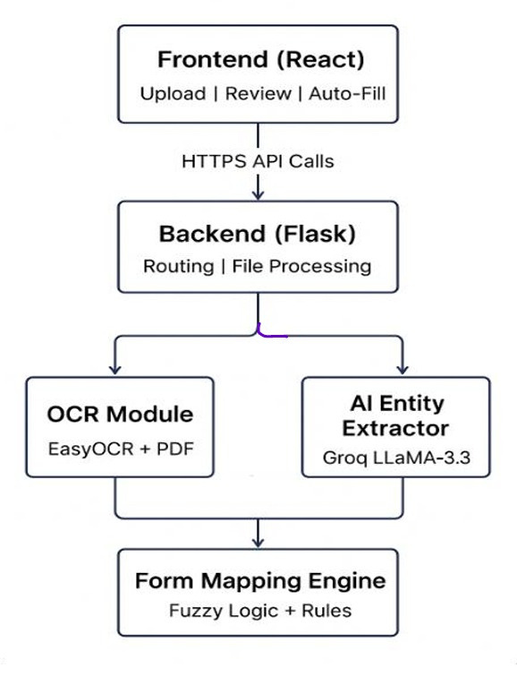

SYSTEM ARCHITECTURE

Slide 7
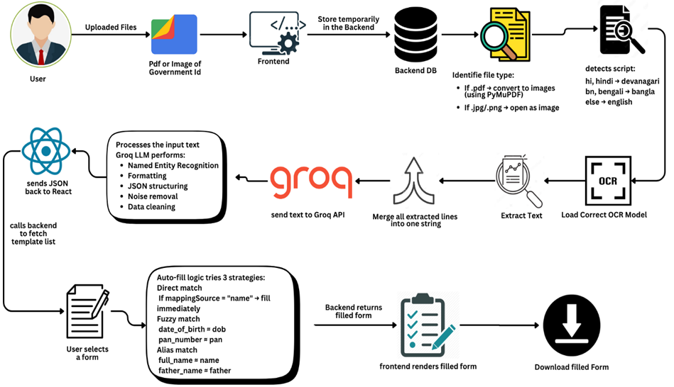
Workflow

Slide 8


IMPLEMENTATION WORKFLOW
1.Document Upload
2. Pre-Processing
3. OCR Text Extraction
4. AI Entity Extraction (LLM)
5. Form Mapping Engine
6. Review / Edit & Download

Slide 9
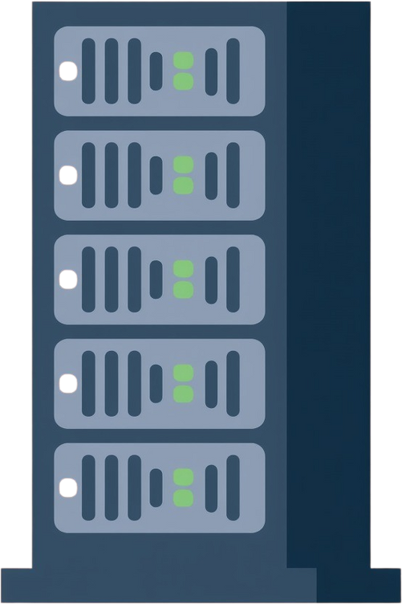
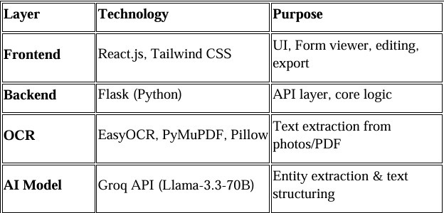
TECHNOLOGY STACK

Slide 10
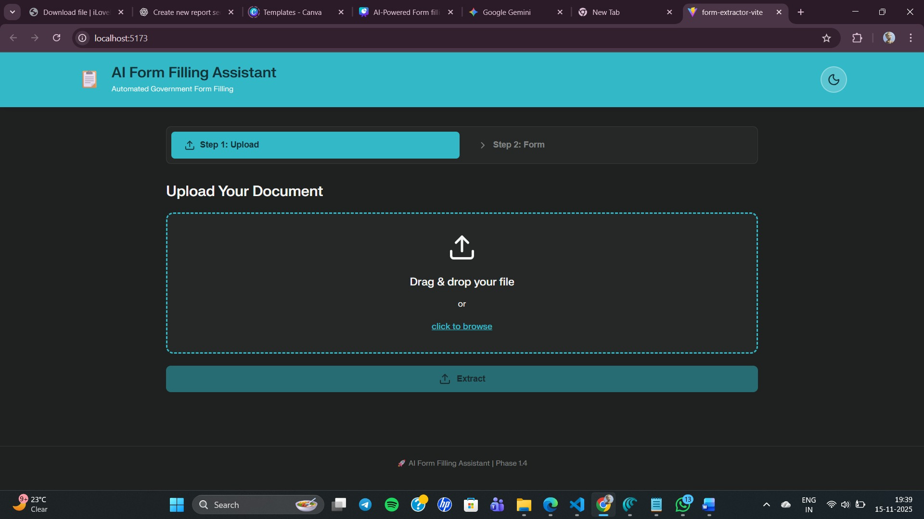
USER INTERFACES
1.Uploadinginterface

Slide 11
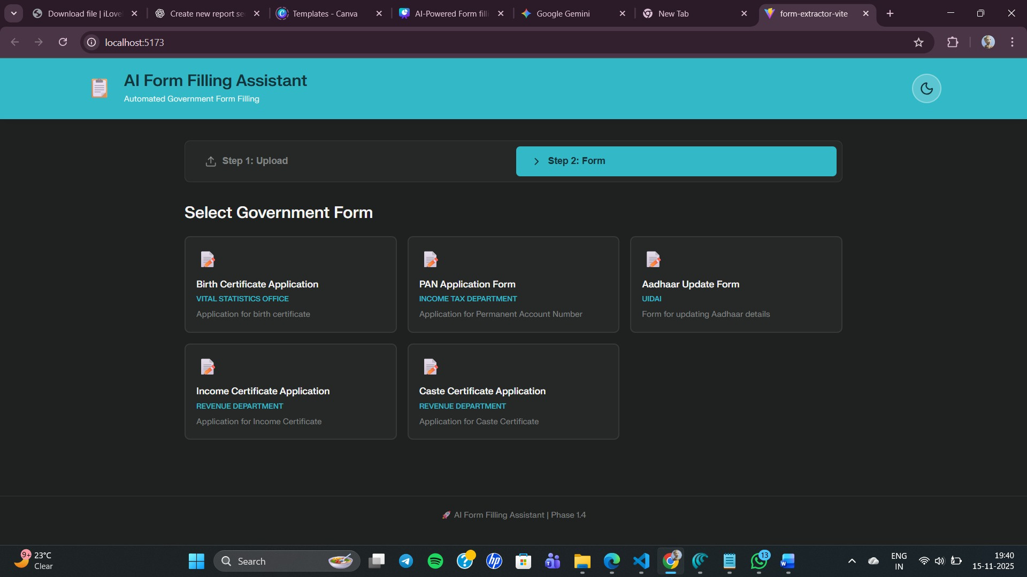
2. Form Templates interface

Slide 12
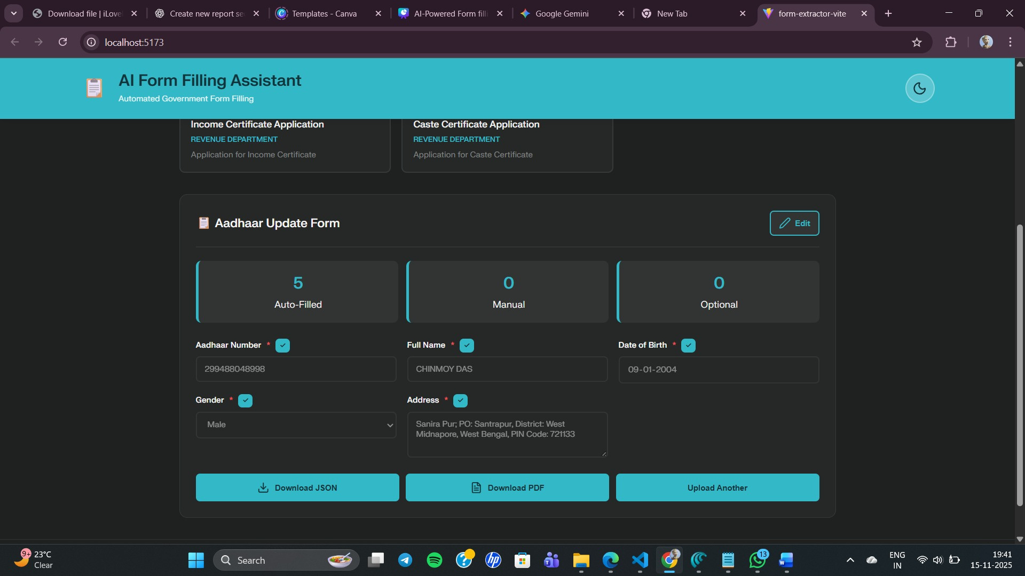

3. Review/edit Interface

Slide 13


FUTURE SCOPE AND FURTHER ENHANCEMENTS
Support for AdditionalGovernmentForms
IntegrationwithGovernment APIs
Improved Multi-Language OCR Models
AI-Based Error Detection & Suggestions

Slide 14

CONCLUSION
This AI-Powered Form Filling Assistant project successfully demonstrates how artificial intelligence, OCR technologies, and intelligent field-mapping techniques can significantly improve the efficiency of government service workflows. By automating the extraction and filling of personal details from documents such as Aadhaar, PAN, and voter IDs, the system reduces manual effort, minimizes errors, and speeds up application processing.

Slide 15

ACKNOWLEDGEMENT
We sincerely thank Intel Corporation for providing us the opportunity to participate in the Intel® Unnati Industrial Training Program 2025, which offered valuable exposure to real-world industry problems and emerging technologies.
We are grateful to the Management and Faculty of MCKV Institute of Engineering for their continuous support and facilitation throughout the program.
We extend our special thanks to Dr. Deep Suman Dev, Assistant Professor, CSE, for his coordination, guidance, and supervision during the training period.
We are also deeply thankful to our project mentor, Professor Puspen Lahiri, for his valuable guidance, insights, and constant encouragement.
Lastly, we appreciate the support of Intel trainers, faculty members, and our team for their dedication and collaboration.

Slide 16
Thank you !

