Slide 1
RAFT: In Search of an Understandable Consensus Algorithm
Diego Ongaro John Ousterhout
USENIX Annual Technical Conference 2014
Slides from a talk by Ongaro and Ousterhout, and a talk by Ion Stoica.
This version edited by S. Sudarshan, IIT Bombay

Slide 2
Motivation (I)
"Consensus algorithms allow a collection of machines to work as a coherent group that can survive the failures of some of its members."
Very important role in building fault-tolerant distributed systems

Slide 3
Motivation (II)
Paxos
Current standard for both teaching and implementing consensus algorithms
Very difficult to understand and very hard to implement
Raft
New protocol (2014)
Much easier to understand
Several open-source implementations

Slide 4
Paxos Limitations
“The dirty little secret of the NSDI community is that at most five people really, truly understand every part of Paxos ;-).” – NSDI reviewer
“There are significant gaps between the description of the Paxos algorithm and the needs of a real-world system…the final system will be based on an unproven protocol.” – Chubby authors

Slide 5
Replicated state machines
Allows a collection of servers to
Maintain identical copies of the same data
Continue operating when some servers are down
A majority of the servers must remain up
Many applications
Typically built around a distributed log
Each server stores a log containing commands

Slide 6

Replicated State Machines
Clients
z←6
Consensus Module
Consensus Module
Consensus Module
State Machine
State Machine
State Machine
x | 1
y | 2
z | 6
x | 1
y | 2
z | 6
x | 1
y | 2
z | 6
Servers
Log
Log
Log
x←3
y←2
x←1
z←6
x←3
y←2
x←1
z←6
x←3
y←2
x←1
z←6
Replicated log ⇒ replicated state machine
All servers execute same commands in same order
Consensus module ensures proper log replication

Slide 7
The distributed log (I)
State machines always execute commands in the log order
They will remain consistent as long as command executions have deterministic results
System makes progress as long as any majority of servers are up
Failure model: fail-stop (not Byzantine), delayed/lost messages

Slide 8
Designing for understandability
Main objective of RAFT
Whenever possible, select the alternative that is the easiest to understand
Techniques that were used include
Dividing problems into smaller problems
Reducing the number of system states to consider

Slide 9
Raft Overview
Leader election
Select one of the servers to act as cluster leader
Detect crashes, choose new leader
Log replication (normal operation)
Leader takes commands from clients, appends them to its log
Leader replicates its log to other servers (overwriting inconsistencies)
Safety
Only a server with an up-to-date log can become leader

Slide 10
Raft basics: the servers
A RAFT cluster consists of several servers
Typically five
Each server can be in one of three states
Leader
Follower
Candidate (to be the new leader)
Followers are passive:
Simply reply to requests coming from their leader

Slide 11
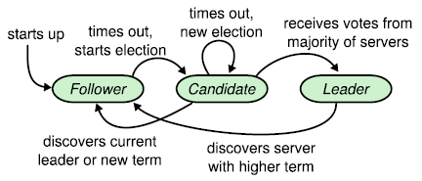
Server states

Slide 12
Raft basics: terms (I)
Epochs of arbitrary length
Start with the election of a leader
End when
Leader becomes unavailable
No leader can be selected (split vote)
Different servers may observe transitions between terms at different times or even miss them

Slide 13
Raft basics: terms (II)

Slide 14
Raft basics: RPC
Servers communicate though idempotent RPCs
RequestVote
Initiated by candidates during elections
AppendEntry: Initiated by leaders to
Replicate log entries
Provide a form of heartbeat
Empty AppendEntry( ) calls

Slide 15
Leader elections
Servers start being followers
Remain followers as long as they receive valid RPCs from a leader or candidate
When a follower receives no communication over a period of time (the election timeout), it starts an election to pick a new leader

Slide 16
The leader fails
Log
State
machine
Client
Log
State
machine
Log
State
machine
Followers notice at different times the lack of heartbeats
Decide to elect a new leader

Slide 17
Example
Follower with the shortest timeout requests to become the new leader
Follower A
Timeouts
Follower B
Leader
X
Last heartbeat

Slide 18
Starting an election
When a follower starts an election, it
Increments its current term
Transitions to candidate state
Votes for itself
Issues RequestVote RPCs in parallel to all the other servers in the cluster.

Slide 19
Acting as a candidate
A candidate remains in that state until
It wins the election
Another server becomes the new leader
A period of time goes by with no winner

Slide 20
Winning an election
Must receive votes from a majority of the servers in the cluster for the same term
Each server will vote for at most one candidate in a given term
The first one that contacted it
Majority rule ensures that at most one candidate can win the election
Winner becomes leader and sends heartbeat messages to all of the other servers
To assert its new role

Slide 21
S1
1
S5
1
1
S2
1
1
Follower
S4
S3
Candidate
Leader

Slide 22
S1
1
S5
1
1
S2
ReqVote (2)
ReqVote (2)
ReqVote (2)
1
ReqVote (2)
2
Follower
S4
S3
Candidate
Leader
S3 timeouts, switch to candidate state,
increment term, vote itself as a leader and ask everyone else to confirm

Slide 23
S1
2
ReqVote(2)
ReqVote (2)
S5
1
1
S2
ReqVote (2)
ReqVote (2)
1
2
Follower
S4
S3
Candidate
Leader
Concurrently S1 timeouts, switch to candidate state,
increment term, vote itself as a leader and ask everyone else to confirm

Slide 24
S1
2
Granted
S5
2
2
S2
Granted
2
2
Follower
S4
S3
Candidate
Leader
S4, S5 grant vote to S1
S2 grants vote to S3

Slide 25
S1
2
Denied
S5
2
2
S2
Denied
2
Denied
2
Follower
S4
S3
Candidate
Leader

Slide 26
S1
2
Denied
S5
2
2
S2
Denied
Denied
Denied
2
Denied
2
Follower
S4
S3
Candidate
Leader
Neither candidate gets majority.
After a random delay between 150-300ms try again.

Slide 27
S1
3
ReqVote (3)
ReqVote (3)
S5
2
2
S2
ReqVote (3)
ReqVote (3)
2
2
Follower
S4
S3
Candidate
Leader
S1 initiates another election for term 3.

Slide 28
S1
3
Granted
Granted
S5
3
3
S2
Granted
Granted
3
3
Follower
S4
S3
Candidate
Leader
Everyone grants the vote to S1

Slide 29
S1
3
Granted
Granted
S5
3
3
S2
Granted
Granted
3
3
Follower
S4
S3
Candidate
Leader
S1 becomes leader for term 3,
and the others become followers.

Slide 30
Hearing from other servers
Candidates may receive an AppendEntries RPC from another server claiming to be leader
If the leader’s term is at greater than or equal to the candidate’s current term, the candidate recognizes that leader and returns to follower state
Otherwise the candidate ignores the RPC and remains a candidate

Slide 31
Split elections
No candidate obtains a majority of the votes in the servers in the cluster
Each candidate will time out and start a new election
After incrementing its term number

Slide 32
Avoiding split elections
Raft uses randomized election timeouts
Chosen randomly from a fixed interval
Increases the chances that a single follower will detect the loss of the leader before the others

Slide 33
Log replication
Leaders
Accept client commands
Append them to their log (new entry)
Issue AppendEntry RPCs in parallel to all followers
Apply the entry to their state machine once it has been safely replicated
Entry is then committed

Slide 34
A client sends a request
Log
State
machine
Client
Log
State
machine
Log
State
machine
Leader stores request on its log and forwards it to its followers

Slide 35
The followers receive the request
Log
State
machine
Client
Log
State
machine
Log
State
machine
Followers store the request on their logs and acknowledge its receipt

Slide 36
The leader tallies followers' ACKs
Log
State
machine
Client
Log
State
machine
Log
State
machine
Once it ascertains the request has been processed by a majority of the servers, it updates its state machine

Slide 37
The leader tallies followers' ACKs
Log
State
machine
Client
Log
State
machine
Log
State
machine
Leader's heartbeats convey the news to its followers: they update their state machines

Slide 38
Log organization
Colors identify
terms

Slide 39

Raft log matching property
If two entries in different logs have the same index and term
These entries store the same command
All previous entries in the two logs are identical

Slide 40
AppendEntries Consistency Check
AppendEntries RPCs include <index, term> of entry preceding new one(s)
● Follower must contain matching entry; otherwise it rejects request
Leader retries with lower log index
● Implements an induction step, ensures Log Matching Property

Slide 41
Why?
Raft commits entries in strictly sequential order
Requires followers to accept log entry appends in the same sequential order
Cannot "skip" entries
Greatly simplifies the protocol

Slide 42
Handling slow followers ,…
Leader reissues the AppendEntry RPC
They are idempotent

Slide 43
Committed entries
Guaranteed to be both
Durable
Eventually executed by all the available state machine
Committing an entry also commits all previous entries
All AppendEntry RPCs—including heartbeats—include the index of its most recently committed entry

Slide 44
Handling leader crashes (I)
Can leave the cluster in a inconsistent state if the old leader had not fully replicated a previous entry
Some followers may have in their logs entries that the new leader does not have
Other followers may miss entries that the new leader has

Slide 45
Handling leader crashes (II)
(new term)

Slide 46
Log Status After Election
When the leader at the top comes to power, it is possible that any of scenarios (a–f) could occur in follower logs.
Each box represents one log entry; the number in the box is its term.
A follower may be missing entries (a–b),
May have extra uncommitted entries (c–d), or both (e–f). or several terms.
E.g. scenario (f) could occur if that server was the leader for term 2, added several entries to its log, then crashed before committing any of them; it restarted quickly, became leader for term 3, and added a few more entries to its log; before any of the entries in either term 2 or term 3 were committed, the server crashed again and remained down for several terms.

Slide 47
An election starts
Log
State
machine
Log
State
machine
Candidate for leader position requests votes of other former followers
Includes a summary of the state of its log

Slide 48
Former followers reply
Log
State
machine
Log
State
machine
?
Former followers compare the state of their logs with credentials of candidate
Vote for candidate unless
Their own log is more "up to date"
They have already voted for another server

Slide 49
Handling leader crashes (III)
Raft solution is to let the new leader to force followers' log to duplicate its own
Conflicting entries in followers' logs will be overwritten

Slide 50
The new leader is in charge
Log
State
machine
Log
State
machine
Newly elected candidate forces all its followers to duplicate in their logs the contents of its own log

Slide 51
How? (I)
Leader maintains a nextIndex for each follower
Index of entry it will send to that follower
New leader sets its nextIndex to the index just after its last log entry
11 in the example
Broadcasts it to all its followers

Slide 52
How? (II)
Followers that have missed some AppendEntry calls will refuse all further AppendEntry calls
Leader will decrement its nextIndex for that follower and redo the previous AppendEntry call
Process will be repeated until a point where the logs of the leader and the follower match
Will then send to the follower all the log entries it missed

Slide 53
How? (III)
By successive trials and errors, leader finds out that the first log entry that follower (b) will accept is log entry 5
It then forwards to (b) log entries 5 to 10

Slide 54
Interesting question
Followers' logs cannot skip entries
How will the leader know which log entries it can commit
Cannot always gather a majority since some of the replies were sent to the old leader
Fortunately for us, any follower accepting an AcceptEntry RPC implicitly acknowledges it has processed all previous AcceptEntry RPCs

Slide 55
A last observation
Handling log inconsistencies does not require a special sub algorithm
Rolling back EntryAppend calls is enough

Slide 56
Safety
Two main questions
What if the log of a new leader did not contain all previously committed entries?
Must impose conditions on new leaders
How to commit entries from a previous term?
Must tune the commit mechanism

Slide 57
Election restriction (I)
The log of any new leader must contain all previously committed entries
Candidates include in their RequestVote RPCs information about the state of their log
Before voting for a candidate, servers check that the log of the candidate is at least as up to date as their own log.
Majority rule does the rest
Definition of Up-To-Date: next slide

Slide 58
Which log is more up to date?
Raft determines which of two logs is more up-to-date by comparing the index and term of the last entries in the logs.
If the logs have last entries with different terms, then the log with the later term is more up-to-date.
If the logs end with the same term, then whichever log is longer is more up-to-date.
A log entry for a term means a leader was elected by a majority, and (inductively) earlier log records are up to date

Slide 59
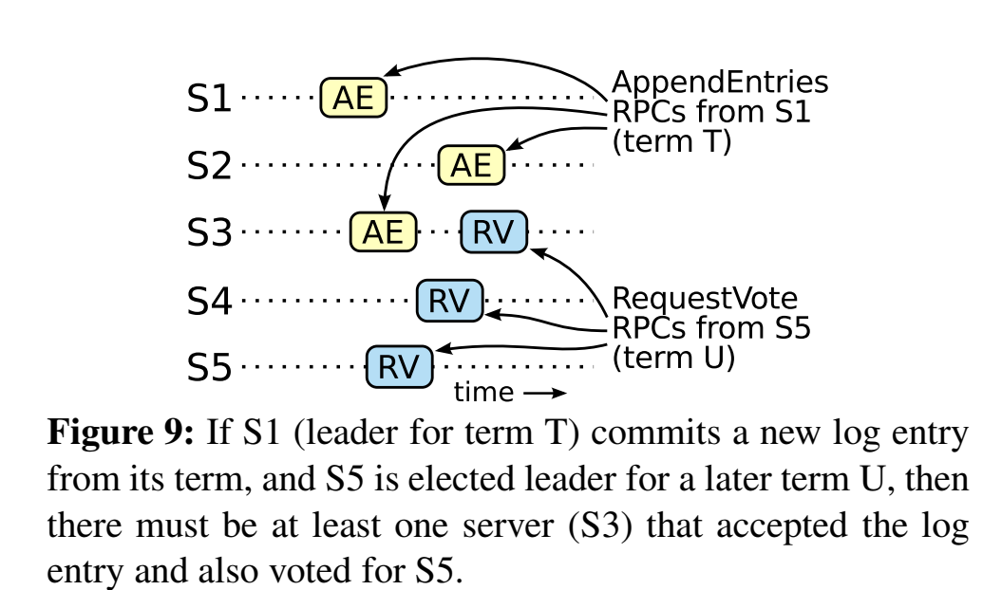
New leader will not erase committed entries

Slide 60
Election restriction (II)
Servers holding
the last committed
log entry
Servers having
elected the
new leader
Two majorities of the same cluster must intersect

Slide 61
Committing entries from previous term
A leader cannot conclude that an entry from a previous term is committed even if stored on a majority of servers.
Leader should never commits log entries from previous terms by counting replicas
Should only do it for entries from the current term
Once it has been able to do that for one entry, all prior entries are committed indirectly

Slide 62
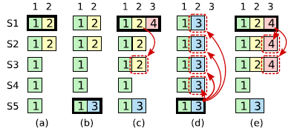
Committing entries from previous term
S1 is leader and partially replicates the log entry at index 2.

Slide 63
Committing entries from previous term
S1 crashes; S5 is elected leader for term 3 with votes from S3, S4, and itself, and accepts a different entry at log index 2.

Slide 64
Committing entries from previous term
S5 crashes; S1 restarts, is elected leader, and continues replication

Slide 65
Committing entries from previous term
S1 crashes, S5 is elected leader (with votes from S2, S3, and S4) and overwrites the entry with its own entry from term 3.

Slide 66
Committing entries from previous term
However, if S1 replicates an entry from its current term on a majority of the servers before crashing, as this entry is committed (S5 cannot win an election).

Slide 67
Explanations
In (a) S1 is leader and partially replicates the log entry at index 2.
In (b) S1 crashes; S5 is elected leader for term 3 with votes from S3, S4, and itself, and accepts a different entry at log index 2.
In (c) S5 crashes; S1 restarts, is elected leader, and continues replication.
Log entry from term 2 has been replicated on a majority of the servers, but it is not committed.

Slide 68
Explanations
If S1 crashes as in (d), S5 could be elected leader (with votes from S2, S3, and S4) and overwrite the entry with its own entry from term 3.
However, if S1 replicates an entry from its current term on a majority of the servers before crashing, as in (e), then this entry is committed (S5 cannot win an election).
At this point all preceding entries in the log are committed as well.

Slide 69
Cluster membership changes
Not possible to do an atomic switch
Changing the membership of all servers at one
Will use a two-phase approach:
Switch first to a transitional joint consensus configuration
Once the joint consensus has been committed, transition to the new configuration

Slide 70
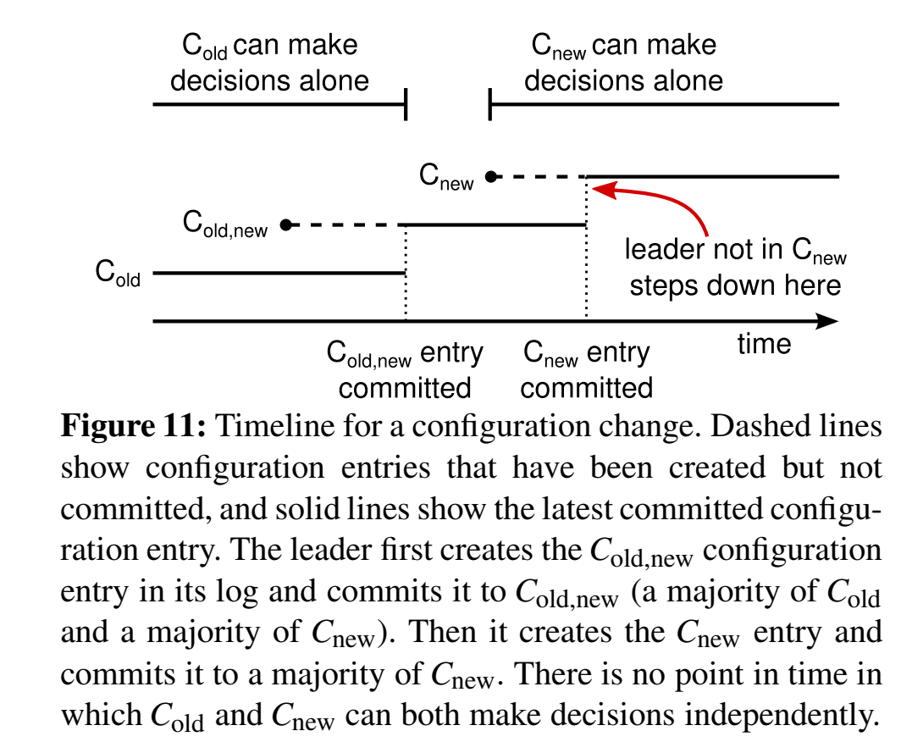
The joint consensus configuration
Log entries are transmitted to all servers, old and new
Any server can act as leader
Agreements for entry commitment and elections requires majorities from both old and new configurations
Cluster configurations are stored and replicated in special log entries

Slide 71
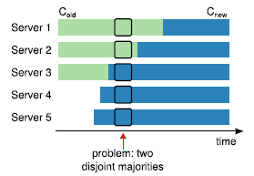
The joint consensus configuration

Slide 72
Implementations
Two thousand lines of C++ code, not including tests, comments, or blank lines.
About 25 independent third-party open source implementations in various stages of development
Some commercial implementations
Automated formal proof of correctness

Slide 73
Performance

Slide 74
Related Work
Paxos, multi Paxos and friends
And implementations such as Chubby, Spanner, ..
ZooKeeper
Viewstamped Replication
Raft has similarities with Zookeeper and VR in that they all elect a leader, and the leader ensures replication in order
But has simpler protocol for dealing with log conflicts
And simpler election protocol

Slide 75
User Studies
Show that Raft is easier to understand than Paxos
Via quiz, etc

Slide 76
Summary
Consensus key building block in distributed systems
Raft similar to Paxos
Raft arguably easier to understand than Paxos
It separates stages which reduces the algorithm state space
Provides a more detailed implementation

