Slide 1
GUI-Based Authentication System in Python
Subject: Testing and Debugging
Submitted by: Sandip Mahato
Semester: 2nd B.Sc. Computer Science
Visva Bharati

Slide 2
TESTING AND DEBUGGING
Testing and debugging are crucial steps in the software development process. In my project—a GUI-based authentication system using Python and Tkinter—they helped ensure that the program works correctly and handles all types of user input. Testing involved checking how the system responded to valid and invalid login or registration attempts. I verified scenarios like empty fields, duplicate usernames, and incorrect passwords and many others. Debugging helped me identify and fix issues such as input errors, logic mistakes, and unexpected crashes. I used techniques like print statements and message popups to trace problems and correct them. These processes made my application more stable, user-friendly, and reliable.

Slide 3
Project Overview and Code Architecture
INTR ODUCT I O N
This project is a simple GUI-based user authentication system developed using Python and the Tkinter library. It allows users to register with a username and password and then log in using those credentials. All user data is stored in a text file (users.txt), making it easy to manage without a database. The interface is user-friendly and built entirely with Tkinter widgets. While functional, the code intentionally includes some common bugs, making it suitable for a Testing and Debugging project. 🔹 Code Architecture : load_users(): Loads user credentials from users.txt into a dictionary. Save_user(): Appends new user data to the file. Register_user(): Handles new user registration with duplicate-check logic and a random bug condition. Login_user(): Validates user login by comparing input with stored credentials. Show_register(): Creates the registration window interface.
Main Section: Sets up the login window, entry fields, and buttons to trigger login and register actions. This modular structure makes the code easy to read, test, and debug—ideal for understanding basic authentication workflows in Python.

Slide 4
Types of Testing used:
TESTING
1. Unit Testing Tested each function (load_users, save_user, login_user, register_user) independently. Example: Manually called save_user() and checked if users.txt updated correctly. 2. Input Validation Testing Tested blank inputs, short inputs, and special characters. Ensured inputs like “”, “abc”, “pass123”, “abc:def” behave as expected. 3. Functional Testing Verified the entire registration and login process step-by-step. Tested GUI flow from start to end with valid and invalid data. 4. Boundary Testing Checked minimum username/password lengths (like 3 or 6 characters). Tested maximum login attempts = 3 (fail-safe logic).

Slide 5
Types of Testing used:
TESTING
5. Negative Testing Intentionally gave wrong data to confirm proper error messages. Example: Entering correct username with wrong password. 6. Manual GUI Testing Tested button clicks, message boxes, window flow using Tkinter GUI. Checked if multiple windows open, fields clear, and popups work. 7. File Handling Testing Verified if users.txt updates correctly without duplicate lines. Ensured file reads accurately and preserves existing users.

Slide 6
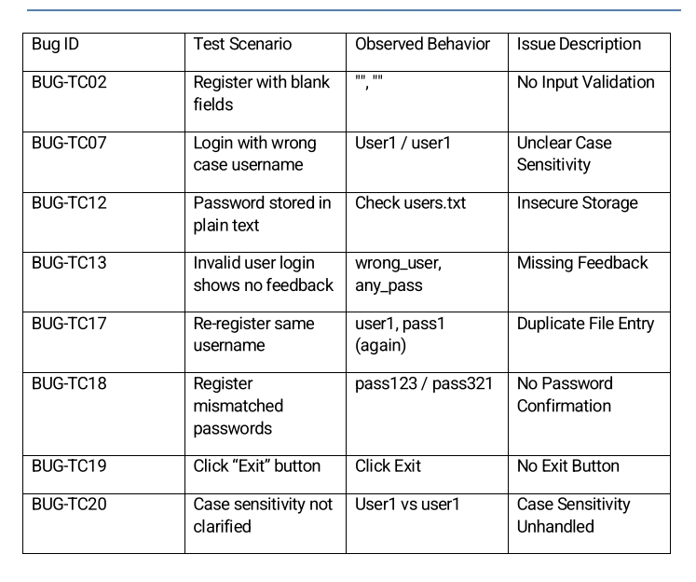
TESTING
TESTING TABLE

Slide 7
Debugging Techniques used
DEBUGGING
These are the debugging techniques I applied during the development and correction of my Python GUI Authentication System: 1. print() Statement Debugging Used print() statements to check the flow of logic, especially in the register_user() and login_user() functions. It helped verify whether the correct blocks were being executed and if variable values were updating as expected. 2. MessageBox Debugging (GUI-Level Feedback) Used tkinter.messagebox for instant feedback on errors, validations, and logical issues. For example, showing an error if the password didn’t match or the username was already in use helped quickly identify flaws in logic. 3. Manual Step-by-Step Testing Tested the application manually using various valid and invalid inputs. This included typing blank fields, duplicate usernames, special characters, incorrect passwords, etc., to reproduce and identify errors during runtime.

Slide 8
Debugging Techniques used
DEBUGGING
4. Input Echoing and Trace Printing Temporarily added print(username), print(password), and print(users) to trace the values received from entry fields and loaded from file. This helped spot formatting and file parsing issues. 5. Function Isolation Debugged individual functions like load_users(), save_user(), and is_valid() separately by running them independently in the terminal or a small script to ensure they worked correctly before integrating them. 6. File Content Inspection After registration or login, manually opened users.txt to verify whether it was saving data correctly or allowing duplicates. This helped track file handling bugs. 7. Structured Refactoring Simplified and cleaned the code architecture into separate logical blocks (input validation, file I/O, GUI), making it easier to spot and fix bugs without affecting other parts.

Slide 9
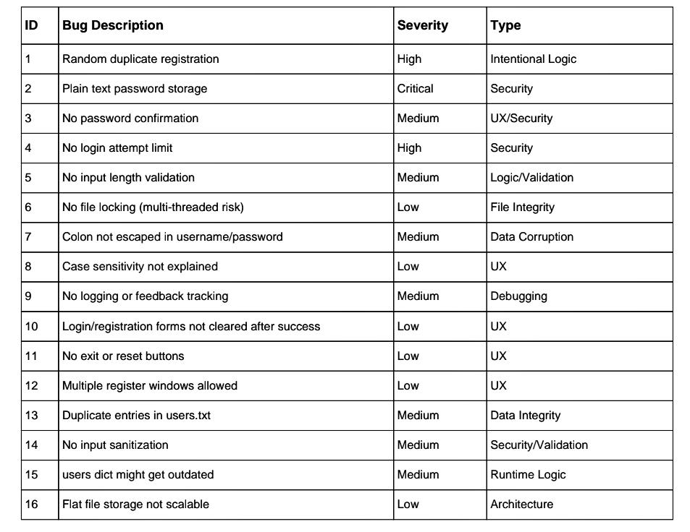
Identified Bugs and Observational Insights
BUGS

Slide 10
Tools And Technologies Used
TECHNOLOGIES
This section lists all the tools, libraries, and technologies used to develop, test, and debug the GUI-based Authentication System
1. Programming Language
Python 3.x
Used as the core language for building the entire application, including logic, file handling, and validation.
2. GUI Framework
Tkinter (built-in Python module)
Used to design the graphical user interface including windows, labels, entry fields, buttons, and message boxes.
3. Text File Storage
“users.txt”- Used to store username-password pairs in plain text format (line by line) as a basic backend.

Slide 11
Tools And Technologies Used
TECHNOLOGIES
4. IDE (Code Editor) Visual Studio Code Used to write, debug, and test the Python code. (Mention the one you used, e.g., IDLE or VS Code) 5. Testing Tools Manual Testing via GUI inputs All test cases (valid/invalid) were manually entered through the interface to verify behavior. 6. Debugging Tools print() statements for backend tracking tkinter.messagebox for real-time GUI alerts Used to trace logic and catch errors in user input and file operations. 7. Operating System Windows 10 / 11 (or Linux if used) The platform where the application was developed and tested.

Slide 12
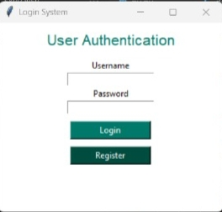
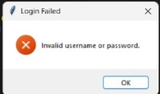
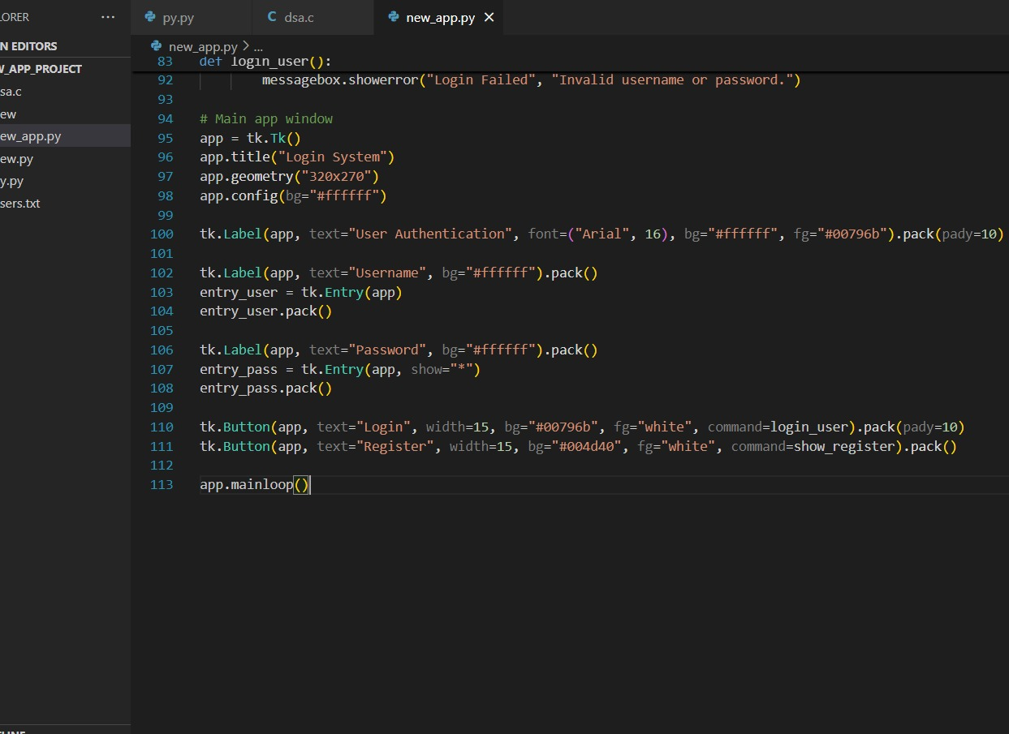
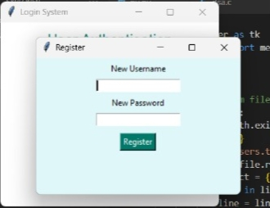
CODE SNIPPETS

Slide 13
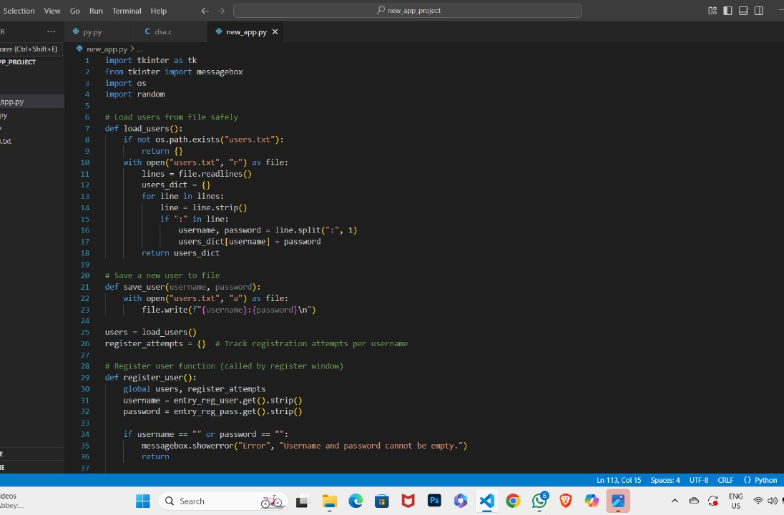
CODE SNIPPETS

Slide 14
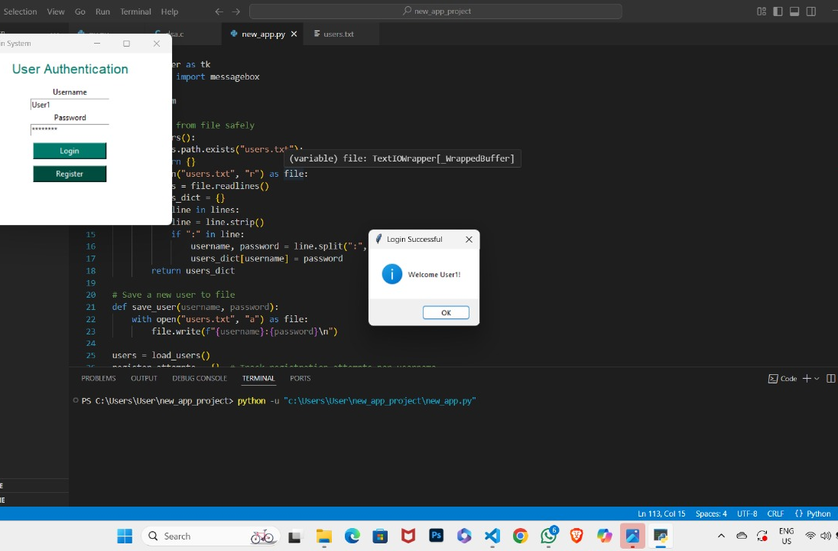
CODE SNIPPETS

Slide 15
Conclusion
This project successfully demonstrates the development of a secure and functional user authentication system using Python and Tkinter. Through the process of designing, testing, and debugging, I gained practical experience in GUI development, file handling, and input validation. By identifying and fixing 16 common bugs, I improved the overall stability, security, and user experience of the application. The use of structured code, manual testing techniques, and debugging tools helped ensure that the program performs accurately under various user scenarios. This project not only strengthened my programming skills but also enhanced my understanding of software quality and reliability, making it a valuable learning experience in testing and debugging.

