Slide 1

WALMART APPLICATION

Slide 2
Outline
Problem Statement
Objective
Microservices
Project Overview
Architecture
Application Flow
Technology and Tools used
Conclusion

Slide 3
Problem Statement
Mr.Sharma is organizing a party in his house, for which he needs to buy a lot of goods. He wanted to check the prices of the goods in Walmart. So, he needs help in finding the prices and keep track of them.

Slide 4
Objective
Create an application which can search in products in Walmart and also keep an eye on its prices.
A user should be able to search for a product on home page but only logged in users can keep the products in watch list for prices.

Slide 5
Microservices
Authentication API
Recommendation API
Favourite API

Slide 6
Onboarding Architecture
Post request
Login/Register
Product type
MYSQL
Token
generated
Payment type
Get/Delete
MYSQL
Post/Get/Delete
Frontend
Angular
Get
Get
Recommendations API
MYSQL
Get
Get
Search product
External API

Slide 7
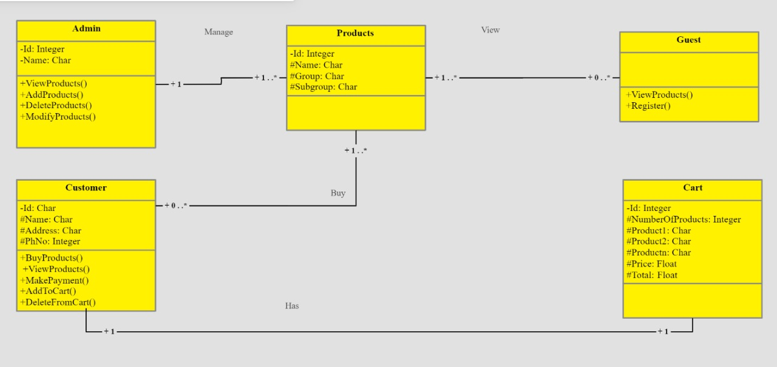
Project Overview

Slide 8
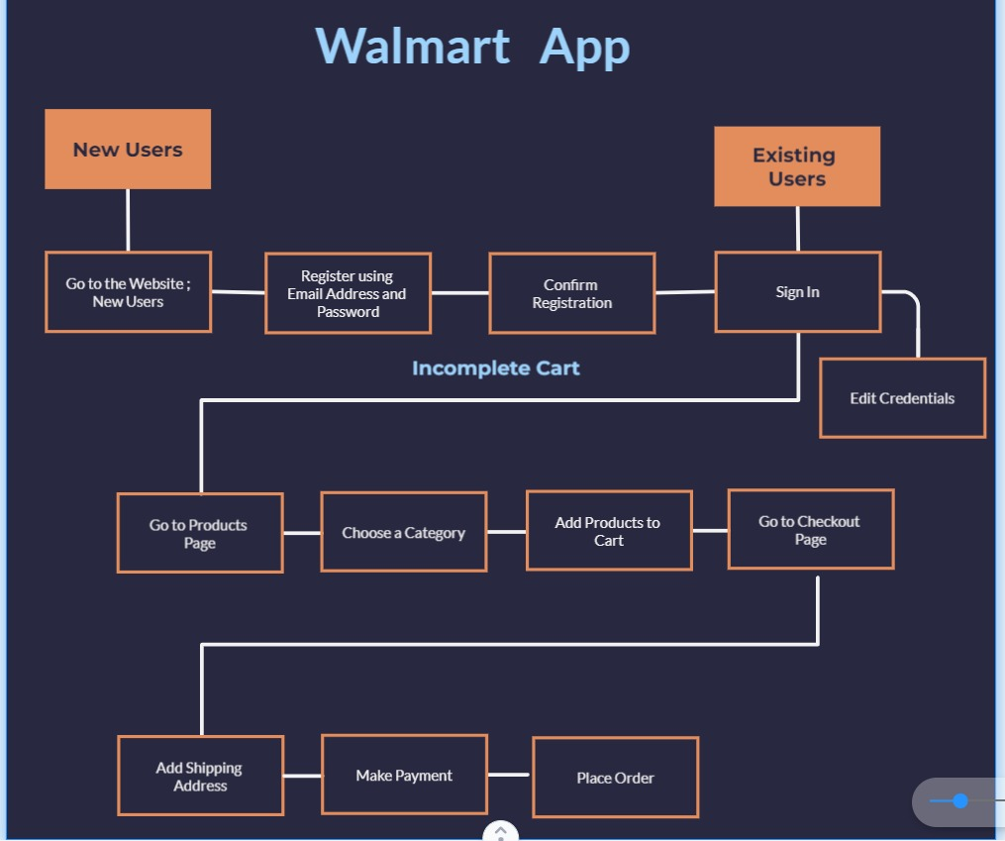
Project Flow

Slide 9
Technology and Tools used
Gitlab
Spring Boot
Angular
MongoDB/ MySQL
Junit

Slide 10
Conclusion
This interface will be available for the general public use through the web interface.
Users can search for the products available in the home page.
Only registered users could be able to keep track of the prices of the products.
Searching of the product can be done by following ways: 1. By product 2. By keyword 3. Upcoming products

Slide 11
THANK YOU

