Slide 1

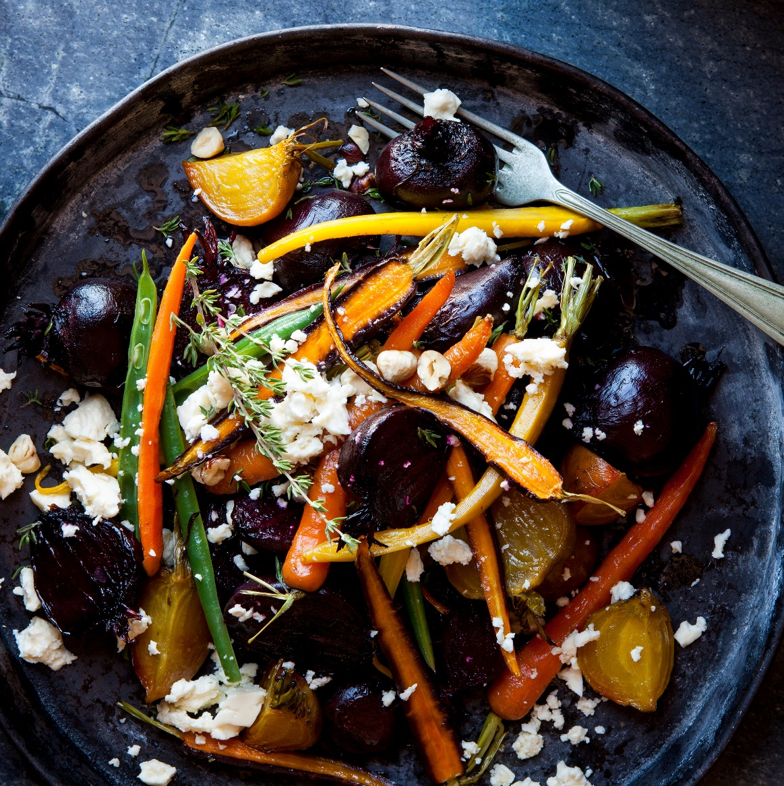
Online Food Delivery System
Group – 1
Project - 5

Slide 2
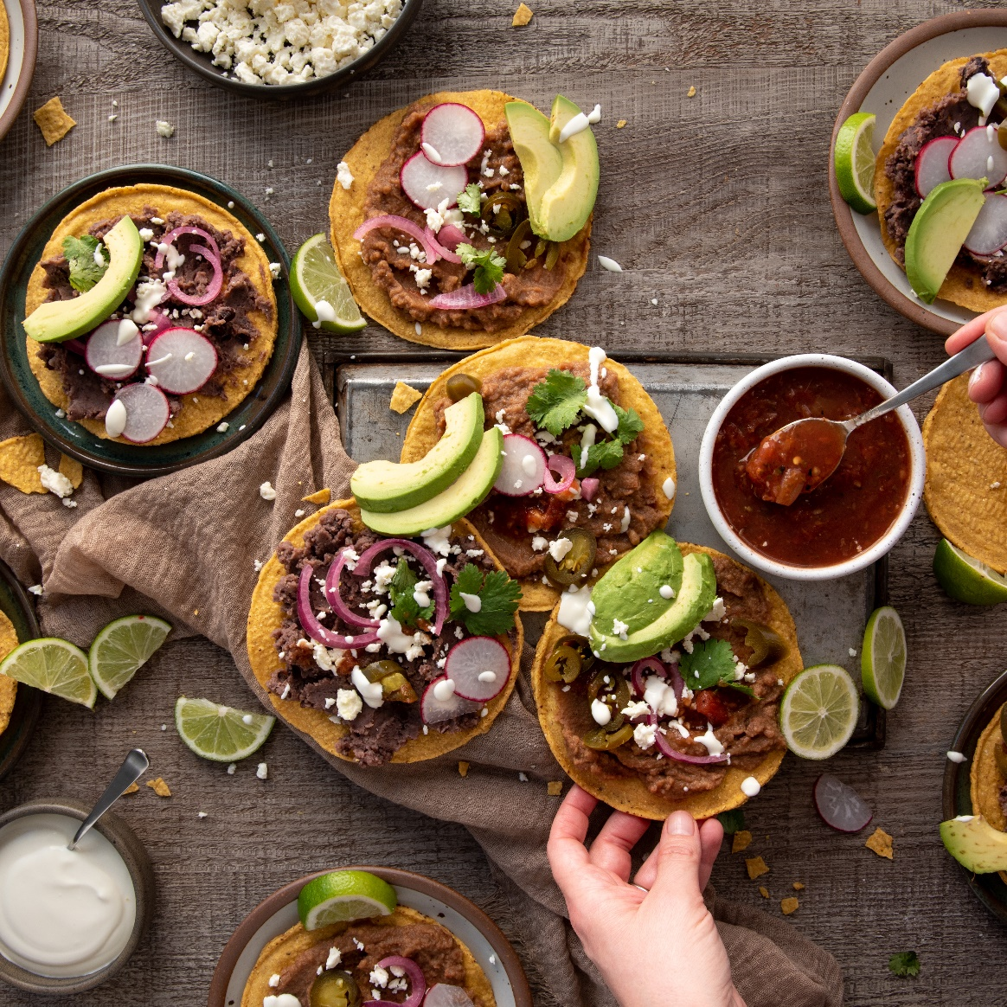
TEAM MEMBERS
Deepak Kumar – 2603968
Dharani Timmanna Komar – 2605910
Bhogaraju Sai Bharadwaj – 2604138
Bavasree C – 2603976
Aswin Jaya Surya – 2605068
Aishwarya X – 2605098
Aniket Singh - 2605511

Slide 3

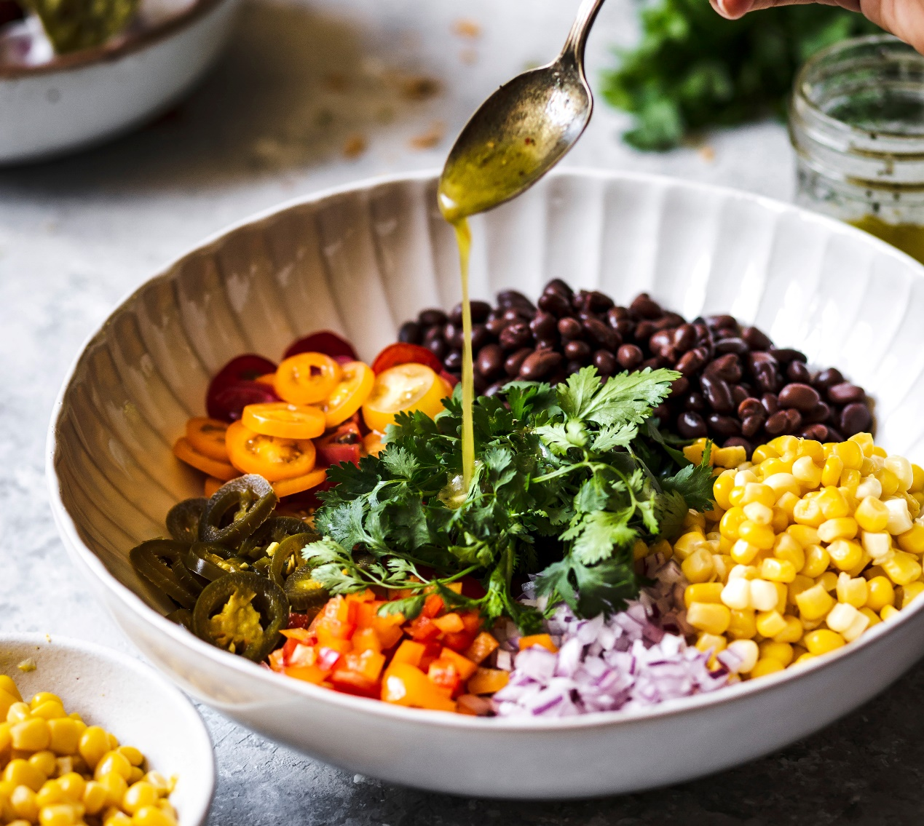
Table of Contents
Problem Statement
Objectives
Introduction
Technologies Stack
Strategy
ER Diagram
Module Functionality
Abstract Modules
Future Enhancement
Pros & Cons
Conclusion

Slide 4
Problem Statement
Foodbox, a restaurant chain established in 2014, has experienced a decline in sales since 2016 due to increasing competition from online food delivery services like Swiggy and Foodpanda.
These competitors have successfully streamlined their operations by eliminating middlemen, which has allowed them to offer better pricing and convenience to customers.
To remain competitive and recapture market share, Foodbox needs to develop a robust online food delivery web application that provides a user-friendly experience, facilitates secure transactions, and maintains comprehensive records of products and categories.

Slide 5
Objectives
Develop a Bug-Free System: Create a reliable online food delivery platform that minimizes errors and ensures a seamless experience for both users and administrators.
Maintain Product and Category Records: Establish a system for efficiently managing and updating records of products and categories available for order, ensuring accurate and up-to-date information for users.
Enhance User Experience: Design an intuitive interface that simplifies the ordering process, making it easy for customers to navigate the menu and place orders.
Facilitate Administrative Management: Create an admin dashboard that allows for easy management of products, categories, and order processing.
Enable Scalability: Design the application to accommodate future growth, allowing for an increasing number of users and expanding menu options.

Slide 6

About the restaurant
FOODBOX
At Foodbox, we blend culinary excellence with the ease of enjoying exceptional meals from home.
Our commitment to high-quality ingredients and masterful preparation shines through in every dish, bringing the elegance of our restaurant directly to you.
Whether you're celebrating a special occasion or simply enjoying a delightful meal, our dedication to impeccable flavors and attention to detail ensures a truly memorable culinary experience right at your doorstep.

Slide 7
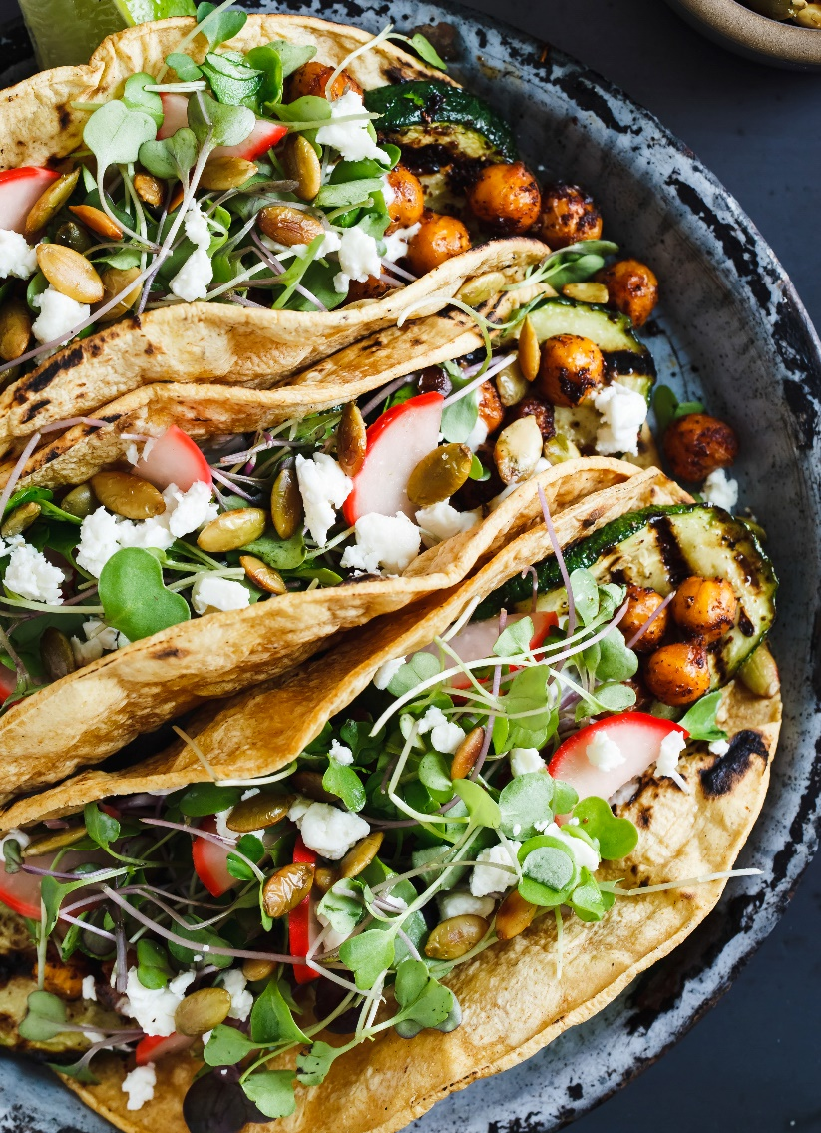
Technology Stack
Front-End : HTML , CSS , Angular
Back-end : SpringBoot , Hibernate
Server : Tomcat
Testing : Postman
Database : MYSQL
Version Control : Git
Editors : STS , VsCode

Slide 8

STRATEGY
Improved User Experience :
Responsive Design
Engaging Sections
Accessible Assistance
Admin Portal :
Efficient management
Streamlined Control
Responsive Query Handling
User Interaction :
Query Assistance
Secure Access Control
Interactive Experience
Key Initiatives :
User-friendly Registrations
Customized Orders
Smooth payment process

Slide 9
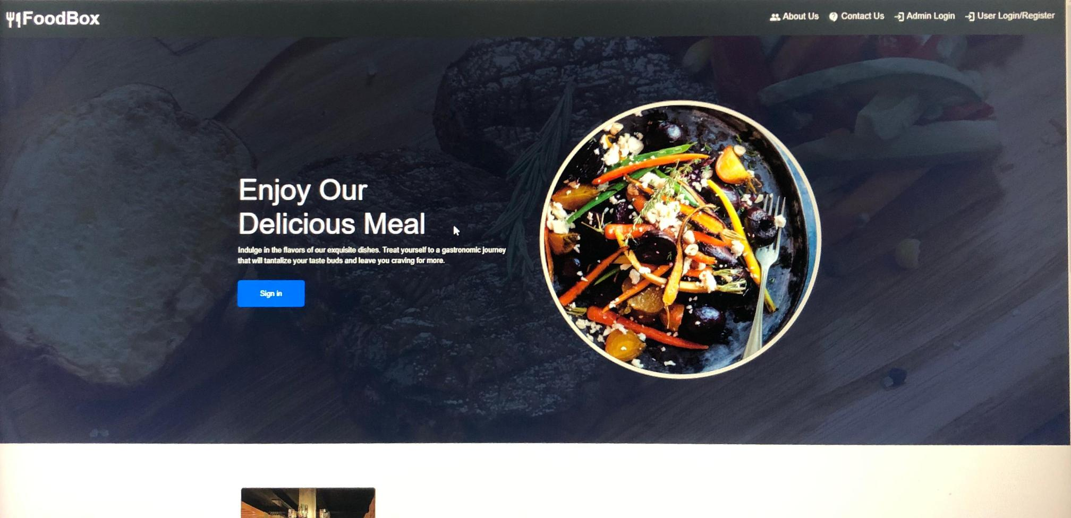

Slide 10
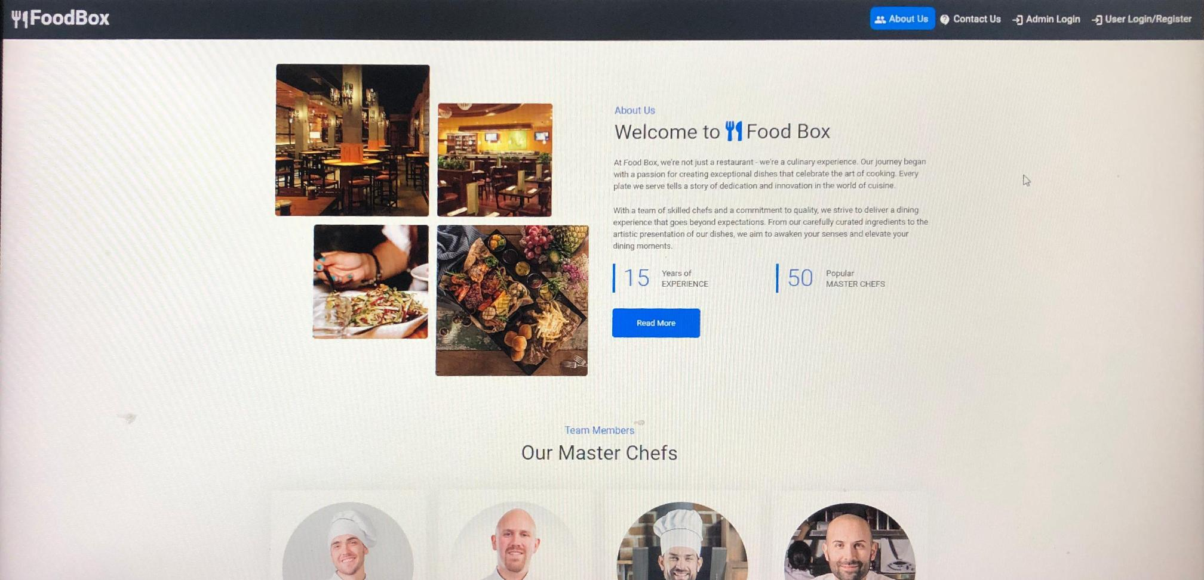

Slide 11
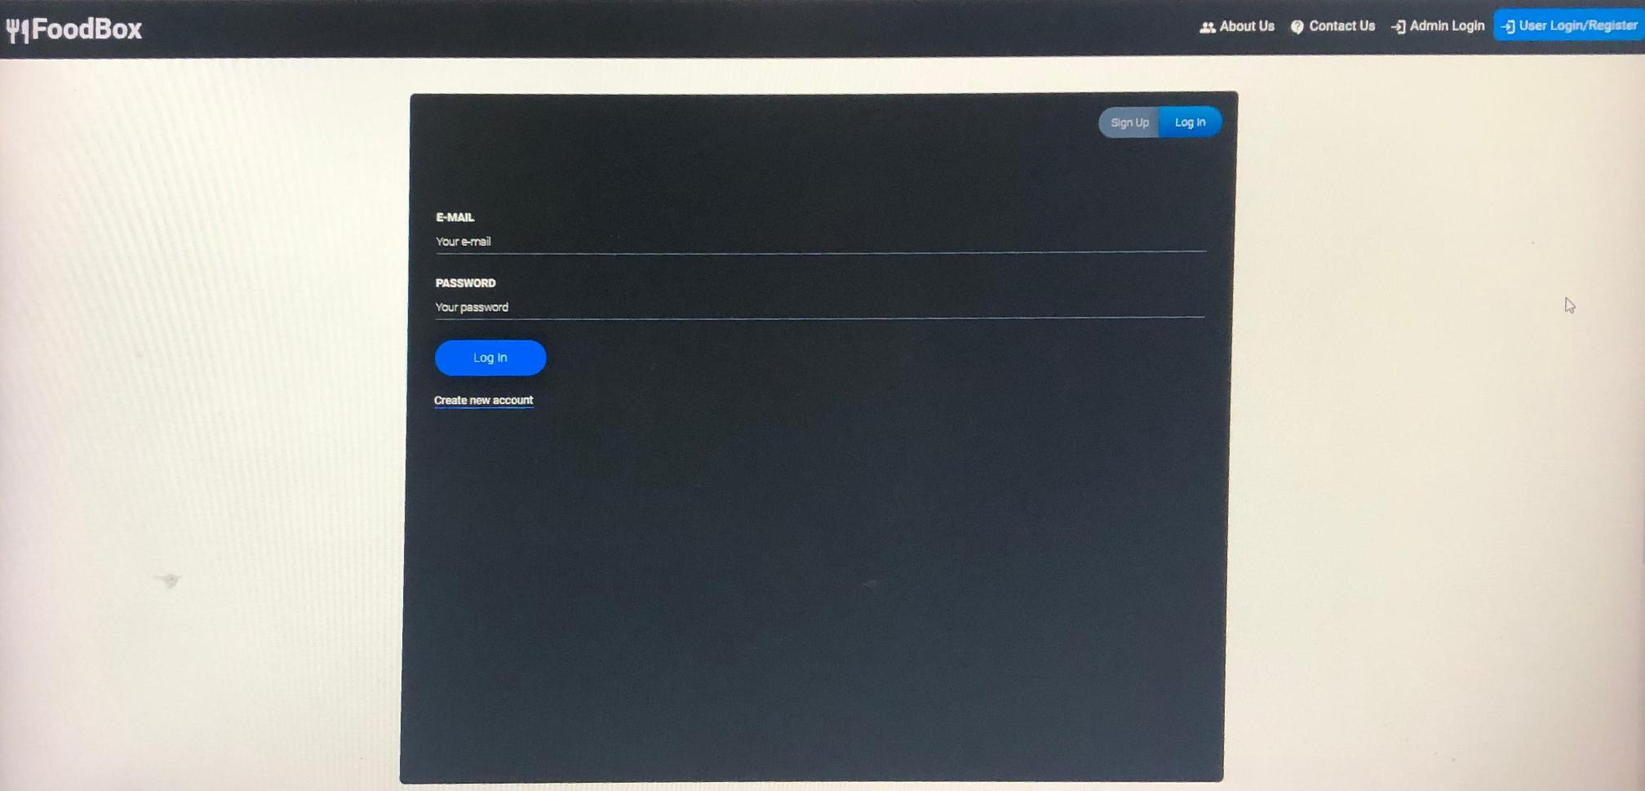

Slide 12
Order
Orderid,
Userid,
Name,
Email,
Contact,
Amount,
Address,
City,
State,
Zip,
PaymentMethod,
PaymentId,
OrderDate
ER DIAGRAM
ContactForm
ContactFormId,
Name,
E-mail,
Subject,
Message
Review
ReviewId,
ReviewName,
ReviewComment,
ReviewStar
DATA
DATA
Admin
AdminId,
Name,
E-mail,
EmployeeId,
Password
User
UserId,
Name,
E-mail,
MobileNumber,
Password
DATA
DATA
Category
CategoryId,
Name
FoodItem
FoodItemId,
CategoryId
Name,
Description,
ActualPrice,
Offer,
ImagePath,
AvailableQuantity,
Enabled
CartItem
CartItemId,
UserId,
FoodItemId
Quantity,
TotalFoodItemCost
DATA
DATA

Slide 13
Module Functionality
FRONTEND (UI)
http://localhost:4200/
(Angular HTML, CSS, .ts, spec.ts)
BACKEND
http://localhost:8084/
(SpringBoot pojo, controllers, Service, Repo)
DATABASE
http://localhost:3306/
(Application Properties
Hibernate Connection
MySql)
Response to UI

Slide 14
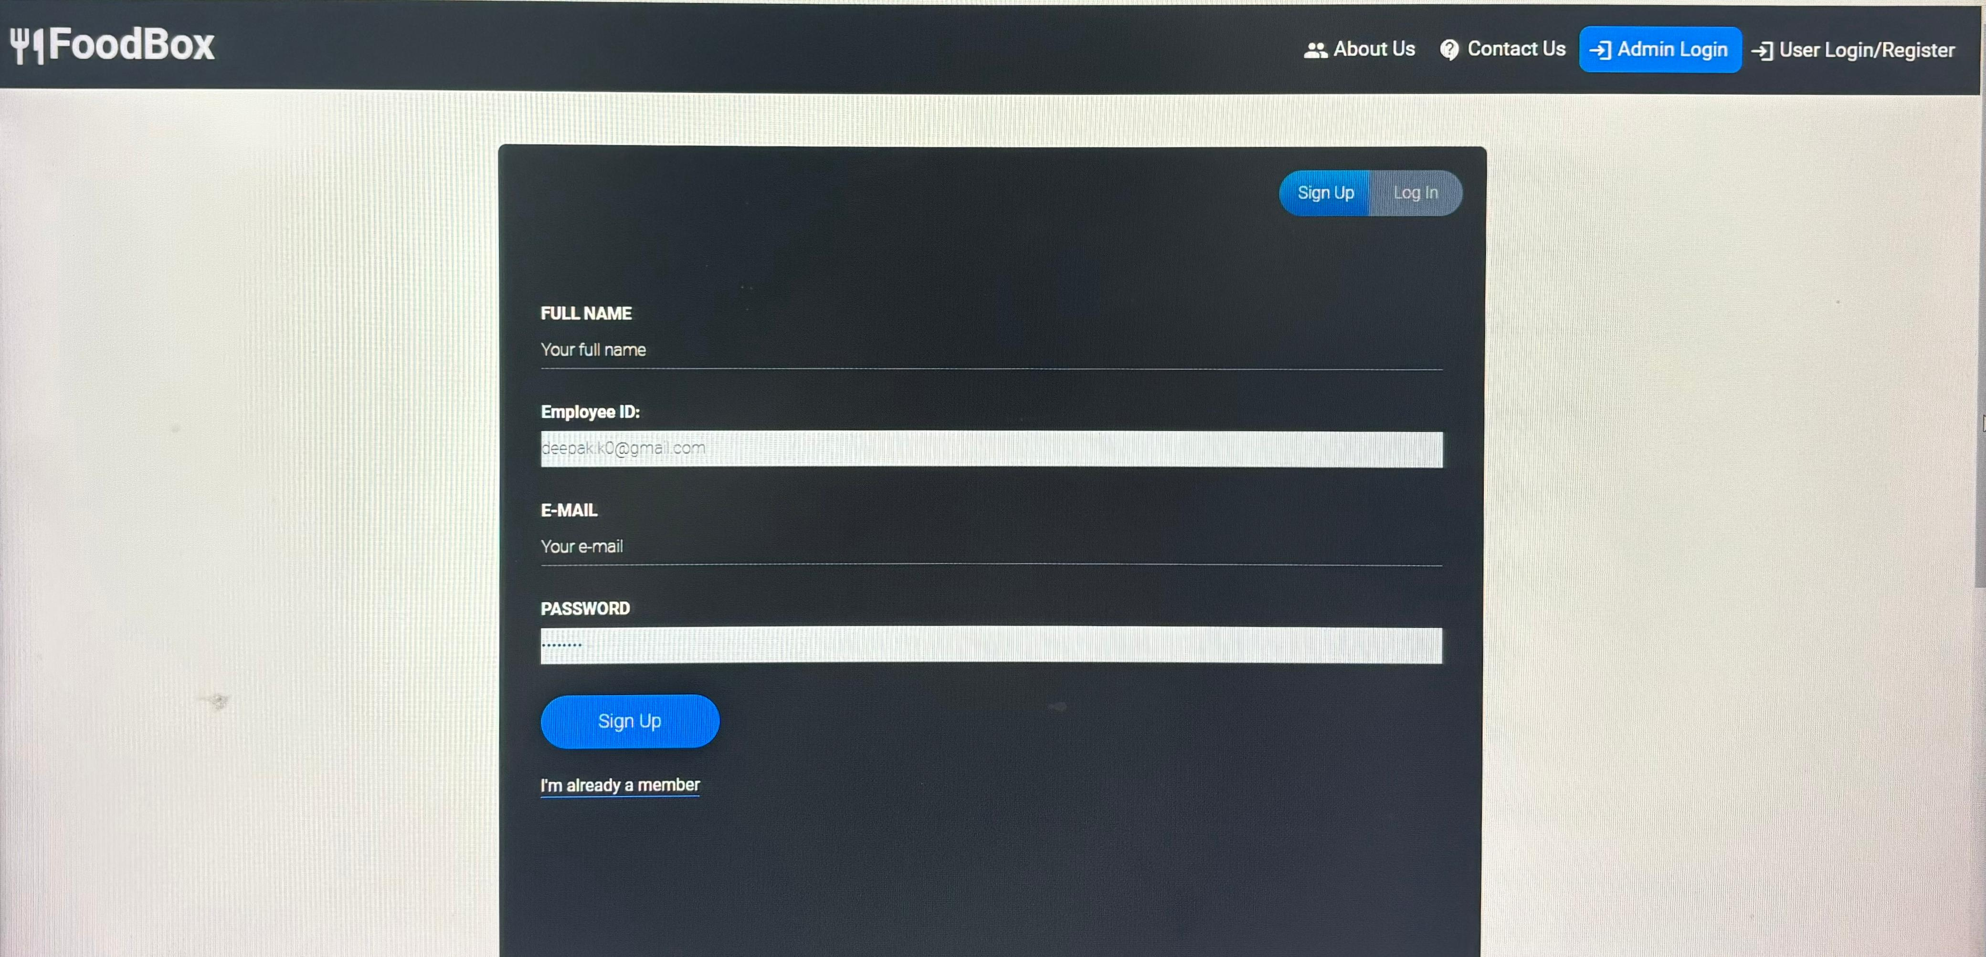
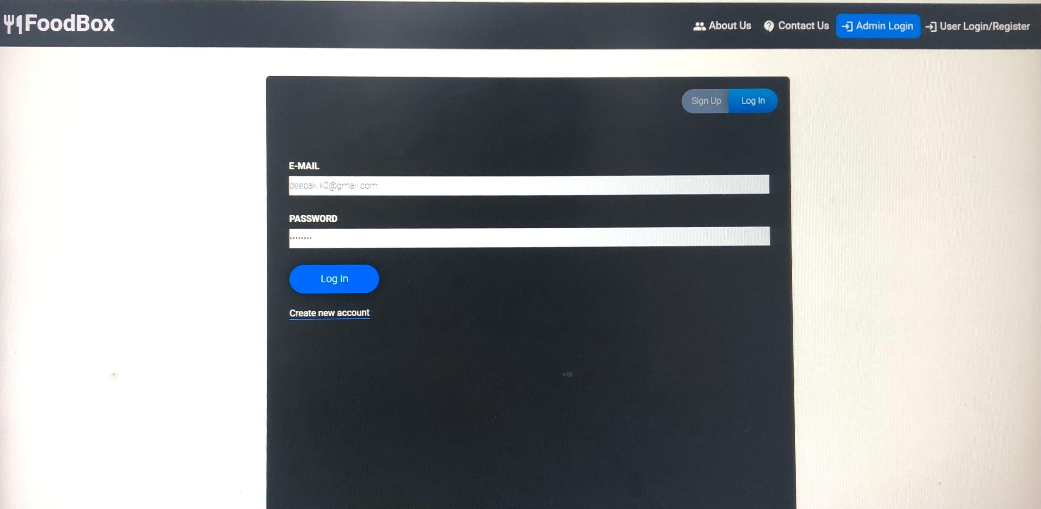
Admin Module
Create Admin Account
Login to portal​
​Add or remove cuisines to or from the application to build a rich product line​
Edit food item details like name, price, cuisine, description
Enable or disable food items​
View Queries
View Reviews

Slide 15
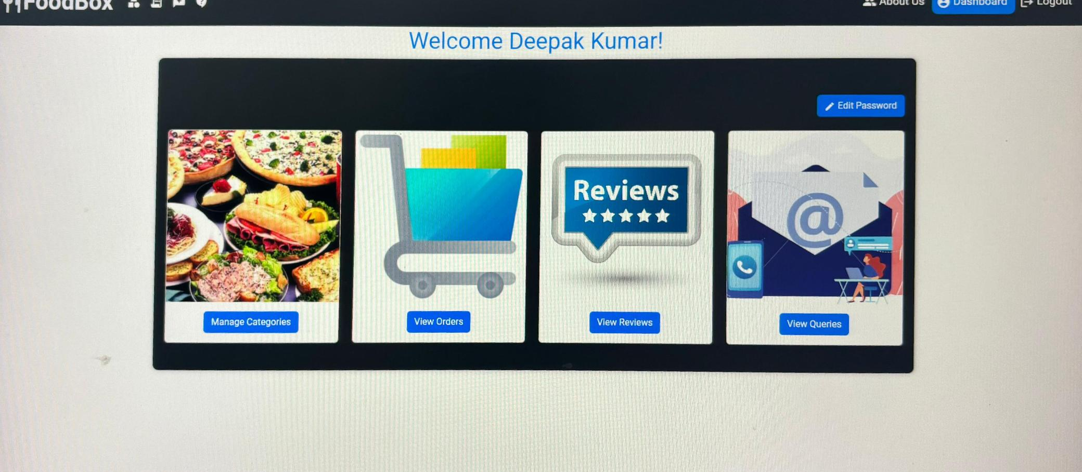

Slide 16
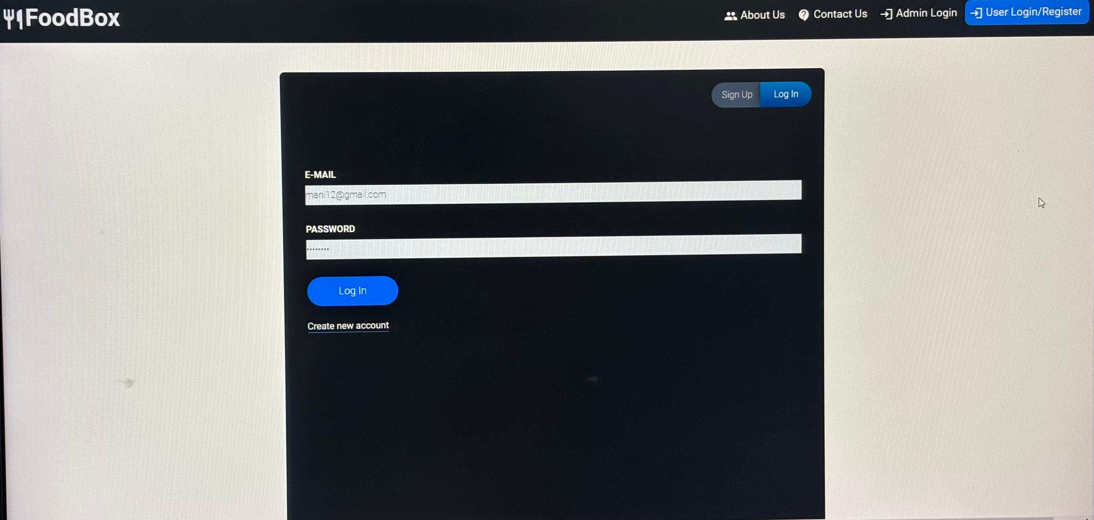
User Module
Create Login Account
Login to portal​​
Choose the food items and add them to your cart
User can choose the payment option
Password Management
Give Queries
Give Reviews

Slide 17
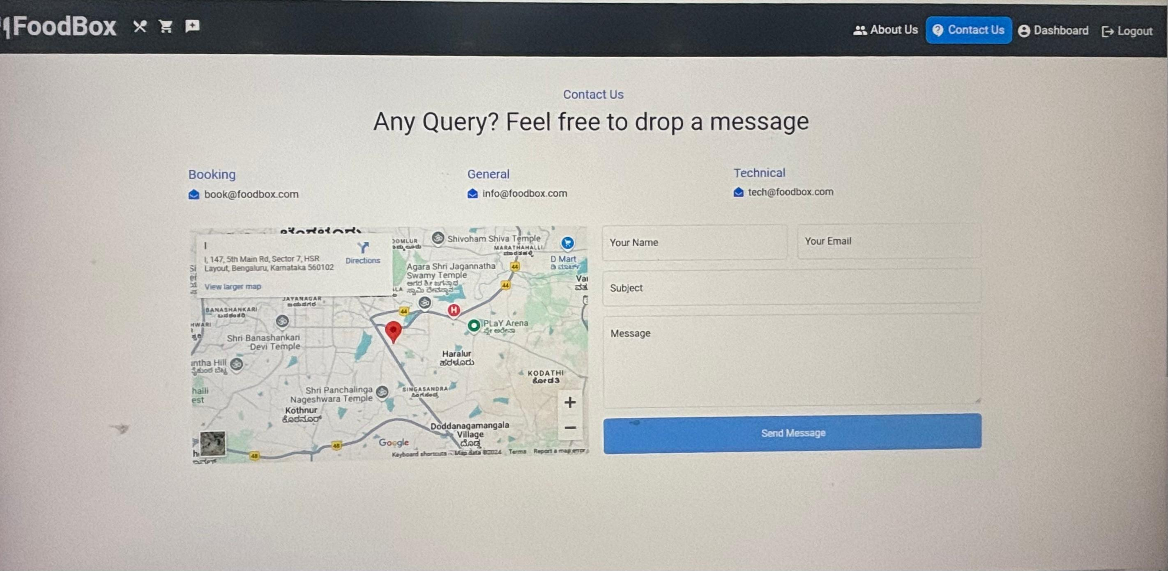
Contact Form Module
Connects with customer support channels for further assistance.
Use to submit the query from the customers
Follow up on customer inquiries to ensure their issues are resolved satisfactorily
Provide easily accessible phone numbers, email addresses, and mailing addresses.

Slide 18
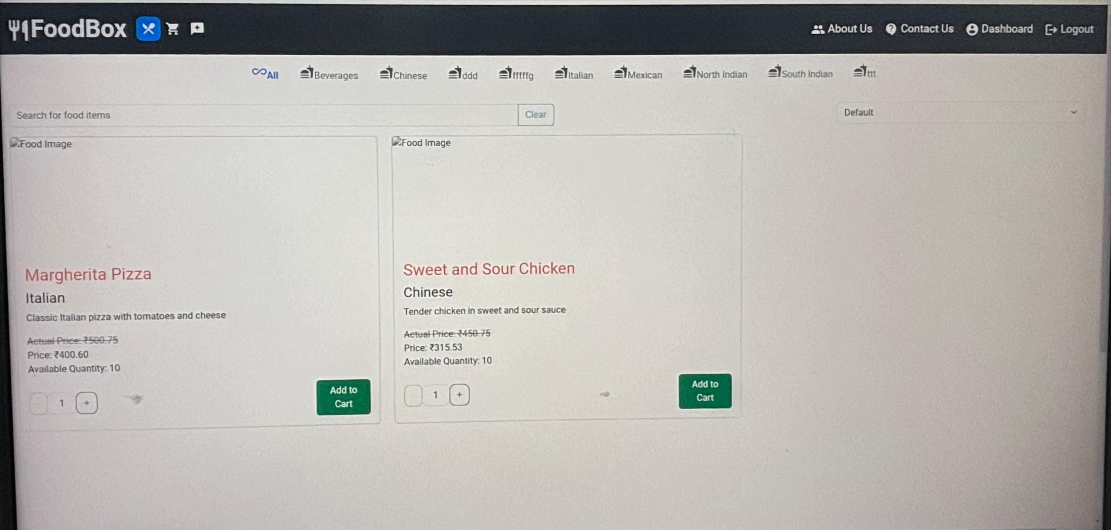
Food Item Module
Present food items in an attractive and visually appealing manner to entice customers.
Keep the food item database up-to-date with new offerings and changes
Allow users to quickly find food items based on name, category, price, or availability.
Showcase food items with visually appealing images that accurately represent their appearance.
Seamlessly integrate with the cart, order, and payment modules for a smooth user experience.

Slide 19
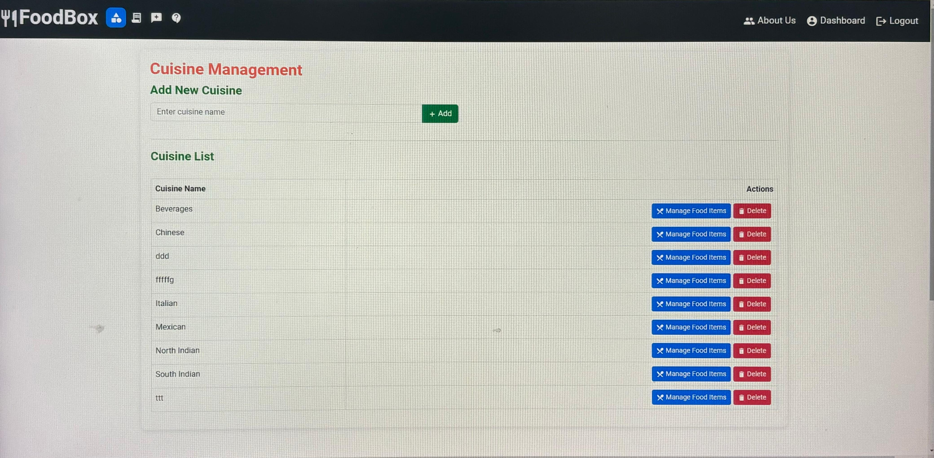
Category Module
Integrate the category module with the food item and menu modules for seamless functionality.
Allow users to search for food items based on category or cuisine.
Allow users to filter food items based on both categories and cuisines.
Allow administrators to add, edit, and delete cuisines.
Organize categories and cuisines in a logical and easy-to-navigate manner.

Slide 20
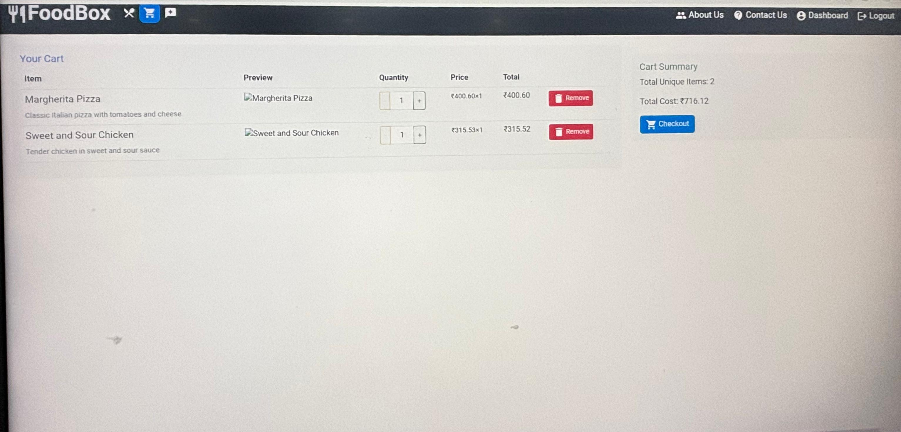
Cart Module
Allows users to add or remove food items from their shopping cart.
Automatically calculates the total price based on the selected items and quantities.
Allows users to save their cart for future purchases.
Facilitates the payment process by connecting to a payment gateway.
Prioritize a smooth and intuitive user experience when interacting with the cart.

Slide 21
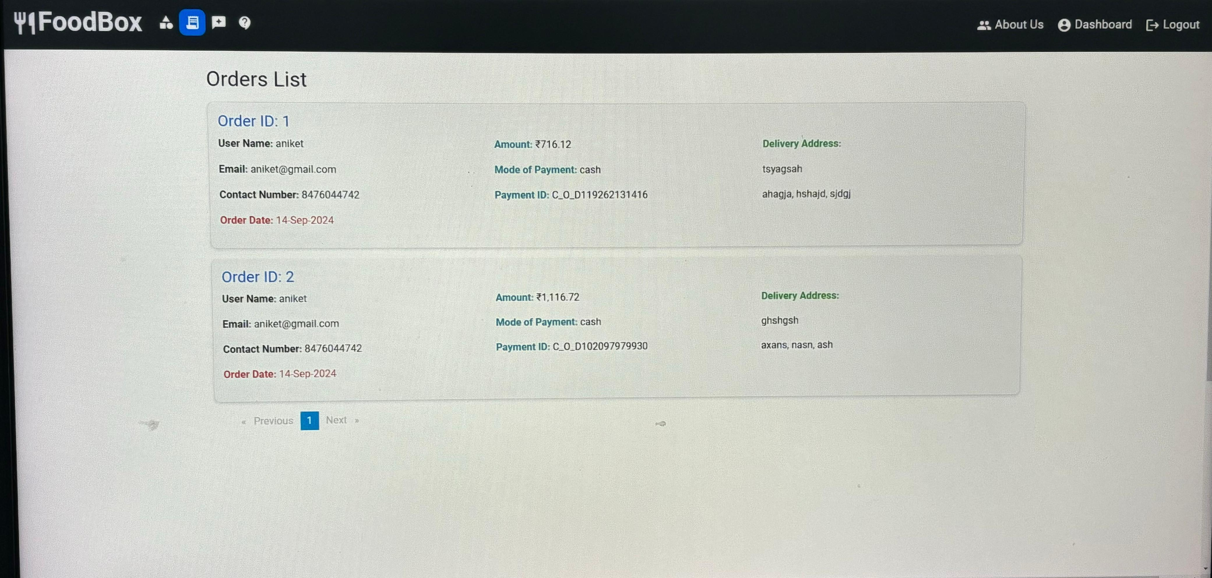
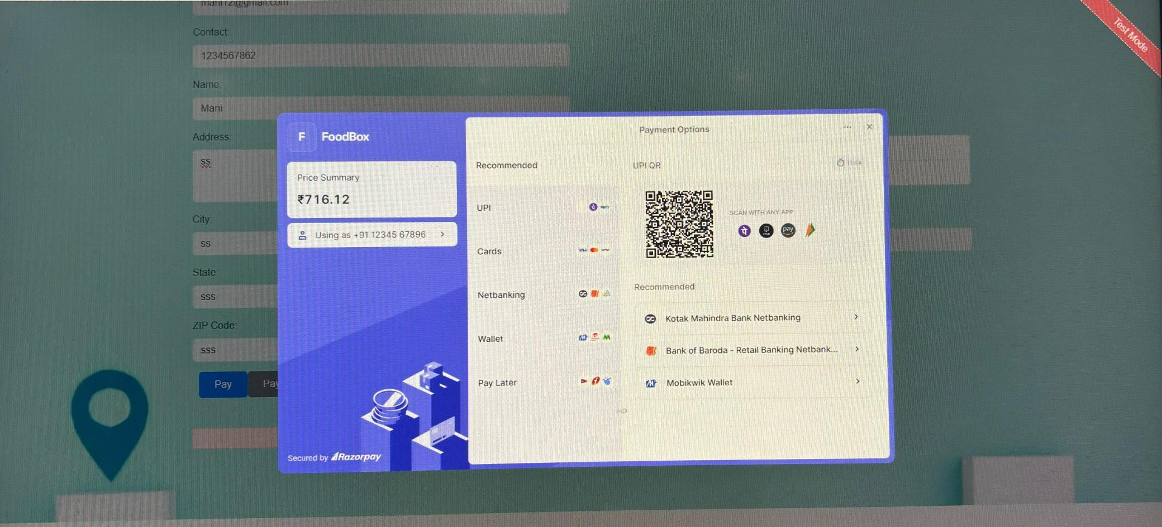
Order Module
Allows users to place orders based on their selected items and quantities.
Generates unique order IDs and stores order details in the database.
Integrates with the payment gateway to process payments.
Displays a clear summary of the order, including items, quantities, prices, and total.
Provides a secure interface for entering payment details.

Slide 22
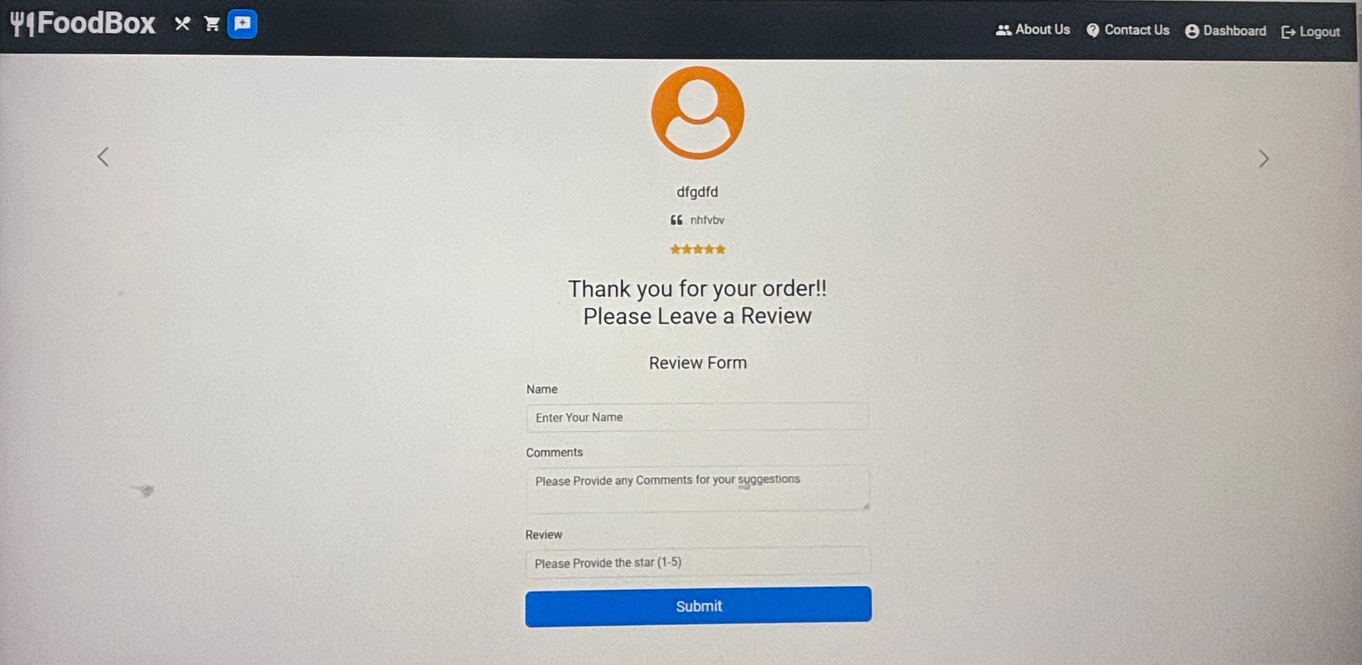
Review Module
Allows users to submit reviews and ratings for food items
A clear and easy-to-use form for submitting reviews, including fields for rating, text review, and optional personal information
Stores reviews in a database, including user information, rating, and text content

Slide 23

Future Enhancements
AI Chatbot Support
Real-time Order Tracking
Subscription Services
Advanced Analytics Dashboard for Admins
Mobile Application Development
Advanced Personalization

Slide 24
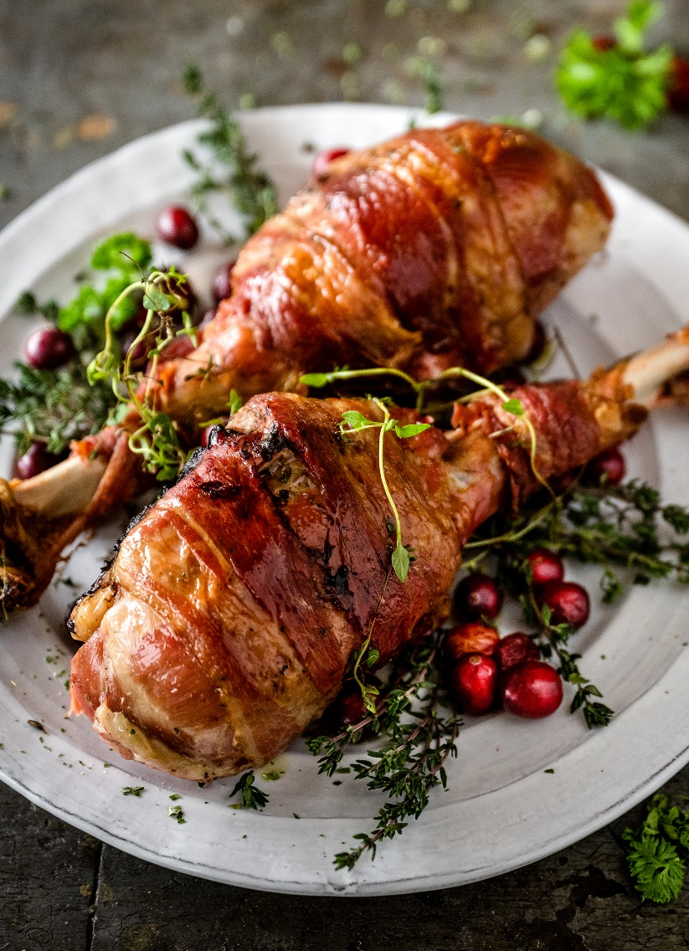
Pros
Convenience
Time – Saving
Accessibility
Special Discounts and Offers
Data Management
Cons
Development Time and Cost
Dependency on Technology
Maintenance and Updates
Quality Concerns
Internet Dependency

Slide 25
Conclusion
Responsive and Fast: Built with Angular and Spring Boot, the FoodBox app ensures a quick and seamless experience for both users and staff.
Comprehensive Management: Our admin tool efficiently handles everything from orders and reviews to food and cuisines, ensuring smooth operations.
Advanced Technology Stack: We leverage technologies like Spring Boot, Hibernate, Angular, HTML, CSS, Bootstrap, and MySQL to create a robust, attractive, and secure application.
User-Centric Design: Our intuitive interface makes it easy for you to navigate and find your favorite meals in no time.
Reliable Performance: With a focus on stability and security, FoodBox guarantees a trustworthy and enjoyable experience every time you use our app

Slide 26
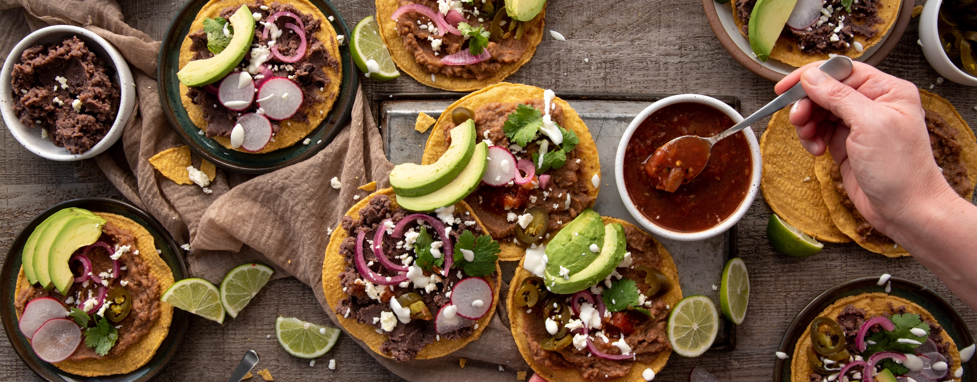
Thank You
Bon appétit

