Slide 1

Introduction to AWS
Amazon Web services

Slide 2
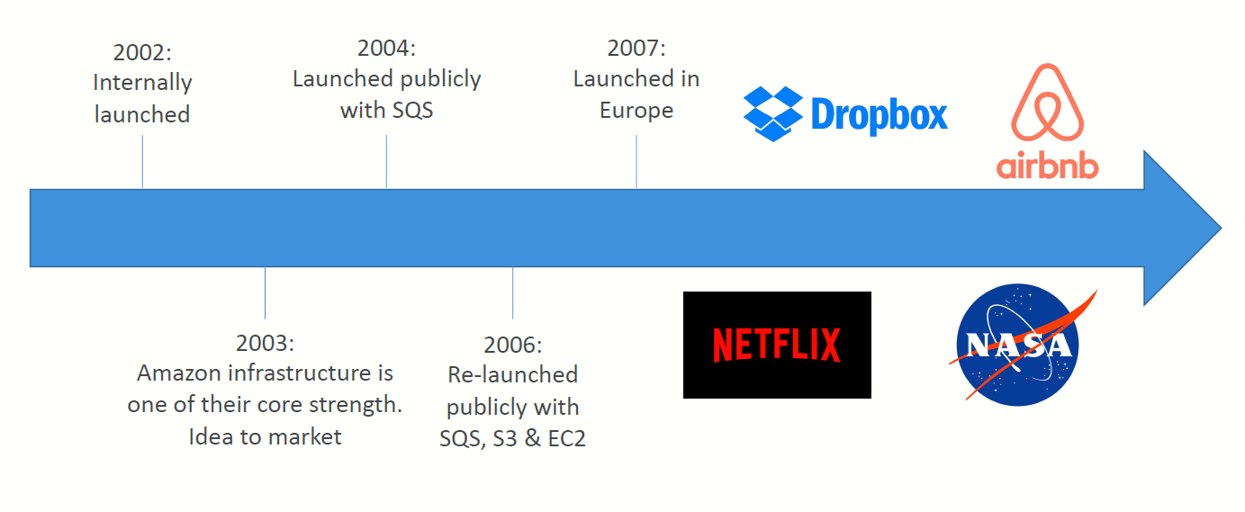
AWS Cloud History

Slide 3
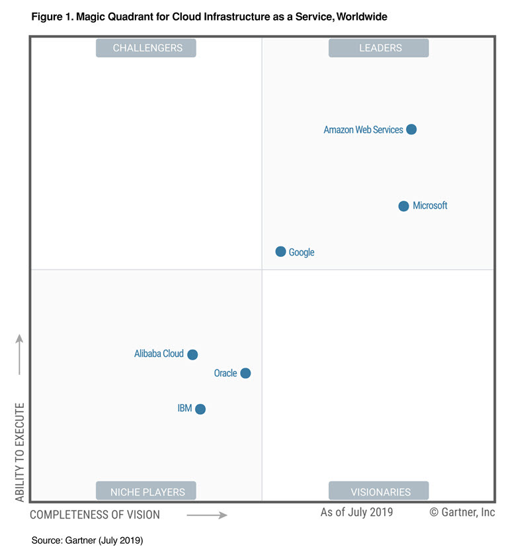
AWS Cloud Number Facts
In 2019, AWS had $35.02 billion in annual revenue
AWS accounts for 47% of the market in 2019 (Microsoft is 2nd with 22%)
Pioneer and Leader of the AWS Cloud Market for the 9th consecutive year
Over 1,000,000 active users

Slide 4

AWS Cloud Use Cases
AWS enables you to build sophisticated, scalable applications
Applicable to a diverse set of industries
Use cases include
Enterprise IT, Backup & Storage, Big Data analytics
Website hosting, Mobile & Social Apps
Gaming

Slide 5
AWS Regions
AWS has Regions all around the world
Names can be us-east-1, eu-west-3…
A region is a cluster of data centers
Most AWS services are region-scoped

Slide 6
How to choose an AWS Region?
Compliance with data governance and legal requirements
Data never leaves a region without your explicit permission
Proximity to customers
Reduced latency
Available services within a Region
New services and new features aren’t available in every Region
Pricing
Pricing varies region to region and is transparent in the service pricing page

Slide 7
AWS Availability Zones
Each region has many availability zones (usually 3, min is 2, max is 6). Example:
ap-southeast-2a
ap-southeast-2b
ap-southeast-2c
Each availability zone (AZ) is one or more discrete data centers with redundant power, networking, and connectivity
They’re separate from each other, so that they’re isolated from disasters
They’re connected with high bandwidth, ultra-low latency networking

Slide 8
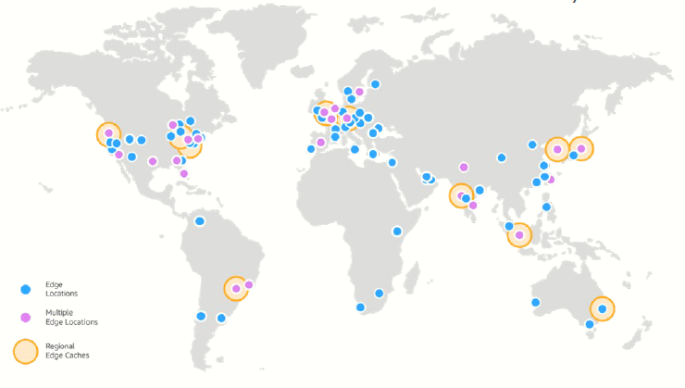
AWS Points of Presence (Edge Locations)
Amazon has 216 Points of Presence (205 Edge Locations & 11 Regional Caches) in 84 cities across 42 countries
Content is delivered to end users with lower latency

Slide 9
AWS Well-Architected Framework
The AWS Well-Architected Framework is a set of best practices that guide you in building resilient and agile applications on the cloud.
Well-Architected design principles
These design principles guide where and how to implement the Well-Architected Framework for cloud-based applications:
Use only as much capacity as your workload requires
Test workloads and applications at a production-scale before deploying them to production.
Create an architecture that evolves
Take advantage of automation to simplify testing
Create data-driven architecture
Schedule live-event simulations to help improve infrastructure

Slide 10
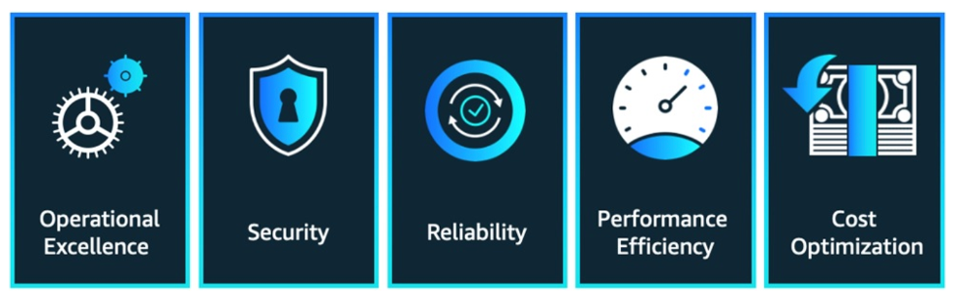
Pillars of an AWS Well-Architected Framework
There are 5 pillars of an AWS Well-Architected Framework
Operational Excellence
Security
Reliability
Cost Optimization
Performance Efficiency

Slide 11
1. Operational Excellence
This pillar outlines that developers and operations teams should seek business insights and customer insights to create applications that effectively support production workloads. This means understanding the risks, possible changes, and goals that drive day-to-day business operations.
Each team member should understand the criticality of their role in managing workloads, the entire workload’s behavior, and what development decisions will make operations successful.
This pillar also maintains that workloads should be designed to:
Easily display information on their working statistics
Enable mechanisms that aid quick feedback, recovery, and refactoring

Slide 12
2. Security
The security pillar emphasizes setting mechanisms that help protect systems, data, and assets. Fundamentally, Well-Architected security revolves around seven design principles:
Enforce logging and monitoring for traceability
Use multiple security controls to ensure security at all application layers
Automate security best practices
Protect data both within storage and in-transit
Adopt an incident management policy
Implement a strong foundation of security
Adopting an Identity and Access Management (IAM) policy is critical to ensuring that only the right users can access permitted resources. An IAM policy administers security by implementing an authentication and authorization layer.

Slide 13
3. Reliability
A Well-Architected Framework defines mechanisms that help an application handle workloads accurately and consistently.
The architecture of the system should be able to prevent and respond to breakdowns automatically.
The design principles for a reliable system include:
Automate recovery
Distribute workloads and requests to eliminate single point of failure
Use only the capacity you need for your production workload
Test incidents and recovery procedures
Manage automation changes

Slide 14
4. Cost Optimization
An organization should aim to deliver optimum and resilient business solutions at the least cost to the user.
Some design principles that guide the Cost Optimization pillar include:
Integrate Cloud Financial Management into the organization’s overall business objectives
Pay only for resources your application requires
Always monitor your application’s efficiency (output vs cost)
Outsource managed services and operating systems to AWS
Cloud Financial Management tools like AWS QuickSight, Cost & Usage Report (CUR), and Cost Explorer offer significant advantages to monitor an organization’s cloud costs.

Slide 15
5. Performance Efficiency
This pillar guides the effective use of computing resources to meet system and business requirements.
Some of the design principles guiding performance efficiency are:
Delegate complex tasks to third-party vendors who have the required skills to implement advanced technology easily
Deploy multi-regional workloads to reduce latency and lower deployment costs
Test and experiment often to take advantage of virtual resources
Utilize serverless functions whenever possible

Slide 16
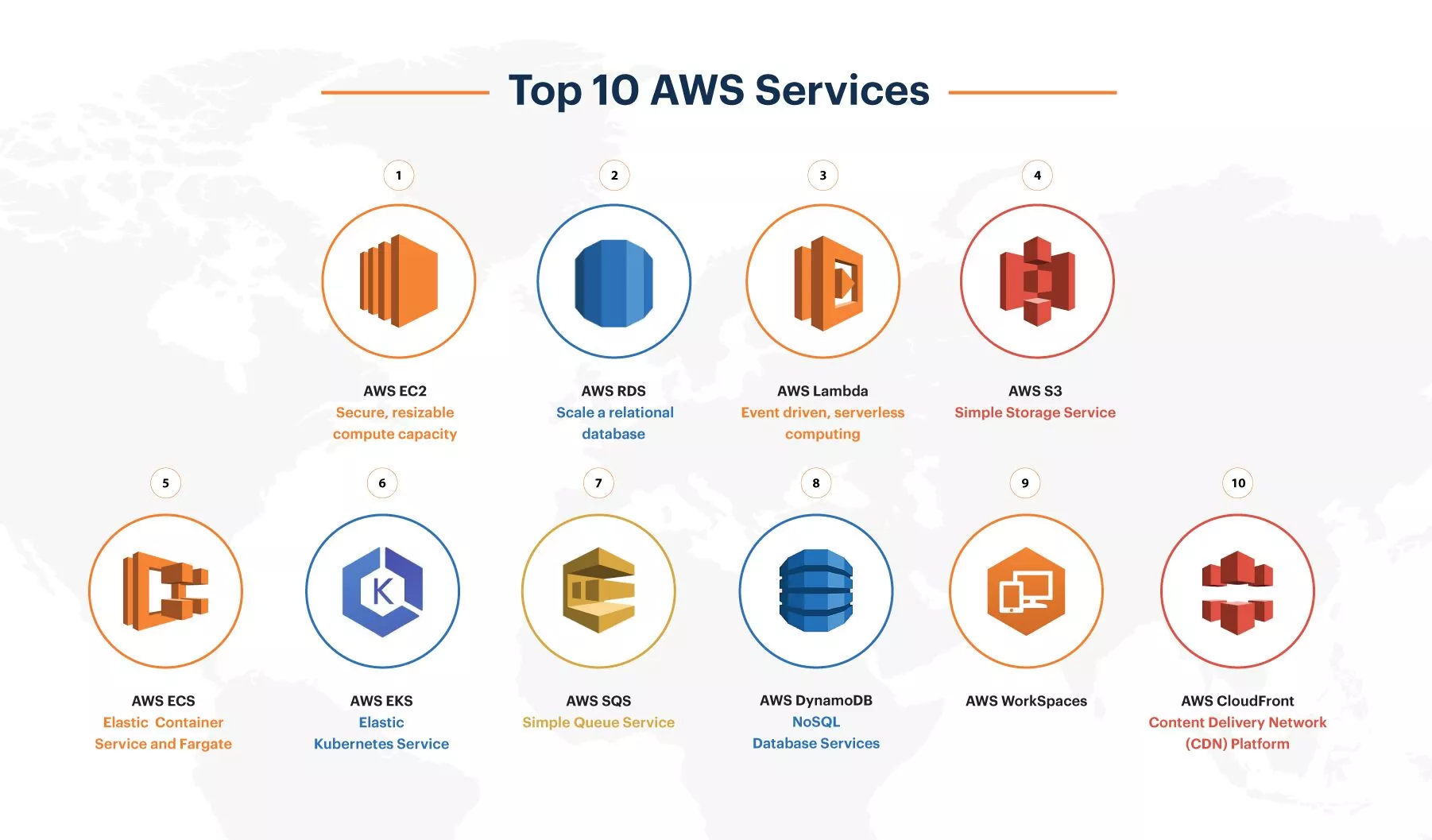

Slide 17
1. AWS EC2 – Elastic Compute Cloud
Amazon Elastic Compute Cloud (Amazon EC2) is a web service that provides secure, resizable compute capacity in the cloud.
Amazon EC2’s simple web service interface allows you to obtain and configure capacity quickly and with minimum effort.
EC2 provides a set of predefined instance profiles, or virtual server definitions, to create virtual machines. You can choose your VM configurations from any of the predefined instance types. VM instances can be memory-optimized, compute-optimized, or storage-optimized.
Users can also create and customize instance profiles to suit their needs. Instances can be self-provisioned or auto-scaled (when integrated with Amazon Auto Scaling) on demand, and stopped when not required, thereby saving costs.
EC2 instances can also be used to deploy containers. You can deploy and manage your own cluster of EC2 instances for running the containers.

Slide 18
2. AWS RDS – Relational Database Service
Almost all applications deployed in AWS will need access to a database. This is where AWS’ Relational Database Service (RDS) fits in.
RDS is a managed service from AWS using which you can set up, operate and scale a relational database in the cloud easily.
As with EC2, Amazon RDS is available as several predefined database instance types – optimized for memory, performance or I/O.
You can also pick the database engine of your choice from the six supported technologies including Amazon Aurora, PostgreSQL, MySQL, MariaDB, Oracle Database, and Microsoft SQL Server. One of the key advantages of RDS is that the managed service automates time-consuming administration tasks such as hardware provisioning, database setup, patching and backups.

Slide 19
3. AWS Lambda
AWS Lambda is an event-driven, serverless computing service that lets you run code without provisioning or managing servers.
With Lambda, you can upload your code as a ZIP file or container image, and Lambda automatically and precisely allocates compute execution power and runs your code based on the incoming request or event.
You can write Lambda functions in your favorite language (Node.js, Python, Go, Java, and more) and use both serverless and container tools, such as AWS SAM or Docker CLI, to build, test, and deploy your functions.

Slide 20
4. AWS S3 – Simple Storage Service
Amazon S3 or Amazon Simple Storage Service is a service that provides is cloud-based persistent storage through a web service interface.
It’s built to store, protect and retrieve data from “buckets” at any time, from anywhere, on any device.
Amazon S3 is a simple key-based object-store. It enables you to simply put data in the cloud and pull it back out through standard REST- and SOAP-based web service APIs.
You are shielded from the details of how it is stored or where it is actually stored. When you store data, you assign a unique object key that can later be used to retrieve the data.
Keys can be any string, and they can be constructed to mimic hierarchical attributes. Alternatively, you can use S3 Object Tagging to organize your data across all of your S3 buckets and/or prefixes.

Slide 21
5. AWS ECS – Elastic Container Service
Amazon Elastic Container Service (Amazon ECS) is a highly scalable, fast container management service that makes it easy to run, stop, and manage containers on a cluster.
ECS comes with two launch types: EC2 and Fargate. The containers can run on a serverless infrastructure that is managed by AWS Fargate.
Alternatively, for more control over your infrastructure, you can run your tasks and services on a cluster of Amazon EC2 instances that you manage.
The containers can run on a serverless infrastructure that is managed by AWS Fargate. Alternatively, for more control over your infrastructure, you can run your tasks and services on a cluster of Amazon EC2 instances that you manage.

Slide 22
6. AWS EKS – Elastic Kubernetes Service
Amazon EKS is a managed Kubernetes service that makes it easy for you to run Kubernetes on AWS and on-premises.
EKS lets you run your Kubernetes applications on both Amazon EC2 and AWS Fargate.
EKS runs the Kubernetes control plane across multiple Availability Zones, automatically detects and replaces unhealthy control plane nodes, and provides on-demand, zero downtime upgrades and patching.
EKS offers a 99.95% uptime SLA. At the same time, the EKS console provides observability of your Kubernetes clusters so you can identify and resolve issues faster.
With EKS, you have the advantage that any application running on EKS is compatible with one running in your existing Kubernetes environment. You can migrate to EKS without applying any changes to code.

Slide 23
7. AWS SQS – Simple Queue Service
Amazon SQS is a fully managed event-queuing service that enables you to decouple and scale microservices and serverless applications.
Using SQS, you can send, store, and receive messages between software components at any volume, without losing messages or requiring other services to be available.
If no workers pull jobs from SQS, the messages stay in the queue.
SQS offers two types of event queues.
Standard queues offer maximum throughput, with best-effort ordering and at-least-once delivery.
SQS FIFO queues offer event processing in the exact order that events are sent, with exactly once processing guarantee, although it comes with a throughput constraint.

Slide 24
Tour of the AWS Console
AWS has Global Services:
Identity and Access Management (IAM)
Route 53 (DNS service)
CloudFront (Content Delivery Network)
WAF (Web Application Firewall)
Most AWS services are Region-scoped:
Amazon EC2 (Infrastructure as a Service)
Elastic Beanstalk (Platform as a Service)
Lambda (Function as a Service)
Rekognition (Software as a Service)

Slide 25
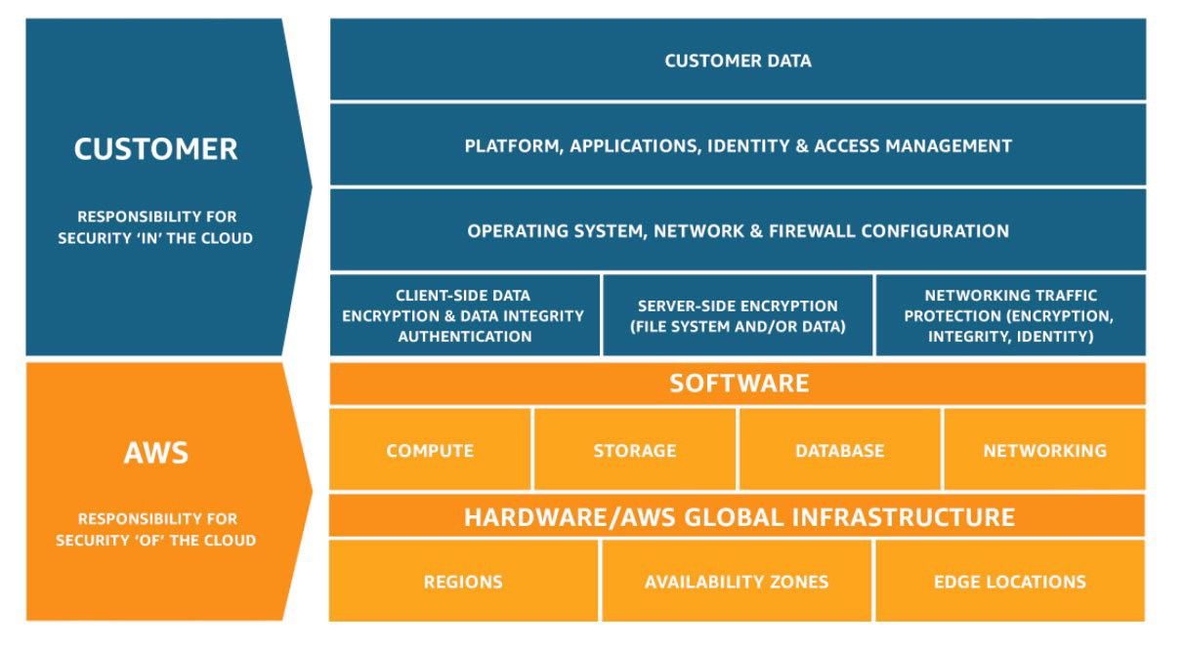
Shared Responsibility Model diagram

