Slide 1

Introduction to AWS Lambda
Amazon Web services

Slide 2
Amazon Serverless
Serverless is a new paradigm in which the developers don’t have to manage servers anymore…
Just deploy code, basically functions.
Initially, Serverless refers to FaaS (Function as a Service)
Serverless does not mean there are no servers, it means aws manage / provision them.

Slide 3
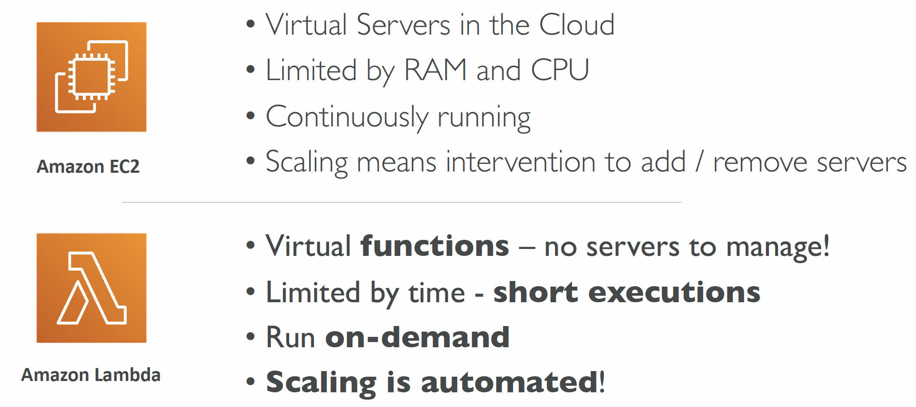
Why AWS Lambda

Slide 4
Amazon Lambda
Easy Pricing:
Pay per request and compute time
Free tier of 1,000,000 AWS Lambda requests and 400,000 GBs of compute time
Integrated with the whole AWS suite of services
Integrated with many programming languages
Easy monitoring through AWS CloudWatch
Easy to get more resources per functions (up to 10GB of RAM)
Increasing RAM will also improve CPU and network

Slide 5
Amazon Lambda Languages
Node.js (JavaScript)
Python
Java (Java 8 compatible)
C# (.NET Core)
Golang
C# / Powershell
Ruby
Custom Runtime API (community supported, example Rust)
Lambda Container Image
The container image must implement the Lambda Runtime API
ECS / Fargate is preferred for running arbitrary Docker images

Slide 6
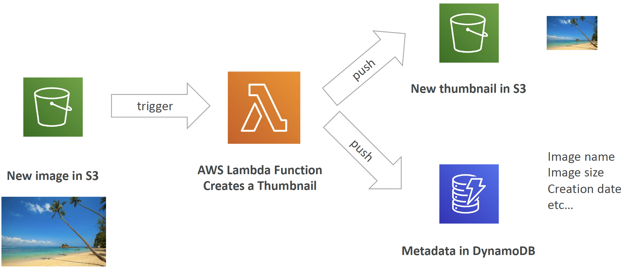
Lambda Serverless Example

Slide 7
AWS Lambda Limits
Execution:
Memory allocation: 128 MB – 10GB (1 MB increments)
Maximum execution time: 900 seconds (15 minutes)
Environment variables (4 KB)
Disk capacity in the “function container” (in /tmp): 512 MB
Concurrency executions: 1000 (can be increased)
Deployment:
Lambda function deployment size (compressed .zip): 50 MB
Size of uncompressed deployment (code + dependencies): 250 MB
Can use the /tmp directory to load other
Size of environment variables: 4 KB

Slide 8
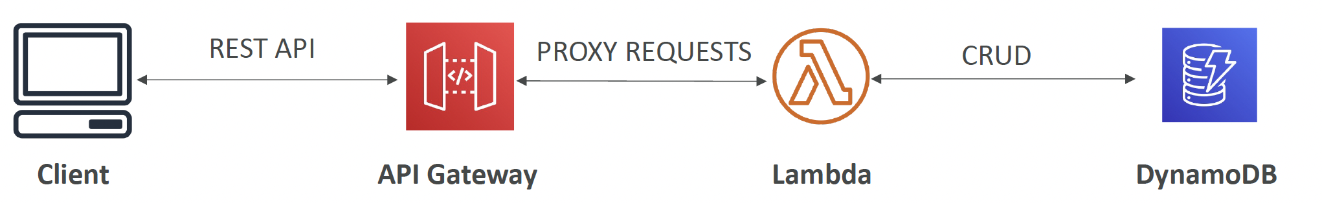
AWS API Gateway
Fully managed service for developers to easily create, publish, maintain, monitor, and secure APIs
Serverless and scalable
Supports RESTful APIs and WebSocket APIs
Support for security, user authentication, API throttling, API keys, monitoring.

Slide 9
Lambda Summary
Lambda is Serverless, Function as a Service, seamless scaling, reactive
Lambda Billing:
By the time run x by the RAM provisioned
By the number of invocations
Language Support: many programming languages except (arbitrary) Docker
Invocation time: up to 15 minutes
Use cases: Create Thumbnails for images uploaded onto S3.
API Gateway: expose Lambda functions as HTTP API

