Slide 1

Introduction to AWS
Day 1
Amazon web services

Slide 2
Cloud Monitoring
Example: CloudWatch Billing metric (us-east-1)

Slide 3
Important Metrics
EC2 instances: CPU Utilization, Status Checks, Network (not RAM)
Default metrics every 5 minutes
Option for Detailed Monitoring ($$$): metrics every 1 minute
EBS volumes: Disk Read/Writes
S3 buckets: BucketSizeBytes, NumberOfObjects, AllRequests
Billing: Total Estimated Charge (only in us-east-1)
Service Limits: how much you’ve been using a service API
Custom metrics: push your own metrics

Slide 4
Amazon CloudWatch Alarms
Alarms are used to trigger notifications for any metric
Alarms actions…
Auto Scaling: increase or decrease EC2 instances “desired” count
EC2 Actions: stop, terminate, reboot or recover an EC2 instance
SNS notifications: send a notification into an SNS topic
Various options (sampling, %, max, min, etc…)
Can choose the period on which to evaluate an alarm
Example: create a billing alarm on the CloudWatch Billing metric
Alarm States: OK. INSUFFICIENT_DATA, ALARM

Slide 5
Amazon CloudWatch Logs
CloudWatch Logs can collect log from:
Elastic Beanstalk: collection of logs from application
ECS: collection from containers
AWS Lambda: collection from function logs
CloudTrail based on filter
CloudWatch log agents: on EC2 machines or on-premises servers
Route53: Log DNS queries
Enables real-time monitoring of logs
Adjustable CloudWatch Logs retention

Slide 6
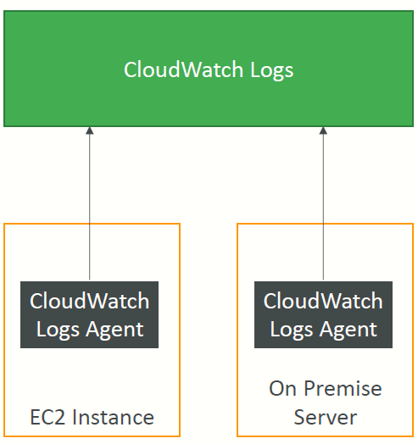
CloudWatch Logs for EC2
By default, no logs from your EC2 instance will go to CloudWatch
You need to run a CloudWatch agent on EC2 to push the log files you want
Make sure IAM permissions are correct
The CloudWatch log agent can be setup on-premises too

Slide 7
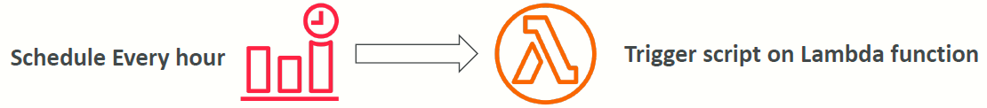
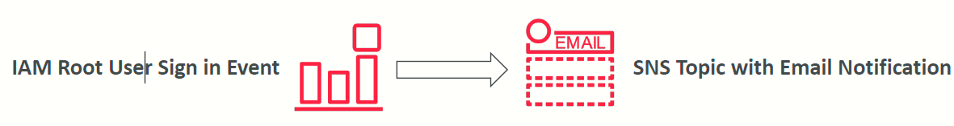
Amazon CloudWatch Events
Schedule: Cron jobs (scheduled scripts)
Event Pattern: Event rules to react to a service doing something
Trigger Lambda functions, send SQS/SNS messages…

Slide 8
Amazon EventBridge
EventBridge is the next evolution of CloudWatch Events
Default event bus: generated by AWS services (CloudWatch Events)
Partner event bus: receive events from SaaS service or applications (Zendesk, DataDog, Segment, Auth0…)
Custom Event buses: for your own applications
Schema Registry: model event schema
EventBridge has a different name to mark the new capabilities
The CloudWatch Events name will be replaced with EventBridge

Slide 9
AWS CloudTrail
Provides governance, compliance and audit for your AWS Account
CloudTrail is enabled by default!
Get an history of events / API calls made within your AWS Account by:
Console
SDK
CLI
AWS Services
Can put logs from CloudTrail into CloudWatch Logs or S3
A trail can be applied to All Regions (default) or a single Region.
If a resource is deleted in AWS, investigate CloudTrail first!

Slide 10
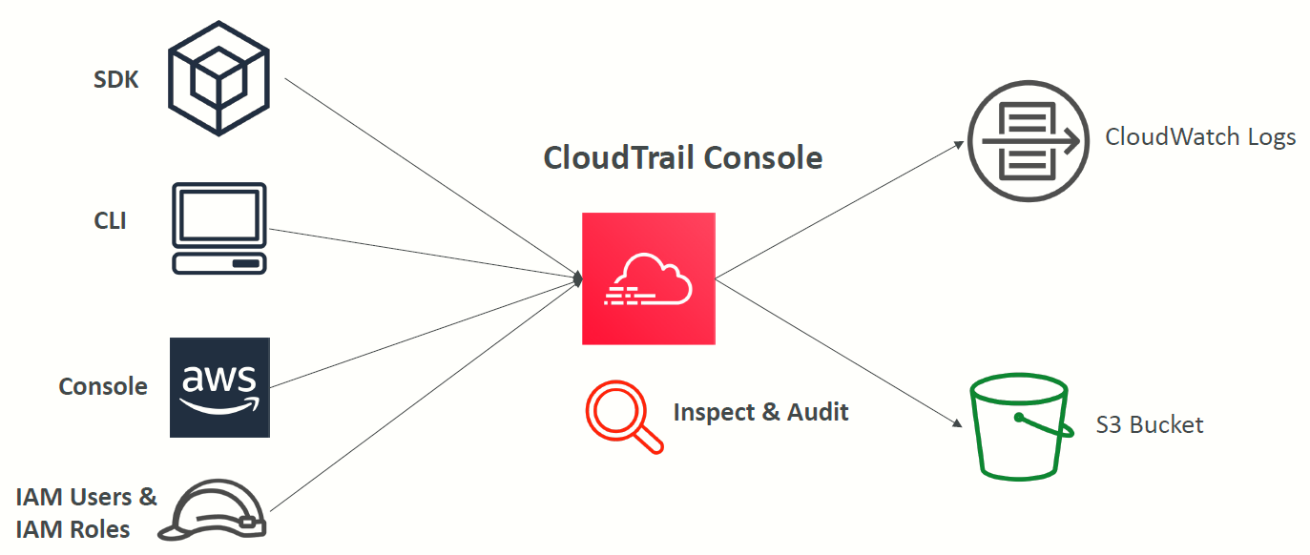
CloudTrail Diagram

Slide 11
CloudTrail Events
Management Events:
Operations that are performed on resources in your AWS account
Examples:
Configuring security (IAM AttachRolePolicy)
Configuring rules for routing data (Amazon EC2 CreateSubnet)
Setting up logging (AWS CloudTrail CreateTrail)
By default, trails are configured to log management events.
Can separate Read Events (that don’t modify resources) from Write Events (that may modify resources)
Data Events:
By default, data events are not logged (because high volume operations)
Amazon S3 object-level activity (ex: GetObject, DeleteObject, PutObject): can separate Read and Write Events
AWS Lambda function execution activity (the Invoke API)
CloudTrail Insights Events:
See next slide

Slide 12
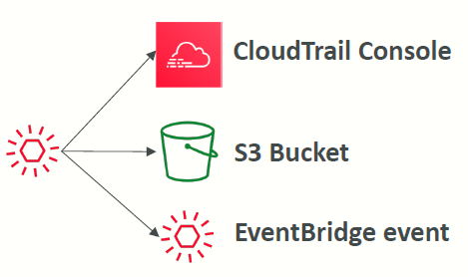
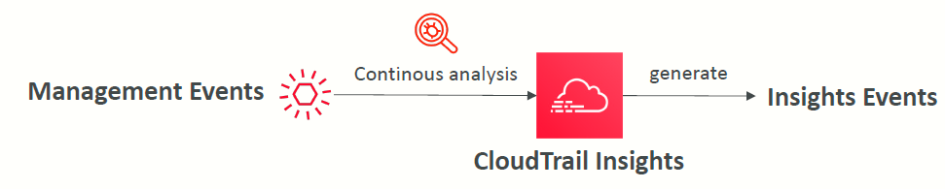
CloudTrail Insights
Enable CloudTrail Insights to detect unusual activity in your account:
inaccurate resource provisioning
hitting service limits
Bursts of AWS IAM actions
Gaps in periodic maintenance activity
CloudTrail Insights analyzes normal management events to create a baseline
And then continuously analyzes write events to detect unusual patterns
Anomalies appear in the CloudTrail console
Event is sent to Amazon S3
An EventBridge event is generated (for automation needs)

Slide 13
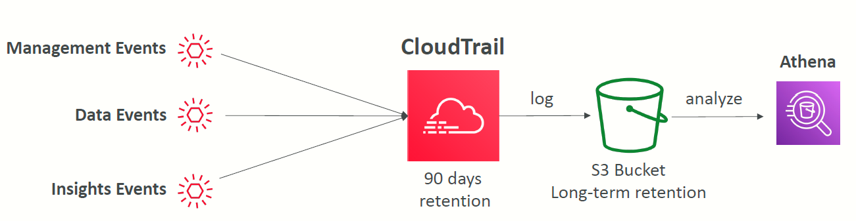
CloudTrail Events Retention
Events are stored for 90 days in CloudTrail
To keep events beyond this period, log them to S3 and use Athena

Slide 14
AWS X-Ray
Debugging in Production, the good old way:
Test locally
Add log statements everywhere
Re-deploy in production
Log formats differ across applications and log analysis is hard.
Debugging: one big monolith “easy”, distributed services “hard”
No common views of your entire architecture
Enter… AWS X-Ray!

Slide 15
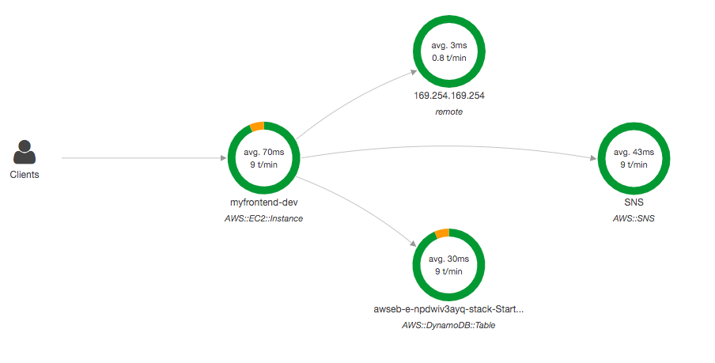
Visual analysis of our applications

Slide 16
AWS X-Ray advantages
Troubleshooting performance (bottlenecks)
Understand dependencies in a microservice architecture
Pinpoint service issues
Review request behavior
Find errors and exceptions
Are we meeting time SLA?
Where I am throttled?
Identify users that are impacted

Slide 17
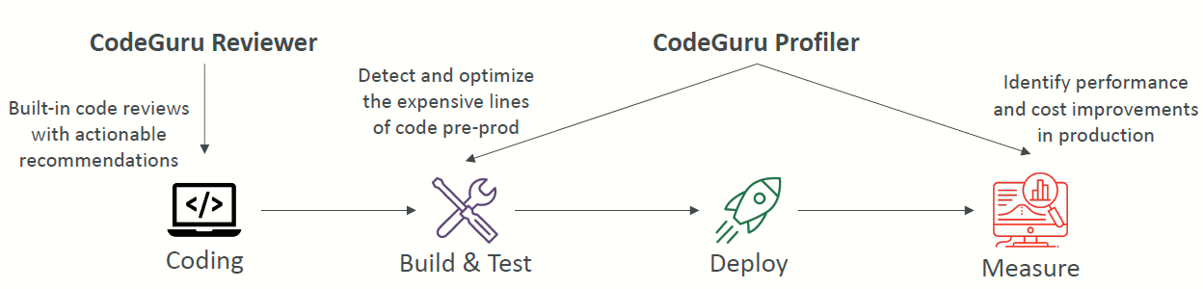
Amazon CodeGuru
An ML-powered service for automated code reviews and application performance recommendations
Provides two functionalities
CodeGuru Reviewer: automated code reviews for static code analysis (development)
CodeGuru Profiler: visibility/recommendations about application performance during runtime (production)

Slide 18
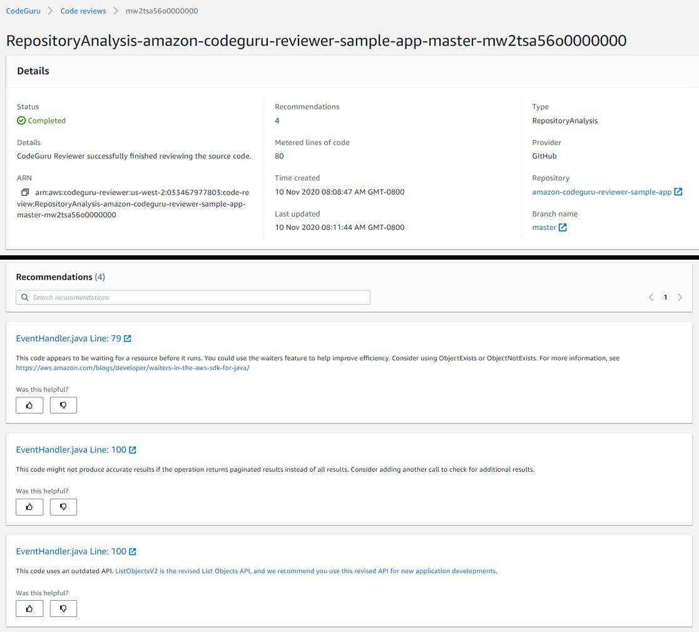
Amazon CodeGuru Reviewer
Identify critical issues, security vulnerabilities, and hard-to-find bugs
Example: common coding best practices, resource leaks, security detection, input validation
Uses Machine Learning and automated reasoning
Hard-learned lessons across millions of code reviews on 1000s of open-source and Amazon repositories
Supports Java and Python
Integrates with GitHub, Bitbucket, and AWS CodeCommit

Slide 19
Amazon CodeGuru Profiler
Helps understand the runtime behavior of your application
Example: identify if your application is consuming excessive CPU capacity on a logging routine
Features:
Identify and remove code inefficiencies
Improve application performance (e.g., reduce CPU utilization)
Decrease compute costs
Provides heap summary (identify which objects using up memory)
Anomaly Detection
Support applications running on AWS or onpremise
Minimal overhead on application

Slide 20
AWS Status - Service Health Dashboard
Shows all regions, all services health
Shows historical information for each day
Has an RSS feed you can subscribe to

Slide 21
AWS Personal Health Dashboard
AWS Personal Health Dashboard provides alerts and remediation guidance when AWS is experiencing events that may impact you.
While the Service Health Dashboard displays the general status of AWS services, Personal Health Dashboard gives you a personalized view into the performance and availability of the AWS services underlying your AWS resources.
The dashboard displays relevant and timely information to help you manage events in progress and provides proactive notification to help you plan for scheduled activities.

Slide 22
AWS Personal Health Dashboard
Global service https://phd.aws.amazon.com/
Shows how AWS outages directly impact you & your AWS resources
Alert, remediation, proactive, scheduled activities

Slide 23
Monitoring Summary
CloudWatch:
Metrics: monitor the performance of AWS services and billing metrics
Alarms: automate notification, perform EC2 action, notify to SNS based on metric
Logs: collect log files from EC2 instances, servers, Lambda functions…
Events (or EventBridge): react to events in AWS, or trigger a rule on a schedule
CloudTrail: audit API calls made within your AWS account
CloudTrail Insights: automated analysis of your CloudTrail Events
X-Ray: trace requests made through your distributed applications
Service Health Dashboard: status of all AWS services across all regions
Personal Health Dashboard: AWS events that impact your infrastructure
Amazon CodeGuru: automated code reviews and application performance recommendations

