Slide 1

EC2
Day 3
Amazon Web services

Slide 2
Amazon EC2
EC2 is one of the most popular of AWS’ offering
EC2 = Elastic Compute Cloud = Infrastructure as a Service
It mainly consists in the capability of :
Renting virtual machines (EC2)
Storing data on virtual drives (EBS)
Distributing load across machines (ELB)
Scaling the services using an auto-scaling group (ASG)
Knowing EC2 is fundamental to understand how the Cloud works

Slide 3
EC2 sizing & configuration options
Operating System (OS): Linux, Windows or Mac OS
How much compute power & cores (CPU)
How much random-access memory (RAM)
How much storage space:
Network-attached (EBS & EFS)
hardware (EC2 Instance Store)
Network card: speed of the card, Public IP address
Firewall rules: security group
Bootstrap script (configure at first launch): EC2 User Data

Slide 4
EC2 User Data
It is possible to bootstrap our instances using an EC2 User data script.
bootstrapping means launching commands when a machine starts
That script is only run once at the instance first start
EC2 user data is used to automate boot tasks such as:
Installing updates
Installing software
Downloading common files from the internet
Anything you can think of
The EC2 User Data Script runs with the root user

Slide 5
Hands-On: Launching an EC2 Instance running Linux
We’ll be launching our first virtual server using the AWS Console
We’ll get a first high-level approach to the various parameters
We’ll see that our web server is launched using EC2 user data
We’ll learn how to start / stop / terminate our instance.

Slide 6
EC2 Instance Types - Overview
You can use different types of EC2 instances that are optimised for different use cases (https://aws.amazon.com/ec2/instance-types/)
AWS has the following naming convention:
m5.2xlarge
m: instance class
5: generation (AWS improves them over time)
2xlarge: size within the instance class

Slide 7
EC2 Instance Types – General Purpose
Great for a diversity of workloads such as web servers or code repositories
Balance between:
Compute
Memory
Networking
In the course, we will be using the t2.micro which is a General Purpose EC2 instance

Slide 8
EC2 Instance Types – Compute Optimized
Great for compute-intensive tasks that require high performance processors:
Batch processing workloads
Media transcoding
High performance web servers
High performance computing (HPC)
Scientific modeling & machine learning
Dedicated gaming servers

Slide 9
EC2 Instance Types – Memory Optimized
Fast performance for workloads that process large data sets in memory
Use cases:
High performance, relational/non-relational databases
Distributed web scale cache stores
In-memory databases optimized for BI (business intelligence)
Applications performing real-time processing of big unstructured data

Slide 10
EC2 Instance Types – Storage Optimized
Great for storage-intensive tasks that require high, sequential read and write access to large data sets on local storage
Use cases:
High frequency online transaction processing (OLTP) systems
Relational & NoSQL databases
Cache for in-memory databases (for example, Redis)
Data warehousing applications
Distributed file systems

Slide 11
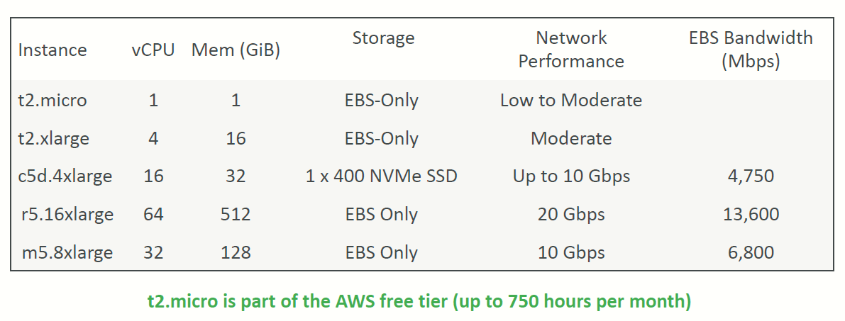
EC2 Instance Types: example

Slide 12
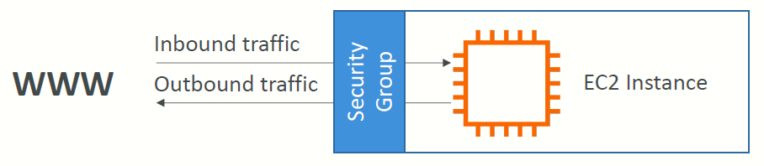
Introduction to Security Groups
Security Groups are the fundamental of network security in AWS
They control how traffic is allowed into or out of our EC2 Instances.
Security groups only contain rules
Security groups rules can reference by IP or by security group

Slide 13
Security Groups Deeper Dive
Security groups are acting as a “firewall” on EC2 instances
They regulate:
Access to Ports
Authorised IP ranges – IPv4 and IPv6
Control of inbound network (from other to the instance)
Control of outbound network (from the instance to other)

Slide 14
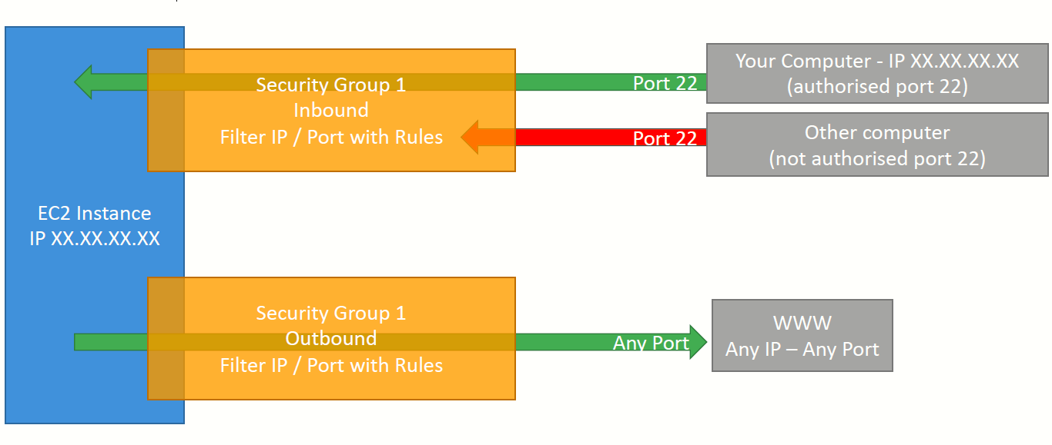
Security Groups Diagram

Slide 15
Security Groups Good to know
Can be attached to multiple instances
Locked down to a region / VPC combination
Does live “outside” the EC2 – if traffic is blocked the EC2 instance won’t see it
It’s good to maintain one separate security group for SSH access
If your application is not accessible (time out), then it’s a security group issue
If your application gives a “connection refused“ error, then it’s an application error or it’s not launched
All inbound traffic is blocked by default
All outbound traffic is authorised by default

Slide 16
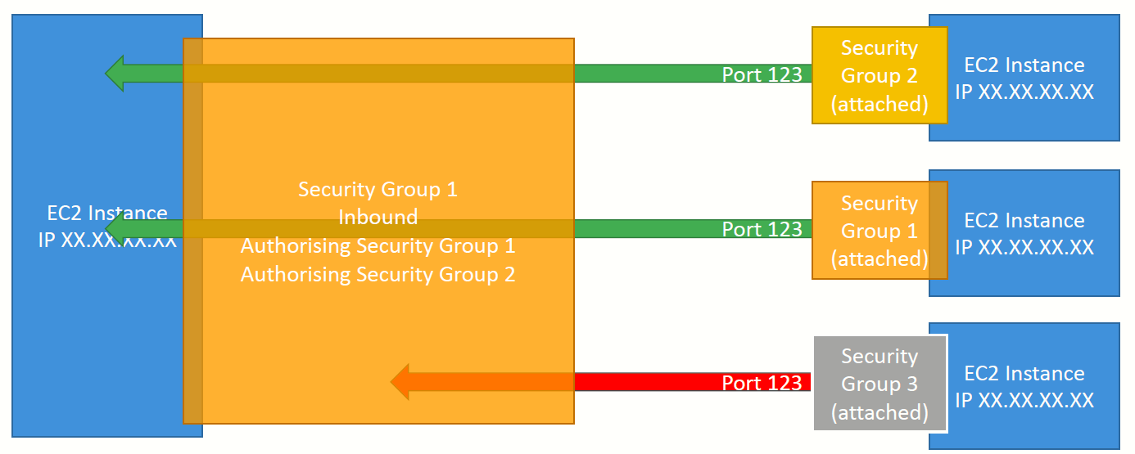
Referencing other security groups Diagram

Slide 17
Classic Ports to know
22 = SSH (Secure Shell) - log into a Linux instance
21 = FTP (File Transfer Protocol) – upload files into a file share
22 = SFTP (Secure File Transfer Protocol) – upload files using SSH
80 = HTTP – access unsecured websites
443 = HTTPS – access secured websites
3389 = RDP (Remote Desktop Protocol) – log into a Windows instance

Slide 18
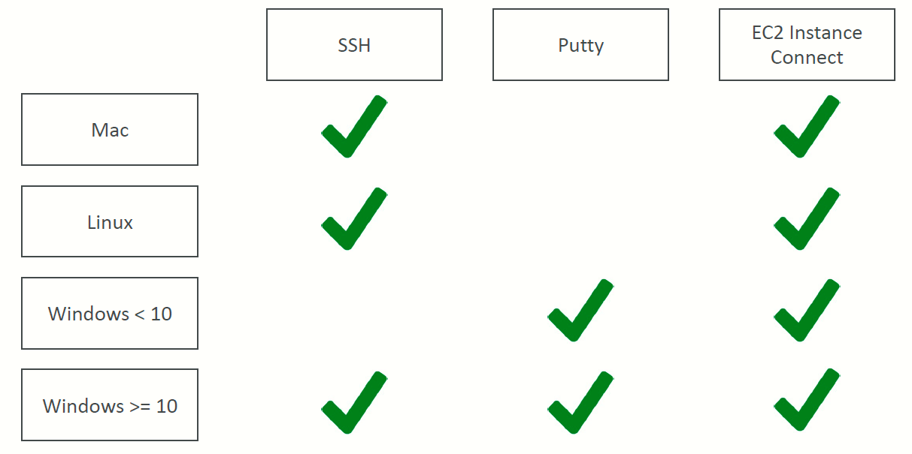
SSH Summary Table

Slide 19
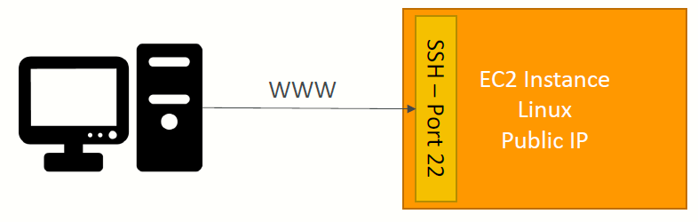
How to SSH into your EC2 Instance
Linux / Mac OS X
We’ll learn how to SSH into your EC2 instance using Linux / Mac
SSH is one of the most important function. It allows you to control a remote machine, all using the command line.
We will see how we can configure OpenSSH ~/.ssh/config to facilitate the SSH into our EC2 instances

Slide 20
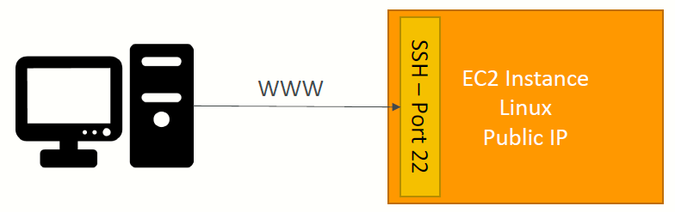
Windows
We’ll learn how to SSH into your EC2 instance using Windows
SSH is one of the most important function. It allows you to control a remote machine, all using the command line.
We will configure all the required parameters necessary for doing SSH on Windows using the free tool Putty.

Slide 21
EC2 Instance Connect
Connect to your EC2 instance within your browser
No need to use your key file that was downloaded
The “magic” is that a temporary key is uploaded onto EC2 by AWS
Works only out-of-the-box with Amazon Linux 2
Need to make sure the port 22 is still opened!

Slide 22
EC2 Instances Purchasing Options
On-Demand Instances – short workload, predictable pricing, pay by second
Reserved (1 & 3 years)
Reserved Instances – long workloads
Convertible Reserved Instances – long workloads with flexible instances
Savings Plans (1 & 3 years) –commitment to an amount of usage, long workload
Spot Instances – short workloads, cheap, can lose instances (less reliable)
Dedicated Hosts – book an entire physical server, control instance placement
Dedicated Instances – no other customers will share your hardware
Capacity Reservations – reserve capacity in a specific AZ for any duration

Slide 23
EC2 On Demand
Pay for what you use:
Linux or Windows - billing per second, after the first minute
All other operating systems - billing per hour
Has the highest cost but no upfront payment
No long-term commitment
Recommended for short-term and un-interrupted workloads, where
you can't predict how the application will behave

Slide 24
EC2 Reserved Instances
Up to 72% discount compared to On-demand
You reserve a specific instance attributes (Instance Type, Region, Tenancy, OS)
Reservation Period – 1 year (+discount) or 3 years (+++discount)
Payment Options – No Upfront (+), Partial Upfront (++), All Upfront (+++)
Reserved Instance’s Scope – Regional or Zonal (reserve capacity in an AZ)
Recommended for steady-state usage applications (think database)
You can buy and sell in the Reserved Instance Marketplace
Convertible Reserved Instance
Can change the EC2 instance type, instance family, OS, scope and tenancy
Up to 66% discount

Slide 25
EC2 Savings Plans
Get a discount based on long-term usage (up to 72% - same as RIs)
Commit to a certain type of usage ($10/hour for 1 or 3 years)
Usage beyond EC2 Savings Plans is billed at the On-Demand price
Locked to a specific instance family & AWS region (e.g., M5 in us-east-1)
Flexible across:
Instance Size (e.g., m5.xlarge, m5.2xlarge)
OS (e.g., Linux, Windows)
Tenancy (Host, Dedicated, Default)

Slide 26
EC2 Spot Instances
Can get a discount of up to 90% compared to On-demand
Instances that you can “lose” at any point of time if your max price is less than the current spot price
The MOST cost-efficient instances in AWS
Useful for workloads that are resilient to failure
Batch jobs
Data analysis
Image processing
Any distributed workloads
Workloads with a flexible start and end time
Not suitable for critical jobs or databases

Slide 27
EC2 Dedicated Hosts
A physical server with EC2 instance capacity fully dedicated to your use
Allows you address compliance requirements and use your existing serverbound software licenses (per-socket, per-core, pe—VM software licenses)
Purchasing Options:
On-demand – pay per second for active Dedicated Host
Reserved - 1 or 3 years (No Upfront, Partial Upfront, All Upfront)
The most expensive option
Useful for software that have complicated licensing model (BYOL – Bring Your Own License)
Or for companies that have strong regulatory or compliance needs

Slide 28
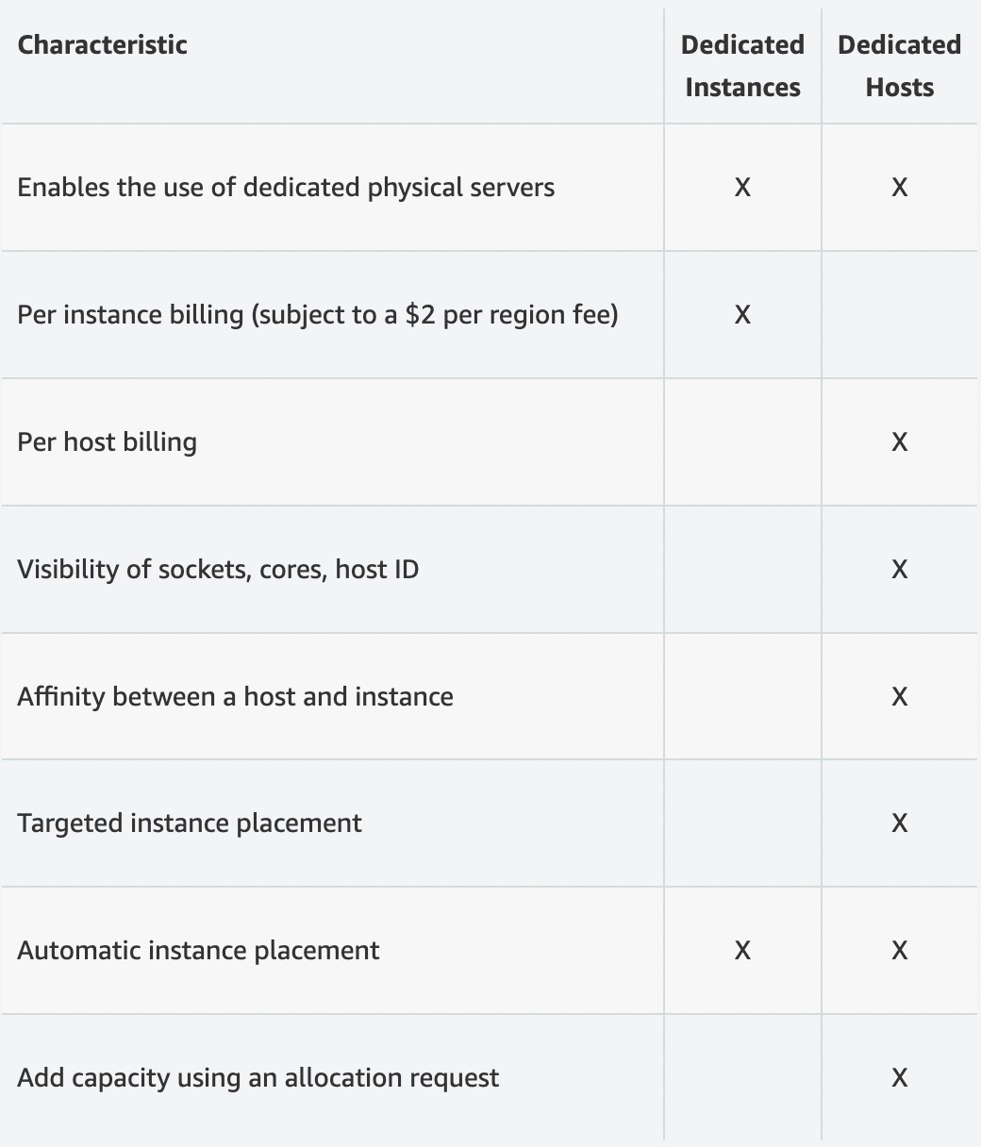
EC2 Dedicated Instances
Instances run on hardware that’s dedicated to you
May share hardware with other instances in same account
No control over instance placement (can move hardware after Stop / Start)

Slide 29
EC2 Capacity Reservations
Reserve On-Demand instances capacity in a specific AZ for any duration
You always have access to EC2 capacity when you need it
No time commitment (create/cancel anytime), no billing discounts
Combine with Regional Reserved Instances and Savings Plans to benefit from billing discounts
You’re charged at On-Demand rate whether you run instances or not
Suitable for short-term, uninterrupted workloads that needs to be in a specific AZ

Slide 30
Which purchasing option is right for me?
On demand: coming and staying in resort whenever we like, we pay the full price
Reserved: like planning ahead and if we plan to stay for a long time, we may get a good discount.
Savings Plans: pay a certain amount per hour for certain period and stay in any room type (e.g., King, Suite, Sea View, …)
Spot instances: the hotel allows people to bid for the empty rooms and the highest bidder keeps the rooms. You can get kicked out at any time
Dedicated Hosts: We book an entire building of the resort
Capacity Reservations: you book a room for a period with full price even you don’t stay in it

Slide 31
Price Comparison (m4.large – us-east-1)
Price Type Price (per hour) | Price Type Price (per hour)
On-Demand $0.10 | On-Demand $0.10
Spot Instance (Spot Price) $0.038 - $0.039 (up to 61% off) | Spot Instance (Spot Price) $0.038 - $0.039 (up to 61% off)
Reserved Instance (1 year) $0.062 (No Upfront) - $0.058 (All Upfront) | Reserved Instance (1 year) $0.062 (No Upfront) - $0.058 (All Upfront)
Reserved Instance (3 years) $0.043 (No Upfront) - $0.037 (All Upfront) | Reserved Instance (3 years) $0.043 (No Upfront) - $0.037 (All Upfront)
EC2 Savings Plan (1 year) $0.062 (No Upfront) - $0.058 (All Upfront) | EC2 Savings Plan (1 year) $0.062 (No Upfront) - $0.058 (All Upfront)
Reserved Convertible Instance (1 year) $0.071 (No Upfront) - $0.066 (All Upfront) | Reserved Convertible Instance (1 year) $0.071 (No Upfront) - $0.066 (All Upfront)
Dedicated Host On-Demand Price | Dedicated Host On-Demand Price
Dedicated Host Reservation Up to 70% off | Dedicated Host Reservation Up to 70% off
Capacity Reservations On-Demand Price | Capacity Reservations On-Demand Price

Slide 32

Shared Responsibility Model for EC2
Infrastructure (global network security)
Isolation on physical hosts
Replacing faulty hardware
Compliance validation
Security Groups rules
Operating-system patches and updates
Software and utilities installed on the EC2 instance
IAM Roles assigned to EC2 & IAM user access management
Data security on your instance

Slide 33
EC2 Section – Summary
EC2 Instance: AMI (OS) + Instance Size (CPU + RAM) + Storage + security groups + EC2 User Data
Security Groups: Firewall attached to the EC2 instance
EC2 User Data: Script launched at the first start of an instance
SSH: start a terminal into our EC2 Instances (port 22)
EC2 Instance Role: link to IAM roles
Purchasing Options: On-Demand, Spot, Reserved (Standard + Convertible + Scheduled), Dedicated Host, Dedicated Instance

