Slide 1

EC2 Instance Storage
Day 2
Amazon Web services

Slide 2
What’s an EBS Volume?
An EBS (Elastic Block Store) Volume is a network drive you can attach to your instances while they run
It allows your instances to persist data, even after their termination
They can only be mounted to one instance at a time (at the CCP level)
They are bound to a specific availability zone
Analogy: Think of them as a “network USB stick”
Free tier: 30 GB of free EBS storage of type General Purpose (SSD) or Magnetic per month

Slide 3
EBS Volume
It’s a network drive (i.e. not a physical drive)
It uses the network to communicate the instance, which means there might be a bit of latency
It can be detached from an EC2 instance and attached to another one quickly
It’s locked to an Availability Zone (AZ)
An EBS Volume in us-east-1a cannot be attached to us-east-1b
To move a volume across, you first need to snapshot it
Have a provisioned capacity (size in GBs, and IOPS)
You get billed for all the provisioned capacity
You can increase the capacity of the drive over time

Slide 4
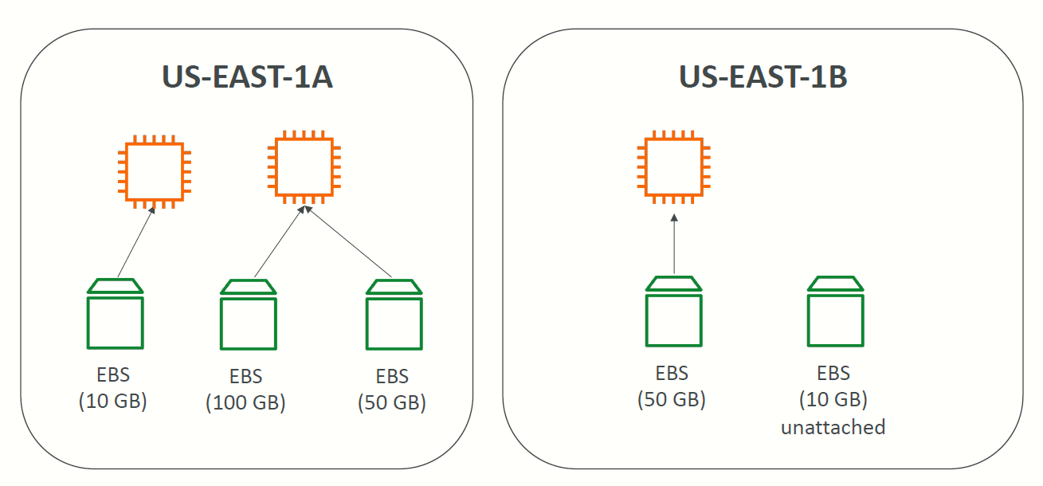
EBS Volume - Example

Slide 5
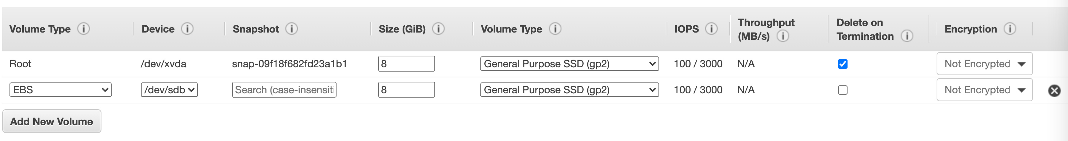
EBS – Delete on Termination attribute
Controls the EBS behaviour when an EC2 instance terminates
By default, the root EBS volume is deleted (attribute enabled)
By default, any other attached EBS volume is not deleted (attribute disabled)
This can be controlled by the AWS console / AWS CLI
Use case: preserve root volume when instance is terminated

Slide 6
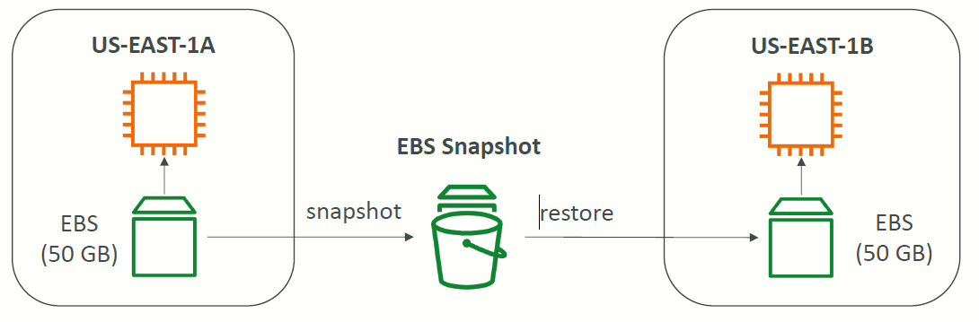
EBS Snapshots
Make a backup (snapshot) of your EBS volume at a point in time
Not necessary to detach volume to do snapshot, but recommended
Can copy snapshots across AZ or Region

Slide 7
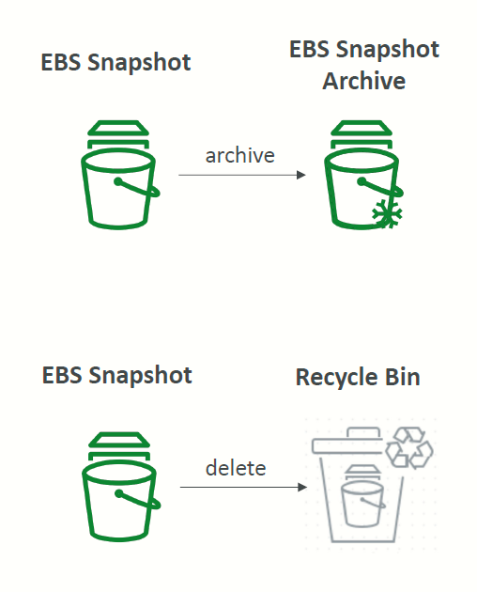
EBS Snapshots Features
EBS Snapshot Archive
Move a Snapshot to an ”archive tier” that is 75% cheaper
Takes within 24 to 72 hours for restoring the archive
Recycle Bin for EBS Snapshots
Setup rules to retain deleted snapshots so you can recover them after an accidental deletion
Specify retention (from 1 day to 1 year)

Slide 8

AMI Overview
AMI = Amazon Machine Image
AMI are a customization of an EC2 instance
You add your own software, configuration, operating system, monitoring…
Faster boot / configuration time because all your software is pre-packaged
AMI are built for a specific region (and can be copied across regions)
You can launch EC2 instances from:
A Public AMI: AWS provided
Your own AMI: you make and maintain them yourself
An AWS Marketplace AMI: an AMI someone else made (and potentially sells)

Slide 9
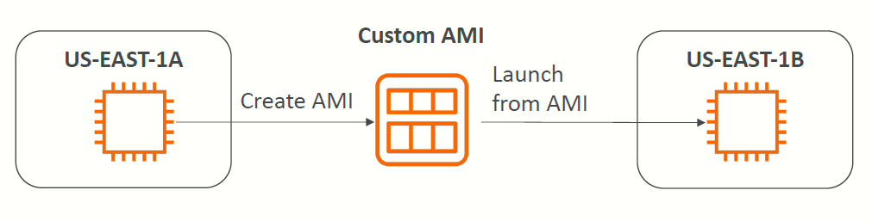
AMI Process (from an EC2 instance)
Start an EC2 instance and customize it
Stop the instance (for data integrity)
Build an AMI – this will also create EBS snapshots
Launch instances from other AMIs

Slide 10
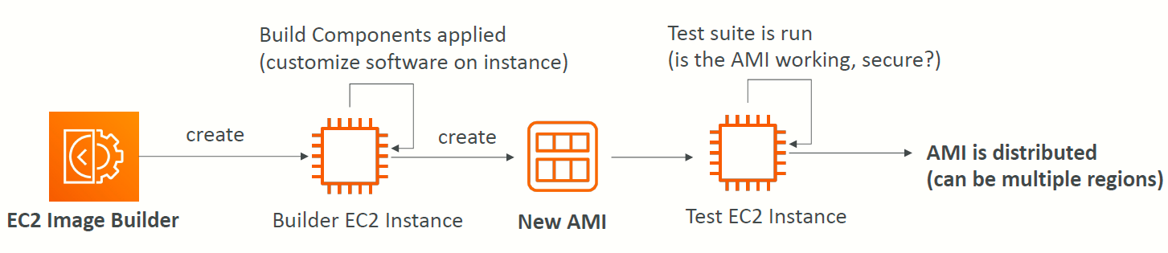
EC2 Image Builder
Used to automate the creation of Virtual Machines or container images
=> Automate the creation, maintain, validate and test EC2 AMIs
Can be run on a schedule (weekly, whenever packages are updated, etc…)
Free service (only pay for the underlying resources)

Slide 11

EC2 Instance Store
EBS volumes are network drives with good but “limited” performance
If you need a high-performance hardware disk, use EC2 Instance Store
Better I/O performance
EC2 Instance Store lose their storage if they’re stopped (ephemeral)
Good for buffer / cache / scratch data / temporary content
Risk of data loss if hardware fails
Backups and Replication are your responsibility

Slide 12
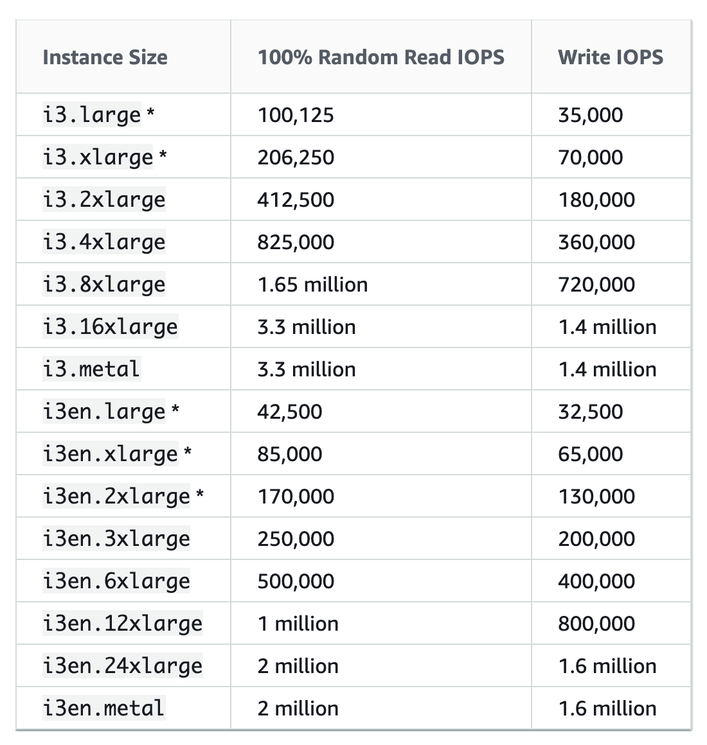
Local EC2 Instance Store

Slide 13
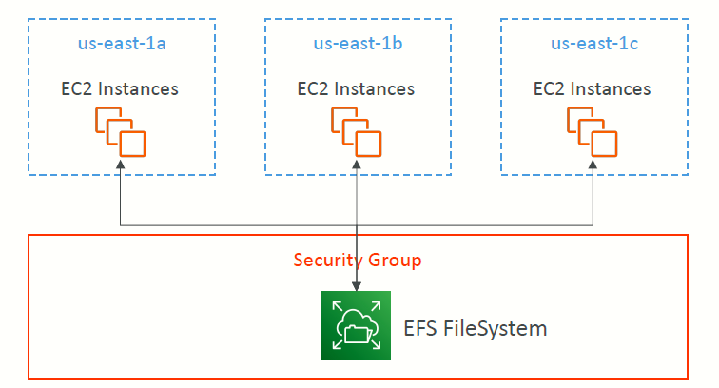
EFS – Elastic File System
Managed NFS (network file system) that can be mounted on 100s of EC2
EFS works with Linux EC2 instances in multi-AZ
Highly available, scalable, expensive (3x gp2), pay per use, no capacity planning

Slide 14
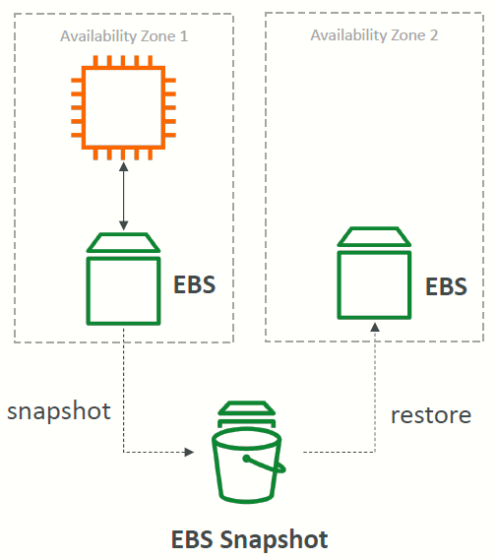
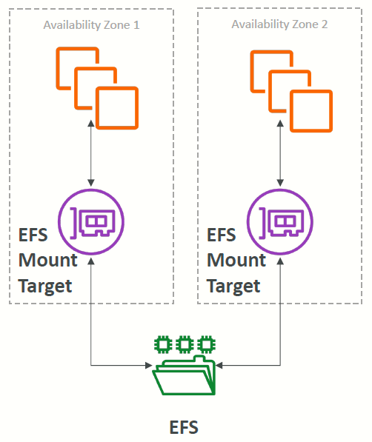
EBS vs EFS

Slide 15
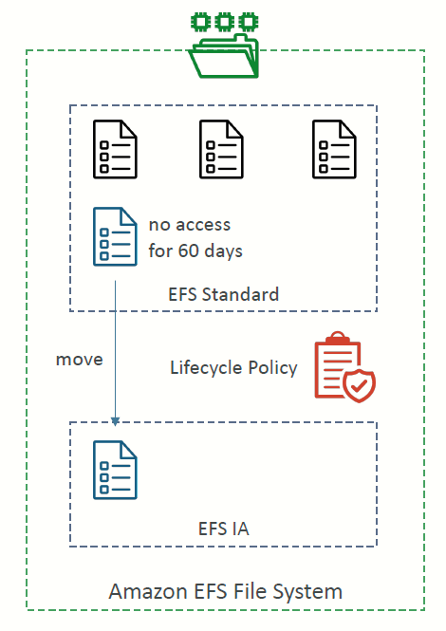
EFS Infrequent Access (EFS-IA)
Storage class that is cost-optimized for files not accessed every day
Up to 92% lower cost compared to EFS Standard
EFS will automatically move your files to EFS-IA based on the last time they were accessed
Enable EFS-IA with a Lifecycle Policy
Example: move files that are not accessed for 60 days to EFS-IA
Transparent to the applications accessing EFS

Slide 16

Shared Responsibility Model for EC2 Storage
Infrastructure
Replication for data for EBS volumes & EFS drives
Replacing faulty hardware
Ensuring their employees cannot access your data
Setting up backup / snapshot procedures
Setting up data encryption
Responsibility of any data on the drives
Understanding the risk of using EC2 Instance Store

Slide 17
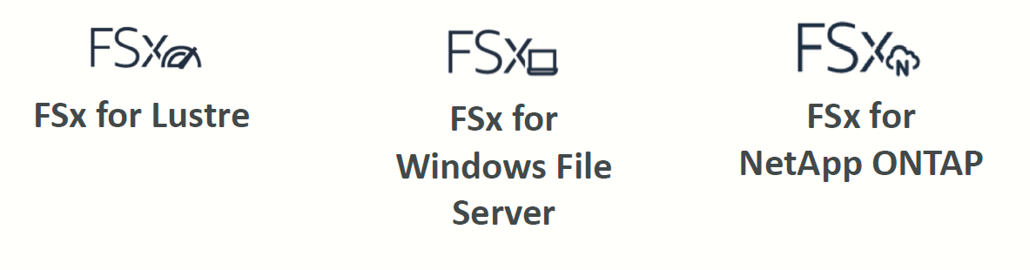
Amazon FSx – Overview
Launch 3rd party high-performance file systems on AWS
Fully managed service

Slide 18
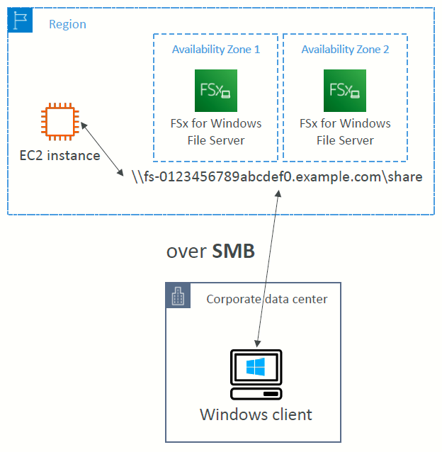
Amazon FSx for Windows File Server
A fully managed, highly reliable, and scalable Windows native shared file system
Built on Windows File Server
Supports SMB protocol & Windows NTFS
Integrated with Microsoft Active Directory
Can be accessed from AWS or your on-premise infrastructure

Slide 19
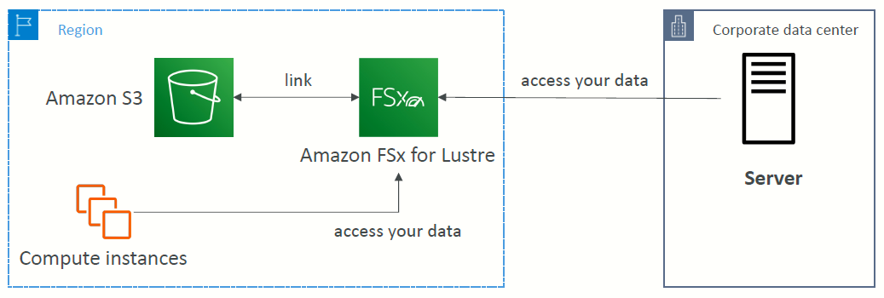
Amazon FSx for Lustre
A fully managed, high-performance, scalable file storage for High Performance Computing (HPC)
The name Lustre is derived from “Linux” and “cluster”
Machine Learning, Analytics, Video Processing, Financial Modeling, …
Scales up to 100s GB/s, millions of IOPS, sub-ms latencies

Slide 20
EC2 Instance Storage - Summary
EBS volumes:
network drives attached to one EC2 instance at a time
Mapped to an Availability Zones
Can use EBS Snapshots for backups / transferring EBS volumes across AZ
AMI: create ready-to-use EC2 instances with our customizations
EC2 Image Builder: automatically build, test and distribute AMIs
EC2 Instance Store:
High performance hardware disk attached to our EC2 instance
Lost if our instance is stopped / terminated
EFS: network file system, can be attached to 100s of instances in a region
EFS-IA: cost-optimized storage class for infrequent accessed files
FSx for Windows: Network File System for Windows servers
FSx for Lustre: High Performance Computing Linux file system

