Slide 1

Elastic Load Balancing & Auto Scaling Groups Section
Day 2
Amazon Web services

Slide 2
Scalability & High Availability
Scalability means that an application / system can handle greater loads by adapting.
There are two kinds of scalability:
Vertical Scalability
Horizontal Scalability (= elasticity)
Scalability is linked but different to High Availability
Let’s deep dive into the distinction, using a call center as an example

Slide 3

Vertical Scalability
Vertical Scalability means increasing the size of the instance
For example, your application runs on a t2.micro
Scaling that application vertically means running it on a t2.large
Vertical scalability is very common for non distributed systems, such as a database.
There’s usually a limit to how much you can vertically scale (hardware limit)

Slide 4
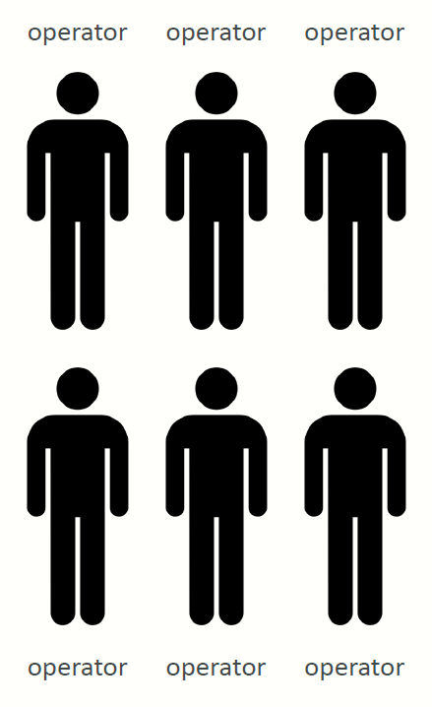
Horizontal Scalability
Horizontal Scalability means increasing the number of instances / systems for your application
Horizontal scaling implies distributed systems.
This is very common for web applications / modern applications
It’s easy to horizontally scale thanks the cloud offerings such as Amazon EC2

Slide 5
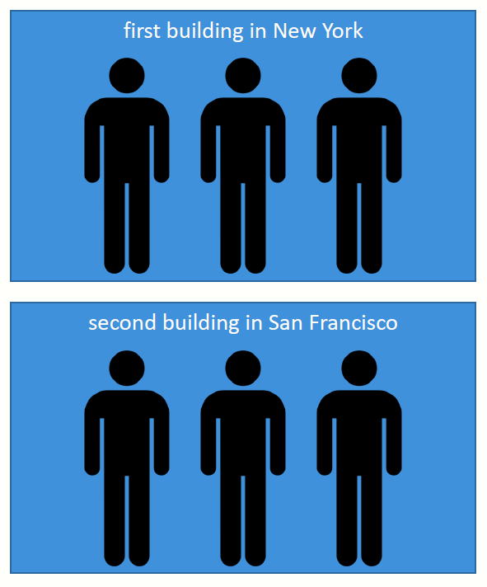
High Availability
High Availability usually goes hand in hand with horizontal scaling
High availability means running your application / system in at least 2 Availability Zones
The goal of high availability is to survive a data center loss (disaster)

Slide 6
High Availability & Scalability For EC2
Vertical Scaling: Increase instance size (= scale up / down)
From: t2.nano - 0.5G of RAM, 1 vCPU
To: u-12tb1.metal – 12.3 TB of RAM, 448 vCPUs
Horizontal Scaling: Increase number of instances (= scale out / in)
Auto Scaling Group
Load Balancer
High Availability: Run instances for the same application across multi AZ
Auto Scaling Group multi AZ
Load Balancer multi AZ

Slide 7
Scalability vs Elasticity (vs Agility)
Scalability: ability to accommodate a larger load by making the hardware stronger (scale up), or by adding nodes (scale out)
Elasticity: once a system is scalable, elasticity means that there will be some “auto-scaling” so that the system can scale based on the load. This is “cloud-friendly”: pay-per-use, match demand, optimize costs
Agility: (not related to scalability - distractor) new IT resources are only a click away, which means that you reduce the time to make those resources available to your developers from weeks to just minutes.

Slide 8
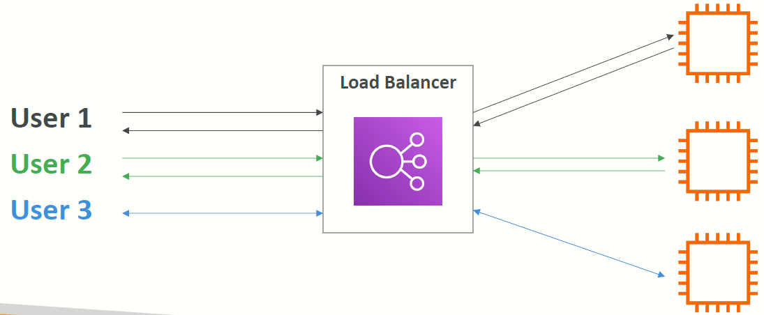
What is load balancing?
Load balancers are servers that forward internet traffic to multiple servers (EC2 Instances) downstream.

Slide 9
Why use a load balancer?
Spread load across multiple downstream instances
Expose a single point of access (DNS) to your application
Seamlessly handle failures of downstream instances
Do regular health checks to your instances
Provide SSL termination (HTTPS) for your websites
High availability across zones

Slide 10
Why use an Elastic Load Balancer?
An ELB (Elastic Load Balancer) is a managed load balancer
AWS guarantees that it will be working
AWS takes care of upgrades, maintenance, high availability
AWS provides only a few configuration knobs
It costs less to setup your own load balancer but it will be a lot more effort on your end (maintenance, integrations)
3 kinds of load balancers offered by AWS:
Application Load Balancer (HTTP / HTTPS only) – Layer 7
Network Load Balancer (ultra-high performance, allows for TCP) – Layer 4
Classic Load Balancer (slowly retiring) – Layer 4 & 7

Slide 11
What’s an Auto Scaling Group?
In real-life, the load on your websites and application can change
In the cloud, you can create and get rid of servers very quickly
The goal of an Auto Scaling Group (ASG) is to:
Scale out (add EC2 instances) to match an increased load
Scale in (remove EC2 instances) to match a decreased load
Ensure we have a minimum and a maximum number of machines running
Automatically register new instances to a load balancer
Replace unhealthy instances
Cost Savings: only run at an optimal capacity (principle of the cloud)

Slide 12
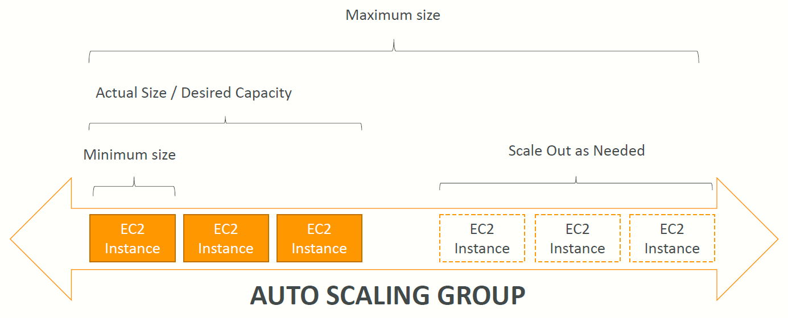
Auto Scaling Group in AWS

Slide 13
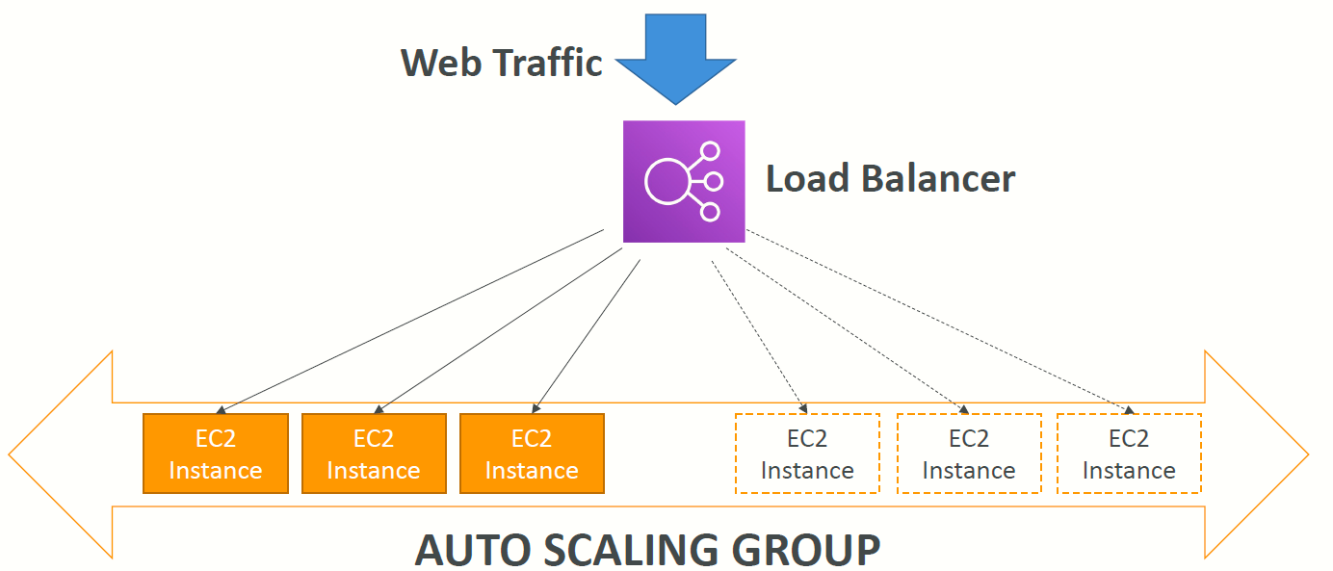
Auto Scaling Group in AWS With Load Balancer

Slide 14
Auto Scaling Groups – Scaling Strategies
Manual Scaling: Update the size of an ASG manually
Dynamic Scaling: Respond to changing demand
Simple / Step Scaling
When a CloudWatch alarm is triggered (example CPU > 70%), then add 2 units
When a CloudWatch alarm is triggered (example CPU < 30%), then remove 1
Target Tracking Scaling
Example: I want the average ASG CPU to stay at around 40%
Scheduled Scaling
Anticipate a scaling based on known usage patterns
Example: increase the min. capacity to 10 at 5 pm on Fridays

Slide 15
Auto Scaling Groups – Scaling Strategies
Predictive Scaling
Uses Machine Learning to predict future traffic ahead of time
Automatically provisions the right number of EC2 instances in advance
Useful when your load has predictable timebased patterns

Slide 16
ELB & ASG – Summary
High Availability vs Scalability (vertical and horizontal) vs Elasticity vs Agility in the Cloud
Elastic Load Balancers (ELB)
Distribute traffic across backend EC2 instances, can be Multi-AZ
Supports health checks
3 types: Application LB (HTTP – L7), Network LB (TCP – L4), Classic LB (old)
Auto Scaling Groups (ASG)
Implement Elasticity for your application, across multiple AZ
Scale EC2 instances based on the demand on your system, replace unhealthy
Integrated with the ELB

