Slide 1
CSS
Modulе 1

Slide 2
Agеnda
1
Introduction to CSS
2
Styles and Style Sheets
3
Formatting with CSS
4
Links and Lists
5
CSS Box Model
6
CSS 3

Slide 3
Introduction to Cascading Style Sheets

Slide 4
Objеctivеs
In this module, you will
Get introduced to CSS
Understand the advantages of using CSS
Explore different versions of CSS
Understand basic syntax of CSS

Slide 5
Introduction to CSS
CSS stands for Cascading Style Sheets
CSS was first developed in 1997 as a way for defining the look and feel of the web pages
HTML documents can be displayed using different styles
Styles define how to display HTML elements
Notes:
Why CSS ?
The earlier versions of HTML did not contain formatting tags. It was primarily used for defining the content of a document like paragraphs, headings etc.
With HTML 3.2 specifications, the formatting tags like color, font etc. were added.
As you are aware, HTML was primarily used for creating user interfaces. When developing large web applications, which contained hundreds of web pages, formatting individual web pages posed challenges. The developers found it very tedious to add formats like color, font etc. for every page.
To overcome this challenge, World Wide Web Consortium(W3C) introduced CSS.
We can create separate CSS files and these files can be used for applying Styles to HTML pages.
CSS offers more options and is more accurate and sophisticated. Most of the modern browsers support CSS.

Slide 6
Cascading Style Sheets (CSS)
CSS, is a standard for formatting Web pages that goes well beyond the limitations of HTML
CSS extends HTML with more than 70 style properties that can be applied to HTML tags

Slide 7
CSS 1
CSS1 was introduced in 1996
It is the first edition of Cascading Style Sheets
Support for several properties
Unique ‘id’ for each property was introduced with CSS 1
Offered enhanced features for implementing margins, borders, padding and positioning
Notes:
CSS1 was introduced in 1996 and it is the first edition of Cascading Style Sheets. CSS 1supported several properties. Unique id for each property was introduced with this version. Even though we could set Margins, borders, padding and positioning through HTML, CSS 1 offered enhanced features to implement these properties. Using Style sheets, it was easy to introduce spacing between lines and rows of tables.
With CSS 1, web designers were able to optimize and easily design web pages.

Slide 8
CSS 2
Published in 1998
Support for Bidirectional texts
New font properties such as shadows were introduced
CSS 2.1 was the last 2nd generation edition of CSS
Notes:
CSS 2 was published in 1998 and it provides enhancement over CSS 1. Support for Bidirectional texts is one of the major enhancement introduced with this edition. Many other new font properties such as shadows were also introduced. CSS 2.1 was the last 2nd generation edition of CSS.

Slide 9
CSS 3
CSS 3 is the latest edition of Cascading Style Sheets
Several new functionalities have been provided through CSS 3
Functions like rounded corners, background decoration, box shadows, which are demonstrated in the subsequent sections, are introduced in this version

Slide 10
Advantages of using CSS
A web application will contains hundreds of web pages, which are created using HTML.
Formatting these HTML Pages will be a laborious process, as formatting elements need to be applied to each and every page.
CSS saves lot of work as we can change the appearance and layout of all the web pages by editing just one single CSS file.

Slide 11
CSS Syntax
The CSS syntax has two main parts : a selector and one or more declarations.
Example :
Property
h1
{color:red }
Value
Selector
Declaration
Notes:
The selector is the HTML element on which you want to apply the style.
Each declaration consists of a property and its value. The property is the attribute of the style you want to change.
In the example above, we are trying to change the color of the heading h1 to red.

Slide 12
Demo : A Simple CSS Style Example
<html><body>
<h1> Wipro Technologies </h1>
</body></html>
<html>
<head>
<style>
h1{color:red}
</style>
</head>
<body>
<h1> Wipro Technologies </h1>
</body>
</html>
Output :
Wipro Technologies
Output :
Wipro Technologies

Slide 13
Quiz
1. The HTML element on which you want to apply styles is known as
a)Declaration
b)Directive
c)Selector
d)Property
2. State whether TRUE or FALSE ;
You can specify only one declaration for a selector.
Notes:
Answers :
c
FALSE

Slide 14
CSS Syntax Rules
A CSS declaration must always end with a semi colon.
There can be multiple declarations represented by multiple property value pairs.
You can also have declarations on separate lines for easy readability as given below :
p { color:blue; text-align:left; }

Slide 15
CSS Comments (/* … */)
You can use comments in CSS to omit certain segment of code. The segment of the code which is designated as comment will be ignored by the browser.
Beginning of comment : /*
End of comment : */
Example :
p { text-align:left; /* background-color:yellow */ color:red; }

Slide 16
Quiz
Which of the following is the correct syntax for comments in CSS ?
<!- css syntax -->
// css syntax
!- css syntax
/* css syntax */
2. State whether TRUE or FALSE ;
A CSS declaration must always end with a semicolon.
Notes:
Answers :
1 : d
2 : TRUE

Slide 17
Summary
In this modulе you were able to :
Get introduced to CSS
Understand the advantages of using CSS
Explore different versions of CSS
Understand basic syntax of CSS

Slide 18
Styles and Style Sheets

Slide 19
Objеctivеs
In this module, you will
Develop a web page that uses selector id
Develop a web page that uses selector class
Explore different types of Style Sheets

Slide 20
CSS Id
CSS allows you to specify your own selectors. There are two types of selectors : id and class.
The selector id is used to specify style for a single, unique element.
This selector uses the “id” element of an HTML element.
This selector is defined with a “#”.
Notes:
Point to remember :
Do not start an ID or a class name with a number !

Slide 21
Demo : CSS Id
<html><head>
<style>
#paragraph{
text-align:right;
color:magenta;
font-family:arial;
font-size:24px;
}
</style>
</head>
<body>
<p> Today's expenses </p>
<p id="paragraph">1234.50</p>
<p id="paragraph"> 34.23</p>
</body></html>
Output :
Today's expenses
1234.50
34.23

Slide 22
CSS class
The CSS class selector is used to specify a style for a group of elements.
The class selector is used on several elements where as the id selector is used on a single element.
You can set a particular style for many HTML elements with the same class.
The class selector uses the HTML class attribute and is defined with a "."

Slide 23
Demo : CSS class
<html><head>
<style>
.custom {
text-align:center;
color:red;
font-size:20px;
}
</style>
</head>
<body>
<p> Example 3</p>
<h1 class="custom">Wipro Technologies</h1>
<p class="custom">Hosur Road</p>
<p class="custom">Bengaluru</p>
</body></html>
Output :
Example 3
Wipro Technologies
Hosur Road
Bengaluru

Slide 24
Quiz
A selector is defined with
#
%
&
@
2. The class selector uses the HTML class attribute and is defined with a _________
#
.
/
-
Notes:
Answers :
a
b

Slide 25
Inserting a StyleSheet
You can insert Styles in three different ways :
External Style Sheet
Styles are specified in an external CSS file
Internal Style Sheet
Styles are specified inside the head section of an HTML page
Inline Styles
Styles are specified inside an HTML element

Slide 26
External Style Sheet
When you want to apply styles to multiple HTML pages, you can use an external style sheet.
The advantage of using an external style sheet is that, you can change the look of an entire web site, just by changing one file.
To link an HTML page to a style sheet, we must use the <link> tag.
The <link> tag must be within the <head> section.
Ex : <head> <link rel="stylesheet" type="text/css" href=“ex1.css” /> </head>

Slide 27
External Style Sheet (Contd.).
The external style sheet should be stored in a file with extension .css
You can use any text editor to create a style sheet file.
This file should not contain any HTML tag.

Slide 28
Demo : External Style Sheet
ex1.css
p{
text-align:center;
font-family:Algerian;
font-size:28px;
}
css4.html
<html>
<head>
<link rel="stylesheet" type="text/css" href="ex1.css" />
</head>
<body>
<p>This paragraph uses styles from an external stylsheet</p>
</body>
</html>
Output :
:This paragraph uses styles from an external stylesheet

Slide 29
Internal StyleSheet
Internal Style Sheets can be used when you want to apply unique styles to a single document.
Internal styles are defined in the head section of an HTML page.
Internal styles are defined using <style> tag.
Example :
<head> <style> p { text-align:left; font-size:24px; }
</style>
</head>

Slide 30
Demo : Internal StyleSheet
Output:
Wipro Technologies
Talent Transformation
This is a demonstration of Internal Stylesheet
<html>
<head>
<style>
h1{text-align:center; font-size:28px;}
h2{text-align:center; font-size:20px;}
p{text-align:left; font-size:16px;}
</style>
</head>
<body>
<h1>Wipro Technologies </h1>
<h2>Talent Transformation </h1>
<p>This is a demonstration of Internal Stylesheet</p>
</body>
</html>

Slide 31
Inline Styles
You can apply style attribute within a particular HTML tag. This method of applying CSS style is known as Inline Style.
You can use the style attribute in the required tag, in the following manner :
<p style="font-family:Algerian;font-size:28px;"> Demo of Inline Style
</p>
As Inline Styles mix content with presentation, you are bound to lose many of the advantages that CSS offers. This is the precise reason, Inline Styles are sparingly used.

Slide 32
Multiple Style Sheets
Multiple Style Sheets can be referenced inside an HTML document.
The questions is, what styles will be applicable when there is more than one style specified?
All styles cascade into a new virtual style sheet by applying the following rules, where the higher number has the greater priority:
Browser default
External Stylesheet
Internal Stylesheet (styles defined in head section)
Inline Style (styles defined in an HTML element)
As you can observe, Inline Style has the highest priority. This means that the inline style defined in an HTML element will override a style defined within the head section, which in turn may override the style defined within an external style sheet.
Notes:
Please Note :
If you place a link to an external style sheet after specifying a style within the head section, then the external style sheet will override the internal style.

Slide 33
Multiple Style Sheets
If we set properties for the same selector in different style sheets, the values will be inherited from the more specific style sheet.
For e.g. : If we have an external style sheet, which defines a style
p {font-size:16 px; color:magenta; text-align:right;}
We have also defined an internal style sheet as follows :
p {color:blue; text-align:left;}
Now, if we link this HTML page to the external style sheet, the resultant style for <p> will have the following values for the defined properties :
p { color:blue;text-align:left;font-size:16px;}
The values of the properties color and text-align in internal style sheet override those in external style sheet, while the value of the property font-size gets inherited.

Slide 34
Quiz
Internal Styles are those styles that are defined within the _______ section of the html document.
html
body
head
title
The correct syntax for accessing an external stylesheet file from within an HTML document is
<link rel="stylesheet" type="text/css" ref="ex1.css" />
<link rel="stylesheet" type="text/css" href="ex1.css" />
<link ref="stylesheet" type=“css/text" file="ex1.css" />
<link rel=“cssstyles" type="text/css" href="ex1.css" />
Notes:
Answers :
c
b

Slide 35
Summary
In this modulе you were able to :
Develop a web page that uses selector id
Develop a web page that uses selector class
Explore different types of Style Sheets

Slide 36
Formatting with CSS Properties

Slide 37
Objеctivеs
In this module, you will
Define Background effect
Apply Text Formatting
Learn how to apply font properties

Slide 38
CSS Background
We can use CSS Background properties to define the background effects of an element.
The following properties can be used for background effects :
background-color
background-image
background-repeat
background-position

Slide 39
Background Color
The background-color property is used to specify the background color of an element.
The background color of a page can be specified by in the selector body.
body {background-color:cyan;}
Similarly, we can specify the background for any element(wherever applicable).
p {background-color:yellow;}

Slide 40
Demo : Background Color
<html>
<head>
<style>
h1{background-color:black;color:cyan;text-align:center;}
p{background-color:yellow; color:red;text-align:center;}
</style>
</head>
<body>
<h1>Wipro Technologies </h1>
<p>Talent Transformation</p>
</body>
</html>
Wipro Technologies
Talent Transformation

Slide 41
Background Image
You can use an image as the background for an element using background-image property.
You can set an image as the background in the following manner :
body{background-image:url(‘java.bmp’);}
By default, the image is repeated, both horizontally and vertically, so as to cover the entire body(or the element on which it is applied).

Slide 42

Demo : Background Image
<html>
<head>
<style>
body {background-image:url("force1.jpg");}
h1 {color:yellow;}
p {color:yellow;}
</style>
</head>
<body>
<h1>Wipro Technologies </h1>
<p>Talent Transformation</p>
</body>
</html>

Slide 43

Demo : Background Image Repeat Horizontally
<html>
<head>
<style>
body {
background-image:url("force1.jpg");
background-repeat:repeat-x;
}
h1 {color:yellow;}
p {color:yellow;}
</style>
</head>
<body>
<h1>Wipro Technologies </h1>
<p>Talent Transformation</p>
</body>
</html>

Slide 44
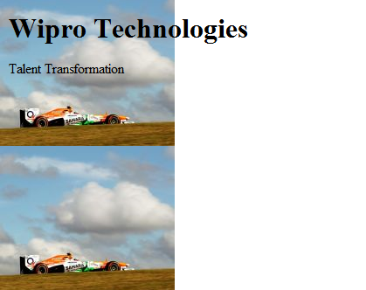
Demo : Background Image Repeat Vertically
<html>
<head>
<style>
body {
background-image:url("force1.jpg");
background-repeat:repeat-y;
}
</style>
</head>
<body>
<h1>Wipro Technologies </h1>
<p>Talent Transformation</p>
</body>
</html>

Slide 45

Demo : Background Image No Repeat
<html>
<head>
<style>
body {
background-image:url(“kitten.jpg");
background-repeat:no-repeat;
}
</style>
</head>
<body>
<h1>Wipro Technologies </h1>
<p>Talent Transformation</p>
</body>
</html>

Slide 46
Background Position
If the background image disturbs the text, i.e. if the text cannot be read clearly due to the image in the background, we can set the position of the background image.
We need to add the property background-position in the selector.
Example :
body {
background-image:url(“kitten.jpg");
background-repeat:no-repeat;
background-position:right top;
}

Slide 47

Demo : Background Position
<html>
<head>
<style>
body {
background-image:url(“kitten.jpg");
background-repeat:no-repeat;
background-position:right top;
}
</style>
</head>
<body>
<h1>Wipro Technologies </h1>
<p>Talent Transformation</p>
</body>
</html>

Slide 48
Background Shorthand
You can also specify all the properties in a single property. This property is known as shorthand property.
For specifying shorthand property, you just need to use background.
Example :
body {
background:cyan url(‘kitten.jpg') no-repeat right top;
}

Slide 49

Background Shorthand
<html>
<head> <style>
body {
background:yellow url("kitten.jpg") no-repeat right top;
}
</style></head>
<body>
<h1>Wipro Technologies </h1>
<p>Talent Transformation</p>
</body>
</html>

Slide 50
Quiz
To set a Background Image using a file, depp1.jpg, you have to use the following syntax :
background-image:(“depp1.jpg”);
bg-image:(“depp1.jpg”);
bg-image:url(“depp1.jpg”);
background-image:url(“depp1.jpg”);
If you do not want the background image to be repeated, you will have to use the syntax :
background-repeat:zero-repeat;
background-repeat:no-repeat;
background-repeat:single;
background-repeat:once;
Notes:
Answers :
d
b

Slide 51
Text Formatting
Now let us have a look at some of the Text Formatting properties.
The following properties can be used for formatting text :
Text Color
Text Alignment
Text Decoration
Text Transformation
Text Indentation

Slide 52
Text Color
The color property is used to set the color of text.
Example :
body { color:blue;}
p1 {color:magenta;}

Slide 53
Text Alignment
You have already observed in many of our previous examples that the text-align property is used for setting the horizontal alignment of text.
We can either align the text to the left, right, center or we can make it justified.
Example :
p { text-align:left;}
h1{text-align:center;}

Slide 54
Text Decoration
You can use text-decoration property to set or remove decorations from text.
This property can be used to remove underlines from hyperlinks.
Example :
To remove decorations :
p {text-decoration:none;}

Slide 55
Text Decoration (Contd.).
You can set decorations in the following manner:
p {text-decoration:overline;}
p {text-decoration:line-through;}
p {text-decoration:underline;}

Slide 56

Demo : Text Decoration
<html>
<head>
<style>
p {text-decoration:line-through;}
h1 {text-decoration:underline;}
h2 {text-decoration:overline;}
</style>
</head>
<body>
<h1>Wipro Technologies </h1>
<br>
<h2>Talent Transformation</h2>
<br>
<p>Cascading Style Sheet Demo</p>
</body>
</html>
Output :

Slide 57
Text Transformation
You can use text-transform property to specify uppercase and lowercase letters of any text.
Use this property to turn everything into uppercase or lowercase letters or capitalize the first letter of each word.
h1 {text-transform:uppercase;}
h2 {text-transform:lowercase;}
p {text-transform:capitalize;}

Slide 58

Demo : Text Transformation
<html>
<head>
<style>
h1 {text-transform:uppercase;}
h2 {text-transform:lowercase;}
p {text-transform:capitalize;}
</style>
</head>
<body>
<h1>Wipro Technologies</h1>
<br>
<h2>Talent Transformation</h2>
<br>
<p>cascading style sheet demo</p>
</body></html>
Output :

Slide 59
Text Indentation
You can use the text-indent property is used to specify the indentation of the first line of a text.

Slide 60
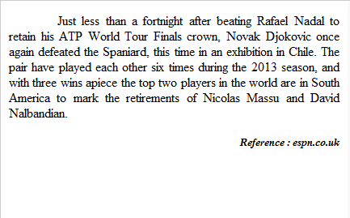
Text Indentation
Output :
<html>
<head><style>
p {text-align:justify; text-indent:60px;}
h5{text-align:right;font-style:italic;}
</style></head>
<body>
<p>
Just less than a fortnight after beating Rafael Nadal to retain his ATP World
Tour Finals crown, Novak Djokovic once again defeated the Spaniard, this time in an exhibition in Chile. The pair have played each other six times during the 2013 season, and with three wins apiece the top two players in the world are in South America to mark the retirements of Nicolas Massu and David Nalbandian.
</p>
<h5>Reference : espn.co.uk</h5>
</body>
</html>

Slide 61
Quiz
To underline the text of a paragraph, you will have to style the paragraph as follows :
p1 {text-transformation:underline;}
p1 {text-transform:underline;}
p1{text-decoration:uline;}
p1{text-decoration:underline;}
To make the first character of every word uppercase, you will have use the style :
h2{text-transformation:capitalize;}
h2{text-transform:capitalize;}
h2{text-transformation:uppercase;}
h2{text-transform:uppercase;}
Notes:
Answers :
d
b

Slide 62
CSS Font
CSS font properties are used to define the font family, size, style and boldness of the text.

Slide 63
CSS Font Family
We can set the font family of text using the font-family property.
It is possible to set more than one value for the font-family property. This is useful in case where the browser may not support the font-family we have specified. If the browser does not support the first font, it tries to set the next font.
Example :
p { font-family:”Arial”, Times, “Sans-serif”;}
Notes:
You can use Sans-serif fonts instead of serif, since they are easier to read.

Slide 64
Font Style
You can use the property font-style to specify italic text.
Example :
If you want text as italic, you can use
p { font-style:italic; }
You can also specify normal text :
p { font-style:normal; }

Slide 65
Font Size
You can use the font-size property to set the size of text.
The font-size value can be absolute or it can be relative.
Absolute size allows you to set the text to a specified size.
On the other hand, relative size sets the size relative to the surrounding elements.
Notes:
By default, the font size is 16 px. i.e. If you do not specify the font-size , then the normal text, as in the case of paragraphs, will always be set to 16 px.

Slide 66
Demo : Setting Font Size with pixels (Absolute size)
<html><head><style>
#p1 {
text-align:center;
color:red;
font-family:arial;
font-weight:bold;
font-size:25px;
}
#p2{
text-align:center;
color:blue;
font-family:Serif;
font-style:italic;
font-size:25px;
}

Slide 67

Demo : Font Size with pixels (Contd.).
#p3{
text-align:center;
font-family:Times;
font-style:normal;
font-size:18px;
}
</style>
</head>
<body>
<p id="p1">Wipro Technologies</p>
<p id="p2"> Bangalore </p>
<p id="p3"> India </p>
</body>
</html>
Output :

Slide 68
Font Size with em (Relative size)
You may face resizing problems, when you use older versions of browsers.
To avoid such problems, you can use set font size using em, instead of pixels.
The em size unit is a W3C recommendation.
1 em is equal to the current font size. The default text size is 16 px. So, the default size of 1 em is 16 px.

Slide 69

Demo : Font Size with Em
<html><head><style>
h1 {
text-align:center;
color:red;
font-weight:bold;
font-size:2em;
}
p{
font-size:1.25em;
}
</style></head>
<body>
<h1>Wipro Technologies</h1>
<p> Bangalore </p>
</body></html>
Output :

Slide 70
Quiz
To set the color of text as red for a paragraph, you will have to use the style :
p{font-color:#ff0000;}
p{text-color:#ff0000;}
p{paragraph-color:#ff0000;}
p{color:#ff0000;}
For specifying the font for the text of a paragraph as arial, you will have to use the style :
p{text-font:arial;}
p{font:arial;}
p{font-family:arial;}
p{text-family;arial;}
Notes:
Answers :
d
c

Slide 71
Summary
In this module, you were able to :
Define Background effect
Apply Text Formatting
Learn how to apply font properties

Slide 72
Links and Lists

Slide 73
Objеctivеs
In this module, you will
Learn how to style a link
Set List Item markers

Slide 74
CSS Links
You can use CSS styles to style any link. Links can be styled in different ways by using any CSS property like color, font-family etc.
Links can be in one of the following states :
a: link – Unvisited link
a: visited – A link that the user has visited
a: hover – A link over which the mouse pointer is moving
a: active – A link, which has been just clicked
Links can be styled according to their states.
Notes:
Important point to remember :
When you are setting the styles for several link states, you are required to follow some order rules:
1. a:hover MUST come after a:link and a:visited
2. a:active MUST come after a:hover

Slide 75
Demo 1 : CSS Links
<html>
<head>
<style>
a:link {color:yellow;}
a:visited {color:blue;}
a:hover {color:red;}
a:active {color:green;}
</style>
</head>
<body>
<p>
<a href="css16.html">Click here to open the html document css16</a>
</p>
</body>
</html>

Slide 76
Demo 2 : CSS Links
You can use text-decoration property for links.
<html><head>
<style>
a:link {text-decoration:none;}
a:visited {text-decoration:none;}
a:hover {text-decoration:underline;color:blue;}
a:active {color:red}
</style>
</head>
<body>
<p>
<a href="css16.html">Click here to open the html document css16</a>
</p>
</body></html>

Slide 77
Demo 3 : CSS Links
You can also use background-color property for links.
<html><head>
<style>
a:link {background-color:blue;}
a:visited {background-color:yellow;}
a:hover {background-color:cyan;}
a:active {background-color:red;}
</style>
</head>
<body>
<p><a href="css16.html">Click here to open the html document css16</a></p>
</body></html>

Slide 78
Quiz
To remove underline from a hyperlink, you will have to use the following css syntax :
a:link{text-decoration:no-underline;}
a:link{text-underline:none;}
a:link{text-decoration:none;}
a:hyperlink(text:no-underline;}
To set the color of the text for a hyperlink, when the mouse pointer moves over it, we have to use :
a) a:hover {background-color:cyan;}
b) a:mouseover {background-color:cyan;}
c) a:mousehover {background-color:cyan;}
d) a:hover {color-cyan;}
Notes:
Answers :
c
a

Slide 79
CSS List
You can use CSS list properties for
Setting different list item markers for ordered lists
Setting different list item markers for unordered lists
Set an image as the list item marker
You can use the following properties to set item markers :
list-style-type
list-style-image

Slide 80
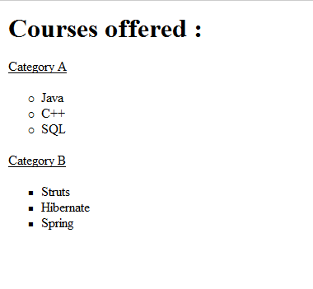
Demo : Different List Item markers for Unordered Lists
<html><head><style>
ul.a {list-style-type:circle;}
ul.b {list-style-type:square;}
p{text-decoration:underline;}
</style></head><body>
<h1>Courses offered :</h1>
<p> Category A </p>
<ul class="a">
<li>Java</li>
<li>C++</li>
<li>SQL</li> </ul>
<p> Category B </p>
<ul class="b">
<li>Struts</li>
<li>Hibernate</li>
<li>Spring</li></ul>
</body></html>
Output :

Slide 81

Demo : Different List Item markers for Ordered Lists
<html><head><style>
ol.a {list-style-type:upper-roman;}
ol.b {list-style-type:lower-alpha;}
p{text-decoration:underline;}
</style></head><body>
<h1>Courses Offered :</h1>
<p>Category A</p>
<ol class="a">
<li>Java</li>
<li>C++</li>
<li>SQL</li></ol>
<p>Category B</p>
<ol class="b">
<li>Struts</li>
<li>Hibernate</li>
<li>Spring</li></ol>
</body></html>
Output :

Slide 82
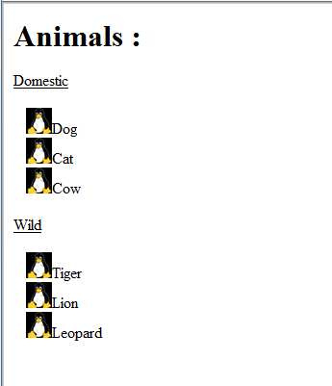
Demo : Image as list Item Marker
You can also specify an image as the list item marker.
<html><head><style>
ul {
list-style-image:url('animal1.bmp');
}
p {text-decoration:underline;}
</style></head><body>
<h1>Animals :</h1>
<p> Domestic </p>
<ul>
<li>Dog</li>
<li>Cat</li>
<li>Cow</li></ul>
<p> Wild </p>
<ul>
<li>Tiger</li>
<li>Lion</li>
<li>Leopard</li></ul>
</body></html>
Output :

Slide 83
Quiz
State whether the following statement is TRUE or FALSE
Using CSS, you can set an image as a list item marker
2. To set an ordered list with the type of list item marker as Upper Case Roman Letter, we have to define the style as follows :
a) ol.a{list-type:upper-roman;}
b) ol.a{list-type:UPPER_ROMAN;}
c) ol.a{list-style-type:roman_upper;}
d) ol.a {list-style-type:upper-roman;}
Notes:
Answers :
TRUE
d

Slide 84
Summary
In this module, you were able to :
Learn how to style a link
Set List Item markers

Slide 85
CSS Box Model

Slide 86
Objеctivеs
At the end of this module, you will bе able to
Design the layout of a document using Box Model
Set the height and Width of an element
Set padding, border and margin properties

Slide 87
Box Model : Introduction
Box model is useful for designing the layout of an HTML Page.
CSS Box model describes a box that wraps around HTML elements.
Using this model, we can define the margins, borders, padding and the actual content. We can place border around elements and space elements in relation to each other.

Slide 88
Box Model : Illustration
Margin
Border
Padding
Content
Notes:
Content : Contains the content that the element holds, which may be text or image.
Padding : It is the clearance area around the content. It is affected by the background color.
Border : Border encloses the padding and the content. It is affected by the background color.
Margin : Margin is the clearance area around the border. It is completely transparent. It does not have background color.

Slide 89
Setting the height and width of an element
You can set the height and width of an element using the height and width properties.

Slide 90
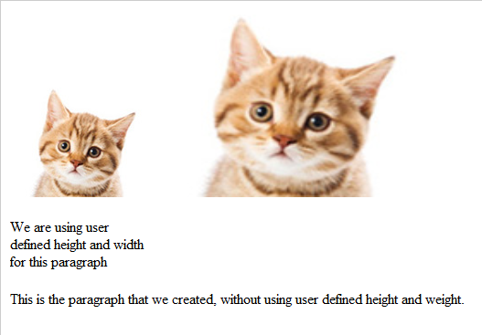
Demo :Setting the height and width
<html><head><style>
img.large{
height:200px; width:300px;
}
img.normal {
height:auto;width:auto;
}
p.custom {
height:120px;width:150px;
}
</style></head><body>
<img class="normal" src="kitten.jpg" />
<img class="large" src="kitten.jpg" />
<p class="custom">We are using user defined height and width for this paragraph</p>
<p>This is the paragraph created without using user defined height and weight. </p>
</body></html>
Output :

Slide 91
CSS Padding
You can use the CSS padding properties to define the space between the element border and the element content.
It is possible to change the top, right, bottom and left padding independently using separate properties.
You can also use a shorthand padding property to change all paddings in a single statement.
Notes:
Point to note :
Paddings are not supposed to be negative. You must avoid assigning negative values for padding.
What is the effect of assigning negative values? Participants are expected to find out.

Slide 92
CSS Padding (Contd.).
Individual padding properties can be specified as follows :
padding-top:20px; padding-bottom:30px; padding-right:25px; padding-left:10px;

Slide 93
CSS Padding (Contd.).
Shorthand padding property can be specified as follows :
padding : 20px 30px 25px 10px;
where
top padding is 20px.
right padding is 30px.
bottom padding is 25px.
left padding is 10px.

Slide 94
CSS Border
You can use the CSS Border properties to specify the style and color of an element’s border.
You can use the following properties :
border-style
border-width
border-color
Notes:
border-style values :
none : No Border
dotted : Dotted Border
dashed : Dashed Border
border-width :
You can set border-width using pixel value.
Ex : border-width:5px;

Slide 95
Demo : CSS Padding and Border
<!DOCTYPE html>
<html><head><style>
p {
background-color:cyan;
}
img.i1
{
padding-top:20px;
padding-bottom:25px;
padding-right:15px;
padding-left:10px;
border-style:solid;
border-width:5px;
border-color:red;
}
Notes:
Some browser may not work properly with padding and border. For e.g. Some versions of Internet Explorer included padding and border in the width property. In such cases, you will not be able to see the effect of explicit padding and border valuesthat you have defined in your document.
To overcome the above problem, you can add
<!DOCTYPE html>
as the first statement in your document :

Slide 96
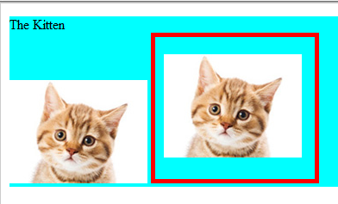
Demo : CSS Padding and Border (Contd.).
</style>
</head>
<body>
<p> The Kitten <br>
<img src="kitten.jpg" />
<img class="i1" src="kitten.jpg" />
</p>
</body>
</html>
Output :

Slide 97
Quiz
If you use negative values for padding, it will result in
An Error. The HTML page will not be displayed.
No error. The HTML page will be displayed with value of padding considered as zero.
The HTML page will be displayed with overlapping of border with the content.
None of the above.
Notes:
Answer is withheld. The participants are expected to try out and find the answer themselves.

Slide 98
CSS Margin
Using CSS Margin properties you can specify the space around elements.
You can also specify different margin for different sides :
margin-top:50px; margin-bottom:30px; margin-right:25px; margin-left:10px;
Notes:
Point to note :
You can also use negative values to overlap content.

Slide 99
CSS Margin (Contd.).
You can also specify Margin shorthand property to specify margin values.
The shorthand property for all margin properties is margin.
margin:50px 30px 25px 10px;
where
top margin is 50px.
right margin is 30px.
bottom margin is 25px.
left margin is 10px.

Slide 100
Demo : CSS Margin
<!DOCTYPE html>
<html>
<head>
<style>
p {
background-color:cyan;
}
img.i1 {
padding:20px;
border-style:solid;
border-width:5px;
border-color:red;
margin: 40px 30px 20px 10px;
}
</style>

Slide 101
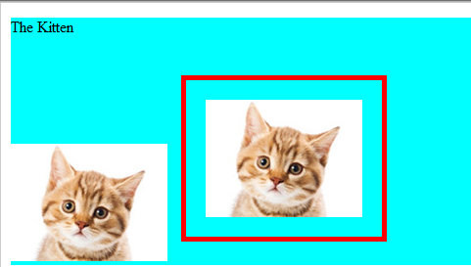
Demo : CSS Margin
</head>
<body>
<p> The Kitten<br>
<img src="kitten.jpg" />
<img class="i1" src="kitten.jpg" />
</p>
</body>
</html>
Output :

Slide 102
Quiz
How do you assign 25px as the value of top margin for a paragraph?
p{margin-top:25px;}
p{top-margin:25px;}
p{upper-margin:25px;}
p{margin-upper:25px;}
2. Which of the following is not a valid border property?
border-style
border-width
border-color
border-height
Notes:
Answers :
a
d

Slide 103
Summary
In this module, you were able to :
Design the layout of a document using Box Model
Set the height and Width of an element
Set padding, border and margin properties

Slide 104
CSS 3

Slide 105
Objеctivеs
At the end of this module, you will bе able to
Explore the new features introduced in CSS3
Set shadows for box and text
Use enhanced border properties
Use enhanced background properties
Explore transform and transition properties

Slide 106
CSS 3 Introduction
As discussed earlier, several new functionalities have been added in CSS 3
In this section, we will be having a look at the following CSS 3 properties :
border-radius
text-shadow
box-shadow
border-image
background-size
transform-rotate
transform-scale
transform-skew
transition
Notes:
Most of the CSS3 demo codes demonstrates in this section will not work with Internet Explorer. Try executing these codes with Firefox.

Slide 107
CSS 3 Border Radius Property
You can use border-radius property to add rounded borders to html elements.
You can also specify different values for four corners in the following manner :
border-top-left-radius:20px; border-top-right-radius:20px; border-bottom-right-radius:30px; border-bottom-left-radius:30px;

Slide 108

Demo : border-radius
<!DOCTYPE html>
<html><head>
<style>
Div {
border:2px solid #111111;
padding:10px 40px;
background:#aa00ee;
width:300px;
border-radius:25px;
}
</style>
</head>
<body>
<div>The border-radius property allows you to add rounded corners to elements.</div>
</body></html>
Output :
Notes:
This code doesn’t work with Internet Explorer. Try executing this code with Firefox.

Slide 109
CSS 3 Text Shadow Property
You can use text-shadow property to apply shadow to text.
text-shadow: h-shadow v-shadow blur color;
Where
h-shadow is the horizontal shadow.
v-shadow is the vertical shadow.
blur is the blur distance.
color is the color of shadow.
Notes:
This code doesn’t work with Internet Explorer. Try executing this code with Firefox.

Slide 110
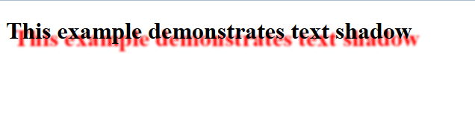
Demo : text-shadow
Output :
<html>
<head>
<style>
h1 {
text-shadow: 10px 10px 2px #FF0000;
}
</style>
</head>
<body>
<h1>This example demonstrates text shadow</h1>
</body>
</html>
Notes:
This code doesn’t work with Internet Explorer. Try executing this code with Firefox.

Slide 111
CSS 3 Box Shadow Property
You can use box-shadow property to attach one or more drop shadows to the box.
text-shadow: h-shadow v-shadow blur spread color;
Where
h-shadow is the horizontal shadow.
v-shadow is the vertical shadow.
blur is the blur distance.
spread is the size of the shadow.
color is the color of shadow.
Notes:
This code doesn’t work with Internet Explorer. Try executing this code with Firefox.

Slide 112
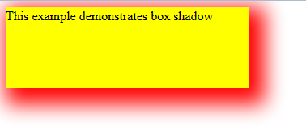
Demo : box-shadow
<!DOCTYPE html>
<html>
<head>
<style>
div {
width:300px;
height:100px;
background-color:yellow;
box-shadow: 10px 10px 25px 10px #ff0000;
}
</style>
</head>
<body>
<div>This example demonstrates box shadow</div>
</body>
</html>
Output :
Notes:
This code doesn’t work with Internet Explorer. Try executing this code with Firefox.

Slide 113
CSS 3 Border Image Property
You can use border-image shorthand property for setting up border-image-source,
border-image-width, border-image-repeat properties.
border-image:url(wonder.bmp) 30 30 round;
where
url is used to specify the image file
border-image:url(wonder.bmp) 30 30 round;

Slide 114
Demo : border-image
<!DOCTYPE html>
<html>
<head>
<style>
div{
border:15px solid transparent;
width:250px;
padding:10px 20px;
}
#tiled {
border-image:url(wonder.bmp) 30 30 round;
}
#stretch {
border-image:url(wonder.bmp) 30 30 stretch;
}
</style>
</head>

Slide 115
Demo : border-image (Contd.).
<body>
<p>The border-image property specifies an image to be used as a border.</p>
<div id="tiled">Here, the image is tiled (repeated) to fill the area</div>
<br>
<div id="stretch">Here, the image is stretched to fill the area</div>
<p>Image that was used for demonstration :</p>
<img src="wonder.bmp">
</body>
</html>
Notes:
This code doesn’t work with Internet Explorer. Try executing this code with Firefox.

Slide 116
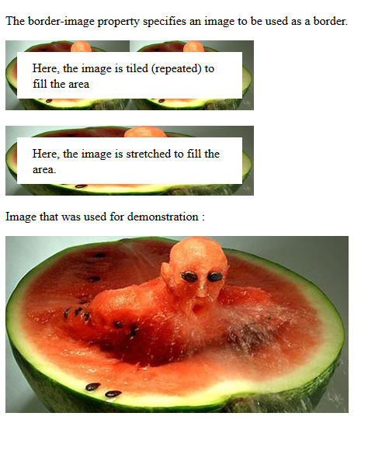
Demo : border-image (Contd.).
Output :
Notes:
This code doesn’t work with Internet Explorer. Try executing this code with Firefox.

Slide 117
Demo : background-size
Using this property, we will see how the background image grows in size as we keep appending the text.
<html>
<head>
<style>
div {
background:url(wonder.bmp);
background-size:100% 100%;
background-repeat:no-repeat;
}
</style>
</head>

Slide 118

Demo : background-size (Contd.).
<body >
<div style = "font-Family:arial; color:yellow; font-size:80px;”>
Welcome to Wipro.
</div>
</body>
</html>
Output :
Notes:
This code doesn’t work with Internet Explorer. Try executing this code with Firefox.

Slide 119
Quiz
If we want to have a div element with box shadow effect having vertical shadow of10px, horizontal shadow of 20px, the spread size as 40px, a blur distance of 30px and the color of shadow as red, which one of the following, we will have to use :
a. div { box-shadow: 40px 30px 20px 10px #ff0000; }
b. div { box-shadow: 10px 20px 30px 40px #ff0000; }
c. div { box-shadow: 20px 10px 30px 40px #ff0000; }
d. div { box-shadow: 20px 10px 40px 30px #ff0000;}
Notes:
Answer : c

Slide 120
transform:rotate method
When you use transform:rotate method, the element rotates clockwise at a given degree.
If you want rotation in anti-clockwise direction, use negative values.

Slide 121
Demo : transform:rotate
<html>
<head>
<style>
div{
width:200px;
height:100px;
background-color:yellow;
/* Rotate div */
transform:rotate(30deg);
}
</style>
</head>
Notes:
This code doesn’t work with Internet Explorer. Try executing this code with Firefox.

Slide 122
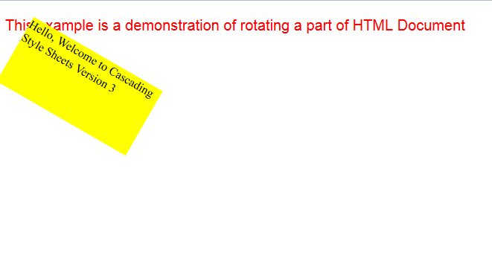
Demo : transform:rotate (Contd.).
<body>
<p style="font-family:arial; color:red; font-size:20px;">
This example is a demonstration of rotating a part of HTML Document
</p>
<div>Hello, Welcome to Cascading Style Sheets Version 3
</div>
</body>
</html>
Output :
Notes:
This code doesn’t work with Internet Explorer. Try executing this code with Firefox.

Slide 123
transform:scale method
When you use transform:scale method, the element increases or decreases in size, depending on the parameters given for the width (X-axis) and the height (Y-axis)
The value scale(2,3) transforms the width to betwice its original size and the height thrice its original size.

Slide 124
Demo : transform:scale method
<html>
<head>
<style>
div {
width:200px;
height:100px;
margin: 0px auto;
background-color:yellow;
}
div#div2 {
background-color:cyan;
transform:scale(2,3);
}
</style>
</head>

Slide 125
Demo : transform:scale method
<body align="centre">
<p style="font-family:arial; color:red; font-size:20px;"> This example is a demonstration of transform:scale method
</p>
<p align="center">
<div>Hello, Welcome to the training on CSS3</div>
<br><br><br><br><br>
<div align="center" id="div2" >
Hello, Welcome to the training on CSS3
</div>
</p>
</body>
</html>
Notes:
This code doesn’t work with Internet Explorer. Try executing this code with Firefox.

Slide 126
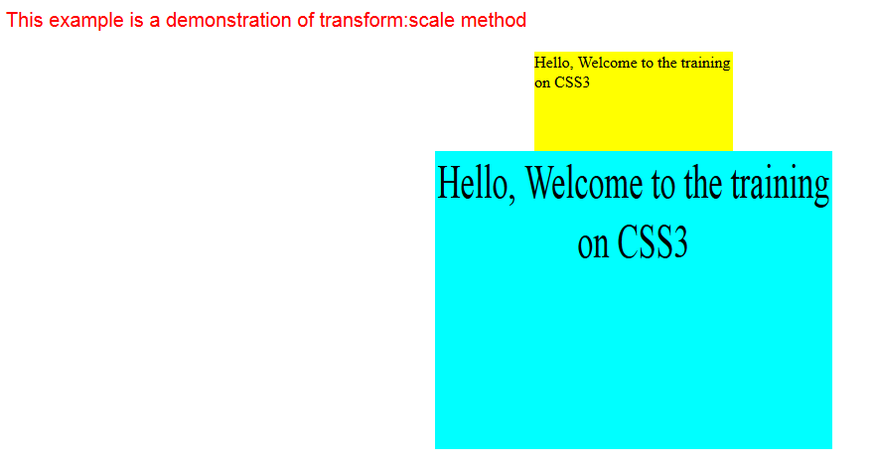
Demo : transform:scale method
Output :
Notes:
This code doesn’t work with Internet Explorer. Try executing this code with Firefox.

Slide 127
transform:skew method
When you use the transform:skew method, the element turns in a given angle, depending on the parameters given for the horizontal (X-axis) and the vertical (Y-axis) lines:
The value skew(35deg,25deg) turns the element 35 degrees around the X-axis and 25 degrees around the Y-axis.

Slide 128
Demo : transform:skew method
<html>
<head>
<style>
div {
width:200px;
height:100px;
margin: 0px auto;
background-color:yellow;
}
div#div2 {
background-color:cyan;
transform:skew(35deg,25deg);
}
</style>
</head>

Slide 129
Demo : transform:skew method (Contd.).
<body align="centre">
<p style="font-family:arial; color:red; font-size:20px;"> This example is a demonstration of transform:skew method
</p>
<p align="center">
<div>Hello, Welcome to the training on CSS3</div>
<br>
<div align="center" id="div2" >
Hello, Welcome to the training on CSS3
</div>
</p>
</body>
</html>
Notes:
This code doesn’t work with Internet Explorer. Try executing this code with Firefox.

Slide 130
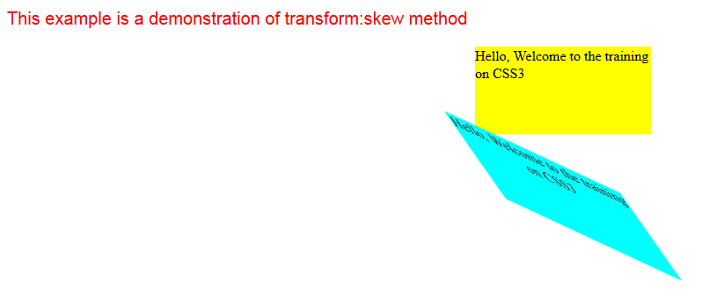
Demo : transform:skew method (Contd.).
Output :
Notes:
This code doesn’t work with Internet Explorer. Try executing this code with Firefox.

Slide 131
CSS3 Transitions
With CSS3, an effect can be added, when changing from one style to another, without using Javascript or Flash animation.
CSS3 transitions are effects that let an element gradually change from one style to another.
For transition effect, we must :
Specify the CSS property for which we want to add an effect.
Specify the duration of this effect.

Slide 132
Demo : CSS Transition
<html>
<head>
<style>
div{
width:100px;
height:100px;
background:red;
transition:width 2s, height 2s;
}
div:hover{
width:200px;
height:200px;
transform:rotate(180deg);
}

Slide 133
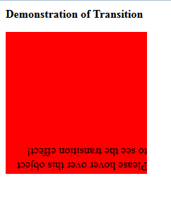
Demo : CSS Transition (Contd.).
</style>
</head>
<body>
<p><b> Demonstration of Transition</b></p>
<div>Please hover over this object to see the transition effect!
</div>
</body>
</html>
Output :
Notes:
This code doesn’t work with Internet Explorer. Try executing this code with Firefox.

Slide 134
Quiz
div1 {transform:rotate(30deg);}
div2 {transform:rotate(-30deg);}
Related to the code given above, which of the following statement is true :
a) div1 rotates 30 degrees anti-clockwise while div2 rotates 30 degrees clockwise
b) div1 rotates 30 degrees clockwise while div2 rotates 30 degrees anti-clockwise
c) Negative values have no effect. Both div1 and div2 rotate 30 degrees in clockwise direction.
d) Negative values have no effect. Both div1 and div2 rotate 30 degrees in anti-clockwise direction.
Notes:
Answer : b

Slide 135
Summary
In this sub-module, you were able to
Explore the new features introduced in CSS3
Set shadows for box and text
Use enhanced border properties
Use enhanced background properties
Explore transform and transition properties

Slide 136
References
w3schools.com (2012). CSS Introduction. Retrieved November 24, 2013, from,
http://www.w3schools.com/default.asp
2. w3schools.com (2012). CSS3. Retrieved November 24, 2013, from,
http://www.w3schools.com/css/css3_intro.asp

Slide 137
Thank You

