Slide 1
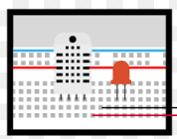


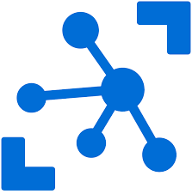

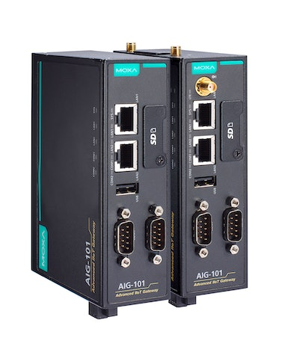

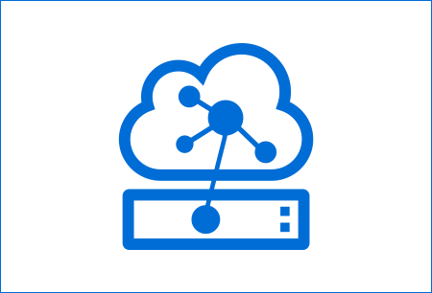
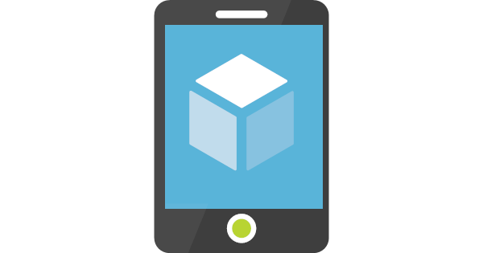
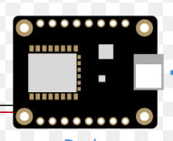

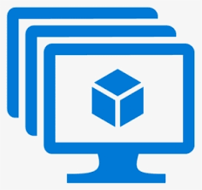
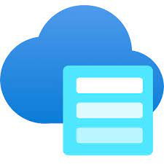




Internet of Things High Level Diagram (Azure)
IoT Things
Azure Cloud
UI Apps
Device Registration
Web App
Device Config
Industrial Devices
IoT
EDGE
HUB
Remote Command
Web API
Cloud Gateway
Mobile App
Sensor Device
IoT EDGE
Device
Telemetry Data
Storage, Time Series DB, Blob, File
Streamed Data
Image, Video
Notification
Alerts
Other Applications
Process
Streamed Data
Dashboard

Slide 2

Internet of Things High Level Diagram (on prem)
IoT Things
On Prem
UI Apps
Device Registration
IoT
Web API
Web App
Device Config
Industrial Devices
Remote Command
Web API
Custom Cloud Gateway
Mobile App
Sensor Device
Custom Docker EDGE
Device
Telemetry Data
Storage, Time Series DB, Blob, File
Streamed Data
Image, Video
Notification
Alerts
Other Applications
Job : Process
Streamed Data
Dashboard

Slide 3
IoT Technology Stack
IoT Things
Iot Technology Stack: C++ / Python, MQTT, TCP, Azure IoT Edge, C# Knowledge Control System. Optional industry standard like Spark Plugin, gPRS communication.
IoT Edge Device: Linux VM or Raspberry PI Hardware or mini Hardware compatible with Linux OS.
Industrial Devices : Communication Protocols (TCP, MQTT, USB, Serial port communication ), Analog and Digital signal. Other Software applications: TCS,USB, API Communication, Serial port communication.
Azure Cloud
Azur IoT Hub : Application Gateway (Devices and IoT Edge will communicate through IoT Hub, Device registration and configuration).
Web API: C#, ASP.Net Core web API, Azure Function Apps: Processing of device streamed, video, image data.
NoSQ (Mongo DB, Cosmos DB): Unstructured IoT data or large telemetry data.
Postgres SQL Time scale DB: Large time series telemetry data.
UI Application
UI Application: Angular / React UI application for telemetry data, Chart and graphical presentation of device telemetry data. Mobile UI : IoT Device Notification, Alert, telemetry data Presentation. (responsive UI compatible with mobile )
Azure Dashboard: Telemetry analytical data.
Email Notification: IoT notification, alert .

Slide 4
Visual studio Code, WSL docker

