Slide 1
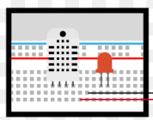
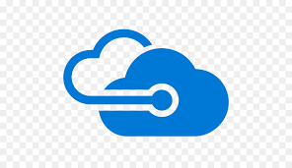
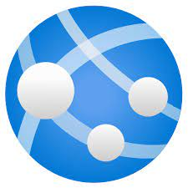
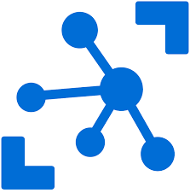
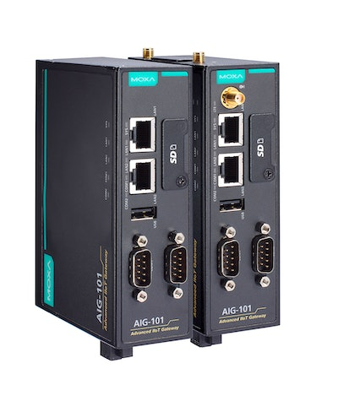

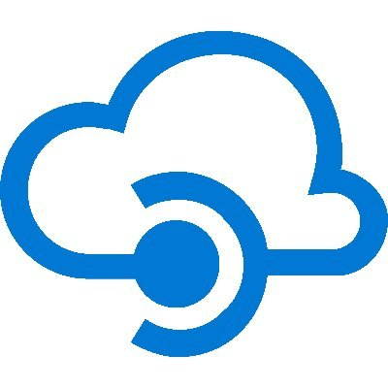
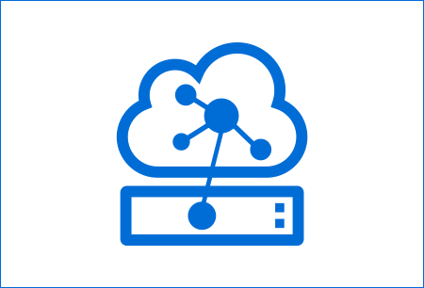
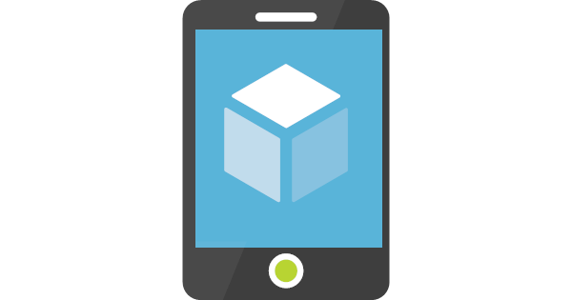
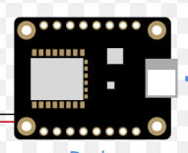
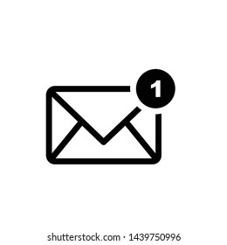
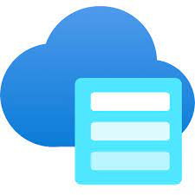
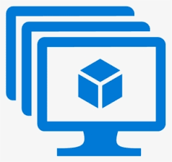
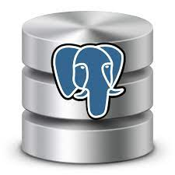
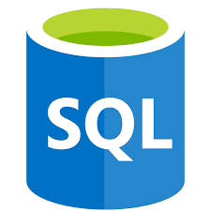

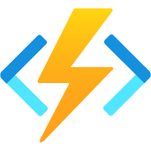
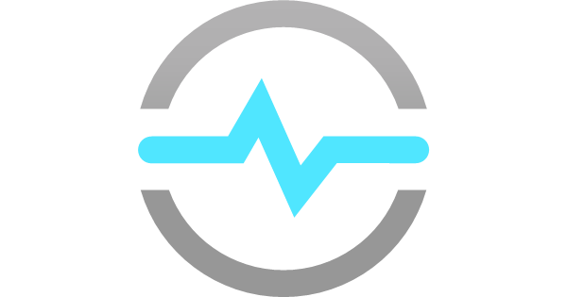
Internet of Things High Level Diagram (Azure)
IoT Device and IoT Edge
Azure IoT Cloud
UI Apps
Device Registration
Device Config
Web App
Industrial Devices
IoT
EDGE
HUB
Remote Command
Web API
Cloud Gateway
Storage, Time Series DB, Blob, File
Mobile App
Sensor Device
IoT EDGE
Device
Telemetry Data
Streamed Data
Image, Video
Notification
Alerts
Other Applications
Dashboard
Process
Streamed Data
Azure Time
Series Insights

Slide 2
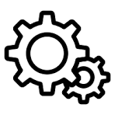
Internet of Things High Level Diagram (on prem)
IoT Device and IoT Edge
On Prem
UI Apps
Device Registration
IoT
Web API
Device Config
Web App
Industrial Devices
Remote Command
Web API
Custom Cloud Gateway
Storage, Time Series DB, Blob, File
Mobile App
Sensor Device
Custom Docker EDGE
Device
Telemetry Data
Streamed Data
Image, Video
Notification
Alerts
Other Applications
Dashboard
Job : Process
Streamed Data

Slide 3
Internet of Things High Level Diagram (Azure)
Summary
IoT Device and IoT Edge:
Device: The physical devices where our data originates and communicates with IoT Edge.
IoT Edge Device: These devices serve an active role in managing device access, configuration, protocol translation and information flow. They may help with device provisioning protocol translation, event rules processing, data filtering, batching and aggregation, buffering of data. IoT Edge Device basically communicates with Cloud Gateway and Azure IoT hub.
Azure IoT Cloud:
Cloud Gateway and Azure IoT EDGE HUB:
Azure IoT Hub enables secure and reliable communication between IoT solution and the physical devices it manages. IoT Hub provides a cloud-hosted solution backend to connect devices with per-device authentication, manage device, configuration, device command and scaled provisioning. Azure IoT Hub tracking events like device creation, device communication failures, and device connections and telemetry message routing.
Azure Function: Function take care of processing of large data like images, videos.
Storage: IoT telemetry data requires large storage. Time Scale DB like Postgres or NOSQL can be used to store such large data.
UI Applications:
IoT real time data can be used to visualized using Angular / React
Microsoft Power BI can be used to visualize real-time sensor data that your Azure IoT hub receives.
Azure Time Series Insights is designed for ad hoc data exploration and operational analysis allowing you to uncover hidden trends, spotting anomalies, and conduct root-cause analysis.

Slide 4
IoT Technology Stack
IoT Device and IoT Edge
IoT Edge Device and Device:
C++ /Python, MQTT, TCP, Azure IoT Edge, C# Knowledge Control System.
Industry standard like Spark Plugin, gPRS communication.
IoT Edge Device: Linux VM or Raspberry PI Hardware or mini Hardware compatible with Linux OS.
Industrial IoT: Communication Protocols (TCP, MQTT, USB, Serial port communication ), Analog and Digital signal. Software Applications: TCS,USB, Serial port communication, API communication.
Azure Cloud
Azur IoT Hub : Azure IoT Hub, MQTT, REST APIs,C#.
Web API: C#, ASP. Net Core web API. Azure Function Apps: To process streamed, video, image data.
Database : NoSQL can be used to store IoT Unstructured data. Telemetry data can be stored in Postgres SQL Time scale DB or NoSQL DB like Mongo DB, Cosmos DB.
UI Application
UI Application: Angular / React UI application will be to visualize telemetry data using Chart and Graphical controls. Azure Dashboard: Telemetry analytical data.
Email Notification: IoT notification, alert .
Azure Time Series Insights: Azure Time Series Insights is a fully managed analytics, storage, and visualization service for managing IoT-scale time-series data in the cloud. It provides massively scalable time-series data storage and enables you to explore and analyze billions of events streaming in from all over the world in seconds.

Slide 5
Design Approach
Azure IoT Solution: In this approach everything is managed by Azure Cloud. Azure IoT Edge will be used to manage IoT Devices. Azure IoT Hub will take care of Cloud Getaway, Device registration, configuration, management and telemetry data. For UI application we wan use Azure Cloud or we can create UI application in Angular/react.
On prem IoT Solution : In this approach need to develop Custom IoT Edge framework based on Linux OS and IoT devices will communicate with custom IoT Edge. Instead of Azure IoT Hub we can create REST API which all pay role of Getaway, Device registration, configuration, management and telemetry data.

