Slide 1
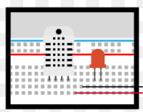
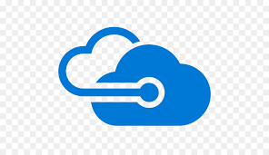
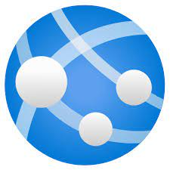

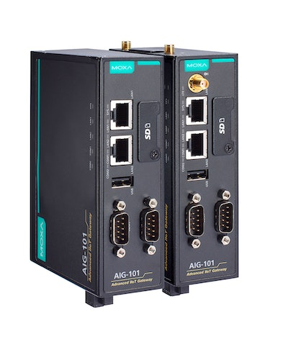

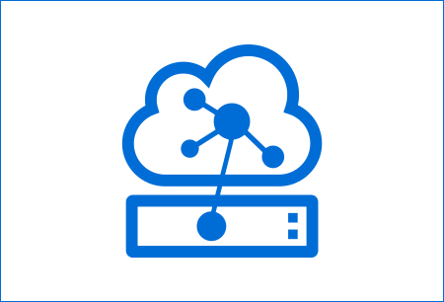
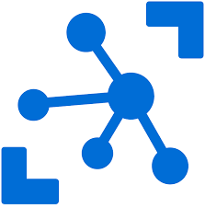
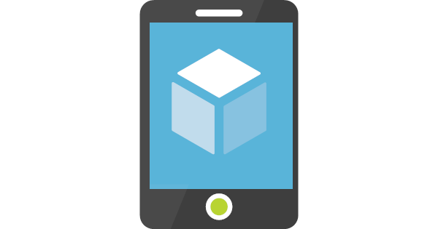
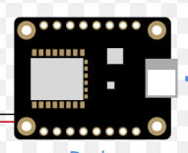
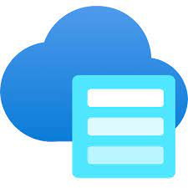
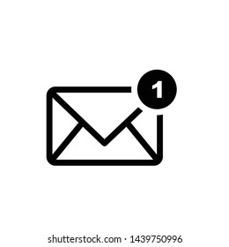
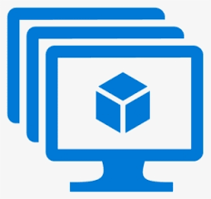



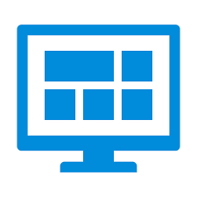
Internet of things High Level Diagram
IoT Things Field
Azure Cloud
UI Apps
Device Config Update
Web API
Web App
Remote Command
Industrial Devices
Storage, Time Series DB, Blob, File
Mobile App
IoT Edge
Device
Azure IoT Hub
Devices
Cloud Gateway
Notification
Alerts
Other Applications
Telemetry Data
Streamed data
Process
Streamed data
Dash Board

Slide 2
IoT Technology Stack
IoT Things Field
Industrial Devices : Communication Protocols (TCS, MQTT, USB, Serial port communication ), Analog and Digital signal.
Senser Devices : Knowle of C++, Python, Control System is required. Other software applications: API Communication, USB, Serial port communication.
Azure IoT Edge: Azure IoT Edge modules with C# or python.
MQTT: MQTT message communication protocol. IoT Edge Device: Linux VM or Raspberry PI Hardware or mini Hardware compatible with Linux OS
Industry standard protocol : Spark Plugin, gPRS
Azure Cloud
Azur IoT Hub : Application Gateway (Devices and IoT Edge will communicate through IoT Hub, Device registration and configuration).
ASP.Net Core Web API: Plays role of receiving telemetry data and device configuration or remote control. Azure Function Apps: Processing of device streamed, Video , Image data.
NoSQ (Mongo DB, Cosmos DB): Store unstructured data. Or large telemetry data.
Postgres SQL Time scale DB: Store large time series data. Telemetry data.
UI Apps
Angular / React UI: Presentation for layer for Iot, Device details, telemetry graphical data Presentation. Mobile UI : IoT notification, alert and , telemetry graphical data Presentation. (responsive UI compatible with mobile )
Azure Dashboard: Telemetry analytical data.
Email Notification: IoT notification, alert .

