Slide 1
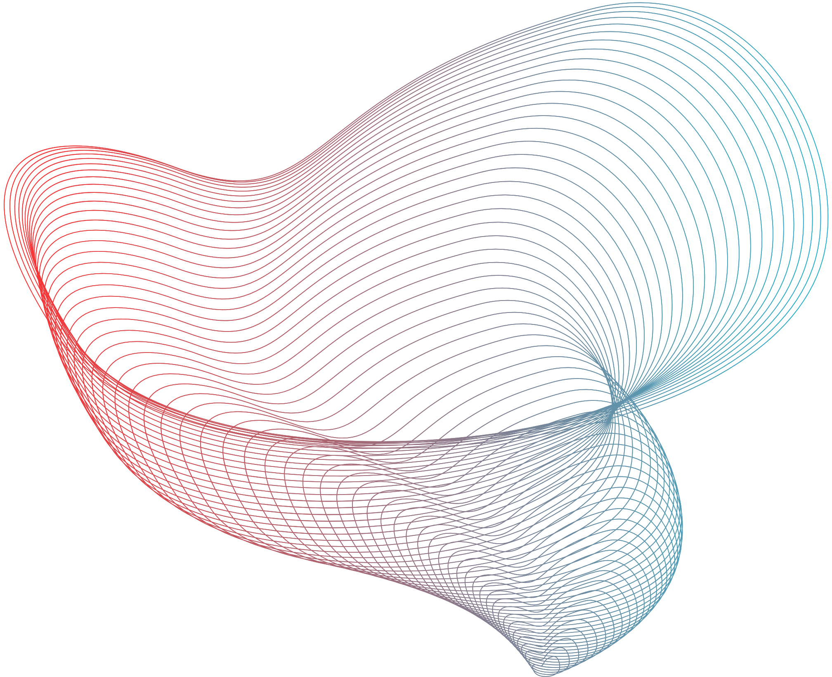


Indian Institute of Technology, Jodhpur
REAL-TIME FRAUD DETECTION IN FINANCIAL TRANSACTIONS
Sandip Rana(M23AID049)
Utpal Mondal(M23AID052)
Soumyajit Karan(M23AID020)

Slide 2

ABOUT THE USE CASE
Financial institutions process thousands of transactions every second. Detecting fraudulent transactions in real-time is crucial to prevent losses and protect customer assets. The system must process data streams in real-time, apply complex analytics to detect patterns indicative of fraud, and trigger alerts for further investigation.
To build a real-time fraud detection system that analyzes financial transactions as they occur, identifies suspicious activities, and alerts the system in near real-time using Apache Kafka and Spark Streaming.

Slide 3



TECHNOLOGY STACK
Data streaming
Apache kafka
Programming
Python with spark engine
Job scheduling
Apache Airflow

Slide 4
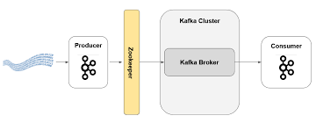
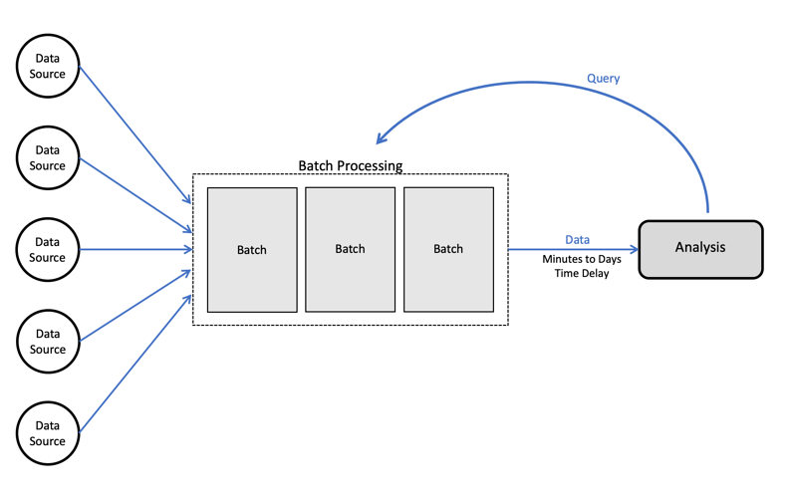
ARCHITECTURE PATTERN USED
Broker Architecture Pattern
Batch Processing Architecture Pattern

Slide 5
WHY USE BROKER ARCHITECTURE OVER
BATCH PROCESSING?
Broker Architecture: This pattern enables real-time or near-real-time communication between producers and consumers. It is ideal when systems need to react to events as they happen, such as in IoT, streaming data, or online services.
Batch Processing: Batch systems process data in large chunks at specific intervals, meaning there is a delay between data generation and processing. This makes it unsuitable for real-time use cases but works well for data analytics, reporting, and non-time-sensitive operations.

Slide 6
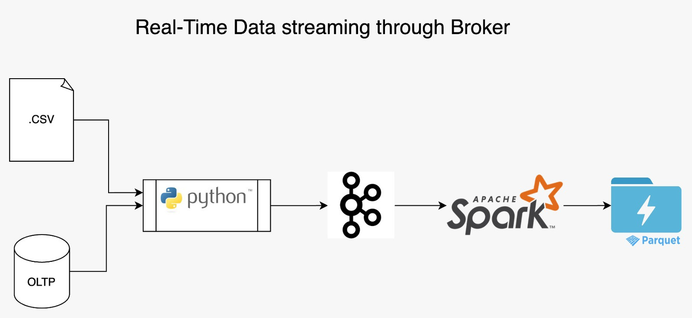
BROKER ARCHITECTURE PATTERN USING KAFKA

Slide 7
BROKER ARCHITECTURE PATTERN - USEFULNESS
Decoupling of Components
Flexibility and Extensibility
Simplified Communication
Scalability
Interoperability
Resilience

Slide 8
WHY KAFKA?
Fast - A single Kafka broker can handle 100 Mbps of reads & writes from 1000 of clients
Scalable - Data streams are partinioed and spread over a cluster of machines to allow data streams larger than the capability of a machine
Durable - Messages are persisted on disk and replicated within the cluster to prevent data loss. Each broker can handle terabytes without performance impact.
Distributed by design - Kafka has a modern cluster-centric design that offers strong durability and fault-tolerance guarantees

Slide 9
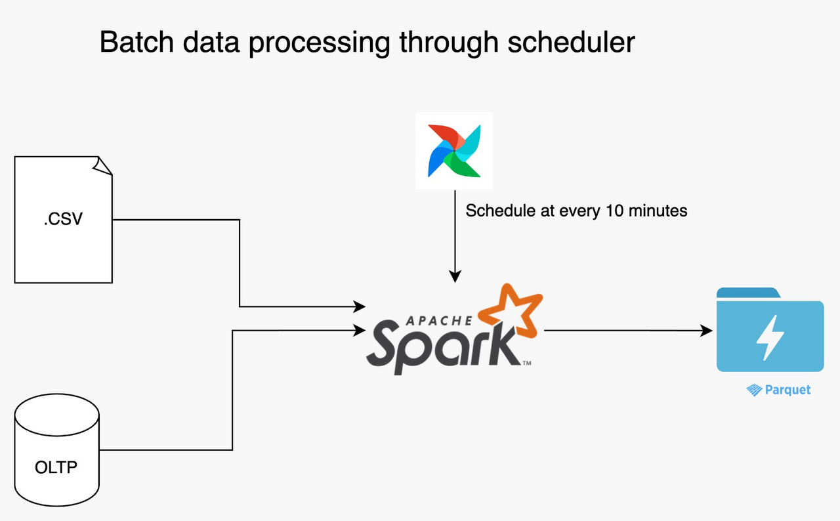
BATCH PROCESSING ARCHITECTURE PATTERN

Slide 10
BATCH PROCESSING ARCHITECTURE - USEFULNESS
Efficiency: It's optimal for processing large volumes of data at once, reducing the overhead that comes with processing data in real-time.
Cost-effectiveness: By executing batch jobs during off-peak hours, you can take advantage of lower compute costs and better resource utilization.
Automation: Many batch processing systems support scheduling, which helps in automating repetitive tasks, leading to increased productivity.
Error Handling: Errors can be handled more gracefully by logging them and rerunning the batch process if needed.
Consistency: Ensures data consistency and integrity, as all data in a batch is processed in a uniform manner.

Slide 11
MODULES OF THE USE CASE
Online Transactional Processing (OLTP) data capture in real-time scenario(In scope)
Captured data processing using machine learning techniques(Future scope)

Slide 12
THANK YOU

