Slide 1
AI, ML, DL & Related Topics
(Refresher)

Slide 2
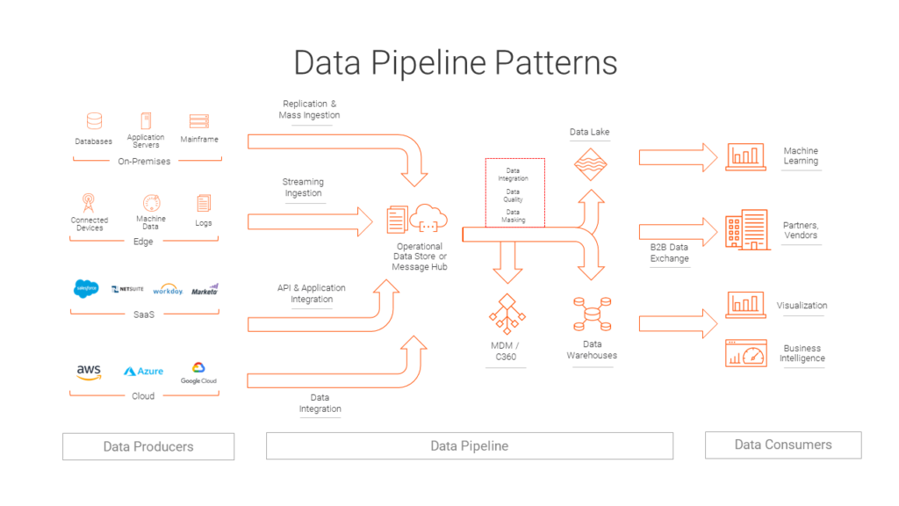
Data Pipeline
For Further Exploration –
Data Engineering Pipeline
The 6 Categories of Data
What are Categorical Data Encoding Methods | Binary Encoding
DB Types
Data Anonymization vs Data Masking: Differences & Best Practices
Leveraging RecordIO for Efficient Training and Cost Reduction in Amazon SageMaker
Also, can refer Data (Engineering) slides in the “Software Architecture and Patterns“ deck.

Slide 3
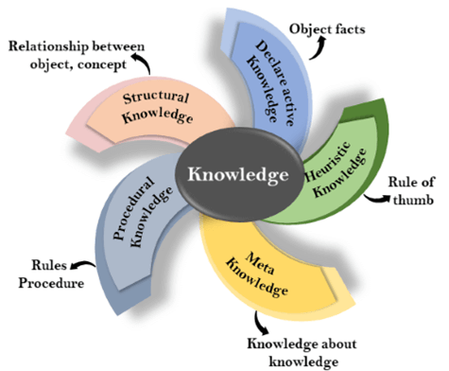
Knowledge Representation
For Further Exploration –
Knowledge Based Agent
A Knowledge Representation Practionary
Data types In Machine Learning

Slide 4
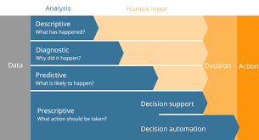
Data Analytics Types
For Further Exploration –
8 Types of Data Analysis
What Is Diagnostic Analytics? How It Works and Examples
BI vs Analytics - What is Business Intelligence (BI) ? What is Analytics ? [2023] - YouTube

Slide 5
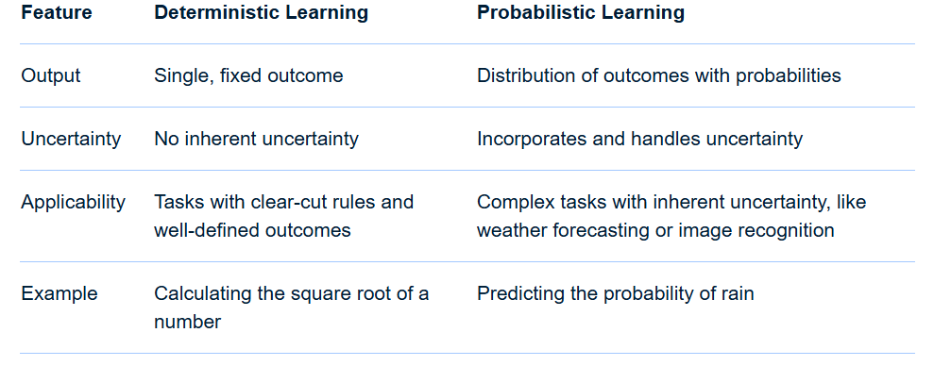
Deterministic vs Probabilistic Learning
In essence: Deterministic learning provides a clear and precise answer, while probabilistic learning offers a range of possibilities and their likelihoods, allowing for a more nuanced understanding of uncertain situations.
Use deterministic techniques for tasks requiring guaranteed consistency, accuracy, and predictability, such as rule-based systems or cryptographic applications, where a fixed output for the same input is essential and uncertainty is low. Use probabilistic techniques when dealing with incomplete or noisy data, needing to handle uncertainty, or for generating diverse, creative outputs, such as in medical diagnosis where confidence levels are important, or in generative AI applications like text creation.
When to Use Deterministic Techniques
Need for Absolute Consistency: When a model must produce the exact same output every time given the same input, such as in a calculator or a simple sort algorithm.

Slide 6
Deterministic vs Probabilistic Learning
Tasks with Clear, Fixed Rules: Ideal for applications with well-defined rules and predictable relationships, like financial forecasting or certain medical diagnostic systems that flag specific symptoms.
Compliance and Auditing: Deterministic models provide auditable and traceable outcomes, which is crucial for regulated environments like finance and healthcare where precise and consistent results are required.
High-Certainty Scenarios: Used when there is a low degree of uncertainty or randomness in the data or process, ensuring precise solutions.
When to Use Probabilistic Techniques
Handling Uncertainty and Incomplete Data: When data is incomplete, noisy, or contains randomness, probabilistic models use statistical inference to make predictions and estimations.
Quantifying Confidence and Risk: These models provide confidence estimates for their predictions, which is vital in fields like medical diagnosis or risk management to understand the likelihood of a particular outcome.
Complex Tasks and Pattern Recognition: Suitable for intricate tasks with underlying patterns that are not always obvious, allowing models to learn from data to make more generalized predictions.
Generating Creative or Diverse Outputs: In Generative AI, probabilistic approaches are used to create novel and diverse content, such as text, images, or music, rather than always returning the same result.
Hybrid Approaches
Often, a combination of both deterministic and probabilistic approaches provides the most effective solution. For example, in predictive maintenance, a deterministic model can define normal machine behavior, while a probabilistic model can analyze sensor data to predict when maintenance is truly needed.

Slide 7
Deterministic vs Probabilistic Learning
For Further Exploration –
Probabilistic vs. Deterministic Models in AI/ML: A Detailed Explanation
What is Deterministic/Probabilistic Data? | Definition from TechTarget
Probabilistic and Deterministic Results in AI Systems - Gaine Technology
What is the difference between deterministic and stochastic models?
Deterministic vs Stochastic - Machine Learning Fundamentals
Deterministic and Probabilistic Matching
Las Vegas vs Monte Carlo

Slide 8
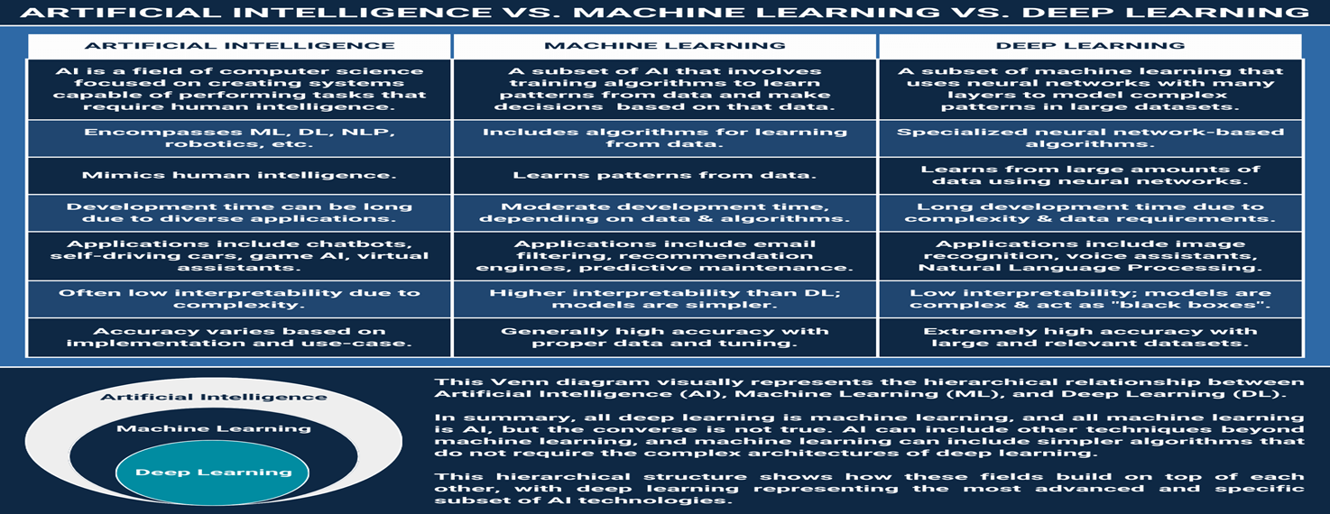
AI, ML, DL
For Further Exploration –
Artificial Intelligence Vs Machine Learning Vs Deep Learning

Slide 9
AI, ML, DL – When and Why to Use And Not to Use
When to Use AI, ML, and DL:
Complex tasks: AI, ML, and DL excel at tasks that are difficult to define or automate with traditional programming, like image recognition, natural language processing, and pattern recognition.
Large datasets: DL is particularly well-suited for processing large amounts of data, where complex patterns can be learned.
Predictive tasks: ML and DL can learn from historical data to predict future outcomes, such as fraud detection or customer churn.
Data-driven insights: AI, ML, and DL can uncover hidden patterns and insights within data that might otherwise be missed.
When human intervention is undesirable: DL can learn and adapt without extensive manual intervention, making it suitable for tasks like autonomous vehicles.
When NOT to Use AI, ML, and DL:
Simpler tasks: If a task can be solved with simple rules or computations, there's no need for complex AI, ML, or DL models.
Limited data: ML and DL models require sufficient data to learn effectively. Insufficient data can lead to poor performance and unreliable results.
Mission-critical systems: ML models, particularly those reliant on extensive data, may not be suitable for highly critical applications where deterministic behavior is essential.
Lack of interpretable models: DL models, while powerful, can be less interpretable than simpler ML models, which can be a drawback in some applications.
Ethical concerns: AI, ML, and DL can raise ethical issues, such as bias or privacy concerns, which should be carefully considered

Slide 10
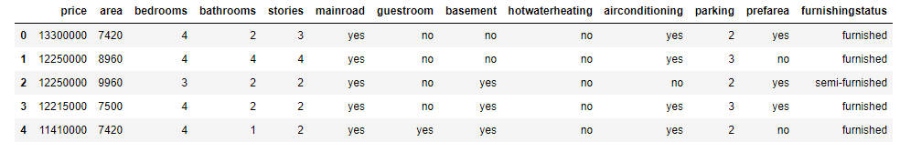

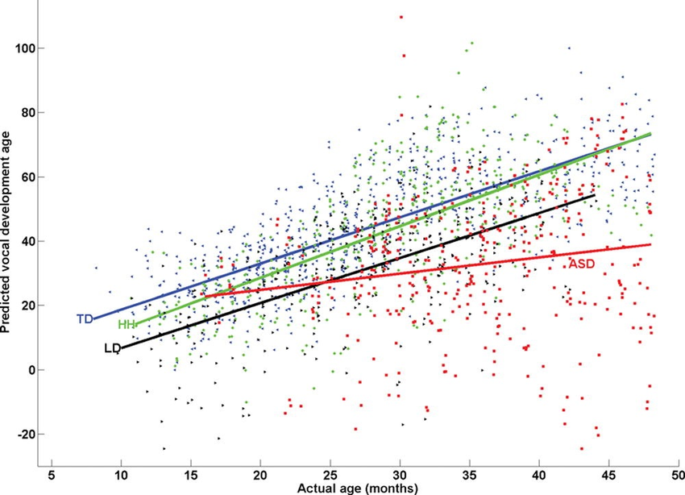
Predictive Analytics Intro Example & y = f(x)
Most AI/ML/DL etc Algorithms’ intent is to find “f” in “y = f(x)” based on data provided for x(& y). Mainly x & y here are multivalued variable(i.e. a variable that can contain many values at different times of measurements) i.e. tabular data of samples of x(& y) e.g. as below –
And such “f” is called parametric model when you assume the form of the function(e,g, linear, quadratic etc) & assume that the parameters are fixed while non-parametric model, if no assumption regarding function’s form is there & the parameters are not fixed.
The number of tunable parameters in a model determines the hypothetical set of functions that can be implemented using that model. In essence we are limited to finding a solution from that set. By increasing the number of parameters you increase the capacity of the hypothesis class of various functions satisfying that model.

Slide 11
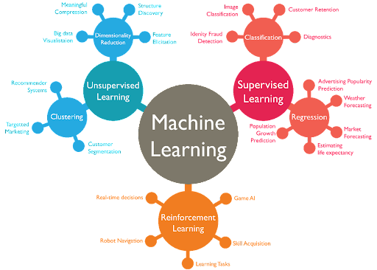
ML Types (& Algorithms) – High Level
N.B. - Some ML algos are based on parametric models while some are based on non-parametric models but most DL algos are based on parametric models
For Further Exploration –
4 Types of Learning in Machine Learning Explained
Difference between Parametric and Non-Parametric Methods – GeeksforGeeks
How do you decide when to use Parametric methods vs Non Parametric methods? [Question] : r/statistics
Algorithm & component reference

Slide 12
ML Types Taxonomy – A Bit More in Detail
I. Based on Supervision
A. Supervised Learning
Overview - Learn from labeled data (input → output mapping).
In Terms of y = f(x) - Both x and y are given and the model is trained to find the form and parameters of “f”. Once f is found, for new x, new y is found and that’s how prediction happens.
Types:
Regression: Predict continuous values (e.g., house price).Mainly based on linear equations[y = f(x)].
Classification: Predict discrete labels (e.g., spam detection). Mainly based on linear in-equalities[e.g. y >= f(x) then y belongs to classA else y belongs to classB]
Ranking: Learn orderings (e.g., search engine ranking).Again, mainly based on linear in-equalities[y >= f(x) or y <= f(x)]
Examples - Linear/Logistic Regression, Decision Trees, SVM, Neural Nets
Key Concepts - Loss functions, generalization, bias-variance
B. Unsupervised Learning
Overview - Discover structure/patterns without labels.
In Terms of y = f(x) – x is given and y is learned here and not provided explicitly. y in general is some form of latent representation(e.g. in Autoencoders)/cluster assignment(assigning cluster index in clustering)/density or model of data distribution(e.g. GMM, VAE, Diffusion Models)/reconstruction
Types:
Clustering: Group similar data (e.g., K-Means, DBSCAN). In terms of y=f(x), y is in general the cluster index

Slide 13
ML Types Taxonomy – A Bit More in Detail
I. Based on Supervision
B. Unsupervised Learning
Types:
Dimensionality Reduction: Compress information (e.g., PCA, t-SNE). In terms of y=f(x), in this case x∈D (high-dimensional), y∈d (lower-dimensional), with d < D.These methods explicitly learn a mapping that compresses information without lossing any valuable information.
Density Estimation: Estimate data distribution (e.g., GMM).In terms of y=f(x), characterizes the range of possible y values and their probabilities for each x.
Representation Learning: Autoencoders, Variational Autoencoders. This can be conceptualized as two sequential functions:
h=fEncoder(x): The encoder function fEncoder maps the high-dimensional, raw input data x into a compact, meaningful intermediate representation h (also called an embedding).
y=fDecoderOrTask(h): The representation h is then used by a decoder or a specific task-oriented function fTask to produce the final desired output y.
Examples - K-Means, PCA, Autoencoders, Gaussian Mixture Models
Key Concepts - Clustering, density estimation, manifold learning
C. Semi-Supervised Learning
Overview - Use small labeled + large unlabeled data.
In Terms of y = f(x) - x is given for all samples and y is given for some small amount of data and for the remaining data, y is learned similar to unsupervised learning
Idea: Regularize models to be consistent across similar unlabeled samples.
Examples - Ladder Networks, MixMatch, FixMatch

Slide 14
ML Types Taxonomy – A Bit More in Detail
I. Based on Supervision
Key Concepts - Consistency regularization, pseudo-labeling
D. Self-Supervised Learning
Overview - Generate supervision from data itself.
In Terms of y = f(x) - Start with raw data: x. Apply a transformation or masking: T(x).Generate target from x: y = G(x).Train a model f: f(T(x)) = G(x), Where: f = model, T = masking/augmentation/corruption, G = target-generating function (identity, mask-reveal, augment, etc.)
Mechanism: Learn via “pretext tasks” — predict parts of input from other parts.
Examples –
Contrastive Learning: SimCLR, MoCo — learn invariant representations.
Masked Prediction: BERT, MAE — predict masked tokens or image patches.
Predictive Coding: CPC, BYOL — predict future embeddings.
Key Concepts - Pretext tasks, embeddings, contrastive loss
E. Reinforcement Learning (RL)
Overview - Learn via interaction and reward signals.
In Terms of y = f(x) - y is action/value → model learns f from reward. y can be
Policy action = π(state),
Value function V(s) = f(s),
Q-function Q(s,a) = f(s,a)
World model next state = f(s,a).
The learning happens through reward signals, not labeled outputs

Slide 15
ML Types Taxonomy – A Bit More in Detail
I. Based on Supervision
E. Reinforcement Learning (RL)
Formalism: Markov Decision Process (MDP).
Families:
Model-Based: Dyna-Q, Dreamer.
Model Free :
Value-Based: Q-learning, DQN.
Policy-Based: REINFORCE, PPO.
Examples - Q-Learning, PPO, DQN, AlphaZero
Key Concepts - Policy, value function, exploration–exploitation
II. Based on Knowledge / Priors Used
A, Deterministic Learning
Description - Fixed parameters learned via optimization (no probability). Done by working directly on data/latent space
Examples - Backpropagation-based Deep Learning
B. Frequentist Learning
Description - Parameters fixed, learn by maximizing likelihood. Done by working directly on data/latent space.
Examples - MLE, Linear Regression, SVM

Slide 16
ML Types Taxonomy – A Bit More in Detail
II. Based on Knowledge / Priors Used
C. Bayesian Learning
Description - Parameters as random variables, infer posterior. Done by working directly on the underlying hypothesis between data or latent space.
Examples - Bayesian Networks, Gaussian Processes
D. Physics-Informed Learning (PIML)
Description - Incorporate physical laws or Ordinary/Partial Differential Equations constraints.
Examples - PINNs (Physics-Informed Neural Networks)
E Symbolic / Neuro-symbolic Learning
Description - Combine logic + neural learning.
Examples - DeepProbLog, Logic Tensor Networks
F. Causal Learning
Description - Learn cause-effect relationships.
Examples - Causal Discovery, Do-calculus, CausalNets
III. Based on Human or Environmental Feedback
A. Active Learning
Description - Model queries the most informative samples.
Techniques - Query-by-committee, uncertainty sampling
B. Interactive Learning
Description - Human-in-the-loop adjusts model interactively.
Techniques - Reinforcement from human feedback (RLHF)

Slide 17
ML Types Taxonomy – A Bit More in Detail
III. Based on Human or Environmental Feedback
C. Curriculum Learning
Description - Train on data from easy → hard (like humans).
Techniques - Task scheduling, dynamic sampling
D. Multi-Agent Learning
Description - Multiple agents learn collaboratively or competitively.
Techniques - MARL, Game-theoretic learning
IV. Based on Data Modality or Representation
A. Representation Learning
Description - Learn useful latent features from data.
Techniques - Autoencoders, Contrastive Learning
B. Metric Learning
Description - Learn distance metrics between samples.
Techniques - Siamese Networks, Triplet Loss
C. Generative Learning
Description - Model data distribution and generate new samples.
Techniques - VAEs, GANs, Diffusion Models

Slide 18
ML Types Taxonomy – A Bit More in Detail
IV. Based on Data Modality or Representation
D. Multimodal Learning
Description - Learn jointly from text, image, audio, etc.
Techniques - CLIP, Flamingo, Gemini models
V. Based on Task or Goal
A. Transfer Learning
Description - Transfer knowledge from one task/domain to another.
Example Techniques - Fine-tuning, Feature extraction
B. Meta-Learning (Learning to Learn)
Description - Model learns how to learn.
Example Techniques - MAML, Reptile, Prototypical Networks
C. Continual / Lifelong Learning
Description - Learn sequentially without forgetting old tasks.
Example Techniques - EWC, GEM, replay-based methods
D. Few-shot / Zero-shot Learning
Description - Learn with very few or no labeled examples.
Example Techniques - GPT models, CLIP, ProtoNets

Slide 19
ML Types Taxonomy – A Bit More in Detail
V. Based on Task or Goal
E. Multitask Learning
Description - Learn multiple related tasks jointly.
Example Techniques - Shared representations, Task grouping
F. Ensemble / Cooperative Learning
Description - Combine multiple models to improve accuracy.
Example Techniques - Bagging, Boosting, Stacking
G Federated Learning
Description - Learn collaboratively without sharing raw data.
Example Techniques - FedAvg, FedProx
H. Distributed / Parallel Learning
Description - Train models across multiple nodes.
Example Techniques - Horovod, DeepSpeed, Parameter servers
VI. Based on Learning Dynamics
A. Online / Incremental Learning
Description - Learn continuously as new data arrives.
Example Methods - SGD, Online Bayesian updates

Slide 20
ML Types Taxonomy – A Bit More in Detail
VI. Based on Learning Dynamics
B. Batch Learning
Description - Train once with all data.
Example Methods - Classic ML training
C. Adversarial Learning
Description - Learn under adversarial perturbations.
Example Methods - GANs, Adversarial Robustness training
D. Evolutionary / Genetic Learning
Description - Use population-based optimization.
Example Methods - NEAT, CMA-ES, Genetic Algorithms
E. Hebbian / Biologically Inspired Learning
Description - Learn via neuron co-activation.
Example Methods - Spike-Timing-Dependent Plasticity (STDP)
VII. Hybrid & Emerging Paradigms (2025 Frontier)
A. Diffusion Learning
Description - Model denoising processes for generative modeling.
Examples - Stable Diffusion, Imagen

Slide 21
ML Types Taxonomy – A Bit More in Detail
VII. Hybrid & Emerging Paradigms (2025 Frontier)
B. Agentic Learning
Description - LLMs learn by acting in environments (self-improving agents).
Examples - AutoGPT, Voyager
C. Self-Reflective / Chain-of-Thought Learning
Description - Models improve by introspection and reasoning traces.
Examples - CoT, Reflexion, Tree-of-Thoughts
D. Graph-based Learning
Description - Learn over relational data (nodes/edges).
Examples - GNNs, Graph Transformers
E Quantum Machine Learning
Description - Use quantum computation principles for learning.
Examples - QNNs, Variational Quantum Circuits
VIII. By Objective Function Type
A. Discriminative Learning
Goal - Learn ( P(YX) )
Examples - classify/predict labels.

Slide 22
ML Types Taxonomy – A Bit More in Detail
VIII. By Objective Function Type
B. Generative Learning
Goal - Learn P(X,Y) or P(X).
Examples - VAE, GAN
C. Energy-based Learning
Goal - Model unnormalized scores for configurations.
Examples - Boltzmann Machines, EBMs
D. Contrastive Learning
Goal - Learn to distinguish positive vs negative pairs.
Examples - SimCLR, CLIP
E. Predictive Coding / Reconstruction-based
Goal - Learn by reconstructing input or predicting next state.
Examples - Autoencoders, Transformers

Slide 23
ML Types Taxonomy – A Bit More in Detail
For Further Exploration –
Which machine learning algorithm should I use? - The SAS Data Science Blog
Data Annotation and Labeling Services for Enterprise AI Models
Machine Learning Cheat Sheets
The Little Book of Deep Learning(Refer Density Modelling on page 18)
Semi-Supervised Learning: Techniques & Examples
Self-Supervised Learning: Definition, Tutorial & Examples
Self-supervised, semi-supervised, and multi-view learning
Masked Autoencoders in Deep Learning | GeeksforGeeks
Self-Supervised Learning: Self-prediction and Contrastive Learning
Self-supervised Pre-training of Text Recognizers
Masked Modeling for Self-supervised Representation Learning on Vision and Beyond

Slide 24
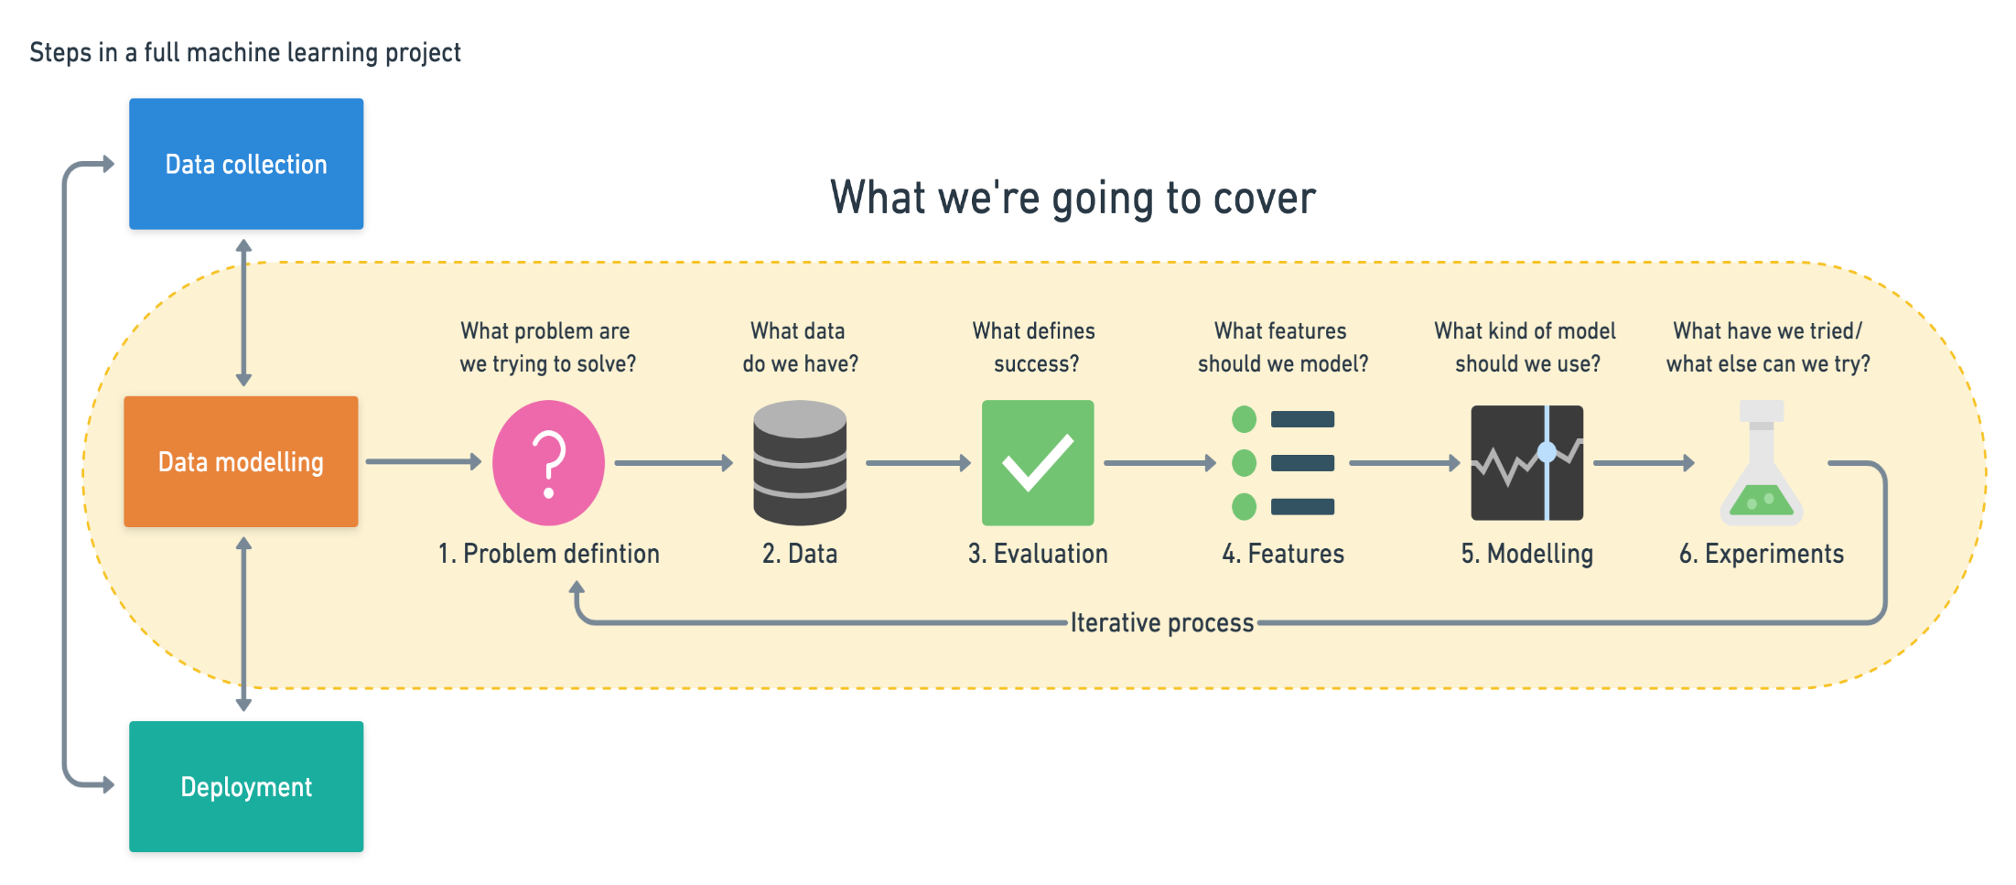
ML Workflow

Slide 25
ML Workflow
🧭 OVERVIEW: The ML Workflow
A typical ML workflow has 8 key stages:
1. Problem Definition
2. Data Collection
3. Data Preparation & Feature Engineering
4. Data Representation & Embedding
5. Model Selection & Training
6. Model Evaluation
7. Deployment & Integration
8. Monitoring, Feedback & Retraining
⚙️ 1. Problem Definition
Objective:
Define what you want to predict or learn.
Identify the type of ML task:
Supervised (classification, regression)
Unsupervised (clustering, dimensionality reduction)
Self-supervised, Reinforcement, Generative, etc.
Outputs:
Clear problem statement
Success metrics (e.g., accuracy, F1-score, RMSE)

Slide 26
ML Workflow
🧩 2. Data Collection
Objective:
Gather relevant data (structured, unstructured, or hybrid).
Activities:
Acquire data from APIs, databases, IoT, sensors, or web scraping.
Handle data licensing, quality, and ethics.
Geometry/Topology Insight:
You’re collecting points in a high-dimensional space that (hopefully) lie on a smooth data manifold.
🧹 3. Data Preparation & Feature Engineering
Objective:
Convert raw data → clean, numerical, and informative features.
Substeps:
Data cleaning (missing values, outliers)
Normalization & scaling
Encoding categorical features
Dimensionality reduction (PCA, UMAP)
Feature extraction (TF-IDF, CNN embeddings)

Slide 27
ML Workflow
🧹 3. Data Preparation & Feature Engineering
Advanced Feature Types:
Statistical: mean, variance, frequency
Semantic: contextual, embedding-based
Graph-based: structural connections
Topological: persistent homology, cluster shape
🧭 4. Data Representation & Embedding
Objective:
Transform data into a space where relationships are geometrically meaningful.
Techniques:
Structured Data: Standardization → vector spaces
Text: Bag of Words, Word2Vec, BERT embeddings
Images: CNN embeddings
Graphs: Graph embeddings (Node2Vec, GNNs)
Manifold Learning: t-SNE, UMAP (learn curved manifolds)

Slide 28
ML Workflow
🧠 5. Model Selection & Training
Objective:
Choose algorithms that can best model your data’s geometry or topology.
Common model families:
Model Type Description Example
Linear Models Flat (Euclidean) decision boundaries Linear regression, logistic
Tree Models Hierarchical partitioning Random Forest, XGBoost
Neural Networks Learn non-linear manifolds CNN, RNN, Transformer
Probabilistic Models Learn probability manifolds Gaussian Mixture Models, VAEs
Graph Models Respect data topology GNNs, message passing networks
📊 6. Model Evaluation
Objective:
Quantify performance on validation/test data.
Ensure generalization and robustness.
Metrics:
Classification: accuracy, precision, recall, F1-score
Regression: MAE, RMSE, R²
Clustering: silhouette, Davies–Bouldin
Generative: FID, IS
Topological: shape preservation metrics in latent space

Slide 29
ML Workflow
🚀 7. Deployment & Integration
Objective:
Package the trained model into production systems or APIs.
Components:
Model serving (REST, gRPC, batch)
Containerization (Docker, Kubernetes)
Scaling (KEDA, autoscaling)
A/B testing
🔁 8. Monitoring, Feedback & Retraining
Objective:
Detect model drift, monitor performance, and retrain when needed.
Aspects:
Data drift: new data deviates from old manifold
Concept drift: decision boundary geometry changes
Performance monitoring: metrics over time

Slide 30
ML Workflow
🧮 Simplified Conceptual Flow
[1] Problem → [2] Data → [3] Features → [4] Representations
↓ ↓ ↓ ↓
Define Goal Collect Engineer Learn Geometry (Embeddings)
↓ ↓ ↓ ↓
[5] Model → [6] Evaluate → [7] Deploy → [8] Monitor
📘 Example: Face Recognition Pipeline
Workflow Step Technique
Data Face images
Feature Engineering CNN feature maps
Embedding FaceNet embedding
Model SVM / Cosine similarity
Evaluation ROC curves
Monitoring Embedding drift detection
For Further Exploration –
Introduction to CRISP DM Framework for Data Science and Machine Learning

Slide 31
Maths for AI, ML, DL etc – High Level
i) Linear Algebra - Representing (non-)deterministic values in the form of sparse(/dense) vectors/matrices in efficient array or other structures & further (parallel) processing like inferential statistics(for non-deterministic values), proximity measures(e.g. distance or similarity[in general normalized-distance = 1 - normalized-similarity]), matrix factorizations etc to gain insights via proper model development.
ii) Statistics & Probability - Very helpful for Descriptive Analytics(including EDA[Exploratory Data Analysis] & to some extent DV[Data Visualization]) & can provide non-deterministic/probabilistic values as needed by Linear Algebra data representation above. Also, can be helpful in handling uncertainity, quantifying likelihood, assessing model performance etc. iii) Multivariable Calculus - mainly used for optimizing the (hyper)parameters of the model or representing the Scientific ML Modelling equations(similar to linear regression).Again here (hyper)parameters can be stochastic as well wherein the values in general are non-deterministic/probabilistic.
iv) Classical and Evolutionary Optimisation - Both classical and evolutionary techniques are used in machine learning (ML) to optimize models by minimizing error or maximizing performance. While classical methods typically use systematic, gradient-based approaches, evolutionary techniques are bio-inspired, population-based, and excel in complex, non-linear problems.
v) Topology/Geometry - Topological/Geometric Intuition behind the Probability, Linear Algebra & Calculus above & Image Analysis/Interpretation/Processing in general. By the way, Graph is a special case of Topology. Basically, Graphs have normal nodes & straight edges while Topology has faces(of any shape as well alongwith facial nodes[i.e. nodes having faces], curved edges, metrics i.e. measurements like length, area, volume but lengths and areas are possible in Graphs as well).Also, the nodes are like geometric objects data while topology is like the edges + the overall structure.

Slide 32
Maths for AI, ML, DL etc – High Level
vi) Information Theory – Mainly used to measure Data Quality. To quantify the amount of info(a.k.a entropy) & measure the accuracy, available in the data sources which ultimately leads to better predictive models. Also, can be helpful in good feature selection, decision tree building, cross-entropy loss, Viterbi Algo(commonly used in NLP) & even encoder-decoder modelling which is at the heart of any Transformer implementation which is the backbone of any DL/LLM/GenAI tool.
vii) Abstract Algebra - Abstract algebra is used in machine learning for applications like topological data analysis (using concepts from algebraic topology to find patterns in data), representing symmetries (like group transformations on images), and in theoretical computer science to create formal, efficient algorithms. It also provides a strong theoretical foundation for areas like linear algebra and helps in developing new models and frameworks.
viii) Chaos & Fractal Theory - Chaos and fractal theory are used in machine learning (ML) primarily to analyze and model complex, nonlinear systems that are often found in real-world data like financial markets, biological processes, and natural phenomena. By treating seemingly random or unpredictable data as a deterministic system with underlying structure, these theories help improve the accuracy and robustness of ML models, particularly for time-series forecasting and complex pattern recognition.
ix) Game Theory - Game theory provides a framework for modeling strategic interactions in machine learning (ML), helping agents make optimal decisions in competitive or cooperative multi-agent environments, seen in areas like Multi-Agent Reinforcement Learning (MARL), adversarial attacks (GANs), and designing efficient systems like smart grids or auction mechanisms, using concepts like Nash Equilibrium and mechanism design to align incentives and predict behavior. ML, in turn, helps solve complex game theory problems, like learning optimal strategies or simplifying large games.

Slide 33
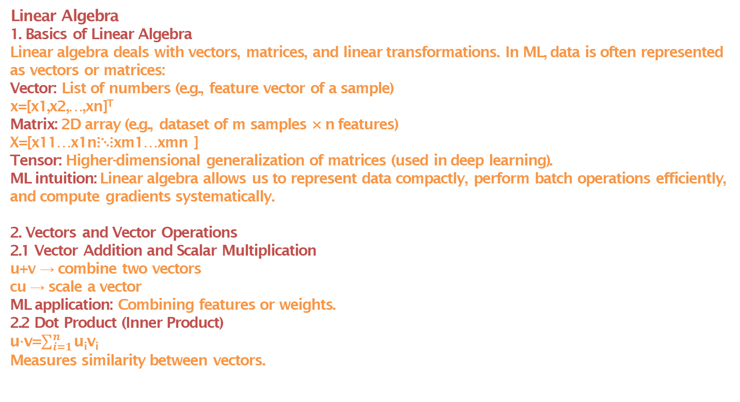
Maths for AI, ML, DL etc – A Bit more in Detail
Linear Algebra
1. Basics of Linear Algebra
Linear algebra deals with vectors, matrices, and linear transformations. In ML, data is often represented as vectors or matrices:
Vector: List of numbers (e.g., feature vector of a sample)
x=[x1,x2,…,xn]^{T}
Matrix: 2D array (e.g., dataset of m samples × n features)
X=[x11…x1n⋮⋱⋮xm1…xmn ]
​Tensor: Higher-dimensional generalization of matrices (used in deep learning).
ML intuition: Linear algebra allows us to represent data compactly, perform batch operations efficiently, and compute gradients systematically.
2. Vectors and Vector Operations
2.1 Vector Addition and Scalar Multiplication
u+v → combine two vectors
cu → scale a vector
ML application: Combining features or weights.
2.2 Dot Product (Inner Product)
u⋅v=$\sum_{i=1}^{n}{\text{u}\text{i}\text{v}\text{i}}$
Measures similarity between vectors.

Slide 34
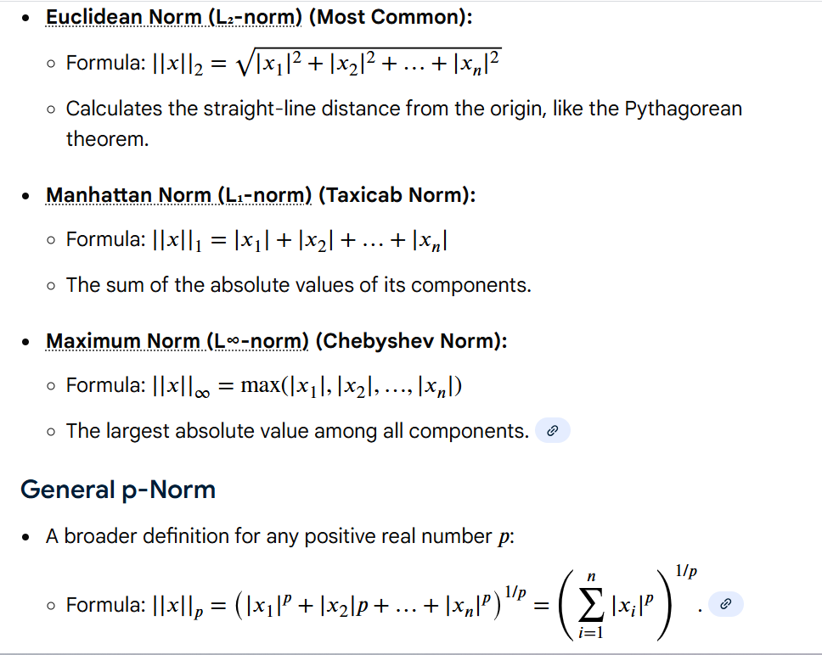
Maths for AI, ML, DL etc – A Bit more in Detail
Linear Algebra
2.2 Dot Product (Inner Product)
Geometric interpretation:
u⋅v=∥u∥∥v∥cosθ
ML application: Cosine similarity in NLP or recommendation systems.
Projection of data along directions.
2.3 Norms (Vector Magnitude)
ML application:
Regularization (L2, L1)
Distance metrics in clustering or KNN.

Slide 35
Maths for AI, ML, DL etc – A Bit more in Detail
Linear Algebra
2.4 Orthogonality
Two vectors are orthogonal if u⋅v=0.Basis vectors are often chosen to be orthogonal for simplicity.
ML intuition: Reduces redundancy between features.
3. Matrices and Matrix Operations
3.1 Matrix Multiplication
C=AB where Cij=∑_{k}A_{ik}B_{kj}
Core operation in ML: linear transformations, neural network forward passes.
Example: Forward pass in a layer:
y=Wx+b
3.2 Transpose
A^{T}
Flip rows ↔ columns.
ML use: Changing feature orientation, covariance computation.
3.3 Inverse
I = A⁻¹A
Solve linear systems:
Ax=b ⟹ x=A⁻¹b

Slide 36
Maths for AI, ML, DL etc – A Bit more in Detail
Linear Algebra
3.3 Inverse
ML use: Least squares solution in linear regression:
θ=(X^{T}X)⁻¹X^{T}y
3.4 Determinant
det(A)
Measure of scaling or singularity.
ML use: Multivariate probability distributions (Gaussian), invertibility check.
3.5 Trace
tr(A)=∑_{i}A_{ii}
Sum of diagonal elements.
ML use: Optimization of quadratic forms, covariance properties.
4. Special Matrices
Identity matrix (I): Acts as 1 in matrix multiplication.
Diagonal matrix: Non-zero elements only on diagonal. Simplifies computations.
Symmetric matrix: A=A^{T}
Eigenvalues are real, important in PCA.

Slide 37
Maths for AI, ML, DL etc – A Bit more in Detail
Linear Algebra
4. Special Matrices
Orthogonal matrix:
Q^{T}Q=IQ^{T}
Q=I. Preserves lengths and angles (used in rotations, SVD).
5. Determinant, Rank, and Null Space
Rank: Number of linearly independent rows/columns.
ML intuition: Number of effective features.
Null space: Solutions of Ax=0
ML intuition: Redundancy in features.
6. Eigenvalues and Eigenvectors
Av=λv
Eigenvector: Direction preserved under linear transformation.
Eigenvalue: Scaling factor along that direction.
ML applications:
PCA (Principal Component Analysis): Eigenvectors of covariance matrix → principal directions.
Spectral clustering: Graph Laplacian eigenvectors.
Stability analysis in optimization.

Slide 38
Maths for AI, ML, DL etc – A Bit more in Detail
Linear Algebra
7. Singular Value Decomposition (SVD)
X=UΣV^{T}
U,V are orthogonal,
Σ is diagonal.
ML applications:
Dimensionality reduction (PCA)
Low-rank approximations
Collaborative filtering (recommendation systems)
8. Linear Systems
Form:
Ax=b
ML application:
Linear regression: Solve normal equations.
Solving constraints in optimization.
9. Vector Spaces and Subspaces
Vector space: Set of vectors closed under addition & scalar multiplication.
Subspace: Subset that is also a vector space.
Basis: Minimum set of vectors that span the space.

Slide 39
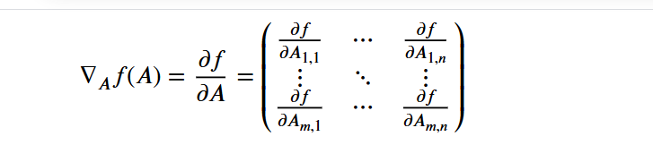
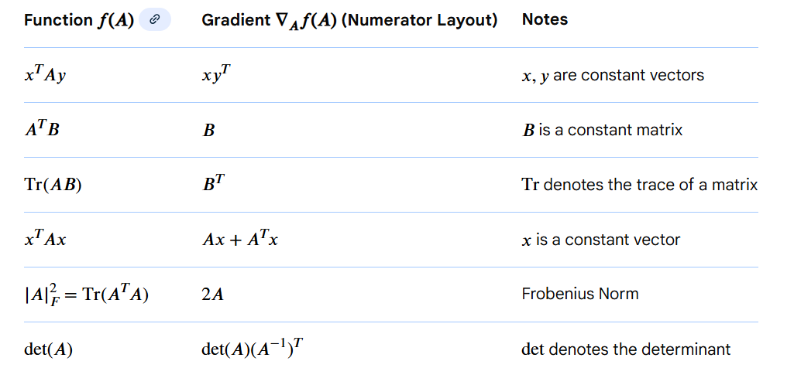
Maths for AI, ML, DL etc – A Bit more in Detail
Linear Algebra
9. Vector Spaces and Subspaces
ML intuition: Feature spaces, embeddings, latent spaces in neural networks.
10. Matrix Calculus for ML
Gradient w.r.t matrix/vector:
Common Matrix Formulas for ML

Slide 40
Maths for AI, ML, DL etc – A Bit more in Detail
Linear Algebra
ML application: Backpropagation in neural networks.
11. Linear Algebra in ML Workflows
Concept ML Application
Vector & Norms Feature representation, distance metrics
Dot product Similarity, kernel methods
Matrix multiplication Linear transformations, NN layers
Eigenvectors & Eigenvalues PCA, spectral clustering
SVD Dimensionality reduction, low-rank approximations
Inverse / Pseudo-inverse Linear regression, least squares
Rank / Nullspace Feature redundancy, solvability
Orthogonality Reduces collinearity, improves numerical stability
Matrix calculus Gradients in vectorized neural networks
12. Advanced Topics (Optional but useful)
Tensor operations: Multi-dimensional generalization for deep learning.
Kronecker product / Hadamard product: For complex layer operations.
Condition number: Numerical stability in inversion and solving linear systems.
Matrix factorization: Collaborative filtering, latent semantic analysis.

Slide 41
Maths for AI, ML, DL etc – A Bit more in Detail
Linear Algebra
Linear Algebra Applications in different ML domains
Recommendation systems:
Matrix factorization and similarity calculations are used to predict user preferences based on their past behavior.
Natural Language Processing (NLP):
Techniques like Word2Vec represent words as vectors, allowing algorithms to understand semantic relationships through vector space operations.
Image and speech recognition:
Images and audio are converted into numerical matrices and vectors, and linear algebra is used for operations like convolutions and signal processing.
For Further Exploration
Vector Projection – Formula, Derivation & Examples | GeeksforGeeks
9 Distance Measures in DataScience
Linear Algebra: Theory, Intuition, Code
Linear Algebra : Foundations to Frontiers
Coding The Matrix
Linear Algebra and Its Applications
Linear Algebra and Learning from Data
Matrix Cookbook

Slide 42
Maths for AI, ML, DL etc – A Bit more in Detail
Probability
Probability theory is used in machine learning to quantify uncertainty, make predictions, and classify data. It is fundamental to building models that can handle real-world data's inherent randomness and noise. Key applications include using probability distributions to express confidence in predictions, employing techniques like Bayes' rule for updating beliefs, and applying algorithms such as Naive Bayes classifiers to categorize data.
Core applications of probability in machine learning
Quantifying uncertainty:
Probability provides a framework to express the likelihood of different outcomes. For example, in a classification task, a model can output the probability of an input belonging to each class, providing a measure of its confidence.
Making predictions:
By modeling uncertainty, probability allows ML models to make predictions and decisions with incomplete information. Algorithms use probability distributions to estimate the likelihood of future events.
Classifying data:
Algorithms like the Naive Bayes classifier use conditional probability to determine the probability of an input belonging to a certain class based on its features.
Bayesian inference:
This approach uses Bayes' rule to combine prior knowledge with new data to update beliefs. The model starts with a "prior" probability and updates it to a "posterior" probability after observing new data.

Slide 43
Maths for AI, ML, DL etc – A Bit more in Detail
Probability
Risk assessment:
Probability is used to assess the risk associated with potential outcomes. This is crucial in fields like finance for predicting stock prices or loan defaults.
Handling noise and uncertainty:
Probability theory provides a way to build robust models by accounting for noise and other uncertainties in the data.
Model selection:
Bayesian methods can use probability to compare different models. The marginal likelihood can be used to penalize overly complex models, a concept known as Bayesian Occam's Razor.
Ways to calculate probability
Probability can be calculated in several ways depending on the context and type of problem.
Let’s go systematically, from classical to modern approaches.
1. Classical (Theoretical) Probability
Definition: If all outcomes of an experiment are equally likely, the probability of an event
A is: P(A) = Number of favorable outcomes/Total number of outcomes
Example: Probability of rolling a 4 on a fair six-sided die:
P(4)=1/6
When to use: Games of chance, combinatorial problems, small finite sample spaces.

Slide 44
Maths for AI, ML, DL etc – A Bit more in Detail
Probability
Ways to calculate probability
2. Empirical (Frequentist) Probability
Definition: Based on observed data from experiments or historical records.
P(A)≈Number of times event A occurred/Total number of trials
Example: If you flip a coin 100 times and get 55 heads, empirical probability of heads:
P(Heads)=55/100 = 0.55
When to use: Real-world experiments where outcomes are not theoretically predictable.
3. Subjective (Bayesian) Probability
Definition: Probability as a degree of belief based on prior knowledge or expert opinion.
Example: A doctor might assign a probability of 0.8 that a patient has a disease based on symptoms and past experience.
Key tool: Bayes’ theorem allows updating beliefs after seeing new data:
P(H∣D)=P(D∣H)P(H)/P(D)
4. Axiomatic Probability
Definition: Probability is defined as a function on a set of events satisfying Kolmogorov’s axioms:
0≤P(A)≤1 for any event A
P(Sample Space)=1
If A and B are mutually exclusive,
P(A∪B)=P(A)+P(B)

Slide 45
Maths for AI, ML, DL etc – A Bit more in Detail
Probability
Ways to calculate probability
4. Axiomatic Probability
Use: Formal mathematical approach, foundation of modern probability theory.
5. Conditional Probability
Definition: Probability of an event
A given event B has occurred:
P(A∣B)=P(A∩B)P(B)
Example: Probability of drawing an ace from a deck given the card is red:
P(Ace∣Red)=2/26=1/13
6. Joint Probability
Definition: Probability of two events
A and B occurring together:
P(A∩B)
Special case: If A and B are independent,
P(A∩B) = P(A)⋅P(B)
7. Probabilities from Probability Distributions
Discrete case: Sum of probabilities for each outcome:
P(X∈A)=∑_{x∈A}P(X=x)

Slide 46
Maths for AI, ML, DL etc – A Bit more in Detail
Probability
Ways to calculate probability
7. Probabilities from Probability Distributions
Continuous case: Integral over the density function
f(x):P(a≤X≤b)=∫abf(x)dx
Example: Normal distribution, Binomial, Poisson, Exponential, etc.
8. Simulation-Based Probability (Monte Carlo)
Definition: Estimate probability by simulating experiments many times.
Example: Estimate π
π by randomly sampling points inside a square and counting how many fall inside an inscribed circle.
P(point in circle)≈points in circle/total points
Use: Complex problems where theoretical or analytical computation is hard.'
✅ Summary:
Theoretical (classical) – based on symmetry and counting.
Empirical (frequentist) – based on data.
Subjective (Bayesian) – based on belief/knowledge.
Distribution-based – via PDFs or PMFs.
Simulation-based – via random experiments.

Slide 47
Maths for AI, ML, DL etc – A Bit more in Detail
Probability
Types of Probability
1)Marginal Probability
Definition
The probability of a single event ignoring other events. Sometimes called the unconditional probability.
P(A)=Probability of event A happening on its own.
Intuition - Focus on one event at a time.
Marginal means “summed over” or “projected from” other variables.
Example
Roll a die. Let A = “roll an even number.”
Ω={1,2,3,4,5,6},A={2,4,6}
P(A)=3/6=0.5
If two dice are rolled, the marginal probability of the first die being 4:
P(X1=4)= P(X1=4,X2=x2) =1/∑x2=1/6
Marginal = “ignore other variables by summing over them.”
2. Joint Probability
Definition
Probability of two (or more) events happening together.
For events A and B
P(A∩B)=Probability that both A and B occur.

Slide 48
Maths for AI, ML, DL etc – A Bit more in Detail
Probability
Types of Probability
2. Joint Probability
Intuition
Focus on co-occurrence.
Think “AND” – both events must happen.
Example
Roll a die. Let A = “even number”, B = “number > 3”
A={2,4,6},B={4,5,6},A∩B={4,6}
P(A∩B)=2/6=1/3
With two dice:
P(X1=4 AND X2=5)=1/36
3. Conditional Probability
Definition
Probability of event A given that event B has occurred.
P(A∣B)=P(A∩B)P(B),P(B)≠0
Intuition
Restrict the universe to B, then see how likely A is inside that restricted universe.
Focus = “A happening under the condition that B is true.”

Slide 49
Maths for AI, ML, DL etc – A Bit more in Detail
Probability
Types of Probability
3. Conditional Probability
Definition
Probability of event A given that event B has occurred.
P(A∣B)=P(A∩B)P(B),P(B)≠0
Intuition
Restrict the universe to B, then see how likely A is inside that restricted universe.
Focus = “A happening under the condition that B is true.”
Example
Roll a die. A = “even number”, B = “>3”
P(A∣B)=P(A∩B)P(B)=(2/6)/(3/6)=2/3
Intuition: Only outcomes >3 are possible ({4,5,6}), 2 of them are even → 2/3.
4. Relationships Between Marginal, Joint, and Conditional Probability
a) From Conditional to Joint
P(A∩B)=P(A∣B)⋅P(B)=P(B∣A)⋅P(A)
b) From Joint to Marginal
P(A)=∑BP(A∩B)(discrete)
P(A)=∫BP(A,B) dB(continuous)

Slide 50
Maths for AI, ML, DL etc – A Bit more in Detail
Probability
Types of Probability
4. Relationships Between Marginal, Joint, and Conditional Probability
c) Bayes’ Theorem
Connects conditional and marginal probabilities:
P(A∣B)=P(B∣A)⋅P(A)P(B)
Intuition: Update belief about A after observing B.
5. Independence (Special Case)
Events A and B are independent if:
P(A∣B)=P(A)
or equivalently,
P(A∩B)=P(A)P(B)
Intuition: Knowing B doesn’t change the probability of A.
6. Multi-Variable Case (Random Variables)
Let X and Y be random variables.
Joint probability:
P(X=x,Y=y)
Marginal probability:
P(X=x)=∑y P(X=x,Y=y)

Slide 51
Maths for AI, ML, DL etc – A Bit more in Detail
Probability
Types of Probability
6. Multi-Variable Case (Random Variables)
Conditional probability:
P(X=x∣Y=y)=P(X=x,Y=y)
Example
Two dice rolled:
X = first die, Y = second die
P(X=4,Y=5)=1/36
P(X=4)=∑y=1/6
P(X=4,Y=y)=6/36=1/6
P(X=4∣Y=5)=1/36 * 6 =1/6
Probability Distributions
1. What is a Probability Distribution?
A probability distribution describes how probabilities are assigned to outcomes of a random variable.
Random variable
X: a function mapping outcomes ω∈Ω to numbers.
Distribution tells us: “For each possible value x, what is the probability that X=x?”
Discrete:
P(X=xi)

Slide 52

Maths for AI, ML, DL etc – A Bit more in Detail
Probability
Probability Distributions
1. What is a Probability Distribution?
Continuous: fX(x),with ∫fX(x)dx=1
Intuition: Probability distribution = rule that tells you how likely each outcome is.
2. Classification of Probability Distributions
A) Discrete Probability Distributions
Definition: Random variable X takes countable values.
Representation: Probability Mass Function (PMF)
P(X=xi)=p_{i,}∑_{i}p_{i}=1
Key Discrete Distributions
Bernoulli Distribution
Outcome: 0 or 1 (success/failure)
PMF:P(X=1)=p,P(X=0)=1−p
Mean: E[X]=p
Variance: Var(X)=p(1−p)
Binomial Distribution
Number of successes in n independent Bernoulli trials(k=0,1,…,n)

Slide 53

Maths for AI, ML, DL etc – A Bit more in Detail
Probability
Probability Distributions
Key Discrete Distributions
Binomial Distribution
Mean: np
Variance: np(1−p)
Poisson Distribution
Number of events in a fixed interval (time/space) with rate λ
P(X=k)=(λ^{k}e^{−λ})/k!, k=0,1,2,...
Mean & Variance: λ
Often used for rare events
Geometric Distribution
Number of trials until first success
P(X=k)=p*(1−p)^{k−1},k=1,2,...
Negative Binomial Distribution
Number of trials until r-th success

Slide 54
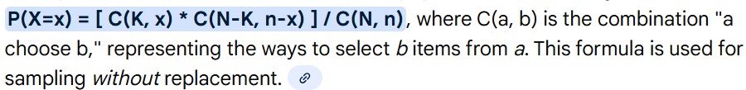
Maths for AI, ML, DL etc – A Bit more in Detail
Probability
Probability Distributions
Key Discrete Distributions
Hypergeometric Distribution
Successes in n draws without replacement from a finite population
B) Continuous Probability Distributions
Definition: Random variable X takes uncountable values, often intervals of real numbers.
Representation: Probability Density Function (PDF)
fX(x)≥0, ∫_{−∞}∞fX(x)dx=1
Probability over interval:
P(a≤X≤b)=∫abfX(x)dx
Key Continuous Distributions
Uniform Distribution
Equal probability over interval [a,b]
fX(x)=1b−a,a≤x≤bf
Mean: (a+b)/2
Variance: (b−a)2/12

Slide 55
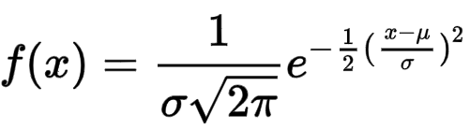
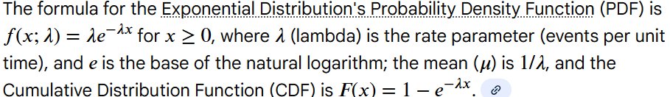
Maths for AI, ML, DL etc – A Bit more in Detail
Probability
Probability Distributions
B) Continuous Probability Distributions
Key Continuous Distributions
Normal (Gaussian) Distribution
Bell-shaped, symmetric
Mean: μ
Variance: σ²
Central Limit Theorem explains its ubiquity
Exponential Distribution
Time between events in a Poisson process
Mean: 1/λ
Variance: 1/λ2
Memoryless property:
P(X>s+t∣X>s)=P(X>t)

Slide 56
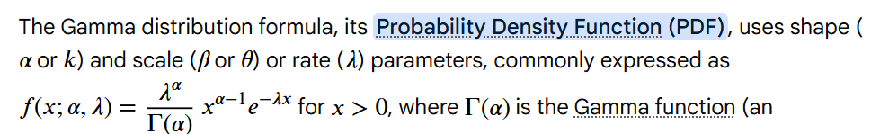
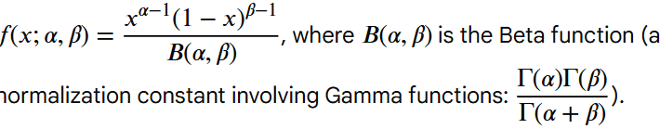
Maths for AI, ML, DL etc – A Bit more in Detail
Probability
Probability Distributions
B) Continuous Probability Distributions
Key Continuous Distributions
Gamma Distribution
Generalization of exponential
Beta Distribution
Models probabilities in [0,1]
Log-Normal Distribution
If Y=ln(X) is normal → X is log-normal
Common in finance, biology

Slide 57
Maths for AI, ML, DL etc – A Bit more in Detail
Probability
Probability Distributions
B) Continuous Probability Distributions
Student’s t, Chi-Square, F distributions
Arise in inferential statistics, hypothesis testing
3. Joint Probability Distributions
Definition: Probability distribution of two or more random variables simultaneously.
P(X=x,Y=y)(discrete),
fX,Y(x,y)(continuous)
Marginal distributions: Sum or integrate out other variables
PX(x)=∑yP(X=x,Y=y)(discrete)
fX(x)=∫fX,Y(x,y)dy(continuous)
Conditional distributions: Restrict to a value of the other variable
P(X=x∣Y=y)=P(X=x,Y=y)P(Y=y)(discrete)
fX∣Y(x∣y=fX,Y(x,y)fY(y)(continuous)
Independence:
X and Y independent if
fX,Y(x,y)=fX(x)fY(y)

Slide 58
Maths for AI, ML, DL etc – A Bit more in Detail
Probability
Probability Distributions
B) Continuous Probability Distributions
4. Key Properties of Distributions
Property Meaning Formula
Mean / Expectation Average value E[X]=∑xipi or ∫xfX(x)dx
Variance Spread Var(X)=E[(X−E[X])2]
Standard Deviation(Risk) Spread in same units σ=Var(X)
Moment Expected value of X nX n = E[Xn]E[X n ]
CDF (Cumulative) Probability X ≤ x FX(x)=P(X≤x)=∑xi≤xpi or ∫−∞xfX(t)dt
Support Values X can take e.g., [0,1] for Uniform, {0,1,...,n} for Binomial
5. Why Probability Distributions Matter
Model uncertainty: They describe randomness mathematically.
Data modeling: Fit distributions to observed data (e.g., Normal, Poisson).
Inferential statistics: Hypothesis testing, confidence intervals.
Machine learning: Generative models, likelihood estimation, Bayesian inference.
Stochastic processes: Continuous-time modeling (Brownian motion, Poisson processes).

Slide 59
Maths for AI, ML, DL etc – A Bit more in Detail
Probability
Probability Distributions
B) Continuous Probability Distributions
6. Visual Intuition
Discrete: PMF = bar chart → probability of each possible value
Continuous: PDF = curve → area under curve = probability
Joint: 2D surface or heatmap → co-occurrence probability
Conditional: Slice joint distribution along fixed variable → new distribution
7. Summary Table of Common Distributions
Type Examples Key Use Mean Variance
Discrete Bernoulli, Binomial, Poisson, Geometric Countable events Varies Varies
Continuous Uniform, Normal, Exponential, Beta, Gamma Continuous events Varies Varies
Joint Multivariate Normal, Multinomial Multiple RVs Vector Covariance
matrix

Slide 60
Maths for AI, ML, DL etc – A Bit more in Detail
Probability
Important Probability Theorems
a) Law of Large Numbers
Average of many independent observations converges to the expected value.
Intuition: Probability in practice matches the theoretical expectation as trials → ∞.
b) Central Limit Theorem
Sum of many independent random variables (under certain conditions) → Normal distribution.
Intuition: Explains why many natural phenomena look Gaussian.
c) Fubini’s Theorem
Allows swapping the order of integration in double integrals over probability spaces.
Intuition: We can compute expectation over multi-dimensional variables systematically.
d) Monotone & Dominated Convergence Theorems
Allow exchanging limits and integrals.
Intuition: Justifies taking limits inside expectations in simulations or sequences of random variables.

Slide 61
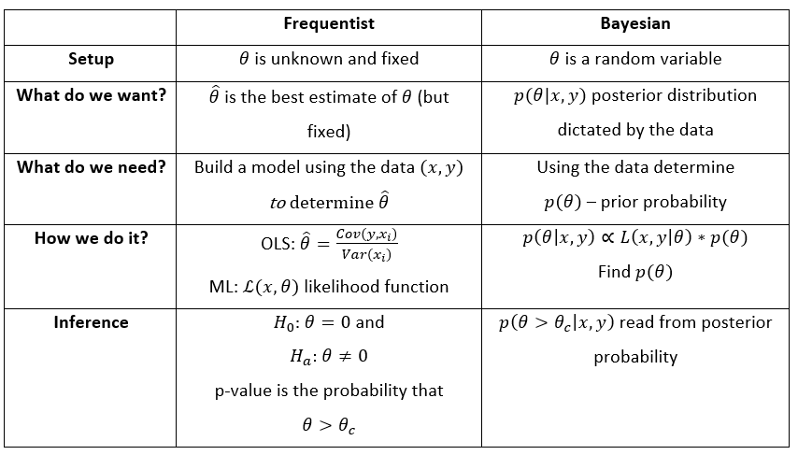
Maths for AI, ML, DL etc – A Bit more in Detail
Probability
Probability Models – Classical/Frequentist vs Bayes vs Markov

Slide 62
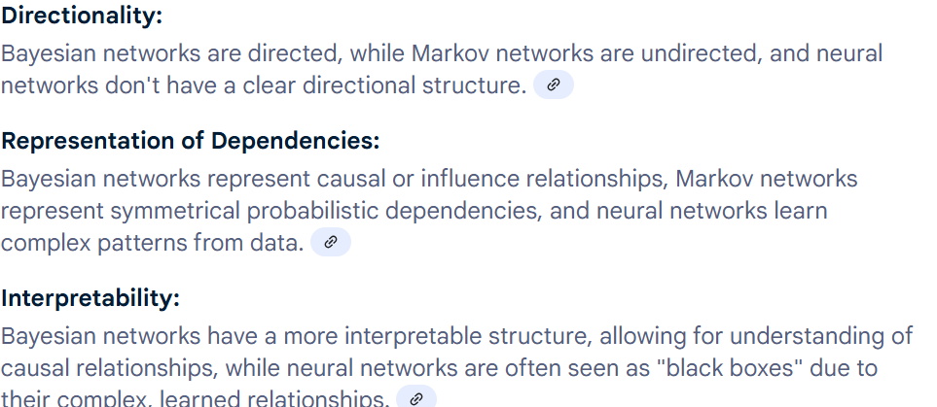
Maths for AI, ML, DL etc – A Bit more in Detail
Probability
Bayesian Network vs Standard Neural Network vs Markov Network
Scenarios where Bayesian Approach can be more powerful than Frequentist Approach
Bayesian methods excel when dealing with limited data, incorporating prior knowledge, or when the goal is to estimate probabilities directly rather than relying on long-run frequencies.
Elaboration:
Limited Data: Frequentist methods often require large sample sizes to provide reliable estimates. Bayesian methods, with their ability to incorporate prior information, can still offer valuable insights even with smaller datasets.
Prior (/Expert) Knowledge: When prior information or expert beliefs are available and relevant, Bayesian methods allow for their formal incorporation into the analysis, which can lead to more accurate and informative results.
Probability of Hypotheses: Bayesian statistics directly calculates the probability of a hypothesis being true, whereas frequentist methods focus on the probability of obtaining observed data. This difference can be particularly useful when the goal is to assess the strength of evidence for a specific hypothesis.
Flexibility and Interpretability: Bayesian methods offer more flexibility in model specification and allow for the use of different prior distributions, making them suitable for complex problems. The results are also often easier to interpret in terms of probabilities and credible intervals, which can be more intuitive for some audiences.

Slide 63
Maths for AI, ML, DL etc – A Bit more in Detail
Probability
Scenarios where Bayesian Approach can be more powerful than Frequentist Approach
Examples:
Clinical Trials: In clinical trials, Bayesian methods can be particularly valuable when prior information about the effectiveness of a treatment is available or when the sample size is limited.
Machine Learning: Bayesian approaches are fundamental to many machine learning algorithms, where the ability to update beliefs based on new data and prior knowledge is crucial.
A/B Testing: Bayesian testing can be advantageous in scenarios where you want to track the probability of one variation performing better than another, even with incomplete data or when you need to make decisions based on a rolling analysis
In summary: While frequentist methods are valuable in many contexts, Bayesian approaches can offer distinct advantages in situations where prior knowledge is valuable, data is limited, or the goal is to estimate the probability of hypotheses

Slide 64
Maths for AI, ML, DL etc – A Bit more in Detail
Probability
Random Processes
A random process, also known as a stochastic process, is a mathematical model that describes how a system or phenomenon evolves over time when randomness is involved. It's essentially a collection of random variables indexed by a parameter, often time, representing a random series of values sequenced over time. These processes are used to model various real-world phenomena, including communication noise, atmospheric changes, and signal fluctuations.
Key Concepts:
Random Variables: Each point in time is a random variable, meaning it has a certain probability of taking on a particular value.
Time-Dependent: The randomness is evolving over time, making it a process, not just a single random variable.
Probability Space: The process is defined on a probability space, where each possible outcome (or realization) of the process has a certain probability of occurring.
Sample Functions: A single realization of the random process, often visualized as a time-series plot, is called a sample function.
Random Processes Types:
a) Based on Time and Value:
Continuous-time, Continuous-valued: Both time and the process's value can take any value within a range (e.g., the temperature of a room).
Continuous-time, Discrete-valued: Time is continuous, but the process's value can only take on specific, distinct values (e.g., the number of customers entering a store in a given time interval).

Slide 65
Maths for AI, ML, DL etc – A Bit more in Detail
Probability
Random Processes
Queueing Theory: Modeling waiting times and system capacity.
Signal Processing: Analyzing and filtering signal
Discrete-time, Continuous-valued: Time is discrete (e.g., measured at specific intervals), and the process's value can take any value within a range (e.g., the stock price at the end of each day).
Discrete-time, Discrete-valued: Both time and the process's value are discrete (e.g., the number of heads in a sequence of coin flips).
b)Based on Statistical Properties:
Stationary: The statistical properties (like mean and variance) of the process do not change over time.
Non-stationary: The statistical properties of the process change over time.
Wide-Sense Stationarity: A commonly used concept, where a process is considered stationary if its mean and autocorrelation function are constant over time.
c) Based on Memory:
Markov Process: The future state of the process depends only on its present state, and not on its past history.
Non-Markovian: The future state of the process depends on its past states as well.
d) Other Notable Types:
Gaussian Process: A process where any finite collection of its values has a multivariate normal distribution.
Poisson Process: A process where events occur randomly and independently at a constant rate.
White Noise: A random process with a flat power spectral density (meaning equal power across all frequencies)
Applications:
Communication Engineering: Noise Modeling, Channel Modelling(e.g. for fading/interference), Signal Processing(noice reduction and signal enhancement), Channel Capacity, Receiver Design etc.
Finance: Modeling stock prices, interest rates, and other financial variables.

Slide 66
Maths for AI, ML, DL etc – A Bit more in Detail
Probability
Bayesian Priors
In Bayesian learning, priors aren't "calculated" from data but are chosen to represent initial beliefs or knowledge about parameters before seeing new data, derived from past research, expert opinion, or even educated guesses, then updated via Bayes' Theorem (Posterior ∝ Likelihood × Prior) to form posterior beliefs, allowing for cumulative learning. Choices range from strong, data-informed priors to weak, uninformative ones (like uniform distributions) when knowledge is scarce, with conjugate priors simplifying calculations.
Sources of Prior Information
Previous Experiments/Data: Using results from earlier studies or historical data to inform your starting point.
Expert Opinion: Eliciting subjective assessments from domain experts for a more informed prior.
Theoretical Knowledge: Incorporating established principles or expected ranges for parameters.
Principle of Indifference: Choosing a uniform distribution (e.g., Beta(1,1)) when there's no information, letting the data dominate.
Types of Priors
Informed/Subjective Prior: Based on specific knowledge, often centered around likely values (e.g., a manufacturing defect rate).
Uninformative/Weak Prior: Allows the likelihood (new data) to have a greater impact, often a flat distribution.
Conjugate Prior: A prior distribution that, when combined with the likelihood, results in a posterior from the same family (e.g., Beta prior for Binomial likelihood), simplifying math.
How Priors are Used (Bayes' Theorem)
Start with Prior (P(θ)): Define your initial belief about a parameter (θ) before data.
Gather Data (D): Collect new observations.
Calculate Likelihood P(D|θ): How probable is the data given different parameter values?.
Compute Posterior P(θ|D): Use the formula P(θ|D) to update the prior with the likelihood.
Iterate: The posterior from one analysis becomes the prior for the next, enabling continuous learning

Slide 67
Maths for AI, ML, DL etc – A Bit more in Detail
Probability
For Further Exploration
Probability in Maths – GeeksforGeeks
Introduction to Probability for Data Science
Blitzstein & Hwang’s Introduction to Probability
Probability, Statistics & Random Processes
The Analysis of Data
Estimating Probabilities from Data – YouTube
Bayesian Statistics the Fun Way: Dominate Data with Humour
Probability: For the Enthusiastic Beginner
Statistical Rethinking: A Bayesian Course with Examples in R | Review 📈
Bayesian versus Frequentist solutions to the Monty Hall Problem
Frequentist v/s Bayesian Statistics
Learning Probabilistic Graphical Models in R
Mastering Probabilistic Graphical Models with Python
Practical Probabilistic Programming
Probability Models for Computer Science
Stochastic process – Wikipedia
Prior probability - Wikipedia
Probability axioms – Wikipedia
A User's Guide to Measure Theoretic Probability

Slide 68
Maths for AI, ML, DL etc – A Bit more in Detail
Statistics
Statistics is a foundational discipline that is critical throughout the entire ML pipeline, including data preparation, model development, and validation.
1. Descriptive Statistics
Used to summarize and understand data.
1.1 Measures of Central Tendency
Mean (Average): Sum of values / count
μ=1/n*∑x_{i}
ML relevance: Used in normalization, regression.
Median: Middle value in sorted data
ML relevance: Robust to outliers, often used in decision trees.
Mode: Most frequent value
ML relevance: Useful in categorical data analysis.
1.2 Measures of Dispersion
Variance: Average squared deviation from mean
σ²=1/n*∑(x_{i}−μ)²
Standard Deviation:
σ=square root of Variance

Slide 69
Maths for AI, ML, DL etc – A Bit more in Detail
Statistics
Range: Max - Min
Interquartile Range (IQR): Q3 - Q1, robust to outliers
ML relevance: Feature scaling, outlier detection, model evaluation.
1.3 Shape of Data
Skewness: Asymmetry of distribution
Kurtosis: “Peakedness” of distribution
ML relevance: Assumptions in regression/ML models, feature engineering.
1.4 Visualization
Histograms, boxplots, density plots, scatter plots
ML relevance: Understand distributions, correlations, anomalies.
2. Statistical Inference
Used to draw conclusions from data and estimate unknown parameters.
2.1 Point and Interval Estimation
Estimate population parameters from sample
Confidence intervals, e.g., 95% CI
ML relevance: Model uncertainty, error bars.

Slide 70
Maths for AI, ML, DL etc – A Bit more in Detail
Statistics
3.2 Hypothesis Testing
Null hypothesis
H0,
alternative
H1​
Test statistics, p-values, Type I/II errors
Common tests: t-test, chi-square, ANOVA
ML relevance: Feature selection, A/B testing, model comparison.
3.3 Parametric vs Non-Parametric
Parametric: Assumes known distribution (t-test, ANOVA)
Non-Parametric: No assumption (Mann-Whitney, Kruskal-Wallis)
ML relevance: Model robustness, small sample sizes, unknown distributions.
4. Correlation and Dependence
4.1 Covariance
Cov(X,Y)=E[(X−μX)(Y−μY)]
Measures linear relationship (scale-dependent)
4.2 Correlation
ρXY=Cov(X,Y)σXσY
Standardized, range [-1,1]

Slide 71
Maths for AI, ML, DL etc – A Bit more in Detail
Statistics
4. Correlation and Dependence
4.2 Correlation
ML relevance: Feature selection, multicollinearity detection.
4.3 Rank-based correlation
Spearman’s rho, Kendall’s tau
ML relevance: Non-linear relationships, robust to outliers.
5. Regression and Modeling
5.1 Linear Regression
y=β0+β1x+ϵ
Estimate coefficients (β) using least squares
ML relevance: Supervised learning, feature importance.
5.2 Logistic Regression
Models probability:
P(Y=1∣X)=σ(Xβ)
ML relevance: Binary classification, probabilistic outputs.
5.3 Assumptions
Linearity, independence, normality of errors, homoscedasticity
ML relevance: Diagnostic checks before modeling.

Slide 72
Maths for AI, ML, DL etc – A Bit more in Detail
Statistics
6. Maximum Likelihood and Estimation
Maximum Likelihood Estimation (MLE): Estimate parameters that maximize likelihood of observed data.
θ^=argmaxθ_{L}(θ∣X)
ML relevance: Logistic regression, Gaussian Mixture Models, probabilistic ML.
Bayesian Estimation: Combines prior and likelihood to get posterior.
ML relevance: Bayesian ML, Bayesian neural networks.
7. Sampling and Resampling Methods
7.1 Sampling
Random, stratified, systematic
ML relevance: Train/test split, cross-validation.
7.2 Bootstrapping
Resample with replacement to estimate distributions of statistics
ML relevance: Confidence intervals, uncertainty estimation.
7.3 Cross-Validation
K-fold, leave-one-out
ML relevance: Model evaluation, hyperparameter tuning.
8. Bias-Variance Tradeoff
Bias: Error from wrong assumptions in the model
Variance: Error from sensitivity to small fluctuations in training set

Slide 73
Maths for AI, ML, DL etc – A Bit more in Detail
Statistics
8. Bias-Variance Tradeoff
Tradeoff: Balance underfitting (high bias) vs overfitting (high variance)
ML relevance: Model selection, regularization (Ridge, Lasso).
9. Multivariate Statistics
Covariance matrix: Measure dependence between multiple variables
Principal Component Analysis (PCA): Dimensionality reduction
Multivariate Gaussian: Models joint distributions
ML relevance: Feature extraction, anomaly detection, generative modeling.
10. Probability Inequalities and Concentration
Markov’s Inequality, Chebyshev’s Inequality: Bound probabilities of large deviations
Law of Large Numbers, Central Limit Theorem: Justify sampling, approximations to normal
ML relevance: Confidence in sample estimates, statistical guarantees.
11. Non-Parametric and Distribution-Free Methods
Kernel Density Estimation (KDE): Estimate probability density
Rank tests, Mann-Whitney, Wilcoxon, Kruskal-Wallis
ML relevance: When distribution assumptions are unknown or violated.

Slide 74
Maths for AI, ML, DL etc – A Bit more in Detail
Statistics
12. Evaluation Metrics in ML (Statistical Measures)
12.1 Regression Metrics
MSE, RMSE, MAE, R-squared
12.2 Classification Metrics
Accuracy, Precision, Recall, F1-score, ROC-AUC
ML relevance: Direct application of probability and statistics.
13. Random Processes and Time Series
Markov Chains, Poisson Processes, Brownian Motion
ML relevance: Sequential modeling, reinforcement learning, stochastic modeling.
14. Key Takeaways
Descriptive statistics → understand data
Statistical inference → draw conclusions from samples
Regression and estimation → build predictive models
Resampling and multivariate methods → validate and reduce dimensionality
Bias-variance and evaluation metrics → optimize ML models
Distribution-free and Bayesian methods → handle unknown distributions and uncertainty.

Slide 75
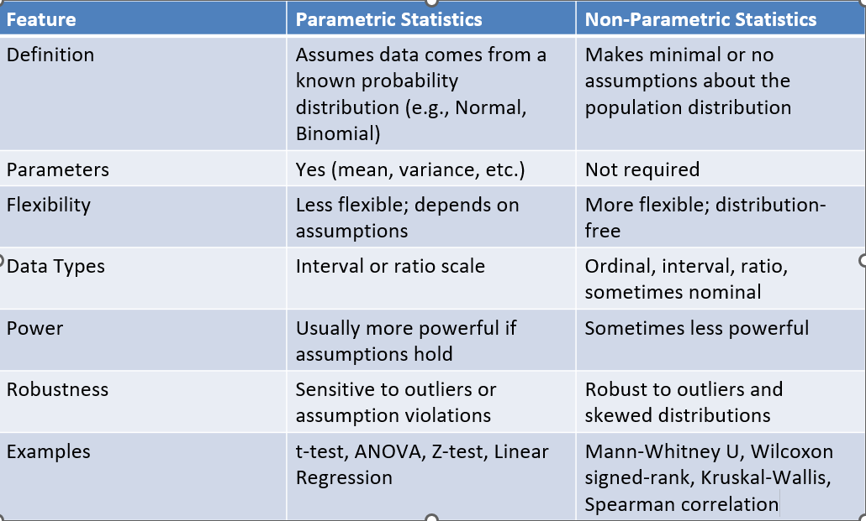
Maths for AI, ML, DL etc – A Bit more in Detail
Statistics
1. Parametric vs Non-Parametric Statistics
2. Parametric Statistics
2.1 Definition
Parametric statistics assumes the population distribution is known, usually described with parameters. Statistical inference involves estimating these parameters and making predictions or testing hypotheses.

Slide 76
Maths for AI, ML, DL etc – A Bit more in Detail
Statistics
2. Parametric Statistics
2.2 Key Assumptions
The population follows a known distribution (e.g., Normal, Poisson).Observations are independent.
Parameters fully describe the population (e.g., mean and variance for Normal).Homogeneity of variance (for tests like ANOVA).
Intuition: “I know the shape of the river, so I can measure its width precisely.”
2.3 Common Parametric Methods
Method Use Assumptions
t-test Compare means of 2 groups Normality, equal variance
ANOVA Compare means of >2 groups Normality, homogeneity of variance
Z-test Compare mean against population mean Known variance, normality
Linear Regression Model relationship between X and Y Linearity, normal residuals,
independence
Maximum Likelihood
Estimation (MLE) Estimate parameters Correct distributional form
2.4 Advantages
Efficient if assumptions hold (smaller sample sizes needed).
Provides direct estimates of population parameters.
Well-studied with clear inferential procedures.

Slide 77
Maths for AI, ML, DL etc – A Bit more in Detail
Statistics
2. Parametric Statistics
2.5 Limitations
Highly sensitive to assumption violations (e.g., non-normality).
Not suitable for ordinal data or unknown distributions.
Can give misleading results if the model is misspecified.
3. Non-Parametric Statistics
3.1 Definition
Non-parametric statistics does not assume a specific population distribution. Instead, it uses the data structure, ranks, or orderings to make inferences.
Intuition: “I don’t know the shape of the river, so I measure where most stones are higher than the water.”
3.2 Key Assumptions
Observations are independent.
Data may be ordinal, interval, or ratio scale.
Minimal assumptions about population shape.

Slide 78
Maths for AI, ML, DL etc – A Bit more in Detail
Statistics
3. Non-Parametric Statistics
3.3 Common Non-Parametric Methods
Method Use Notes
Mann-Whitney U Test Compare 2 independent groups Alternative to t-test
Wilcoxon Signed-Rank Test Compare 2 paired groups Alternative to paired t-test
Kruskal-Wallis Test Compare >2 independent groups Alternative to ANOVA
Spearman Rank Correlation Assess monotone relationship Non-linear, robust to outliers
Chi-Square Test Association between categorical Compares observed vs expected
variables counts
Kernel Density Estimation (KDE) Estimate probability density Smooth, distribution-free
Bootstrap / Resampling Estimate CI or standard errors Distribution-free
3.4 Advantages
Flexible: works for any distribution.
Robust to outliers and skewed data.
Can be applied to ordinal or non-numeric data.
3.5 Limitations
Generally less efficient/powerful than parametric methods if assumptions hold.
May require larger sample sizes for accuracy.
Interpretation can be less straightforward (ranks or medians instead of means).
4. Key Differences Summarized
Feature Parametric Non-Parametric
Assumptions Strong, known distribution Weak or none
Parameter estimation Yes No
Data requirements Interval/ratio Ordinal, interval, ratio, sometimes nominal
Robustness Sensitive to outliers Robust
Sample size needed Smaller Usually larger
Flexibility Less flexible More flexible
Efficiency High if assumptions hold Lower if parametric assumptions hold
Examples t-test, ANOVA, regression Mann-Whitney, Kruskal-Wallis, Spearman
5. When to Use Which
Scenario Recommended Approach
Data normal, interval/ratio, small sample Parametric
Data not normal, ordinal, unknown distribution Non-Parametric
Population unknown, large sample Non-Parametric (or robust parametric methods)
Testing medians/ranks Non-Parametric
Estimating mean/variance Parametric
6. Intuition & Analogy
Parametric: You know the “river shape” → measure width precisely.
Non-Parametric: You don’t know the “river shape” → measure approximate positions of stones.
Parametric = model-based
Non-Parametric = data-driven
7. Applications in Machine Learning
Parametric: Linear regression, Logistic regression, Naive Bayes (assumes Gaussian or Bernoulli), Gaussian Mixture Models.
Non-Parametric: K-Nearest Neighbors, Decision Trees, Kernel Density Estimation, Random Forests, Bootstrap sampling, Rank-based feature selection.

Slide 79
Maths for AI, ML, DL etc – A Bit more in Detail
Statistics
4. Parametric vs Non-Parametric Statistics(Key Differences Summarized)
Feature Parametric Non-Parametric
Assumptions Strong, known distribution Weak or none
Parameter estimation Yes No
Data requirements Interval/ratio Ordinal, interval, ratio,
sometimes nominal
Robustness Sensitive to outliers Robust
Sample size needed Smaller Usually larger
Flexibility Less flexible More flexible
Efficiency High if assumptions hold Lower if parametric
assumptions hold
Examples t-test, ANOVA, regression Mann-Whitney, Kruskal-Wallis,
Spearman
5. When to Use Which
Scenario Recommended Approach
Data normal, interval/ratio, small sample Parametric
Data not normal, ordinal, unknown distribution Non-Parametric
Population unknown, large sample Non-Parametric (or robust parametric methods)
Testing medians/ranks Non-Parametric
Estimating mean/variance Parametric

Slide 80
Maths for AI, ML, DL etc – A Bit more in Detail
Statistics
6. Intuition & Analogy
Parametric: You know the “river shape” → measure width precisely.
Non-Parametric: You don’t know the “river shape” → measure approximate positions of stones.
Parametric = model-based
Non-Parametric = data-driven
7. Applications in Machine Learning
Parametric: Linear regression, Logistic regression, Naive Bayes (assumes Gaussian or Bernoulli), Gaussian Mixture Models.
Non-Parametric: K-Nearest Neighbors, Decision Trees, Kernel Density Estimation, Random Forests, Bootstrap sampling, Rank-based feature selection.

Slide 81
Maths for AI, ML, DL etc – A Bit more in Detail
Statistics
Statistics is a foundational discipline that is critical throughout the entire ML pipeline, including data preparation, model development, and validation.
Essential uses of statistics in ML
Data exploration and preparation
Descriptive statistics: These summarize and organize data to help you understand its characteristics. Examples include calculating the mean, median, and mode (central tendency) and variance and standard deviation (data spread).
Data visualization: Statistical plots like histograms, box plots, and scatter plots reveal the underlying patterns, distributions, and relationships between variables. This helps identify outliers and guide preprocessing steps like scaling and normalization.
Model development and training
Algorithm foundation: Many classic ML algorithms, such as linear and logistic regression, are rooted in statistical methods. Probabilistic models like Naive Bayes are based directly on statistical probability theory.
Feature engineering: Statistical techniques like correlation analysis and Chi-Squared tests help identify the most important features for a model. Principal Component Analysis (PCA) uses statistical methods to reduce dimensionality while preserving key information.
Bias-variance tradeoff: This central concept in ML is a statistical framework for understanding a model's complexity. A high-bias model is too simple and underfits the data, while a high-variance model is too

Slide 82
Maths for AI, ML, DL etc – A Bit more in Detail
Statistics
Essential uses of statistics in ML
complex and overfits it. Regularization methods like LASSO and Ridge Regression are statistical techniques used to manage this tradeoff.
Bayesian inference: This probabilistic statistical approach incorporates prior knowledge to update the probability of a hypothesis as new evidence becomes available. It is used in ML for parameter estimation and robust decision-making under uncertainty.
Model evaluation and validation
Performance metrics: For regression, statistical metrics include Mean Squared Error (MSE), Root Mean Squared Error (RMSE), and R-squared. For classification, metrics derived from the confusion matrix, like precision, recall, F1-score, and ROC-AUC, are used.
Hypothesis testing: Statistical tests like A/B testing can be used to compare the performance of different models or to ensure a model's predictive power is not simply due to chance.
Confidence intervals: These provide a range of values to quantify the uncertainty in a model's estimated performance, such as classification accuracy.
In summary, statistics is the foundational framework for building, training, and validating ML models, making its role far broader than just performance evaluation.

Slide 83
Maths for AI, ML, DL etc – A Bit more in Detail
Statistics
Statistical Modeling
What is Statistical Modeling?
A statistical model is a mathematical representation of observed data. It captures patterns, relationships, and randomness in the data to make inferences, predictions, or decisions.
Formally, a statistical model expresses:
Y=f(X,θ)+ϵY
Y: Response variable(s) (what we want to model/predict)
X: Predictor variable(s) (features)
θ: Model parameters
ϵ: Random error (captures unobserved variation)
Goal: Understand the relationship between X and Y, quantify uncertainty, and predict outcomes.
A. Linear vs Non-Linear Models
Linear Models
Relationship between predictors and response is linear:
Y=β0+β1X1+⋯+βpXp+ϵ
Examples: Linear regression, ANOVA
Non-Linear Models
Relationship is non-linear in parameters:
Y=β0+β1X12+β2exp(X2)+ϵ
Examples: Logistic regression, Poisson regression, splines

Slide 84
Maths for AI, ML, DL etc – A Bit more in Detail
Statistics
Statistical Modeling
Building Blocks of Statistical Models
A. Probability Distributions
Modeling relies on assumptions about how data is generated
Common distributions:
Normal (Gaussian): For continuous, symmetric data
Bernoulli/Binomial: For binary outcomes
Poisson: For count data
Exponential/Gamma: For survival/time-to-event data
B. Likelihood Function
Likelihood measures how likely observed data is given parameters:
L(θ)=P(data∣θ)
Maximum Likelihood Estimation (MLE): Find θ that maximizes L(θ)
C. Model Assumptions
Every statistical model has assumptions:
Linearity of relationships (linear regression)
Independence of observations
Homoscedasticity (constant variance of errors)
Normality of errors

Slide 85
Maths for AI, ML, DL etc – A Bit more in Detail
Statistics
Statistical Modeling
Building Blocks of Statistical Models
C. Model Assumptions
No multicollinearity among predictors
Violating assumptions can bias estimates.
D. Error Terms and Residuals
Residual = observed - predicted
Residual analysis checks model assumptions, detects outliers, and identifies patterns not captured by the model
Common Statistical Models
A. Regression Models
Linear Regression
Predicts continuous outcomes
Key methods: OLS (Ordinary Least Squares)
Diagnostics: R², Adjusted R², residual plots
Generalized Linear Models (GLM)
Extends linear regression to non-normal outcomes
Components:
Random component: Distribution of Y

Slide 86
Maths for AI, ML, DL etc – A Bit more in Detail
Statistics
Statistical Modeling
Common Statistical Models
A. Regression Models
Components:
Systematic component: Linear predictor Xβ
Link function: Connects mean of Y to linear predictor
Examples:
Logistic regression (binary)
Poisson regression (count)
Gamma regression (continuous, positive)
Mixed-Effect Models
Handle hierarchical/clustered data
Includes fixed and random effects
Example: Student scores nested in schools
B. Time Series Models
Data indexed by time
Aim: Forecast future values
Models:
AR, MA, ARMA, ARIMA

Slide 87
Maths for AI, ML, DL etc – A Bit more in Detail
Statistics
Statistical Modeling
Common Statistical Models
B. Time Series Models
Exponential smoothing
State-space models, Kalman filter
C. Multivariate Models
Multiple response variables
Examples:
MANOVA (Multivariate ANOVA)
Canonical correlation analysis
Factor analysis, PCA (dimensionality reduction)
D. Survival / Reliability Models
Event-time modeling
Models:
Kaplan-Meier estimator (non-parametric)
Cox proportional hazards model
Parametric survival models (Weibull, exponential)

Slide 88
Maths for AI, ML, DL etc – A Bit more in Detail
Statistics
Statistical Modeling
E. Bayesian Statistical Models
Define prior distributions for parameters
Use observed data to compute posterior distribution:
Posterior ∝ Likelihood × Prior
Advantages: Handles small sample sizes, incorporates prior knowledge
Techniques: MCMC, Gibbs sampling, Variational Inference
Model Evaluation Metrics
Regression
Mean Squared Error (MSE)
Root Mean Squared Error (RMSE)
R², Adjusted R²
Classification
Accuracy, Precision, Recall, F1-score
ROC curve, AUC
Time Series
MAE, MAPE, RMSE
Residual diagnostics (autocorrelation, stationarity)

Slide 89
Maths for AI, ML, DL etc – A Bit more in Detail
Statistics
Statistical Modeling
Model Selection and Validation
Underfitting: Model too simple
Overfitting: Model too complex
Techniques:
Cross-validation (k-fold, LOOCV)
AIC, BIC (model comparison)
Regularization: Lasso (L1), Ridge (L2), ElasticNet
Advanced Statistical Modeling Concepts
A. Hierarchical / Multilevel Models
Data has nested structure
Example: Patients within hospitals
B. Bayesian Hierarchical Models
Combine hierarchical models with Bayesian inference
C. Latent Variable Models
Unobserved (latent) variables explain observed data
Examples:
Factor analysis
Latent Dirichlet Allocation (topic modeling)
Structural equation modeling (SEM)

Slide 90
Maths for AI, ML, DL etc – A Bit more in Detail
Statistics
Statistical Modeling
Advanced Statistical Modeling Concepts
D. Non-Linear / Non-Parametric Models
Splines, GAMs (Generalized Additive Models)
Kernel regression, smoothing methods
E. Copulas
Model dependence structure between multiple random variables
F. Statistical Learning Theory
Bridges classical stats with ML
Concepts: Bias-variance tradeoff, VC dimension, regularization
Statistical Modeling Workflow
Problem definition: Outcome, predictors, type of model
Data exploration: EDA, missing value handling, visualization
Model selection: Parametric/non-parametric, regression/classification
Parameter estimation: MLE, Bayesian inference
Model diagnostics: Residuals, assumptions
Model validation: Cross-validation, holdout sets
Interpretation and inference: Coefficients, effect sizes, significance
Prediction and deployment: Forecasting, risk assessment, decision-making
Key Tools & Libraries
R: lm(), glm(), lme4, survival, brms (Bayesian)
Python: statsmodels, scikit-learn, PyMC, lifelines
MATLAB: Statistics and Machine Learning Toolbox

Slide 91
Maths for AI, ML, DL etc – A Bit more in Detail
Statistics
Estimation Theory
Estimation theory is a branch of statistics that focuses on determining the values of unknown parameters in a statistical model based on observed data. It involves using sample data to estimate the values of population parameters, like the mean or variance. These estimates can be point estimates (single values) or interval estimates (a range of values).
Key Concepts:
Estimator: A rule or formula that uses sample data to calculate a single value (point estimate) or a range of values (interval estimate) for an unknown population parameter.
Estimate: The specific value or range calculated by the estimator.
Population Parameter: A numerical characteristic of the entire population, such as the population mean or standard deviation.
Sample Statistic: A numerical characteristic of the sample, such as the sample mean or standard deviation, used to estimate the population parameter.
Point Estimation: Using a single value from the sample data to estimate the population parameter.
Interval Estimation: Providing a range of values within which the true population parameter is likely to fall, along with a confidence level.
Confidence Interval: An interval estimate that provides a range of values within which the population parameter is likely to lie, along with a specified level of confidence (e.g., 95%).
Bias: The systematic difference between the expected value of an estimator and the true value of the parameter being estimated. An unbiased estimator has an expected value that equals the true parameter value.
Consistency: A property of an estimator where its accuracy increases as the sample size grows.
Efficiency: A property of an estimator where it has the smallest variance among all unbiased estimators.

Slide 92
Maths for AI, ML, DL etc – A Bit more in Detail
Statistics
Statistical Sampling
1. What is Statistical Sampling?
Statistical sampling is the process of selecting a subset (sample) from a population to make inferences about the whole population.
Why sampling exists
Studying the entire population (census) is:
Expensive
Time-consuming
Sometimes impossible
Sampling lets us:
Estimate population parameters
Quantify uncertainty
Make decisions with limited data
Key idea:
A well-chosen small sample can tell you a lot about a big population.
2. Population vs Sample
Term Meaning
Population Entire group of interest
Sample Subset drawn from population
Parameter True population value (μ, σ, p)
Statistic Sample estimate (xˉ,s,p^)

Slide 93
Maths for AI, ML, DL etc – A Bit more in Detail
Statistics
Statistical Sampling
2. Population vs Sample
Example:
Population mean height = μ (unknown)
Sample mean height = xˉ(known)
3. Why Random Sampling is Critical
Randomness ensures:
Each unit has a known, non-zero probability
No systematic bias
Valid probability theory applies
Without randomness:
No valid confidence intervals
No valid hypothesis tests
No reliable p-values
4. Types of Sampling
Probability Sampling
These allow error estimation.
1. Simple Random Sampling (SRS)
Every unit has equal probability.
✔ Unbiased
❌ Requires full population list

Slide 94
Maths for AI, ML, DL etc – A Bit more in Detail
Statistics
Statistical Sampling
4. Types of Sampling
Probability Sampling
2. Stratified Sampling
Population divided into homogeneous strata, sample from each.
✔ Lower variance
✔ Ensures subgroup representation
Example: Sampling students by gender or department
3. Cluster Sampling
Population divided into heterogeneous clusters, sample clusters.
✔ Cost-effective
❌ Higher variance
Example: Select cities → sample households
4. Systematic Sampling
Select every k-th unit.
✔ Simple
❌ Risk if hidden periodicity exists

Slide 95
Maths for AI, ML, DL etc – A Bit more in Detail
Statistics
Statistical Sampling
4. Types of Sampling
B. Non-Probability Sampling (Exploratory / Risky)
❌ No valid statistical inference
Type Problem
Convenience Selection bias
Judgment Subjective
Snowball Network bias
Quota No randomness
5. Sampling Biases
Common Biases
Bias Description
Selection bias Non-random inclusion
Non-response bias Missing responses
Coverage bias Population undercoverage
Survivorship bias Only “winners” sampled
Voluntary response Extreme opinions dominate
Rule:
Large biased samples are worse than small unbiased samples.

Slide 96
Maths for AI, ML, DL etc – A Bit more in Detail
Statistics
Statistical Sampling
6. Sampling Distribution (Most Important Concept)
Definition
The sampling distribution is the distribution of a statistic over repeated samples.
Central Limit Theorem (CLT)
If sample size is large:
Xˉ∼N(μ,σ²/n)
✔ Works regardless of population distribution
✔ Foundation of confidence intervals and tests
7. Sample Size Determination
For Mean Estimation
n=z² σ²/E²
For Proportion Estimation
n=z²p(1−p)/E²
Where:
σ = Population standard deviation (if unknown, use sample s for large samples)
E = margin of error
z = confidence level factor
p = estimated proportion

Slide 97
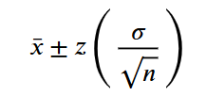
Maths for AI, ML, DL etc – A Bit more in Detail
Statistics
Statistical Sampling
8. Precision vs Accuracy
Term Meaning
Accuracy Closeness to true value
Precision Low variability
Random error ↓ → Precision ↑
Bias ↓ → Accuracy ↑
9. Confidence Intervals (Sampling in Action)
A confidence interval gives a range of plausible population values.
Example:
95% CI interpretation:
If we repeat sampling many times, 95% of such intervals will contain the true parameter.
10. Sampling & Hypothesis Testing
Sampling enables:
t-tests
z-tests
χ² tests
F-tests

Slide 98
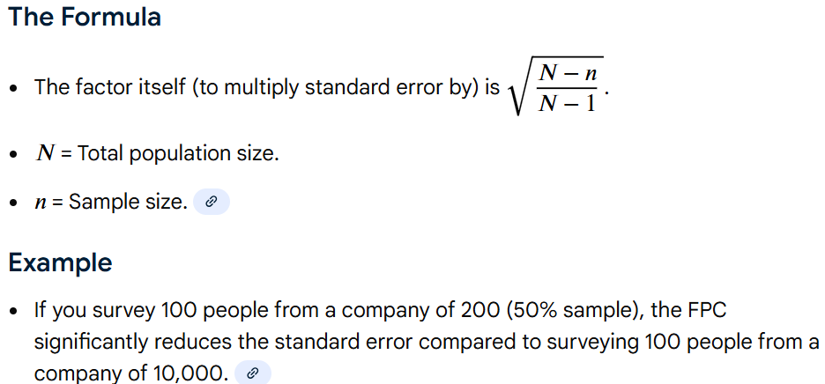
Maths for AI, ML, DL etc – A Bit more in Detail
Statistics
Statistical Sampling
10. Sampling & Hypothesis Testing
Logic:
Assume null hypothesis
Observe sample statistic
Compute probability (p-value)
Decide if result is unlikely
11. Finite Population Correction (FPC)
When sampling without replacement from small populations:

Slide 99
Maths for AI, ML, DL etc – A Bit more in Detail
Statistics
Statistical Sampling
12. Sampling in Practice (Real-World)
Surveys
Opinion polls
Market research
Census sampling
ML / Data Science
Train-test split
Bootstrapping
Cross-validation
Engineering & Quality
Acceptance sampling
Process control
13. Advanced Sampling Concepts
Bootstrapping
Resample with replacement from sample.
✔ No distributional assumptions
✔ Used when theory fails
Importance Sampling
Sample from modified distribution to estimate rare events.

Slide 100
Maths for AI, ML, DL etc – A Bit more in Detail
Statistics
Statistical Sampling
13. Advanced Sampling Concepts
Used in:
Bayesian inference
Monte Carlo simulations
Adaptive Sampling
Sampling strategy evolves based on observed data.
14. Common Myths
❌ Bigger sample always better
❌ Random = haphazard
❌ 95% CI means 95% chance true value lies inside
❌ Non-random sampling can still be “statistically valid”
15. Big Picture Mental Model
Population
↓ (random sampling)
Sample
↓ (statistic)
Sampling Distribution
↓ (CLT)
Inference (CI, tests, decisions)

Slide 101
Maths for AI, ML, DL etc – A Bit more in Detail
Statistics
Statistical Tests
Statistical tests are done to make decisions under uncertainty using data. More precisely, they help us decide whether an observed pattern in data is real or could have occurred just by random chance.
1. The core problem
You observe data with randomness.
You must decide whether an observed pattern is real or accidental.
Statistical tests exist to make reliable decisions under uncertainty.
2. The hypothesis-testing framework (foundation)
Every statistical test follows this logic:
Hypotheses
Null hypothesis (H₀): No effect / randomness
Alternative hypothesis (H₁): Effect exists
Test statistic
A number measuring distance from H₀:
Mean difference → t
Squared deviation → χ²
Variance ratio → F
Sampling distribution
Probability distribution of the statistic assuming H₀ is true.
Decision rule
If the observed statistic is too unlikely → reject H₀.

Slide 102
Maths for AI, ML, DL etc – A Bit more in Detail
Statistics
Statistical Tests
3. What statistical tests are used for
A. Testing hypotheses
Statistical tests evaluate statements like:
“The mean is 50”
“Two groups are different”
“These variables are independent”
They do this by comparing:
Null hypothesis (H₀): No effect / no difference / randomness
Alternative hypothesis (H₁): Effect exists / difference exists
B. Separating signal from noise
Data always contains randomness.
Statistical tests answer:
Is this pattern strong enough that random noise is unlikely to explain it?
Example:
Is higher accuracy due to a better model—or just luck?
C. Quantifying uncertainty
Instead of “yes/no,” tests provide:
p-values → how surprising the data is under H₀
confidence intervals → range of plausible values
This avoids overconfident conclusions.

Slide 103
Maths for AI, ML, DL etc – A Bit more in Detail
Statistics
Statistical Tests
D. Generalizing from sample to population
You usually observe:
a sample, not the whole population
Tests allow:
Controlled extrapolation
Error guarantees (Type I & Type II errors)
E. Decision-making
Used to justify actions:
Accept/reject a treatment
Deploy a new model
Choose one process over another
With known risk levels (e.g., 5% false alarm).
4. Why chi-square, t, F etc exist
These distributions arise naturally from Gaussian noise.
Distribution Arises from Used when
Chi-Square(χ²) Sum of squared normals Counts, variance, independence
Student’s-t Normal ÷ √(χ²/df) Small samples, unknown variance, signification co-
efficient in regression
F (χ²₁/df₁) ÷ (χ²₂/df₂) Comparing variances, ANOVA

Slide 104
Maths for AI, ML, DL etc – A Bit more in Detail
Statistics
Statistical Tests
5. Intuition using everyday language(Think of statistical tests as a courtroom):
H₀ = “Innocent until proven guilty”
Data = evidence
Test statistic = strength of evidence
p-value = “How likely is this evidence if innocent?”
Decision = reject or fail to reject H₀
6. p-values (correct meaning)
p-value = P(observing data this extreme | H₀ is true)
❌ NOT the probability H₀ is false
❌ NOT the probability results are due to chance
It measures surprise, not truth.
7. Errors and risk control
Statistical tests control long-run error rates.
Error Meaning
Type I False alarm
Type II Missed detection
Type S: Wrong direction
Type M: Exaggerated size

Slide 105
Maths for AI, ML, DL etc – A Bit more in Detail
Statistics
Statistical Tests
8. Confidence intervals (often superior)
Confidence intervals answer:
What values are consistent with the data?
Key link:
Null value outside CI ⇔ test rejects H₀
CI shows effect size + uncertainty
9. Frequentist vs Bayesian testing
Frequentist
Assumes fixed parameter
Uses p-values
Controls error rates
Bayesian
Parameters are random variables
Produces posterior probabilities
Uses prior + likelihood
Both solve the same decision problem differently.

Slide 106
Maths for AI, ML, DL etc – A Bit more in Detail
Statistics
Statistical Tests
10. Information-theoretic interpretation (deep insight)
Statistical testing ≈ model compression:
H₀ = simpler model
H₁ = complex model
Test asks:
Does extra complexity explain data significantly better?
This connects to:
Likelihood ratio tests
MDL
AIC / BIC
Occam’s razor
11. Why statistical tests still matter in ML & AI
Model comparison
Is improvement real or noise?
Feature selection
Is feature informative or spurious?
A/B testing
Safe deployment decisions

Slide 107
Maths for AI, ML, DL etc – A Bit more in Detail
Statistics
Statistical Tests
12. Why statistical tests still matter in ML & AI
Distribution shift detection
Performance degradation alerts
Even large neural networks rely on statistical inference.
Prevent overfitting masquerading as discovery
Provide explainability beyond accuracy
Enable causal reasoning, not just correlation
Support model validation & monitoring
13. Why p-values “break” in big data
With large samples:
Tiny effects become “significant”
Practical importance ≠ statistical significance
Solution:
Effect sizes
Confidence intervals
Bayesian methods
Domain reasoning

Slide 108
Maths for AI, ML, DL etc – A Bit more in Detail
Statistics
Statistical Tests
14. Conceptual hierarchy (mental model)
Randomness
↓
Probability distributions
↓
Test statistics
↓
p-values / confidence intervals
↓
Decisions with controlled risk
Final one-paragraph synthesis
Statistical tests exist to distinguish signal from noise by comparing observed data against what randomness alone would produce, using probability distributions to quantify uncertainty, control error rates, and support rational decision-making — from classical experiments to modern machine learning systems.

Slide 109
Maths for AI, ML, DL etc – A Bit more in Detail
Statistics
For Further Exploration
Statistics in Maths – GeeksforGeeks
Modern Statistics: Intuition, Math, Python, R
Introduction to the New Statistics
Naked Statistics Review
Head First Statistics: A Brain-Friendly Guide
Statistics Essentials For Dummies
The Signal and the Noise - Wikipedia
Statistics Done Wrong
How Not to Be Wrong – Wikipedia
The Art of Statistics Review - How to Learn Machine Learning
Salmon Run: Book Review: Statistics every Programmer Needs
All-Of-Statistics: Self-study on Larry Wasserman's "All of Statistics“
All of Nonparametric Statistics
P-Value: Comprehensive Guide to Understand, Apply, and Interpret – GeeksforGeeks
Confidence Interval – GeeksforGeeks
P Value, Significance Level, Confidence Interval and Confidence Level
Law of Large Numbers & Central Limit Theorem
AI and Data Scientist Roadmap(Check the Statistics section)
Inference Books – The Stats Geek
Estimation theory – Wikipedia
GATE 2026 Statistics Syllabus

Slide 110
Maths for AI, ML, DL etc – A Bit more in Detail
Calculus
Calculus is used in machine learning primarily for optimization, where differential calculus helps find the best model parameters by minimizing a cost function using algorithms like gradient descent.
Multivariable calculus is essential for optimizing complex models with many parameters, particularly in neural networks and deep learning. Integral calculus also has applications, such as calculating metrics like the area under a curve for the receiver operating characteristic (ROC) curve.
Differential Calculus
1. Derivatives
Definition: Rate of change of a function with respect to a variable.
Notation: f′(x)=df/dx
Intuition: Measures slope. How fast the output changes if input changes slightly.
ML Application: Loss function optimization: We compute derivatives of the loss w.r.t model parameters to update them in gradient descent.
θ←θ−η∂L/∂θ
2. Partial Derivatives
Definition: Derivative of a multivariable function w.r.t one variable, keeping others constant.
Notation:
∂f/∂xi
ML Application:
Neural networks have multiple parameters (weights and biases). Partial derivatives help update each weight individually in backpropagation.

Slide 111
Maths for AI, ML, DL etc – A Bit more in Detail
Calculus
Differential Calculus
3. Gradient
Definition: Vector of all partial derivatives. Points in the direction of steepest increase.
∇f(x)=[∂f/∂x1,∂f/∂x2,…,∂f/∂xn]
ML Application: Gradient Descent: Move in opposite direction of gradient to minimize loss.
4. Higher-Order Derivatives
Hessian Matrix: Matrix of second-order partial derivatives.
H_{ij}=∂²f/∂x_{i}∂x_{j}
ML Application: Newton’s method and optimization of convex functions.Tells about curvature: helps in faster convergence.
5. Chain Rule
Definition: Derivative of a composite function.
Dy/dx=dy/du⋅du/dx
ML Application:
Backpropagation in neural networks: Computes gradient efficiently across layers.
Integral Calculus
1. Definite and Indefinite Integrals
Indefinite: Anti-derivative.

Slide 112
Maths for AI, ML, DL etc – A Bit more in Detail
Calculus
Integral Calculus
1. Definite and Indefinite Integrals
Definite: Area under curve between two points.
ML Application:
Expectation and Probability:
E[X]=∫xp(x)dx
Regularization: L2 norm can be interpreted as integral of squared weights (energy).
2 Multivariate Integrals
Integrals over multiple variables:
∫∫f(x,y) dx dy∫∫f(x,y)dxdy
ML Application:
Marginal probabilities:
p(x)=∫p(x,y)dy
Used in probabilistic models, Gaussian Mixture Models.
3. Gradient and Integral Connection
Gradient is derivative of loss. Integral can accumulate gradient over a range (used in continuous optimization problems).

Slide 113
Maths for AI, ML, DL etc – A Bit more in Detail
Calculus
Vector Calculus
1. Divergence and Curl
Advanced, mostly in physics-inspired ML or fluid dynamics models.
Intuition: Measures flux or rotation of vector fields.
2 Jacobian
Matrix of all first-order derivatives of vector function.
J_{ij}=∂f_{i}∂x_{j}
ML Application: Transformations of data in normalizing flows.Useful in backpropagation for vector-valued outputs.
3. Hessian
Already mentioned; second-order derivatives matrix. Critical in optimization.
Optimization in ML
Calculus is heavily applied here:
1 Gradient Descent
Iteratively update parameters to minimize loss:
θ←θ−η∇θL
2. Stochastic Gradient Descent (SGD)
Uses derivatives on mini-batches instead of whole dataset. Faster and scalable.
3. Second-Order Methods
Newton-Raphson: Uses Hessian. Rarely used in deep learning (too expensive).

Slide 114
Maths for AI, ML, DL etc – A Bit more in Detail
Calculus
Special Calculus Concepts for ML
1. Chain Rule in Backprop
Neural network with layers
L=f(g(h(x))):
2. Taylor Series
Approximate functions locally: f(x)≈f(x0)+′(x0)(x−x0)+f′′(x0)2(x−x0)2+…
ML Use: Optimizing loss using second-order approximations.
3. Lagrange Multipliers
For constrained optimization:
L(x,λ)=f(x)−λg(x)
ML Use: SVM optimization with constraints.
Calculus in Probability and Statistics for ML
PDF & CDF derivatives:
f(x)=ddxF(x)
MLE: Maximize likelihood using derivatives.
KL Divergence: Requires derivative of log functions w.r.t parameters.
Backprop through probabilistic layers in VAEs uses gradients.

Slide 115
Maths for AI, ML, DL etc – A Bit more in Detail
Calculus
Summary Table of Calculus → ML Application
Calculus Concept ML Application
Derivative Gradient descent, loss minimization
Partial Derivative Neural network weight update
Gradient Direction of steepest descent
Hessian Second-order optimization, curvature
Chain Rule Backpropagation
Integral Expectation, probability, regularization
Jacobian Data transformation, backprop with vector outputs
Taylor Series Approximation, optimization
Lagrange Multipliers Constrained optimization (e.g., SVM).
Other Differential and multivariable calculus Applications
Differential calculus
Neural network activation functions:
Calculus is used to compute the derivatives of activation functions (like sigmoid or ReLU). This is essential for backpropagation, as it allows the network to learn and adjust its weights.
Regularization:
Calculus is used to compute the penalties in techniques like L1 and L2 regularization, which help prevent overfitting by adding a penalty term to the cost function.
Reinforcement learning:
Gradient ascent, the opposite of gradient descent, uses differential calculus to maximize rewards in
reinforcement learning algorithms.

Slide 116
Maths for AI, ML, DL etc – A Bit more in Detail
Calculus
Advanced optimizers:
Second derivatives (Hessian matrix) provide information about the curvature of the loss function, which can be used by more advanced optimization algorithms to converge faster.
Integral calculus
Expectation and variance:
It is used to calculate the expected value and variance of random variables in probabilistic models, which are fundamental concepts for understanding the behavior of systems and making predictions.
Bayesian inference:
Integrals are essential for calculating posterior probabilities in Bayesian methods, enabling the model to update its beliefs based on new evidence.
Optimization and loss functions:
Integrals are used to define and compute the overall values of continuous loss functions, helping to quantify the error between a model's predictions and the actual data.
Continuous data:
Helps in handling real-world data that is continuous, not just discrete.
Generative AI:
Integral concepts are used in certain generative models to handle continuous transformations.

Slide 117
Maths for AI, ML, DL etc – A Bit more in Detail
Calculus
Variational Calculus(Calculus of Variations)
Variational Calculus is at the mathematical heart of modern machine learning, especially in optimization, probabilistic inference, and deep learning theory.
🧭 1. What Is Variational Calculus (Intuition)
Variational calculus deals with functionals — mappings from a function to a scalar — and finding the function that minimizes (or maximizes) that functional.It’s the continuous analogue of optimization over vectors.
Example:
Instead of minimizing f(x), we minimize a functional J[y]=∫abL(x,y(x),y′(x)) dx to find the function y(x) that gives the smallest value of J.
The Euler–Lagrange equation
dx(∂L∂y′)−∂L∂y=0dxd​ is the key condition for an extremum.
🤖 2. Why It Matters in Machine Learning
Area Role of Variational Calculus
Optimization Deriving gradient-based updates, functional regularizers,
and continuous-time analogues (gradient flow).
Variational Inference (VI) Minimizing a functional representing KL divergence
between approximate and true posteriors.
Neural ODEs / Physics-Informed Networks Continuous optimization of functions constrained by
differential equations.

Slide 118
Maths for AI, ML, DL etc – A Bit more in Detail
Calculus
Variational Calculus(Calculus of Variations)
🤖 2. Why It Matters in Machine Learning
Area Role of Variational Calculus
Optimal Transport / Wasserstein Distance Solving functional optimization problems over probability
distributions.
Energy-based Models Learning probability densities via energy function
minimization.
Control & Reinforcement Learning Policy optimization using Pontryagin’s principle (a
variational principle).
⚙️ 3. Key Mathematical Foundations
Multivariable calculus — gradients, Jacobians, Hessians.
Functional analysis — spaces of functions (e.g. Hilbert, Banach).
Optimization theory — convexity, constrained optimization.
Measure theory / Probability theory — since ML involves expectations over distributions.
📘 4. Core Topics in Variational Calculus
Level Topic ML Connection
Beginner Functionals, Euler–Lagrange equations Foundations of optimization in
function space
Intermediate Boundary conditions, constraints,
Lagrange multipliers for functionals Regularization, constrained
optimization

Slide 119
Maths for AI, ML, DL etc – A Bit more in Detail
Calculus
Variational Calculus(Calculus of Variations)
📘 4. Core Topics in Variational Calculus
Level Topic ML Connection
Intermediate Hamiltonian and Lagrangian Neural ODEs, optimal control
formulations
Advanced Variational inequalities Adversarial learning, constrained
inference
Advanced Calculus of variations on manifolds Geometric deep learning
Advanced Variational inference (ELBO derivations) Bayesian deep learning
🧩 5. Variational Calculus in Machine Learning Examples
🧠 (a) Variational Autoencoders (VAEs)
Objective: L=Eqϕ(z∣x)[log⁡pθ(x∣z)]−DKL(qϕ(z∣x)∥p(z))
This is derived from minimizing a variational functional — the KL divergence between approximate and true posterior.
🔄 (b) Neural ODEs
The training loss is a functional over continuous trajectories:
J=∫0TL(y(t),y˙(t),t) dt
Optimized using adjoint methods — a form of variational calculus.
📊 (c) Optimal Transport
Problem: Find T minimizing
∫c(x,T(x))p(x)dx — a variational problem over transport maps.

Slide 120
Maths for AI, ML, DL etc – A Bit more in Detail
Calculus
Variational Calculus(Calculus of Variations)
🎯 (d) Reinforcement Learning (Policy Optimization)
Variational formulations underlie the Hamilton–Jacobi–Bellman equation and policy gradient derivations.
Variational Calculus for Data and Model Drift
Variational Bayesian methods for non-stationary data streams
Adaptive forgetting: In a data stream, the underlying data distribution may change over time, violating the common assumption that data points are independent and identically distributed (i.i.d.).
Hierarchical priors: Variational inference (VI), a method that approximates complex probability distributions through optimization, can be extended using hierarchical priors. This creates a model where the learning rate for forgetting past data is itself a variable that the model infers, instead of being a fixed hyperparameter.
Gradual vs. abrupt drift: This framework allows the model to capture the smoothness of concept drift, automatically adapting its forgetting rate to handle both gradual and abrupt changes in the data distribution.
Optimal control theory for automated model retraining
Calculus of variations as a foundation: Optimal control theory, which uses calculus of variations, provides a mathematical framework for decision-making in dynamic systems.
Optimal retraining policies: You can apply this theory to define an optimal control policy for a machine learning system. This policy would dictate when to retrain the model, on what data, and how to allocate computational resources.

Slide 121
Maths for AI, ML, DL etc – A Bit more in Detail
Calculus
Variational Calculus(Calculus of Variations)
Variational Calculus for Data and Model Drift
Optimal control theory for automated model retraining
Minimizing costs: The functional to be minimized would be a cost function that considers factors like prediction error (drift), computational costs of retraining, and the costs associated with using a stale model. By finding the minimum of this functional, you find the most efficient strategy for managing model drift.
Tracking optimal geodesic paths
Comparing data distributions: You can use optimal transport theory, which has foundations in variational calculus, to measure the difference between data distributions. A common example is the Wasserstein metric, which finds the "cost" of transforming one distribution into another.
Detecting drift: By measuring the Wasserstein distance between a reference data distribution (e.g., your training data) and the incoming data stream, you can detect when a significant drift has occurred.
Geodesic paths: As data drifts, you can imagine the distribution moving along a "geodesic" path in the space of probability distributions. Variational methods can be used to track this path, giving a continuous measure of drift rather than a simple snapshot comparison.
Applications in dynamic systems
Non-stationary Gaussian Processes (GPs): For problems involving non-stationary time-series data, GPs can be extended using variational inference. In this case, the kernel parameters of the GP are allowed to

Slide 122
Maths for AI, ML, DL etc – A Bit more in Detail
Calculus
Variational Calculus(Calculus of Variations)
Applications in dynamic systems
vary in time, creating a more flexible model that can adapt to non-stationary behavior like data drift.
Reinforcement learning (RL): In RL, the agent learns an optimal policy to maximize its reward. This is a classic optimal control problem where variational methods can be applied to find the optimal control signal. In the context of model drift, this could involve training an RL agent to find the optimal retraining policy to maintain performance
For Further Exploration
Calculus Made Easy
Community Calculus
Why squared error? | benkuhn.net
Introductory Functional Analysis with Applications
A Course in Functional Analysis
Calculus of Variations For Dummies
Euler–Lagrange equation – Wikipedia

Slide 123
Maths for AI, ML, DL etc – A Bit more in Detail
Optimisation
Introduction to Optimization in ML
Optimization in ML refers to finding the best model parameters (weights, biases, hyperparameters) that minimize a loss function or maximize a performance metric.
Loss function example: L(θ)=1/N*∑i=1N(y_{i}−y^_{i})² where θ = model parameters.
Optimization goal:
θ∗=argmin_{θ}L(θ)
Two main categories:
Numerical (Gradient-based) Optimization – uses derivatives to navigate the loss surface.
Evolutionary / Metaheuristic Optimization – derivative-free, population-based approaches.
2. Numerical Optimization
2.1 Gradient-Based Methods
2.1.1 Gradient Descent (GD)
Idea: Move opposite to the gradient to reach minimum.
Update rule:
θ←θ−η∇θL where η = learning rate.
Variants in ML:
Batch Gradient Descent – uses all data to compute gradient. Stable but slow.
Stochastic Gradient Descent (SGD) – uses one sample per iteration. Faster, noisy updates.
Mini-Batch Gradient Descent – compromise between batch and SGD.
Applications: Neural networks, linear/logistic regression.

Slide 124
Maths for AI, ML, DL etc – A Bit more in Detail
Optimisation
2.1.2 Momentum
Adds “memory” to updates to accelerate convergence and reduce oscillations.
vt​=γvt−1+η∇θ​L
θ←θ−vt
2.1.3 Adaptive Learning Rate Methods
AdaGrad – scales learning rate inversely with historical gradient magnitudes.
RMSProp – fixes AdaGrad’s rapid decay issue.
Adam (Adaptive Moment Estimation) – combines momentum + RMSProp. Widely used in deep learning.
2.2 Second-Order Methods
Uses Hessian (second derivatives) to understand curvature of loss surface.
Newton-Raphson Method:
θ←θ−H−1∇θLθ←θ−H −1 ∇ θ​ L
Pros: Fast convergence near optimum.
Cons: Expensive for large models.
Quasi-Newton Methods (e.g., BFGS):
Approximate Hessian to reduce computation.
Often used in small/medium-sized ML problems.

Slide 125
Maths for AI, ML, DL etc – A Bit more in Detail
Optimisation
2.3 Constrained Optimization
Some ML problems have constraints:
min⁡_{θ}L(θ) such that gi(θ)≤0,hj(θ)=0
Techniques:
Lagrange multipliers (e.g., SVM optimization)
Projected gradient descent
2.4 Line Search and Step Size Selection
Determines how far to move along gradient direction.
Methods: Exact line search, backtracking, Armijo rule.
3. Evolutionary / Metaheuristic Optimization
Why use evolutionary methods?
Derivative-free, can handle non-differentiable, discontinuous, multi-modal functions.
Useful for hyperparameter tuning, neural architecture search, reinforcement learning policies.
3.1 Genetic Algorithms (GA)
Inspired by natural selection.
Steps:
Initialize a population of candidate solutions (chromosomes).
Evaluate fitness (e.g., model performance).
Selection – pick better solutions.

Slide 126
Maths for AI, ML, DL etc – A Bit more in Detail
Optimisation
3. Evolutionary / Metaheuristic Optimization
3.1 Genetic Algorithms (GA)
Steps:
Crossover – combine solutions.
Mutation – random variation.
Repeat for several generations.
Applications: Hyperparameter tuning, feature selection.
3.2 Evolutionary Strategies (ES)
Focus on mutation and selection, less on crossover.
Uses Gaussian noise to perturb solutions:
θ′=θ+σN(0,I)
Evaluate fitness and select top performers.
Applications: Reinforcement learning policy optimization, neural network weight optimization.
3.3 Particle Swarm Optimization (PSO)
Inspired by bird flocking/swarming.
Each particle updates based on:
Its own best position
Global best position

Slide 127
Maths for AI, ML, DL etc – A Bit more in Detail
Optimisation
3. Evolutionary / Metaheuristic Optimization
3.3 Particle Swarm Optimization (PSO)
Update rule:
vi←ωvi+c1r1(pi−xi)+c2r2(g−xi)
Applications: Hyperparameter tuning, continuous optimization.
3.4 Simulated Annealing (SA)
Inspired by metal cooling process.
Probabilistically accepts worse solutions to escape local minima.
Temperature T decreases over time.
Applications: Combinatorial optimization, neural architecture search.
3.5 Other Metaheuristics
Differential Evolution (DE)
Ant Colony Optimization (ACO)
Cuckoo Search, Firefly Algorithm
All these are population-based, derivative-free, stochastic approaches.
4. Hybrid Approaches
Sometimes gradient-based + evolutionary algorithms are combined:
Use GA to search global space, then gradient descent for local refinement.
Example: Neural Architecture Search (NAS).

Slide 128
Maths for AI, ML, DL etc – A Bit more in Detail
Optimisation
5. Choosing Between Numerical and Evolutionary Optimization
Criteria Numerical (Gradient-Based) Evolutionary / Metaheuristic
Differentiability Required Not required
Computation Efficient for large models Expensive for large models
Convergence Can be trapped in local minima Can escape local minima
Scalability High Medium/Low
Use Case Neural networks, convex Hyperparameter tuning, combinatorial
optimization
6. Practical ML Tips
Deep Learning: Mostly gradient-based (SGD, Adam) due to high dimensionality.
Hyperparameters / Neural Architecture: Evolutionary or Bayesian optimization.
Small-scale non-differentiable problems: Evolutionary methods like GA, PSO.
Regularization / Constraints: Include in loss or use constrained optimization.

Slide 129
Maths for AI, ML, DL etc – A Bit more in Detail
Optimisation
Iterative Optimisation Algorithms
Iterative optimization algorithms are a broad category of algorithms that repeatedly apply a process to refine a solution until a desired criterion is met or a certain number of iterations are completed. This contrasts with "direct" or "analytical" optimization methods that aim to find a solution in a single, closed-form calculation.
Key characteristics of iterative optimization algorithms:
Repetitive Refinement: They start with an initial guess and iteratively improve it through a sequence of steps.
Convergence Criteria: They typically include a condition to determine when to stop iterating, such as reaching a certain level of accuracy, a maximum number of iterations, or a negligible change in the solution between iterations.
Approximation: They often provide approximate solutions, especially for complex or non-linear problems where exact analytical solutions are unavailable or computationally expensive.
Examples of iterative optimization algorithms:
Gradient Descent and its variants (e.g., Adam, RMSprop): Widely used in machine learning to minimize loss functions by repeatedly adjusting model parameters in the direction of the steepest descent of the gradient.
Newton's Method: An iterative method for finding roots of a function or minimizing functions, using both the first and second derivatives.

Slide 130
Maths for AI, ML, DL etc – A Bit more in Detail
Optimisation
Examples of iterative optimization algorithms:
Particle Swarm Optimization (PSO): A metaheuristic inspired by social behavior, where "particles" iteratively search for optimal solutions in a multi-dimensional space.
Genetic Algorithms (GAs): Inspired by natural selection, they iteratively evolve a population of candidate solutions through processes like mutation and crossover.
Contrast with other optimization algorithms (direct/analytical methods):
Closed-form solutions: Some simpler optimization problems, particularly those that are linear or convex with specific structures, can be solved directly using mathematical formulas or matrix operations in a single step. For example, finding the minimum of a simple quadratic function might involve setting its derivative to zero and solving for the variable.
Limited applicability: Direct methods are often limited to specific types of problems with well-defined mathematical properties. Iterative methods offer greater flexibility and can tackle a wider range of complex, non-linear, and high-dimensional optimization problems where direct solutions are not feasible.
In essence, iterative optimization algorithms provide a powerful and flexible framework for solving a wide array of optimization problems, especially when analytical solutions are elusive, by progressively refining an initial estimate until an acceptable solution is found.
Gradient descent is an iterative optimization algorithm used to find the best-fit line (regression line) for a given dataset by minimizing a cost function, typically the Mean Squared Error (MSE). The process involves repeatedly adjusting the slope (weight) and intercept (bias) of the line.

Slide 131
Maths for AI, ML, DL etc – A Bit more in Detail
Optimisation
Examples of iterative optimization algorithms:
Here's how to use gradient descent to find the regression line equation:
Initialize Parameters: Start with initial values for the slope (m) and intercept (b) of the regression line (y=mx+b). These can be set to zero or small random values.
Define the Cost Function: For linear regression, the Mean Squared Error (MSE) is commonly used as the cost function. It measures the average squared difference between the predicted values and the actual values in the dataset where (N) is the number of data points.
Calculate Gradients: Compute the partial derivatives of the cost function with respect to (m) and (b). These derivatives represent the "gradient" or slope of the cost function at the current parameter values.
Variations for Efficiency and Effectiveness:
Stochastic Gradient Descent (SGD): Instead of calculating the gradient for all data points (which can be slow for large datasets), SGD calculates it for a small random subset of data points (a "batch"). This makes each step faster, even though the direction might be a bit "noisy."
Momentum: Imagine a ball rolling down a hill. It doesn't stop instantly when the slope flattens slightly; it carries some momentum. Momentum in optimization helps the algorithm "smooth out" oscillations and accelerate through flat regions or small local minima.
Adaptive Learning Rates (e.g., Adam, RMSprop): These algorithms dynamically adjust the learning rate for each parameter based on its past gradients. This is like having a smart hiker who knows to take smaller steps when the terrain is rugged and larger steps when it's smooth.

Slide 132
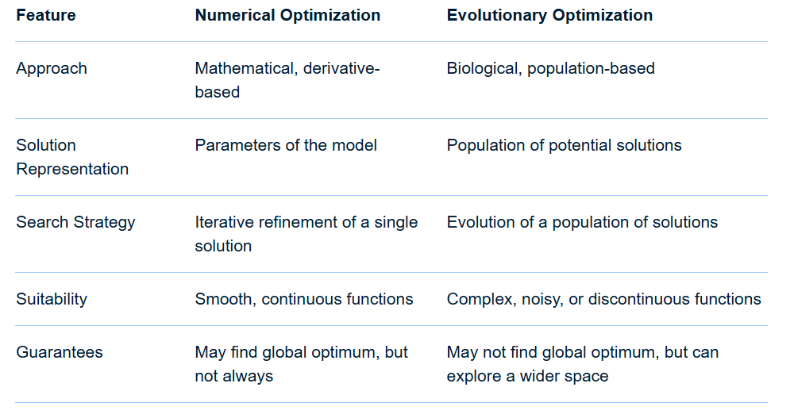
Maths for AI, ML, DL etc – A Bit more in Detail
Optimisation
Classical/Numerical and Evolutionary Optimisation Summary

Slide 133
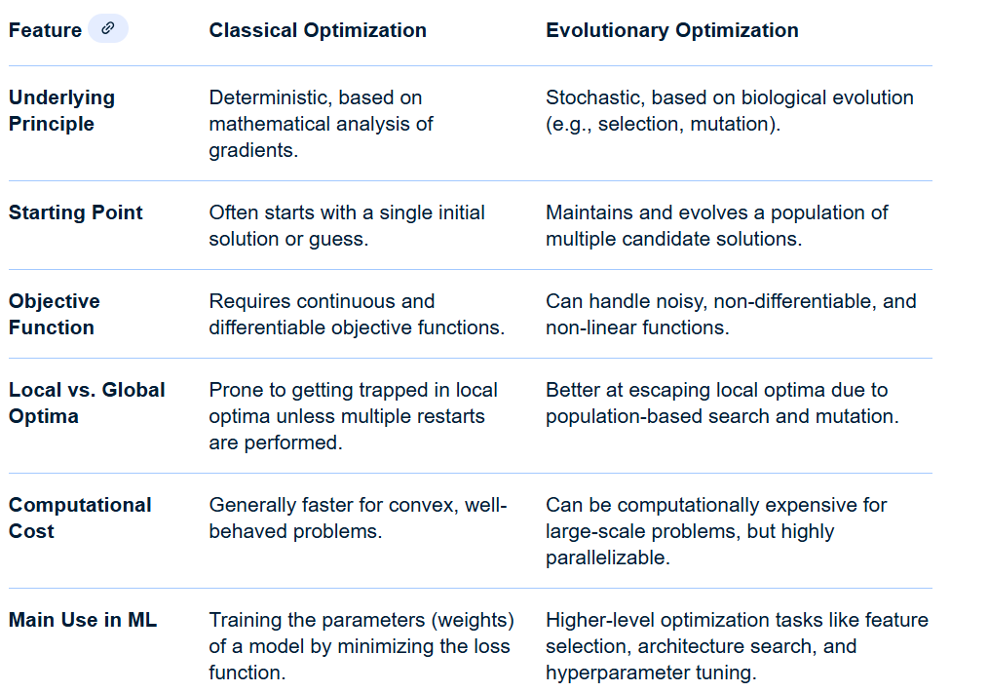
Maths for AI, ML, DL etc – A Bit more in Detail
Optimisation
Classical/Numerical and Evolutionary Optimisation Summary

Slide 134
Maths for AI, ML, DL etc – A Bit more in Detail
Optimisation
Classical/Numerical optimization techniques in ML Summary
Classical optimization uses mathematical and deterministic principles to find optimal solutions. These methods rely on the differentiability and continuity of the functions they are optimizing.
Technique | How it Works | Used For
Gradient Descent (GD) | An iterative first-order optimization algorithm that adjusts model parameters in the opposite direction of the gradient of the objective function. It aims to find the minimum of a cost or loss function. | Training simple models like linear regression or small neural networks.
Stochastic Gradient Descent (SGD) | Updates model parameters for each training example individually or in small batches. This is more computationally efficient for large datasets than standard gradient descent. | Training deep neural networks (DNNs), where computing the gradient for the full dataset is unfeasible.

Slide 135
Maths for AI, ML, DL etc – A Bit more in Detail
Optimisation
Classical/Numerical optimization techniques in ML Summary
Technique | How it Works | Used For
Adaptive learning rate methods (e.g., AdaGrad, RMSProp, Adam) | These are advanced variants of SGD that automatically adjust the learning rate for each parameter. Adam, for example, combines the advantages of momentum and RMSProp for faster and more stable convergence. | Training deep neural networks, especially on large, sparse datasets.
Newton's Method and Quasi-Newton Methods | Second-order optimization techniques that use both the first (gradient) and second (Hessian) derivatives of the objective function. They typically converge faster but are more computationally expensive. | Smaller-scale or specific convex optimization problems where the Hessian matrix is manageable to compute.
Constrained optimization (e.g., Lagrange Multipliers | A method for finding the maximum or minimum of a function subject to equality or inequality constraints. It introduces additional variables to turn a constrained problem into an unconstrained one. | Training Support Vector Machines (SVMs), which involves solving a constrained optimization problem

Slide 136
Maths for AI, ML, DL etc – A Bit more in Detail
Optimisation
Evolutionary optimization techniques in ML Summary
Evolutionary algorithms (EAs) are metaheuristic, population-based search techniques inspired by biological evolution. They are powerful for tackling complex, non-linear, or high-dimensional problems where classical methods might struggle
Technique | How it Works | Used For
Genetic Algorithms (GA) | Mimics natural selection by creating an initial population of candidate solutions. These solutions evolve over generations through selection, crossover (recombination), and mutation to produce progressively "fitter" individuals. | Feature selection, hyperparameter tuning, and neural architecture search..
Differential Evolution | A stochastic, population-based method that generates new solutions by combining existing population members. | Continuous parameter optimization, especially for complex, non-differentiable problems.

Slide 137
Maths for AI, ML, DL etc – A Bit more in Detail
Optimisation
Evolutionary optimization techniques in ML Summary
Technique | How it Works | Used For
Particle Swarm Optimization (PSO) | Inspired by the social behavior of bird flocks or fish schooling. A population of candidate solutions ("particles") moves through the search space, adjusting their positions based on their own best-known position and the swarm's global best position. | Hyperparameter tuning, feature selection, and training neural networks.
Evolutionary Strategies (ES | Optimization techniques specifically designed for continuous parameter problems, often using self-adaptive mutation rates. | Solving complex optimization problems, such as black-box optimization.
Simulated Annealing (SA) | A trajectory-based metaheuristic that accepts worse solutions with a certain probability that decreases over time. This helps the algorithm avoid getting trapped in local minima. | Optimizing neural network weights and for hyperparameter tuning.

Slide 138
Maths for AI, ML, DL etc – A Bit more in Detail
Optimisation
Hybrid optimization techniques in ML Summary
In many cases, hybrid methods combine the strengths of both classical and evolutionary approaches to tackle complex challenges more effectively.
Classical + Evolutionary: Evolutionary algorithms can be used for global search to find promising regions, while classical gradient-based methods can be used for fine-tuning within those regions.
Evolutionary for Hyperparameter Tuning: EAs are often used to find optimal hyperparameters (e.g., learning rate, number of layers) for deep learning models, which are then trained using classical gradient-based methods.
Combining Models: Hybrid machine learning can involve combining different algorithms in a layered or parallel architecture. For example, deep learning models can be used for feature extraction, with a traditional ML model for the final classification.

Slide 139
Maths for AI, ML, DL etc – A Bit more in Detail
Optimisation
For Further Exploration
Optimization for Data Science – GeeksforGeeks
Optimization Algorithms in Machine Learning - GeeksforGeeks
Convex vs. Non-Convex Functions
Taxonomy of optimization methods
Hands-On Mathematical Optimization with Python
Algorithms for Convex Optimization
About OR-Tools | Google for Developers
Awesome-Operations-Research
Parallel Numerical Algorithms
Algorithms for Optimization
An Introduction to Bayesian Thinking
Bayesian Optimisation
Bayesian Data Analysis
Bayesian Modeling and Computation in Python
Evolution Strategies From Scratch in Python
Genetic Algorithms And Artificial NeuralNets in Vanilla JS
Introduction to Evolutionary Algorithms | IntechOpen
Clever Algorithms
Genetic-Algorithms
Artificial-Intelligence-for-Big-Data
Hands-On-Genetic-Algorithms-with-Python
Principles of Soft Computing,
Optimisation under Uncertainity
Decision AI

Slide 140
Maths for AI, ML, DL etc – A Bit more in Detail
Geometry, Differential Geometry and Topology
🧭 Conceptual Layout Overview
+--------------------------------------+
| Topology |
| (Global structure of data manifold) |
|--------------------------------------|
| - Deformation allowed (rubber sheet)
| - No distances or angles
| - Properties: connectedness, holes, genus
| - Example shape: Torus or Möbius strip
| - ML Link: Topological Data Analysis (TDA)
|--------------------------------------|
| Keyword: "Global Shape" |
+--------------------------------------+
▲
| Abstraction Level ↑
|
+--------------------------------------+
| Differential Geometry |
| (Local smooth structure of manifolds)|
|--------------------------------------|
| - Curved surfaces with tangent planes

Slide 141
Maths for AI, ML, DL etc – A Bit more in Detail
Geometry, Differential Geometry and Topology
Conceptual Layout Overview
| - Geodesics = shortest paths
| - Riemannian metrics define curvature
| - Example: Sphere, hyperbolic surface
| - ML Link: Manifold Learning, Riemannian Optimization
|--------------------------------------|
| Keyword: "Local Curvature" |
+--------------------------------------+
▲
|
+--------------------------------------+
| Geometry |
| (Flat Euclidean structures) |
|--------------------------------------|
| - Points, lines, distances, angles
| - Euclidean metric (L2 norm)
| - Example: Plane, vector space
| - ML Link: Metric Learning, Embeddings
|--------------------------------------|
| Keyword: "Local Distances and Angles” |
+--------------------------------------+

Slide 142
Maths for AI, ML, DL etc – A Bit more in Detail
Geometry, Differential Geometry and Topology
🔍 Details of Each Layer
🧮 1. Geometry (Base Layer)
Visualize: A flat Cartesian grid with dots (data points) connected by straight lines.
What it shows: Distance between points, clusters, and orientation.
Key ML concepts: k-NN, SVM (distance-based), Word2Vec embeddings (similarity = geometric distance),
Euclidean loss (L2 loss)
Mental picture: Like plotting points on paper and measuring distances using a ruler.
🌊 2. Differential Geometry (Middle Layer)
Visualize: Now, the paper bends smoothly into a curved 2D surface (a sphere or saddle).
At any small patch, you can still draw a tiny flat tangent plane touching the surface.
What it shows: Smooth curvature — local geometry still looks Euclidean, but globally curved.
Key ML concepts: Manifold learning (Isomap, LLE, t-SNE), Latent space curvature in VAEs / diffusion models, Riemannian optimization (natural gradients, geodesics)
Mathematical analogy: Each data point has a tangent space — a local linearization for computations.
Mental picture: A globe: locally flat (city maps), globally curved (Earth).Detects Local structures.
🌀 3. Topology (Top Layer)
Visualize: Now ignore distances and curvature — imagine a rubber sheet that can stretch or bend freely without tearing. You focus only on connectivity and holes.
What it shows: Which regions are connected or contain holes, independent of geometry.

Slide 143
Maths for AI, ML, DL etc – A Bit more in Detail
Geometry, Differential Geometry and Topology
🔍 Details of Each Layer
🌀 3. Topology (Top Layer)
Key ML concepts:
Topological Data Analysis (TDA): detects global structures like loops, clusters, and voids in high-dimensional data.
Mapper algorithm: builds topological summaries of data manifolds.
Model robustness: topology reveals structure invariant to deformation.
Mental picture: A coffee mug and a doughnut — both have one hole → same topology.
🧩 II. CONCEPTUAL FOUNDATIONS
1️⃣ Geometry
Geometry studies measurable properties of shapes and spaces.
Core concepts:
Points, lines, planes, surfaces
Distances (metrics)
Angles
Symmetry and transformations
Coordinate systems
Variants:
Euclidean geometry: flat space, Pythagorean metric
Affine geometry: focuses on points and lines without distance
Projective geometry: adds points at infinity
Computational geometry: algorithms for spatial data
Intuition for ML:
Geometry gives us the metric foundation — how to measure distances or similarities between data points.
➡️ Example:
In Euclidean embeddings, you minimize Euclidean distances between similar examples.
In k-NN, SVM, or K-means, distance metrics determine boundaries.
2️⃣ Differential Geometry
Differential geometry extends geometry by adding smoothness and calculus.
Core concepts:
Manifolds: locally Euclidean smooth surfaces (data manifolds)
Tangent space: linear approximation at a point
Curvature: how a surface bends
Geodesics: shortest paths on curved spaces
Riemannian metric: generalization of distance in curved space
Differential forms, gradients, connections
Intuition:
Think of a curved manifold (e.g., a sphere or complex data manifold).
We can’t use simple Euclidean distances globally, but locally it “looks flat.”
Mathematical structures:
Concept Meaning
M
M Manifold (space where data lies)
T
p
M
T
p
​
M Tangent space at point
p
p
g
p
(
⋅
,
⋅
)
g
p
​
(⋅,⋅) Riemannian metric (inner product on tangent space)
∇
∇ Connection (defines parallel transport and geodesics)
In ML:
Differential geometry provides the language of smooth transformations and manifolds — crucial for representation learning and optimization.
➡️ Example connections:
Manifold Learning: Assumes high-dimensional data lies on a smooth manifold (Isomap, LLE, t-SNE).
Riemannian Optimization: Optimization on curved parameter spaces (e.g., orthogonal matrices, PSD matrices).
Latent Space Geometry in VAEs / Diffusion Models: Latent space often forms a manifold with meaningful geodesics.
Geometric Deep Learning: Neural networks on non-Euclidean domains (graphs, manifolds, groups).
3️⃣ Topology
Topology studies global, qualitative properties of space — shape without distances.
Core concepts:
Open/closed sets
Continuity and homeomorphisms
Connectedness
Compactness
Genus (holes in a surface)
Homology and homotopy groups
Intuition:
Two shapes are topologically equivalent if one can be smoothly deformed into the other without tearing or gluing.
→ A coffee mug and a doughnut are the same topologically (one hole).
In ML:
Topology gives structural and global insights about the shape of data.
➡️ Examples:
Topological Data Analysis (TDA):
Captures “shape of data” via persistent homology.
Identifies holes, loops, clusters in high-dimensional data.
Manifold Topology:
Understanding data connectivity (e.g., non-convex latent spaces).
Neural network expressivity:
Topology of decision boundaries determines model complexity.
Feature robustness:
Topological invariants are stable under small perturbations (robust features).
🎯 Integration with Machine Learning Concepts
Mathematical Layer Data-Level Idea ML Analogy
Geometry Measure distances and angles Euclidean embeddings, metric learning, k-NN
between samples
Differential Geometry Data lies on a smooth Manifold learning, latent space analysis,
manifold with curvature Riemannian optimization
Topology Global connectivity and shape Topological Data Analysis, Mapper,
of data manifold robustness of features

Slide 144
Maths for AI, ML, DL etc – A Bit more in Detail
Geometry, Differential Geometry and Topology
🧩 II. CONCEPTUAL FOUNDATIONS
1️⃣ Geometry
Variants:
Projective geometry: adds points at infinity
Computational geometry: algorithms for spatial data
Intuition for ML: Geometry gives us the metric foundation — how to measure distances or similarities between data points.
Example: In Euclidean embeddings, you minimize Euclidean distances between similar examples.In k-NN, SVM, or K-means, distance metrics determine boundaries.
2️⃣ Differential Geometry
Differential geometry extends geometry by adding smoothness and calculus.
Core concepts:
Manifolds: locally Euclidean smooth surfaces (data manifolds)
Tangent space: linear approximation at a point
Curvature: how a surface bends
Geodesics: shortest paths on curved spaces
Riemannian metric: generalization of distance in curved space
Differential forms, gradients, connections
Intuition:
Think of a curved manifold (e.g., a sphere or complex data manifold).
We can’t use simple Euclidean distances globally, but locally it “looks flat.”
Mathematical structures:
Concept Meaning
M
M Manifold (space where data lies)
T
p
M
T
p
​
M Tangent space at point
p
p
g
p
(
⋅
,
⋅
)
g
p
​
(⋅,⋅) Riemannian metric (inner product on tangent space)
∇
∇ Connection (defines parallel transport and geodesics)
In ML:
Differential geometry provides the language of smooth transformations and manifolds — crucial for representation learning and optimization.
➡️ Example connections:
Manifold Learning: Assumes high-dimensional data lies on a smooth manifold (Isomap, LLE, t-SNE).
Riemannian Optimization: Optimization on curved parameter spaces (e.g., orthogonal matrices, PSD matrices).
Latent Space Geometry in VAEs / Diffusion Models: Latent space often forms a manifold with meaningful geodesics.
Geometric Deep Learning: Neural networks on non-Euclidean domains (graphs, manifolds, groups).
3️⃣ Topology
Topology studies global, qualitative properties of space — shape without distances.
Core concepts:
Open/closed sets
Continuity and homeomorphisms
Connectedness
Compactness
Genus (holes in a surface)
Homology and homotopy groups
Intuition:
Two shapes are topologically equivalent if one can be smoothly deformed into the other without tearing or gluing.
→ A coffee mug and a doughnut are the same topologically (one hole).
In ML:
Topology gives structural and global insights about the shape of data.
➡️ Examples:
Topological Data Analysis (TDA):
Captures “shape of data” via persistent homology.
Identifies holes, loops, clusters in high-dimensional data.
Manifold Topology:
Understanding data connectivity (e.g., non-convex latent spaces).
Neural network expressivity:
Topology of decision boundaries determines model complexity.
Feature robustness:
Topological invariants are stable under small perturbations (robust features).
🎯 Integration with Machine Learning Concepts
Mathematical Layer Data-Level Idea ML Analogy
Geometry Measure distances and angles Euclidean embeddings, metric learning, k-NN
between samples
Differential Geometry Data lies on a smooth Manifold learning, latent space analysis,
manifold with curvature Riemannian optimization
Topology Global connectivity and shape Topological Data Analysis, Mapper,
of data manifold robustness of features

Slide 145
Maths for AI, ML, DL etc – A Bit more in Detail
Geometry, Differential Geometry and Topology
🧩 II. CONCEPTUAL FOUNDATIONS
2️⃣ Differential Geometry
We can’t use simple Euclidean distances globally, but locally it “looks flat.”
Mathematical structures:
Manifold (space where data lies)
Tangent space at point
Riemannian metric (inner product on tangent space)
Connection (defines parallel transport and geodesics)
In ML: Differential geometry provides the language of smooth transformations and manifolds — crucial for representation learning and optimization.
Example connections: Manifold Learning: Assumes high-dimensional data lies on a smooth manifold (Isomap, LLE, t-SNE).
Riemannian Optimization: Optimization on curved parameter spaces (e.g., orthogonal matrices, PSD matrices).
Latent Space Geometry in VAEs / Diffusion Models: Latent space often forms a manifold with meaningful geodesics.
Geometric Deep Learning: Neural networks on non-Euclidean domains (graphs, manifolds, groups).
3️⃣ Topology
Topology studies global, qualitative properties of space — shape without distances.

Slide 146
Maths for AI, ML, DL etc – A Bit more in Detail
Geometry, Differential Geometry and Topology
🧩 II. CONCEPTUAL FOUNDATIONS
3️⃣ Topology
Core concepts:
Open/closed sets
Continuity and homeomorphisms
Connectedness
Compactness
Genus (holes in a surface)
Homology and homotopy groups
Intuition: Two shapes are topologically equivalent if one can be smoothly deformed into the other without tearing or gluing.
→ A coffee mug and a doughnut are the same topologically (one hole).
In ML: Topology gives structural and global insights about the shape of data.
Examples:
Topological Data Analysis (TDA):
Captures “shape of data” via persistent homology.
Identifies holes, loops, clusters in high-dimensional data.
Manifold Topology:
Understanding data connectivity (e.g., non-convex latent spaces).
Neural network expressivity:
Topology of decision boundaries determines model complexity.

Slide 147
Maths for AI, ML, DL etc – A Bit more in Detail
Geometry, Differential Geometry and Topology
🧩 II. CONCEPTUAL FOUNDATIONS
3️⃣ Topology
Feature robustness:
Topological invariants are stable under small perturbations (robust features).
🎯 Integration with Machine Learning Concepts
Mathematical Layer Data-Level Idea ML Analogy
Geometry Measure distances and angles Euclidean embeddings, metric learning, k-NN
between samples
Differential Geometry Data lies on a smooth Manifold learning, latent space analysis,
manifold with curvature Riemannian optimization
Topology Global connectivity and shape Topological Data Analysis, Mapper,
of data manifold robustness of features
🧠 HOW THEY CONNECT IN MACHINE LEARNING
Mathematical Domain ML Concept Example
Geometry Metric learning, embeddings Word2Vec, Siamese networks
Differential Geometry Manifold learning, Riemannian Isomap, t-SNE, SphereFace
optimization
Topology Shape of data, global structure Persistent homology, Mapper algorithm

Slide 148
Maths for AI, ML, DL etc – A Bit more in Detail
Geometry, Differential Geometry and Topology
🧠 HOW THEY CONNECT IN MACHINE LEARNING
➤ 1. Geometry in ML
Feature space geometry: distance metrics define neighborhood and clustering.
Embedding learning: model learns to map data into geometric space where semantics = distances.
Geometric regularization: e.g., angular loss, cosine similarity.
➤ 2. Differential Geometry in ML
Optimization on manifolds: e.g., training orthogonal weight matrices or normalized embeddings.
Latent manifolds: generative models learn smooth latent manifolds.
Riemannian gradients: natural gradient descent adapts to parameter curvature.
➤ 3. Topology in ML
Topological data analysis (TDA): finds global features like loops/holes.
Topological regularization: ensures decision boundaries have desired topology.
Model interpretability: topology reveals structure of learned representations.
🧠 Visual Flow (Mental Animation)
Start with Geometry:
Points scattered in flat space → measure distances → cluster or classify.
Bend it to Differential Geometry:
The space folds smoothly — distances change locally → represent data on a manifold.
Melt it to Topology:
Distances disappear — only the global “connectedness” and number of holes matter.

Slide 149
Maths for AI, ML, DL etc – A Bit more in Detail
Geometry, Differential Geometry and Topology
🧩 Connecting Example — Faces Dataset
Concept Visualization ML Relevance
Geometry Distance between two Similarity-based learning
face images (Euclidean pixel
difference)
Differential Geometry Smooth changes in lighting or Manifold learning, latent
expression move along a space
curved face-manifold
Topology Different identities form
disconnected manifolds;
manifold may loop (pose variations) TDA for structure
discovery
🧭 INTERRELATION: Data Manifold Hypothesis
Most ML theory unites these under the data manifold hypothesis:
Real-world high-dimensional data lies near a smooth low-dimensional manifold embedded in high-dimensional space. Geometry defines local distances and structure. Differential geometry defines smooth curvature and tangent spaces.Topology defines global connectivity and shape of the manifold.

Slide 150
Maths for AI, ML, DL etc – A Bit more in Detail
Geometry, Differential Geometry and Topology
🧩 Related ML Fields and Techniques
Field Underlying Math
Manifold Learning Differential geometry & topology
Metric Learning Geometry
Geometric Deep Learning Differential geometry on graphs/manifolds
Topological Data Analysis (TDA) Algebraic topology
Representation Learning Geometric & topological constraints on latent space
Information Geometry Differential geometry of probability distributions
Neural Collapse Theory Geometric structure of last-layer features

Slide 151
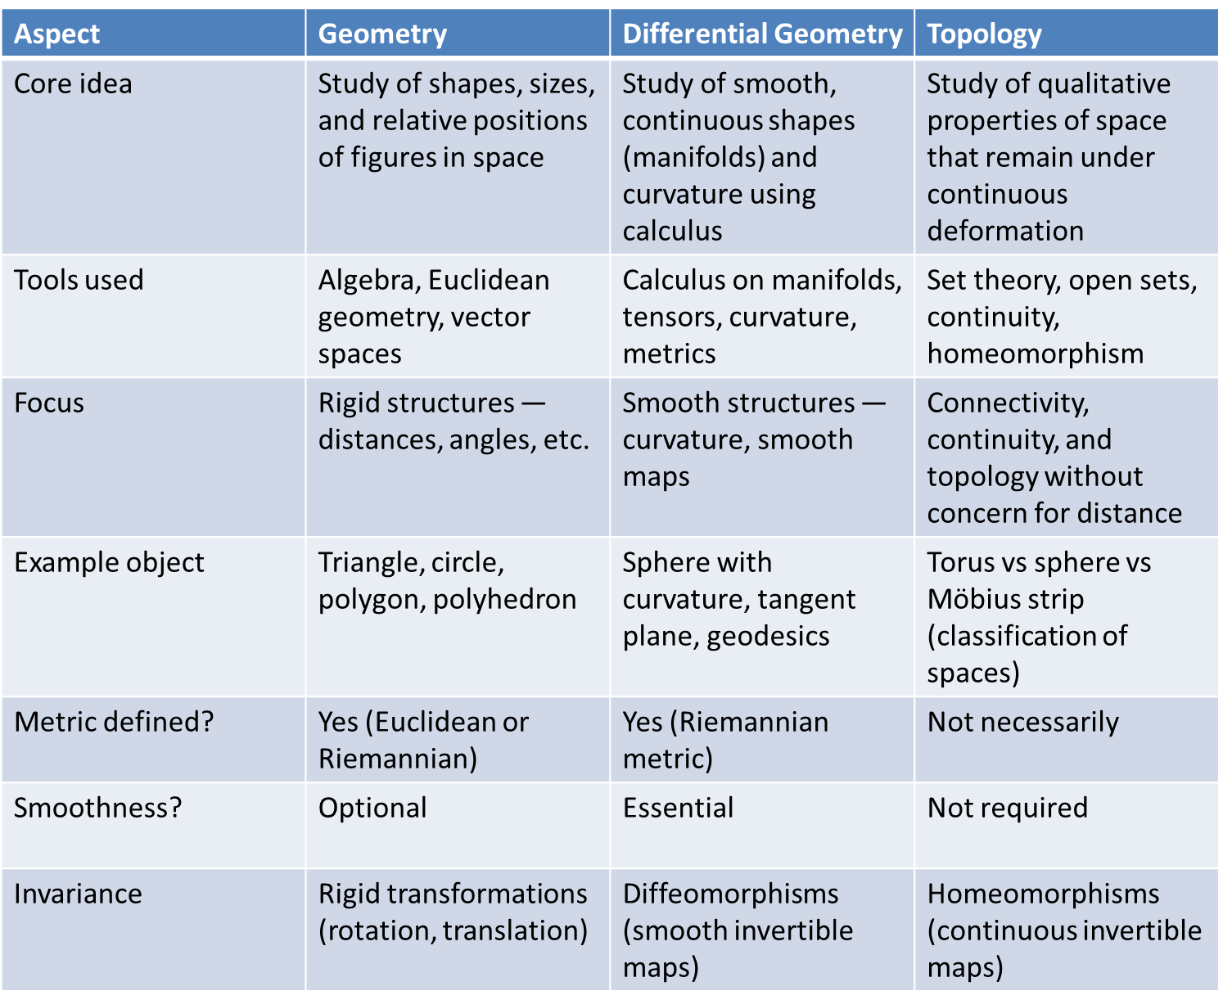
Maths for AI, ML, DL etc – A Bit more in Detail
Geometry, Differential Geometry and Topology
Summary

Slide 152
Maths for AI, ML, DL etc – A Bit more in Detail
Geometry, Differential Geometry and Topology
For Further Exploration
Geometrical Methods of Mathematical Physics
The Shape of Data
Shapes, Spaces, Simplices, and Structure: Geometry, Topology, and Machine Learning
Of Shapes and Spaces: Geometry, Topology, and Machine Learning
Manifolds, Tensors, and Forms
Topology Illustrated
Topological Data Analysis for Machine Learning I: Algebraic Topology
Topological Machine Learning II: Topology-Based Graph Learning
An Introduction to Topological Data Analysis

Slide 153
Maths for AI, ML, DL etc – A Bit more in Detail
Information Theory
Information theory is used in machine learning to provide a mathematical foundation for concepts like entropy and mutual information, which are applied in algorithms for feature selection, model evaluation, and building decision trees. Key applications include using cross-entropy as a loss function, employing information gain for splitting in decision trees, and minimizing KL divergence in tasks like training Variational Autoencoders.
1. Core Information-Theoretic Quantities (Foundation)
These define what information is and how to measure it.
1.1 Entropy (H)
Meaning: Uncertainty / randomness of a variable
ML Uses:
Decision trees (ID3, C4.5): split criterion
Feature selection
Regularization via entropy maximization
Language modeling uncertainty
Exploration in RL
Pattern: Prefer features that reduce entropy fastest
1.2 Joint, Conditional Entropy
H(X,Y) & H(Y∣X)

Slide 154
Maths for AI, ML, DL etc – A Bit more in Detail
Information Theory
1. Core Information-Theoretic Quantities (Foundation)
1.2 Joint, Conditional Entropy
ML Uses:
Multi-task learning
Conditional generation
Bayesian networks
Label noise modeling
1.3 Mutual Information (MI)
I(X;Y)=H(X)−H(X∣Y)
Meaning: Shared information between variables
ML Uses:
Feature selection (max relevance)
Representation learning
Disentanglement
Contrastive learning
Causal discovery
Clustering quality
Pattern: Learn representations that maximize MI with labels but minimize MI with nuisances

Slide 155
Maths for AI, ML, DL etc – A Bit more in Detail
Information Theory
1. Core Information-Theoretic Quantities (Foundation)
1.4 Conditional Mutual Information
I(X;Y∣Z)
ML Uses:
Causal inference
Feature redundancy removal
Graphical model structure learning
Conditional independence tests
1.5 KL Divergence
DKL(P∥Q)
Meaning: Distance between distributions
ML Uses:
Variational Inference
VAEs
Bayesian learning
Knowledge distillation
Policy optimization (TRPO, PPO)
Pattern: Learn model distribution Q close to true data P

Slide 156
Maths for AI, ML, DL etc – A Bit more in Detail
Information Theory
1. Core Information-Theoretic Quantities (Foundation)
1.6 Cross-Entropy
H(P,Q)
ML Uses:
Classification loss
Language models
Softmax training
Key Insight: Minimizing cross-entropy = minimizing KL divergence
1.7 Jensen–Shannon Divergence
Symmetric, bounded version of KL
ML Uses:
GANs (original GAN objective)
Distribution comparison
Clustering
1.8 Total Correlation (Multivariate MI)
TC(X1,…,Xn)
ML Uses:
Disentangled representations
Factorized latent variables

Slide 157
Maths for AI, ML, DL etc – A Bit more in Detail
Information Theory
1. Core Information-Theoretic Quantities (Foundation)
1.8 Total Correlation (Multivariate MI)
ML Uses:
Independent Component Analysis (ICA)
2. Information-Theoretic Learning Principles
2.1 Maximum Entropy Principle
Choose the least-biased model consistent with constraints
ML Uses:
Logistic regression
CRFs
Language models
Inverse RL
2.2 Minimum Description Length (MDL)
Best model = shortest code length
ML Uses:
Model selection
Regularization
Occam’s razor formalization
Neural compression

Slide 158
Maths for AI, ML, DL etc – A Bit more in Detail
Information Theory
2. Information-Theoretic Learning Principles
2.2 Minimum Description Length (MDL)
Pattern: Accuracy + simplicity = generalization
2.3 Information Bottleneck (IB)
min⁡I(X;Z) such that I(Z;Y)≥c
ML Uses:
Representation learning
Deep learning theory
Feature compression
Robust models
Variants
Deep Information Bottleneck
Variational IB
Conditional IB
2.4 Rate–Distortion Theory
Trade-off between:
Compression (rate)
Error (distortion)

Slide 159
Maths for AI, ML, DL etc – A Bit more in Detail
Information Theory
2. Information-Theoretic Learning Principles
2.4 Rate–Distortion Theory
ML Uses
Autoencoders
Quantization
Neural compression
Lossy representation learning
3. Information Theory in Supervised Learning
3.1 Feature Selection
Max-Relevance (MI with label)
Min-Redundancy (MI between features)
mRMR algorithm
3.2 Decision Trees
Information gain
Gain ratio
Entropy reduction
3.3 Regularization as Information Control
L2 ≈ Gaussian prior (low KL)

Slide 160
Maths for AI, ML, DL etc – A Bit more in Detail
Information Theory
3. Information Theory in Supervised Learning
3.3 Regularization as Information Control
Dropout ≈ noise injection → entropy increase
Label smoothing → entropy regularization
4. Representation Learning & Deep Learning
4.1 Information Flow in Deep Networks
Early layers: compress input
Later layers: preserve task-relevant info
Information Bottleneck View of DL
Compression phase
Fitting phase
4.2 Mutual Information Neural Estimation (MINE)
Estimate MI for high-dimensional neural reps
ML Uses:
Self-supervised learning
Representation diagnostics
Causal representation learning

Slide 161
Maths for AI, ML, DL etc – A Bit more in Detail
Information Theory
4. Representation Learning & Deep Learning
4.3 Disentanglement
Minimize total correlation
Maximize independent factors
Models
β-VAE
FactorVAE
InfoGAN
4.4 Contrastive Learning (InfoNCE)
Maximize MI between:
Views of same data
Past and future
Examples
SimCLR
MoCo
CPC
BYOL (implicit MI)
5. Unsupervised Learning
5.1 Clustering
Maximize MI between data and cluster assignments
Minimize conditional entropy
Algorithms
InfoMax clustering
Agglomerative clustering (entropy-based)
5.2 ICA (Independent Component Analysis)
Minimize mutual information among components
5.3 Topic Models
KL divergence minimization
Entropy regularization
6. Information Theory in Reinforcement Learning
6.1 Maximum Entropy RL
max⁡E[R]+αH(π)
Benefits
Better exploration
Robust policies
Multi-modal behavior
Algorithms
Soft Q-Learning
SAC
MaxEnt IRL
6.2 Information-Theoretic Exploration
Intrinsic reward = information gain
Curiosity = entropy reduction of dynamics model
6.3 Policy Regularization
KL-constrained policy updates
Trust regions
7. Information Theory & Causality
7.1 Causal Discovery
Conditional MI tests
Transfer entropy
Directed information
7.2 Transfer Entropy
Detect directional influence over time
ML Uses
Time-series causality
Neuroscience
Financial ML
7.3 Invariant Causal Representation
Maximize MI with target
Minimize MI with environment
8. Generative Models
8.1 VAEs
KL divergence regularization
Rate–distortion trade-off
8.2 GANs
JS divergence
Wasserstein distance (info-geometry)
8.3 Diffusion Models
Variational bounds
Entropy reduction over timesteps
9. Optimization & Training Dynamics
9.1 Information Geometry
Fisher Information
Natural gradient descent
ML Uses
Faster convergence
Stable training
Trust region methods
9.2 Fisher Information Matrix
Measures parameter sensitivity
ML Uses
Continual learning (EWC)
Model pruning
Uncertainty estimation
10. Evaluation & Generalization
10.1 PAC-Bayes Bounds
Generalization in terms of:
Empirical loss
KL divergence from prior
10.2 Description Length as Metric
Model complexity
Overfitting detection
11. Advanced & Emerging Patterns
11.1 Information-Theoretic Fairness
Minimize MI between prediction and sensitive attributes
11.2 Privacy-Preserving ML
Differential privacy
Mutual information leakage bounds
11.3 Neural Compression
Quantization via rate–distortion
Pruning via Fisher information
11.4 Multimodal Learning
Cross-modal MI maximization
Alignment objectives
12. System-Level Design Patterns
Pattern 1: Compress → Predict
Remove nuisance info before prediction
Pattern 2: Max Info / Min Nuisance
Preserve task signal, kill spurious correlations
Pattern 3: Entropy-Regularized Control
Stability via uncertainty
Pattern 4: KL-Constrained Learning
Safe updates, stable training
13. Mental Model (One-Line Summary)
Machine learning is the art of deciding what information to keep, what to discard, and how efficiently to represent it.

Slide 162
Maths for AI, ML, DL etc – A Bit more in Detail
Information Theory
5. Unsupervised Learning
5.1 Clustering
Maximize MI between data and cluster assignments
Minimize conditional entropy
Algorithms
InfoMax clustering
Agglomerative clustering (entropy-based)
5.2 ICA (Independent Component Analysis)
Minimize mutual information among components
5.3 Topic Models
KL divergence minimization
Entropy regularization
6. Information Theory in Reinforcement Learning
6.1 Maximum Entropy RL
max⁡E[R]+αH(π)
Benefits
Better exploration
Robust policies
Multi-modal behavior
Algorithms
Soft Q-Learning
SAC
MaxEnt IRL
6.2 Information-Theoretic Exploration
Intrinsic reward = information gain
Curiosity = entropy reduction of dynamics model
6.3 Policy Regularization
KL-constrained policy updates
Trust regions
7. Information Theory & Causality
7.1 Causal Discovery
Conditional MI tests
Transfer entropy
Directed information
7.2 Transfer Entropy
Detect directional influence over time
ML Uses
Time-series causality
Neuroscience
Financial ML
7.3 Invariant Causal Representation
Maximize MI with target
Minimize MI with environment
8. Generative Models
8.1 VAEs
KL divergence regularization
Rate–distortion trade-off
8.2 GANs
JS divergence
Wasserstein distance (info-geometry)
8.3 Diffusion Models
Variational bounds
Entropy reduction over timesteps
9. Optimization & Training Dynamics
9.1 Information Geometry
Fisher Information
Natural gradient descent
ML Uses
Faster convergence
Stable training
Trust region methods
9.2 Fisher Information Matrix
Measures parameter sensitivity
ML Uses
Continual learning (EWC)
Model pruning
Uncertainty estimation
10. Evaluation & Generalization
10.1 PAC-Bayes Bounds
Generalization in terms of:
Empirical loss
KL divergence from prior
10.2 Description Length as Metric
Model complexity
Overfitting detection
11. Advanced & Emerging Patterns
11.1 Information-Theoretic Fairness
Minimize MI between prediction and sensitive attributes
11.2 Privacy-Preserving ML
Differential privacy
Mutual information leakage bounds
11.3 Neural Compression
Quantization via rate–distortion
Pruning via Fisher information
11.4 Multimodal Learning
Cross-modal MI maximization
Alignment objectives
12. System-Level Design Patterns
Pattern 1: Compress → Predict
Remove nuisance info before prediction
Pattern 2: Max Info / Min Nuisance
Preserve task signal, kill spurious correlations
Pattern 3: Entropy-Regularized Control
Stability via uncertainty
Pattern 4: KL-Constrained Learning
Safe updates, stable training
13. Mental Model (One-Line Summary)
Machine learning is the art of deciding what information to keep, what to discard, and how efficiently to represent it.

Slide 163
Maths for AI, ML, DL etc – A Bit more in Detail
Information Theory
6. Information Theory in Reinforcement Learning
6.1 Maximum Entropy RL
Multi-modal behavior
Algorithms
Soft Q-Learning
SAC
MaxEnt IRL
6.2 Information-Theoretic Exploration
Intrinsic reward = information gain
Curiosity = entropy reduction of dynamics model
6.3 Policy Regularization
KL-constrained policy updates
Trust regions
7. Information Theory & Causality
7.1 Causal Discovery
Conditional MI tests
Transfer entropy
Directed information

Slide 164
Maths for AI, ML, DL etc – A Bit more in Detail
Information Theory
7. Information Theory & Causality
7.2 Transfer Entropy
Detect directional influence over time
ML Uses
Time-series causality
Neuroscience
Financial ML
7.3 Invariant Causal Representation
Maximize MI with target
Minimize MI with environment
8. Generative Models
8.1 VAEs
KL divergence regularization
Rate–distortion trade-off
8.2 GANs
JS divergence
Wasserstein distance (info-geometry)

Slide 165
Maths for AI, ML, DL etc – A Bit more in Detail
Information Theory
8. Generative Models
8.3 Diffusion Models
Variational bounds
Entropy reduction over timesteps
9. Optimization & Training Dynamics
9.1 Information Geometry
Fisher Information
Natural gradient descent
ML Uses:
Faster convergence
Stable training
Trust region methods
9.2 Fisher Information Matrix
Measures parameter sensitivity
ML Uses:
Continual learning (EWC)
Model pruning
Uncertainty estimation

Slide 166
Maths for AI, ML, DL etc – A Bit more in Detail
Information Theory
10. Evaluation & Generalization
10.1 PAC-Bayes Bounds
Generalization in terms of:
Empirical loss
KL divergence from prior
10.2 Description Length as Metric
Model complexity
Overfitting detection
11. Advanced & Emerging Patterns
11.1 Information-Theoretic Fairness
Minimize MI between prediction and sensitive attributes
11.2 Privacy-Preserving ML
Differential privacy
Mutual information leakage bounds
11.3 Neural Compression
Quantization via rate–distortion
Pruning via Fisher information
11.4 Multimodal Learning
Cross-modal MI maximization

Slide 167
Maths for AI, ML, DL etc – A Bit more in Detail
Information Theory
11. Advanced & Emerging Patterns
11.4 Multimodal Learning
Alignment objectives
12. System-Level Design Patterns
Pattern 1: Compress → Predict
Remove nuisance info before prediction
Pattern 2: Max Info / Min Nuisance
Preserve task signal, kill spurious correlations
Pattern 3: Entropy-Regularized Control
Stability via uncertainty
Pattern 4: KL-Constrained Learning
Safe updates, stable training
13. Mental Model (One-Line Summary)
Machine learning is the art of deciding what information to keep, what to discard, and how efficiently to represent it.

Slide 168
Maths for AI, ML, DL etc – A Bit more in Detail
Information Theory
For Further Exploration
Information Theory in Machine Learning - GeeksforGeeks
Information Theory Explained for Machine Learning
Information Theory, Inference, and Learning Algorithms
Information Theory: From Coding to Learning
How are information and Decision Theory used in Statistics?
Deep Learning with the Information Bottleneck Principle

Slide 169
Maths for AI, ML, DL etc – A Bit more in Detail
Abstract Algebra
1. Algebraic Structures → Core ML Foundations
1.1 Sets & Mappings (Functions)
Used everywhere
Hypothesis spaces
Feature spaces
Model as a function:
f:X→Y
ML usage
Loss functions
Kernel mappings
Feature transformations
1.2 Groups
A group = (G, ∘) with closure, identity, inverse.
Where groups appear in ML
Symmetry & invariance
Rotations, translations, permutations
Example: image translation invariance
Optimization
Gradient descent over Lie groups

Slide 170
Maths for AI, ML, DL etc – A Bit more in Detail
Abstract Algebra
1. Algebraic Structures → Core ML Foundations
1.2 Groups
Optimization on manifolds
Data augmentation
Apply group actions to generate new samples
Examples
Rotation group SO(2), SO(3) in vision
Permutation groups in graphs
1.3 Group Actions
Group acting on a set:g⋅x
ML relevance
Invariant / equivariant models
Regularization via symmetry
Examples
CNNs → translation group
Graph Neural Networks → permutation group

Slide 171
Maths for AI, ML, DL etc – A Bit more in Detail
Abstract Algebra
2. Linear Algebra (Vector Spaces) — Algebraic View
2.1 Vector Spaces
Most ML models operate in vector spaces.
Algebraic view
Features = vectors
Models = linear maps
Layers = compositions of linear maps
2.2 Linear Transformations (Homomorphisms)
T(v+w)=T(v)+T(w)
ML usage
Neural network layers
Dimensionality reduction
Autoencoders
2.3 Dual Spaces
Linear functionals on vectors.
ML usage
Attention mechanisms
Kernel methods

Slide 172
Maths for AI, ML, DL etc – A Bit more in Detail
Abstract Algebra
2. Linear Algebra (Vector Spaces) — Algebraic View
2.3 Dual Spaces
Representer theorem
3. Rings & Fields
3.1 Fields
A field supports +, −, ×, ÷.
ML usage
Real numbers ℝ (almost all ML)
Finite fields (crypto + privacy ML)
3.2 Rings
Rings appear when multiplication doesn’t require division.
ML relevance
Polynomial rings
Boolean rings
3.3 Polynomial Rings
R[x1,x2,...,xn]

Slide 173
Maths for AI, ML, DL etc – A Bit more in Detail
Abstract Algebra
3. Rings & Fields
3.3 Polynomial Rings
ML usage
Polynomial regression
Feature engineering
Kernel methods
Example
Polynomial kernel:
K(x,y)=(x⋅y+c)
4. Algebras (Vector Space + Multiplication)
4.1 Associative Algebras
Vector space with multiplication.
ML usage
Matrix algebra
Tensor algebra
Neural network computation graphs
4.2 Tensor Algebra
Critical for deep learning.

Slide 174
Maths for AI, ML, DL etc – A Bit more in Detail
Abstract Algebra
4. Algebras (Vector Space + Multiplication)
4.2 Tensor Algebra
ML usage
CNNs
Transformers
Multi-modal models
4.3 Lie Algebras
Infinitesimal version of Lie groups.
ML relevance
Continuous symmetries
Robotics
Physics-informed ML
Normalizing flows on manifolds
5. Representation Theory (Extremely Important)
5.1 Group Representations
Map group elements → matrices.

Slide 175
Maths for AI, ML, DL etc – A Bit more in Detail
Abstract Algebra
5. Representation Theory (Extremely Important)
5.1 Group Representations
ML impact
Model Algebraic Structure
CNN Translation group
GNN Permutation group
SE(3)-Transformer Rotation + translation
5.2 Equivariance & Invariance
f(gx)=gf(x)
Used in
Computer vision
Molecular ML
Physics ML
6. Lattices, Boolean Algebra & Logic
6.1 Boolean Algebra
AND, OR, NOT

Slide 176
Maths for AI, ML, DL etc – A Bit more in Detail
Abstract Algebra
6. Lattices, Boolean Algebra & Logic
6.1 Boolean Algebra
ML usage
Decision trees
Rule-based models
Feature selection
6.2 Lattices
Partial order structures.
ML usage
Concept lattices
Formal Concept Analysis
Hierarchical clustering
7. Universal Algebra & Category Theory
7.1 Universal Algebra
Abstract study of algebraic systems.
ML usage
Model abstraction
Neural architecture generalization

Slide 177
Maths for AI, ML, DL etc – A Bit more in Detail
Abstract Algebra
7. Universal Algebra & Category Theory
7.1 Universal Algebra
ML usage
Program synthesis ML
7.2 Category Theory (Very Advanced ML)
Objects + morphisms.
ML relevance
Differentiable programming
Compositional ML
Probabilistic programming
Examples
Monads → probabilistic models
Functors → data transformations
Backpropagation as a functor
8. Algebraic Geometry (Advanced / Research)
8.1 Varieties & Ideals
Zero sets of polynomials.

Slide 178
Maths for AI, ML, DL etc – A Bit more in Detail
Abstract Algebra
8. Algebraic Geometry (Advanced / Research)
8.1 Varieties & Ideals
ML usage
Model identifiability
Causal discovery
Constraint learning
8.2 Gröbner Bases
Solving polynomial systems.
ML usage
Symbolic regression
Learning algebraic constraints
9. Algebraic Topology (Borderline but Powerful)
9.1 Homology Groups
Capture shape of data.
ML usage
Topological Data Analysis (TDA)
Persistent homology
Anomaly detection

Slide 179
Maths for AI, ML, DL etc – A Bit more in Detail
Abstract Algebra
10. Semirings & Tropical Algebra
10.1 Semirings
Addition + multiplication (no inverse).
ML usage
Dynamic programming
Viterbi algorithm
Graph algorithms
10.2 Tropical Algebra
Replace + with min/max.
ML usage
Shortest path
Structured prediction
Max-plus neural networks
11. Algebra in Optimization & Learning Theory
11.1 Monoids
Associative + identity.

Slide 180
Maths for AI, ML, DL etc – A Bit more in Detail
Abstract Algebra
11. Algebra in Optimization & Learning Theory
11.1 Monoids
ML usage
Sequence models
Aggregation functions
11.2 Algebraic View of Loss Landscapes
Symmetry groups create flat minima
Parameter identifiability issues
12. Algebraic ML Patterns (Practical)
Pattern 1: Exploit Symmetry
Reduce data + improve generalization
CNNs
Equivariant networks
Pattern 2: Algebraic Constraints
Encode domain rules directly
Physics-informed ML
Causal ML

Slide 181
Maths for AI, ML, DL etc – A Bit more in Detail
Abstract Algebra
12. Algebraic ML Patterns (Practical)
Pattern 3: Composition
Build complex models from simple morphisms
Deep learning
Modular ML systems
Pattern 4: Invariant Features
Learn quotient spaces
Metric learning
Contrastive learning
13. Mapping Abstract Algebra → ML Areas
Algebra Topic ML Area
Groups CNNs, GNNs, Robotics
Rings Kernels, feature maps
Fields Numerical ML
Lie algebras Manifold optimization
Representations Equivariant DL
Boolean algebra Trees, rules

Slide 182
Maths for AI, ML, DL etc – A Bit more in Detail
Abstract Algebra
13. Mapping Abstract Algebra → ML Areas
Algebra Topic ML Area
Category theory Differentiable programming
Algebraic geometry Causal ML
Semirings Graph ML
Topology TDA
For Further Exploration
Abstract Algebra: Theory and Applications
An Elementary Introduction to Groups and Representations
Geometric Deep Learning and Equivariant Neural Networks
Geometric Deep Learning - Grids, Groups, Graphs, Geodesics, and Gauges
An Introduction to Group Equivariant Deep Learning
Lie Groups
Category Theory Resources
Awesome Neural Geometry

Slide 183
Maths for AI, ML, DL etc – A Bit more in Detail
Chaos and Fractal Theory
Chaos and fractal theory are used in machine learning (ML) primarily to analyze and model complex, nonlinear systems that are often found in real-world data like financial markets, biological processes, and natural phenomena. By treating seemingly random or unpredictable data as a deterministic system with underlying structure, these theories help improve the accuracy and robustness of ML models, particularly for time-series forecasting and complex pattern recognition.
Applications of chaos theory in ML
Chaos theory studies complex, deterministic nonlinear systems that are highly sensitive to initial conditions, a concept popularized as the "butterfly effect". Despite their unpredictability, these systems have underlying structure that ML can help model and forecast, especially over shorter time horizons.
Time-series forecasting
Chaotic time-series data, which can appear random, are generated by complex systems like weather patterns, financial markets, and fluid dynamics.
Techniques: By combining chaos theory with recurrent neural networks (RNNs) and Long Short-Term Memory (LSTM) networks, ML models can predict the short-term behavior of these systems with greater accuracy.
Method: A time-series is first reconstructed into a multi-dimensional phase space using techniques like Takens' embedding theorem. The reconstructed phase space points are then used to train a neural network, which can learn the underlying dynamics to forecast future values

Slide 184
Maths for AI, ML, DL etc – A Bit more in Detail
Chaos and Fractal Theory
Time-series forecasting
Example: For forecasting electricity prices, wind power, and stock market indices, hybrid models using neural networks and chaos theory have proven more effective than traditional methods.
Understanding complex systems
ML helps in understanding the underlying dynamics of chaotic systems, which is difficult with traditional analytical methods.
Modeling: Studies have shown that some ML models, like reservoir computing, can effectively model and mimic chaotic systems from observed data alone.
Characterization: Researchers use ML to predict properties of chaotic systems, such as their spatial extent or attractor dimension, providing deeper insights into their behavior.
Initialization: Chaotic maps, such as the Chen system, can be used to generate chaotic sequences that initialize the weights and biases of neural networks. This can lead to faster convergence and more robust training compared to standard initialization methods.
Feature extraction
In complex data with hidden dynamics, chaos theory can be used for feature extraction.
Chaotic learning: A novel paradigm known as "chaotic learning" involves embedding real-world data (e.g., brain EEG signals, protein data) into a chaotic dynamical system. Statistical features are then extracted from the resulting chaotic trajectories and used to train an ML model for downstream prediction tasks.

Slide 185
Maths for AI, ML, DL etc – A Bit more in Detail
Chaos and Fractal Theory
Applications of fractal theory in ML
Fractal geometry describes shapes that exhibit self-similarity at different scales, a property found in many natural and complex objects. In ML, fractal theory is used to characterize the complexity of data and to inform the design of learning algorithms.
Image processing and computer vision
Fractal features provide a robust and scale-invariant way to characterize image textures, a task where traditional methods can struggle.
Texture analysis: The fractal dimension, a non-integer value that quantifies an object's complexity, can be used as a powerful feature for classifying different types of textures.
Feature extraction: In computer vision, fractal features help identify unique patterns missed by conventional methods, leading to more accurate classification, segmentation, and reconstruction.
Algorithmic design: Advanced techniques like multi-scale fractal residual networks are used to improve the reconstruction of high-resolution images from low-resolution ones.
Feature extraction from signals
Fractal dimension analysis is useful for extracting key features from complex biological and engineering signals.
EEG analysis: For diagnosing neurological disorders like Alzheimer's or schizophrenia, fractal dimensions can be extracted from segments of EEG signals to represent changes in brain activity. This significantly reduces the dimensionality of the data while preserving crucial information.

Slide 186
Maths for AI, ML, DL etc – A Bit more in Detail
Chaos and Fractal Theory
Signal recognition: In communication, fractal features can be extracted from modulated signals and fed into ML classifiers like Random Forest to identify the signal type with high accuracy, even in noisy environments.
Improved neural network architectures
The principles of fractal geometry have inspired new approaches for designing and training ML models.
Fractal networks: These networks prioritize patterns over absolute values and leverage self-similarity to learn from smaller datasets.
Training stability: The relationship between neural network training and fractals has been explored, revealing that the boundary of a network's trainability is itself fractal. This can provide insights into designing more robust and adaptable networks
For Further Exploration
Chaos and Fractals
Introduction to Chaos, Fractals and Dynamical Systems
Does God Play Dice? – Wikipedia
The Beauty of Fractals – Wikipedia
Fractals and Chaos
Difference Equations from Rabbits to Chaos
Chaos and Fractals Books

Slide 187
Maths for AI, ML, DL etc – A Bit more in Detail
Game Theory
1. Core Game-Theoretic Foundations (Must-Know)
1.1 Players, Actions, Payoffs
Players → agents / models / learners
Actions (strategies) → model outputs, policies, hyperparameters
Payoffs (utilities) → reward, loss, accuracy, profit, regret
ML mapping
Model = rational agent
Loss function = negative utility
Training = strategy optimization
1.2 Types of Games
(A) By Cooperation
Non-cooperative games (dominant in ML)
Cooperative games (coalitions, profit sharing)
(B) By Information
Complete information
Incomplete information (Bayesian games)
(C) By Time
Static (one-shot)
Dynamic / repeated games

Slide 188
Maths for AI, ML, DL etc – A Bit more in Detail
Game Theory
1. Core Game-Theoretic Foundations (Must-Know)
1.3 Strategy Types
Pure strategy
Mixed strategy (probabilistic)
Behavioral strategy
ML relevance
Mixed strategies ↔ stochastic policies
Exploration in RL
2. Equilibrium Concepts (Central to ML)
2.1 Nash Equilibrium (NE)
No player benefits from unilateral deviation.
Used in:
GANs
Multi-agent RL
Competitive markets
Adversarial robustness
GAN objective
min⁡_{G}max⁡_{D}V(G,D)

Slide 189
Maths for AI, ML, DL etc – A Bit more in Detail
Game Theory
2. Equilibrium Concepts (Central to ML)
2.2 Variants of Nash
Pure NE
Mixed NE
Approximate NE (ε-NE) ← practical ML
2.3 Stackelberg Equilibrium (Leader–Follower)
Leader commits first.
ML uses
Bilevel optimization
Meta-learning
AutoML
Adversarial training
Example:
Defender commits model → attacker reacts
2.4 Correlated Equilibrium
Coordination via signals
Less restrictive than Nash

Slide 190
Maths for AI, ML, DL etc – A Bit more in Detail
Game Theory
2. Equilibrium Concepts (Central to ML)
2.4 Correlated Equilibrium
Used in:
Multi-agent coordination
Recommendation systems
3. Zero-Sum vs General-Sum Games
3.1 Zero-Sum Games
u1+u2=0
Used in:
GANs (idealized)
Adversarial learning
Minimax optimization
Key theorem:
Minimax Theorem (von Neumann)
3.2 General-Sum Games
Cooperation + competition
Most real ML systems

Slide 191
Maths for AI, ML, DL etc – A Bit more in Detail
Game Theory
3. Zero-Sum vs General-Sum Games
3.2 General-Sum Games
Used in:
Markets
Auctions
Multi-agent simulations
Social learning
4. Learning in Games (Very Important for ML)
4.1 Fictitious Play
Assume others are stationary
Best-respond to empirical average
Used in:
Self-play
Policy iteration
4.2 Best Response Dynamics
πi_{t+1}=BR(π−i_{t})π
GAN instability arises from non-convergent BR dynamics.

Slide 192
Maths for AI, ML, DL etc – A Bit more in Detail
Game Theory
4. Learning in Games (Very Important for ML)
4.3 No-Regret Learning
Each agent minimizes regret over time.
Algorithms:
Hedge
Multiplicative Weights
Online Gradient Descent
Key result
No-regret learners → convergence to Nash (in some games)
4.4 Replicator Dynamics
Evolutionary update rule:
x˙_{i}=x_{i}(u_{i}−uˉ)
Used in:
Evolutionary ML
Population-based training
Neuroevolution

Slide 193
Maths for AI, ML, DL etc – A Bit more in Detail
Game Theory
5. Evolutionary Game Theory (EGT)
5.1 Evolutionarily Stable Strategy (ESS)
Robust against invasion.
Used in:
Robust model strategies
Diversity preservation
AutoML populations
5.2 Population Games
Strategies are distributions
Agents sampled from population
ML mapping:
Ensemble learning
Population-based RL
6. Game Theory + Optimization (Critical Bridge)
6.1 Minimax Optimization
min⁡xmax⁡yf(x,y)
Gradient Descent–Ascent
Extra-Gradient

Slide 194
Maths for AI, ML, DL etc – A Bit more in Detail
Game Theory
6. Game Theory + Optimization (Critical Bridge)
6.1 Minimax Optimization
Optimistic Mirror Descent
Used in:
GAN training
Adversarial robustness
6.2 Bilevel Optimization
min⁡xf(x,y∗(x))s.t. y∗(x)=arg⁡min⁡yg(x,y)xmin​ f(x,y ∗ (x))s.t. y ∗ (x)=arg ymin​ g(x,y)
Used in:
Hyperparameter tuning
Meta-learning
Stackelberg games
7. Adversarial Learning as a Game
7.1 Adversarial Examples
Attacker vs classifier
Defender vs perturbations

Slide 195
Maths for AI, ML, DL etc – A Bit more in Detail
Game Theory
7. Adversarial Learning as a Game
7.1 Adversarial Examples
Game:
Attacker maximizes loss
Defender minimizes worst-case loss
7.2 Robust Optimization
min⁡_{θ}max⁡_{δ}∈ΔL(θ,x+δ)
8. Multi-Agent Reinforcement Learning (MARL)
8.1 Game-Theoretic RL
Each agent has its own reward
Environment = other agents
8.2 Solution Concepts in MARL
Nash Q-learning
Correlated Q-learning
Friend-or-Foe learning

Slide 196
Maths for AI, ML, DL etc – A Bit more in Detail
Game Theory
8. Multi-Agent Reinforcement Learning (MARL)
8.3 Centralized Training, Decentralized Execution (CTDE)
Game-aware training pattern.
Used in:
Robotics
Traffic control
Swarm intelligence
9. Mechanism Design (Reverse Game Theory)
9.1 Mechanism Design Basics
Design rules so selfish agents behave optimally.
Used in:
Auctions
Marketplaces
Incentive-aligned ML systems
9.2 Truthfulness / Incentive Compatibility
VCG mechanisms
Proper scoring rules

Slide 197
Maths for AI, ML, DL etc – A Bit more in Detail
Game Theory
9. Mechanism Design (Reverse Game Theory)
9.2 Truthfulness / Incentive Compatibility
Used in:
Crowdsourcing labels
Federated learning incentives
10. Game Theory in Modern ML Systems
10.1 GANs (Canonical Example)
Generator vs Discriminator
Non-convex, non-concave game
No global NE in practice
Advanced variants:
Wasserstein GAN → smoother game
Unrolled GANs → anticipate opponent
10.2 Self-Play Systems
AlphaGo
AlphaZero
MuZero

Slide 198
Maths for AI, ML, DL etc – A Bit more in Detail
Game Theory
10.2 Self-Play Systems
Key idea:
Learning optimal strategies by playing against yourself
10.3 Fairness, Bias & Social Learning
Groups as players
Fairness constraints as payoffs
11. Common Failure Modes (Important)
Issue Game-Theoretic Cause
GAN mode collapse Cyclic dynamics
Non-convergence No NE / unstable NE
Exploitable policies Not equilibrium-robust
Reward hacking Bad incentive design
12. Design Patterns for ML Systems
Pattern 1: Minimax Loop
Used in:
GANs
Robust training

Slide 199
Maths for AI, ML, DL etc – A Bit more in Detail
Game Theory
12. Design Patterns for ML Systems
Pattern 2: Leader–Follower (Stackelberg)
Used in:
Adversarial defense
Hyperparameter optimization
Pattern 3: Population-Based Training
Used in:
Evolutionary search
AutoML
Pattern 4: Mechanism-Aware Learning
Used in:
Market ML
Platform economics
13. Mathematical Tools
Fixed point theory
Convex–concave analysis
Variational inequalities

Slide 200
Maths for AI, ML, DL etc – A Bit more in Detail
Game Theory
13. Mathematical Tools
Differential games
Stochastic approximation
14. How Game Theory Connects to Your Broader ML Interests
Game dynamics ↔ nonlinear dynamical systems
Repeated games ↔ temporal causality
Strategy spaces ↔ algebraic structures
MARL ↔ causal multi-agent environments
For Further Exploration
Stanford’s Multi Agent Systems Course
Stanford’s Algorithmic Game Theory Course
Algorithmic Game Theory
Open-ended Learning in Symmetric Zero-sum Games
Which Training Methods for GANs do actually Converge?
Prediction, Learning, and Games
Introduction to Online Convex Optimization

Slide 201
Maths for AI, ML, DL etc Resources
For Further Exploration In General
The Roadmap of Mathematics for Machine Learning
Some Great Resources to understand the Maths Behind AI
Probability and Statistics - GeeksforGeeks
Bookshelves - Mathematics LibreTexts
Bookshelves - Statistics LibreTexts
Green Tea Press – Free books by Allen B. Downey
List of mathematical functions – Wikipedia
Mathematical model – Wikipedia
Numerical analysis - Wikipedia
Numerical Algorithms: Methods for Computer Vision, Machine Learning, and Graphics
Mike X Cohen
Operations Research: Applications and Algorithms
OPERATIONS RESEARCH (SCHAUMS OUTLINE SERIES)
Evan Chen’s Higher Maths Lecture Notes
Dexter Chua’s Higher Maths Lecture Notes
The Princeton Companion to Mathematics
The Princeton Companion to Applied Mathematics

Slide 202
ML Workflow with High Level Underlying Maths
Stage A — Problem definition & data collection
Main math: Probability & Statistics
Why: Define target distribution, decide whether task is regression/classification/structured prediction; choose losses reflecting probabilistic objectives (e.g., negative log-likelihood).
Concrete: If output y is continuous, model p(y∣x) (e.g., Gaussian) and minimize negative log-likelihood:
L(θ)=−∑_{i}logpθ(y_{i}∣x_{i})
Practical tip: Use prior knowledge to choose likelihood family (Poisson for counts, Bernoulli for binary, etc.)
Stage B — Data cleaning & EDA
Main math: Statistics, Linear Algebra, Geometry (visualization), Fractal/Chaos (if time-series)
Statistics: summary statistics, outlier detection (z-score), hypothesis testing, confidence intervals.
Example: z-score
z=x−μσ​
Linear algebra: PCA for dimensionality reduction & identifying correlated features.
PCA from SVD: if data matrixX∈R n×d(centered), SVD
X=UΣV⊤, principal components are columns of V.
Geometry: t-SNE/UMAP visualize manifold structure (intuition: distance/neighborhood preservation).

Slide 203
ML Workflow with High Level Underlying Maths
Stage B — Data cleaning & EDA
Time series / chaos: compute autocorrelation, Lyapunov exponents (see advanced section) to detect deterministic chaotic behavior vs. stochastic noise.
Practical note: Implement PCA with numpy.linalg.svd or sklearn.decomposition.PCA.
Stage C — Feature engineering & representation
Main math: Linear Algebra, Probability, Geometry/Topology, Calculus (for feature transforms)
Linear algebra: linear combinations, projections, kernel methods. For example, polynomial features expand x↦(1,x,x2,… ) — these are linear algebra operations on feature vectors.
Probability: feature augmentation using likelihood ratios or log-odds.
Example: convert probabilities to logit:
logit(p)=ln(p/1−p) where ln = log_{e}(natural logarithm)
Topology: use persistent homology (TDA) to generate features that capture shape/holes at multiple scales (useful for structured data like point clouds).
Practical: scaling (standardization) — subtract mean and divide by std (linear algebra operations on vectors). Use scikit-learn pipelines for repeatability.

Slide 204
ML Workflow with High Level Underlying Maths
Stage D — Model selection & mathematical formulation
Main math: Linear Algebra, Probability & Statistics, Geometry, Calculus
Linear models: linear regression/reg logistic regression.
Matrix form: ordinary least squares
(OLS) solution:
β^=(X⊤X)⁻¹X⊤y (when invertible; regularize when ill-conditioned).
Probabilistic models: Bayesian models use posterior - p(θ∣D)∝p(D∣θ)p(θ).
Example: Gaussian linear regression with prior leads to closed-form MAP.
Neural networks: composition of linear maps and nonlinearities — use calculus for gradients. Architectures live in parameter space (geometry matters).
Kernel methods: Mercer's theorem uses functional analysis; kernel trick computes inner products in feature space without explicit mapping
k(x,x′)=⟨ϕ(x),ϕ(x′)⟩.SVM primal/dual rely on quadratic programming.
Decision: choose a model based on bias-variance tradeoff (statistics) and geometry of data (is data on a low-dim manifold?).

Slide 205
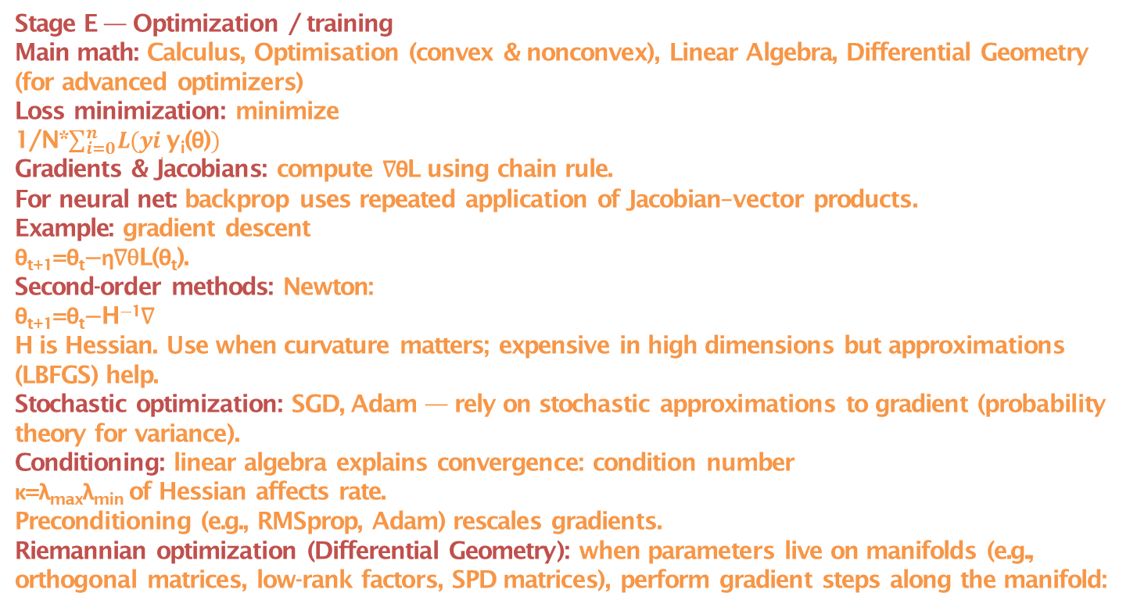
ML Workflow with High Level Underlying Maths
Stage E — Optimization / training
Main math: Calculus, Optimisation (convex & nonconvex), Linear Algebra, Differential Geometry (for advanced optimizers)
Loss minimization: minimize
1/N*$\sum_{i=0}^{n}{L(yi,\text{y}\text{i}\text{(}\text{θ}\text{)})}$
Gradients & Jacobians: compute ∇θL using chain rule.
For neural net: backprop uses repeated application of Jacobian–vector products.
Example: gradient descent
θ_{t+1}=θ_{t}−η∇θL(θ_{t}).
Second-order methods: Newton:
θ_{t+1}=θ_{t}−H⁻¹∇
H is Hessian. Use when curvature matters; expensive in high dimensions but approximations (LBFGS) help.
Stochastic optimization: SGD, Adam — rely on stochastic approximations to gradient (probability theory for variance).
Conditioning: linear algebra explains convergence: condition number
κ=λ_{max}⁡λ_{min} of Hessian affects rate.
Preconditioning (e.g., RMSprop, Adam) rescales gradients.
Riemannian optimization (Differential Geometry): when parameters live on manifolds (e.g., orthogonal matrices, low-rank factors, SPD matrices), perform gradient steps along the manifold:

Slide 206
ML Workflow with High Level Underlying Maths
Stage E — Optimization / training
use Riemannian gradient, retractions, exponential map.
Examples: training orthogonal RNNs, optimization on Stiefel manifold.
Practical: use autograd frameworks (PyTorch, TensorFlow) for gradients; use torch.optim for optimizers.
For manifold optimization: libraries like geoopt or pymanopt (conceptually).
Stage F — Evaluation & uncertainty quantification
Main math: Probability & Statistics, Information Theory, Topology (for robust metrics), Game Theory (calibration under adversary)
Metrics: accuracy, precision/recall, ROC AUC for classifiers; MSE, MAE for regressors.
Statistical tests: significance of improvement (paired t-tests, bootstrap).
Calibration & uncertainty: predictive distribution
p(y∣x), credibility intervals, Bayesian credible intervals vs frequentist confidence intervals. Evaluate with proper scoring rules like negative log-likelihood or Brier score.
Information criteria: AIC/BIC for model comparison (statistically penalized likelihood).
Robustness / adversarial: apply game-theoretic tests (adversarial examples)
Practical: use cross-validation with careful folds (time series require forward chaining) — statistics required to avoid leakage.

Slide 207
ML Workflow with High Level Underlying Maths
Stage G — Deployment, monitoring & maintenance
Main math: Probability (concept drift detection), Statistics (control charts), Optimization (resource allocation)
Concept drift: test if distribution p(x,y) is changing over time — use statistical two-sample tests (e.g., Kolmogorov-Smirnov on features, or monitor performance metrics with CUSUM charts).
Model updating: online optimization (stochastic updates) or periodic retraining using new data.
Resource allocation: optimization for latency vs accuracy tradeoffs (constrained optimization).
Practical: log inputs & predictions; compute drift statistics periodically.
3) Advanced topics
Linear Algebra (deep role)
Everything matrix/vectorized:
datasets X∈R n×d,
parameters W∈R d×k
SVD / Eigenanalysis: PCA, spectral clustering (use graph Laplacian eigenvectors), low-rank approximations.
Matrix calculus: derivatives w.r.t matrices (useful for deriving gradient updates).
Practical: watch for numerical conditioning; use stable SVD and regularization.

Slide 208
ML Workflow with High Level Underlying Maths
3) Advanced topics
Probability & Statistics (foundational)
Generative vs discriminative modeling. Likelihoods, Bayesian inference, conjugacy (Gaussian—Gaussian), MLE & MAP.
Uncertainty quantification: Bayesian posterior, approximate inference (VI, MCMC).
Probabilistic graphical models (factorization of joint distribution) — use conditional independencies to simplify inference.
Example: logistic regression is derived by modeling P(y=1∣x)=σ(w⊤x) and maximizing the log-likelihood.
Calculus (derivatives, integrals, chain rule)
Gradients & Hessians for learning and curvature.
Backpropagation is repeated chain rule applications.
Integrals in expectation-based losses:
Ep(x)[f(x)], MC estimates.
Practical: numerical stability (softmax + logsumexp trick to avoid overflow/underflow).
Optimisation (convex & nonconvex)
Convex optimization: guarantees global optimum, used in SVMs, LASSO (coordinate descent, proximal methods).

Slide 209
ML Workflow with High Level Underlying Maths
3) Advanced topics
Optimisation (convex & nonconvex)
Nonconvex optimization: deep learning — rely on SGD and heuristics; analyze with landscape tools (saddle points, local minima).
Regularization & constraints: L1 (sparsity), L2 (ridge), elastic net. Proximal gradient methods handle nondifferentiable regularizers.
Practical: choose learning rate schedules, weight decay; monitor training vs validation gap (overfitting).
Geometry (including Differential Geometry & Topology)
Manifold hypothesis: high-dimensional data often concentrates near low-dim manifolds → motivates nonlinear dimensionality reduction.
Riemannian geometry: optimization on manifolds using Riemannian gradient and retraction (example: optimizing orthonormal weights on Stiefel manifold; Fisher information metric in natural gradient).
Natural gradient: precondition gradient by Fisher information
F: ∇~=F⁻¹∇. It follows from information geometry (treat parameter space as Riemannian manifold with metric F).
Topology (TDA): persistent homology captures connected components/holes across scales; yields persistence diagrams used as features or for anomaly detection.

Slide 210
ML Workflow with High Level Underlying Maths
3) Advanced topics
Geometry (including Differential Geometry & Topology)
Practical libraries: ripser, gudhi for persistent homology (conceptual; implementation details not shown here).
Chaos & Fractal theory (when relevant)
Chaotic systems & ML: many real systems (weather, finance, physiological) show deterministic chaos. Use embeddings (Takens’ theorem) to reconstruct attractors from time series.
Takens embedding: build state vectors
X_{t}=[x_{t}, x_{t−τ},…,x_{t−(m−1)τ}]
Lyapunov exponent: positive exponent
λ>0 implies sensitive dependence on initial conditions. Estimate from time series to see predictability horizon
T∼1/λ
Fractal dimension (e.g., Hausdorff or correlation dimension): measures complexity of attractor; can guide model capacity needed.
ML uses: forecasting chaotic time series with reservoir computing, RNNs, or models that incorporate delay embeddings.
Practical caution: chaotic series might look random locally; probabilistic forecasting and short horizon predictions are often more realistic than long-range deterministic forecasts.

Slide 211
ML Workflow with High Level Underlying Maths
3) Advanced topics
Game Theory (multiagent, adversarial)
Adversarial ML: model as a two-player zero-sum game (attacker vs defender).
GANs use minimax:
Training is alternating optimization — analyze via game theory (Nash equilibria, convergence issues).
Mechanism design & incentives: in recommender systems or auction settings, design objective functions accounting for strategic users.
Multi-agent RL: compute equilibria (Nash, correlated) — optimization in policy space often nonconvex and multi-objective.
Robustness: worst-case (minimax) formulations protect against distributional shift:
min_{θ} max_{q}∈U E(x,y)∼qℓ(fθ(x),y)
Practical: adversarial training (PGD attacks) is an application of game theory + optimization + calculus.
4) Practical recipes & checks (how to use math without getting lost)
If data dimension >> samples: use dimensionality reduction (PCA, SVD) and regularization (Ridge/Lasso). Linear algebra + statistics.

Slide 212
ML Workflow with High Level Underlying Maths
4) Practical recipes & checks (how to use math without getting lost)
If model doesn’t converge: check conditioning of Hessian (linear algebra), reduce learning rate (optimization), use preconditioning (Adam) or second-order approximations.
If predictions overconfident: use calibration (isotonic regression, Platt scaling) or Bayesian/ensemble methods.
If data on manifold (images, speech): embed with convolutional architectures (exploit local geometry) or explicitly use manifold learning methods.
If adversaries present: use minimax/robust optimization and adversarial training (game theory + optimization).
5) Quick reference cheats (formulas & keywords)
PCA via SVD:
X=UΣV⊤
→ PCs = columns of V
OLS: β^=(X⊤X)⁻¹X⊤y
Logistic grad:
∇=−∑(y−σ(w⊤x))x
Gradient descent:
θ←θ−η∇

Slide 213
ML Workflow with High Level Underlying Maths
5) Quick reference cheats (formulas & keywords)
Newton step:
Δθ=−H⁻¹∇
Natural gradient:
Δθ=−F⁻¹∇
GAN objective:
min_{G} max_{D} E[logD(x)]+E[log1−D(G(z)))]
Takens embedding:
X_{t}=[x_{t},x_{t−τ},…,x_{t−(m−1)τ}]

Slide 214
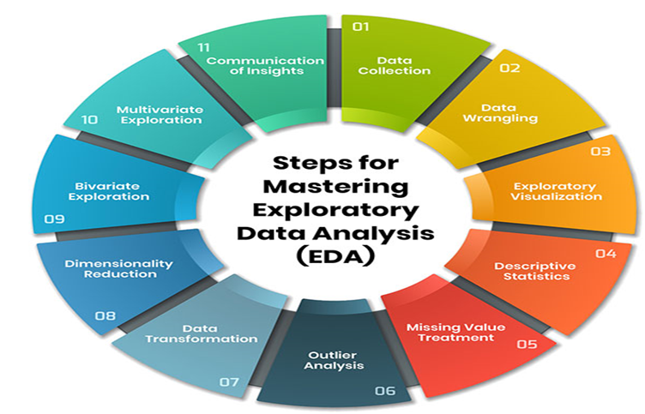
EDA(Exploratory Data Analysis)

Slide 215
EDA(Exploratory Data Analysis)
1. What Is EDA?
EDA = Systematic process of understanding a dataset before modeling.
Goals:
detect patterns
identify anomalies
test assumptions
understand distributions
spot relationships
generate hypotheses
prepare for feature engineering & modeling
EDA is both quantitative (stats) + visual (plots).
2. Core Components of EDA
Data Cleaning
Univariate Analysis
Bivariate & Multivariate Analysis
Missing Value Analysis
Outlier Analysis
Feature Relationships & Correlation
Distribution & Density Analysis
Time-Series EDA

Slide 216
EDA(Exploratory Data Analysis)
2. Core Components of EDA
Text/NLP EDA
Image EDA
EDA for ML Readiness
3. DATA UNDERSTANDING (STRUCTURE & QUALITY)
3.1 Dataset Structure
Rows, columns
Data types (int, float, object, datetime, category)
Primary keys / duplicates
Cardinality (unique values)
Data volume & memory footprint
Techniques:
.info(), .describe()
Value counts
Schema validation
3.2 Data Quality Checks
Missing values %
Invalid values (negative age, zero price)
Data inconsistencies

Slide 217
EDA(Exploratory Data Analysis)
3. DATA UNDERSTANDING (STRUCTURE & QUALITY)
3.2 Data Quality Checks
Out-of-domain values
Unexpected formats
4. MISSING VALUE ANALYSIS
4.1 Types of Missingness
MCAR: Missing Completely At Random
MAR: Missing At Random
MNAR: Missing Not At Random
4.2 Techniques
Missing heatmap
Missingness correlation matrix
Missingness indicator features
Group-wise missing patterns
Plots:
Heatmap (seaborn/missingno)
Matrix plot
Bar plot of missing %

Slide 218
EDA(Exploratory Data Analysis)
5. UNIVARIATE ANALYSIS
For numerical variables
Histogram
KDE (kernel density estimation)
Box plot
Violin plot
ECDF
Quantile summary
Rug plot
Extract statistics:
mean, median, mode
variance, std, IQR
skewness, kurtosis
quantiles (1%, 5%, 25%, 75%, 95%)
Detect:
normality
heavy tails
multi-modality
truncation/censoring

Slide 219
EDA(Exploratory Data Analysis)
5. UNIVARIATE ANALYSIS
For categorical variables
Frequency bar chart
Pie chart (rarely recommended)
Count plot
Proportions
Entropy
Dominant class ratio
Detect:
high cardinality
long-tail distributions
class imbalance
6. BIVARIATE ANALYSIS
6.1 Numerical vs Numerical
Scatterplot
Hexbin plot
Joint plot
2D KDE
Correlation (Pearson/Spearman/Kendall)
Regression line
Residual plots

Slide 220
EDA(Exploratory Data Analysis)
6. BIVARIATE ANALYSIS
6.2 Catagorical vs Numerical
Box plot
Violin plot
Swarm plot
Strip plot
Category-wise summary tables
ANOVA test
Kruskal-Wallis test
6.3 Catagorical vs Catagorical
Crosstab
Mosaic plot
Heatmap of proportions
Chi-square test
7. MULTIVARIATE ANALYSIS
Used for understanding interactions among 3+ variables.
Techniques:
Pairplot / scatter matrix
Parallel coordinate plots

Slide 221
EDA(Exploratory Data Analysis)
7. MULTIVARIATE ANALYSIS
Techniques:
Andrews curves
Dimensionality reduction for visualization (PCA, t-SNE, UMAP)
Clustermap / hierarchical clustering
Correlation matrix
Partial dependence patterns
8. OUTLIER ANALYSIS
8.1 Statistical Methods
IQR method
Z-score
Modified Z-score
Percentile thresholds
8.2 Model-Based Methods
Isolation Forest
DBSCAN
LOF (Local Outlier Factor)
Autoencoders for anomaly detection

Slide 222
EDA(Exploratory Data Analysis)
8. OUTLIER ANALYSIS
8.3 Visualization for outliers
Box plot
Scatter + highlight
Distribution tails
Quantile plots
9. DISTRIBUTION ANALYSIS
Key questions:
Normal? Log-normal? Exponential? Power-law? Bimodal?
Heavy tails?
Skewness?
Tools:
Histogram
KDE
Q-Q plot
P-P plot
Statistical tests:
Shapiro–Wilk
Kolmogorov–Smirnov
Anderson–Darling

Slide 223
EDA(Exploratory Data Analysis)
10. CORRELATION & DEPENDENCY ANALYSIS
10.1 Correlation Types
Pearson (linear)
Spearman (rank-based)
Kendall (non-parametric)
10.2 Limitations
only checks pairwise
cannot detect non-linear relationships
10.3 Alternatives (Non-Linear Dependencies)
Mutual information
MIC (Maximal Information Coefficient)
HSIC kernel independence
Distance correlation
10.4 Visual Tools
Correlation heatmap
Clustered heatmap
Directional dependency graph

Slide 224
EDA(Exploratory Data Analysis)
11. DATA PROFILING & SUMMARY STATISTICS
11.1 Basic Profiling
describe()
percentiles
missing stats
Uniqueness
11.2 Advanced Profiling
pandas-profiling / ydata-profiling
sweetviz
dataprep
Generates automated EDA reports.
12. EDA FOR FEATURE ENGINEERING
Common feature-engineering insights from EDA:
skewed → log transform
cyclic → sine/cosine encoding
high-cardinality → target encoding
correlated → drop redundant
outliers → winsorize
imbalanced → resampling

Slide 225
EDA(Exploratory Data Analysis)
12. EDA FOR FEATURE ENGINEERING
Common feature-engineering insights from EDA:
periodicity → Fourier terms
EDA helps define:
boundaries
bins
polynomial degree
interactions
time windows
13. TIME-SERIES EDA
Special domain because order matters.
13.1 Time Structure Understanding
Trend
Seasonality
Cycles
Level shifts
Holidays
13.2 Plots
Line plot
Lag plot

Slide 226
EDA(Exploratory Data Analysis)
13. TIME-SERIES EDA
13.2 Plots
Autocorrelation (ACF)
Partial autocorrelation (PACF)
Seasonal decomposition (STL)
Rolling statistics plot
Heatmap of seasonality (hour × day)
13.3 Checks
stationarity (ADF test)
changepoints
Volatility
14. TEXT/NLP EDA
14.1 Token-Level
Most common words
Word clouds
Word frequency distribution (Zipf’s Law)
Vocabulary size
Length distribution

Slide 227
EDA(Exploratory Data Analysis)
14. TEXT/NLP EDA
14.2 Structure
POS tags
Named entities
Sentence length distribution
Language detection
14.3 Embedding-based
Cluster words with embeddings
t-SNE over sentences
14.4 Text quality issues
HTML noise
emojis
unicode issues
spelling variations
15. IMAGE EDA
15.1 Pixel-Level
pixel histograms
color channel distribution

Slide 228
EDA(Exploratory Data Analysis)
15. IMAGE EDA
15.1 Pixel-Level
missing/corrupted images
15.2 Metadata
EXIF tags
image shapes
aspect ratio distribution
15.3 Model-based
feature maps
clusters of embeddings
anomaly detection on images
16. EDA PATTERNS & BEST PRACTICES
16.1 80/20 Pattern
80% of insights come from:
histograms
scatterplots
correlation matrix
groupby summaries

Slide 229
EDA(Exploratory Data Analysis)
16. EDA PATTERNS & BEST PRACTICES
16.2 Progressive EDA Pattern
Overview
Univariate
Bivariate
Multivariate
Domain-specific
ML-readiness checks
16.3 “EDA for ML” Pre-Checks
data leakage
class imbalance
multicollinearity
distribution mismatch (train vs test)
stratification necessity
16.4 ML Leakage Checks
target in features
date/time leakage
forward-looking values in time-series

Slide 230
EDA(Exploratory Data Analysis)
17. STATISTICAL TESTS COMMON IN EDA
Numerical Comparison
t-test
ANOVA
Mann–Whitney U
Kruskal–Wallis
Categorical Comparison
Chi-square
Fisher's Exact Test
Distribution Tests
Shapiro–Wilk
KS test
Jarque–Bera
18. AUTOMATED EDA TOOLS
ydata-profiling (pandas-profiling)
sweetviz
AutoViz
Dataprep EDA
Dython (for categorical + numerical dependency)
Lux (automatic visual EDA in Jupyter)
Great Expectations (validation + expectations)

Slide 231
EDA(Exploratory Data Analysis)
19. END-TO-END EDA WORKFLOW (Industry Standard)
Load data
Check structure & schema
Understand data types
Univariate analysis
Bivariate analysis
Correlation and non-linear dependency
Missing value analysis
Outlier detection
Domain-specific EDA
Validate assumptions
Extract insights for:
feature engineering
data cleaning
modeling
Create EDA report
20. SUMMARY
EDA consists of:
A. Understanding Data
structure, types, missingness, quality

Slide 232
EDA(Exploratory Data Analysis)
20. SUMMARY
EDA consists of:
B. Summaries
descriptive statistics
frequency tables
C. Visualization
univariate (histograms)
bivariate (scatter/box)
multivariate (pairplot, heatmap)
D. Statistical Tests
correlation, independence, distribution tests
E. Patterns & Trends
seasonality, clusters, segments
F. Anomalies
outliers, patterns of missingness

Slide 233
EDA(Exploratory Data Analysis)
20. SUMMARY
EDA consists of:
G. Pre-model Checks
leakage
imbalance
collinearity
Transformations
H. Automated EDA
profiling tools

Slide 234
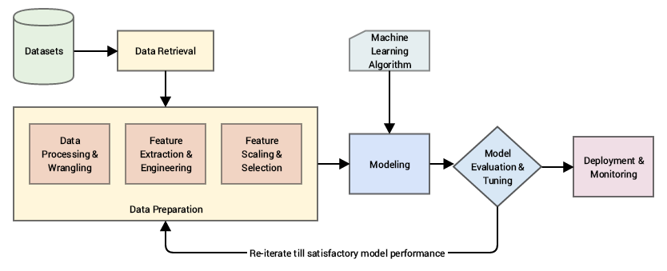
Feature Engineering

Slide 235
Feature Engineering
1. Foundations of Feature Engineering
Feature engineering = transforming raw data → representations that maximize model performance.
It includes:
Feature Extraction
Feature Construction / Creation
Feature Selection
Feature Transformation
Representation Learning (DL)
Domain-specific feature design
2. Feature Types
2.1 Numerical Features
Continuous (e.g., age, price)
Discrete (e.g., number of clicks)
Ratio/interval features
2.2 Categorical Features
Nominal (color)
Ordinal (rating levels)

Slide 236
Feature Engineering
2. Feature Types
2.3 Text Features
Characters, tokens, sentences, embeddings
2.4 Time-based Features
Calendar fields, lags, rolling windows
2.5 Image Features
Pixels, filters, embeddings
2.6 Audio Features
MFCC, spectrograms, Chroma
2.7 Geospatial Features
Coordinates, distances, geohashes
2.8 Graph Features
Degree, centrality, node2vec

Slide 237
Feature Engineering
3. General Feature Engineering Techniques
3.1 Handling Missing Values
Mean/median/mode imputation
KNN imputation
Interpolation (time series)
Indicator flags (“was_missing”)
3.2 Encoding Categorical Variables
A. Basic Encodings
One-Hot Encoding
Ordinal Encoding
Binary Encoding
Hash Encoding (for high-cardinality)
B. Target-based Encodings
Mean Encoding
Weight of Evidence (WOE)
Leave-one-out encoding
James–Stein encoding
CatBoost encoding

Slide 238
Feature Engineering
3. General Feature Engineering Techniques
3.3 Scaling & Normalization
Standardization (z-score)
Min–Max scaling
Robust scaling (IQR-based)
Power transform (Box–Cox, Yeo–Johnson)
Quantile transform
3.4 Polynomial Feature Generation
Squared terms
Interaction terms
Cross-features (e.g., income * age)
3.5 Discretization / Binning
Equal-width bins
Equal-frequency bins
K-means binning
Decision-tree-based binning

Slide 239
Feature Engineering
3. General Feature Engineering Techniques
3.6 Feature Crossing (Common in Tabular DL & Recommenders)
Examples:
city × profession
gender × product_category
device × time_of_day
Techniques:
Manual crossing
Embedding cross
DCN (Deep & Cross Network)
AutoCross (AutoML)
3.7 Statistical Feature Transformations
Log, sqrt, reciprocal
Box–Cox transform
Z-score anomalies
Winsorization (outlier handling)
Feature whitening

Slide 240
Feature Engineering
3. General Feature Engineering Techniques
3.8 Dimensionality Reduction
(Links to your earlier “y=f(x) in clustering/dim reduction” questions.)
Linear
PCA
SVD
ICA
LDA (supervised)
Non-linear
t-SNE
UMAP
ISOMAP
Kernel PCA
3.9 Feature Selection Techniques
A. Filters
Mutual information
Chi-square test
F-test / ANOVA
Correlation-based selection
Variance threshold

Slide 241
Feature Engineering
3. General Feature Engineering Techniques
3.9 Feature Selection Techniques
B. Wrappers
Stepwise selection
RFE (Recursive Feature Elimination)
Genetic algorithms
C. Embedded
Lasso (L1)
Elastic Net
Tree-based importance (RF, XGBoost)
Model-based SHAP selection
4. Domain-Specific Feature Engineering
4.1 Time Series Feature Engineering
Basics
Lags: y(t−1), y(t−7), y(t−30)
Rolling statistics
rolling mean
rolling std
rolling skew
rolling min/max

Slide 242
Feature Engineering
4. Domain-Specific Feature Engineering
4.1 Time Series Feature Engineering
Expanding window features
Exponential moving averages
Calendar features
hour, day, month
weekend, holiday
season
quarter
Fourier / spectral techniques
Fourier terms
Wavelet transforms
Decomposition features
Trend
Seasonality
Residual
4.2 NLP Feature Engineering
Classical
Bag of Words
TF-IDF

Slide 243
Feature Engineering
4. Domain-Specific Feature Engineering
4.2 NLP Feature Engineering
Classical
N-grams
POS tags
Dependency parses
Topic distributions (LDA)
Deep learning
Word embeddings: word2vec, GloVe, fastText
Sentence embeddings: BERT, SBERT
Contextual embeddings (Transformers)
Character-level features:
char n-grams
subword embeddings
4.3 Computer Vision Feature Engineering
Classical CV
SIFT
SURF
ORB
HOG

Slide 244
Feature Engineering
4. Domain-Specific Feature Engineering
4.3 Computer Vision Feature Engineering
Classical CV
LBP (local binary patterns)
Deep learning representations
CNN feature maps
Transfer learning embeddings (ResNet, EfficientNet)
Vision Transformer embeddings
Augmentation as feature engineering:
Rotation
Flip
Blur
Noise
Cropping
CutMix, MixUp
4.4 Recommender System Feature Engineering
User features
demographics
preferences
behavioural sequences

Slide 245
Feature Engineering
4. Domain-Specific Feature Engineering
4.4 Recommender System Feature Engineering
Item features
metadata (category, price)
embeddings (text, image)
Interaction features
user × item crosses
time decay features
recency/frequency
Sequential features (Transformers)
next-item prediction embeddings
4.5 Graph Feature Engineering
Node degree
PageRank
Shortest-path distances
Node2vec, DeepWalk embeddings
GraphSAGE embeddings
Community membership

Slide 246
Feature Engineering
5. Self-Supervised / Deep Representation Learning Features
Feature creation is done via pretext tasks:
Masked token prediction (BERT) → text embeddings
Contrastive learning (SimCLR, MoCo) → image/text embeddings
Autoencoders → latent representations
BYOL / DINO → self-supervised CV features
SimSiam → representation without negative samples
MAE (Masked Autoencoder) → ViT latent features
Techniques:
Contrastive losses
Momentum encoders
Clustering-based SSL (DeepCluster, SwAV)
Generative SSL (VAEs, MAEs)
6. Advanced Feature Engineering Patterns
6.1 Interaction Detection (Automated)
Neural networks find non-linear interactions
Gradient boosting identifies splits
SHAP interaction values
AutoML systems (H2O, AutoFeat)

Slide 247
Feature Engineering
6. Advanced Feature Engineering Patterns
6.2 Feature Embedding Unification
Convert all data to embeddings:
Categorical → embedding
Text → transformer embedding
Images → CNN / ViT embedding
Graph → GNN embedding
Then concatenate and feed to DL models
.
6.3 Feature Stores (for Enterprise ML)
Central place to store curated features
Compute once, reuse many times
Online/offline feature parity
Examples: Feast, Databricks Feature Store
7. Feature Engineering Workflow (End-to-End)
Understand domain
Explore raw data (EDA)
Handle missing, outliers
Transform variables
Encode categorical

Slide 248
Feature Engineering
7. Feature Engineering Workflow (End-to-End)
Generate cross-features
Create statistical aggregates
Build domain-specific features
Perform selection / dimensionality reduction
Validate with cross-validation
Store & version features
8. Feature Engineering for Deep Neural Networks
Batch normalization
Embedding layers
Positional encodings
Learned feature extraction via convolutions/attention
Residual connections (feature reuse)
Deep learning = automated feature engineering.
But you still engineer:
Input normalization
Tokenization strategies
Data augmentations
Patchify images (ViT)
Spectrogram generation (audio)

Slide 249
Feature Engineering
9. Summary
Feature engineering categories:
Cleaning
Encoding
Scaling
Transformation
Interaction & polynomial features
Dimensionality reduction
Domain features (time series, text, vision, audio, graph)
Representation learning
Feature selection
Feature crossing
Automated feature engineering / AutoML
Feature stores

Slide 250
Feature Engineering
Non-Linear to Linear Transformations
Transforming non-linear data into (approximately) linear form is a classic and very powerful feature-engineering problem.
1. Mathematical Transformations of Features (Univariate)
These directly linearize common nonlinear relationships.
1.1 Log Transform
Use when: Exponential growth, multiplicative effects, heavy skew
y=alog(x)+b
Examples
Revenue vs users
Price elasticity
Variance stabilization
Features
x → log(x)
x → log(1 + x) (handles zero)
x → log(1 + |x|) (handles zero + -ve values)
1.2 Power / Root Transforms
Use when: Polynomial or diminishing returns
Box-Cox Transformation(learned power)
x(λ)=(x^{λ}−1)/λ if λ≠0 else ln(x) if λ=0

Slide 251
Feature Engineering
Non-Linear to Linear Transformations
1. Mathematical Transformations of Features (Univariate)
1.3 Reciprocal Transform
Use when: Hyperbolic relationships
y=(a/x)+b
Common in:
Latency vs throughput
Physics / economics
2. Polynomial Feature Engineering (Multivariate)
Transforms nonlinear boundaries into linear ones in higher-dimensional space.
2.1 Polynomial Expansion
x→[x,x2,x3]
Multivariate:
(x1,x2)→[x1,x2,x12,x22,x1x2]
Key idea
Nonlinear in input → linear in parameters
⚠️ Risk: Overfitting, multicollinearity
2.2 Interaction Features
Use when: Combined effects matter
y=ax1x2+b

Slide 252
Feature Engineering
Non-Linear to Linear Transformations
2. Polynomial Feature Engineering (Multivariate)
2.2 Interaction Features
Examples:
Price × demand
Age × income
Volatility × volume
3. Basis Function Expansion (Linear in Parameters)
Generalizes polynomial features.
3.1 Spline Features
Piecewise linearization:
f(x)=∑k_{w}k_{ϕ}k(x)
Common bases:
B-splines
Natural splines
Why it works
Locally linear, globally flexible

Slide 253
Feature Engineering
Non-Linear to Linear Transformations
3. Basis Function Expansion (Linear in Parameters)
3.2 Radial Basis Functions (RBFs)
ϕi(x)=exp(−(||x−μ_{i}||)²/2σ²)
Turns nonlinear curves into linear regression over RBF features.
4. Trigonometric Transforms (Periodic Data)
4.1 Fourier Features
x→[sin(2πx),cos(2πx)]
Use when
Seasonality
Cycles
Time-of-day, day-of-week
Examples:
Traffic
Trading volume
Energy demand

Slide 254
Feature Engineering
Non-Linear to Linear Transformations
5. Feature Discretization (Nonlinear → Piecewise Linear)
5.1 Binning / Bucketing
Effectively:
Step-wise linearization
Used heavily in:
Credit scoring
Risk models
Marketing propensity
5.2 Target Encoding with Bins
Turns nonlinear dependence into linear weight estimation.
6. Kernel-Inspired Explicit Mappings
Linear models + engineered kernel features.
6.1 Polynomial Kernel Expansion
(x⊤x′+c)d⇒explicit polynomial features(x ⊤ x ′ +c) d ⇒explicit polynomial features
6.2 Random Fourier Features
Approximates RBF kernels:
x→[cos(w_{i}⊤x+b_{i})]
Linear model ≈ nonlinear kernel machine

Slide 255
Feature Engineering
Non-Linear to Linear Transformations
7. Monotonic Nonlinear → Linear via Rank Transforms
7.1 Quantile / Rank Transform
x→rank(x)
Benefits:
Removes nonlinear scaling
Robust to outliers
Often used before:
Linear regression
PCA
Factor models
8. Learned Feature Transformations (Pre-Linearization)
8.1 Autoencoder Bottleneck
x→z→y
Train nonlinear encoder, then:
Linear model on latent space
Used in:
Finance factor models
Signal compression

Slide 256
Feature Engineering
Non-Linear to Linear Transformations
8. Learned Feature Transformations (Pre-Linearization)
8.2 Learned Embeddings
Categorical or continuous embeddings:
Target encoding
Neural embeddings → linear downstream
9. Domain-Specific Linearization Tricks
Finance
Nonlinear Linear Feature
Returns Log returns
Volatility Variance
Compounding log(price)
Queueing / Systems
Nonlinear Linear
Load Utilization
Latency 1 / throughput

Slide 257
Feature Engineering
Non-Linear to Linear Transformations
9. Domain-Specific Linearization Tricks
Marketing
Nonlinear Linear
Saturation log(spend)
Frequency sqrt(impressions)
10. Diagnostic Workflow
Step 1: Visualize
Scatter plot
Partial dependence
Residuals vs x
Step 2: Hypothesize form
Exponential → log
Polynomial → power
Periodic → sine/cosine
Step 3: Validate linearity
Residual independence
R² improvement
Stability across folds

Slide 258
Feature Engineering
Non-Linear to Linear Transformations
Mental Model
All nonlinear modeling = linear modeling in a transformed space
Model What changes
Linear Regression Raw features
Polynomial Regression Feature space
Kernel SVM Implicit feature space
Neural Network Learned feature space

Slide 259
EDA(Exploratory Data Analysis) And Feature Engineering Resources
A Comprehensive Guide to Mastering Exploratory Data Analysis
Exploratory vs. Confirmatory Analysis: Key Differences
Datapreparation-Handbook
The-Well-Grounded-Data-Analyst
Data: A Collection of Problems from Many Fields for the Student and Research Worker
What are the most effective data cleaning and validation tools?
Detecting and Treating Outliers | Treating the odd one out!
Outlier Detection in Python
How to Handle Big-p, Little-n (p >> n) in Machine Learning - MachineLearningMastery.com
Data Leakage in Machine Learning - MachineLearningMastery.com
Fundamentals of Data Visualization
Data Cleaning In 5 Easy Steps + Examples
Cleaning-Data-for-Effective-Data-Science
Python-Data-Cleaning-Cookbook-Second-Edition
Python-Data-Cleaning-and-Preparation-Best-Practices
Data-Cleaning-and-Exploration-with-Machine-Learning
Practical-Data-Science-using-Python
Practical-Data-Science-with-Python
Data Science from Scratch
Applied-Geospatial-Data-Science-with-Python
Missing data books – The Stats Geek
What is Feature Engineering?
What is Feature Scaling and Why is it Important?
Feature Selection in Machine Learning
Transfer Entropy for Feature Selection
Assumption Selection and Feature Selection
Categorical data: Feature crosses
Python-Feature-Engineering-Cookbook
Feature Engineering for Machine Learning

Slide 260
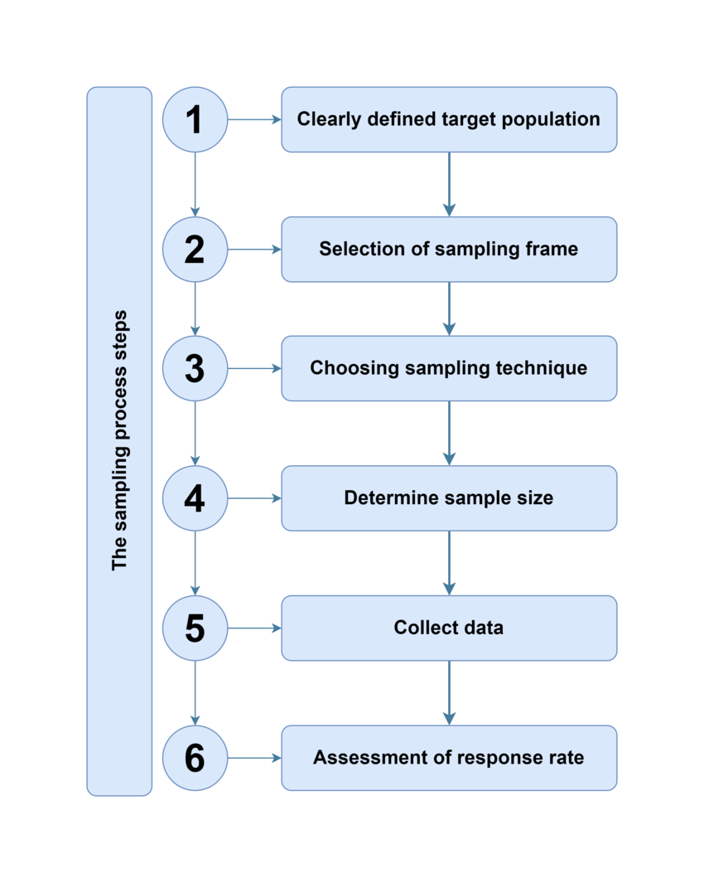
Sampling
For Further Exploration –
About Sampling
Sampling Methods | Types, Techniques & Examples
Population vs Sampling Frame vs Sample
How does sampling frame and sampling unit influence your sample size calculation?
Statistics and Probability | Khan Academy

Slide 261
Imbalanced Data
In Classification, even after sampling(or even without any sampling) there might be a case of Imbalanced Data(e.g. in a classification task, there can be 3 classes & majority of input data pointing to class 1 & a very low minority of input data pointing to class2 & class3) & to tackle Imbalanced data, mainly re-sampling training data or loss functions like class-balanced loss or focal loss are used.
For Further Exploration –
CB Loss: Class-Balanced Loss Based on Effective Number of Samples
Focal Loss : A better alternative for Cross-Entropy
Cost-Sensitive Learning for Imbalanced Classification
www.cheatsheets.aqeel-anwar.com
Difference in Proportions of Labels (DPL) - Amazon SageMaker AI
10 Techniques to handle imbalance class in Machine Learning

Slide 262
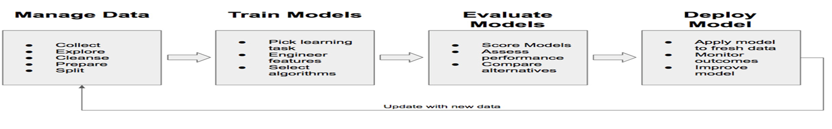
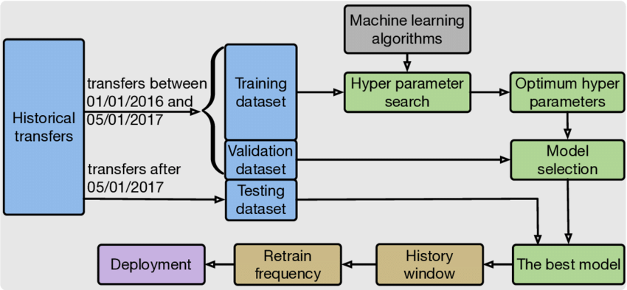
ML Modelling Workflow

Slide 263
ML Modelling Workflow (Steps)
Data Seggregation - The input data needs to be segregated into –
i) Training set - say 60%.this is the data that we will train our model(say to fit the model to the data i.e. to find the function f)
ii) Validation set - say 20%. this is needed to validate how good is our model & used in the Evaluation phase. Above segregation can be done based on 60-20(or some other % based distribution) rule or something as complex as k-fold Cross-Validation
iii) Test set - say 20%. This is needed to provide an unbiased evaluation of a final model to fit on the training dataset.
The training, validation & test set are all in general assumed to be drawn from the same underlying distribution.
For Further Exploration
What is the Difference Between Test and Validation Datasets
Time based splitting and determining if Train & Test data come from the same distribution

Slide 264
ML Modelling Workflow (Steps)
Model Selection & Training - Do the training on the training set to fit/find the model. Here a decision you have to take is to use classical ML or DL algos. General thumb rule is to use classical ML algos for structured/tabular data(except time-series data & graph data) & to use DL techniques for unstructured data(text, speech, music, images, videos etc), time-series data & graph data. Also, in case of classical ML algos, understanding of tree based models(number of trees & levels within the trees etc) is crucial too.
Refer Tree Based Machine Learning Algorithms & The Effects of the Depth and Number of Trees in a Random Forest for more info.
An important concept related to training is Cost/Loss function(which needs to be converged so that the error <= threshold value & thereby we will get the optimal parameter values)
ML Taks and Loss Functions Choices
The selection of a loss function in machine learning is dictated by several factors, primarily the nature of the task and the characteristics of the data.

Slide 265
ML Modelling Workflow (Steps)
ML Tasks and Loss Functions Choices
1. Task Type:
Regression Tasks (predicting continuous values):
Mean Squared Error (MSE) / L2 Loss: Commonly used, penalizes larger errors more significantly due to squaring. Suitable when large errors are particularly undesirable and
the data is relatively free of extreme outliers.
Mean Absolute Error (MAE) / L1 Loss: More robust to outliers as it considers absolute differences. Useful when the data contains significant outliers that could disproportionately affect MSE.
Huber Loss: A hybrid, combining the advantages of MSE and MAE. It behaves like MSE for small errors and MAE for large errors, offering robustness to outliers while maintaining differentiability.
Classification Tasks (predicting discrete labels):
Binary Cross-Entropy: For binary classification problems (two classes). Measures the dissimilarity between predicted probabilities and true labels.
Categorical Cross-Entropy: For multi-class classification problems (more than two classes) where each instance belongs to exactly one class.
Sparse Categorical Cross-Entropy: Similar to categorical cross-entropy but used when labels are integers directly (not one-hot encoded).

Slide 266
ML Modelling Workflow (Steps)
ML Taks and Loss Functions Choices
Hinge Loss: Primarily used for Support Vector Machines (SVMs), encourages a clear margin between classes.
2. Data Characteristics:
Outliers: If the dataset contains significant outliers, loss functions like MAE or Huber Loss are preferred over MSE due to their robustness.
Class Imbalance: In classification tasks with imbalanced classes, specialized loss functions like Focal Loss can be beneficial, as they give more weight to misclassified minority class samples.
3. Model Type and Optimization:
Differentiability: Most optimization algorithms, especially gradient-based methods, require the loss function to be differentiable to compute gradients effectively. This is why non-differentiable functions like 0-1 loss are rarely used directly for optimization.
Output Layer Activation: The choice of loss function is often coupled with the activation function of the output layer. For example, a softmax activation in the output layer for multi-class classification is typically paired with categorical cross-entropy loss.
4. Performance Metrics and Interpretability:
Consider the primary performance metric you aim to optimize (e.g., accuracy, F1-score, precision, recall). The loss function should ideally align with this metric.Some loss functions offer more intuitive interpretations of error than others, which can be valuable for understanding model behavior.

Slide 267
ML Modelling Workflow (Steps)
ML Taks and Loss Functions Choices
In summary, the decision involves understanding the problem's nature (regression vs. classification), the data's properties (outliers, imbalance), and the model's requirements for optimization. Often, starting with a common and well-understood loss function for your task type (e.g., MSE for regression, cross-entropy for classification) and then adjusting based on specific data characteristics or performance needs is a practical approach
Also, instead of just minimizing the loss function it’s better to minimize the objective function wherein objective function = loss function + regularization. This approach can handle overfitting of the model to training data.
For Further Exploration
Loss function – Wikipedia, How are the cost functions for Neural Networks derived
Difference Between the Cost, Loss, and the Objective Function
A Simple Understanding of the ML Landscape with Various Cost Functions!,
The Role of Cost Functions in Machine Learning
What is Cost Function in Machine Learning
A list of cost functions used in neural networks, alongside applications
Keras Loss Functions: Everything You Need to Know
PyTorch Loss Functions: The Ultimate Guide

Slide 268
ML Modelling Workflow (Steps)
ML Taks and Optimisation Techniques Choices
Another important concept is to use some Optimisation technique(s) to optimise the cost function (e.g. to minimise the loss) . Generally, for deterministic & stochastic/probabilistic data we use different techniques. Choosing the right optimization technique for a specific machine learning task involves considering several factors related to the problem, the data, and the model itself.
1. Problem Type and Model:
Supervised Learning (Regression/Classification):
For tasks with a clear target variable, gradient-based optimizers like Stochastic Gradient Descent (SGD), Adam, RMSprop, or Adagrad are commonly used, especially in deep learning. The choice among these often depends on the specific neural network architecture and dataset characteristics.
Unsupervised Learning:
Optimization in unsupervised learning often focuses on minimizing reconstruction error (e.g., in autoencoders) or maximizing separation (e.g., in clustering). The optimization techniques used will align with the objective function of the chosen unsupervised algorithm.
Reinforcement Learning:
Optimization in reinforcement learning involves maximizing a cumulative reward, often

Slide 269
ML Modelling Workflow (Steps)
ML Taks and Optimisation Techniques Choices
using techniques like policy gradient methods or Q-learning, which have their own specialized optimization approaches.
2. Data Characteristics:
Data Size:
For very large datasets, stochastic optimizers (like SGD or Adam with mini-batches) are preferred as they update model parameters using small subsets of data, making training computationally feasible.
Data Sparsity:
Optimizers that adapt learning rates per parameter, such as Adagrad, RMSprop, or Adam, can be beneficial for sparse data as they can assign larger learning rates to less frequently occurring features.
Data Noise:
Robust optimizers or techniques with regularization can help mitigate the impact of noisy data.
3. Computational Resources and Training Time:
Computational Power:
Some optimizers, like Adam, can be more computationally intensive than basic SGD. The available hardware (CPU/GPU) and memory can influence the choice.

Slide 270
ML Modelling Workflow (Steps)
ML Taks and Optimisation Techniques Choices
Training Time:
Optimizers that converge faster are often preferred, especially for large models or datasets where training time is a significant concern. Adaptive learning rate optimizers often offer faster convergence.
4. Model Complexity and Architecture:
Deep Learning Models:
Adaptive learning rate optimizers (Adam, RMSprop) are widely used and often perform well for deep neural networks due to their ability to handle complex loss landscapes and vanishing/exploding gradients.
Simpler Models:
For linear models or simpler machine learning algorithms, basic gradient descent variants or even closed-form solutions might be sufficient and more computationally efficient.
5. Hyperparameter Tuning and Experimentation:
Hyperparameter Sensitivity:
Different optimizers have varying sensitivities to their hyperparameters (e.g., learning rate, momentum). Careful tuning is often required to achieve optimal performance.

Slide 271
ML Modelling Workflow (Steps)
ML Taks and Optimisation Techniques Choices
Similar logic can be extended to deterministic/probabilistic Embeddings. Embeddings will be discussed later. Now, the aforementioned optimisation techniques are to estimate optimal values of parameters of the function & not hyper-parameters, a concept explained later
For Further Exploration
Essential-Math-For-AI
Calculate Maximum Likelihood Estimator with Newton-Raphson Method using R(MLE and Joint Probability Distribution to be used for independent events)
Bayesian_Inference_Basic_Tutorial(Bayesian Inference to be used for dependent events)
MLE, MAP and Bayesian Inference.
Understanding Optimization Algorithms in Machine Learning
Optimization Essentials for Machine Learning
6 Continuous Optimisation with Iterative Algorithms

Slide 272
ML Modelling Workflow (Steps)
ML Taks and Evaluation Metrics Choices
We calculate various evaluation metrics, based on which we decide how good our model is, for various ML tasks using the validation set data.To choose ML evaluation metrics, first identify the task type (classification, regression etc), then consider business goals and the costs of different errors. For example, in a medical diagnosis task, a false negative is more costly, so recall is more important than accuracy. For imbalanced datasets, focus on metrics like F1-score, precision, or recall instead of accuracy.
Classification tasks
When classes are balanced or both false positives and false negatives are equally costly:
Accuracy: The simplest metric, representing the proportion of correct predictions out of all predictions.
When a false positive is more costly:
Precision: The proportion of predicted positive instances that were actually positive. It measures how many of the things you "called" as positive were actually positive.
When a false negative is more costly:
Recall (Sensitivity): The proportion of actual positive instances that were correctly identified. It measures how many of the true positives were correctly identified.
When both false positives and false negatives are important:
F1-Score: The harmonic mean of precision and recall, providing a single metric that balances both.
For multi-class classification, especially with an imbalanced dataset:
Micro-accuracy: Often a good choice for aligning with business needs in multi-class problems.

Slide 273
ML Modelling Workflow (Steps)
ML Taks and Evaluation Metrics Choices
Regression tasks
To understand the magnitude of errors:
Mean Absolute Error (MAE): The average of the absolute errors. It is less sensitive to outliers than MSE.
Mean Squared Error (MSE): The average of the squared errors. It penalizes larger errors more heavily than MAE.
Root Mean Squared Error (RMSE): The square root of the MSE. It provides error in the same units as the target variable and is also sensitive to outliers.
To account for business preferences:
Consider a specific metric based on whether over-forecasting or under-forecasting is more problematic.
General guidelines
Understand the problem and business objectives: The most important factor is aligning the metric with the actual goal of the project.
Consider the cost of errors: What are the consequences of a false positive versus a false negative?
Be aware of data distribution: For imbalanced datasets, standard accuracy can be misleading. Choose metrics like F1-score, precision, or recall.
Evaluate multiple metrics: Don't rely on a single metric. Using a combination provides a more comprehensive understanding of your model's performance.
Prediction – the final stage wherein, if we are satisfied with the evaluation metrics then predict the outcome on our test(& actual) data.

Slide 274
ML Modelling Workflow (Steps)
ML Taks and Evaluation Metrics Choices
For Further Exploration
Evaluation Metrics for Your Regression Model
How to Evaluate Clustering Algorithms?
Performance Metrics in Machine Learning
Fundamentals of Machine Learning Model Evaluation
Sensitivity and Specificity

Slide 275
ML Modelling Workflow (Steps)
Model Experimentation(Retraining[if needed]) - if we are not satisfied with the evaluation metrics, we can try any/some/all the following –
a) cleaning the data more in some other ways or re-sampling or trying other different ways of feature engineering
b) using some different ML algo
c) changing the cost function or parameter optimiser or both
d) Regularisation - if your model works great with the training data but works very poorly with actual/test data that means the data is over-fitted & to overcome overfitting, we use various regularisation techniques e.g. in regression we can use lasso(L1)/ridge(L2) while in DL networks we can use Dropout(& other) technique(s). In general Regularization takes into account the model’s complexity or capacity; we incur a penalty for overly complex models. It can prevent the parameters of the model from getting too large the assumption being that large weights mean more complex models & vice versa.
Various Regularisation Techniques
Regularization techniques in machine learning are employed to prevent overfitting and improve the generalization ability of models. Overfitting occurs when a model learns the training data too well, including noise, and performs poorly on unseen data. Here are various common regularization techniques:
1. L1 Regularization (Lasso Regression):
Adds a penalty equal to the absolute value of the magnitude of the coefficients to the loss function.
Promotes sparsity in the model, effectively performing feature selection by shrinking some coefficients to zero.

Slide 276
ML Modelling Workflow (Steps)
Various Regularisation Techniques
2. L2 Regularization (Ridge Regression):
Adds a penalty equal to the squared magnitude of the coefficients to the loss function.
Shrinks coefficients towards zero, but rarely to exactly zero, thus reducing their impact without eliminating features.
3. Elastic Net Regularization:
Combines both L1 and L2 regularization penalties.Useful when there are highly correlated features, offering the benefits of both feature selection (from L1) and coefficient shrinkage (from L2).
4. Dropout (for Neural Networks):
During training, randomly sets a fraction of neurons to zero at each update.Prevents complex co-adaptations between neurons and forces the network to learn more robust features.
5. Early Stopping:
Monitors the model's performance on a validation set during training.Stops training when the performance on the validation set starts to degrade, preventing the model from overfitting to the training data.
6. Data Augmentation:
Artificially increases the size and diversity of the training dataset by creating modified versions of existing data (e.g., rotating images, adding noise to audio).Helps the model learn more robust features and reduces reliance on specific training examples.
7. Batch Normalization:
Normalizes the inputs of each layer in a neural network, reducing internal covariate shift.
Allows for higher learning rates and makes the training process more stable, indirectly acting as a

Slide 277
ML Modelling Workflow (Steps)
Various Regularisation Techniques
regularizer.
8. Weight Decay:
A form of L2 regularization specifically applied to the weights in neural networks, where weights are gradually reduced over time during training.
9. Pruning (for Decision Trees and Ensembles):
Reduces the complexity of tree-based models by removing branches or nodes that provide little predictive power.
The choice of regularization technique and its specific parameters often depends on the type of model, the characteristics of the dataset, and the observed level of overfitting. Often, a combination of these techniques yields the best results.
For Further Exploration
Intuitive Understanding of Bias and Variance Trade-Off
Machine Learning Fundamentals: Bias and Variance.
Understanding the Bias-Variance Tradeoff
5 ways to achieve right balance of Bias and Variance in ML model
How To Address Bias-Variance Tradeoff in Machine Learning
L2 vs L1 Regularization in Machine Learning
Everything you wanted to know about Lasso & Ridge Regression
Regularization (mathematics) - Wikipedia
The-Regularization-Cookbook.

Slide 278
ML Modelling Workflow (Steps)
HyperParameter tuning - Any ML process can be defined as ML = (Representation) + Objective/Training function + Optimisation(e.g. minimise some loss function or converge a function or find the MLE of some joint Probability Distribution) . As of now, just keep in mind that Representation is needed only for unstructured data(& not needed for structured/tabular data) & we need to do optimisation in any ML algo for any data(structured/unstructured) & while doing that we use some parameters called HyperParameters(e.g. epoch size, batch size, learning rate etc). The difference between parameters & hyper-parameters is that parameters are kind of outputs we want to find out to define the model properly while hyper-parameters are configurable input parameters that we use as part of the optimisation process.
Various Hyperparameter Tuning Techniques
Hyperparameter tuning is a critical step in machine learning to optimize model performance. Several techniques are employed to find the best set of hyperparameters for a given model and dataset:
Grid Search:
This technique involves defining a set of hyperparameter values to explore for each hyperparameter.
The model is then trained and evaluated for every possible combination of these values.
The combination yielding the best performance metric (e.g., accuracy, F1-score) is selected.
Pros: Thorough and guarantees finding the best combination within the defined grid.
Cons: Computationally expensive, especially with a large number of hyperparameters or a wide range of values.

Slide 279
ML Modelling Workflow (Steps)
Various Hyperparameter Tuning Techniques
Random Search:
Instead of exhaustively trying all combinations, Random Search samples hyperparameter values randomly from a defined distribution for each hyperparameter.This allows for a more efficient exploration of the search space, often finding good solutions faster than Grid Search, especially in high-dimensional spaces.
Pros: More efficient than Grid Search for large search spaces, often finds good solutions quickly.
Cons: Does not guarantee finding the absolute best combination, as it relies on random sampling.
Bayesian Optimization:
This method uses a probabilistic model (e.g., Gaussian Process) to model the relationship between hyperparameters and the objective function (e.g., validation loss).It iteratively selects the next set of hyperparameters to evaluate based on the model's predictions and uncertainty, aiming to find the optimum with fewer evaluations.
Pros: Efficient for complex search spaces and typically requires fewer iterations than Grid or Random Search.
Cons: Can be more complex to implement and computationally more demanding per iteration than simpler methods.
Genetic Algorithms (Evolutionary Algorithms):
Inspired by natural selection, these algorithms maintain a "population" of hyperparameter combinations.
Through processes like selection, crossover, and mutation, new generations of hyperparameter sets are created, aiming to improve performance over time.

Slide 280
ML Modelling Workflow (Steps)
Various Hyperparameter Tuning Techniques
Pros: Suitable for highly complex search spaces and can explore non-linear relationships between hyperparameters.
Cons: Can be computationally intensive and require careful tuning of the algorithm's own parameters.
Hyperband:
This technique is designed for efficient resource allocation during hyperparameter optimization.
It adaptively allocates resources (e.g., training epochs) to promising hyperparameter configurations, discarding poorly performing ones early on.
Pros: Efficiently allocates resources, making it suitable for scenarios with limited computational resources or time.
Cons: Can be more complex to set up than simpler methods.
Choosing the right technique depends on factors such as the complexity of the model, the size of the hyperparameter search space, and available computational resources. Often, a combination of these techniques or a more advanced library like Optuna or HyperOpt is used for practical hyperparameter tuning.
For Further Exploration
ML Optimization Methods and Techniques
A Gentle Introduction to Premature Convergence
Difference Between a Batch and an Epoch in a Neural Network
How to Configure the Learning Rate When Training Deep Learning Neural Networks
Hyperparameter-Tuning-with-Python

Slide 281
ML Modelling Workflow (Steps)
For Further Exploration -
Steps in Machine Learning: A Comprehensive Guide
4 Stages of the Machine Learning (ML) Modeling Cycle
About-loss-and-loss-functions
The-Little-Book-of-ML-Metrics
Calibration of Machine Learning Models
How to select a machine learning algorithm - Azure Machine Learning | Microsoft Learn
Machine Learning Algorithm Cheat Sheet
Hands-On-Simulation-Modeling-with-Python
PracticalSimulations

Slide 282
Design of Experiments
In Machine Learning (ML), experiments and their design are crucial for optimizing model performance and understanding their behavior. Design of Experiments (DOE) helps systematically explore and identify the best combinations of hyperparameters, leading to improved model accuracy. ML experiments also involve comparing different algorithms and fine-tuning models to ensure they generalize well to unseen data.
How Experiments Are Used in ML:
Optimizing Model Performance: DOE techniques help systematically explore the hyperparameter space to find the optimal configuration for a given model.
Comparing Algorithms: Experiments allow for comparing the effectiveness of different machine learning algorithms and methods.
Evaluating Model Generalization: Cross-validation and other techniques are used in experiments to assess how well a model generalizes to new, unseen data.
Fine-tuning Models: Experiments help in fine-tuning model parameters and architectures to improve performance.
Understanding Model Behavior: By systematically varying inputs and observing outputs, experiments provide insights into how models behave.
Reproducibility: Meticulous documentation and version control are essential in ML experiments to ensure results can be replicated.
Design of Experiments (DOE) in ML:
Systematic Exploration: DOE provides a structured way to test different combinations of factors (e.g., hyperparameters, features).
Identifying Optimal Combinations: It helps identify the best combinations of variables to achieve the desired outcome (e.g., optimal model performance).
Handling Non-Linear Relationships: ML models can handle complex, non-linear relationships, unlike traditional statistical DOE approaches, which often assume linearity.
Data Generation: DOE can be used to generate informative datasets when data is scarce or expensive to collect.
Key Aspects of ML Experiments:
Define Objectives and Hypotheses: Clearly state what you want to achieve and any hypotheses you are testing.
Choose Data and Methods: Select appropriate datasets and machine learning algorithms for your experiment.
Design Experimental Setup: Determine how you will manipulate variables, collect data, and analyze results.
Cross-validation: Use cross-validation techniques to ensure the model's performance is not overly reliant on a specific split of the data.
Experiment Tracking: Utilize tools like MLflow or TensorBoard to log experiment parameters and results.
Analyze and Interpret Results: Draw conclusions from your experiment and use them to inform further development
For Further Exploration –
Machine Learning Experiments Done Right
The Design of Experiments - Wikipedia

Slide 283
Factors Influencing Model Size
Several factors influence the size of a machine learning (ML) model, including the number of parameters, the type of data, and the model architecture. Data quality, feature selection, and the choice of algorithm also play a role.
Detailed Breakdown:
1. Model Architecture: The complexity of the model's architecture directly impacts its size. For example, deep neural networks with many layers and connections will generally have a larger number of parameters compared to simpler linear models.
2. Number of Parameters: The number of learnable parameters (weights and biases) within the model determines its size. More parameters mean a larger model.
3. Data Type and Complexity: The type of data used to train the model (e.g., images, text, tabular data) and the complexity of the relationships within the data can influence the model size. For instance, image recognition models often require significantly larger models compared to simpler regression tasks.
4. Feature Selection: The number of features used by the model can also impact its size. More features may necessitate a more complex model with a larger parameter set.
5. Algorithm Choice: The specific ML algorithm chosen can influence the model's size and complexity. Some algorithms, like support vector machines (SVM) or decision trees, can be implemented with fewer parameters compared to neural networks.
6. Data Quality and Quantity: The quality and quantity of the training data can impact the size of the model needed to achieve a desired level of performance. Larger datasets with more complex patterns may require larger models.
7. Computational Constraints: Practical considerations like available computing resources (memory, processing power) can also influence the choice of model size. A smaller model may be preferred if computational constraints are a major concern.
8. Data Dimensionality: The number of features or variables in the dataset directly affects the model's complexity and size.
9. Hyperparameter Tuning: Adjusting hyperparameters (e.g., learning rate, regularization parameters) can also influence the model's complexity and size
10. Training Techniques: The specific training methods and techniques used can also affect the model size. For example, regularization techniques can help prevent overfitting and reduce model complexity, while techniques like fine-tuning can adapt pre-trained models to new tasks, potentially impacting the final model size
In summary, the size of an ML model is a multifaceted aspect influenced by the interplay of model architecture, data characteristics, algorithm choice, and practical considerations.

Slide 284
Reducing Model Size
Reducing model size involves techniques like altering data types, pruning, updating feature selection, and compression, all aimed at minimizing the size of a machine learning model while maintaining or even improving its accuracy, making it more efficient and deployable on resource-constrained devices.
Key methods for reducing model size:
Data Type Quantization: Reducing the precision of numerical data types (e.g., from 32-bit floats to 8-bit integers) can significantly decrease model size with minimal accuracy loss, especially for certain tasks like image classification.
Pruning: This involves removing unimportant connections or neurons from a neural network, effectively reducing its size while maintaining performance.
Different pruning techniques exist, such as structured pruning (removing entire layers or groups of neurons) and unstructured pruning (removing individual weights).
Feature Selection: Identifying and removing irrelevant features from the training data can lead to a smaller model with improved accuracy by focusing on the most important features.
Techniques like feature importance analysis or correlation analysis can help in selecting the most relevant features.
Compression: Various compression techniques can be applied to model parameters, including knowledge distillation, low-rank approximation, and quantization, to reduce the overall model size while preserving accuracy.
Benefits of reducing model size:
Faster inference: Smaller models require less computation and memory, leading to faster prediction times.
Lower storage requirements: Smaller models take up less space on disk, making them easier to deploy on devices with limited storage.
Improved energy efficiency: Reduced computation leads to lower energy consumption.
Portability: Smaller models can be more easily deployed on edge devices with limited resource
For Further Exploration –
5 Key Factors Determining Model Complexity: A Data Overview
Reduce Memory Footprint of Deep Neural Networks

Slide 285
Model Performance Improvement Methods
To improve machine learning model performance, consider data augmentation, feature engineering, hyperparameter tuning, and ensemble methods, along with regular model monitoring and evaluation. Additionally, addressing data issues like missing values and outliers, and choosing the right algorithms are crucial.
Here's a more detailed breakdown:
1. Data is King:
Data Augmentation: Increase the size and diversity of your training data by adding synthetic or transformed examples.
Feature Engineering: Create new features or transform existing ones to better represent the data and improve model accuracy.
Data Cleaning: Handle missing values and outliers appropriately to prevent them from negatively impacting the model.
Data Preprocessing: Ensure your data is properly formatted and scaled before feeding it into the model.
2. Model Selection and Optimization:
Algorithm Choice: Select an appropriate algorithm for your problem and data, and consider trying multiple algorithms and comparing their performance.
Hyperparameter Tuning: Optimize the model's hyperparameters (settings that control the learning process) using techniques like grid search or Bayesian optimization.
Ensemble Methods: Combine multiple models to improve overall performance and reduce variance.
3. Monitoring and Evaluation:
Regular Evaluation: Track model performance using appropriate metrics and compare it against a benchmark.
Model Drift: Detect and address changes in the data distribution that can lead to model performance degradation.
Feedback Loops: Implement feedback loops to learn from mistakes and adapt to new data.
4. Other Important Considerations:
Feature Selection: Select the most relevant features for your model to reduce complexity and improve performance.
Regularization: Use techniques like regularization to prevent overfitting and improve generalization.
Cross-Validation: Use cross-validation to assess model performance on unseen data and evaluate model stability.
For Further Exploration –
A Complete Guide to Data Augmentation | DataCamp
How to Improve ML Models [Lessons From Ex-Amazon]
Why is my machine learning model not converging? | HopHR
Data-Augmentation-with-Python

Slide 286
Business Metrics For Model Evaluation
Business metrics are crucial for evaluating the real-world value and impact of machine learning (ML) models. These metrics go beyond purely technical performance and focus on how the model affects key business outcomes. Metrics like Return on Investment (ROI), Customer Lifetime Value (CLTV), and the reduction in operational costs are essential for demonstrating the model's value to the business.
Key Business Metrics for Evaluating ML Models:
Return on Investment (ROI):This measures the financial gain or loss of an investment in an ML model. ROI helps determine the model's profitability and justifies the cost of development and deployment.
Customer Lifetime Value (CLTV):ML models can be used to predict customer behavior and improve customer retention, ultimately increasing CLTV.
Operational Cost Reduction: ML models can automate tasks, improve efficiency, and reduce human intervention, leading to cost savings.
Sales Growth: ML models can be used to optimize marketing campaigns, personalize customer experiences, and drive sales.
Improved Customer Satisfaction :By understanding customer needs and preferences, ML models can help businesses provide better products and services, leading to increased satisfaction.
Reduced Risk and Fraud: ML models can identify and prevent fraudulent activities, protect sensitive data, and mitigate financial risks.
Increased Productivity:ML models can automate tasks, streamline workflows, and enable employees to focus on higher-value activities, boosting productivity.
Faster Decision-Making: ML models can provide real-time insights and predictions, enabling faster and more informed decision-making.
Improved Supply Chain Efficiency:ML models can optimize inventory management, predict demand, and improve logistics, leading to increased efficiency.
Enhanced Product Development: ML models can help identify trends, understand customer preferences, and improve product development.
Why Business Metrics Matter:
Demonstrates Value: Business metrics provide a clear and tangible measure of the value that an ML model brings to the organization.
Justifies Investment: They help justify the investment in ML development and deployment by showing the return on that investment.
Guides Decision- Making:Business metrics inform decision-making about which ML models to prioritize and how to optimize their performance.
Measures Success: They provide a framework for measuring the success of ML initiatives and ensuring that they align with business goals.
Informs Future Investments: By tracking business metrics, organizations can learn from their ML experiences and make more informed decisions about future investments.

Slide 287
Statistical Tests
Statistical tests are primarily performed during the data exploration, feature selection, and model evaluation phases of a machine learning workflow. They help in understanding data distributions, identifying significant relationships between features and the target variable, and assessing model performance.
Data Exploration: Statistical tests are used to analyze data distributions, identify outliers, and understand relationships between variables. This helps in gaining insights into the data and identifying potential issues that need to be addressed during data preparation.
Feature Selection: Statistical tests, like the t-test and ANOVA, are used to assess the statistical significance of different features in predicting the target variable. This helps in selecting the most relevant features for model training.
Model Evaluation: After model training, statistical tests are used to evaluate the model's performance on unseen data and assess its ability to generalize. Techniques like cross-validation and hypothesis testing are employed to evaluate the model's accuracy, precision, recall, and other relevant metrics.
In essence, statistical tests are integral to various stages of the machine learning workflow, ensuring that the analysis and model development process is data-driven and statistically sound.
For Further Exploration –
Choosing the Right Statistical Test | Types & Examples

Slide 288
ML Techniques Taxonomy
ML Techniques
Instance Based Learning - Doesn’t train any model but saves the training dataset & prediction happens comparing instances in prediction phase against the saved training dataset(e.g. using distance metrics). Generally useful for small datasets.E.g - KNN
Model Based Learning – Trains a model based on training data & uses the model for prediction.Generally used for large datasets
Regression
Linear Models
Non-Linear Models
Differential Models
Hierarchical
Models
Classification
Bayesian
Models
Clustering
E.g - K-Means /Hierarchical
Dimensionality Reduction
E.g – DROP/DEL
MDP
Models
NN/DL
Models
Regression (using Equations)
Classification(using In-Equalities)
Dimensionality Reduction
Density/Energy Models

Slide 289
ML Techniques Taxonomy contd…
Some salient points from the previous slide –
MDP stands for Markov Decision Process which is the base/foundation for almost all Reinforcement Learning Algos while NN/DL stands for Neural-Network/Deep-Learning.
Density/Energy based model use Information Theory as their mathematical foundation in general. DBSCAN(used for Clustering) & Diffusion techniques(used for image generation) are examples of Energy/Density based Learning.
We can have models which are combination of models e.g. Decision Tree/Random Forests(an ensemble of Decision trees) is a Hierarchical Energy/Density based model to solve nonlinear problems(similar to kernel methods).
Differential Models uses (Ordinary/Partial) Differential Equations/In-Equalities as the training model for SciML based regression and classification tasks.For SciML, can refer Scientific Machine Learning (SciML) & SciML: Open Source Software for Scientific Machine Learning, Physics-Informed AI, and Differentiable Programming
KNN is a non-linear algo
For Further Exploration –
A Tour of Machine Learning Algorithms
Machine Learning Algorithms
Why is it recommended to choose an odd value for K in K nearest neighbors
Understanding K-Nearest Neighbors (KNN) Regression in Machine Learning
What is Classification Threshold
Clustering in Machine Learning | GeeksforGeeks
Types of Linkages in Hierarchical Clustering
Understanding Dimensionality Reduction | DataCamp
Machine-Learning-Algorithms
Mastering-Machine-Learning-Algorithms
HandsOn-Unsupervised-Learning-with-Python
Hands-on Unsupervised Learning Using Python
ML algorithms in depth
How to Compare Machine Learning Models and Algorithms
Choosing the right estimator — scikit-learn 1.6.1 documentation

Slide 290
Classical ML Algos(Regression Algorithms)
Regression algorithms are used to predict a continuous outcome based on one or more independent variables. Common types include linear regression, polynomial regression, and regression trees. Each algorithm has its strengths and weaknesses, and the best choice depends on the nature of the data and the relationships being modeled.
Linear Regression:
Pros: Simple to implement, interpret, and computationally efficient. It provides clear insights into the relationships between variables.
Cons: Struggles with complex, non-linear data, sensitive to outliers, and assumes independence, homoscedasticity, and normality, which may not hold in many real-world scenarios.
When to use: When the relationship between the independent and dependent variables is believed to be linear, or when you need a simple and interpretable model.
Polynomial Regression:
Pros: Can capture non-linear relationships by adding polynomial terms to the model.
Cons: Can be computationally more intensive than linear regression, and overfitting is a risk if the polynomial degree is too high.
When to use: When the data exhibits a curvilinear relationship that can be reasonably approximated by a polynomial curve.
Regression Trees (Decision Trees):
Pros: Can capture complex, non-linear relationships, good for handling categorical features, and can be visualized.
Cons: Prone to overfitting, can be sensitive to small changes in the data, and can be difficult to interpret if they become very deep.
When to use: When the data is complex, non-linear, or when you want to incorporate both numerical and categorical features in your mode

Slide 291
Classical ML Algos(Classification Algorithms)
Classification algorithms are used to categorize data into distinct classes. Popular choices include K-Nearest Neighbors (KNN), Naive Bayes, Support Vector Machines (SVM), Decision Trees, Random Forests, and Logistic Regression. Each has pros and cons, and the best choice depends on factors like data size, complexity, and interpretability requirements.
1. K-Nearest Neighbors (KNN):
Pros: Simple to understand and implement, handles both numerical and categorical data, and can be visualized easily.
Cons: Can be prone to overfitting, especially with many features, and performance can be unstable with small data variations.
When to use: Small to medium-sized datasets where interpretability and simplicity are important.
2. Naive Bayes:
Pros: Simple, computationally efficient, requires less training data, and can handle both continuous and discrete data.
Cons: Relies on a strong assumption of feature independence, which might not always hold true in real-world data.
When to use: Simple classification problems, especially with a limited amount of data.
3. Support Vector Machines (SVM):
Pros: Effective in high-dimensional spaces, memory-efficient, and less influenced by outliers.
Cons: Computationally expensive, no direct probability estimates, and requires careful kernel function selection.
When to use: Data with clear separation between classes, or when dealing with high-dimensional data.

Slide 292
Classical ML Algos(Classification Algorithms) contd…
4. Decision Trees:
Pros: Easy to interpret and visualize, can handle both numerical and categorical data, and don't require feature scaling.
Cons: Prone to overfitting, especially with deep trees, and can be unstable with small changes in the training data.
When to use: When interpretability and understanding the decision-making process are crucial.
5. Random Forests:
Pros: Generally more robust and accurate than single decision trees, less prone to overfitting, and can handle missing values well.
Cons: Can be harder to interpret than single decision trees, and may require more computational resources.
When to use: When a more accurate and robust model is needed than a single decision tree, and interpretability is less critical.
6. Logistic Regression:
Pros: Simplicity, ease of understanding and implementation, interpretable coefficients, and can handle both binary and multi-class classification.
Cons: Assumes a linear relationship between variables, may not be suitable for highly non-linear data, and can be susceptible to overfitting.
When to use: Simple binary or multi-class classification problems, especially when interpretability and ease of understanding are important.

Slide 293
Classical ML Algos(Clustering Algorithms)
Clustering algorithms group similar data points together. K-means, hierarchical clustering, and density-based clustering are popular choices. K-means is efficient for spherical clusters but sensitive to outliers and requires defining the number of clusters. Hierarchical clustering offers a hierarchical view of clusters but can be computationally expensive. Density-based clustering finds clusters of arbitrary shapes and is robust to outliers but struggles with high-dimensional data and varying densities.
Here's a more detailed look:
1. K-Means Clustering:
How it works: Assigns data points to clusters based on distance from cluster centroids (means).
Pros: Simple, fast, and widely used.
Cons: Requires specifying the number of clusters in advance, sensitive to outliers and initial centroid placement, and performs poorly with non-spherical clusters.
When to use: When clusters are roughly spherical and similar in size, and you have a good idea of the number of clusters.
2. Hierarchical Clustering:
How it works: Builds a hierarchy of clusters, starting with individual data points and merging them based on similarity.
Pros: Provides a hierarchical view of clusters, doesn't require specifying the number of clusters in advance, and can be insightful for exploratory data analysis.
Cons: Can be computationally expensive for large datasets, sensitive to the choice of distance metric, and can be difficult to interpret the hierarchy.
When to use: When exploring the structure of data and visualizing the relationships between clusters is important.

Slide 294
Classical ML Algos(Clustering Algorithms) contd…
3. Density-Based Clustering (e.g., DBSCAN):
How it works: Groups together data points that are densely packed together, separating them from areas of low density.
Pros: Doesn't require specifying the number of clusters in advance, finds clusters of arbitrary shapes, and is robust to outliers.
Cons: Struggles with clusters of varying densities, high-dimensional data, and can be sensitive to parameter tuning.
When to use: When you want to find clusters of arbitrary shapes, have data with varying densities, and don't want to specify the number of clusters in advance.
4. Other Clustering Algorithms:
Affinity Propagation: Uses message passing to find cluster representatives and is robust to outliers, but can be computationally expensive.
Distribution-based Clustering: Assumes data is generated from probabilistic distributions and estimates the parameters of these distributions.
Soft Clustering: Allows data points to belong to multiple clusters simultaneously, which is useful when boundaries are not clear-cut.
Choosing the Right Algorithm: The best algorithm depends on the characteristics of your data, the goals of your analysis, and the available computational resources.
Consider the following:
Data Shape: Are clusters roughly spherical or have arbitrary shapes?
Number of Clusters: Do you know the number of clusters in advance, or are you exploring the data?
Outliers: Are there many outliers in the data?
Data Size and Dimensionality: Are you dealing with large or high-dimensional datasets?
Computational Resources: Do you have the time and resources to run computationally intensive algorithms?
For Further Exploration-
Cluster analysis
Technical Report, SC_TR_00021 Clusters

Slide 295
Classical ML Algos(Dimensionality Reduction Algorithms)
Dimensionality reduction algorithms reduce the number of variables (features) in a dataset while preserving the most important information, improving computational efficiency and data visualization. Common algorithms include Principal Component Analysis (PCA), which transforms data into orthogonal axes, and techniques like t-SNE and UMAP, which are popular for visualizing high-dimensional data in lower dimensions.
Popular Dimensionality Reduction Algorithms:
1. Principal Component Analysis (PCA):
Pros:
Reduces dimensionality by identifying principal components that capture the most variance in the data.
Useful for data compression and noise reduction.
Can be used for data visualization.
Cons:
May not be suitable for nonlinear data.
Can lose information if not used carefully.
When to use:
When you have high-dimensional data that can be well represented by a smaller set of principal components.
When you want to reduce the complexity of your data for better visualization or model performance.
2. t-distributed Stochastic Neighbor Embedding (t-SNE) and Uniform Manifold Approximation and Projection (UMAP):
Pros:
Excellent for visualizing high-dimensional data in lower dimensions.
Useful for identifying clusters and patterns in data.
Cons:
Can be computationally expensive, especially with large datasets.
May distort distances between points in high-dimensional space.
When to use:
When you want to visualize the structure of your data in 2D or 3D space.
When you want to explore patterns and clusters in high-dimensional data.

Slide 296
Classical ML Algos(Dimensionality Reduction Algorithms) contd…
3. Linear Discriminant Analysis (LDA):
Pros:
Reduces dimensionality while maximizing the separation between different classes.
Cons:
Assumes data is normally distributed and that classes have the same covariance.
When to use:
In supervised learning scenarios where you want to separate different classes.
4. Feature Selection:
Pros:
Removes irrelevant or redundant features, improving model performance.
Cons:
Can be computationally intensive to find the optimal feature subset.
When to use:
When you want to identify the most relevant features for a specific task.
For Further Exploration-
Stanford CS229: Machine Learning | Summer 2019
Eigenvalues and eigenvectors (Principal Components are the Eigenvectors of the covariance matrix)
Principal Component Analysis (PCA)
Lecture: Principal Componenet Analysis (PCA)
Singular Value Decomposition as Simply as Possible
Top 10 Dimensionality Reduction Techniques for Machine Learning(ML) in 2025
Dimension Reduction
Geometric Structure of High-Dimensional Data and Dimensionality Reduction
Nonlinear dimensionality reduction

Slide 297
Classical ML Algos(Non Linear Models)
To train non-linear models in machine learning, consider using algorithms like decision trees, random forests, support vector machines (SVMs) with kernel functions, or neural networks. Additionally, feature engineering techniques, including creating polynomial features or interactions, can help capture complex relationships in the data. Regularization methods and ensemble learning can also improve model performance and prevent overfitting.
Here's a more detailed breakdown:
1. Non-linear Algorithms:
•Decision Trees and Random Forests: These algorithms naturally handle non-linear relationships by partitioning the data space into regions based on different features. Random Forests, which are an ensemble of decision trees, can further improve generalization and capture non-linear patterns.
•Support Vector Machines (SVMs) with Kernels: SVMs can be used for both classification and regression. By employing kernel functions (e.g., radial basis function, polynomial), SVMs can map data into higher-dimensional spaces to find non-linear separating hyperplanes.
•Neural Networks: These models are highly flexible and can learn complex non-linear relationships by adjusting weights and biases during training. They utilize non-linear activation functions at each node to capture intricate patterns.
•K-Nearest Neighbors (KNN): This algorithm predicts based on the average of the nearest neighbors, which can be effective in capturing local non-linearities.

Slide 298
Classical ML Algos(Non Linear Models) contd…
2. Feature Engineering:
•Polynomial Features: Adding polynomial terms (e.g., x², x³) to your features can help capture curved relationships
•Interaction Features: Creating combinations of existing features (e.g., x1 * x2) can reveal non-linear interactions between variables.
•Non-linear Transformations: Applying functions like logarithms or square roots to features can sometimes make relationships more linear or easier to model.
3. Regularization and Model Tuning:
•Regularization: Techniques like Ridge or Lasso regression help prevent overfitting by penalizing large coefficients in the model
•Hyperparameter Tuning: Experiment with different model parameters (e.g., learning rate for neural networks, kernel parameter for SVM) to find the optimal configuration for your data.
•Cross-validation: Use cross-validation techniques to ensure your model generalizes well to unseen data.
4. Ensemble Methods:
•Ensemble Learning: Combining the predictions of multiple non-linear models can often lead to improved accuracy and robustness. Examples include bagging (e.g., Random Forests) and boosting (e.g., Gradient Boosting).
5. Evaluation and Tuning:
•Residual Analysis:
Examine the differences between predicted and actual values to assess the goodness-of-fit of your model
•Performance Metrics:
Use appropriate metrics (e.g., MSE, R²) to evaluate the model's performance and identify areas for improvement
For Further Exploration –
How (and why) are random forests able to represent both linear and non linear data

Slide 299
Classical ML Algos(Decision Trees for Non Linear Regression and Classification)
Decision trees can handle non-linear regression and classification problems by partitioning the data space into different regions, where each region is associated with a specific prediction or class label. This allows them to capture complex relationships between features and target variables without requiring explicit feature transformations or polynomial terms, unlike linear models.
Here's a more detailed explanation:
1. Decision Tree Structure and Non-linear Relationships:
Decision trees build a tree-like structure where each internal node represents a decision based on a feature, and each branch represents a possible outcome of that decision.The leaf nodes represent the final predictions or class labels. This hierarchical structure allows the tree to create non-linear decision boundaries, effectively dividing the data space into different regions.Unlike linear regression, which assumes a linear relationship between features and the target variable, decision trees can capture complex, non-linear patterns by creating different decision boundaries in various parts of the data space.
2. How Decision Trees Handle Regression:
Predicting Continuous Values: In regression, the goal is to predict a continuous target variable (e.g., house price, temperature).
Leaf Nodes as Predictions: Decision trees predict continuous values by assigning a value to each leaf node.
Partitioning for Regression: The tree partitions the data space into different regions, and each region has a corresponding predicted value in its leaf node.
Non-linear Boundaries: The non-linear decision boundaries created by the tree allow it to capture complex relationships where the relationship between features and the target variable isn't a simple linear function.

Slide 300
Classical ML Algos(Decision Trees for Non Linear Regression and Classification) contd…
3. How Decision Trees Handle Classification:
Predicting Discrete Classes: In classification, the goal is to predict a discrete class label (e.g., spam or not spam, cat or dog).
Leaf Nodes as Class Labels: Decision trees predict class labels by assigning a class label to each leaf node.
Partitioning for Classification: The tree partitions the data space into different regions, and each region is associated with a specific class label in its leaf node.
Non-linear Decision Boundaries: The non-linear decision boundaries allow the tree to separate the data into different classes based on complex, non-linear relationships between features and class labels.
4. Advantages of Decision Trees for Non-linear Problems:
No Feature Transformation Needed: Unlike some linear models that require feature transformations or polynomial terms, decision trees can directly handle non-linear relationships without preprocessing.
Handling High-dimensional Data: Decision trees can effectively handle high-dimensional data, where the number of features is large.
Interpretability: The tree structure makes it easy to understand the decision-making process and interpret the model's behavior.
In summary: Decision trees excel at handling non-linear regression and classification problems by partitioning the data space into different regions, allowing them to capture complex relationships without the need for feature transformations or polynomial terms
For Further Exploration –
How can decision trees improve regression analysis?
CART (Classification And Regression Tree) in Machine Learning | GeeksforGeeks

Slide 301
Classical ML Algos(Kernel Methods for Non Linear Regression and Classification)
Kernel methods enable linear models to solve nonlinear problems by implicitly mapping data into a higher-dimensional feature space where the data becomes linearly separable. This is achieved through a kernel function, which computes the inner product of data points in the transformed space, without explicitly calculating the higher-dimensional coordinates.
Here's a more detailed breakdown:
1. Mapping to a Higher-Dimensional Space:
Kernel methods leverage a "kernel trick" to map the original data points from the input space (where the problem appears nonlinear) to a higher-dimensional feature space.This mapping is often implicit, meaning the data points are not explicitly transformed, but the kernel function indirectly calculates their similarity in the higher-dimensional space.
2. Exploiting Linear Separability in the Feature Space:
In the higher-dimensional feature space, the data might become linearly separable, allowing linear models like Support Vector Machines (SVMs) to effectively find a hyperplane that separates the classes.This hyperplane, which is linear in the feature space, translates to a potentially complex, nonlinear decision boundary in the original input space.
3. Kernel Functions and Inner Products:The key to this process is the kernel function, which calculates the inner product of data points in the feature space.
Various kernel functions exist, such as polynomial kernels, radial basis function (RBF) kernels, and sigmoid kernels, each with different mapping properties.
The choice of kernel function influences the complexity of the learned decision boundary and the model's ability to capture nonlinear relationships.

Slide 302
Classical ML Algos(Kernel Methods for Non Linear Regression and Classification) contd…
4. Benefits of Kernel Methods:
Flexibility:Kernel methods can handle complex, nonlinear relationships in the data, allowing for more accurate classification and regression models.
Efficiency:The "kernel trick" allows computations to be performed in the original input space, even though the mapping happens in a higher-dimensional space, avoiding the need to explicitly compute and store data in the higher-dimensional space.
Versatility:Kernel methods are widely used in various machine learning tasks, including classification, regression, and feature extraction.
In summary: Kernel methods provide a powerful approach for solving nonlinear problems by leveraging linear models in a transformed, higher-dimensional space, achieved through the use of kernel functions that implicitly compute the inner products of data points in the transformed space.
For Further Exploration –
How do Kernels Learn Non-Linear Functions?
Exploring the Kernel Trick's Role in Enhancing Nonlinear Classification
Intuition Behind Kernels in Machine Learning
Kernel Cookbook
Learning: Support Vector Machines
Learning with Kernels: Support Vector Machines, Regularization, Optimization, and Beyond

Slide 303
Classical ML Algos(Decision Trees vs Kernel Methods for NonLinear Regression and Classification)
Kernel methods offer the advantage of handling non-linear relationships in data by implicitly mapping it into a higher-dimensional space, while decision trees are known for their simplicity and interpretability. However, kernel methods can be computationally expensive and sensitive to noise and hyperparameters, while decision trees are prone to overfitting and instability to data changes.
Kernel Methods:
Pros:
Handles nonlinear relationships: Kernel methods, like SVMs, can effectively capture complex patterns in data by mapping it into higher-dimensional spaces, where linear methods can be applied.
Versatile: They can be used for both classification and regression problems.
Effective with limited data: Kernel methods can perform well even with a small amount of training data.
Robustness: They can be relatively robust to noise and outliers.
Cons:
Computational cost: Training kernel methods, especially for large datasets, can be computationally expensive due to the kernel matrix.
Sensitive to hyperparameters: The choice of kernel function and its parameters can significantly impact performance, and tuning these hyperparameters can be challenging.
Overfitting: Kernels can overfit the training data if not properly tuned.
Curse of dimensionality: As the dimensionality of the feature space increases, the data can become sparse, making it harder to generalize.
Instability: They can be sensitive to small changes in the training data.

Slide 304
Classical ML Algos(Decision Trees vs Kernel Methods for NonLinear Regression and Classification) contd…
Decision Trees:
Pros:
Interpretability: Decision trees are easy to understand and visualize, making it clear how decisions are made.
Minimal data preprocessing: They require less data preprocessing compared to some other methods.
Handles both numerical and categorical data: Decision trees can effectively handle both types of data.
Fast training and prediction: They can be relatively fast to train and make predictions.
Cons:
Prone to overfitting: Deep trees can overfit the training data, leading to poor generalization.
Instability: Small changes in the training data can lead to significant changes in the tree structure.
Unstable to noise: They can be sensitive to noise in the data.
Overfitting: Decision trees can overfit the training data, especially with deep trees on small datasets.
Greedy algorithm: They make greedy decisions at each node, which may not always lead to the optimal solution.
Computational cost on large datasets: Training decision trees on large datasets can be computationally expensive.
Difficulty with unbalanced datasets: They may favor the majority class in unbalanced datasets.

Slide 305
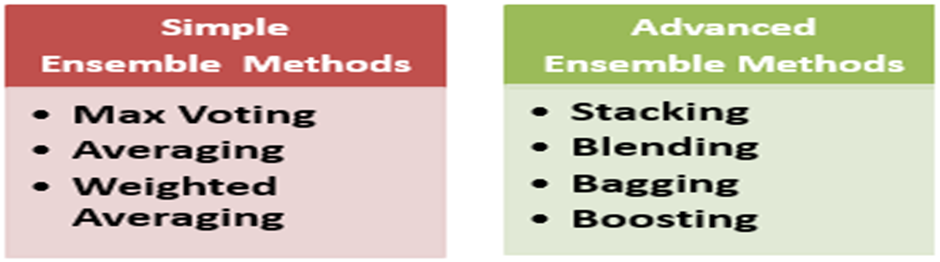
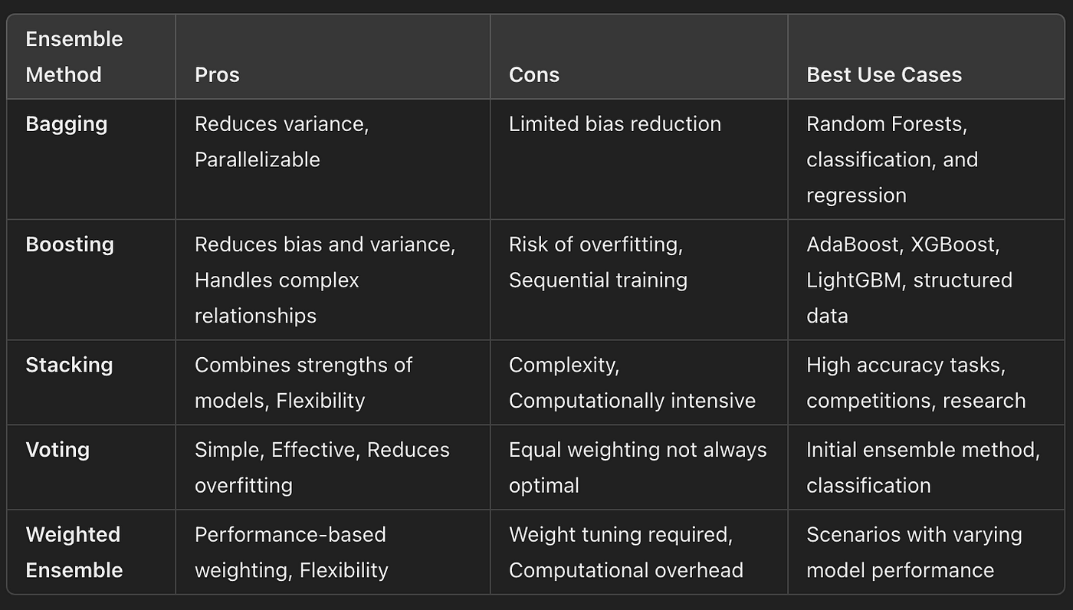
Ensemble Learning
For Further Exploration –
Ensemble Methods in Machine Learning - Prwatech
Ensemble Learning Algorithms Cheatsheet
Ensemble-Methods-Notebooks
Ensemble-Machine-Learning-Cookbook
Hands-On-Ensemble-Learning-with-Python

Slide 306
Data, Latent Features and Hypothesis
✅ 1. DATA
What it is
Raw information directly observed in the world. Available for structured as well unstructured data.
Forms
Structured: tables, numbers, timestamps
Unstructured: images, audio, text
Labels (optional): class names, regression targets
Characteristics
Directly measurable
No hidden meaning by itself
Full of noise
Contains both useful and useless signals
Example
An image: 2D pixel grid
A dataset row: Temperature, humidity, sales
A sentence: “The movie was amazing”
✅ 2. LATENT FEATURES (Representation / Embeddings)
What they are
Hidden, compressed, abstract representations learned internally by the model from data. Generall,y implicitly lies within unstructured data. These features are not explicitly provided — the model “discovers” them.

Slide 307
Data, Latent Features and Hypothesis
✅ 2. LATENT FEATURES (Representation / Embeddings)
Why they exist
Models cannot operate directly on raw messy data, so they:
compress
transform
reorder
disentangle
the underlying structure into a form useful for prediction.
Examples
For an image → CNN latent local features might represent:
edges
shapes
textures
object parts
object identity
For text → Transformer embeddings represent:
semantics
emotion
syntactic structure
relationships between words

Slide 308
Data, Latent Features and Hypothesis
Properties of latent features
Not interpretable directly
Encode meaning, not appearance
Dense vectors (like 768-dim for BERT, 4096-dim for CLIP, etc.)
Emerged through training, not designed manually
Intuition
Latent features are the model’s understanding of the data.
✅ 3. HYPOTHESIS
What it is
The mapping f(x) the model learns from Data → Output.
In classical ML:
Hypothesis = model + parameter values
Example: a linear model y = w·x + b
In deep learning:
Hypothesis = entire neural network function
architecture
weights
activations
learned representations
Hypothesis Space
The set of all possible f(x) that the model could learn.

Slide 309
Data, Latent Features and Hypothesis
✅ 3. HYPOTHESIS
Examples:
For linear regression → hypotheses are all possible straight lines
For a neural network → hypotheses are all functions representable by that network
Why hypothesis matters
Learning = searching the hypothesis space to find the best f(x).
🔥 Putting Them Together
Here is the relation:
Data → Latent Features → Hypothesis → Prediction
Data goes into the model
Model transforms it into latent features
These latent features are evaluated by the hypothesis function f(x)
Output is produced
🚀 A Very Simple Analogy
Data = raw ingredients (vegetables, spices)
Latent features = chopped vegetables, curry paste (preprocessed/meaningful representations)
Hypothesis = recipe (how everything combines to produce final dish)

Slide 310
Data, Latent Features and Hypothesis
🎯 Summary Table
Concept What it is Origin Role
Data Raw inputs Given by world Provide information
Latent Features Hidden representations Learned by model Capture structure/meaning
Hypothesis f(x): mapping from input Defined by Makes predictions
to output architecture
+ weights
N.B –
In case of structured data, the mapping is from data to some (predictive) output(using some hypothesis).The output can be some latent feature as well just like in unsupervised learning(check next some slides).
In case of unstructured data, the mapping is data -> latent feature1(using some hypothesis) -> latent feature2(using some hypothesis)->………latent featureN(using some hypothesis) -> output.

Slide 311
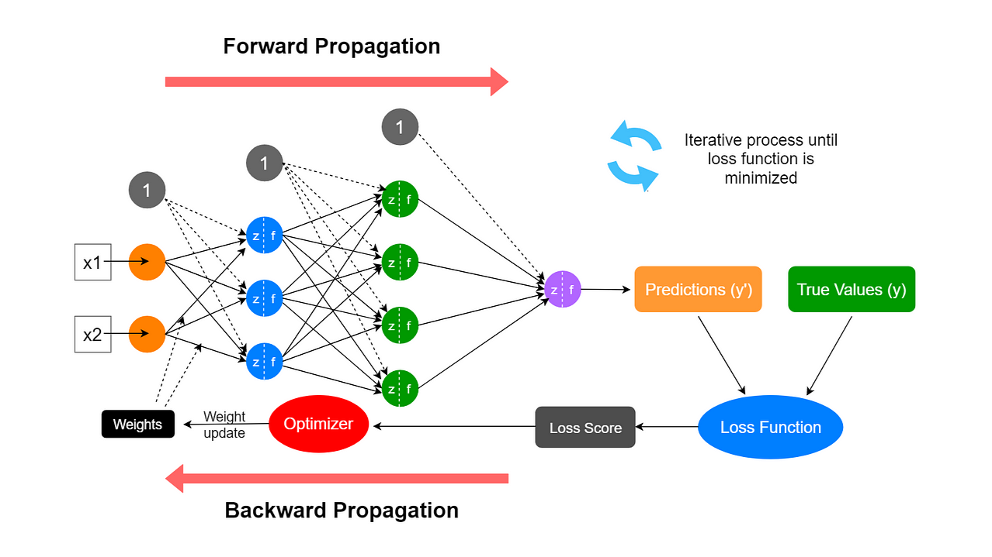
Forward and Backward Propagation in (Deep) Neural Networks

Slide 312
Forward and Backward Propagation in (Deep) Neural Networks
For Further Exploration –
DeepMind x UCL | Deep Learning Lectures
Forward Propagation in Neural Networks(Every link in the chain from start to end should be differentiable or atleast should be able to satisfactorily approximate the function’s derivative)
Backpropagation - Wikipedia
Activation functions in Neural Networks
What is Learning Rate in Machine Learning? | IBM
The need for small learning rates on large problems
Types Of Learning Rules in ANN | GeeksforGeeks
Neural Network: Breaking The Symmetry | Towards Data Science
[D] Why we initialize the Neural Networks with random values in order to break the symmetry
Dropout in neural networks: what it is and how it works
Loss Functions and Optimization Algorithms. Demystified.
Optimizers in Deep Learning
Difference between Batch Gradient Descent and Stochastic Gradient Descent | GeeksforGeeks
Epoch vs. Batch vs. Iteration in Neural Networks
Grokking-Deep-Learning
Enhancing-Deep-Learning-with-Bayesian-Inference
Probabilistic-Deep-Learning-with-TensorFlow

Slide 313
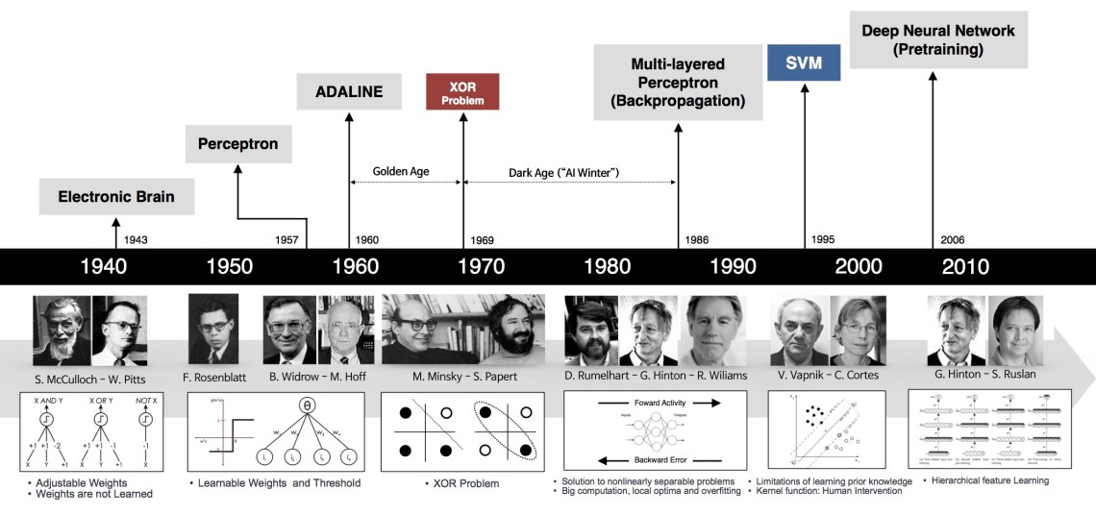
Neural Networks Evolution
For Further Exploration –
Implementing Models of Artificial Neural Network | GeeksforGeeks
Hebbian Learning Rule with Implementation of AND Gate | GeeksforGeeks
Hopfield Neural Network | GeeksforGeeks
Multilayer Perceptrons in Machine Learning: A Comprehensive Guide
Hierarchical Feature Learning Explained
Neocognitron

Slide 314
Relationship between (Deep) Neural Networks and Kernel Methods
Kernel methods and neural networks (NNs) are both powerful tools in machine learning, and they share some conceptual and mathematical relationships. Here’s a detailed look at their connections:
1. Feature Space Transformation
Kernel Methods: Kernel methods (like Support Vector Machines) implicitly map input data into a high-dimensional feature space using a kernel function which computes the inner product of the transformed inputs without explicitly performing the transformation.
Neural Networks: Neural networks also transform input data through multiple layers of non-linear transformations, effectively learning a feature space that can be very high-dimensional.
2. Universal Approximation Theorem
Both kernel methods and neural networks can approximate any continuous function given sufficient capacity (e.g., a sufficiently large network or a rich enough kernel). This is known as the Universal Approximation Theorem for neural networks and is conceptually similar to the ability of kernel methods to approximate functions based on their kernels. For a visual proof of the Universal Approximation Theorem, refer Visual Proof that Neural Network can compute any function.
3. Reproducing Kernel Hilbert Space (RKHS)
Kernel methods operate in a Reproducing Kernel Hilbert Space, where the kernel function defines the inner product. This space allows for the representation of functions as linear combinations of kernel functions.
Neural networks can also be viewed as learning representations in a function space, where the learned weights and activations can be interpreted as defining a new function space.
4. Connections through Regularization
Regularization techniques in both paradigms are similar. For example, the regularization term in kernel methods often involves the norm of the weights in the RKHS, while in neural networks, techniques like L2 regularization control the weights in the network.

Slide 315
Relationship between (Deep) Neural Networks and Kernel Methods contd…
5. Kernelized Neural Networks
Some neural networks can be interpreted as kernel methods. For instance, the output of a single-layer neural network with a specific activation function can be expressed in terms of a kernel function, making it possible to see connections between certain architectures and kernel methods.
6. Implicit and Explicit Kernels
In some cases, neural networks learn to use implicit kernels through their architecture. For example, convolutional neural networks (CNNs) can be seen as applying localized kernel operations (convolutions) to the input data.
7. Gradient-Based Optimization vs. Kernel Methods
Neural networks typically rely on gradient-based optimization techniques (like backpropagation), while kernel methods often employ optimization techniques to find the best hyperplane or decision boundary in the transformed space.
Conclusion
While kernel methods and neural networks are distinct in their approaches and implementations, they share fundamental mathematical principles that allow them to model complex relationships in data. Understanding these connections can help in choosing the right method for a specific problem or in designing hybrid models that leverage the strengths of both approaches.In general, in the kernel trick, kernels have to be (hand) designed upfront but in Neural Networks, the features are learnt gradually & eventually.

Slide 316
Mathematical Operations Representations using Neural Networks
Neural networks can represent mathematical operations by mapping input data to output data through interconnected nodes, learning the relationships between them. These networks use a combination of weighted sums and activation functions to perform computations, essentially learning mathematical functions. This allows them to perform tasks like solving equations, recognizing patterns in data, and even extrapolating to predict solutions beyond the training data.
1. Input and Weights:
• Neural networks take numerical inputs (e.g., numbers, features from an image).
• Each input is connected to a node (neuron) in the next layer via a weight. These weights determine the strength of the connection and are adjusted during training.
2. Weighted Sum:
• At each node, the inputs are multiplied by their corresponding weights, and the products are summed together.
• A bias term is often added to this sum as well.
3. Activation Function:
• The weighted sum is then passed through an activation function.
• Activation functions introduce non-linearity, allowing the network to learn complex relationships. Examples include ReLU, Tanh, and Sigmoid.
• The output of the activation function becomes the input to the next node.
4. Training and Learning:
• The network learns by adjusting the weights and biases to minimize the difference between its predictions and the actual values.
• This process is often called "backpropagation," where the error is calculated and used to update the weights and biases.

Slide 317
Mathematical Operations representations using Neural Networks contd…
5. Mathematical Operations:
• By combining these steps across multiple layers, a neural network can learn to represent various mathematical operations.
• For example, by training a network to solve equations, it can learn the underlying mathematical functions and their relationships.
• They can also learn to generalize and extrapolate to solve problems beyond the training data.
6. Examples:
• Equation Solving: A network can be trained to map input equations to their solutions, effectively learning how to solve them.
• Pattern Recognition: Neural networks can recognize patterns in data, which can be related to mathematical relationships.
• Arithmetic: Networks can be trained to perform basic arithmetic operations like addition, subtraction, and multiplication
For Further Exploration-
Simple guide to Neural Arithmetic Logic Units (NALU): Explanation, Intuition and Code
Can neural networks do arithmetic? A survey on the elementary numerical skills of state-of-the-art deep learning models
Neural networks to solve advanced mathematics equations
Mathematical Neural Networks
A Neural Network Solves, Explains, and Generates University Math Problems by Program Synthesis and Few-Shot
The Representation Theory of Neural Networks
Using Neural Networks in optimization problems

Slide 318
Overfitting in Heavily OverParameterized Neural Networks
Heavily parameterized neural networks don't always overfit data due to a combination of factors, including their ability to learn complex, non-linear relationships, the use of regularization techniques, and the influence of large-scale training data.
Here's a more detailed explanation:
Capacity and Complexity: While a large number of parameters might seem to increase the risk of overfitting, neural networks can also use this capacity to learn more intricate patterns in the data, leading to better generalization.
Regularization Techniques: Techniques like dropout, L1/L2 regularization, and data augmentation help to mitigate overfitting by reducing the model's complexity and preventing it from memorizing the training data.
Large-scale Data: When trained on large datasets, neural networks can learn more robust and generalizable representations, even with a high number of parameters.
Double Descent: The concept of double descent suggests that very complex models can actually generalize well when they have enough capacity, as they might find a "sweet spot" in the parameter space where they learn the underlying structure of the data rather than noise.
Effective Low Complexity: Some research also suggests that heavily parameterized models may be effective at learning representations that have a relatively low "effective complexity" even though they have a large number of parameters.
In essence, while the potential for overfitting exists with heavily parameterized models, various factors can work to mitigate this risk, allowing these models to achieve excellent generalization performance.
For further Exploration –
Why over-parameterised deep neural networks don’t overfit?
The Overfitting Iceberg
5 Techniques to Prevent Overfitting in Neural Networks
A Modern Take on the Bias-Variance Tradeoff in Neural Networks

Slide 319
Representation Learning for Text, Image & Sound
Representation learning techniques are used to convert raw data into meaningful, structured patterns for machine learning. These methods help models understand the underlying semantics of the data by learning hierarchical features, from simple edges in an image to complex object shapes or abstract concepts in text and sound.
For Text - Bag-of-Words (BoW): A foundational technique that represents text as an unordered set of words, ignoring word order but capturing word frequency. TF-IDF (Term Frequency-Inverse Document Frequency): A more sophisticated method that weights word importance based on how frequently a word appears in a document and how rare it is across the entire corpus.
N-Gram-
A statistical model that focuses on sequences of words, providing insights into the context and relationships between terms. Word Embeddings (e.g., Word2Vec): These methods map words into dense vector spaces, where words with similar meanings are closer together, allowing for analogical operations and a more abstract representation of concepts.

Slide 320
Representation Learning for Text, Image & Sound
For Images - Convolutional Neural Networks (CNNs): Deep learning models that automatically learn hierarchical features from raw pixel data. Early layers might detect edges, while deeper layers combine these into more complex representations of objects and scenes.
Contrastive Learning: A popular technique for learning visual representations by training models to pull similar images closer and push dissimilar ones apart in the feature space. Data Augmentation: Involves creating modified copies of existing images (e.g., rotations, flips) to increase the dataset size and improve the model's ability to generalize and learn robust features.
For Sound - Spectrograms and CNNs: Audio signals can be converted into spectrograms, which visually represent the frequency content over time. CNNs can then be applied to these spectrograms to learn patterns for tasks like speech recognition. Embeddings: Similar to text, audio can be represented by embeddings that capture the semantic meaning of sounds, creating a numerical representation for downstream tasks. Contrastive Learning: This technique can also be applied to audio data, learning to distinguish between different sounds by placing similar audio segments closer in the learned representation space.

Slide 321
Representation Learning for Text(Bag of Words)
The bag-of-words (BoW) model is applied in Natural Language Processing (NLP) and Information Retrieval for tasks such as document classification, sentiment analysis (e.g., analyzing customer reviews), and spam filtering. It's also used in computer vision for image classification and retrieval by treating image features as "words". BoW serves as a feature generation tool, transforming text into a numerical vector of word frequencies, allowing machine learning models to process and understand it.
Key applications in NLP:
Document Classification:
Categorizing documents into predefined classes, like sorting legal texts or classifying customer support tickets.
Spam Filtering:
Detecting and filtering unwanted emails by analyzing the frequency of certain words associated with spam.
Sentiment Analysis:
Determining the overall sentiment (positive, negative, or neutral) expressed in text, such as customer reviews of products or services.
Information Retrieval:
Finding relevant documents based on user queries by matching word frequencies.
Document Clustering:
Grouping similar documents together based on their word content.
Applications in Computer Vision:
Image Classification/Retrieval: Treating local image features as "visual words" to classify images or find similar ones within a dataset.
How it works:
The BoW model simplifies text by creating a "bag" of its words, disregarding grammar and word order. Each document or image is then represented as a vector of word or feature counts, which acts as a numerical feature for a machine learning model to use in tasks like classification.
Why it's used:
Simplicity:
It is easy to implement and computationally efficient, making it a good starting point for many tasks.
Feature Extraction:
It converts unstructured text data into structured numerical data that machine learning algorithms can process.
For Further Exploration
Bag-of-words model - Wikipedia

Slide 322
Representation Learning for Text(Problems with Bag of Words)
The main problems with the Bag of Words (BoW) model are its insensitivity to word order and context, which leads to a loss of meaning and grammatical nuance. It also produces sparse, high-dimensional vectors, making it computationally difficult to model and learn from. Furthermore, BoW struggles with polysemy (words with multiple meanings) and struggles to recognize semantic relationships between words that co-occur frequently but are not directly related.
Loss of Meaning and Context
Ignores Word Order:
The model treats words as a "bag," disregarding their order in a sentence. This means sentences with different meanings but the same words, like "I am happy" versus "I am not happy," can be represented identically.
Lacks Semantic Information:
BoW only captures the presence and frequency of words, not the underlying meaning or context. For instance, the word "Python" could refer to a programming language or a snake, a distinction BoW cannot make.
Computational and Data Issues
Sparsity:
For large vocabularies, BoW models generate very large, but sparse, vectors with many zero entries. This increases computational complexity and makes it challenging for algorithms to learn effectively from the data.
Vocabulary Size:
Carefully managing the vocabulary is crucial. A large vocabulary leads to high dimensionality and sparsity, while an overly restrictive one might miss important information.
Inability to Capture Complex Language Nuances
No Grammatical Structure:
Punctuation and grammatical structure are ignored during preprocessing, further stripping away meaning.
Compound and Related Words:
BoW treats multi-word phrases like "artificial intelligence" as separate words, losing their combined meaning. It also doesn't understand that "cake" and "baking" are more related than "cake" and "racing".

Slide 323
Representation Learning for Text(TF-IDF)
The TF-IDF (Term Frequency-Inverse Document Frequency) model is used in many text mining and natural language processing (NLP) applications, such as information retrieval for search engines, text classification (e.g., spam filtering, sentiment analysis), keyword extraction to summarize documents, document similarity for content grouping, and building recommender systems. It works by assigning a numerical score to words, giving higher importance to terms that are frequent in a document but rare in the overall corpus.
Components:
Term Frequency (TF): Measures how frequently a term appears in a document. It’s calculated as: TF(t,d)=Number of times term t appears in document dTotal number of terms in document d
Inverse Document Frequency (IDF): Measures how important a term is across the corpus. It’s calculated as: IDF(t,D)=log(Total number of documents in corpus DNumber of documents containing term t)
Key Applications of TF-IDF:
Information Retrieval:
TF-IDF helps search engines determine the relevance of documents by ranking them based on how well they match a user's query, providing more accurate search results.
Text Classification:
It is used to categorize documents into different topics or classes. Examples include filtering spam emails and determining the sentiment (positive or negative) expressed in a text.
Keyword Extraction:
By identifying words with the highest TF-IDF scores, the model can extract key terms from a document, which can then be used for tagging or summarizing its main themes.
Document Similarity & Clustering:
TF-IDF transforms documents into numerical vectors, allowing for the measurement of similarity between them. This capability is used to group similar documents together, such as clustering news articles or customer feedback.
Recommender Systems:
In recommender systems, TF-IDF can be used to analyze user preferences and item descriptions, enabling the recommendation of relevant content or products based on their textual similarities.
Fraud detection and cybersecurity:
By analyzing linguistic patterns in text-based data, TF-IDF can flag deviations from expected norms, which helps in detecting threats like phishing emails or fraudulent insurance claims.
For Further Exploration
tf–idf - Wikipedia

Slide 324
Representation Learning for Text(Problems with TF-IDF)
Problems with the TF-IDF model include ignoring word order and semantics, a heavy reliance on raw word frequency that can lead to bias, difficulty in handling rare words, potential for sparse matrices in large datasets, and issues with longer documents causing length bias. The bag-of-words approach means TF-IDF doesn't understand context or relationships between words.
Specific Problems and Limitations
No semantic understanding:
TF-IDF treats words as isolated units and doesn't grasp their meaning or the context in which they are used. This can lead to misinterpretations of text.
Ignores word order:
As a "bag-of-words" model, TF-IDF discards word sequence information. This can be problematic because word order can significantly alter the meaning of a sentence.
Bias towards longer documents:
Longer documents tend to have higher term frequencies for words, potentially skewing TF-IDF scores if not properly normalized.
Sensitivity to rare words:
Words that appear very infrequently in the corpus get a high Inverse Document Frequency (IDF) score, which can unfairly inflate their importance.
Sparse matrices and memory:
For very large datasets with numerous unique terms, the resulting TF-IDF matrix can become extremely large and sparse, leading to high memory consumption and difficulty in interpretation.
Assumes word independence:
TF-IDF treats words as independent entities, which is unrealistic for natural language where words are often related in complex ways.
Doesn't account for stop words:
Without a mechanism to handle common words (stop words), these frequent terms can be given undue weight in the feature building process.
Why these limitations matter
Contextual errors:
The inability to understand context and word relationships can lead to incorrect classification or information retrieval results.
Poor generalization:
TF-IDF can struggle to generalize on large or complex datasets, potentially leading to significant performance drops on unseen data.
Inaccurate importance:
The scoring can sometimes misrepresent the actual importance of a word or phrase within a document, especially when semantics are crucial.

Slide 325
Representation Learning for Text(N-Gram)
An n-gram model is a statistical language model that predicts the probability of a word occurring based on the preceding (n-1) words in a text sequence, trained on a corpus of text data. By breaking down text into sequential "n-grams" (like unigrams, bigrams, or trigrams), these models capture local context to improve applications such as speech recognition, machine translation, and text generation. Common applications leverage these models for predictive text, spell checking, and other text analytics tasks.
How it Works
1. N-grams:
The process involves identifying sequences of 'n' consecutive words (or characters) in a text.
Unigram (1-gram): A single word.
Bigram (2-gram): Two consecutive words.
Trigram (3-gram): Three consecutive words.
2. Training:
The model is trained on a large text corpus to count the frequency of these n-grams.
3. Probability Estimation:
Based on the frequency counts, the model estimates the probability of a word following a given sequence of (n-1) words.
Example
Consider the phrase "The quick brown...".
Bigram Model:
Given "brown," it predicts the most likely next word based on how often "brown" is followed by other words in the corpus.
Trigram Model:
Given "quick brown," it predicts the next word based on the context of those two preceding words.
Applications
N-gram models are used in various Natural Language Processing (NLP) tasks:
Predictive Text: Suggesting the next word as you type.
Speech Recognition: Helping to interpret spoken words.
Machine Translation: Improving the accuracy of translated text.
Spelling and Grammar Correction: Identifying and suggesting more probable word choices.
Limitations
Data Sparsity:
With larger values of 'n', it becomes less likely to find repeated occurrences of the same n-gram, leading to sparse data.
Lack of Long-Range Context:
N-gram models only consider a limited, fixed context (the previous n-1 words), failing to capture broader sentence or document context.

Slide 326
Representation Learning(Embeddings)
Embeddings are numerical representations of complex data, with applications in natural language processing (NLP), such as sentiment analysis and machine translation; computer vision, including image recognition; recommendation systems for personalized suggestions; information retrieval, to improve search engines; and scientific research, for analyzing complex biological or material data. They enable machine learning models to understand semantic relationships and contextual information within data, leading to more accurate and insightful applications in a wide range of fields.
Key Applications of Embeddings
Natural Language Processing (NLP):
Sentiment Analysis: Classifying text by understanding the semantic meaning of words.
Machine Translation: Converting words and sentences into vectors in a shared space to facilitate translation.
Information Retrieval/Search Engines: Matching user queries with relevant documents based on semantic similarity, rather than just keywords.
Language Generation: Generating coherent and contextually relevant text, music, or images by understanding relationships between concepts.
Computer Vision:
Image Recognition: Processing images to identify and classify objects with high precision.
Object Detection: Locating specific objects within an image.
Recommendation Systems:
Personalized Recommendations: Suggesting items like products, movies, or books based on the similarity of user profiles and item descriptions.
Scientific Research:
Material Science: Predicting the properties of new materials by analyzing their atomic structures.
Bioinformatics: Understanding and analyzing large genomic datasets to discover new patterns and insights.
Other Applications:
Data Preprocessing: Cleaning and normalizing data, such as handling irregularities in large training datasets.
Anomaly Detection: Identifying unusual patterns or outliers within datasets.
Generative AI: Creating more realistic and contextually relevant content, from text to images.

Slide 327
Representation Learning(Raw Data to Embeddings Conversion)
Converting raw data into embeddings involves transforming various data types (text, images, audio, etc.) into dense numerical vectors that capture semantic or contextual meaning. The specific techniques depend on the data type: For Text Data: Word Embeddings (e.g., Word2Vec, GloVe, FastText): These techniques learn vector representations for individual words based on their co-occurrence patterns in a large text corpus. Word2Vec: Uses neural networks (CBOW or Skip-gram) to predict words based on context or context based on words. GloVe (Global Vectors for Word Representation): Leverages global co-occurrence statistics to create word vectors. FastText: Extends Word2Vec by considering character n-grams, allowing it to handle out-of-vocabulary words and morphological variations. Contextual Embeddings (e.g., BERT, GPT, Transformer-based models): These models generate embeddings that capture the meaning of a word in its specific context within a sentence or document. They use self-attention mechanisms to understand relationships between words. BERT (Bidirectional Encoder Representations from Transformers): A pre-trained transformer model that considers both left and right context for generating word embeddings. Sentence Transformers: Fine-tuned BERT or other transformer models specifically designed to generate semantically meaningful sentence embeddings. For Image Data: Convolutional Neural Networks (CNNs): Pre-trained CNNs like ResNet, VGG, or Inception can extract features from images, and these features can serve as image embeddings. The output of a specific layer (e.g., the last pooling layer before the classification head) can be used as the embedding vector. Vision Transformers (ViTs): These models adapt the transformer architecture for image processing, treating image patches as sequences and learning contextual embeddings for them.

Slide 328
Representation Learning(Raw Data to Embeddings Conversion)
For Other Data Types (Audio, Tabular Data, etc.):
Audio Embeddings: Techniques like Mel-frequency cepstral coefficients (MFCCs) or deep learning models trained on audio data can generate embeddings for speech or other audio signals. Tabular Data Embeddings: For categorical features, one-hot encoding or learned embeddings can be used. For numerical features, simple scaling or more complex autoencoder-based approaches can create embeddings. Graph Embeddings: Techniques like Node2Vec or Graph Neural Networks (GNNs) can generate embeddings for nodes or edges in a graph structure. General Steps for Generating Embeddings: Data Preprocessing: Clean and prepare the raw data according to its type (e.g., tokenization for text, resizing for images). Model Selection: Choose an appropriate embedding model based on the data type and desired properties of the embeddings (e.g., capturing semantic similarity, context-awareness). Embedding Generation: Apply the selected model to the preprocessed data to generate the numerical vector representations (embeddings).
Benefits of using Embeddings –
a) The matrices formed are low dimensional dense matrices & so occupies less space.
b) The matrices carries semantics & so the words like invest, bank & finance are nearby in the vector space.
For Further Exploration
Word Embeddings and Word2Vec Clearly Explained
Multi Vector Embedding
“Periodic table of machine learning” could fuel AI discovery

Slide 329
Representation Learning(Semantic Composition of Embeddings)
Semantic composition of embeddings refers to the methods and models used to combine individual word or phrase embeddings into a single embedding that represents the combined meaning of the entire phrase or sentence, thereby capturing deeper semantic relationships and context. This process involves creating new embeddings by applying mathematical operations, such as averaging or more complex functions learned through techniques like genetic programming, to the constituent word embeddings.
Key Concepts
Word Embeddings:
These are vector representations of words in a high-dimensional space, where words with similar meanings are positioned closer to each other.
Semantic Relationships:
Embeddings capture semantic similarities (e.g., "king" and "queen") and other relationships (e.g., "red" ball vs. "chocolate" ball) based on their usage in text.
Compositionality:
The goal is to understand how the meanings of individual words combine to form the meaning of the whole, a concept known as compositionality.
Why Semantic Composition is Important
Understanding Complex Meanings:
By combining word embeddings, models can create a single vector that captures the meaning of a sentence or phrase, which is crucial for tasks like question answering, text summarization, and machine translation.
Handling Novel Combinations:
Humans often create new word combinations, such as "deepfake," and compositionality models aim to learn how to represent these new meanings effectively.
Bridging Word-Level and Sentence-Level Semantics:
It extends the semantic understanding from individual words to larger linguistic units, enabling more nuanced language interpretation.
Methods for Composition
Simple Aggregation:
A common approach is to average the embeddings of the words in a sentence to obtain a single vector representing the overall meaning.
Learned Composition Models:
More sophisticated methods involve learning functions to combine embeddings.
Genetic Programming (GP):
This technique can be used to automatically discover effective composition methods for word embeddings.
Transformer Models:
Architectures like BERT are also tested to see how well they represent compositions and generate embeddings for combined words.

Slide 330
Embeddings and Vector DBs for Enterprise/Web Search
In Enterprise search there are mainly 2 ways to search data –
a)Using DB columns value wherein we search for some DB column values using Sql & where clause with proper indexing applied to the columns mentioned in the where clause.
b) Free Text search - say there is some text in some DB column “I invested in Microsoft stock” & here there can be 2 requirements-
i) return this column text if the user searches for “invest” or “invested”. That’s normal free text search done by tools like Apache Solr, ElasticSearch or OpenSearch(all these tools mostly uses the concept of inverted index). Most of these tools use (partial) exact match based search.
ii) return this column text if the user searches bank or finance since these words are somewhat related to the word invest in the global text corpora. That’s Semantic Search & for that we need Embeddings(for Semantic match).
But why do we need Vector DBs? - that’s to store the vector space & the associated embeddings in the most optimal way (for later usage as part of search query). So what’s the whole Embeddings & Vector DBs based search process like –
a) via some offline process convert the text corpora into word/sentence Embeddings & document Embeddings & store the vector space & associated Embeddings in the Vector DBs.
b) When the user searches for some word/sentence, convert it into word/sentence embedding & then check in the documents embeddings, which word/sentence Embeddings are near-by, using vector distance formulas like Euclidean Distance or Cosine Distance or Manhattan Distance & then return those documents as search results.
Similar to free text search, Embeddings & Vector DBs can be used for sections of image search or a whole image search or a video search or for searching all videos which contains some image or even multi-modal search & many more similar search apps.
For Further Exploration
Vector database development
Vector Database Engineering
Vector-Search-for-Practitioners-with-Elastic
How to build a search engine with word embeddings
Vector Graph Embeddings
Awesome-Vector-Database

Slide 331
Rankings in Embeddings Based Search
For any Search Ranking problem it’s ideal to visualise the Search problem as a graph with nodes(e.g. containing the document embeddings) & edges(e.g. for the relation between the document embeddings) so that we can calculate ranks associated with both nodes & edges & then applying some weight factor to these ranks, we can calculate the overall rank of the document. So in case of web pages(as document texts), we can convert all the word/sentence/document texts into corresponding Embeddings & store them in Vector DBs & when the user queries some text(word/sentence), convert that into corresponding Embeddings & then the search results should be sorted based on a combination of weightage given to Nodes & Edges Ranking
Nodes Ranking - here ideally it should 1st show the result corresponding to [partial] exact match & then other results based on sorted near-by distance. This is more of Content Relevance Ranking.
Link/Edge Ranking - e.g. Google uses PageRank algo using complex distributed linear algebra techniques(mainly solving system of linear equations [wherein the parameters of the equations are probabilities] & using EigenValue/EigenVector concepts). The main logic used here is to give more importance to a document which has more links referring to it. By the way, for some complex search requirement, one may have to develop his/her own custom Link/Edge Ranking algo.
For Further Exploration
Inverted Index
Introduction to Ranking Algorithms, Ranking Algorithms & Types
Ranking Entities with Multi-Criteria Decision Making Methods(MCDM)
Ranking and learning to rank - Practical Recommender Systems
Understanding Page Rank. In simple terms
Link Analysis Algorithms Explained
PageRank
AMultitaskRankingSystem

Slide 332
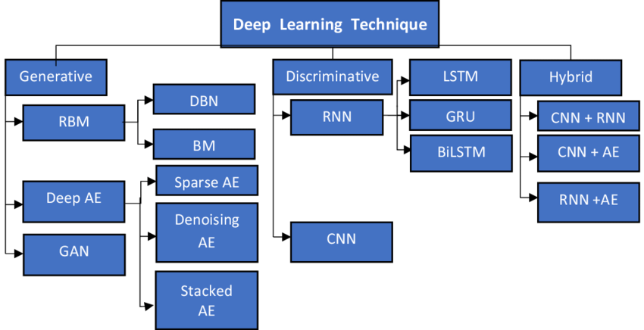
Deep Learning Architectures
For Further Exploration –
8 Deep Learning Architectures Data Scientists Must Master
Deep learning architectures

Slide 333
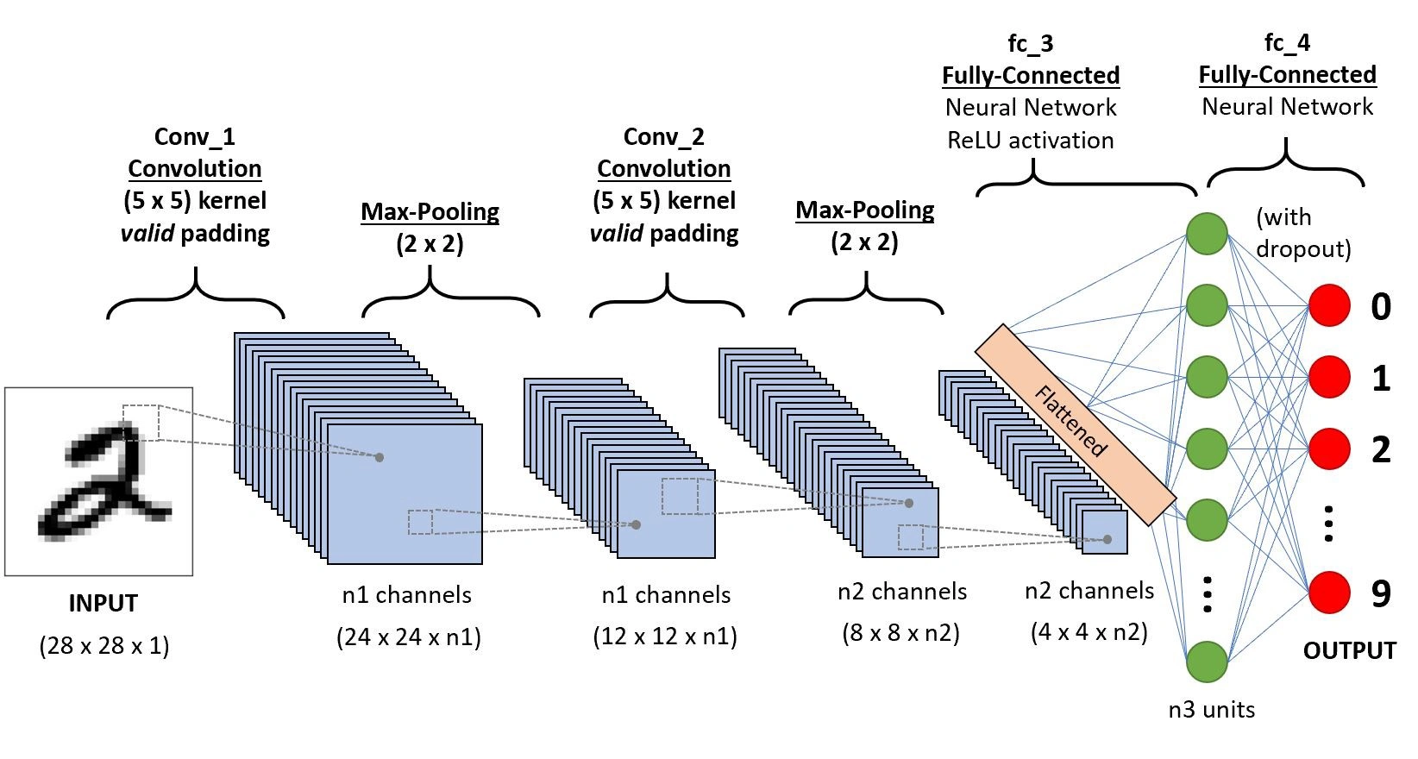
CNN Architecture
The kernel weights are learned here. For an i/p image size i, kernel filter size k and stride s, the o/p image size is given by “floor(((i-k)/s) + 1)”.
For Further Exploration –
Intuitive Guide to Convolution
The Convolution of Two Functions | Definition & Properties – YouTube
Backpropagation in Convolutional Neural Networks | GeeksforGeeks
Different Types of CNN Architectures

Slide 334
Invariance in Computer Vision
In computer vision, invariance refers to the ability of a system to recognize objects or patterns despite variations in their appearance, such as changes in scale, orientation, or viewpoint. There are several types of invariance, including translation, scale, and rotation invariance, as well as more complex transformations like affine invariance. Invariant object recognition is a crucial aspect of robust visual systems, allowing for reliable identification even under different conditions.
1. Translation Invariance:
Definition: The system's output (e.g., object recognition) remains the same regardless of the object's position within the image.
Example: A face detector might identify a face as a "face" even if it's located at the left, center, or right of the image.
Relationship to Equivariance: Translation equivariance means the system's response changes in a predictable way as the input shifts. For example, a "face-iness" heat map might have bumps that shift with the location of the face.
2. Scale Invariance:
Definition: The system recognizes objects of different sizes.
Example: A system could identify a car as a car, regardless of whether it's a small car in the distance or a large car close up.
3. Rotation Invariance:
Definition: The system recognizes objects regardless of their orientation.
Example: A system could identify a cat as a cat, whether it's standing upright, on its side, or upside down.

Slide 335
Invariance in Computer Vision contd…
4. Viewpoint Invariance:
Definition: The system recognizes objects from different viewpoints or angles.
Example: A horse could be identified whether it's viewed from the front, side, or back.
5. Affine Invariance:
Definition: The system can handle more complex geometric transformations like perspective foreshortening and image warping.
Example: A system might be able to recognize an object even if it's distorted due to a camera lens effect or a change in perspective.
6. Other Types:
Partial Invariance: The system might be invariant to some transformations but not others.
Intrinsic Invariance: This refers to invariance due to the way an object is represented, not just from experience.
Example-Based Invariance: This refers to invariance learned from seeing the same object under different conditions.
Importance of Invariance:
Invariance is crucial for building robust and reliable visual systems because it allows them to perform object recognition or pattern detection even when there are variations in the image that are not relevant to the task at hand. For example, if a system can't recognize a face regardless of its position or size, it's less likely to be useful in a real-world scenario.

Slide 336
Techniques to handle invariance in Image Recognition
Invariant image recognition techniques aim to identify objects or patterns in images despite variations in their appearance due to transformations like scale, rotation, or viewpoint. These techniques involve extracting features from images that remain consistent even when the object or scene is scaled, rotated, or viewed from a different angle. Common methods include SIFT (Scale-Invariant Feature Transform), moment invariants (like Hu moments), and template matching.
Here's a breakdown of some key techniques:
1. Scale-Invariant Feature Transform (SIFT): SIFT is a powerful algorithm for identifying and matching features that are invariant to scaling, rotation, and affine distortion.It detects keypoints in an image and describes them with feature vectors.These features are then used to match between different images, allowing for object recognition even if the object is at a different scale or orientation.SIFT is widely used in applications like object recognition, image stitching, and 3D reconstruction.
2. Moment Invariants: Moment invariants are mathematical features derived from an image's moments that remain unchanged under certain transformations, such as rotation, scaling, and translation.Hu moments are a well-known example of moment invariants.They can be used to extract robust features for image recognition.Invariant moments are frequently used in image processing as features in the recognition process,.
3. Template Matching: Template matching involves comparing a small template image with different regions of a larger image to find matching patterns. It can be used to detect objects or patterns even if they are at different scales or positions. However, it can be sensitive to variations in lighting, orientation, and scale, so it's often combined with other techniques like SIFT.

Slide 337
Techniques to handle invariance in Image Recognition contd…
4. Other Techniques:
Convolutional Neural Networks (CNNs): CNNs, a type of deep learning model, are also used for image recognition and can be trained to be invariant to certain transformations.
Integral Transforms: Integral transforms like Fourier transforms can be used to extract features that are invariant to certain transformations.
Structured Neural Networks: These networks are designed to be invariant to specific types of transformations, such as rotation or translation.
In summary, invariant image recognition techniques leverage features that remain consistent across transformations, enabling robust object recognition even when the image is scaled, rotated, or viewed from a different perspective.

Slide 338
How CNN handles Vision Invariance
Convolutional Neural Networks (CNNs) leverage several architectural elements to achieve various types of vision invariance, including translational, rotational, and scale invariance. These elements include convolutional layers with shared weights, pooling layers, and, to a lesser extent, fully connected layers.
1. Convolutional Layers:
Shared Weights: Convolutional layers utilize a set of learnable parameters (weights and biases) that are shared across all spatial locations in the input feature map. This means that a particular filter learns a feature (e.g., an edge) and can detect it regardless of its location in the image. This shared weight mechanism enables translation invariance, as the same filter will be applied to different positions of the input, allowing the network to recognize features regardless of their location.
Feature Extraction: Convolutional layers extract hierarchical features from the input, starting with low-level features (edges, textures) in the earlier layers and progressing to more complex patterns (objects, shapes) in the deeper layers. This hierarchical feature extraction enables the network to learn robust representations of the input that are less sensitive to variations in position, scale, and orientation.
Receptive Fields: Each neuron in a convolutional layer has a receptive field, which is the region of the input image that influences its output. By convolving the input with a filter, the network effectively "looks" at only a small region of the input, reducing the number of parameters and making the network more efficient. This local connectivity contributes to the network's ability to learn robust features that are invariant to small shifts in the input.
2. Pooling Layers:
Downsampling: Pooling layers reduce the spatial dimensions of the feature maps by summarizing information within local regions. This can be achieved through operations like max pooling (taking the maximum value within a region) or average pooling (taking the average value).

Slide 339
How CNN handles Vision Invariance contd…
Translation Invariance: Pooling introduces a degree of local translation invariance by focusing on the most prominent features within a region, regardless of their precise location. This makes the network less sensitive to small shifts in the input image.
Scale Invariance: Pooling also contributes to scale invariance by summarizing information across larger regions, making the network less sensitive to variations in the size of objects.
3. Fully Connected Layers:
Integration of Features: Fully connected layers connect every neuron in the previous layer to every neuron in the current layer, allowing the network to integrate the features extracted by the convolutional and pooling layers.
Classification: Fully connected layers are typically used at the end of the network for tasks like classification, where they map the extracted features to a final output (e.g., class probabilities).
In summary, the combination of convolutional layers with shared weights, pooling layers for downsampling and local translation invariance, and fully connected layers for integrating and classifying features allows CNNs to achieve various types of vision invariance, making them robust to variations in input images
For Further Exploration –
Deep Convolutional Neural Networks as Models of the Visual System
A Comparison of Pooling Methods for Convolutional Neural Networks
Convolution & Pooling Layers. Convolution Layer: | by Nikita Malviya | Medium

Slide 340
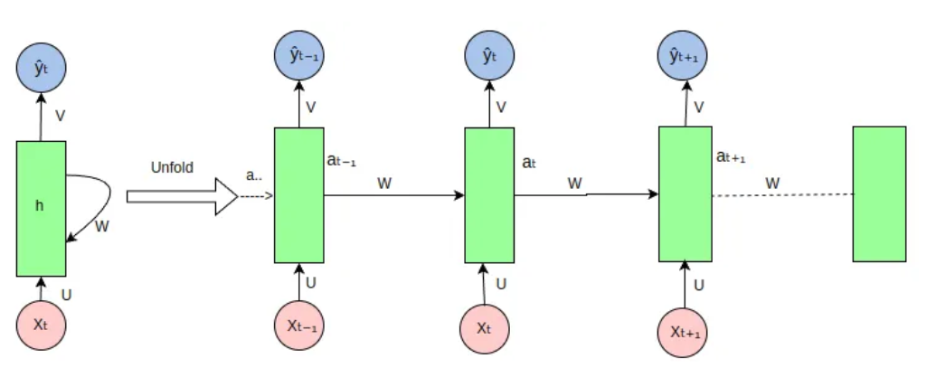
RNN Architecture
For Further Exploration –
The intuition behind recurrent neural networks
Back Propagation through time – RNN | GeeksforGeeks
Sequence Models & Recurrent Neural Networks (RNNs)
RNN vs LSTM vs GRU
Encoders-Decoders, Sequence to Sequence Architecture.
Recurrent Neural Networks (RNNs): Challenges and Limitations
ML For Sequential Data

Slide 341
Self Attention, Cross Attention & Multihead Attention
Self-attention, cross-attention, and multi-head attention are all variations of the attention mechanism used in deep learning models, particularly in transformers. Self-attention focuses on relationships within a single sequence, while cross-attention bridges the gap between two distinct sequences. Multi-head attention is a technique that uses multiple parallel attention mechanisms to capture different aspects of a sequence, often used in conjunction with self-attention or cross-attention.
Self-Attention:
Focus: Within a single sequence, enabling a model to attend to different positions within that sequence to understand its meaning.
Mechanism: Transforms an input sequence into query, key, and value vectors. These vectors are then used to compute attention weights, effectively determining the importance of each element in the sequence relative to others.
Applications: Commonly used in encoders and decoders of transformer models, capturing dependencies within a single input sequence.
Cross-Attention:
Focus: Between two different sequences, allowing models to relate information from one sequence to another.
Mechanism: Similar to self-attention, it utilizes query, key, and value vectors, but these vectors come from different sequences.
Applications: Crucial in encoder-decoder architectures, enabling information transfer between an input sequence and an output sequence.
Multi-Head Attention:
Focus: Enhances the ability of attention mechanisms to capture complex relationships by using multiple "heads".
Mechanism: Divides the input sequence into multiple "heads," each of which independently calculates attention weights. The outputs of these heads are then combined to produce a final output.
Applications: Used in conjunction with self-attention and cross-attention, particularly in transformer models, allowing for more nuanced and comprehensive understanding of sequences.
For Further Exploration –
Attention Networks: A simple way to understand Self-Attention
Attention Networks: A simple way to understand Cross-Attention
Attention Networks: A simple way to understand Multi-Head Attention
Transformer Attention Mechanism in NLP | GeeksforGeeks
Attention (machine learning) - Wikipedia

Slide 342
Contextual & Positional Encoding
Contextual embeddings and positional embeddings are both crucial for NLP models like Transformers, but they serve different purposes. Contextual embeddings capture the meaning of words in relation to their surrounding words, allowing for different representations of the same word in different contexts. Positional embeddings, on the other hand, provide the model with information about the position of each word in a sequence, helping it understand the order of words.
Here's a more detailed breakdown:
Contextual Embeddings:
Dynamic: They adapt to the context, unlike static embeddings which represent words with fixed vectors.
Purpose: Allow a word to have multiple representations based on its surrounding context, enabling better handling of word sense disambiguation and polysemy.
Example: ELMo and BERT are popular models that generate contextual embeddings by considering the surrounding words.
Positional Embeddings:
Purpose: Provide the model with information about the position of each word in a sequence, which is crucial for understanding the order of words.
How it works: Transformers, which process words in parallel, need positional embeddings to understand the order of words in a sentence.
Example: Sine and cosine functions are often used to generate positional embeddings
Focus: Contextual embeddings focus on the meaning of words in relation to their context, while positional embeddings focus on the order of words in a sequence.
Dynamic vs. Static: Contextual embeddings are dynamic, changing based on context, while positional embeddings are generally static within a given sequence.
Application: Contextual embeddings are useful for tasks that require nuanced understanding of language, such as sentiment analysis and text generation, while positional embeddings are crucial for any NLP model that relies on the order of words.
For Further Exploration –
How to build custom NER model with Context based Word Embeddings in Vernacular languages
A Gentle Introduction to Positional Encoding

Slide 343
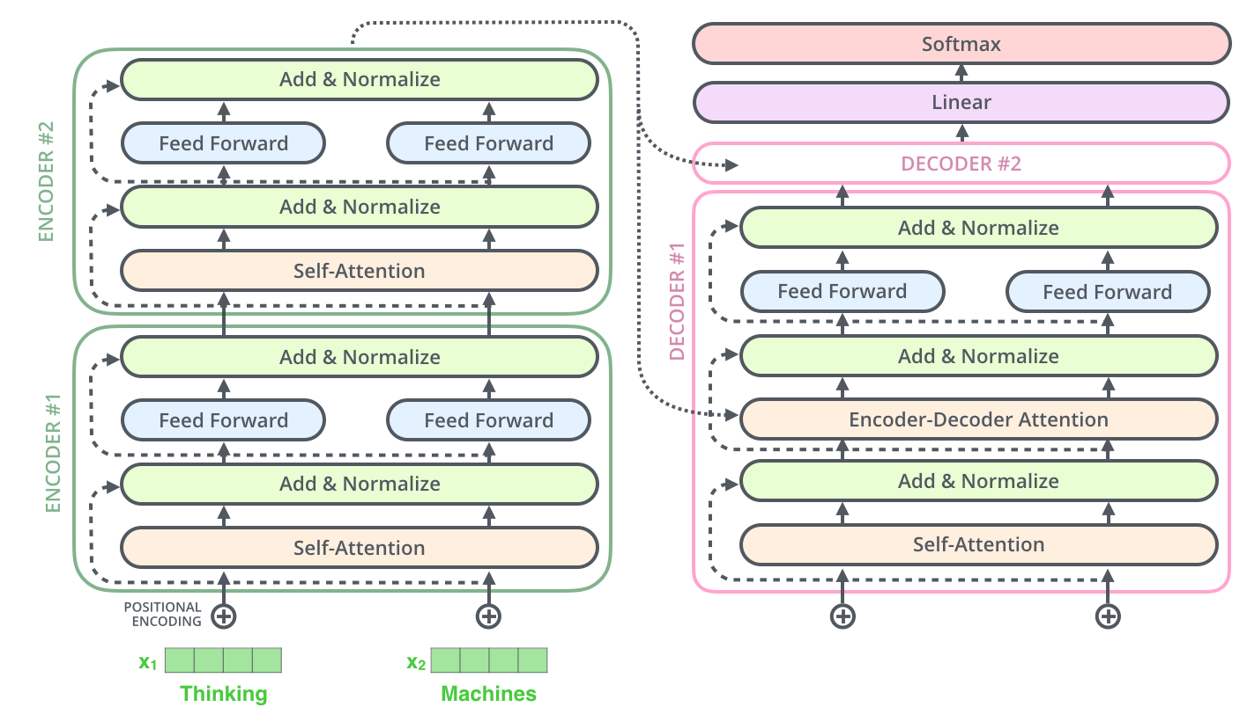
Transformer Architecture
Refer Transformer Neural Networks , The Illustrated Transformer , An Intuitive Introduction to the Vision Transformer & How does backpropagation in a transformer work? to understand the intricate details of the (vision) Transformer Architecture

Slide 344
Graph ML
Graph ML refers to applying machine learning techniques to data represented as graphs. This approach is used in various fields like social networks, knowledge graphs, and drug discovery, where understanding relationships between entities is crucial.
Elaboration:
Graph Machine Learning (GML):
Core Idea: GML leverages the structure of graphs (nodes and edges) to perform machine learning tasks. It's essentially machine learning applied to data that naturally exists in a network or relational form.
Applications: GML finds use in diverse areas including:
Social Networks: Analyzing user connections, identifying influential individuals, and understanding network dynamics.
Knowledge Graphs: Representing and querying knowledge-based information, like in databases or semantic networks.
Drug Discovery: Modeling molecular structures and predicting drug efficacy.
Transportation: Optimizing traffic flow and routing.
Recommendation Systems: Suggesting products or content based on user preferences and connections.
Key Algorithms:
GML often uses algorithms like:
Graph Embedding Methods: Techniques that convert graph structures into lower-dimensional vector representations, enabling tasks like node similarity search and graph clustering.
Graph Neural Networks (GNNs): Neural networks specifically designed to process graph data. GNNs learn node representations based on their connections and features, allowing for tasks like node classification, edge prediction, and graph classification.
Other Algorithms: Various other ML algorithms can be adapted for use with graph data, including Laplacian regularization, and graph kernels.

Slide 345
Applications and Further Resources Related to Graph ML
The Ontology Pipeline
Graph Applications
Powering Geospatial Data Science with Graph Machine Learning
Semantic Modeling for Data[Book]
Graph-Data-Modeling-in-Python
The Practitioner’s Guide to Graph Data
8 Practical Steps to Graph Exploration
Graph Analytics and Knowledge Graph Use Cases
Graph-Data-Science-with-Neo4j
Hands-On-Graph-Analytics-with-Neo4j
Cypher-Querying
Getting-Started-with-the-Graph-Query-Language-GQL
Graph-Data-Modeling-in-Python
Modern-Graph-Theory-Algorithms-with-Python
Knowledge Graphs
Graph Algorithms
Graph Data Science with Python and Neo4j – AVA®- An Orange Education Label
Graph algorithms - Neo4j Graph Data Science
Distributed Graph Analytics
GraphX – Spark
Graph Algorithms | Apache Flink
Graph-Powered Machine Learning

Slide 346
Applications and Further Resources Related to Graph ML
Graph-Machine-Learning
Graph-Powered Analytics And Machine Learning With TigerGraph
What Are Graph Neural Networks?
Graph Neural Networks: Libraries, Tools, and Learning Resources
Graph Representation Learning
Deep Learning on Graphs
Hands-On-Graph-Neural-Networks-Using-Python
Applications of Graph Neural Networks (GNN)
Graph Neural Network Applications and its Future
Applications of Graph Neural Networks (GNNs)
Knowledge Graphs and LLMs in Action
Social Network Analysis
Handbook of Graphs and Networks in People Analytics
Networks, Crowds, and Market
Algorithms for Information Networks (Jon Kleinberg)
Applied-Deep-Learning-on-Graphs
GNNBook@2023
Awesome-Graph-Universe

Slide 347
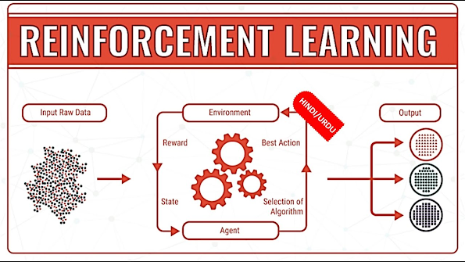
RL(Reinforcement Learning)
Key concepts in reinforcement learning include the agent, environment, state, action, and reward, which form the core loop where the agent learns by trial and error. Other crucial concepts are the policy, the agent's strategy for choosing actions; value function, which estimates future rewards; and the fundamental trade-off between exploration (trying new actions) and exploitation (using known good actions) to maximize long-term reward.
Core components
Agent: The learner or decision-maker that takes actions in the environment.
Environment: The external system or world with which the agent interacts.

Slide 348
RL(Reinforcement Learning)
State: A representation of the environment's current situation or condition at a given point in time.
Action: A move or decision the agent can make.
Reward: A scalar feedback signal from the environment that indicates how good or bad an action was in a particular state. This can be positive, negative, or zero.
Learning concepts
Policy : The agent's strategy or rule for selecting an action in a given state. It dictates how the agent behaves.
Value Function A function that estimates the expected long-term reward an agent can receive starting from a specific state and following a particular policy.
Exploration vs. Exploitation: A fundamental dilemma in reinforcement learning.
Exploration: Trying new and potentially unknown actions to discover better rewards in the future.
Exploitation: Choosing the action that is currently known to provide the highest reward. The goal is to balance these two
to maximize the cumulative reward over time.
Cumulative Reward: The total reward, which is a sum of all future rewards, that the agent aims to maximize. This encourages the agent to make decisions that lead to high rewards in the long run, not just immediate gains.
Algorithms and methods
Temporal Difference (TD) learning: A class of methods that update value estimates based on the difference between predicted and actual outcomes. For example, 1-step TD updates the value of a state based on the reward received and the value of the next state.
Q-Learning: A model-free reinforcement learning algorithm that learns the quality of taking a specific action in a given state. It estimates an action-value function, denoted as Q(s,a).
Deep Q-Networks (DQN): An advanced algorithm that combines Q-learning with deep neural networks. This allows it to handle high-dimensional state spaces, such as those found in images.
Policy Gradients: A class of algorithms that directly optimize the policy function. They adjust the policy parameters to increase the probability of actions that lead to higher rewards.
Actor-Critic Methods: These methods, a form of adaptive dynamic programming, maintain and update both a policy (the "actor") and a value function (the "critic"). This dual approach is more computationally efficient and stable than traditional value-based or policy-based methods
.

Slide 349
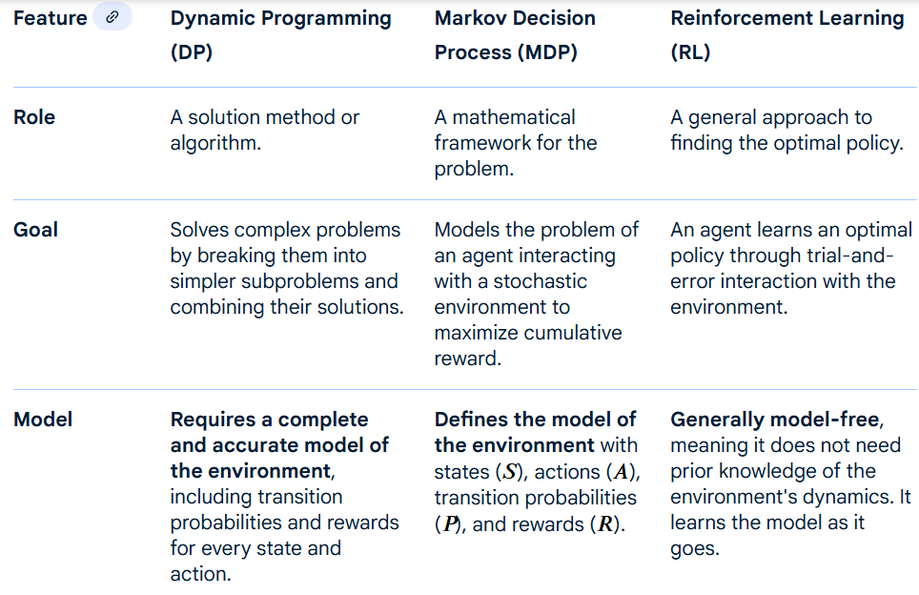
RL(Reinforcement Learning)
Dynamic Programming, Markov Decision Process and RL

Slide 350
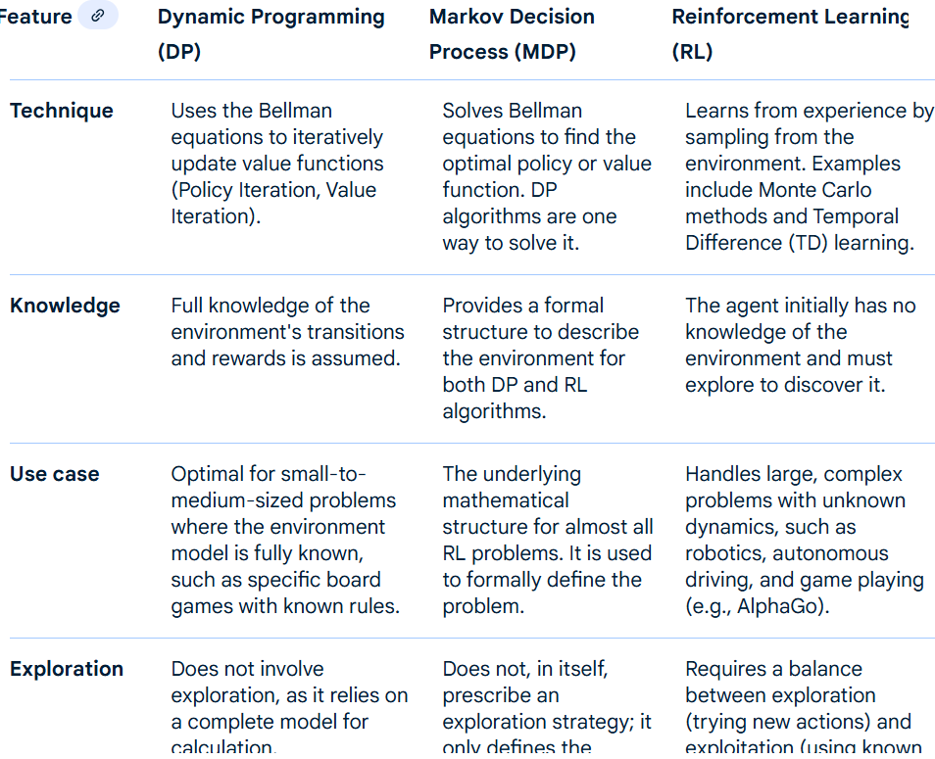
RL(Reinforcement Learning)
Dynamic Programming, Markov Decision Process and RL

Slide 351
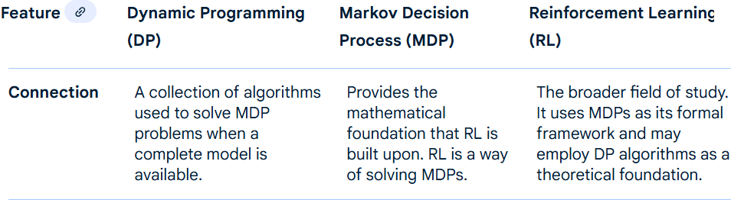
RL(Reinforcement Learning)
Dynamic Programming, Markov Decision Process and RL

Slide 352
RL(Reinforcement Learning)
RL Policies
The main types of policies used by RL agents are deterministic policies and stochastic policies. Deterministic policies always output the same action for a given state, while stochastic policies output a probability distribution over actions, allowing for exploration. Another important distinction is whether the agent is on-policy (using the same policy for data collection and learning) or off-policy (using a separate "behavior" policy for data collection and a different "target" policy for learning), as seen with methods like Q-learning.
By action selection
Deterministic Policy: A policy that, for any given state, will always produce the exact same action.
Example: A robot arm is programmed to always move to the exact same coordinates when it sees a specific red block.
Stochastic Policy: A policy that assigns a probability to each possible action in a given state.
Example: A game-playing agent may have a 70% chance of moving left and a 30% chance of moving up when in a certain
position, allowing it to explore different options.
Subtypes:
Categorical Policies: Used for discrete action spaces.
Diagonal Gaussian Policies: Used for continuous action spaces.
By learning method
On-Policy: The agent learns from the actions taken by its current policy. It needs to collect new data by following the same policy it is trying to improve.
Example: SARSA is an on-policy algorithm where the agent updates its Q-values based on the action taken by its current
policy.
Off-Policy: The agent can learn from data generated by a different policy (a "behavior policy") than the one it is trying to learn (a "target policy").
Example: Q-learning is an off-policy algorithm. It uses data from a behavior policy (which can be exploratory) to update the
values of a target policy, which is often a greedy, reward-maximizing policy.

Slide 353
RL(Reinforcement Learning)
Value Function Techniques used in RL
Value function techniques in reinforcement learning (RL) use algorithms to estimate the expected cumulative reward from a given state or state-action pair, guiding the agent toward decisions that maximize long-term rewards.
Key techniques include using the Bellman equation to recursively define value functions, applying algorithms like Q-learning and Deep Q-Networks (DQN) to learn and approximate these values, and employing Temporal Difference (TD) learning for incremental updates based on experienced rewards and estimated future values.
Foundational concepts
Bellman equations: A set of recursive equations that define the value of a state or state-action pair. The value of the current state is expressed as the immediate reward plus the discounted value of the next state, forming the basis for many algorithms. Basically, uses advanced variant of Dynamic Programming.
State-value function V(s): Estimates the expected return (cumulative reward) from a given state s, assuming the agent follows a specific policy.
Action-value function Q(s,a): Estimates the expected return from taking a specific action a in state s, and then following the policy thereafter.
Other important techniques
Function approximation: A technique used when the state space is too large to store in a table. Neural networks (as in
DQN) or other function approximators are used to estimate the value function for unseen states.
Classification-based value function training: A more recent technique that frames value function learning as a
classification problem instead of a regression problem, which can improve performance and scalability in certain
domains.

Slide 354
RL(Reinforcement Learning)
Techniques to solve Exploration vs Exploitation Dilemma in RL
Common techniques to solve the exploration-exploitation dilemma in reinforcement learning include epsilon-greedy, which explores randomly with a small probability (varepsilon), and Upper Confidence Bound (UCB), which selects actions based on both past performance and uncertainty. Other methods, like Thompson Sampling, use a probabilistic approach, while more advanced techniques like those based on maximum entropy or count-based exploration can also be employed to guide the learning process more efficiently.
.
Simple strategies
Epsilon-greedy: The agent chooses a random action with a small probability, (varepsilon)*(exploration), and selects the best-known action with probability (1-varepsilon)*(exploitation). A common approach is to start with a high (varepsilon) and gradually decrease it over time as the agent learns more about the environment.
Upper Confidence Bound (UCB): This method balances exploration and exploitation by selecting actions that have a high potential reward and/or high uncertainty. It favors actions that have not been tried often, while also considering their past success, which can lead to faster convergence.
Probabilistic and advanced strategies
Thompson Sampling: This is a Bayesian approach where the agent maintains a probability distribution over the possible outcomes of each action. It then samples a value from each action's distribution and chooses the action with the highest sampled value, ensuring a natural balance between exploration and exploitation.
Count-based exploration: This technique encourages exploration by assigning a higher value to states or actions that have been visited less frequently. This is typically used in environments with small, discrete state spaces.
Maximum Entropy reinforcement learning: This approach includes the entropy of the policy in the reward function, encouraging the agent to explore by being as random as possible while still maximizing its expected rewards. This method can help prevent premature convergence to a suboptimal policy.

Slide 355
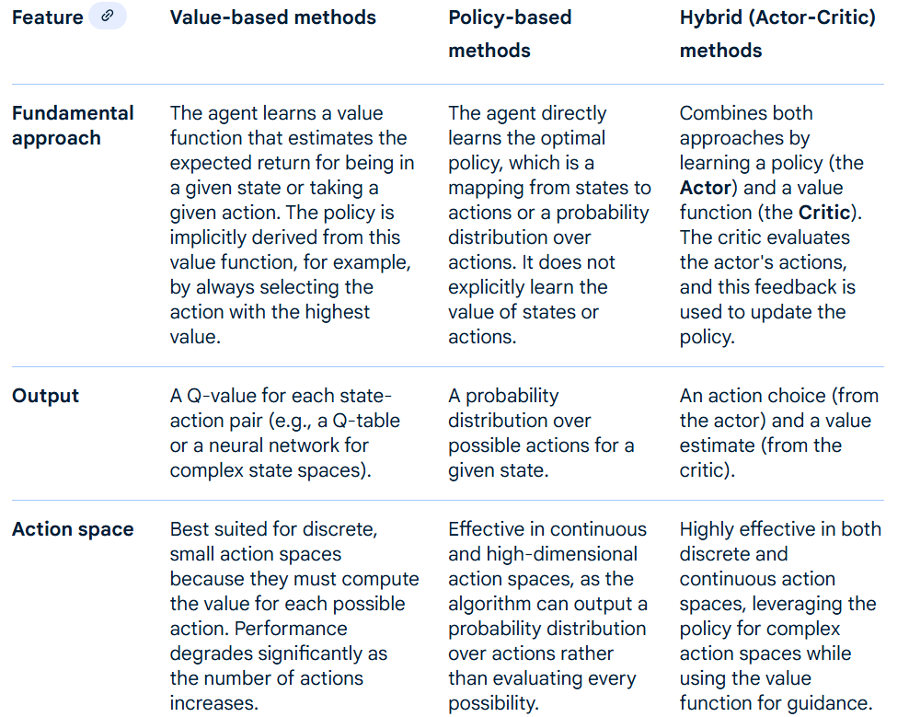
RL(Reinforcement Learning)
Value Based vs Policy Based vs Hybrid Methods in RL

Slide 356
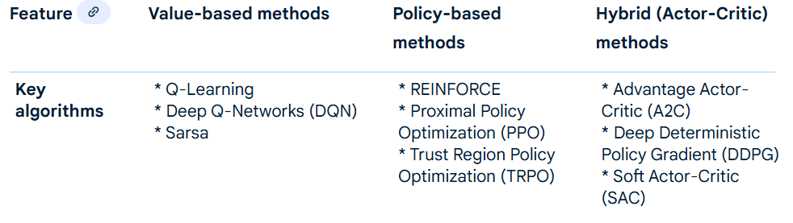
RL(Reinforcement Learning)
Value Based vs Policy Based vs Hybrid Methods in RL

Slide 357
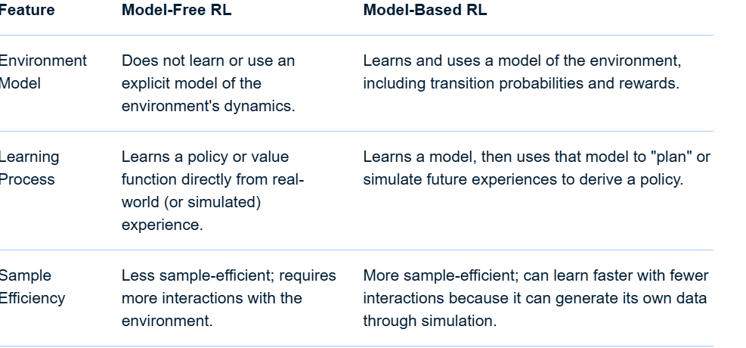
RL(Reinforcement Learning)
Model Based vs Model Free Methods in RL
Model-based RL learns a model of the environment to "plan" future actions, making it more sample-efficient, while model-free RL learns a policy or value function directly from experience without an environment model, making it simpler but less sample-efficient. Model-free methods learn from trial-and-error interactions, while model-based methods use their learned model to simulate scenarios, reducing the need for real-world interactions.

Slide 358
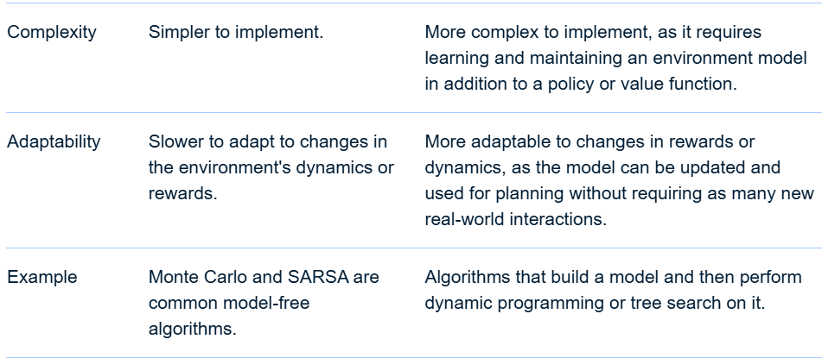
RL(Reinforcement Learning)
Model Based vs Model Free Methods in RL

Slide 359
RL(Reinforcement Learning)
For Further Exploration –
Reinforcement Learning, Intuition, and Abductive Reasoning
Markov Decision Processes (MDPs) and Dynamic Programming
Markov Decision Processes and Dynamic Programming
Understanding the Markov Decision Process (MDP) | Built In
Reinforment Learning Techniques
Algorithms for Decision Making
Some Good RL Resources – I
Some Good RL Resources – II
RLHF-book
OpenRLHF
Reinforcement Learning: Tasks, Exploration vs Exploitation
Exploration-Exploitation Tradeoff Explained with Code
Exploration vs Exploitation in RL The Dilemma Explained
Sequential Decision Analytics – CASTLE
Model-Based and Model-Free Reinforcement Learning
Model Based Reinforcement Learning
RL-Taxonomy

Slide 360
Econometrics Models
Econometric models are statistical models used in economics to understand and predict economic phenomena. They help bridge economic theory with empirical data, allowing economists to test hypotheses, establish causal relationships, and make forecasts. These models can be used to analyze the relationship between variables like consumer spending, income, and interest rates.
Here's a more detailed look:
1. Purpose of Econometric Models:
Test Economic Theories: Econometric models allow economists to statistically test whether economic theories align with real-world data.
Establish Causality: They can help determine if one variable causes changes in another, even when controlled experiments are not possible.
Forecasting: Econometric models can be used to predict future trends based on historical data.
Policy Evaluation: They can help evaluate the potential impact of different policies.
Decision Making: Econometric models can provide insights to help businesses and policymakers make informed decisions.
2. Types of Econometric Models:
Regression Models: A fundamental model used to estimate the relationship between a dependent variable and one or more independent variables.
Time Series Models: Models like ARIMA (Autoregressive Integrated Moving Average) are used to analyze data that changes over time.
Panel Data Models: These models analyze data that has both cross-sectional (different individuals or groups) and time-series dimensions. Panel data combines both regression & time series to allow for longitudinal studies.

Slide 361
Econometrics Models contd …
Logit and Probit Models: These models are used when the dependent variable is binary (yes/no, 0/1).
Simultaneous Transfer Function Models: These models are used to analyze simultaneous relationships between multiple variables.
Vector Autoregression (VAR) Models: These models are used to analyze the dynamic relationships between multiple time series variables.
3. Key Concepts in Econometric Modeling:
Endogeneity: A situation where the independent variable is correlated with the error term, leading to biased estimates.
Multicollinearity: A situation where independent variables are highly correlated with each other, making it difficult to isolate the effect of each variable.
Cointegration: A concept related to time series data where two or more variables move together in the long run despite not being stationary.
4. Examples of Econometric Models in Use:
Macroeconomic Models: Used to model the overall economy, including GDP, inflation, and interest rates.
Financial Econometric Models: Used to analyze financial markets, predict stock prices, and assess financial risk.
Demand Models: Used to analyze consumer demand for goods and services.
Supply Models: Used to analyze the supply of goods and services.
5. Advantages and Limitations:
Advantages: Econometric models can be powerful tools for understanding and predicting economic phenomena.
Limitations: Models can be based on assumptions that may not always hold true, and they can be complex to build and interpret.

Slide 362
When to use which Econometrics Model
Regression models the relationship between a dependent and one or more independent variables, while time series models analyze data ordered by time, and panel data combines time series and cross-sectional data. Logit and probit models are used for binary outcomes, and simultaneous transfer function and vector autoregression (VAR) models are used for time series analysis with multiple variables and potentially feedback loops.
1. Regression:
Purpose: Predicts the value of a dependent variable based on one or more independent variables.
Data: Cross-sectional data, where observations are made at a single point in time.
Assumptions: Data points are independent, the relationship between variables is linear, and residuals are normally distributed.
Example: Predicting housing prices based on size, location, and number of bedrooms.
When to use: When you have data where the relationship between variables is expected to be linear and the assumptions of linear regression are met.
2. Time Series:
Purpose: Analyzes data ordered by time to identify trends, patterns, and seasonality.
Data: Time series data, where observations are made at regular intervals over time.
Models: Autoregressive (AR), moving average (MA), and autoregressive integrated moving average (ARIMA) models are common.
Example: Forecasting stock prices or sales figures over time.
When to use: When you have data where the order of observations matters, and you want to predict future values based on past patterns.

Slide 363
When to use which Econometrics Model contd…
3. Panel/Longitudinal Data:
Purpose: Combines time series data with cross-sectional data (observations across multiple entities over time).
Advantages: Allows for analysis of individual heterogeneity and changes over time within the same entities.
Data: Panel data, which combines cross-sectional and time-series data (repeated observations of the same units over time).
Example: Analyzing changes in income over time for different individuals or households.
When to use: When you have data from multiple entities observed repeatedly over time, allowing for a deeper understanding of trends and patterns.
4. Logit and Probit Models:
Purpose: Model the probability of a binary outcome (e.g., yes/no, success/failure).
Data: Can be used with cross-sectional data, time series data, or panel data.
Difference: Logit uses the logistic function, while probit uses the cumulative standard normal distribution.
Example: Predicting whether a customer will click on an ad or not.
When to use: When you want to model the probability of a binary outcome based on one or more predictor variables.
5. Simultaneous Transfer Function:
Purpose: Analyzes the relationship between multiple input and output variables in a system.
Transfer Function: Represents the relationship between an input and output variable, allowing for lagged effects and other dynamic relationships.
Data: Multivariate time series data, where multiple variables are observed over time.
Focus: Describes how changes in one variable affect other variables within the system.
Example: Modeling the relationship between different parts of a machine or a complex system.
When to use: When you need to understand the dynamic relationships between multiple variables in a complex system.

Slide 364
When to use which Econometrics Model contd…
6. Vector Autoregression (VAR):
An extension of the autoregressive model to multivariate time series, where each variable is modeled as a function of its own past values and the past values of other variables.
Purpose: Models multiple time series variables simultaneously, allowing for feedback and interaction between them.
Example: Modeling the relationship between inflation, interest rates, and unemployment.
When to use: When you have multiple time series variables that are likely to influence each other, and you want to model their relationships and forecast their future values
In essence, regression analysis is a broader approach for examining relationships between variables, while time series analysis focuses on data over time. Panel data combines both to allow for longitudinal studies. Logit and probit are specific regression techniques for binary outcomes, and simultaneous transfer function and VAR models are more specialized techniques for multivariate time series analysis.

Slide 365
Techniques to Solve Time Series Problems
Time series problems can be tackled using a variety of techniques, ranging from traditional statistical methods like moving averages and ARIMA models to more advanced approaches like machine learning with LSTM networks. The choice of technique depends on the nature of the data and the specific problem at hand.
1. Statistical Methods:
Moving Averages: Simple and effective for smoothing out short-term fluctuations and highlighting trends.
Exponential Smoothing: Assigns exponentially decreasing weights to past observations, useful for forecasting with trends and seasonality.
ARIMA (Autoregressive Integrated Moving Average): A powerful model for capturing autocorrelation and seasonality in time series data.
SARIMA (Seasonal ARIMA):An extension of ARIMA that specifically accounts for seasonal patterns in the data.
TBATS (Theil's Best of Autoregressive, Trend, and Seasonal Models):A state-space model that can handle various time series patterns.
2. Machine Learning Methods:
Linear Regression: Can be used with lagged values of the time series as features for prediction.
Long Short-Term Memory (LSTM) networks: Recurrent neural networks that are well-suited for capturing long-term dependencies in time series data.
Other ML models: Random Forest, XGBoost, and other tree-based models can be used by converting time series into a supervised learning problem.
3. Other Techniques:
ACF (Autocorrelation Function) and PACF (Partial Autocorrelation Function) plots:Help identify the structure of the data and determine the appropriate order for ARIMA models.
Decomposition: Breaking down the time series into its components (trend, seasonality, and residual) can help in identifying and modeling these patterns.
Feature Engineering: Creating new features from the time series data, such as lags, rolling statistics, or time-related features, can improve model performance.
Cross-Validation: Techniques like "Rolling Forecast Origin" and "Expanding Window" can be used to evaluate the performance of time series models.
4. Model Selection and Evaluation:
Consider the nature of the data: Stationarity, seasonality, and trends are key factors to consider when choosing a model.
Evaluate model performance: Use appropriate metrics like MAE (Mean Absolute Error), MSE (Mean Squared Error), or RMSE (Root Mean Squared Error) to compare the performance of different models.
Tune model parameters: Use techniques like grid search or random search to find the optimal values for model parameters.

Slide 366
Techniques to Solve Panel/Longitudinal Data Problems
Panel data problems, particularly those related to serial correlation and endogeneity, can be addressed through several techniques. These include using robust standard errors, dynamic panel models, and addressing endogeneity through instrumental variables or lagged variables. Additionally, techniques like fixed effects and random effects models can help mitigate omitted variable bias.
Elaboration:
Serial Correlation: This occurs when error terms in a regression model are correlated across time, violating the assumption of independence. Solutions include adjusting standard errors to account for serial correlation, using a different estimator (like GMM), or transforming the data.
Endogeneity: This arises when a predictor variable is correlated with the error term, leading to biased estimates. Techniques like instrumental variables (IV) and Generalized Method of Moments (GMM) estimators can address this.
Fixed Effects vs. Random Effects: These models address omitted variable bias by controlling for unobserved heterogeneity across individuals. Fixed effects models estimate a separate intercept for each individual, while random effects models assume a random intercept for each individual.
Dynamic Panel Models: These models account for the persistence of effects over time, which is important when the dependent variable in the current period is influenced by its past values.
Robust Standard Errors: These account for heteroskedasticity (unequal variances) and serial correlation, providing more reliable standard errors and inference.
Data Transformation: Techniques like differencing can help address serial correlation or stationarity issues in the data.
Addressing Multicollinearity: This occurs when predictor variables are highly correlated. Techniques like dropping variables or using regularization methods (like Lasso or Ridge regression) can help mitigate this.
Handling Missing Data: Panel data can have missing values. Techniques like listwise deletion, mean imputation, or more advanced imputation methods can be used to handle missing values.
Diagnostic Testing: Statistical tests can be used to validate model assumptions and identify potential issues like serial correlation, heteroskedasticity, and endogeneity.
In summary, addressing panel data problems requires a multi-pronged approach, including addressing serial correlation and endogeneity, choosing appropriate estimators, and validating model assumptions through diagnostic tests.

Slide 367
Techniques to Solve Logit/Probit Problems
Logit and probit models, both used for analyzing binary outcomes, are typically solved using the maximum likelihood estimation (MLE) method. This involves finding the parameter values (coefficients) that maximize the likelihood function, which represents the probability of observing the data given those parameter values. Software packages like Stata, R, and Python with libraries like statsmodels provide tools to perform MLE estimation for logit and probit models.
Here's a more detailed look at the process:
1. Formulating the Model:
Logit: Models the log-odds of the outcome as a linear combination of predictor variables.
Probit: Models the probability of the outcome as a cumulative standard normal distribution of a linear combination of predictor variables.
In both cases, the model is expressed as: P(Y = 1 | X) = g(Xβ), where P(Y=1|X) is the probability of the outcome being 1 given the predictor variables X, Xβ is a linear combination of predictors and their coefficients, and g is either the logistic function (for logit) or the cumulative standard normal function (for probit).
2. Defining the Likelihood Function:
The likelihood function represents the probability of observing the data given the model's parameters. It's based on the assumed distribution of the binary outcome (Bernoulli distribution).For a sample of n observations, the likelihood function is the product of the individual likelihoods for each observation.
3. Applying Maximum Likelihood Estimation:
MLE aims to find the parameter values that maximize the likelihood function. This is typically done using numerical optimization techniques, such as gradient ascent or Newton-Raphson methods, which iteratively adjust the parameter values until the likelihood function reaches its maximum.
Statistical software packages provide functions to perform MLE for logit and probit models, often using iterative numerical algorithms to find the parameter estimates.
4. Interpreting the Results:
Coefficients: The estimated coefficients indicate the effect of each predictor variable on the outcome. For logit, the coefficients represent the change in the log-odds of the outcome, while for probit, they represent the change in the z-score or probit index.
Standard Errors and Confidence Intervals: These provide measures of the precision and uncertainty of the parameter estimates.
Significance Tests: Tests (like likelihood ratio tests or Wald tests) can be performed to assess the statistical significance of the coefficients and the overall model.
Predicted Probabilities: Logit and probit models can be used to predict the probability of the outcome for new observations by plugging the predictor values into the estimated model.

Slide 368
Techniques to Solve Simultaneous Transfer Function Problems
To solve simultaneous transfer function problems, the most common techniques involve manipulating block diagrams or directly working with the system equations and Laplace transforms. The goal is to find the overall transfer function relating the output to the input of a system with multiple components.
Here's a breakdown of common methods:
1. Block Diagram Reduction:
Series Connection: If two transfer functions G1(s) and G2(s) are in series, the overall transfer function is the product: G(s) = G1(s) * G2(s).
Parallel Connection: If two transfer functions G1(s) and G2(s) are in parallel, the overall transfer function is their sum: G(s) = G1(s) + G2(s).
Feedback Loops: With feedback, the overall transfer function is more complex. For a feedback loop with transfer function G(s) and feedback transfer function H(s), the overall transfer function is: G(s) / (1 + G(s) * H(s)).
2. Direct Manipulation of System Equations and Laplace Transforms:
Formulate System Equations: Write down the differential equations that describe the system's behavior.
Laplace Transform: Apply the Laplace transform to each equation, assuming zero initial conditions.
Solve for the Output: Use algebraic manipulation to isolate the Laplace transform of the output variable (e.g., Y(s)) in terms of the Laplace transform of the input variable (e.g., U(s)).
Derive Transfer Function: The transfer function G(s) is then the ratio of the Laplace transform of the output to the Laplace transform of the input: G(s) = Y(s) / U(s).
3. Other Techniques:
State-Space Representation: For complex systems, the state-space representation can be used to derive the transfer function. This involves formulating the system equations in state-space form and then using the state-space equations to derive the transfer function.
Augmented Matrix Method: Similar to solving simultaneous linear equations, the augmented matrix method can be used to solve for unknowns in transfer function problems, especially when dealing with multiple inputs and outputs.
Example: Consider two transfer functions, G1(s) = 1/s and G2(s) = 1/(s+1). If they are in series, the overall transfer function G(s) is:
G(s) = G1(s) * G2(s) = (1/s) * (1/(s+1)) = 1/(s(s+1)).
If they are in parallel, G(s) is:
G(s) = G1(s) + G2(s) = 1/s + 1/(s+1) = (s+1 + s)/(s(s+1)) = (2s+1)/(s(s+1)).

Slide 369
Techniques to Solve Vector AutoRegression Problems
Solving Vector Autoregression (VAR) problems involves a systematic process, including data preparation, model specification, estimation, and evaluation. This process involves analyzing time series characteristics, checking for stationarity, determining the optimal lag order, and evaluating model performance through diagnostic tests.
Here's a more detailed breakdown:
1. Data Preparation and Analysis:
Examine the Data: Understand the nature of the time series, including any trends, seasonality, and potential non-stationarity.
Test for Stationarity: Use tests like the Augmented Dickey-Fuller (ADF) test to determine if the time series is stationary. If not, consider differencing to achieve stationarity.
Transform the Series (if needed): If non-stationarity is detected, apply differencing to make the series stationary.
2. Model Specification and Estimation:
Train-Test Split: Divide the data into training and testing sets to evaluate the model's performance.
Lag Selection: Determine the optimal number of lags (p) for the VAR model. Use criteria like the Akaike information criterion (AIC) or Schwarz criterion (SC) to choose the best lag order.
Apply the VAR Model: Fit the VAR model with the chosen lag order on the training data.
Estimate the Model: Use Ordinary Least Squares (OLS) or Maximum Likelihood Estimation (MLE) to estimate the model's parameters.
3. Model Evaluation and Forecasting:
Evaluate the Model: Assess the model's performance using the test set, considering metrics like root mean squared error (RMSE) or mean absolute error (MAE).
Diagnostic Tests: Conduct diagnostic tests, such as Granger causality tests, impulse response functions (IRFs), and variance decomposition, to evaluate the model's adequacy and identify any issues.
Forecast: Generate forecasts using the trained VAR model.
Invert Transformations (if needed): If the data was transformed, invert the transformations to obtain forecasts in the original scale.
4. Advanced Techniques:
Impulse Response Functions (IRFs): Analyze the impact of shocks on the system by visualizing how variables react to disturbances.
Variance Decomposition: Understand how much of the variance in each variable is explained by shocks to other variables.
Cointegration: If variables are non-stationary but have a stationary linear combination, consider using a Vector Error Correction Model (VECM).
Nonlinear VAR models: Explore Threshold VAR (TVAR) or other nonlinear VAR models to capture complex relationships.
By following these steps, you can effectively build, estimate, and evaluate VAR models to analyze and forecast multivariate time series data.

Slide 370
Stochastic Econometrics Models
Stochastic econometric models incorporate randomness and uncertainty in economic phenomena, using probability distributions to represent possible outcomes. These models are used to analyze economic data and make predictions, accounting for the fact that many economic factors are not perfectly predictable.
Key Concepts:
Random Variables: Stochastic models deal with random variables, which are variables whose values are numerical outcomes of a random phenomenon.
Probability Distributions: The models use probability distributions to represent the likelihood of different values of the random variables.
Monte Carlo Simulation: A common technique used in stochastic modeling is Monte Carlo simulation, which involves running numerous simulations with different random inputs to generate a distribution of possible outcomes.
Stochastic Error Term: In econometric models, a stochastic error term is included to account for unobserved factors and measurement errors that contribute to the variability in the data.
Dynamic Stochastic General Equilibrium (DSGE) Models:
These models are used in macroeconomics to analyze the effects of shocks and policy changes on the overall economy.
Common Examples of Stochastic Models:
Regression Models: These models can incorporate stochastic error terms to account for unobserved factors.

Slide 371
Stochastic Econometrics Models contd…
Time Series Models: Models like ARIMA (Autoregressive Integrated Moving Average) are used to analyze data over time, often incorporating stochastic components to capture trends and seasonality.
Financial Models: Stochastic models are widely used in finance to price derivatives, assess risk, and manage portfolios.
Markov Chain Models: These models are used to predict future states of a system based on its past states, often used in economics and finance to model economic transitions.
Advantages of Stochastic Models:
Account for Uncertainty: Stochastic models allow for the incorporation of uncertainty and randomness in economic analysis, leading to more realistic predictions.
Explore Range of Outcomes: By simulating multiple scenarios, stochastic models can provide insights into the potential range of outcomes, not just a single point estimate.
Understand Risk: Stochastic models can be used to assess risk and uncertainty in economic decisions.

Slide 372
Resources For (Or Related to) Random Processes/Estimation Theory /Econometrics Applications
Econometrics - Wikipedia
Econometrics Beat: Dave Giles' Blog: (Legally)
Econometrics
Introduction to Econometrics with R
Schaum's Outline of Statistics and Econometrics, Second Edition
Introductory Econometrics: A Modern Approach with MindTap
Econometrics A-Z: Theories, Models, Functions, and Data | Udemy
Modern-Time-Series-Forecasting-with-Python
Practical-Time-Series-Analysis
Tsururu
Demand Forecasting Best Practices
Fighting Churn
Inventory Explained
Investing for Programmers
Articles by Fervent | Finance Articles, Accounting Articles
Python-for-Algorithmic-Trading-Cookbook
Machine-Learning-for-Algorithmic-Trading
Developing High-Frequency Trading Systems
Getting-Started-with-Forex-Trading-Using-Python
Stochastic process
Schaum's Outline of Probability, Random Variables, and Random Processes
Stochastic Processes – Notes and Study Guides

Slide 373
Resources For (Or Related to) Random Processes/Estimation Theory/Econometrics Applications contd…
Stochastic Processes for Finance
Advanced Stochastic Processes
Logistic regression / Generalized linear model books – The Stats Geek
Longitudinal and clustered data analysis books – The Stats Geek
The Basics of Survival Analysis
Ultimate Guide to Survival Analysis
Stanford University Survival Analysis.pdf
Survival analysis
Survival analysis books – The Stats Geek
Reliability engineering
System Reliability Theory.pdf
Probability Distributions Used in Reliability Engineering
Queueing theory
Basic Queueing Theory: Foundations of System Performance Modeling
Introduction to Queueing Theory and Stochastic Teletraffic Models
AI-driven blind source separation for fast operational modal analysis of structures – ScienceDirect
Decision theory – Wikipedia

Slide 374
Spatio Temporal Data
Spatio-temporal data is information that relates to both location (space) and time, capturing how real-world phenomena change and evolve over both dimensions. It is multidimensional, combining geographical attributes with temporal attributes to describe objects or events in space and time, such as the movement of a vehicle, changing weather patterns, or the spread of a disease. This data requires specialized analysis and management techniques to uncover patterns, make predictions, and understand complex systems across various fields.
Key Characteristics
Combination of Space and Time:
The defining feature is the integration of spatial location (like GPS coordinates) with temporal information (like timestamps).
Multidimensionality:
Spatio-temporal data is inherently multi-dimensional, often represented as a combination of spatial and temporal components.
Dynamic Correlation:
It captures the dynamic relationship between spatial and temporal elements, showing how things move, change, and influence each other over time and space.

Slide 375
Spatio Temporal Data
Examples
Moving Objects:
The path and location of a moving car, flight, or pedestrian over a period.
Weather Patterns:
Tracking temperature, rainfall, or storm systems and how they evolve over a geographic area and time.
Disease Surveillance:
Monitoring the location and timing of disease outbreaks to detect epidemics.
Environmental Monitoring:
Observing changes in pollution levels or forest cover across different regions over time.
Applications and Analysis
Spatiotemporal Data Mining:
Techniques used to find patterns, correlations, and trends within spatio-temporal datasets.
Prediction:
Using historical spatio-temporal data to predict future events, such as predicting earthquake risks or weather changes.
Urban Planning and Traffic Management:
Analyzing traffic flow and population movements to optimize infrastructure and services.
Environmental Science:
Studying climate change trends and the spread of ecological changes.
Geographic Information Systems (GIS):
Managing and visualizing spatio-temporal data for various spatial applications.
Traffic Prediction: CNN-LSTMs or STGNNs can be used to predict traffic flow based on historical traffic patterns, road network data, and time-of-day information.
Disease Outbreak Prediction: Spatiotemporal statistical models and deep learning techniques can be used to analyze the spread of infectious diseases and predict potential outbreaks.

Slide 376
Spatio Temporal Data
Data Representation and Preprocessing
Vector and Raster Data:
Traditional methods for representing spatial information in Geographical Information Systems (GIS).
Spatio-Temporal Graphs:
Used to represent complex systems like transportation networks by converting data into graph structures, which allows for specific algorithm applications.
Data Preprocessing:
Includes transforming data to fit statistical assumptions (e.g., normality) and testing for spatial clustering and non-independence.
Data Fusion:
The process of integrating data from various sources, like IoT sensors and GIS, to create a unified representation for analysis.
Feature Engineering: Transforming raw data into a format suitable for machine learning algorithms, including selecting relevant spatial and temporal features.

Slide 377
Techniques to Solve Spatio Temporal Prediction Problems
Spatio-temporal problems, involving both spatial and temporal dimensions, can be addressed using a variety of techniques, including deep learning models, statistical methods, and specialized algorithms. These techniques aim to capture and analyze the complex interactions and dependencies between spatial locations and time, often leading to improved predictions, pattern recognition, and understanding of dynamic phenomena.
Deep Learning Approaches:
Convolutional Neural Networks (CNNs): Effective for extracting spatial features from data, like image-like representations or grids.
Recurrent Neural Networks (RNNs) and Long Short-Term Memory (LSTM): Well-suited for capturing temporal dependencies and sequential patterns in time series data.
CNN-LSTMs: Combine CNNs for spatial feature extraction with LSTMs for temporal analysis, offering a powerful framework for learning spatio-temporal patterns.
Spatiotemporal Graph Neural Networks (STGNNs): Leverage graph structures to represent relationships between spatial locations and capture temporal dynamics.
Statistical and Physics-Inspired Models
Spatiotemporal Point Processes:
Generalize spatial point processes to include time, useful for analyzing events that occur at specific locations and moments.
Hierarchical Dynamic Spatiotemporal Models (DSMs):
These include techniques like Kalman filtering, used for data assimilation and modeling dynamic processes.
Spatio-Temporal Autoregressive Regression (STAR) Models:
These models account for both spatial and temporal autocorrelation in time series data, especially for lattice-based data.

Slide 378
Techniques to Solve Spatio Temporal Prediction Problems contd…
Physics-Inspired Models:
Models derived from physical principles, such as stochastic differential equations, can capture complex spatio-temporal processes.
Specialized Algorithms:
Spatiotemporal k Nearest Neighbors Test: Evaluates the clustering of data points based on their proximity in both space and time.
For Further Exploration
Spatio-temporal Networks: Modeling and Algorithms | SpringerLink
IOS Press Ebooks - Chapter 19. Neuro-Symbolic Spatio-Temporal Reasoning
Introduction to Spatiotemporal Data
Spatio-Temporal Statistics with R

Slide 379
Streaming, Incremental & Online Learning
Streaming, incremental, and online learning are closely related machine learning paradigms focused on handling continuous data streams and adapting models in real-time or near real-time. Online learning, sometimes referred to as incremental learning, processes data sequentially, updating the model with each incoming data point or batch of data. This contrasts with traditional batch learning, which processes the entire dataset at once.
Here's a breakdown:
Streaming Data: Streaming data refers to a continuous flow of data that arrives over time, often in real-time or near real-time.
Examples include sensor readings, social media feeds, stock market data, and customer interactions.
Streaming data is a key characteristic of online and incremental learning.
Incremental/Online Learning:
Incremental learning: (also known as online learning) is a machine learning paradigm where the model is updated as new data arrives.
This contrasts with batch learning, where the model is trained on the entire dataset at once.
Online learning: allows the model to adapt to changing data distributions and learn from new information in real-time.
Key Differences and Relationships:
Online learning focuses on real-time processing and continuous updates. It processes data sequentially and updates the model with each incoming data point or batch of data.Incremental learning focuses on updating and retaining knowledge from previous data. It can process data in batches and learn from these batches.Online learning can be seen as a specific type of incremental learning, where data is processed sequentially, one piece at a time.
Incremental-online learning combines the best aspects of both approaches. It incrementally updates the model while adapting to a continuous stream of data in real-time.
Use Cases:
Real-time fraud detection: Online learning algorithms can continuously learn from new transaction data to identify fraudulent patterns.
Recommendation systems: Online learning models can adapt to changing user preferences and provide personalized recommendations.
Stock price forecasting: Online learning algorithms can continuously refine predictions based on the latest market data.
Weather forecasting: Online learning models can adapt to changing weather conditions and provide accurate forecasts.
In summary, streaming data provides the context, while online and incremental learning offer the techniques to handle and adapt to this dynamic data stream..

Slide 380
Streaming, Incremental & Online Learning
For Further Exploration –
From Batch to Real-time ML
Welcome to Event Streaming Patterns
Online machine learning
Practical-ML-Streaming-Data
Awesome-Online-Machine-Learning

Slide 381
Causal AI
Causal AI is a field of artificial intelligence that focuses on understanding and modeling cause-and-effect relationships, going beyond just identifying correlations between data. It aims to determine how variables influence each other, rather than simply observing what happens together. This is crucial for making accurate predictions and informed decisions, as it allows for more nuanced understanding of how things work.
Key Concepts:
Causality vs. Correlation: Causal AI distinguishes between correlation (two variables are related) and causation (one variable directly influences another).
Understanding "Why": Unlike traditional machine learning, which often focuses on "what" will happen, Causal AI delves into the "why" behind events, offering more actionable insights.
Intervention and Prediction: Causal AI allows for simulating interventions and predicting their effects, something that is difficult with correlational models.
Transparency and Explainability: Causal AI models can provide clear explanations of cause-and-effect relationships, enhancing trust and understanding.
Addressing Confounding Bias: Causal inference methods help control for confounding factors, which are variables that can influence both the cause and the effect, leading to misleading conclusions about the relationship between the two. Estimating Causal Effects: Causal inference aims to estimate the specific effect of a particular factor on an outcome, such as the impact of a marketing campaign on sales. Using Counterfactual Thinking: Causal inference often relies on counterfactual thinking, which involves imagining what would have happened if the cause hadn't occurred.
Types of Causal Inference: Methods include randomized controlled trials, instrumental variable analysis, and synthetic control methods, each with its strengths and limitations.

Slide 382
Causal AI
Techniques:
Propensity Score Matching (PSM): This method helps to create a more controlled observational study by matching individuals with similar characteristics (e.g., age, socioeconomic status) to those who received the treatment, thus mitigating bias. PSM estimates the probability of receiving the treatment based on observed characteristics and then matches individuals based on these probabilities.
Difference-in-Differences (DiD): DiD is used to compare outcomes between a treatment group and a control group over time, before and after an intervention is introduced. By analyzing changes in outcomes over time, DiD can help isolate the effect of the intervention from other potential influences.
Instrumental Variables (IV): IVs are variables that are correlated with the treatment but not with the outcome, except through the treatment. They are used to address situations where there might be endogeneity (where the treatment variable is correlated with unobserved factors that also affect the outcome).
Synthetic Control Methods: This technique is used when a specific unit (e.g., a city, country) receives a treatment that is not available to others. It creates a "synthetic control" group that mimics the characteristics of the treated unit, allowing researchers to compare outcomes before and after the intervention.
Directed Acyclic Graphs (DAGs): DAGs are a visual representation of causal relationships between variables. They help researchers identify potential confounding variables and design studies to minimize biases.
Bayesian Networks: These are probabilistic models that can represent complex relationships between variables and can be used to estimate causal effects.
Structural Equation Modeling (SEM): SEM allows researchers to test complex causal relationships between multiple variables simultaneously.
Causal Forests: This is a machine learning technique that can be used to estimate causal effects in complex datasets.
Counterfactual Analysis: This approach focuses on what the outcome would have been if the treatment had not been applied, often used in evaluating the impact of policies or interventions.
Granger Causality: This method determines whether one time series can predict another, providing evidence for a causal relationship between them.

Slide 383
Causal AI
Key Considerations in Causal Inference: Confounding: Confounding occurs when a third variable influences both the treatment and the outcome, leading to a spurious correlation. Selection Bias: This bias arises when individuals are selected for treatment based on factors that are also associated with the outcome. Assumptions: Causal inference techniques often rely on certain assumptions, such as the absence of confounding or selection bias, which should be carefully considered and validated. Causal inference techniques are valuable tools for understanding the impact of interventions and policies, but it's important to choose the appropriate method for the specific research question and carefully consider the underlying assumptions and potential biase.
For Further Exploration –
Covariance vs. Correlation: Differences to Know
Introduction to the Correlation Matrix
Analysis of covariance
A Practical Causal Inference Example for Beginners
Causal AI: An Extensive Introduction
Causal Artificial Intelligence Book
CausalML Book
Yes! Six Causality Books That Will Get You From Zero to Advanced (2024) | by Aleksander Molak
Causal Data Science with Directed Acyclic Graphs
Causal-Inference-with-Bayesian-Networks
An Open Source Ecosystem for Causal Machine Learning

Slide 384
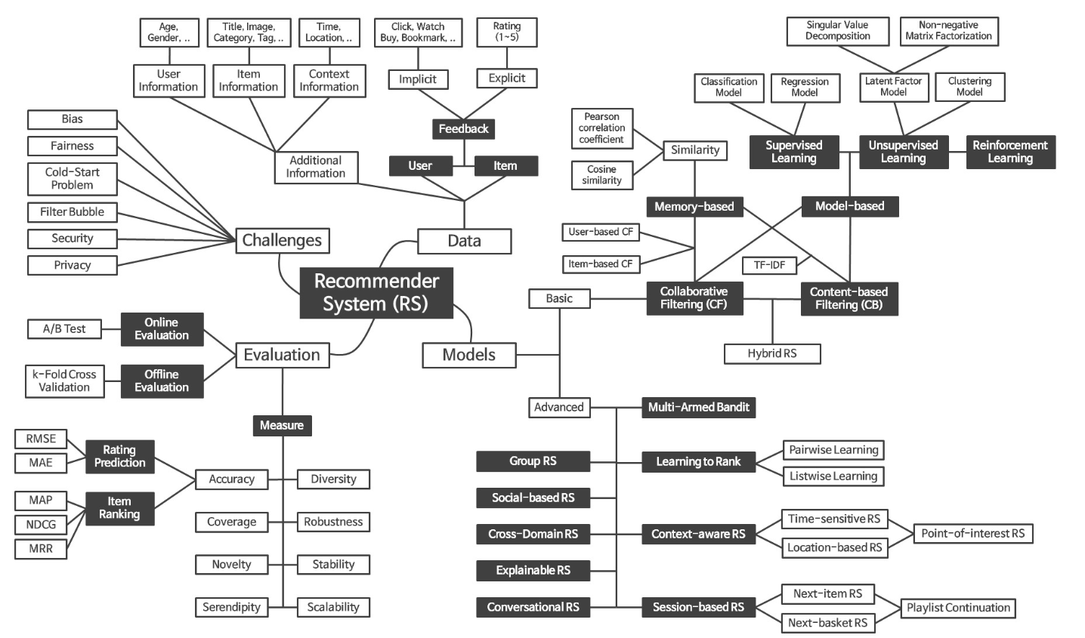
RecSys
For Further Exploration
RecSys Basics
RecSys Intro
RecSys Algo & Architecture
How to Build a RecSys
Architecting RecSys
How does Netflix recommend movies? Matrix Factorization
Machine Learning for Recommender Systems
Personalized Machine Learning
Recommender Systems: The Textbook

Slide 385
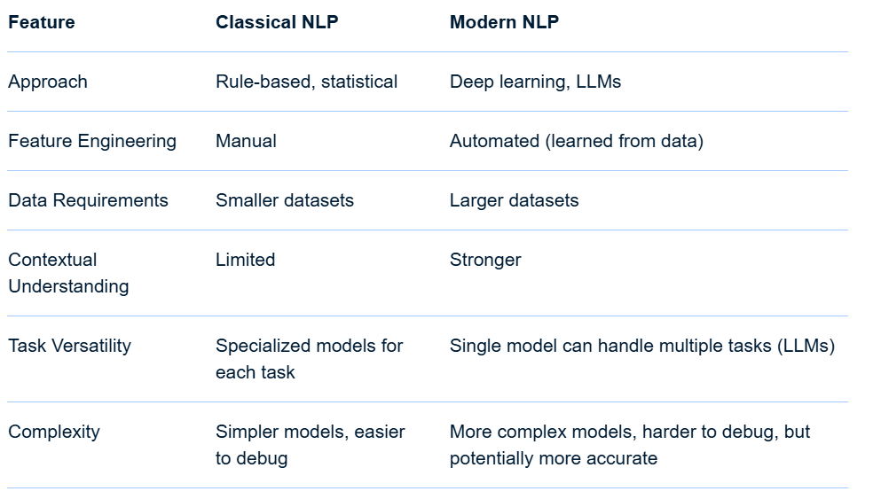
Classical vs Modern NLP
For Further Exploration
Your Guide to Natural Language Processing (NLP) Approaches: Statistical and Symbolic NLP
A short explanation of the history of the natural language models
The Evolution and Impact of Natural Language Processing (NLP) | LinkedIn

Slide 386

NLP Workflow

Slide 387
NLP Workflow
A graph ontology-based Natural Language Processing (NLP) workflow creates a structured knowledge graph from unstructured text by combining NLP techniques with a domain-specific ontology. This process allows for deeper semantic understanding beyond simple keyword extraction by modeling entities, their attributes, and their relationships.
Workflow steps
1. Text acquisition and preprocessing
This initial phase involves preparing the text data for analysis.
Data acquisition: Gather textual data from various sources, such as web pages, articles, books, social media, or other documents.
Text cleaning: Remove irrelevant information, such as HTML tags, ads, and other noise. Handle special characters and unify text formatting.
Tokenization: Split the raw text into smaller units, such as sentences and words (tokens).
Normalization: Standardize the tokens to their base form.
This typically includes:
Stemming: Reducing words to their word stem (e.g., "running" becomes "run").
Lemmatization: Reducing words to their dictionary or morphological root form (e.g., "better" becomes "good").
Stop-word removal: Filter out common words that carry little semantic meaning (e.g., "the," "is," "a").
2. Ontology definition
Before extracting information, you must define the schema or blueprint for your knowledge graph.
Domain analysis: A subject-matter expert analyzes the text to identify the key concepts (entities) and the important types of relationships that exist between them.
Class/entity definition: Define the main types of objects or concepts relevant to the domain. For example, in a medical domain, classes could be Disease, Symptom, or Drug.

Slide 388
NLP Workflow
Property definition: Define the attributes or data properties associated with each class. For example, a Drug might have a property for its brandName or dosage.
Relationship definition: Define the types of relationships (or object properties) that can exist between different classes. For example, a Drug treats a Disease, and a Patient experiences a Symptom.
3. Information extraction
This phase uses advanced NLP techniques to extract structured data from the preprocessed text.
Named Entity Recognition (NER): Identify and classify named entities in the text into predefined categories. Using the ontology as a guide, an NER model can recognize mentions of Disease or Drug (or e.g. PII data) within sentences.
Relation extraction: Identify the semantic relationships between the entities recognized in the previous step. For example, after identifying the entities "aspirin" and "headache," relation extraction would determine that "aspirin" treats "headache". This often involves a combination of rule-based, statistical, or machine learning approaches.
Co-reference resolution: Identify when different words or phrases refer to the same entity. For example, resolving that "the company" and "it" in a text both refer to "Google." This helps in consolidating nodes in the graph.
Attribute extraction: Identify and extract the specific properties associated with an entity, such as a date, location, or numerical value.
4. Graph construction
This is the central step where the extracted information is used to populate the knowledge graph.
Entity-to-node mapping: Create a node in the graph for each unique entity extracted from the text. The node is assigned a label corresponding to its class in the ontology (e.g., a node with the label Drug).
Attribute-to-property mapping: Add the extracted attributes as properties to the corresponding entity nodes. For example, adding brandName: "Aspirin" to the "aspirin" node.

Slide 389
NLP Workflow
Relationship-to-edge mapping: Create edges (relationships) between nodes based on the relationships identified during extraction. The edges are labeled with the appropriate relationship type from the ontology (e.g., an edge labeled treats connecting the "aspirin" node to the "headache" node).
Disambiguation and merging: If the same entity is mentioned in different ways (e.g., "IBM" and "International Business Machines"), the workflow must use techniques to merge these into a single, canonical node, often using unique identifiers.
5. Graph enrichment and querying
Once constructed, the knowledge graph can be further enhanced and used for sophisticated analysis.
Reasoning and inference: Apply logical rules (reasoners) defined in the ontology to infer new relationships or facts that were not explicitly stated in the text. For example, if a Drug treats a Disease, and a Disease is a Type of Condition, the system could infer that the Drug treats a Condition.
Semantic search: Leverage the graph structure to enable more advanced, context-aware search queries. Instead of keyword matching, users can query based on relationships, such as "find all drugs that treat a disease experienced by patients over 50".
Visualization: Visualize the resulting graph to help users explore and understand the complex relationships and insights contained within the data.

Slide 390
NLP Workflow
Example: Building a knowledge graph of news articles
Text acquisition: Gather news articles about financial markets.
Ontology definition: Define entities like Company, Person, StockMarketIndex, and relationships like Acquires, Announces, and Affects.
Information extraction:
NER: Identify entities like "Microsoft" (Company) and "Dow Jones" (StockMarketIndex).
Relation extraction: Discover that "Microsoft acquires GitHub" creates an Acquires relationship.
Graph construction:
Create nodes for Microsoft and GitHub.
Add an edge labeled Acquires from the Microsoft node to the GitHub node.
Querying: A user could now ask a query like "show me all companies that have acquired another company in the last year" and the graph could provide a direct answer.

Slide 391
Applications and Further Resources related to NLP
Natural Language Processing (NLP) Tutorial | GeeksforGeeks
Natural Language Processing: Data Analysis Like Never Before
Natural Language Processing: Concepts and Workflow
Taming Text
NLP with Python and Spacy
Mastering-spaCy
Practical NLP
Machine Learning for Text
Speech and Language Processing
Graph-based Natural Language Processing and Information Retrieval
Representation Learning for Natural Language Processing
Sentiment Analysis
7 Applications of Deep Learning for Natural Language Processing
How to create a Spell Checker with NLP?
NLP: Building a Grammatical Error Correction mode
Open-Resume
Resume-Matcher
Text to Speech Models
Crafting conversational AI: Speech-to-text (STT)
Azure AI services for Call Center Overview
Contact centers with Azure Communication Services
Call Center Telephony Integration
Call-Center-AI
Amazon Q in Connect
Contact Center as a Service | Google Cloud

Slide 392

Classical vs Modern Computer Vision
For Further Exploration
Deep Learning Vs Traditional Computer Vision

Slide 393

Computer Vision Workflow
For Further Exploration-
Workflow of Computer Vision: From Data Acquisition to Decision Making
Understanding the Key Steps in a Computer Vision Project

Slide 394
Applications and Further Resources Related to Computer Vision
Computer Vision Tutorial | GeeksforGeeks
9 Applications of Deep Learning for Computer Vision
Foundations of Computer Vision
15 Computer Visions Projects You Can Do Right Now
Image Processing: Techniques, Types, & Applications
Hands-On-Image-Processing-with-Python
Why you should care about classical approaches to computer vision
Concepts in Classical Computer Vision | Artificial Intelligence in Plain English
Image representation in Computer Vision | by Sumitkrsharma | Medium
Computer Vision Lectures
Feature Extraction and IP in Computer Vision
Classical and Modern Techniques of Computer Vision
Image Processing, Analysis, and Machine Vision
CV Lecture Notes
Notes on Multi-View Geometry in Computer Vision
Deep Learning Applications for Computer Vision | Serokell
Transformers-for-NLP-and-Computer-Vision
Computer Vision and Deep Learning Courses - CVDL Master
Intelligent-Document-Processing-with-AWS-AI-ML
Tesseract-OCR
Identity Management with Biometrics
Hands-On-Vision-and-Behavior-for-Self-Driving-Cars
Applied-Deep-Learning-and-Computer-Vision-for-Self-Driving-Cars
Drone Development from Concept to Flight
Robotics for Programmers
Computational Principles of Mobile Robotics
Computer-Vision-Guide

Slide 395

Language Modelling using Embeddings

Slide 396

Language Modelling using Embeddings

Slide 397
Language Modelling using Embeddings
Computational challenge and common approximations
For a very large vocabulary, computing the sum over all possible words in the denominator is extremely computationally expensive. To solve this, models use approximation methods during training:
Hierarchical Softmax: Replaces the flat softmax layer with a hierarchical, tree-like structure. This reduces the computation from normalizing over the entire vocabulary to only following a path of nodes in the tree, which significantly speeds up training.
Negative Sampling: Replaces the multiclass classification problem with a set of binary classification problems. Instead of calculating a probability for all words, the model is trained to distinguish the correct next word from a small number of randomly sampled "negative" (incorrect) words.
Training with Cross-Entropy Loss
The model is trained to minimize the difference between its predicted probability distribution and the true distribution of the data, which is effectively a one-hot encoded vector where the correct word has a probability of 1. This is done using Cross-Entropy Loss. Minimizing this loss is mathematically equivalent to maximizing the log-likelihood of the correct word. For a single-token prediction, the cross-entropy loss is:
L=-log (P(w_{t}|c))
Minimizing this loss encourages the model to assign high probabilities to the correct next word (w_{t}).

Slide 398
Language Modelling using Embeddings
How embeddings enable this calculation
Embeddings are the key to making this calculation possible and meaningful, as they allow the model to operate on semantic relationships rather than simple word co-occurrence counts.
Contextual representation: The model uses embeddings to create the hidden state vector (h). For example, in a transformer model, the embeddings of the preceding words are processed through multiple layers to produce a final hidden state that represents the context.
Meaningful scoring: The dot product compares the context vector (h) with the embedding of every possible next word in the vocabulary. Words with similar meanings or that are appropriate for the context will have embedding vectors aligned with (h), resulting in a high dot product and, therefore, a high probability.
Vector mathematics: By representing words as dense vectors, the model can use efficient matrix operations (like dot products) to perform complex comparisons. This is a vast improvement over older methods like n-gram models, which rely on storing and counting fixed-length word sequences.
For Further Exploration
What are Language Models in NLP? - GeeksforGeeks

Slide 399
LLM(Large Language Models)
🧠 1. Foundations of LLMs
1.1 What is an LLM
An LLM (Large Language Model) is a neural network trained on massive amounts of text to understand and generate human-like language. It predicts the next token (word, subword, or character) given previous context.
Core idea: “Predict the next word.”
Example: GPT, PaLM, Claude, LLaMA, Gemini.
🧩 2. Mathematical Core: Language Modeling
2.1 Probability Modeling
Language modeling using Embeddings described in some previous slides.
2.2 Tokenization
Before processing, text is converted into tokens (subword units).
Byte Pair Encoding (BPE), WordPiece, SentencePiece.
Helps handle unknown words, rare words, and multiple languages.
⚙️ 3. Transformer Architecture (Backbone of LLMs)
3.1 Key Components
Embedding layer – converts tokens into continuous vectors.
Positional encoding – adds information about token order.
Attention mechanism – computes relevance between tokens.
Feed-forward network – transforms attention outputs nonlinearly.
Layer normalization & residual connections – stabilize training.

Slide 400
LLM(Large Language Models)
3.2 Self-Attention
At each position, the model attends to every other position to decide what’s important.
Enables context-aware understanding.
🧰 4. Training Paradigm
4.1 Pretraining
LLMs are trained on diverse internet-scale datasets using the next token prediction (causal LM) objective
Data sources: books, Wikipedia, code, forums, papers.
Massive compute: thousands of GPUs over weeks.
4.2 Fine-tuning
After pretraining, models are adapted for specific tasks:
Supervised Fine-Tuning (SFT) – on curated labeled datasets.
Instruction Tuning – train to follow human-written prompts.
Domain adaptation – finance, law, code, etc.
4.3 Reinforcement Learning from Human Feedback (RLHF)
A pipeline to align models with human preferences:
Collect prompt–response pairs ranked by humans.
Train a reward model.
Optimize LLM via PPO (Proximal Policy Optimization) to maximize reward.

Slide 401
LLM(Large Language Models)
💬 5. Context and Memory
5.1 Context Window
The number of tokens the model can "see" at once (e.g., 4K–1M tokens).
Larger context ⇒ better reasoning, multi-document understanding.
5.2 Attention Mechanisms for Long Context
Techniques:
FlashAttention
Sparse Attention
Rotary Positional Embedding (RoPE)
Transformer-XL, Reformer, Longformer – handle longer sequences.
🔍 6. Emergent Abilities
When scaled up (parameters, data, compute), LLMs exhibit:
In-context learning: can follow instructions from few examples in the prompt.
Chain-of-thought reasoning: can explain intermediate steps.
Translation, summarization, code generation, reasoning – emerge spontaneously.
🧮 7. Scaling Laws
Empirical laws discovered by OpenAI & DeepMind.
Scaling improves performance predictably — but with diminishing returns.

Slide 402
LLM(Large Language Models)
🧱 8. Architecture Variants
Model Type Objective Examples
Causal LM (Decoder-only) Next-token prediction GPT, LLaMA, Mistral
Masked LM (Encoder-only) Masked token prediction BERT, RoBERTa
Seq2Seq (Encoder–Decoder) Conditional generation T5, FLAN, BART
Mixture of Experts (MoE) Sparse activation of subnetworks Mixtral, Switch Transformer
🧭 9. Evaluation and Benchmarks
9.1 Intrinsic metrics
Perplexity – measures predictive uncertainty.
Loss curves – for convergence and scaling.
9.2 Extrinsic metrics
Benchmarks like MMLU, BIG-bench, HELM, GSM8K, ARC.
Human evals for fluency, factuality, alignment.
🧩 10. Retrieval and Tool Use
Modern LLMs are often augmented with external systems:
Retrieval-Augmented Generation (RAG) – combine LLM + database/search.
Tool use – call APIs, calculators, or code interpreters.
Agents – orchestrate multi-step reasoning using planning and memory.

Slide 403
LLM(Large Language Models)
⚖️ 11. Alignment, Safety, and Ethics
Key issues:
Hallucination: generating plausible but false info.
Bias: reflecting social/political bias in data.
Privacy: leaking sensitive training data.
Security: prompt injection, data poisoning.
Solutions:
RLHF, RLAIF (AI feedback), Constitutional AI.
Red-teaming and continuous alignment tuning.
🚀 12. Future Trends
Multimodal LLMs: text + vision + audio + video. (e.g., GPT-4V, Gemini 1.5 Pro)
Long-context models: up to millions of tokens.
Smaller, efficient models: quantization, LoRA, distillation.
Reasoning-focused LLMs: symbolic–neural hybrids, self-reflection.
Autonomous agents: self-planning, memory, goal execution.
Mixture-of-Experts (MoE): A more recent architecture that uses multiple smaller models (experts) to handle different tasks, which can improve efficiency and performance. Llama 4 is an example of this architecture.

Slide 404
LLM(Large Language Models)
🧠 Summary Map
Concept Description
Tokenization Converts text to model-readable units
Transformer Architecture enabling contextual attention
Self-Attention Core mechanism for relational understanding
Pretraining Massive unsupervised learning
Fine-tuning & RLHF Alignment with human instructions
Emergent abilities Reasoning, few-shot learning
Scaling laws Predict performance with data/compute
RAG & Tools Extend model with external knowledge
Safety & Ethics Mitigate bias, hallucination, misuse

Slide 405

LLM (Models)

Slide 406

LLM (Models)

Slide 407

LLM (Models)

Slide 408

LLM (Models)

Slide 409
LLM (Models)

Slide 410

LLM (Models)

Slide 411
Encoding Strategies in LLMs
Encoding strategies in LLMs involve transforming raw text into a format the model can understand, using techniques like tokenization (e.g., BPE) to break down text into smaller units, positional encoding to add information about token order, and embedding to represent tokens as numerical vectors. Advanced methods also include encoding different data types like graphs, restructuring parameters for efficiency, and creating a contextual understanding of dependencies.
Common encoding strategies
Tokenization: Splitting text into smaller units called tokens.Techniques like Byte Pair Encoding (BPE) merge frequent character pairs to create a smaller, more efficient vocabulary, breaking down rare words into subwords. Word boundary tokens are added to correctly reconstruct the original words during decoding.
Embedding: Converting tokens into numerical vectors (embeddings) that capture semantic meaning.These vectors are used to represent the input data in a way the model can process.
Positional Encoding: Adding information about the position of each token in a sequence. This is crucial because the self-attention mechanism in transformers, which are common in LLMs, does not inherently process positional information.
Advanced and specialized encoding
Contextual Compression Encoding (CCE): Aims to make models more efficient by identifying and removing redundant parameter clusters while preserving essential linguistic relationships.
Contextually Structured Token Dependency Encoding: Refines token interactions by explicitly encoding syntactic and semantic dependencies, leading to more coherent text generation.
Graph Encoding: For graph-related tasks, different strategies are used to encode the graph structure for the LLM. For example, an incident encoder can be better than an adjacency encoder for tasks where information about node connections is important.
One-Hot Encoding: While a more traditional method for categorical variables, it's a fundamental concept in encoding. It represents each category as a binary vector with a (1) for the present category and 0s elsewhere.

Slide 412
Decoding Strategies in LLMs
Top-K sampling introduces randomness by choosing from the top K most probable words, producing more creative and natural text, while Beam Search deterministically explores multiple likely sequences and selects the highest-scoring one, resulting in more coherent and precise text. Beam Search is generally better for tasks requiring high accuracy, such as language translation, whereas Top-K sampling excels in creative text generation like story writing or in chatbots needing variation and coherence.
Top-K Sampling
How it works:
After a language model generates a probability distribution for the next token (word), Top-K sampling filters out all but the K most probable tokens and then randomly selects a token from this reduced set, according to its relative probability. Strengths:
Creativity and Diversity: It avoids repetitive or predictable text by allowing less likely but still plausible options to be chosen, leading to more natural-sounding outputs.
Efficiency: It's a one-pass sampling method, making it efficient for real-time applications.
Weaknesses:
Fixed K: The number of considered options is fixed, which can lead to selecting very unlikely words if the probability distribution is very sharp.
Repetitive potential: Although generally more creative than deterministic methods, if K is too low, it can still produce text that is too predictable, according to Aussie AI.
Beam Search
How it works: At each step, Beam Search maintains a fixed number of the most promising partial sequences (the "beam"), expanding each by one token and keeping only the top-scoring sequences to form the new beam.
Strengths:
High Coherence and Accuracy: By evaluating multiple sequences simultaneously, Beam Search ensures the output is contextually appropriate and accurate.

Slide 413
Decoding Strategies in LLMs
Flexibility: The beam width is a hyperparameter that can be adjusted to trade off between computational cost and output quality.
Weaknesses:
Deterministic: Can lead to bland or repetitive text by favoring high-probability sequences and failing to explore potentially valuable but initially less likely continuations.
Computational Cost: Expanding the beam to a higher width increases the search space, leading to higher computational demands, notes Uncodemy.
When to Use Which
Use Beam Search for: Tasks that require precision and factual accuracy, like machine translation or for generating content where repetitive phrasing must be minimized.
Use Top-K Sampling for: Creative writing, chatbots, or other applications where a balance between coherence and variety is desired, leading to more human-like and engaging output.
For Further Exploration-
Decoding Strategies in Large Language Models – Maxime Labonne

Slide 414
LLM Training, Fine Tuning And Alignment
LLM training involves three main methods: Pretraining, using massive amounts of unlabeled text to build a general understanding of language; Fine-tuning, adapting the pre-trained model to specific tasks using labeled data and supervised learning; and Reinforcement Learning (RL), a subsequent step to align the model's behavior with desired outcomes through trial-and-error feedback. These methods, often combined with initial data processing and ongoing evaluation, create capable and specialized LLMs.
1. Pretraining
What it is: The initial, foundational stage where a model is trained on vast, diverse, and unlabeled text datasets from the internet, books, and other sources.
Goal: To develop a broad, generalized understanding of language, grammar, semantics, and world knowledge.
Method: Uses self-supervised learning, where the model predicts missing words or the next word in a sequence without human-provided labels.
Key aspect: Requires significant computational power and engineering effort to process massive amounts of data and create tokens (smaller units of text).
2. Fine-tuning
What it is: A specialized adaptation of a pre-trained model to perform well on specific tasks or domains.
Goal: To tailor the model's knowledge and capabilities for targeted applications, such as customer service, content generation, or machine translation.
Method: Involves supervised learning with labeled datasets that guide the model toward specific, correct outputs.
Key aspect: Allows the model to learn domain-specific patterns and nuances for more precise and context-aware responses
3. Reinforcement Learning (RL) & Alignment
What it is: A later stage that refines the model's behavior and encourages helpfulness while discouraging harmful or biased outputs.
Goal: To align the model's behavior with human preferences and ensure it acts as a more desirable assistant.
Method: Based on trial and error, where the agent (the model) receives rewards for good actions and penalties for poor ones, adjusting its policy accordingly.
Key aspect: Reinforces desirable behaviors and helps the model achieve more beneficial outcomes.

Slide 415
LLM Training, Fine Tuning And Alignment
Supporting Steps & Processes
Data Processing: Before training, raw text data is cleaned, pre-processed, and tokenized into machine-readable units.
Evaluation: After fine-tuning, the model's performance is continuously evaluated using benchmarks to ensure it meets necessary criteria for deployment and performs well across different contexts.
Iterative Improvement: The entire training and evaluation process is often iterative, with models undergoing multiple stages to continuously improve their usefulness and alignment.
Pre-Training
Pre-training techniques for Large Language Models (LLMs) primarily involve unsupervised learning on massive text datasets to teach foundational language skills like grammar, syntax, and world knowledge. Key methods include next token prediction, used by models like GPT, and masked language modeling, used by models like BERT, where the model either predicts the next word in a sequence or fills in missing words. Techniques also involve using large-scale data sources like the internet, books, and Wikipedia, and employing optimizations like weight decay, gradient clipping, and learning rate schedulers to stabilize training.
Pre-training techniques
Next Token Prediction: This is the most common technique for generative LLMs. The model is trained to predict the next word or token in a sequence, given the preceding words. This self-supervised task allows the model to learn context and relationships between words.
Masked Language Modeling (MLM): This technique, famously used in BERT, involves randomly masking certain words in a sentence and training the model to predict the original masked words. This helps the model learn to understand the context from both directions (left and right of the masked word).
Data Collection and Preparation: Pre-training relies on vast, diverse datasets.
Common sources include:
Web crawl data (e.g., Common Crawl)
Books (e.g., BookCorpus, Project Gutenberg)
Wikipedia and knowledge bases

Slide 416
LLM Training, Fine Tuning And Alignment
Code repositories (e.g., GitHub) and public forums (e.g., Reddit)
Training Stability: Techniques are used to ensure the model trains effectively and doesn't become unstable:
Weight Decay: A regularization technique to prevent weights from becoming too large.
Gradient Clipping: Caps the magnitude of gradients to prevent large updates from disrupting training.
Learning Rate Scheduler: Adjusts the learning rate during training, often following a cosine curve to gradually decrease it.
Batch Size: A careful balance is struck between batch size and computational resources to ensure efficient convergence.
The outcome of pre-training
Foundation Model: The result of pre-training is a "base" or "foundation" model that has a strong grasp of language but is not yet specialized for specific tasks like following instructions.
Fine-tuning: This base model is the starting point for fine-tuning, a subsequent stage where the model is further trained on smaller, task-specific datasets to make it helpful and safe for applications like chatbots.
Fine Tuning Techniques
Fine-tuning LLMs involves retraining a pre-trained model on a smaller, task-specific dataset to improve its performance for a particular task or domain. Key techniques include full fine-tuning, which retrains the entire model; Parameter-Efficient Fine-Tuning (PEFT), which updates only a small number of parameters to save on computation; and prompt tuning, which adds trainable "soft prompts" to the input without changing model weights. Other methods involve adding adapter layers or using reinforcement learning with human feedback (RLHF).
Parameter-Efficient Fine-Tuning (PEFT)
Adapter layers:
Inserts new layers into the existing model and only trains these added layers, keeping the original parameters frozen.
LoRA (Low-Rank Adaptation):
A PEFT method that injects low-rank matrices into the model's layers. This is more efficient than full fine-tuning and can achieve comparable results.

Slide 417
LLM Training, Fine Tuning And Alignment
QLoRA:
An even more efficient version of LoRA that further optimizes by quantizing the low-rank parameters.
Other fine-tuning techniques
Full Fine-tuning:
Updates every single parameter in the pre-trained model. This is highly effective but also the most computationally expensive method.
Prompt Tuning:
Modifies the input by adding a set of "soft prompts" (trainable embeddings) to the start of the input prompt. The model's parameters are not changed.
Reinforcement Learning from Human Feedback (RLHF):
Uses human feedback to further align the model's behavior with desired outcomes, often used to improve helpfulness and safety.
Multitask Fine-tuning:
Trains the model on multiple tasks simultaneously, which can improve generalization and efficiency.
LLM Alignment
LLM alignment is the process of ensuring a large language model (LLM) generates outputs that are helpful, harmless, and consistent with human values, goals, and ethical standards. It bridges the gap between an LLM's ability to predict text and human expectations for safe, truthful, and useful responses, especially when dealing with complex or nuanced requests. Techniques like supervised fine-tuning and reinforcement learning from human feedback (RLHF) are used to achieve this alignment by fine-tuning the model based on user feedback and preferences.
Why is alignment necessary?
Human values and ethics:
LLMs trained on vast datasets can inadvertently learn biases or produce harmful content. Alignment aims to prevent this by ensuring the model's behavior aligns with ethical guidelines.

Slide 418
LLM Training, Fine Tuning And Alignment
Goal-oriented assistance:
LLMs are often used to perform tasks. Alignment ensures the model doesn't just produce a technically correct but unhelpful or nonsensical answer, but one that is useful and meets the user's underlying intent.
Safety and predictability:
Alignment helps prevent risky outcomes, such as a model providing instructions for a dangerous activity instead of refusing the request.
How is it done?
Supervised Fine-Tuning (SFT):
The model is trained on a curated dataset of prompts and desired, high-quality responses.
Reinforcement Learning from Human Feedback (RLHF):
A "reward model" is trained to predict how much humans would prefer a given response.
The LLM is then fine-tuned using this reward model to generate outputs that score highly on human preference.
Direct Preference Optimization (DPO):
A more recent method that combines supervised fine-tuning and preference optimization into a single step, often by using an odds ratio to train the model on both preferred and rejected responses.
Prompt Engineering:
Providing clear, explicit instructions in the prompt to guide the model's behavior on a specific query.

Slide 419
LLM Resources
How Large Language Models Work. From zero to ChatGPT(Highly Recommended Article to read)
Unveiling the Intuition behind LLMs and Gen AI
A Gentle Introduction to LLM, Part 1
A Gentle Introduction to LLM, Part 2
6 Core LLM Architectures
LLM Architecture
Exploring Multimodal Large Language Models
Absolute Zero Training
Developing an LLM: Building, Training, Finetuning
Train Your Own LLM – Tutorial
What is LLM Pre-Training?
Fine-tuning Large Language Models (LLMs) | w/ Example Code
Fine-Tuning LLMs - The Complete Guide - 2-hours Course
Training & Fine-Tuning LLMs: Techniques
LLMs-from-scratch
Awesome-LLM-Books
Domain-Specific-Small-Language-Models
A Comprehensive Survey of LLM Alignment Techniques

Slide 420
GenAI
🧠 1. What is Generative AI?
Generative AI (GenAI) refers to AI systems that create new content — text, images, code, music, video, 3D models, or designs — that resembles human-made or real-world data.
💡 Core Idea:
Learn the underlying probability distribution of data P(x) and then sample new data points x′ from it. So, instead of just classifying or predicting labels (as in traditional AI), GenAI creates.
🧩 2. Mathematical and Probabilistic Foundations
2.1 Data Distribution Learning
Generative models aim to learn
Pθ(x)≈Pdata(x).
2.2 Latent Variables
They often model data using latent variables
z:P(x)=∫P(x∣z)P(z)dz
where z captures hidden structure or abstract features (e.g., “style,” “pose,” “tone”).
2.3 Sampling
Once trained, new samples are generated by:
Sampling
z∼P(z)
Generating
x′∼P(x∣z)

Slide 421

GenAI
⚙️ 3. Key Families of Generative Models

Slide 422

GenAI
⚙️ 3. Key Families of Generative Models

Slide 423
GenAI
🧱 4. Core Building Blocks
4.1 Neural Architectures
Transformers → dominant for text, multimodal models.
U-Net → backbone of diffusion models (for image generation).
CNNs & RNNs → still used in audio/video models.
4.2 Latent Space
Encodes high-level concepts (e.g., “dog,” “sunset”) in numeric form.
Enables interpolation, editing, and style transfer.
4.3 Conditioning
GenAI often generates conditional outputs:
P(x∣c) where c could be:
A prompt (text)
A class label
Another image or sound
Example: “Generate an image of a futuristic city at night.”
🧮 5. Training Paradigms
5.1 Self-Supervised Learning
Uses large unlabeled datasets by predicting missing or masked parts:
Masked Language Modeling (BERT)
Next-token prediction (GPT)
Masked Autoencoders (MAE) for images
5.2 Adversarial Training (GANs)
Two networks compete:
Generator → creates fake data.
Discriminator → distinguishes real vs fake.
They reach an equilibrium where fakes become indistinguishable from real data.

Slide 424
GenAI
5.3 Diffusion Training
Model learns to reverse a noise-adding process.
Trained to denoise images step-by-step.
📚 6. Generative AI Pipeline (Universal Workflow)
Data collection and preprocessing
Model design (Transformer, GAN, VAE, Diffusion)
Training (unsupervised/self-supervised)
Fine-tuning or alignment (domain-specific or RLHF)
Sampling/inference (prompt → generation)
Post-processing (filtering, ranking, style control)
🔍 7. GenAI Modalities
Modality Example Models Description
Text GPT, Claude, Gemini Natural language generation
Code Codex, CodeLLaMA Code synthesis and completion
Image DALL·E, Midjourney, SDXL Text-to-image
Audio Jukebox, MusicLM Music, voice, sound generation
Video Runway Gen-2, Sora Text-to-video
3D / CAD DreamFusion, Point-E 3D object synthesis
Multimodal GPT-4V, Gemini, Claude 3 Opus Unified text + image + audio understanding
🧠 8. Prompt Engineering & Control
GenAI outputs depend heavily on conditioning inputs (prompts).
Techniques:
Prompt tuning: embedding optimization for specific tasks.
Prefix tuning / soft prompts: learnable tokens prepended to inputs.
Instruction tuning: training on prompt–response pairs.
ControlNet / adapters: external conditioning modules for structure and pose control in images.

Slide 425
GenAI
⚖️ 9. Evaluation Metrics
Quantitative
Perplexity – for text generation.
FID (Fréchet Inception Distance) – for image realism.
BLEU / ROUGE / METEOR – for text similarity.
CLIP score – for text-image alignment.
Qualitative
Human evaluations: realism, coherence, creativity, factuality.
🤖 10. Alignment, Ethics & Safety
10.1 Key Risks
Hallucination – plausible but false outputs.
Bias & Fairness – reproduction of social or cultural bias.
Deepfakes & misinformation
Copyright and data privacy issues
Environmental impact (training energy cost)
10.2 Alignment Techniques
RLHF (Reinforcement Learning from Human Feedback)
Constitutional AI (rule-based self-alignment)
RLAIF (AI Feedback)
Red-teaming and safety fine-tuning
🚀 11. Applications by Sector
Sector GenAI Use Cases
Software & IT Code generation, documentation
Healthcare Drug discovery, synthetic data
Finance Report generation, scenario simulation
Media & Design Art, advertising, video content

Slide 426
GenAI
Sector GenAI Use Cases
Education Tutoring, adaptive learning
Manufacturing CAD design, defect simulation
Legal & Compliance Contract summarization, policy drafting
🧩 12. Advanced and Emerging Concepts
12.1 Multimodal Fusion
Combine different sensory inputs (text + vision + sound) into a single model.
12.2 Agentic Systems
GenAI models that can plan, reason, and act autonomously:
Tool use (search, code execution)
Memory & state tracking
Goal-directed behavior
12.3 Personalization
Fine-tuning on user-specific data to create personalized AI assistants.
12.4 Efficient Fine-tuning
LoRA (Low-Rank Adaptation)
Adapters
Prompt-based tuning
Reduce compute while adapting models.
12.5 Synthetic Data Generation
Generate artificial data for training other models — essential for privacy and rare cases.
📈 13. GenAI System Architecture (High-level)
Typical stack:
Data layer → collection + preprocessing + storage
Model layer → LLM / Diffusion / GAN
Alignment layer → RLHF, safety filters

Slide 427
GenAI
Retrieval & Tool layer → RAG, API connectors
Application layer → chatbots, copilots, creative tools
Monitoring layer → safety, observability, drift detection
🌍 14. Industry Ecosystem
Category Examples
Foundation Models GPT, Claude, Gemini, LLaMA, Mistral
Image Models DALL·E, Midjourney, Stable Diffusion
Video Models Runway Gen-2, Sora
Audio Models MusicGen, AudioLM
Open-source Ecosystem Hugging Face, Stability AI, EleutherAI
Toolkits LangChain, LlamaIndex, Weaviate, Pinecone
🔮 15. Future of GenAI
Truly multimodal agents (text + vision + action).
Self-improving AIs — feedback loops for continuous learning.
Model–tool symbiosis — AI reasoning + external computation.
Ethical & legal frameworks for synthetic content.
Neuro-symbolic hybrids — logic + deep learning fusion.
Federated & edge GenAI — privacy-preserving models.
🧭 Summary Table
Concept Description
Generative modeling Learning data distributions to create new data
Latent space Encoded abstract representation of features
Diffusion & GANs Core image/video generative architectures
LLMs Text and code generation backbones
Training (self-supervised) Learning from unlabeled data
Alignment (RLHF) Making models follow human values

Slide 428
GenAI
Concept Description
Multimodality Combining text, vision, sound, and motion
Evaluation & ethics Measuring realism, safety, bias
Applications Cross-domain creative and analytical systems
GenAI and Joint Probability Distributions
Joint probability distributions are the foundation of generative AI because they model the likelihood of all variables in a dataset occurring together, allowing the model to learn the underlying structure of the data. By estimating this joint probability, a generative AI model can then sample from it to create new, realistic data instances (like text, images, or music) that share the same statistical properties as the training data.
How it works:
Learning the Data Distribution: A generative AI model is trained on a dataset and learns the joint probability distribution of that data, represented as P(X) or P(X,Y). This distribution captures how different features or variables in the data are related to each other.
Modeling the Data Structure: Instead of just predicting a label for an input (like in a discriminative model), a generative model aims to understand the entire data generation process. It learns how data points are formed, often by decomposing the joint distribution into a series of conditional probabilities, such as P(x_{i}|x_{1}……x_{i-1})
Generating New Data: Once the model has learned the joint distribution and its conditional components, it can generate new data. This involves a sequential process: The model samples from the learned distribution to create the first data point or feature. It then uses the learned conditional probabilities to generate the next feature, taking into account the already generated features. This process continues until a complete, new data instance is created.

Slide 429
GenAI
GenAI and Joint Probability Distributions
How is Generative AI different from other Machine Learning techniques?*
Discriminative Models: These models learn the relationship between the features
Generative AI, often hailed as the magician of the digital era, possesses a profound ability to create new content,
ranging from images and music to text
Example: If a generative AI model is trained on images of faces, it will learn the joint probability distribution of
pixel values and features that constitute a realistic face. After learning this distribution, it can generate novel
faces that are statistically similar to the training data, even if they are completely new and unique.
In essence, the joint probability distribution acts as the "blueprint" that generative AI models use to understand
and then replicate complex data patterns, enabling them to create new content.
For Further Exploration-
Probability: Joint vs. Marginal vs. Conditional - GeeksforGeeks
Enigma of Generative AI: A Journey through Conditional and Joint Probability Distributions
Let's learn Everything about Generative AI together.
Generative AI Models Explained

Slide 430


GenAI
GenAI vs LLM

Slide 431
GenAI Models
For Further Exploration-
Generative models vs Discriminative models for Deep Learning.
Generative AI Models Types, Training and Evaluation Strategy
Generative AI Tutorial GeeksforGeeks | Restackio
Generative AI: Advantages & Disadvantages | LinkedIn
How to choose the right Gen AI model | Google Cloud Blog
GAN, Diffusion, & Autoencoder Models
(Variational) AutoEncoders
Likelihood-based Generative Models I:
A Beginner's Guide to Restricted Boltzmann Machines (RBMs)
A Generative Restricted Boltzmann Machine
Autoregressive Diffusion Models (Machine Learning Research Paper Explained)
Generative Deep Learning
Text-to-Image Generation with Databricks and Generative AI
U-Net – Wikipedia
Denoising Diffusion Model Implementation from Scratch
Understanding Vision-Language Models with CLIP: A Hands-On Guide
Generative-AI-with-Python-and-PyTorch

Slide 432

RAG
For Further Exploration-
8 Retrieval Augmented Generation (RAG) Architectures You Should Know in 2025
Advanced RAG Techniques | DataCamp
An Easy Introduction to Multimodal Retrieval-Augmented Generation
Chunking Strategies for RAG in Generative AI
Augment LLMs with RAGs or Fine-Tuning | Microsoft Learn
RAG Cheaheet
RAG Vs. Fine Tuning: Which One Should You Choose?

Slide 433
LLMs and GenAI Resources
For Further Exploration –
What are Foundation Models?
What is Fine-Tuning LLM? Methods & Step-by-Step Guide in 2025
AI model fine-tuning concepts | Microsoft Learn
Transfer Learning vs Fine Tuning LLMs: Differences
What are the most effective ways to choose a pre-trained model for your deep learning task?
What are the best practices for choosing a pre-trained model for transfer learning?
Influence response generation with inference parameters - Amazon Bedrock
The Training Process of Foundation Models and Innovations in Optimization | LinkedIn
Prepare data for Foundation Model Fine-tuning - Azure Databricks | Microsoft Learn
Methods for tuning foundation models - IBM Documentation
Techniques for customising Foundation Models | by Aruna Pattam | Medium
What are foundation model evaluations? - Amazon SageMaker AI
Evaluate, compare, and select the best foundation models for your use case in Amazon Bedrock (preview) | AWS News Blog
KPIs for gen AI: Measuring your AI success | Google Cloud Blog
8 metrics to measure GenAI’s performance and business value | TechTarget
Pretrain-Vision-and-Large-Language-Models-in-Python
Small Language Models: A Guide With Examples
Small language models emerge for domain-specific use cases
Building-Domain-Specific-Language-Models
An Easy Introduction to Multimodal Retrieval-Augmented Generation
A comparative study of retrieval-based and generative-based chatbots using Deep Learning and Machine Learning
The Panoramic Guide to Diffusion Models in Machine Learning
A Visual Guide to Mixture of Experts (MoE)
Multimodality and Large Multimodal Models (LMMs)
Announcing the AWS Well-Architected Generative AI Lens | AWS Architecture Blog
GenAIBook: "Generative AI in Action" book's code repository
Multimodal Models and Fusion - A Complete Guide | Medium
Awesome-Generative-AI-Guide

Slide 434
NeuroSymbolic AI
Neuro-symbolic AI combines neural networks with symbolic reasoning techniques to create more robust and capable AI systems. It leverages the strengths of both approaches: the pattern recognition and learning capabilities of neural networks, and the ability of symbolic AI to reason and represent knowledge. This hybrid approach aims to improve AI's accuracy, explainability, and ability to handle complex, real-world problems.
Here's a more detailed explanation:
Neural Networks: These are inspired by the human brain and are used for tasks like image recognition, natural language processing, and prediction. They excel at learning complex patterns from data, but can struggle with reasoning and representing knowledge explicitly.
Symbolic AI: This approach relies on logic, rules, and knowledge representations to reason and solve problems. It can handle abstract concepts and generate explanations for its decisions, but may struggle with learning from unstructured data.
Neuro-symbolic AI: By combining these two approaches, neuro-symbolic AI aims to create systems that can:
Learn from data: Neural networks can be used to extract patterns and features from data.
Reason logically: Symbolic AI can be used to represent knowledge and apply rules to reason about the extracted patterns.
Explain their decisions: The use of symbolic reasoning makes the AI's decision-making process more transparent and understandable.
Generalize to new situations: By combining learning and reasoning, neuro-symbolic AI can potentially generalize better to new and unseen data.
Benefits of Neuro-symbolic AI:
Improved accuracy and reliability:By combining the strengths of both neural and symbolic AI, neuro-symbolic systems can achieve higher accuracy and reliability.
Enhanced explainability: Symbolic reasoning makes it easier to understand how neuro-symbolic systems arrive at their decisions.
Better generalizability: The ability to reason and represent knowledge allows neuro-symbolic systems to generalize better to new situations.
Ability to handle complex problems :Neuro-symbolic AI can tackle complex problems that require both pattern recognition and logical reasoning.
Examples of Neuro-symbolic AI applications:
Robotics:Neuro-symbolic AI can be used to develop robots that can learn from experience and also reason about their environment.
Natural language processing :Neuro-symbolic AI can be used to create more robust and accurate natural language processing systems that can understand and generate human-like language.
Medical diagnosis: Neuro-symbolic AI can be used to assist doctors in diagnosing diseases by integrating medical knowledge with patient data.
Knowledge graphs: Neuro-symbolic AI can be used to build and maintain knowledge graphs, which are used to represent and reason about complex relationships between concepts.
For Further Exploration –
Neuro-symbolic AI
Neuro-Symbolic-AI: Neuro-Symbolic AI

Slide 435

Agentic AI(Internet of AI Agents)
Agentic AI is one of the most important emerging paradigms in artificial intelligence today, especially as we move beyond passive LLMs (like chatbots) toward autonomous, goal-driven AI agents that can reason, plan, act, and learn continuously.
🧠 1. What is Agentic AI?
Agentic AI refers to AI systems that exhibit agency — meaning they can set goals, make decisions, take actions, and adapt based on feedback from their environment. Unlike static AI models that only respond to prompts, agentic systems operate autonomously in pursuit of objectives.

Slide 436

Agentic AI(Internet of AI Agents)
Example:
A GenAI model like GPT-5 answers your questions.
A Sales Agent AI uses GPT-5 reasoning + memory + tools to autonomously find leads, write emails, schedule follow-ups, and optimize strategies without direct human commands.
⚙️ 2. Core Components of Agentic AI
Agentic AI systems combine multiple layers beyond a standard LLM. These are often visualized as a cognitive architecture stack:
,

Slide 437
Agentic AI(Internet of AI Agents)
🔁 3. Cognitive Loop (Perception → Reason → Act → Learn)
The Agentic AI loop mimics human cognition:
Perceive → Gather information about the world or environment.
Reason → Analyze, plan, and make decisions.
Act → Take steps via tools or APIs.
Learn → Observe outcomes and improve future behavior.
This cycle allows agentic systems to be autonomous, adaptive, and goal-directed.
🧩 4. Key Concepts & Techniques
Here are the essential technical and conceptual foundations:
a. Autonomy
Ability to perform tasks without constant human oversight.
Built via task planning, self-prompting, and self-correction loops.
b. Goal-Oriented Behavior
Agents operate toward explicit objectives or inferred goals.
Often implemented via “planner–executor” architectures.
c. Memory Systems
Agents maintain episodic (experience-based) and semantic (knowledge-based) memories.
Tools: vector databases, Redis, Milvus, Chroma.
d. Tool Use
Agents extend capabilities by invoking APIs or systems (e.g., web search, file systems, databases).
Example: LangChain Tools, OpenAI Functions, HuggingFace Agents.

Slide 438

Agentic AI(Internet of AI Agents)
e. Reasoning and Reflection
They self-evaluate decisions and improve their next steps.
“Reflexion,” “Tree-of-Thought,” and “Meta-Reasoning” architectures enable this.
f. Multi-Agent Collaboration
Multiple specialized agents can coordinate.
Example: One planner agent decomposes tasks, multiple worker agents execute subtasks.
g. Safety and Alignment
Since agents act autonomously, ethical constraints, guardrails, and human oversight are crucial.
Includes intent verification, sandboxing, and approval checkpoints.
🧭 5. Types of Agentic AI Systems

Slide 439
Agentic AI(Internet of AI Agents)
🧩 6. Architectures and Frameworks
Some popular agentic frameworks:
LangChain – memory + tools + reasoning chains
CrewAI – multi-agent collaboration framework
AutoGen (Microsoft) – dialogue-driven agent orchestration
Semantic Kernel (Microsoft) – LLM orchestration with planning + memory
OpenDevin / AutoGPT / BabyAGI – early autonomous agent prototypes
📈 7. Learning and Adaptation
Agentic AI uses several learning paradigms:
Reinforcement Learning (RL) – learn from actions’ rewards
Self-Reflective Learning – assess outcomes and adjust reasoning
Meta-Learning – “learn to learn” based on prior tasks
Continual Learning – update long-term memory over time
🛡️ 8. Safety, Alignment & Governance
As autonomy increases, so do risks.
Key challenges:
Goal misalignment (agent optimizes wrong metrics)
Runaway actions (infinite loops, harmful operations)
Data poisoning (bad feedback corrupting memory)
Security vulnerabilities (unauthorized API actions)

Slide 440
Agentic AI(Internet of AI Agents)
Solutions:
Human-in-the-loop checkpoints
Role-based permissions
Ethical reward models
Environment sandboxing
🌐 9. Real-World Applications
Domain Example
Software Dev Autonomous coding agents (Devin, SWE-Agent)
Finance Algorithmic trading assistants
Operations Intelligent process automation agents
Healthcare Diagnostic or triage agents
Marketing AI Campaign Optimizers
Education Personalized tutoring agents
Customer Support Fully autonomous service agents
🔮 10. Future Directions
Agentic AI is moving toward:
Agentic societies (agents collaborating like humans)
Self-governing AI ecosystems
Neuro-symbolic reasoning integration
Ethical self-awareness and intent verification
Agentic automation of entire enterprises

Slide 441
Agentic AI(Internet of AI Agents)
🧭 In Summary
Concept Description
Agentic AI Autonomous, goal-driven, self-improving AI systems
Core Loop Perceive → Reason → Act → Learn
Key Abilities Autonomy, memory, reasoning, tool use, adaptation
Architectures LangChain, AutoGen, Semantic Kernel
Challenges Safety, alignment, evaluation, control.
Reasoning and Planning in Agentic AI
In Agentic AI, planning generally comes before action, and reasoning informs the planning process. The agent first uses reasoning to understand the task and then creates a plan, which is a structured sequence of steps, before executing any actions.
How it works
Reasoning:
The agent first analyzes the user's input and establishes the goal. Reasoning is used to break down the complex problem into smaller, manageable sub-tasks.
Planning:
Once the problem is decomposed, the agent creates a "roadmap" or plan that sequences the sub-tasks. This plan provides the structure and order needed to achieve the goal, outlining the actions to be taken.

Slide 442
Agentic AI(Internet of AI Agents)
Reasoning and Planning in Agentic AI
Action:
The agent then executes the plan. This is where the agent performs the actual steps it previously outlined.
Adaptation:
Agentic AI systems are adaptive, meaning they can go back and adjust the plan based on new information or unexpected outcomes during execution.
This "reasoning-then-planning-then-acting" cycle is a core component of how agentic AI systems achieve goals autonomously and intelligently.
Core techniques
Reasoning:
Inference and Logic: Using logic and available information to draw conclusions, solve problems, and make informed decisions.
Contextual Understanding: Processing information from perception and memory to understand the current situation, which is crucial for planning and decision-making.
Analysis: Identifying patterns in data and analyzing potential outcomes to select the most appropriate course of action.

Slide 443
Agentic AI(Internet of AI Agents)
Reasoning and Planning in Agentic AI
Planning:
Task Decomposition: Breaking down a complex goal into a series of smaller, more manageable sub-tasks.
Action Sequencing: Determining the order in which tasks should be performed, creating a step-by-step action plan to reach the goal.
Anticipation: Looking ahead and considering future states to create a proactive plan before taking action.
Iterative Refinement and Adaptation:
Tool Use: Calling external tools like APIs, databases, or knowledge graphs to get specific information or perform actions that are not part of the model's core function.
Reflection: Using a feedback loop to evaluate the results of actions and refine the plan or the reasoning behind the actions.
Machine Learning: Using machine learning algorithms to continuously improve plans and decision-making by learning from data.
Decision-Making:
Goal-Oriented Actions: Choosing actions that directly contribute to achieving a pre-defined goal.
Risk Analysis: Contemplating different potential outcomes and analyzing the risks associated with each possible action.
Adaptive Plans: Being able to adapt the plan if the initial execution doesn't go as expected

Slide 444
Agentic AI(Internet of AI Agents)
Reasoning Techniques
Chain of thought (CoT) reasoning techniques involve a set of methods that guide large language models (LLMs) to solve complex problems by breaking them down into smaller, logical, step-by-step intermediate steps, mimicking human-like reasoning. This technique improves the accuracy and transparency of the AI's problem-solving process by encouraging it to "show its work" rather than providing an immediate, final answer.
Key techniques and concepts
Decomposition:
The core of CoT is to break down a complex problem into a series of simpler, more manageable sub-problems. For example, a math problem can be split into multiplication and then addition steps.
Step-by-step reasoning:
After decomposing the problem, the LLM is prompted to reason through each individual step sequentially before arriving at the final answer. This makes the process transparent and verifiable.
Prompting:
This can be done in two main ways:
Zero-shot CoT: You simply add a phrase like "Let's think step by step" to the prompt to encourage the model to show its reasoning.
Few-shot CoT: You provide the model with a few examples of a problem being solved step-by-step before asking it to solve a new problem. The model then uses the provided examples as a pattern.
Increased accuracy and transparency:

Slide 445
Agentic AI(Internet of AI Agents)
Reasoning Techniques
By following a logical progression, CoT helps to reduce errors, especially in tasks like mathematical word
problems, common sense reasoning, and symbolic manipulation. It also makes the AI's decision-making process more understandable.
Versatility:
CoT is a versatile technique applicable to a wide range of complex tasks, such as arithmetic, logical puzzles, and decision-making scenarios.
Test-time scaling:
Some advanced applications of CoT involve giving the AI more time or additional prompts during testing to improve accuracy
Tree of Thought (ToT) reasoning techniques involve an AI model exploring multiple reasoning paths simultaneously, much like a human brain using trial and error, and then evaluating these paths to find the most promising solution. This is achieved by generating multiple potential solutions or intermediate steps, evaluating the viability of each thought or branch, and then searching through the "tree" of possibilities using algorithms like Depth-First Search or Breadth-First Search to find the best outcome.
Core techniques
Thought Generation:
At each step, the model generates multiple thoughts or potential intermediate solutions to the problem.
This can be done using a sample method, which applies a Chain-of-Thought (CoT) prompt iteratively to generate branching paths.

Slide 446
Agentic AI(Internet of AI Agents)
Reasoning Techniques
Thought Evaluation:
A prompt is used to evaluate the generated thoughts. This step assesses the viability of each reasoning path.
The vote method is an example where the model is asked to analyze and vote on the most promising choice among the generated options.
Path Selection and Search:
Based on the evaluation, the model selects the most promising paths to continue exploring.
Search algorithms like Depth-First Search (DFS) or Breadth-First Search (BFS) are used to systematically navigate and prune the thought tree.
Greedy search: can also be used to simply select the highest-scoring paths.
How it works
ToT starts with an initial input and creates a branching structure, with each branch representing a different line of reasoning.
It moves beyond the linear progression of traditional prompting, allowing for parallel exploration of multiple potential solutions.
The model can backtrack from unproductive paths and re-evaluate previous thoughts, much like human problem-solving.
This approach is particularly effective for tasks that require complex reasoning, multi-step planning, or creative problem-solving, such as math puzzles and creative writing.

Slide 447
Agentic AI(Internet of AI Agents)
Reasoning Techniques
Graph of Thoughts (GoT) is a reasoning technique for large language models that represents the thought process as a graph rather than a linear chain or tree. It models thoughts as vertices and their dependencies as edges, allowing for more complex reasoning patterns like self-loops, feedback, and the combination of multiple ideas, which are not possible in simpler methods like Chain of Thought or Tree
of Thought.
Key features of Graph of Thoughts:
Graph structure:
Represents the LLM's reasoning as a general graph (often a Directed Acyclic Graph or DAG), where each node is a piece of information or a "thought" and edges show the relationships between them.
Non-linear reasoning:
Captures the non-sequential nature of human thought, allowing for concepts like backtracking, merging of ideas, and applying feedback loops to refine thoughts.
Flexibility:
Moves beyond linear or tree-like structures to allow for arbitrary graph-based transformations, such as aggregating multiple thoughts or refining specific branches.
Core operations:
Involves generating initial thoughts, aggregating them, and then refining them, which can be structured as a template or a dynamic process.
Comparison to other methods:
GoT extends Chain of Thought (CoT) and Tree of Thought (ToT) by enabling more complex operations like aggregation and refinement that aren't supported by tree structures.

Slide 448
Agentic AI(Internet of AI Agents)
Reasoning Techniques
How it works:
Represent the process as a graph: Each thought or piece of information becomes a node (vertex) in the graph.
Map dependencies: The relationships or dependencies between these thoughts are represented as edges. An edge from node A to node B means that thought B was derived from or built upon thought A.
Apply graph operations: The framework can then apply operations such as:
Combining nodes: Merging multiple nodes to create a more complex or coherent thought.
Refining nodes: Applying transformations to enhance a thought, potentially using feedback loops to improve it.
Scoring: Evaluating different thoughts and selecting the best ones to continue the process.
Benefits:
Improved reasoning:
GoT can lead to higher quality outcomes by more realistically modeling the complexity of human thought.
Enhanced problem-solving:
It provides a more flexible and efficient way to manage and manipulate the information generated by LLMs, improving performance on complex tasks.
Scalability:
Some versions, like Adaptive Graph of Thoughts, use dynamic decomposition to focus computation on the most critical subproblems, making the approach more scalable

Slide 449
Agentic AI(Internet of AI Agents)
How Reasoning Techniques used in Agentic AI
Chain of Thought (CoT)
Concept: CoT is a prompting technique that instructs a large language model (LLM) to break down a complex problem into a sequence of logical, intermediate steps before arriving at a final answer.
Usage in agents: In agentic AI, this linear reasoning process powers the agent's ability to plan and execute multi-step tasks in a logical order.
Example: A customer service agent with CoT might process a complex inquiry by first breaking it down into sub-steps like "identify customer," "check order status," and "draft response." Each step builds on the last, creating a traceable path to the solution.
Tree of Thought (ToT)
Concept: ToT is an evolution of CoT that represents reasoning as a branching tree structure, allowing the AI to explore multiple paths simultaneously. This simulates human problem-solving, where one might consider several potential solutions and backtrack from unpromising ones.
Usage in agents: Agents use ToT for tasks that require deep, strategic thinking and decision-making by evaluating potential outcomes at each branch of the thought process.
Example: A creative writing agent using ToT might explore several different plot developments or character arcs from a single initial idea. It would then self-evaluate each branch to select the most promising narrative path.
Graph of Thought (GoT)
Concept: GoT is the most advanced and flexible of the three. It models reasoning not as a simple chain or tree, but as a dynamic graph where different "thoughts" are represented as nodes and their relationships are represented as edges. This allows for more intricate and non-linear reasoning.

Slide 450
Agentic AI(Internet of AI Agents)
How Reasoning Techniques used in Agentic AI
Usage in agents: GoT enables agents to solve highly elaborate problems by combining, refining, and strengthening thoughts using dynamic feedback loops. It overcomes the linear limitations of CoT and the hierarchical constraints of ToT.
Example: A research agent using GoT could take a user's query and first break it down into initial concepts (nodes). It would then perform parallel searches for each concept. The agent could then merge new information into the existing graph, identify knowledge gaps, and initiate new reasoning branches to strengthen or refine its understanding.
How these techniques fit into the agentic workflow
These reasoning methods are a critical part of the overall agentic AI workflow, which generally includes the following steps:
Perception: The agent collects data from its environment.
Reasoning and planning: The agent uses a method like CoT, ToT, or GoT to interpret the user's goal, break it down into steps, and formulate an approach.
Execution: The agent takes action, often by using external tools, based on its reasoning and plan.
Learning: The agent learns from the outcome of its actions and adapts its future behavior.
The choice of technique depends on the complexity of the task:
For straightforward tasks, a linear CoT is often sufficient.
For more ambiguous problems requiring multiple parallel explorations, ToT is a more effective strategy.
For highly complex, multi-dimensional problems that require combining, evaluating, and refining a network of ideas, GoT provides the most advanced framework.

Slide 451
Agentic AI(Internet of AI Agents)
For Further Exploration –
How AI Agents will replace traditional tools
Reasoning-From-Scratch
Some Basic Agentic Resources
AI Agents Types
Goal-Oriented Vs Task-Oriented AI Agents | Restackio
3-Agentic-Design-patterns
AI Agents Design Patterns Explained
Agentic Design Patterns
Why Memory Matters for AI Agents: Insights from Nikolay Penkov
Agentic AI Resources
Agentic AI Middlewares
Agentic AI Terms
MCP-for-Beginners
Agentic AI: A Progression of Language Model Usage
Artificial Intelligence: Foundations of Computational Agents
Reasoning language model
How AI Agents Work
Agentic AI Resources
More Agentic Resources
Multi-agent system: Types, working, applications and benefits

Slide 452
Agentic AI(Internet of AI Agents)
For Further Exploration –
Patterns for Building Production Grade Agentic AI using Multi-Agent Systems , Patterns 1–5
How to implement handoffs between agents
Agentic AI Project Structure
AgentOps Maturity Framework
AI Agent Performance Metrics
7 Agentic Laws
Internet of Agents (IoA): A Novel Artificial Intelligence AI Framework for Agent Communication and Collaboration
Emerging Internet of AI Agents (MCP vs A2A vs NANDA vs Agntcy
Build your own MCP Server
Building-Agentic-AI-Systems
Agentic AI EcoSytem
AWS Agentic AI Framework
The Ultimate Tools Stack for AI Agents
Steps to build AI Agents with Memory
Agentic Design Patterns - Google Docs
Enterprise Agentic AI Lessons
AI Engineer Roadmap
AI Agents Roadmap

Slide 453
NeuroMorphic AI
Neuromorphic AI, or neuromorphic computing, is a field of research that aims to mimic the structure and function of the human brain to create more efficient and powerful AI systems. It does this by developing hardware and software that emulate the way biological neurons and synapses communicate.
Here's a more detailed explanation:
Key Concepts:
Mimicking the Brain: Neuromorphic computing seeks to replicate the brain's architecture and functionality, including the way neurons and synapses communicate via electrical signals (spikes).
Spiking Neural Networks (SNNs):These networks are a core component of neuromorphic computing, as they model the spiking behavior of biological neurons.
Event-Driven Computation: Unlike traditional AI that uses continuous data streams, neuromorphic systems often process information in an event-driven manner, triggered by discrete signals.
Energy Efficiency: By mimicking the brain's energy-efficient communication methods, neuromorphic systems have the potential to be significantly more power-efficient than traditional AI systems.
Parallel Processing:The brain processes information in a highly parallel manner, and neuromorphic systems can leverage this to achieve faster computation.
Applications and Potential:
AI Acceleration: Neuromorphic chips can accelerate AI workloads by enabling faster and more efficient processing.
Edge AI: Neuromorphic computing is well-suited for edge AI applications where devices need to process data locally with limited power consumption.
Autonomous Systems: The ability to process real-time data and make quick decisions makes neuromorphic computing suitable for autonomous systems like robots and self-driving cars.
Robotics: Neuromorphic computing can enable robots to perceive and interact with their environment in a more natural and efficient way.
Future of AI :Neuromorphic computing is considered a promising path towards the next generation of AI, potentially leading to more powerful and energy-efficient AI systems.

Slide 454
NeuroMorphic AI (Related) Resources
Neural Engineering Object
Assembly Language Succinctly
Types of VLSI Design flows
Types of VLSI Design: A Practical Guide for Beginners
VLSI Design Quick Guide
Very-large-scale integration

Slide 455

AutoML(Search for Best ML/DL Architecture)
For Further Exploration –
AutoML: Components, techniques, working, tools, platforms and use cases
Awesome-AutoML
Awesome-AutoML-Books
EvolutionaryDeepLearning

Slide 456

ML-Engineering/MLOps/LLMOps
For Further Exploration –
CPUs and GPUs: What to use when for AI/ML workloads | Rafay
Retraining Model During Deployment: Continuous Training and Continuous Testing
MLps Repo
MLOps & LLMOps Resources
MLOps Guide
MLOps guide
Machine-Learning-Engineering-with-Python
MLOps Roadmap
ML-Design-Patterns
Building a Machine Learning Platform [Definitive Guide]
Build a Machine Learning Platform (From Scratch)

Slide 457
Instance Types & how they effect performance
Different instance types in machine learning (ML) like memory-optimized, compute-optimized, general-purpose, and inference-optimized cater to specific workloads and impact performance differently. Memory-optimized instances excel at processing large datasets, while compute-optimized ones are best for high-performance computing (HPC) tasks. General-purpose instances offer a balance of resources, and inference-optimized instances are geared towards model deployment and prediction.
Memory-Optimized:
Ideal for: Large datasets, real-time big data analytics, in-memory databases, and workloads requiring high memory-to-vCPU ratios.
Performance: Fast processing of large datasets stored in RAM.
Example: Amazon EC2 M5, R5, R6 instances.
ML Applications: Large language models (LLMs), deep learning model training, and analytics pipelines.
Compute-Optimized:
Ideal for: Compute-intensive tasks, HPC, batch processing, scientific modeling, and high-performance web servers.
Performance: High throughput for processing data, especially beneficial for tasks requiring high CPU power.
Example: Amazon EC2 C5, C6, C7 instances.
ML Applications: Model training, scientific simulations, and batch inference.

Slide 458
Instance Types & how they effect performance contd…
General-Purpose:
Ideal for: A wide range of workloads, web servers, application servers, gaming servers, and general-purpose computing.
Performance: Balanced CPU, memory, and network resources, providing a good price-performance ratio for diverse tasks.
Example: Amazon EC2 T4, T5, M5, M6 instances.
ML Applications: General-purpose ML tasks, prototyping, and smaller-scale deployments.
Inference-Optimized:
Ideal for: Deploying and serving trained models for real-time predictions.
Performance: Optimized for low-latency predictions and high throughput of inference requests.
Example: Amazon EC2 P5, G5 instances.
ML Applications: Deployment of trained models for various applications, including image recognition, natural language processing, and recommendation systems.
In summary, selecting the appropriate instance type depends on the specific workload and performance requirements of the ML task. Memory-optimized instances handle large datasets, compute-optimized instances are geared towards computationally demanding tasks, general-purpose instances offer a balance, and inference-optimized instances are ideal for model deployment.

Slide 459
Why GPUs/TPUs needed for Deep Neural Networks
TPUs (Tensor Processing Units) and GPUs (Graphics Processing Units) are both specialized processors used in AI for accelerating computations, but they have distinct strengths and weaknesses. TPUs are custom-designed ASICs optimized for tensor-based calculations in neural networks, offering high performance and energy efficiency, especially for large-scale AI models. GPUs, on the other hand, are more versatile and can handle a wider range of tasks, including graphics rendering and other parallel processing workloads, making them suitable for a broader range of AI applications.
Key Differences and Considerations:
Specialization: TPUs are highly specialized for machine learning, particularly neural networks, while GPUs are more general-purpose and can handle diverse tasks.
Performance: TPUs generally offer faster performance for tensor-based calculations in neural networks, especially for large-scale models, and can be more energy-efficient than GPUs.
Flexibility: GPUs offer more flexibility and compatibility with a wider range of software frameworks and AI workloads, according to Telnyx.
Cost: TPUs, being a cloud service, have higher hourly costs than GPUs for some workloads, but their performance advantages can lead to lower overall costs for large-scale AI tasks.
Software Support: TPUs are tightly integrated with TensorFlow, Google's machine learning framework, while GPUs have broader support for various frameworks like TensorFlow, PyTorch, and Caffe, according to Tailscale.
Interconnects: TPUs use Google's custom Inter-Chip Interconnect (ICI) for high-bandwidth, low-latency communication across pods of TPUs, while GPUs rely on technologies like NVLink and NVSwitch for multi-GPU setups.
Use Cases: TPUs are well-suited for large-scale AI tasks like training massive language models, while GPUs are better for tasks that require versatility, such as real-time graphics rendering, image processing, and diverse AI workloads.
For Further Exploration-
What’s the difference between CPUs, GPUs and TPUs?
Understanding TPUs vs GPUs in AI: A Comprehensive Guide | DataCamp

Slide 460

Distributed ML

Slide 461
Distributed ML
For Further Exploration –
Distributed Machine Learning: Algorithms and Frameworks
Understanding Data Parallelism in Machine Learning | Telesens
Introduction to Model Parallelism - Amazon SageMaker AI
Distributed-Machine-Learning-with-Python
Distributed-ML-Patterns
Ray(an AI compute engine)
Deta Fundamentals of Accelerated DataScience | NVIDIA
Accelerating End to End DataScience Workflows | NVIDIA
Enhancing DataScience Outcomes with Efficient Workflows | NVIDIA

Slide 462

Responsible AI
Responsible AI (RAI) is one of the most critical pillars of modern AI practice, especially as AI systems (and now Agentic AI) become more autonomous, pervasive, and high-impact.

Slide 463

Responsible AI
🧠 1. What is Responsible AI?
Responsible AI (RAI) refers to the principles, practices, and governance mechanisms ensuring that AI systems are ethical, fair, safe, transparent, and accountable across their entire lifecycle. It ensures that AI systems benefit humanity without causing harm — technically, socially, or environmentally.
⚖️ 2. Core Principles of Responsible AI

Slide 464
Responsible AI
🧩 3. Pillars of Responsible AI
3.1 Ethical Foundation
AI must respect human rights, dignity, and fairness.
Ethical decision-making frameworks
Compliance with social norms and cultural diversity
3.2 Technical Robustness
AI should perform reliably across contexts and resist manipulation.
Model validation and testing
Adversarial robustness
Safe failure modes
3.3 Governance and Policy
Defined oversight structures for data, models, and decisions.
Clear accountability for outcomes
Governance boards and ethics committees
3.4 Operationalization
Embedding responsible practices in AI lifecycle:
Data collection → Fairness, privacy
Model design → Bias audits
Deployment → Explainability, monitoring
Post-deployment → Continuous evaluation and retraining

Slide 465
Responsible AI
🔍 4. Key Concepts and Subdomains
Fairness and Bias Mitigation
Algorithmic Bias: When models learn prejudiced correlations from data.
Mitigation Techniques:
Pre-processing (data balancing)
In-processing (fair loss functions)
Post-processing (equalized outcomes)
Metrics:
Statistical parity
Equal opportunity difference
Disparate impact ratio
b. Explainability (XAI)
Goal: Make model reasoning understandable.
Techniques:
Model-agnostic: LIME, SHAP, Anchors
Model-specific: Decision trees, attention maps
Explainability trade-off: Accuracy vs interpretability
c. Privacy and Security
Data Privacy:
Differential privacy
Federated learning
Homomorphic encryption

Slide 466
Responsible AI
Security Risks:
Data poisoning
Model inversion
Adversarial attacks
d. Accountability and Governance
Assign roles: developer, data owner, auditor
Maintain audit trails for data and decisions
Use model cards and data sheets for documentation
Introduce AI risk management processes
e. Human Oversight
Human-in-the-loop (HITL) or human-on-the-loop (HOTL) design
Escalation mechanisms for uncertain or critical decisions
Human override capability in autonomous systems
f. Environmental and Social Responsibility
Track and minimize carbon footprint of model training
Use green AI principles (energy efficiency, smaller models)Assess societal impact: accessibility, inequality, misinformation
🧮 5. Responsible AI Across the Lifecycle
AI Lifecycle Stage: RAI Actions
Data Collection : Source diversity, consent, anonymization
Data Preparation: Bias detection, synthetic data balancing
Model Training: Fairness constraints, robust evaluation
Validation: Testing for edge cases, adversarial robustness
Deployment: Explainable dashboards, human-in-loop mechanisms

Slide 467
Responsible AI
Monitoring: Drift detection, ongoing fairness checks
Retirement: Secure decommissioning, transparency of lifecycle
🧰 6. Responsible AI Frameworks & Tools
Framework Description Provided by Microsoft
Responsible AI Standard Governance model for AI ethics
Microsoft/Google Responsible AI Practices
Principles for fairness, interpretability, privacy
Google/IBM AI Fairness 360 (AIF360)
Open-source bias detection toolkit
IBM AI Explainability 360 (AIX360) Explainability tools
IBM Fairlearn Fairness metrics and mitigation
Microsoft Ethics Guidelines for Trustworthy AI
EU AI ethical guidelines European Commission
NIST AI Risk Management Framework (RMF)
U.S. standard for AI risk and governance
🧭 7. Governance, Regulation, and Standards
7.1 Regulatory FrameworksEU AI Act (2024):
Classifies AI risk levels; mandates audits for high-risk systems.
OECD AI Principles: International ethical AI standards.
UNESCO Recommendation on AI Ethics: Global ethical governance blueprint.
India’s Approach (NITI Aayog’s #AIforAll): Emphasizes inclusion and human-centric AI.

Slide 468
Responsible AI
7.2 Internal Governance
Establish Responsible AI boards
Maintain Model Risk
Management (MRM) structures
Create AI ethics scorecards for ongoing evaluation
🧠 8. Key Technical Topics in RAI
ResearchAreocus Causal Fairness
Ensuring fairness through causal inference rather than correlation
Value Alignment
Aligning model goals with human intentions
Interpretability in Deep Models
Understanding large model internals
Ethical Reinforcement Learning
Reward shaping with ethical constraints
Responsible Generative AI
Mitigating misinformation, hallucination, and deepfake risks
🛡️ 9. Challenges in Responsible AI
Implementation Trade-offs: Fairness vs accuracy, privacy vs personalization
Lack of interpretability in deep models
Dynamic bias from model drift
Accountability gaps in multi-agent or distributed systems
Cross-cultural ethics: what’s “fair” differs across societies

Slide 469
Responsible AI
🌱 10. Future Directions in Responsible AI
Agentic Responsibility: Ensuring autonomous agents remain controllable
AI Constitutional Frameworks: Hardcoding ethical constraints into reasoning models (Anthropic’s Constitutional AI)
AI Assurance & Auditing Systems: Continuous model monitoring
AI for Good: Social-impact-oriented AI development
Responsible GenAI: Managing hallucinations, data misuse, misinformation
🧩 11. Summary Table
Dimension Goal Example Practice
Fairness Equal treatment Bias audit before deployment
Transparency Explainable models LIME/SHAP for interpretability
Privacy Protect user data Federated learning
Accountability Assign responsibility Governance committee
Safety Prevent harm Adversarial testing
Human Control Keep humans in loop Override systems
Sustainability Reduce footprint Energy-efficient AI training
🏗️ 12. How to Implement Responsible AI in Practice
Step 1: Define RAI policy→ Create an internal Responsible AI charter aligned with global standards.
Step 2: Build governance structure→ Ethics board, technical review committees, audit trails.
Step 3: Integrate into ML lifecycle→ Add RAI checkpoints into MLOps pipelines (bias scan, explainability, fairness reports).
Step 4: Continuous monitoring→ Use dashboards for model drift, bias drift, explainability drift.
Step 5: Educate teams→ Train developers and decision-makers on RAI practices.

Slide 470
Responsible AI
For Further Exploration –
Demystifying Responsible AI: Principles and Best Practices for Ethical AI Implementation
Responsible AI Principles and Challenges for Businesses
Responsible AI Principles | Cognizant
Platform-and-Model-Design-for-Responsible
Responsible AI – Building AI Responsibly – AWS
Google AI - AI Principles
Assess AI systems and make data-driven decisions with Azure Machine Learning Responsible AI dashboard
AI Fairness
How to Reduce Bias in Machine Learning
Open ResponsibleAI
Generative AI Ethics: 11 Biggest Concerns and Risks | Informa TechTarget
Transparency, Explainability, and Interpretability of AI
Building trust: Foundations of security, safety and transparency in AI
What is Human-Centred AI and Its Design Principles?
Privacy-Preserving in Machine Learning (PPML)
Securing generative AI: An introduction to the Generative AI Security Scoping Matrix
Blockchain Tethered AI
AI Risks

Slide 471

Experiment Driven Development

Slide 472
Experiment Driven Development
Experiment-Driven Development (EDD) is an emerging and powerful approach that bridges software engineering, data science, and AI development. It’s especially valuable when dealing with uncertain problem spaces, such as ML, GenAI, and product optimization, where decisions can’t rely on assumptions but must be validated through experiments.
🧩 1. What is Experiment-Driven Development?
Definition: Experiment-Driven Development is a systematic, iterative approach to building software, models, or products where each decision is guided by controlled experiments rather than intuition or upfront design assumptions. It combines principles of scientific experimentation, agile development, and data-driven decision-making to continuously learn what works.
In short:🧪 EDD = Agile + Data Science + Continuous Learning
⚙️ 2. Why Experiment-Driven Development?
Traditional Development Relies on upfront design/specifications
Limited validation until late stages
Risk of building features that users don’t need
EDD Approach
Every idea → hypothesis → experiment → evidence → learning
Focus on minimizing uncertainty
Encourages continuous validation and innovation

Slide 473
Experiment Driven Development
🔁 3. The Experiment-Driven Development Lifecycle
Stage | Description | Example
1. Define Hypothesis | Formulate an assumption that can be tested | Personalized recommendations will increase engagement by 10%
2. Design Experiment | Plan how to test it (A/B test, simulation, prototype) | Randomly divide users into A/B groups
3. Build Minimal Solution | Develop minimal code/model needed to run the test | Quick prototype using current backend
4. Run Experiment | Deploy and collect data | Run A/B test for 2 weeks
5. Analyze Results | Use statistical analysis to verify outcomes | Engagement increased by 12% (p < 0.05)
6. Learn and Iterate | Keep, modify, or discard based on evidence | Keep feature, optimize UI further
This scientific loop is the heart of EDD : Hypothesize → Build → Measure → Learn → Iterate

Slide 474
Experiment Driven Development
🔬 4. Core Principles of EDD
Principle Meaning
Hypothesis-Driven Every feature, model, or decision starts as a hypothesis that must be tested.
Data-Backed Decision Making Decisions come from experiment results, not opinions.
Incremental Learning Continuous feedback loops refine understanding over time.
Fail Fast, Learn Fast Small experiments reveal what doesn’t work before full investment.
Controlled Experiments Changes are tested with control and treatment groups.
Reproducibility & Transparency Experiments are documented and repeatable.
Cross-Functional Collaboration Developers, data scientists, and product owners work together.
⚗️ 5. The Anatomy of a Good Experiment
Clear Objective: What question are we answering?
Testable Hypothesis: Form “If…, then…” statements.
Control vs Treatment: Compare with baseline.
Defined Metrics: Choose measurable success criteria.
Statistical Significance: Ensure results are valid, not random.
Small Scope: Each experiment isolates one variable.
Repeatable and Transparent: Results can be reproduced and audited.
🧮 6. Types of Experiments in EDD
Type Description Example
A/B Testing Compare two versions of a feature UI variant A vs. B
Multivariate Testing Test multiple parameters simultaneously Button color × layout
Canary Releases Gradual rollout of features to a small subset Deploy to 5% of users

Slide 475
Experiment Driven Development
Type Description Example
Feature Flag Experiments Toggle features dynamically for testing Enable “new search” only for beta users
Model Experiments Compare machine learning models XGBoost vs. RandomForest
Prompt Experiments (GenAI) Compare prompt formulations Prompt A vs. Prompt B response quality
🧩 7. Key Concepts and Techniques
Hypothesis Formulation
“We believe that doing X will result in Y improvement, measured by Z metric.”
Helps align teams on clear, measurable expectations.
b. Metrics Design
Primary metrics: Directly test hypothesis (conversion, latency, accuracy)
Guardrail metrics: Ensure no negative side effects (performance, fairness)
Leading indicators: Early signals of success or risk
c. Experiment Design
Randomization
Control vs treatment groups
Power analysis (sample size estimation)
Confidence intervals and p-values
d. Statistical Validity
Avoid p-hacking or multiple comparison bias
Use Bayesian inference for continuous learning

Slide 476

Experiment Driven Development
e. Causal Inference
Distinguish correlation vs causation
Use techniques like difference-in-differences, instrumental variables
🧰 8. EDD Tooling and Infrastructure

Slide 477
Experiment Driven Development
🧱 9. EDD vs Other Development Methodologies
Approach | Primary Focus | Decision Basis | Feedback Cycle
TDD (Test-Driven Development) | Code correctness | Unit tests | Before code commit
BDD (Behavior-Driven Development) | User behavior | Acceptance criteria | During development
EDD (Experiment-Driven Development) | Product/Model effectiveness | Experiment outcomes | After release (continuous)

Slide 478
Experiment Driven Development
📈 10. Benefits of Experiment-Driven Development
✅ Reduces risk through evidence-based validation
✅ Promotes a culture of learning and innovation
✅ Improves customer experience via data-backed decisions
✅ Accelerates improvement cycles
✅ Aligns teams with measurable outcomes
⚠️ 11. Common Pitfalls and Challenges
❌ Poorly defined hypotheses
❌ Biased samples or insufficient randomization
❌ Ignoring confounding variables
❌ Over-emphasis on statistical significance without business impact
❌ Lack of experiment documentation
❌ “Experiment fatigue” — too many parallel tests
🧭 12. Governance and Ethics in Experimentation
As experiments affect real users, ethics and governance matter:
Informed consent and user transparency
Data privacy compliance (GDPR, HIPAA)
Bias monitoring in AI/ML experiments
Experimentation impact reviews — prevent harm to user groups
Ethical experimentation is a core pillar of Responsible AI + Experiment-Driven Development convergence.

Slide 479
Experiment Driven Development
🧠 13. Applying EDD in Different Domains
Domain Application Example
Software Products A/B testing features or UI layouts
Machine Learning Comparing model architectures and hyperparameters
GenAI Systems Evaluating prompt effectiveness, LLM fine-tuning
Business Strategy Experimenting with pricing models or workflows
Agentic AI Systems Running controlled reasoning and goal-selection experiments
🔮 14. Future of Experiment-Driven Development
Automated Experimentation Systems (AutoML + AutoA/B)
Reinforcement Learning + Continuous Experimentation loops
Causal Machine Learning for product decisions
Closed-loop feedback in Agentic AI — where agents autonomously design and evaluate experiments
Integration with Responsible AI for ethical experimentation governance
🧩 15. Summary Table
Concept Description
Core Idea Continuous, hypothesis-driven experimentation to guide development
Key Loop Hypothesize → Build → Measure → Learn
Metrics Primary, Guardrail, Leading
Validation Statistical testing & causal inference
Tools Optimizely, LaunchDarkly, MLflow, PromptLayer
Applications Feature testing, ML model selection, GenAI prompt tuning
Values Learning, Evidence, Adaptation, Ethics

Slide 480
Experiment Driven Development
For Further Exploration-
Experiment-Driven Development In A Nutshell – FourWeekMBA
Experimentation-driven development | Statsig
Experiment Driven Development | Sama
How to apply hypothesis-driven development | Statsig
Data-driven hypothesis development | Thoughtworks Germany
Micro-Experiments and Experiment Driven Development
A/B Testing Simplified: Steps to Data-Driven Decisions | Statsig
A/B testing - Wikipedia
15 Math Concepts Every Data Scientist Should Know (Check especially Chapters 2 & 7 for A/B Testing)
A/B Testing Statistics: An Intuitive Guide For Non-Mathematicians | CRO
A/B Testing: A Complete Guide to Statistical Testing | by Francesco Casalegno
A/B Testing Statistics Made Simple – Invesp
Statistical Significance in A/B Testing – a Complete Guide | Analytics-Toolkit.com
Awesome-Agile/A-B-Testing.md at master · lorabv/awesome-agile · GitHub
The ultimate guide to A/B testing | Ronny Kohavi (Airbnb, Microsoft, Amazon)
Experimentation for Engineers: From A/B Testing to Bayesian Optimization
A Summary of Udacity A/B Testing Course | by Kelly Peng | Towards Data Science
Experiment-Driven Development: A/B Testing and Beyond with AI | LinkedIn

Slide 481
DataScience/AI/ML/DL Related Projects, Certifications & Interview Resources
ML-Contests-Conf
290+ Machine Learning Projects with Python
DeepLearningExamples
GenerativeAIExamples
Microsoft Certified: Azure Data Engineer Associate - Certifications | Microsoft Learn
Microsoft Certified: Azure AI Fundamentals - Certifications | Microsoft Learn
Microsoft Certified: Azure AI Engineer Associate - Certifications | Microsoft Learn
Microsoft Certified: Azure Data Scientist Associate - Certifications | Microsoft Learn
AWS Certified Data Engineer Associate 2025 - Hands On! | Udemy
AWS Certified Machine Learning Engineer Associate: Hands On! | Udemy
AWS Certified Machine Learning Specialty 2025 - Hands On! | Udemy
GCP - Google Cloud Professional Data Engineer Certification | Udemy
NVIDIA-Certified Associate - Generative AI LLMs (NCA-GENL) | Udemy
NVIDIA-Certified Associate: Generative AI and LLM (NCA-GENL) | Udemy
NVIDIA-Certified Associate: Gen AI Multimodal (NCA-GENM) | Udemy
Coders Camp | Medium
Ace The Data Science Interview
Cracking the Data Science Interview
Introduction to Machine Learning Interviews
ML Questions
Machine-Learning-Interview
100-Days-Of-ML-Code
Machine Learning Interviews[Book]
Deep Learning Interviews
Machine Learning System Design
Machine Learning System Design Interview
Generative AI System Design Interview
Data-Science-Interview-Questions-Answers

Slide 482
Further Resources for Exploration
Machine Learning Tutorial | GeeksforGeeks
Ultimate Machine Learning and AI (Check equivalent Git Repos by Googling)
Artificial Intelligence
Artificial Intelligence: A Modern Approach
Hands-On Machine Learning with Scikit-Learn, Keras, and TensorFlow: Concepts, Tools, and Techniques
Trevor Hastie’s Books
Neural Networks and Learning Machines
Awesome-Conformal-Prediction
Active Learning and Transfer Learning
The Theory and Practice of Enterprise AI(Check the Algorithmic Marketing download link also given at the bottom of the page)
Agentic Artificial Intelligence
Compendium-of-free-ML-reading-resources
Pradeep Menon’s Articles
aman.ai • the art of artificial intelligence
Charu Aggarwal
DataTrek – YouTube
100 Days of GATE Data Science and AI – A Complete Guide For Beginners
Start Here with Machine Learning
AI by Hand
The 7 levels of AI
Awesome-AI-Data
The latest in Machine Learning | Papers With Code
MDPI - Publisher of Open Access Journals

Slide 483
Further Resources for Exploration contd…
V7 Blog
Machine Learning in Plain English – Medium
Ridhima Kumar – Medium
Venkat Raman | LinkedIn
AI Engineer Roadmap
AI Engineering[
AI Engineering Landscape
Machine-Learning-Cheat-Sheet
AI Value Creators
The Chief AI Officer's Handbook | Data | eBook
Ilya Sutskever's Top 30

Slide 484
Some Other Good To Know References
Inference vs Prediction - Data Science Blog: Understand. Implement. Succed.
Models Demystified
Mathematical Modeling and Simulation with MATLAB - Open Textbook Library
What is the difference between predictive modelling, statistical analysis, and machine learning? - Quora
Future of Platform Engineering with AI Agents | LinkedIn
Transforming the Software Development Lifecycle (SDLC) with Generative AI
Integrating Game Theory and Artificial Intelligence: Strategies for Complex Decision-Making
Game Theory Can Make AI More Correct and Efficient
The Impact of Dyslexic Thinking on Responsible AI and the Testing of Reinforcement Learning-Driven LLMs | LinkedIn
AI for Audio - MATLAB & Simulink
Real-Time Video Processing with AI: Techniques and Best Practices for 2025
An Introduction to the Theory of Spin Glasses
Finance and Capital markets | Khan Academy
Mathematical finance – Wikipedia
Stochastic-Finance-Notes.pdf
Stochastic-Finance-with-Python
Asymptotics and neural networks | NatWest Corporates and Institutions
NSE Academy Certification Modules, NCFM Exam - NSE India

Slide 485
Thank You

