Slide 1

A Technical Report on Coordinated Manipulator/Spacecraft motion control for Space Robotic Systems
Submitted by: Sandip Sharan Senthil Kumar (119340196)
&
Kiran Ajith (119112397)
Institute : University of Maryland-College Park
Course : Control of Robotic Systems (Project-01)

Slide 2
Table of contents
Introduction
System kinematics
System dynamics
Control modes
Coordinated control
Simulation example
Future directions
Conclusion
1 ʢ 34

Slide 3
ABSTRACT
⊚ The concept of coordinated motion control for space manipulators and their spacecrafts is explained in the paper.
⊚ The system barycentric vectors are used in this paper to write the dynamics of a free-flying robotic system.
⊚ This paper develops a new control method that considers the orientation and position of the spacecraft and its manipulators.
⊚ To control the motion of the robotic system, a new Transposed-Jacobian controller with inertial feedback is created.
⊚ An example of this method is also provided in this study.
2 ʢ 34

Slide 4
INTRODUCTION
⊚ The free-flying space robotic system is one in which a spacecraft is mounted with robotic manipulators[1].
⊚ A manipulator is fitted on a free-flying spacecraft with a reaction jet attitude control system.
⊚ The position and attitude of the spacecraft may be disturbed by the movements of the robotic manipulator placed on the spacecraft.
⊚ The control method described here offers the system’s ideal position and velocity command profiles as well as the minimum possible time-and-space motions for the manipulator[2].
1 https://www.cambridge.org/core/journals/robotica/article/abs/freeflying-robots-in-space-an-overview-of-dynamics-modeling-planning-and-control/2ED87D8AE237FB84EDDE44D4FD124435
2 https://www.researchgate.net/publication/36010935_On_the_dynamics_and_control_of_space_manipulators
3 ʢ 34

Slide 5
INTRODUCTION
⊚ There are two types of space manipulators considered in this thesis paper.
(i) Free-Flying type (ii) Free-floating type
⊚ Both the systems include a spacecraft or a platform in which manipulator(s) are mounted.
⊚ In case of a free-flying spacecraft the control system is active & can be transferred arbitrarily to any position/orientation.
⊚ In case of a free-floating spacecraft the control system is turned off & the spacecraft is let to rotate/move by the forces/torques produced by its manipulator.
1 https://www.cambridge.org/core/journals/robotica/article/abs/freeflying-robots-in-space-an-overview-of-dynamics-modeling-planning-and-control/2ED87D8AE237FB84EDDE44D4FD124435
2 https://www.researchgate.net/publication/36010935_On_the_dynamics_and_control_of_space_manipulators
4 ʢ 34

Slide 6
INTRODUCTION
⊚ Impacts between the uncontrolled spacecraft and its environment may limit schemes which allow the spacecraft to be uncontrolled to eliminate the use of reaction jet fuel.
⊚ Lagrangian Formulation is used to describe the dynamics equation to describe the motion of the free-flying body.
⊚ Barycentric vectors are used to represent the position and velocity of the body.
⊚ The system’s Center of Mass is used to represent the translational degrees of freedom of the system.
1 https://www.cambridge.org/core/journals/robotica/article/abs/freeflying-robots-in-space-an-overview-of-dynamics-modeling-planning-and-control/2ED87D8AE237FB84EDDE44D4FD124435
2 https://www.researchgate.net/publication/36010935_On_the_dynamics_and_control_of_space_manipulators
5 ʢ 34

Slide 7
CONTROL SCHEMES FOR SPACE MANIPULATORS
For controlling the space manipulators numerous techniques has been proposed. These schemes are classified into three categories:
⊚ In the first category, studied by Dubowsky et al., spacecraft position and attitude can be controlled with reaction jets which compensate for the dynamic forces exerted on the spacecraft [1].
⊚ In the second category, studied by Longman et al., spacecraft’s attitude can be controlled but not its translation. This estimates required torques to keep a spacecraft orientation fixed and uses reaction wheels to provide control for spacecraft [2].
⊚ In the third category, studied by Spofford and Akin, spacecraft is assumed as a free-flying system switching between free-flying and free-floating control modes to reduce the usage of reaction jet fuels and to increase the workspace of the manipulator [3].
1 https://ntrs.nasa.gov/citations/19900020555
2 https://arc.aiaa.org/doi/abs/10.2514/6.1985-1885
3 https://arc.aiaa.org/doi/10.2514/3.25365
6 ʢ 34

Slide 8

MODELING OF FREE-FLYING MANIPULATOR SYSTEMS
SYSTEM KINEMATICS:
⊚ The primary goal of this project is to obtain analytical equations for the position and velocity of a space manipulator system’s arbitrarily positioned point “m” (shown in figure below)
⊚ By differentiating the position vectors, linear velocities can be obtained, and the transformation matrix can be used to find the orientation of the various linkages.
⊚ The body 0 in figure below is the spacecraft and the bodies k represent the manipulator links
7 ʢ 34

Slide 9
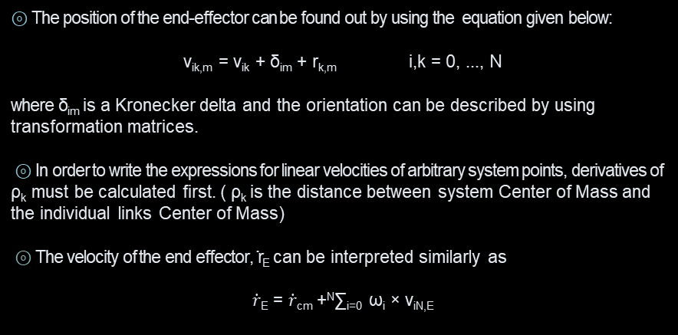
MODELING OF FREE-FLYING MANIPULATOR SYSTEMS
SYSTEM KINEMATICS:
⊚ The position of the end-effector can be found out by using the equation given below:
v_{ik,m} = v_{ik} + δ_{im} + r_{k,m} i,k = 0, ..., N
where δ_{im} is a Kronecker delta and the orientation can be described by using transformation matrices.
⊚ In order to write the expressions for linear velocities of arbitrary system points, derivatives of ρ_{k} must be calculated first. ( ρ_{k} is the distance between system Center of Mass and the individual links Center of Mass)
⊚ The velocity of the end effector, ̇r_{E} can be interpreted similarly as
$\dot{r}$_{E} = $\dot{r}$_{cm} +^{N}∑_{i=0} ω_{i} × v_{iN,E}
8 ʢ 34

Slide 10
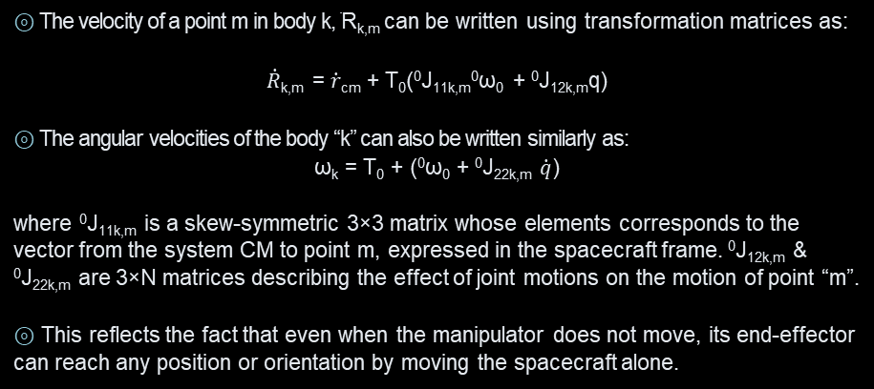
MODELING OF FREE-FLYING MANIPULATOR SYSTEMS
SYSTEM KINEMATICS:
⊚ The velocity of a point m in body k, ̇R_{k,m} can be written using transformation matrices as:
$\dot{R}$_{k,m} = $\dot{r}$_{cm} + T₀(⁰J_{11k,m}⁰ω₀ + ⁰J_{12k,m}q)
⊚ The angular velocities of the body “k” can also be written similarly as:
ω_{k} = T₀ + (⁰ω₀ + ⁰J_{22k,m} $\dot{q}$)
where ⁰J_{11k,m} is a skew-symmetric 3×3 matrix whose elements corresponds to the vector from the system CM to point m, expressed in the spacecraft frame. ⁰J_{12k,m} & ⁰J_{22k,m} are 3×N matrices describing the effect of joint motions on the motion of point “m”.
⊚ This reflects the fact that even when the manipulator does not move, its end-effector can reach any position or orientation by moving the spacecraft alone.
9 ʢ 34

Slide 11
MODELING OF FREE-FLYING MANIPULATOR SYSTEMS
SYSTEM KINEMATICS (SUMMARY):
⊚ A modeling methodology that describes the kinematics of a free-flying space manipulator system is developed using an approach based on barycenters.
⊚ The system CM co-ordinates, the spacecraft attitude and the joint angles vector of the manipulator were chosen as the independent variables.
⊚ Closure Equations and differential kinematical equations are derived.
⊚ This approach yielded an explicit and a compact description of free-flying manipulator systems and will be used again.
12 ʢ 34

Slide 12
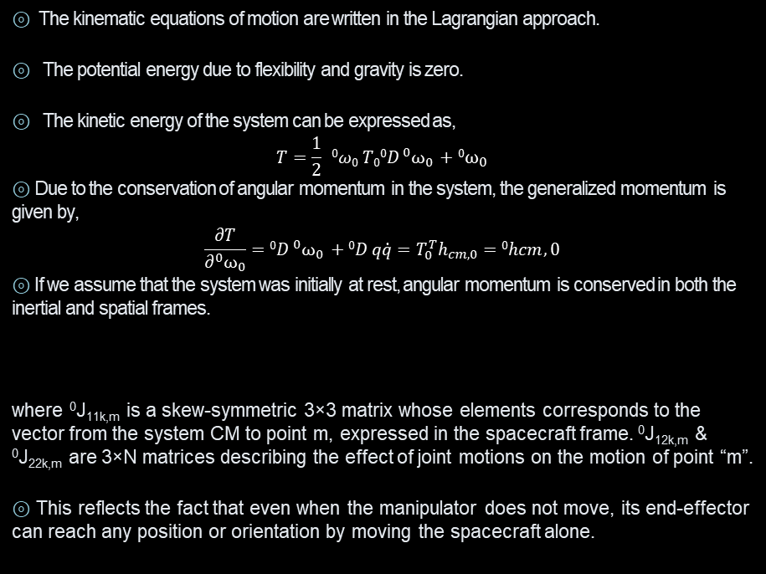
MODELING OF FREE-FLYING MANIPULATOR SYSTEMS
SYSTEM DYNAMICS:
⊚ The kinematic equations of motion are written in the Lagrangian approach.
⊚ The potential energy due to flexibility and gravity is zero.
⊚ The kinetic energy of the system can be expressed as,
$$T=\frac{1}{2} 0ω0 T0{0D }^{0}ω_{0} +{0ω}_{0}$$
⊚ Due to the conservation of angular momentum in the system, the generalized momentum is given by,
$$\frac{∂T}{∂^{0}ω_{0}}={0D }^{0}ω_{0} +0D q\dot{q}=T_{0}^{T}h_{cm,0}=0hcm,0$$
⊚ If we assume that the system was initially at rest, angular momentum is conserved in both the inertial and spatial frames.
where ⁰J_{11k,m} is a skew-symmetric 3×3 matrix whose elements corresponds to the vector from the system CM to point m, expressed in the spacecraft frame. ⁰J_{12k,m} & ⁰J_{22k,m} are 3×N matrices describing the effect of joint motions on the motion of point “m”.
⊚ This reflects the fact that even when the manipulator does not move, its end-effector can reach any position or orientation by moving the spacecraft alone.
13 ʢ 34

Slide 13
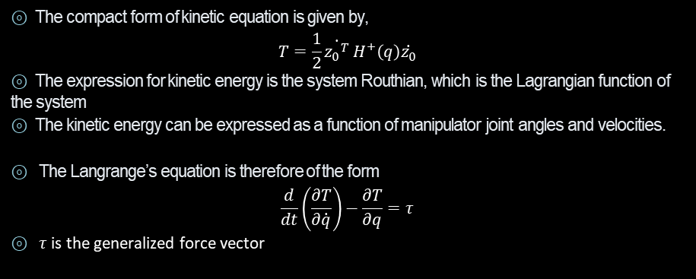
MODELING OF FREE-FLYING MANIPULATOR SYSTEMS
SYSTEM DYNAMICS:
⊚ The compact form of kinetic equation is given by,
$$T=\frac{1}{2}\dot{{z_{0}}^{T}} H^{+}\left(q\right)\dot{z_{0}}$$
⊚ The expression for kinetic energy is the system Routhian, which is the Lagrangian function of the system
⊚ The kinetic energy can be expressed as a function of manipulator joint angles and velocities.
⊚ The Langrange’s equation is therefore of the form
$$\frac{d}{dt}\left(\frac{∂T}{∂\dot{q}}\right)−\frac{∂T}{∂q}=τ$$
⊚ $τ$ is the generalized force vector
14 ʢ 34

Slide 14

MODELING OF FREE-FLYING MANIPULATOR SYSTEMS
SYSTEM DYNAMICS:
⊚ Applying the generalized force vector equation to the Lagrangian function results in a set of N dynamic equations of the form:
$$H^{+}\left(q\right) \ddot{z_{0}}+C^{+}\left(q, ^{0}ω_{0},\dot{q})\right\}=Q$$
⊚ The generalized forces are a combination of disturbance forces and control forces.
$$Q=Q_{c}+ Q_{d}$$
where $Q_{c}$ represents control forces and $Q_{d}$ represents disturbance forces
15 ʢ 34

Slide 15
MODELING OF FREE-FLYING MANIPULATOR SYSTEMS
SYSTEM DYNAMICS SUMMARY:
⊚ A modeling methodology that describes the dynamics of a free-flying space manipulator system is developed using an approach based on barycenters.
⊚ The system Jacobian was derived and shown to be in configurations that are distinct from the usual kinematically singular configurations: these are due to the dynamic coupling between manipulator motions and its spacecraft.
⊚ The Characteristics and capabilities of a free-flying and free-floating systems were analyzed.
⊚ This approach yielded an explicit and a compact description of free-flying manipulator systems and will be used again.
16 ʢ 34

Slide 16


CONTROL MODES FOR SPACE MANIPULATOR SYSTEMS
It is well known that one generally needs three basic elements in order to control a fixed-base manipulator.
⊚ An invertible representation of manipulator kinematics, which can in form of a Jacobian.
⊚ A set of dynamic equations describing the response of manipulator joint angles to actuator torques or forces.
⊚ Third, a control algorithm using internally or externally provided sensory information in order to calculate torques/forces required to achieve a desired task.
Block diagram for a free-floating system operating in Inertially-Referenced End-Point Motion Control
General block diagram for closed loop control
17 ʢ 34

Slide 17
CONTROL MODES FOR SPACE MANIPULATOR SYSTEMS
Usually, two modes of motion control are implemented in fixed-based systems.
⊚ Similarly, to fixed-based systems, a space manipulator may operate under different modes, differing by the control objective.
⊚ As in the fixed-based case, kinematics are not needed to achieve this task and a simple PD joint controllers are enough.
Unlike fixed-based systems, there are two types of cartesian space motion control: Spacecraft-Referenced End-Point Motion Control and Inertially Referenced End-Point Motion Control.
Joint angles of a manipulator are commanded to some desired angles
The end-effector is commanded to move with respect to some fixed coordinated frame
18 ʢ 34

Slide 18
CONTROL MODES FOR SPACE MANIPULATOR SYSTEMS
Spacecraft-Referenced End-Point Motion Control | Inertially-Referenced End-Point Motion Control
The mode of control where the manipulator end-point is commanded to move to a location fixed to its own spacecraft. For example, in the figure (A), the task is to move the end-effector to close to the screw which is fixed with respect to the spacecraft. | Inertially-Referenced End-Point Motion Control, is the mode where the manipulator end-point is commanded to move with respect to inertial space. For example, in the figure (B), a desired trajectory is fixed in inertial space, and the controllers receives feedback from instrumentation fixed on the spacecraft(an inertially-fixed camera)
19 ʢ 34

Slide 19
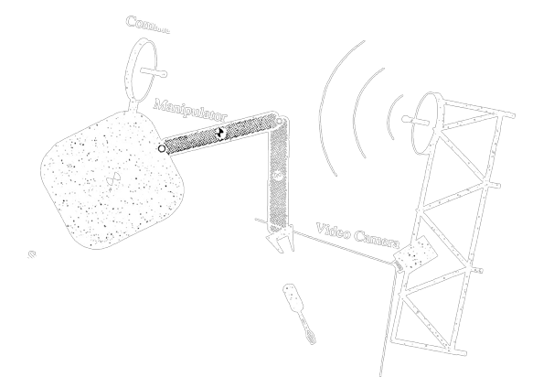
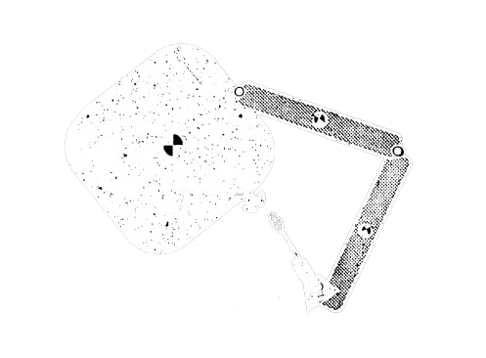
Figure (A)
Spacecraft-Referenced End-Point Motion Control
Figure (B)
Inertially-Referenced End-Point Motion Control
20 ʢ 34

Slide 20
COORDINATED CONTROL FOR SPACE MANIPULATOR SYSTEMS
⊚ Forces can be generated by thruster (jet) actuators, while torques may be generated by thruster actuators, momentum gyros or reaction wheels.
Spacecraft actuators are required for the following reasons:
To keep a spacecraft’s position and attitude fixed.
To move the entire system freely in space.
To compensate for external disturbances.
⊚ The similarity between the dynamic equation mentioned in the previous slides and the equation of motion leads to an investigation of whether the control laws are applicable in the fixed-base manipulators can be applied for space robotic systems
21 ʢ 34

Slide 21
COORDINATED CONTROL FOR SPACE MANIPULATOR SYSTEMS
However, there are two differences between two case that must be pointed out. They are:
Appropriate representation of a spacecraft’s attitude is required
Due to spacecraft’s mobility, a space robotic system is inherently redundant
⊚ This redundancy can be used as an advantage, that the location and attitude of the spacecraft can be controlled to follow some predefined path in order to avoid impacts and making the end-effector to reach any desirable position (i.e.) infinite workspace
⊚ As noted in System Kinematics, even when the manipulator has six DoF, (N=6), J+ is not a square matrix and therefore is not invertible, although its rank is always six. If N=6, then J+ is a 6 × 12 matrix.
22 ʢ 34

Slide 22
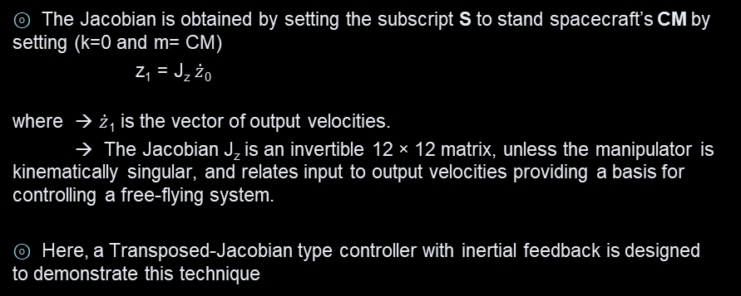
COORDINATED CONTROL FOR SPACE MANIPULATOR SYSTEMS
⊚ The Jacobian is obtained by setting the subscript S to stand spacecraft’s CM by setting (k=0 and m= CM)
z₁ = J_{z} $\dot{z}$₀
where → $\dot{z}$₁ is the vector of output velocities.
→ The Jacobian J_{z} is an invertible 12 × 12 matrix, unless the manipulator is kinematically singular, and relates input to output velocities providing a basis for controlling a free-flying system.
⊚ Here, a Transposed-Jacobian type controller with inertial feedback is designed to demonstrate this technique
23 ʢ34

Slide 23
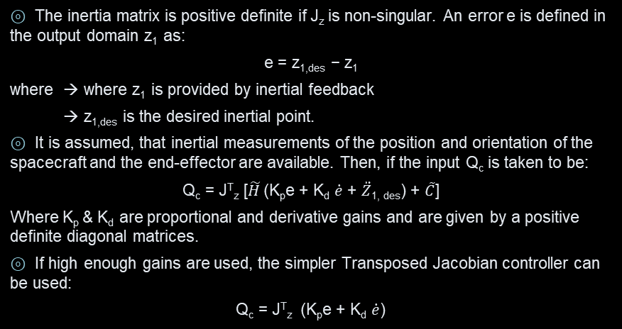
COORDINATED CONTROL FOR SPACE MANIPULATOR SYSTEMS
⊚ The inertia matrix is positive definite if J_{z} is non-singular. An error e is defined in the output domain z₁ as:
e = z_{1,des} − z₁
where → where z₁ is provided by inertial feedback
→ z_{1,des} is the desired inertial point.
⊚ It is assumed, that inertial measurements of the position and orientation of the spacecraft and the end-effector are available. Then, if the input Q_{c} is taken to be:
Q_{c} = J^{T}_{z} [$\tilde{H}$(K_{p}e + K_{d} $\dot{e}$ + $\ddot{Z}$_{1, des}) + $\tilde{C}$]
Where K_{p} & K_{d} are proportional and derivative gains and are given by a positive definite diagonal matrices.
⊚ If high enough gains are used, the simpler Transposed Jacobian controller can be used:
Q_{c} = J^{T}_{z} (K_{p}e + K_{d} $\dot{e}$)
24 ʢ 34

Slide 24
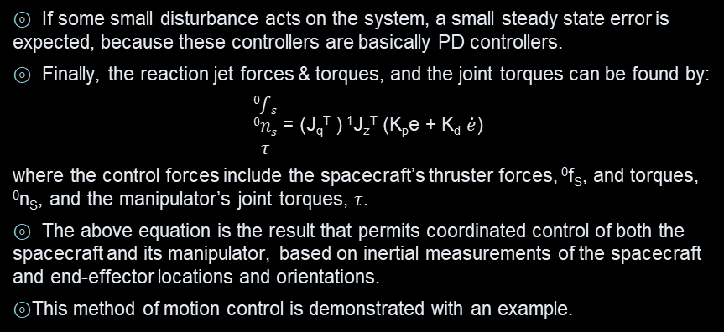
COORDINATED CONTROL FOR SPACE MANIPULATOR SYSTEMS
⊚ If some small disturbance acts on the system, a small steady state error is expected, because these controllers are basically PD controllers.
⊚ Finally, the reaction jet forces & torques, and the joint torques can be found by:
$\begin{matrix}0fs \\ 0ns \\ τ\end{matrix}$ = (J_{q}^{T} )⁻¹J_{z}^{T} (K_{p}e + K_{d} $\dot{e}$)
where the control forces include the spacecraft’s thruster forces, ⁰f_{S}, and torques, ⁰n_{S}, and the manipulator’s joint torques, $τ$.
⊚ The above equation is the result that permits coordinated control of both the spacecraft and its manipulator, based on inertial measurements of the spacecraft and end-effector locations and orientations.
⊚ This method of motion control is demonstrated with an example.
25 ʢ 34

Slide 25
COORDINATED CONTROL FOR SPACE MANIPULATOR SYSTEMS
SUMMARY:
⊚ The results obtained show that nearly any control algorithm which can be applied to conventional terrestrial fixed-base manipulators, can be directly applied to space manipulators.
⊚ The steps required to do this includes identification of the right inertia, Jacobian and Transformation matrices
⊚ These elements also can be used to find the feasible motions for the system and avoid commands that are physically impossible.
26 ʢ 34

Slide 26
SIMULATION EXAMPLE
⊚ A controller capable of simultaneously controlling a spacecraft’s motion and its manipulator’s end-effector motion was designed.
⊚ The system in the example is planar and consists of a two DOF manipulator mounted on a three DOF spacecraft.
⊚ Its parameters including mass, inertia, and kinematic properties are given in the table below.
Body | L_{i} (m) | r_{i} (m) | m_{i} (Kg) | I_{i} (Kg m²)
0 | 0.5 | 0.5 | 40 | 6.667
1 | 0.5 | 0.5 | 4 | 0.343
2 | 0.5 | 0.5 | 3 | 0.250
27 ʢ 34

Slide 27
SIMULATION EXAMPLE
⊚ The spacecraft is assumed to be equipped with thrusters that can provide forces and torques proportional to the commanded control input.
⊚ In this case the dependent coordinates vector, z_{0,} and the vectors of the coordinates to be controlled, z₁, are:
z₀ = [⁰x_{cm}, ⁰y_{cm},θ,q₁,q₂]^{T}, z₁ = [x_{S},y_{S},θ,x_{E},y_{E}]^{T}
where → ⁰x_{cm} , ⁰y_{cm} are the system CM coordinates with respect to an inertia frame
→ θ is the spacecraft’s attitude
→ q₁, q₂ are the manipulator joint angles
→ x_{S}, y_{S} are the spacecraft’s CM coordinates
→ x_{E}, y_{E} are the end effector’s coordinates.
28 ʢ 34

Slide 28
SIMULATION EXAMPLE
⊚ The controller defined in the previous slides(controls) allows the specification of a desired trajectory for both the spacecraft and the manipulator. Hence, the motion of the whole system can be coordinated.
⊚ If the given trajectory is not feasible, the desired motion will not be achieved, but the controller will try instead to come as close as possible to the specified trajectory
⊚ In the simulations that follow, the inertially fixed frame is set at the position of the system CM at the initial time, when (θ,q₁,q₂) = (21°, -58°, 60.3°) and the end-effector is at (2.0, 0.0).
⊚ In this coordinate frame, the end-effector is commanded to move to point (1.5, 1.5). The spacecraft is commanded to move to (θ,x_{S},y_{S}) = (15°, 0.5, 0.5).
⊚ The gains used are Kp = diag(30, 30, 30, 30, 30) and Kd = diag(60, 60, 60, 60, 60).
29 ʢ 34

Slide 29

SIMULATION EXAMPLE
⊚ The Figure below shows the motion of the spacecraft system in inertial space
⊚ Note that if the spacecraft were fixed at its initial location, the end-effector would have reached point B in an almost singular configuration.
⊚ If the spacecraft were free-floating and its reaction jets were turned off, then point B could not have been reached from point A following the straight-line path, due to the existence of dynamic singularities.
⊚ In contrast to these schemes, coordinated control permits the end-effector to reach point B in a favorable configuration, away from singularities.
30 ʢ 34

Slide 30
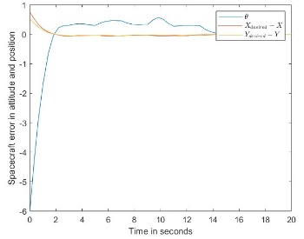
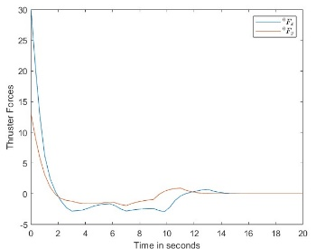
SIMULATION EXAMPLE
⊚ The Figure (A) shows the error in the spacecraft’s
position and attitude during the end-effector motion.
⊚ The Figure (B) shows the reaction jet forces required
to move the spacecraft during the first five seconds of
the maneuver.
Figure (A)
Figure (B)
31 ʢ 34

Slide 31
FUTURE DIRECTION
⊚ Using the manipulator redundancy, the fuel expenditure can be minimized (or) improve a system’s reliability, an under-explored issue.
⊚ Numerous intriguing path-planning-related issues are still open for discussion. For instance, if a system is free-floating, an end-effector path can be used to additionally regulate the attitude of the system’s spacecraft.
⊚ It would also be desirable to have useful end-effector pathways that would enable a free-floating system to use its Path Dependent Workspace without encountering any issues.
⊚ While focusing on the principles of space manipulators, this thesis made idealistic assumptions about these systems.
⊚ Practically speaking, further significant difficulties must be addressed. The control of numerous manipulator systems, joint (or) link flexibilities, interactions between manipulators & payloads during grasping, sensing and sensor data fusion, as well as safety and reliability issues, may be a few of these.
32 ʢ 34

Slide 32
CONCLUSION
⊚ The investigation of the structure, specifications, and constraints of controllers to be employed in the management of spacecraft-borne manipulators was the primary driving force behind this thesis.
⊚ The basis for coordinated control of a spacecraft and its manipulator is the addition of the spacecraft’s position and attitude to the control needs.
⊚ This plan can be used to prevent a robotic system from negatively impacting its surroundings or to keep a beneficial manipulator configuration.
⊚ These methods are shown via a Transposed-Jacobian type controller with inertial feedback.
⊚ Although this type of control may not always feasible, the analysis presented here can lead to new developments in this important direction.
33 ʢ34

Slide 33
References
Papadopoulos, E., “The Dynamics and Control of Space Manipulator Systems,” Ph.D. Thesis, Department of Mechanical Engineering, MIT, 1990. https://dspace.mit.edu/bitstream/handle/1721.1/13705/24343671-MIT.pdf?sequence=2
Spofford, J., and Akin, D., “Redundancy Control of a Free-Flying Telerobot,” Proc. of the AIAA Guidance, Navigation and Control Conference, Minneapolis, MN, August 1988. https://arc.aiaa.org/doi/10.2514/3.25365
Dubowsky, S., Vance, E., and Torres, M., “The Control of Space Manipulators Subject to Spacecraft Attitude Control Saturation Limits,” Proc. of the NASA Conference on Space Tele robotics, JPL, Pasadena, CA, Jan.31-Feb. 2, 1989. https://ntrs.nasa.gov/citations/19900020555
Papadopoulos, E., and Dubowsky, S., “On the Nature of Control Algorithms for Space Manipulators,” Proc. of the IEEE International Conference on Robotics and Automation, Cincinnati, OH, May 1990. https://ieeexplore.ieee.org/document/105384
34 ʢ 34

