Slide 1

Introduction to Management Science
Thirteenth Edition
Chapter 2
Linear Programming: Model Formulation and Graphical Solution
Copyright © 2019, 2016, 2013 Pearson Education, Inc. All Rights Reserved
Notes:
If this PowerPoint presentation contains mathematical equations, you may need to check that your computer has the following installed:
1) MathType Plugin
2) Math Player (free versions available)
3) NVDA Reader (free versions available)

Slide 2
Learning Objectives
2.1 Model Formulation
2.2 A Maximization Model Example
2.3 Graphical Solutions of Linear Programming Models
2.4 A Minimization Model Example
2.5 Irregular Types of Linear Programming Problems
2.6 Characteristics of Linear Programming Problems

Slide 3
Linear Programming: An Overview
Objectives of business decisions frequently involve maximizing profit or minimizing costs.
Linear programming uses linear algebraic relationships to represent a firm’s decisions, given a business objective, and resource constraints.
Steps in application:
Identify problem as solvable by linear programming.
Formulate a mathematical model of the unstructured problem.
Solve the model.

Slide 4
Model Components
Decision variables - mathematical symbols representing levels of activity by the firm.
Objective function - a linear mathematical relationship describing an objective of the firm, in terms of decision variables - this function is to be maximized or minimized.
Constraints - requirements or restrictions placed on the firm by the operating environment, stated in linear relationships of the decision variables.
Parameters/Co-efficents - numerical coefficients and constants used in the objective function and constraints.
I have 4 pieces of wood for making chairs – Parameter
Each chair require 0.5 piece of wood – Coefficient.

Slide 5
Generic LP Problems
MAX (or MIN): c₁X₁ + c₂X₂ + … + c_{n}X_{n}
Subject to: a₁₁X₁ + a₁₂X₂ + … + a_{1n}X_{n} <= b_{1 This is a constraint}
:
(LHS) a_{k1}X₁ + a_{k2}X₂ + … + a_{kn}X_{n} >=b_{k} (RHS)
:
a_{m1}X₁ + a_{m2}X₂ + … + a_{mn}X_{n} = b_{m}
X₁, X₂ >= 0

Slide 6
Generic LP Problems
c₁, c_{2,} … c_{n} are called objective function coefficients and may represent the marginal profits or costs associated with the DVs X₁, X₂, .. X_{n}
a_{ij} represents the numeric coefficient in the i^{th} constraint of DV X_{j}
The objective function and constraints of a LP represent different linear combinations of the DVs.
X₁, X₂ >= 0 are called non-negativity constraints

Slide 7
Linear Programming (LP) Problems
In many situations, different types of functions can be used to represent the objective function and constraints.
Some times the functions are linear (straight lines) or non-linear (curves). Some times the DVs can be integers or can assume fractional values.
LP contains objective and constraints which are both linear.
LP forms a good starting point for other Optimization techniques.

Slide 8
Summary of Model Formulation Steps
Step 1: Define the decision variables
How many bowls and mugs to produce?
Step 2: Define the objective function
Maximize profit OR Minimize cost
Step 3: Define the constraints
The resources (clay and labor) available

Slide 9
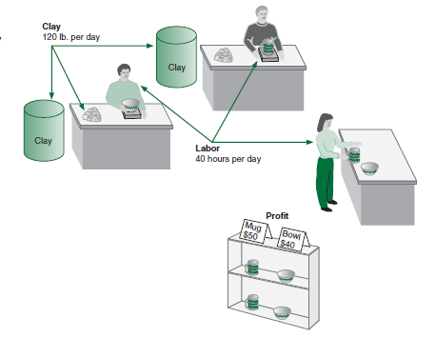
L P Model Formulation 1 (1 of 3)
Resource Requirements
product | Labor (Hr./Unit) | Clay (Lb./Unit) | Profit ($/Unit)
Bowl | 1 | 4 | 40
Mug | 2 | 3 | 50
Figure 2.1 Beaver Creek Pottery Company
Product mix problem - Beaver Creek Pottery Company
How many bowls and mugs should be produced to maximize profits given labor and materials constraints?
Product resource requirements and unit profit:

Slide 10
L P Model Formulation 1 (2 of 3)
Resource Availability: (RHS)
40 hrs of labor per day
120 lbs of clay
Decision Variables:
x₁ = number of bowls to produce per day
x₂ = number of mugs to produce per day
Objective Function:
Maximize Z = $40x₁ + $50x₂
Where Z = profit per day
Resource Constraints: (LHS)
hours of labor
pounds of clay
Non-Negativity Constraints:

Slide 11
L P Model Formulation 1 (3 of 3)
Complete Linear Programming Model:
Maximize
subject to:

Slide 12
Feasible Solutions
A feasible solution does not violate any of the constraints:
Example:
Labor constraint check:
Clay constraint check:

Slide 13
Infeasible Solutions
An infeasible solution violates at least one of the constraints:
Example:
Labor constraint check:

Slide 14
Learning Objective 2.3
Graphical Solutions of Linear Programming Models

Slide 15
Graphical Solution of L P Models
Graphical solution is limited to linear programming models containing only two decision variables (can be used with three variables but only with great difficulty).
Graphical methods provide a picture of how a solution for a linear programming problem is obtained.

Slide 16
Solving LP Problems: A Graphical Approach
The constraints of an LP problem defines its feasible region.
The best point in the feasible region is the optimal solution to the problem.
For LP problems with 2 variables, it is easy to plot the feasible region and find the optimal solution.

Slide 17
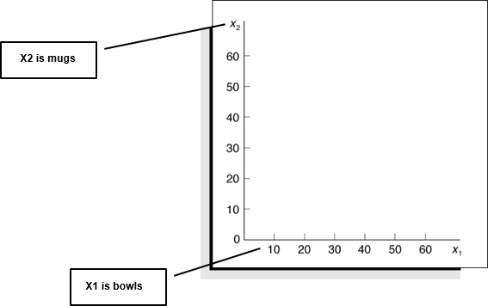
Coordinate Axes
Maximize
subject to:
Figure 2.2 Coordinates for graphical analysis

Slide 18
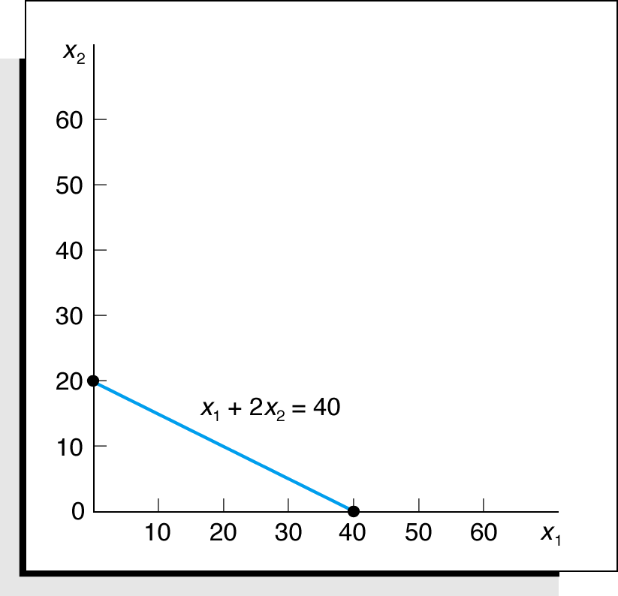
Labor Constraint
Figure 2.3 Graph of labor constraint or Labor Constraint line

Slide 19
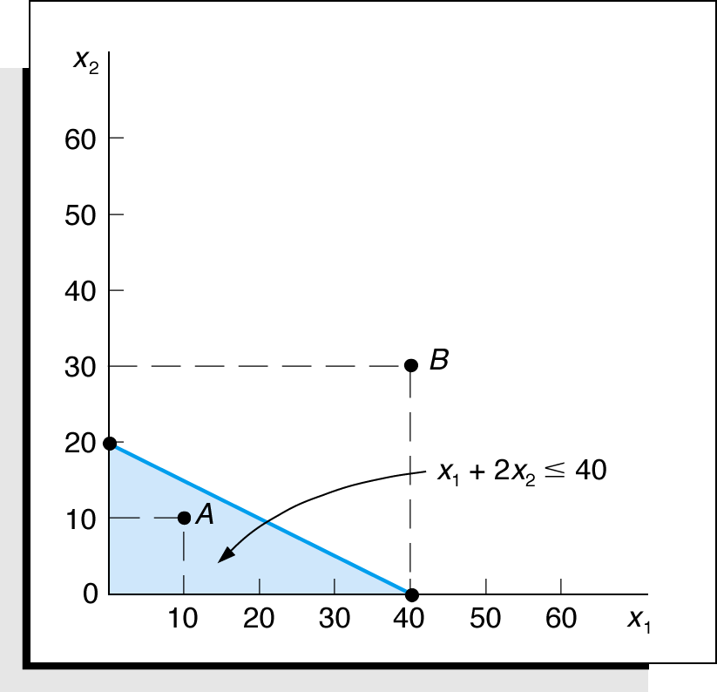
Labor Constraint Area
Figure 2.4 Labor constraint area

Slide 20
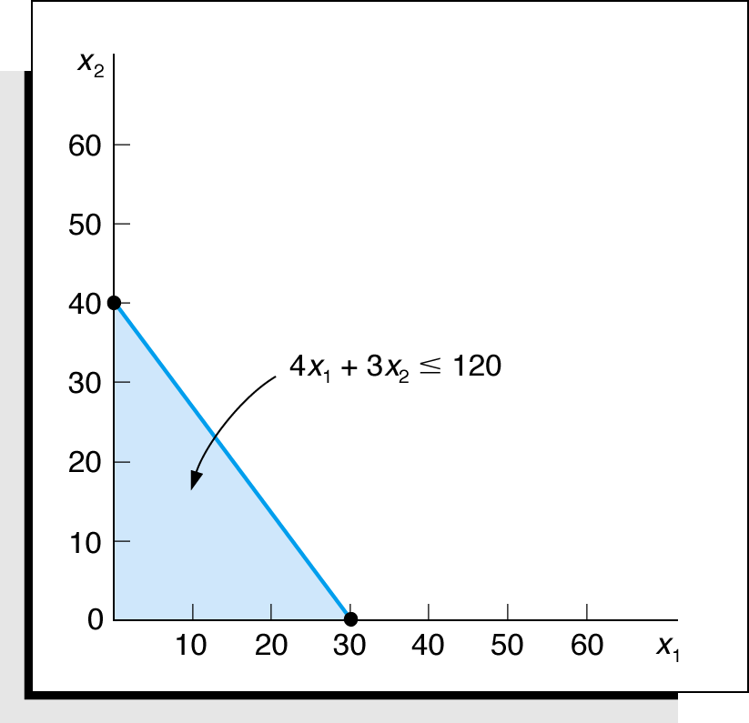
Clay Constraint Area
Figure 2.5 The constraint area for clay

Slide 21
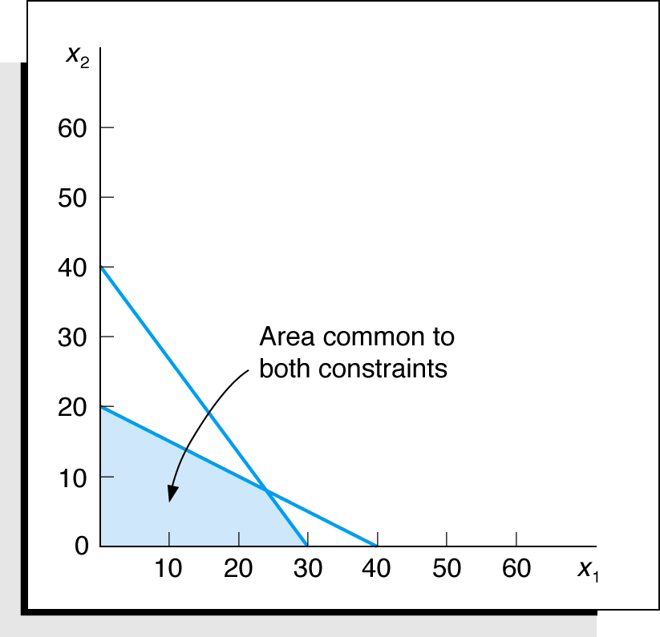
Both Constraints
Figure 2.6 Graph of both Clay and Labor constraints

Slide 22
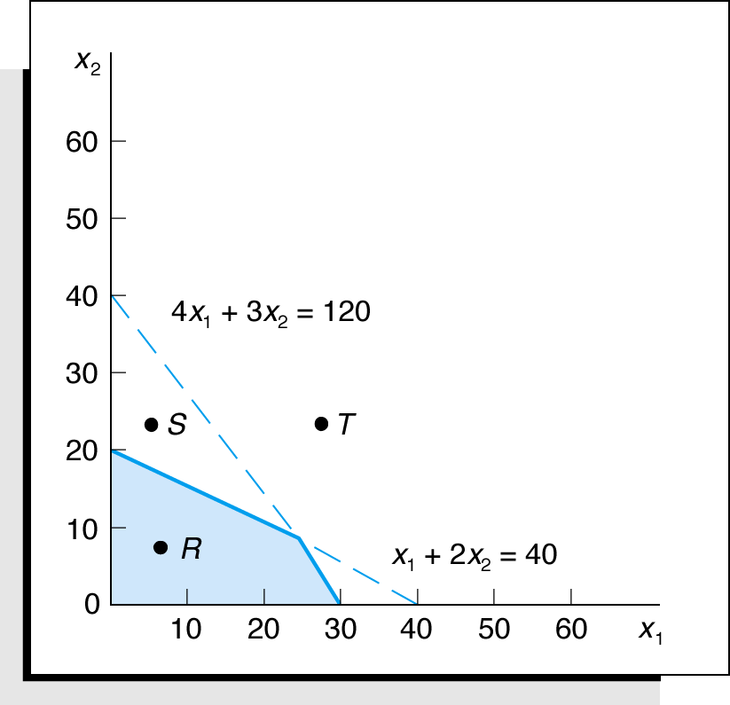
Feasible Solution Area
Figure 2.7 The feasible solution area constraints or Feasible Region of the model

Slide 23
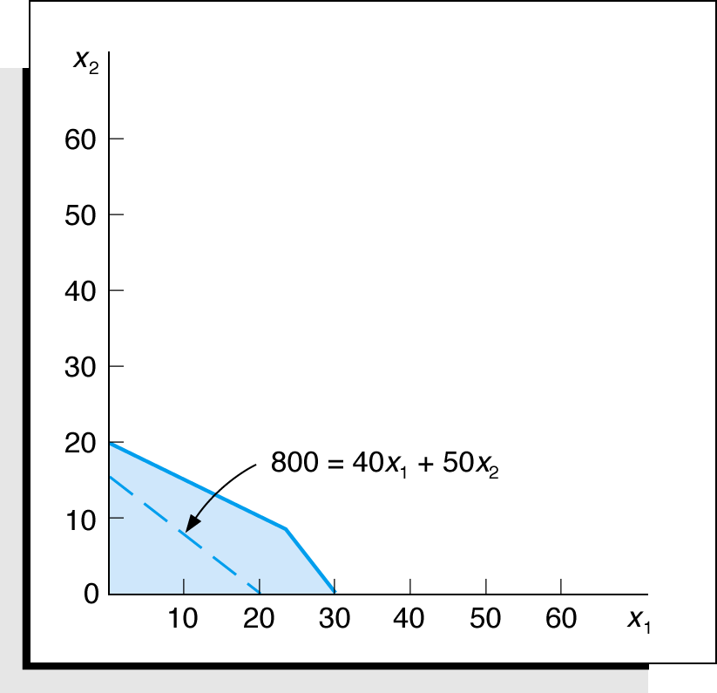
Objective Function Solution Z= $800
Figure 2.8 Objective function line for Z = $800

Slide 24
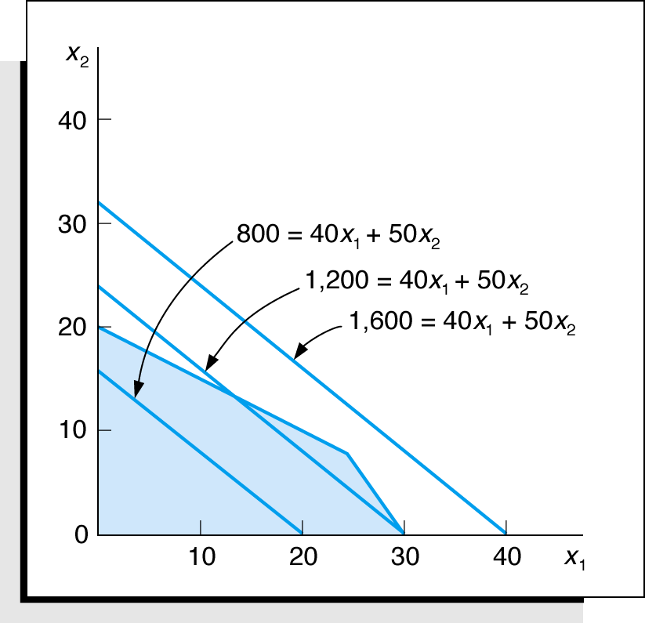
Alternative Objective Function Solution Lines
Figure 2.9 Alternative objective function lines for profits, Z, of $800, $1,200, and $1,600. Note: The lines are parallel.
The lines move away from the origin (0,0) because the objective is to Maximize.

Slide 25
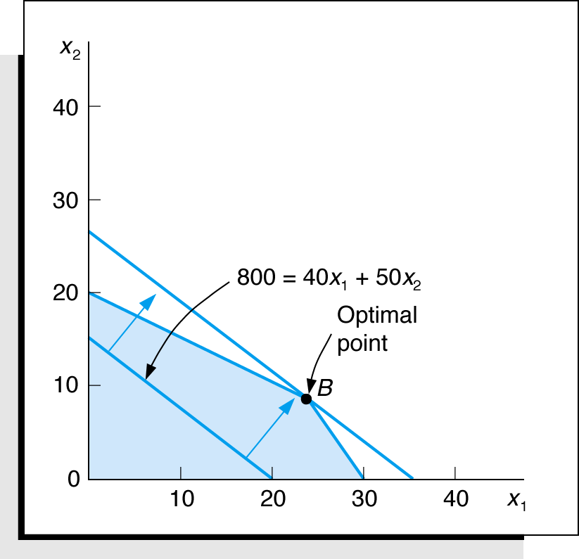
Optimal Solution
The optimal solution point is the last point the objective function touches as it leaves the feasible solution area.
Figure 2.10 Identification of optimal solution point

Slide 26
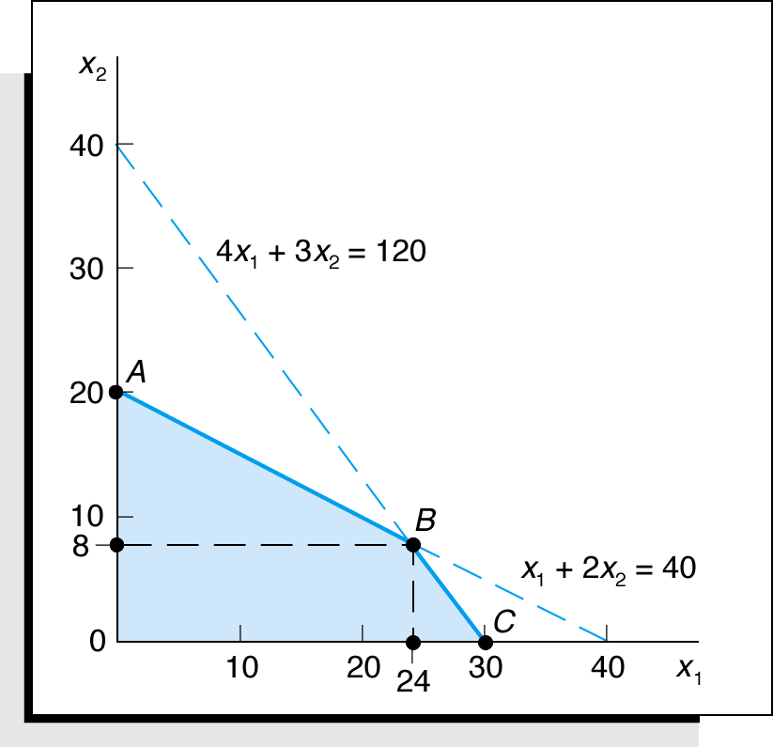
Optimal Solution Coordinates
Figure 2.11 Optimal solution coordinates

Slide 27
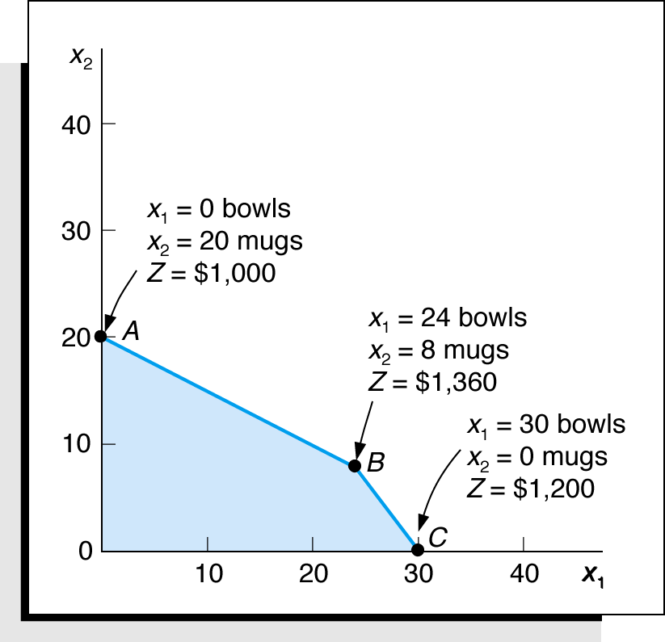
Extreme (Corner) Point Solutions
Figure 2.12 Feasible Solutions at all corner points

Slide 28
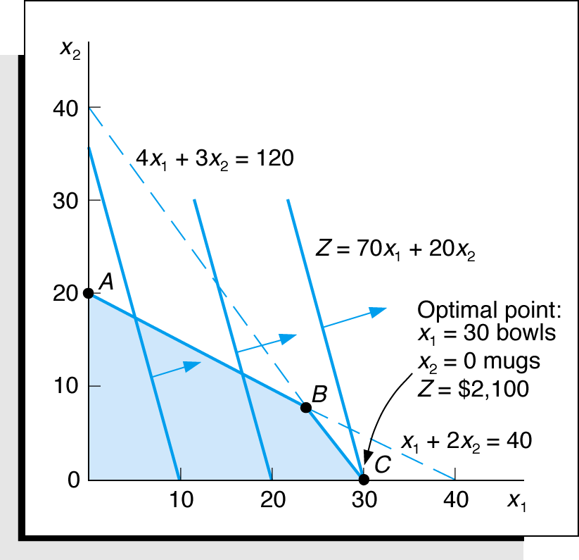
Optimal Solution for New Objective Function
Maximize
subject to:
Figure 2.13 Optimal solution with

Slide 29
Slack Variables
Standard form requires that all constraints be in the form of equations (equalities).
A slack variable is added to a
constraint to convert it to an equation (=).
A slack variable typically represents an unused resource.
A slack variable contributes nothing to the objective function value.

Slide 30
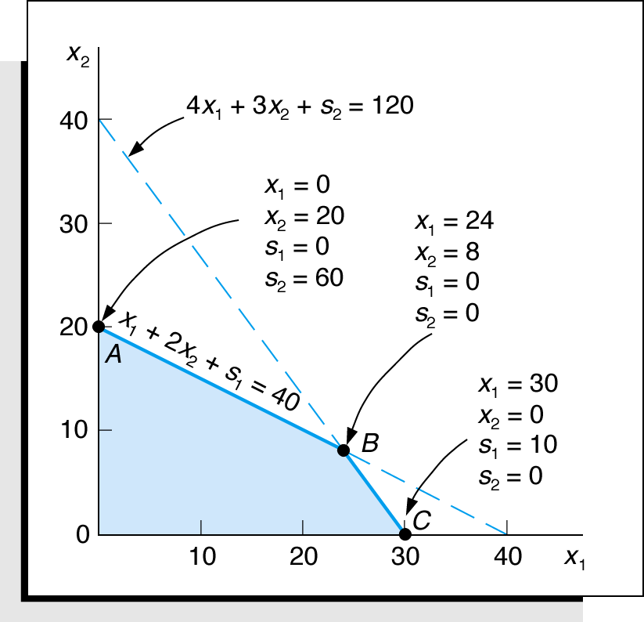
Linear Programming Model: Standard Form -- Here we are enumerating the corner points
Max
Z = $40X₁ + $50X₂ + 0S₁ + 0S₂
subject to:
Where:
x₁ = number of bowls
x₂ = number of mugs
s₁, s₂ are slack variables
Figure 2.14 Solutions at points A, B, and C with slack

Slide 31
Learning Objective 2.4
A Minimization Model Example

Slide 32
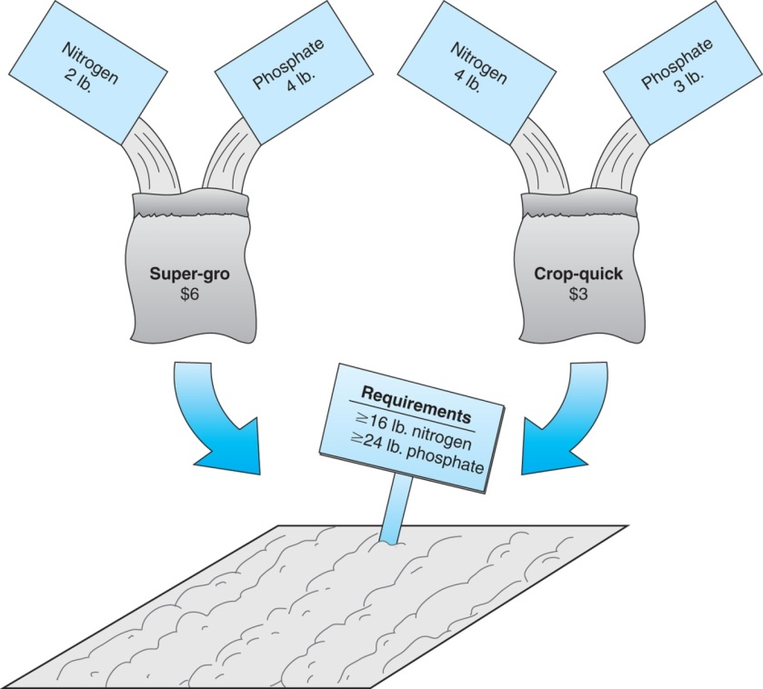
L P Model Formulation 2 (1 of 2)
Two brands of fertilizer available – Super-gro, Crop-quick.
Field requires at least 16 pounds of nitrogen and 24 pounds of phosphate.
Super-gro costs $6 per bag, Crop-quick $3 per bag.
Problem: How much of each brand to purchase to minimize total cost of fertilizer given following data ?
Figure 2.15 Fertilizing farmer’s field
Chemical Contribution
Brand | Nitrogen (lb./bag) | Phosphate (lb./bag)
Super-gro | 2 | 4
Crop-quick | 4 | 3

Slide 33
L P Model Formulation 2 (2 of 2)
Decision Variables:
x₁ = bags of Super-gro
x₂ = bags of Crop-quick
The Objective Function:
Minimize Z = $6x₁ + 3x₂
Where: $6x₁ = cost of bags of Super-Gro
$3x₂ = cost of bags of Crop-Quick
Model Constraints:

Slide 34
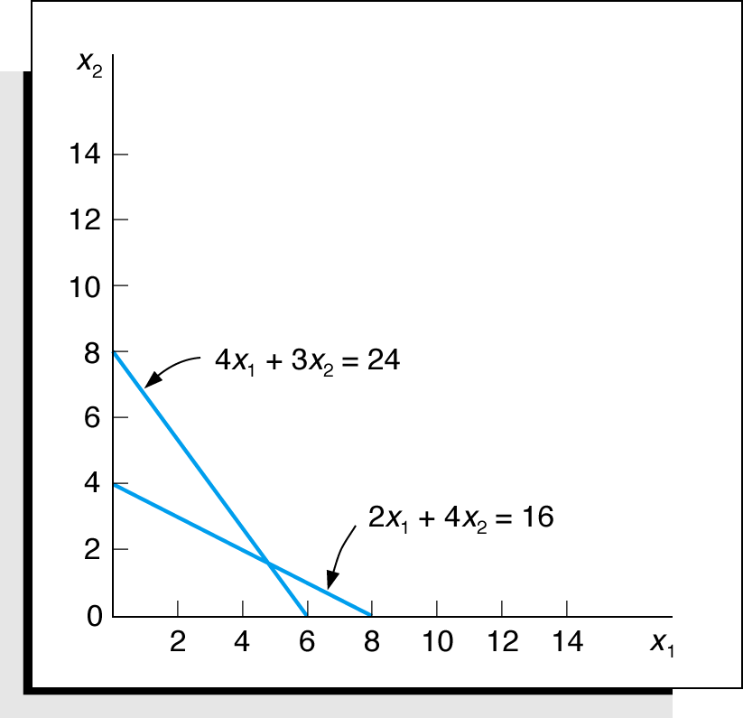
Constraint Graph
Minimize
subject to:
Figure 2.16 Constraint lines for fertilizer model

Slide 35
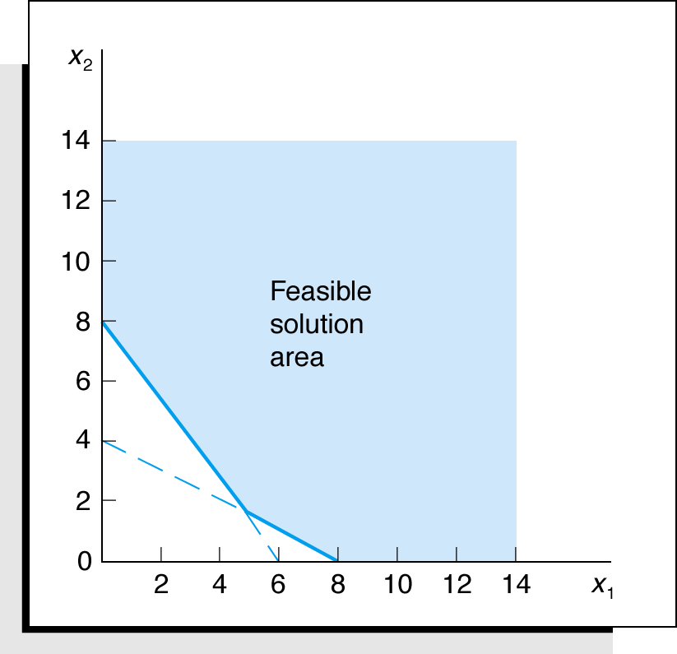
Feasible Region
Figure 2.17 Feasible solution area

Slide 36
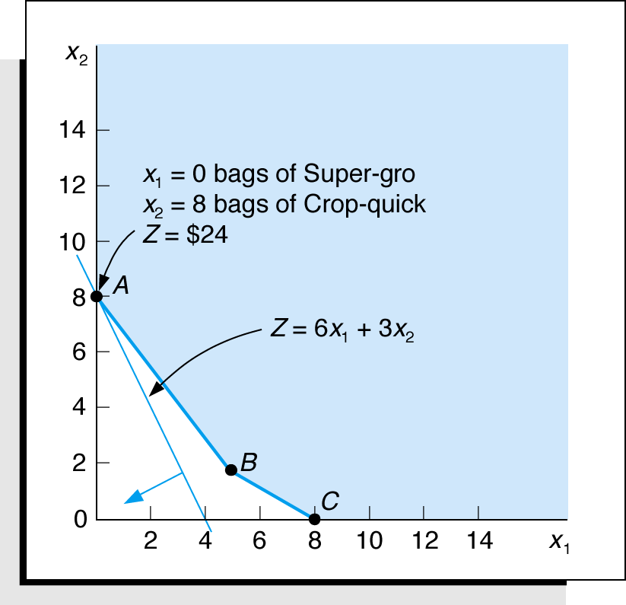
Optimal Solution Point
The optimal solution of a minimization problem is at the extreme point closest to the origin.
Figure 2.18 The optimal solution point

Slide 37
Surplus Variables
constraint to convert it to an equation (=).
A surplus variable represents an excess above a constraint requirement level.
A surplus variable contributes nothing to the calculated value of the objective function.
Subtracting surplus variables in the farmer problem constraints:
A surplus variable is subtracted from a

Slide 38
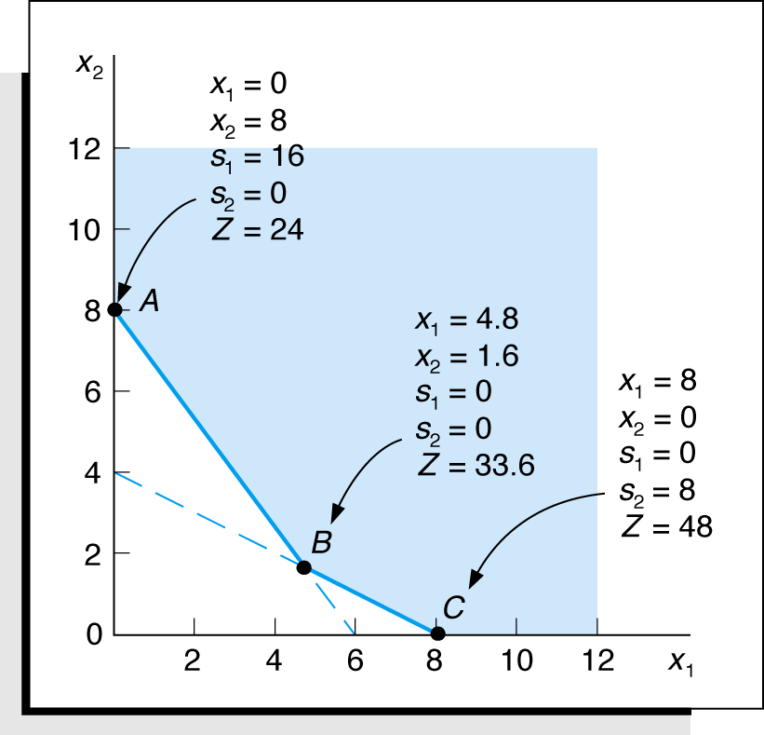
Graphical Solutions
Minimize
subject to:
Figure 2.19 Graph of the fertilizer example

Slide 39
Irregular Types of Linear Programming Problems
For some linear programming models, the general rules do not apply.
Special types of problems include those with:
Multiple optimal solutions
Infeasible solutions
Unbounded solutions

Slide 40
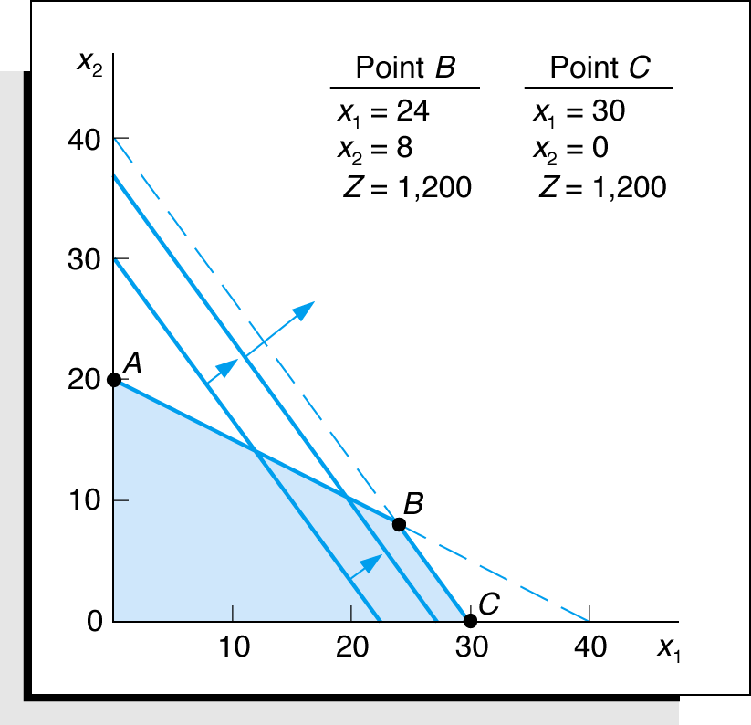
Multiple Optimal Solutions Beaver Creek Pottery Feasible region remains the same. Objective function changes.
The objective function is parallel to a constraint line.
Maximize
subject to:
Where:
x₁ = number of bowls
x₂ = number of mugs
Figure 2.20 Graph of the Beaver Creek Pottery example with multiple optimal solutions

Slide 41
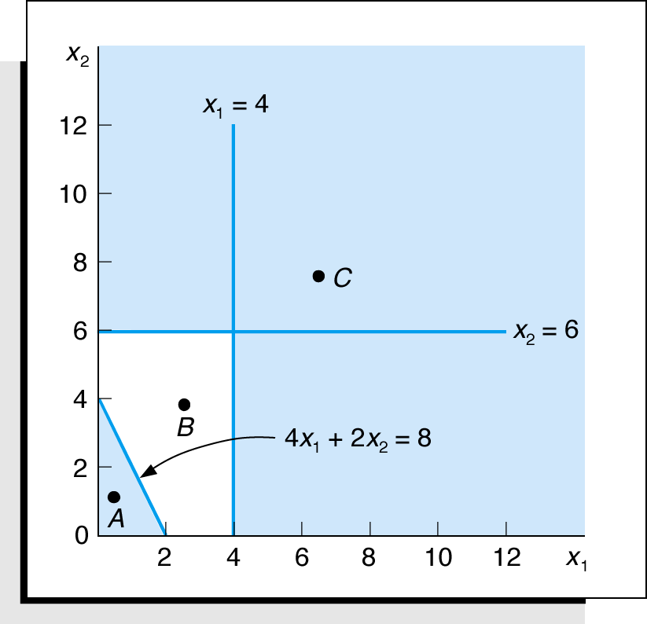
An Infeasible Problem -- No way to satisfy all constraints. This happens due to errors in formulation.
Every possible solution violates at least one constraint:
Maximize
subject to:
Figure 2.21 Graph of an infeasible problem

Slide 42
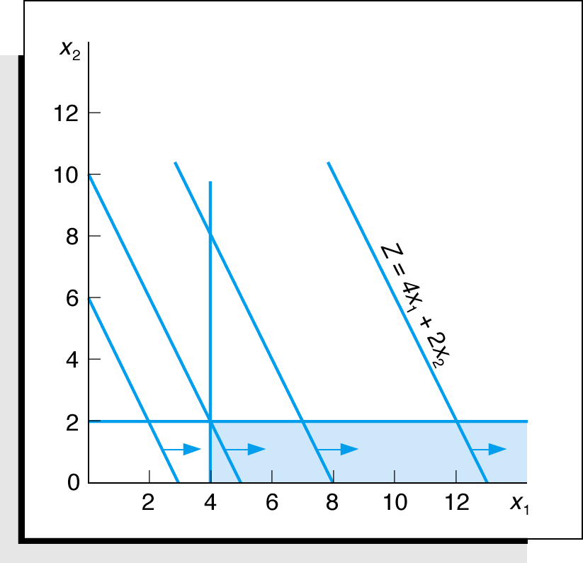
An Unbounded Problem -- Due to errors in formulation. Omitted constraints or use of erroneous inequality.
Value of the objective
function increases indefinitely:
Maximize
subject to:
Figure 2.22 Graph of an unbounded problem

Slide 43
Properties of Linear Programming Models
Proportionality - The rate of change (slope) of the objective function and constraint equations is constant.
Additivity - Terms in the objective function and constraint equations must be additive.
Divisibility - Decision variables can take on any fractional value and are therefore continuous as opposed to integer in nature.
Certainty - Values of all the model parameters are assumed to be known with certainty (non-probabilistic).

Slide 44
Problem Statement: Example Problem N o. 1
Hot dog mixture in 1000-pound batches.
Two ingredients, chicken ($3/lb) and beef ($5/lb).
Recipe requirements:
at least 500 pounds of “chicken”
at least 200 pounds of “beef”
Ratio of chicken to beef must be at least 2 to 1.
Determine optimal mixture of ingredients that will minimize costs.

Slide 45
Solution: Example Problem N o. 1 (1 of 2)
Step 1:
Identify decision variables.
x₁ = lb of chicken in mixture
x₂ = lb of beef in mixture
Step 2:
Formulate the objective function.
Minimize Z = $3x₁ + $5x₂
where Z = cost per 1,000-lb batch
$3x₁ = cost of chicken
$5x₂ = cost of beef

Slide 46
Solution: Example Problem N o. 1 (2 of 2)
Step 3: Establish Model Constraints
The Model: Minimize

Slide 47
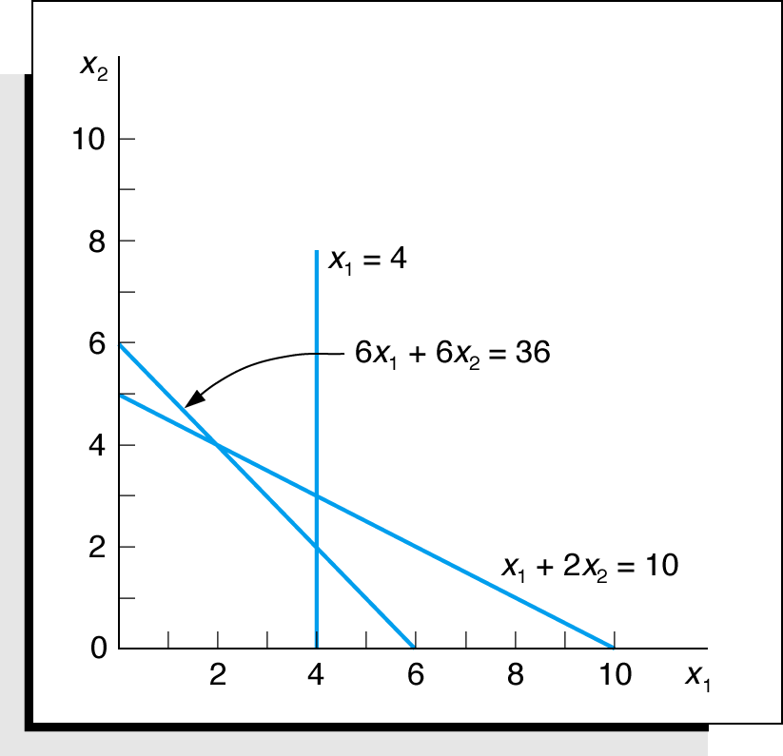
Example Problem N o. 2 (1 of 3)
Solve the following model graphically:
Maximize
subject to:
Step 1: Plot the constraints as equations
Figure 2.23 Constraint equations

Slide 48
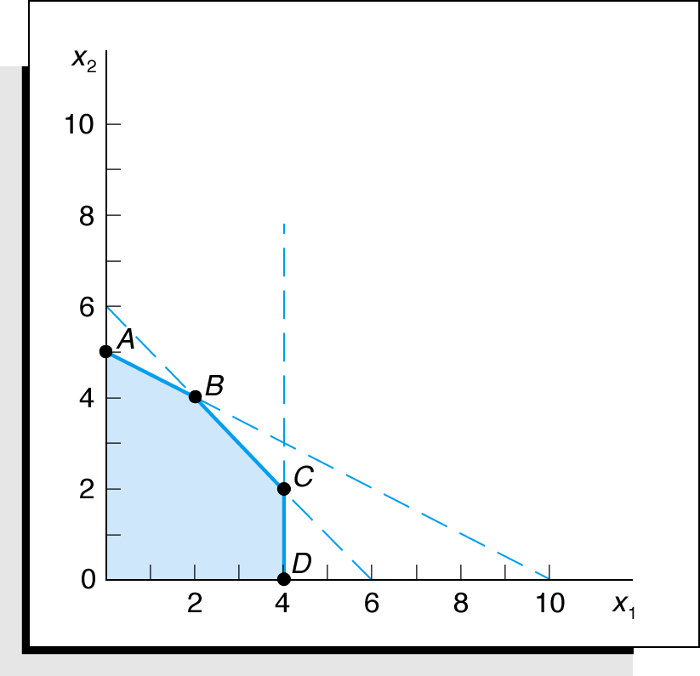
Example Problem N o. 2 (2 of 3)
Step 2: Determine the feasible solution space
Figure 2.24 Feasible solution space and extreme points

Slide 49
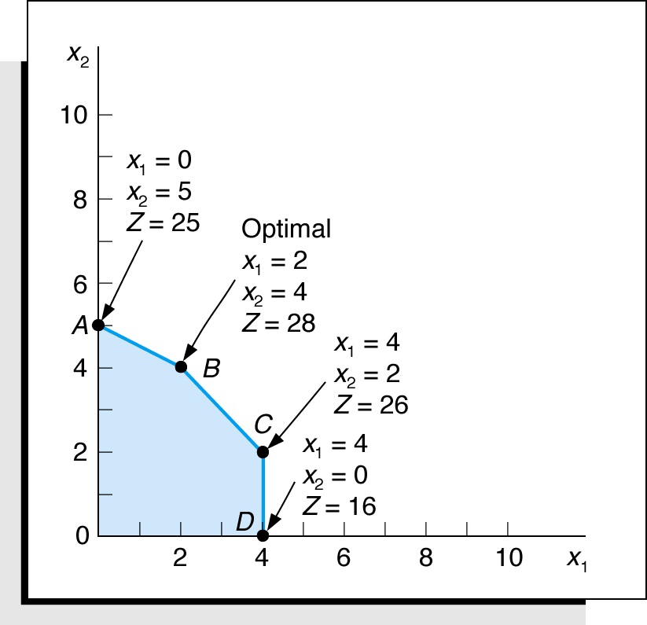
Example Problem N o. 2 (3 of 3)
Step 3 and 4: Determine the solution points and optimal solution
Figure 2.25 Optimal solution point

Slide 50

Copyright

