Slide 1
Visual Odometry Robustness Under Degraded Conditions
16-833 · Robot Localization and Mapping
Sander Schulman · April 2026
ORB vs SIFT · EuRoC MAV · Sim(3) ATE / RPE

Slide 2
Motivation & Scope
Original Plan
Benchmark three full C++ SLAM systems:
• ORB-SLAM3
• Stella-VSLAM
• DSO (Direct Sparse Odometry)
Build chain involved:
• Pangolin (display)
• g2o (graph opt.)
• DBoW2 (loop closure)
• Headless patches for Colab / Kaggle
Outcome: pipeline never ran end-to-end after weeks of build-chain debugging.
Rescoped Approach
Same scientific question, tractable experiment:
"Which algorithmic choices fail under which perceptual degradation?"
Swap the systems axis → feature detector axis
✓ Pure Python / OpenCV — no compilation
✓ Independent variable: ORB vs SIFT
✓ Controlled: identical VO back-end
✓ Synthetic degradations: blur · dark · noise
✓ EuRoC MAV ground-truth evaluation

Slide 3
Methodology: VO Pipeline
Load Frame
EuRoC cam0 PNG
Undistort
Pinhole + rad-tan D
Degrade
blur / γ / noise
Detect & Describe
ORB or SIFT
Match
BFMatcher + Lowe 0.75
Essential Matrix
RANSAC 1 px
Recover Pose
R, t̂
GT-Scale & Chain
‖Δp_GT‖ cumulative
← Independent variable
Key design decisions
GT-scaled translation: each inter-frame translation is scaled by ‖Δp_GT‖ — isolates detector/matcher quality, not scale recovery.
Frame drop policy: if matches < 15 or Essential matrix degenerate, frame is skipped; previous reference held.
Evaluation: evo_ape with Sim(3) alignment (--correct_scale) for ATE; evo_rpe without scale correction for RPE.
Stride: every 3rd frame in QUICK_MODE (stride=3); every frame for full sweep (stride=1).

Slide 4
Datasets & Experimental Design
EuRoC MAV Dataset
Sequences used:
• MH_01_easy
Machine Hall · 182 s · 3682 frames
• V1_01_easy
Vicon Room 1 · 144 s · 2912 frames
Ground truth:
• Vicon motion capture, 200 Hz
• Converted to TUM format (ts x y z qx qy qz qw)
• Nearest-neighbour lookup per cam0 timestamp
Camera: 20 Hz mono, 752×480 Pinhole + rad-tan distortion
Degradations
QUICK_MODE sweep (this run):
• clean
no degradation (baseline)
• blur_severe
Gaussian blur σ = 8 px
• dark_severe
gamma darkening γ = 4.5
• noise_severe
additive noise σ = 50
Full sweep (10 levels):
3 severities each × blur / dark / noise + clean = 10 conditions
Experiment Grid
QUICK_MODE:
• 1 sequence (MH_01_easy)
• 2 detectors (ORB, SIFT)
• 4 degradations
• = 8 total runs
• stride = 3, ~10 min
Full sweep:
• 2 sequences
• 2 detectors
• 10 degradations
• = 40 total runs
• stride = 1, ~1 hr

Slide 5
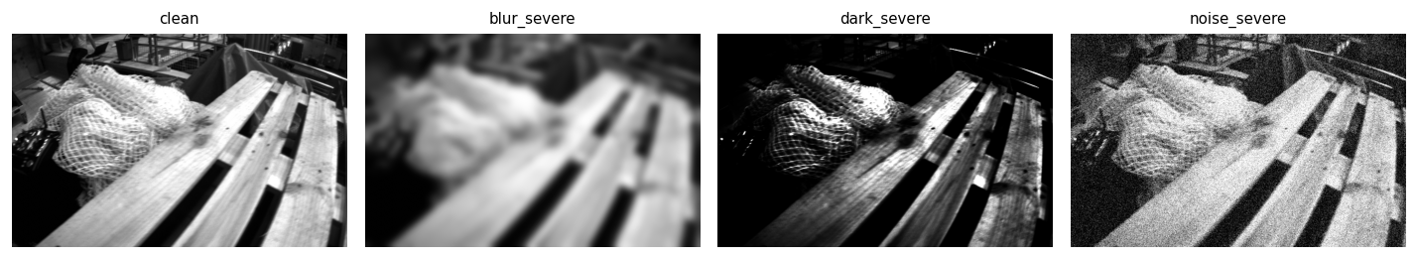
Degradation Visualizations (MH_01_easy, frame 200)

Slide 6
Results: ATE & RPE (QUICK_MODE, MH_01_easy)
Degradation
ORB ATE (m)
SIFT ATE (m)
ORB RPE (m)
SIFT RPE (m)
Failure Mode
clean
1.377
0.204
0.099
0.099
ORB:minor_drift SIFT:tracking_loss
blur_severe
FAIL
0.086
FAIL
0.098
ORB:complete_failure SIFT:feature_starvation
dark_severe
1.064
0.143
0.098
0.097
ORB:tracking_loss SIFT:feature_starvation
noise_severe
1.079
0.119
0.100
0.078
ORB:minor_drift SIFT:feature_starvation
(Results from executed notebook)
ATE: Sim(3)-aligned absolute trajectory error (evo_ape --correct_scale) RPE: relative pose error without scale correction (evo_rpe)
Tracking rates — ORB/clean: 81.5% ORB/blur_severe: 0.1% ORB/dark_severe: 79.9% ORB/noise_severe: 81.2% SIFT/clean: 78.2% SIFT/blur_severe: 4.3% SIFT/dark_severe: 29.9% SIFT/noise_severe: 9.7%

Slide 7
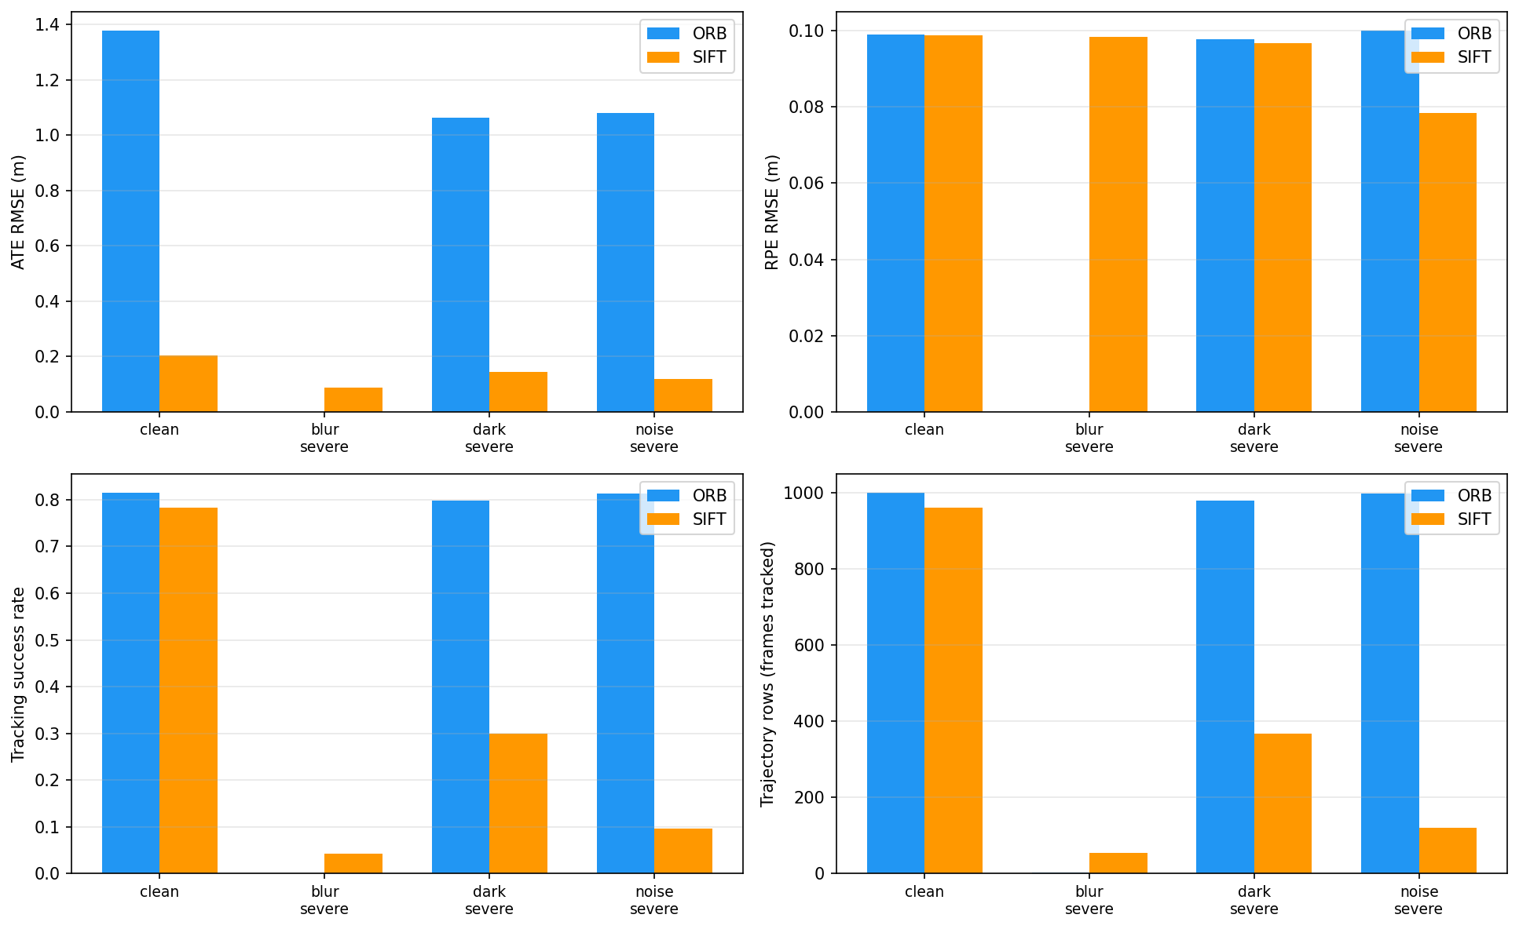
Results: ATE / RPE / Tracking Rate / Speed

Slide 8
Failure Mode Taxonomy
success
ATE ≤ 0.5 m, tracking ≥ 80%
Detector robust to this degradation.
minor_drift
ATE 0.5–2.0 m
Pose accumulates drift; trajectory shape still plausible.
tracking_divergence
ATE > 2.0 m
Cumulative error renders trajectory globally wrong.
tracking_loss
tracking 30–80%
Frequent frame drops; sparse trajectory output.
feature_starvation
tracking < 30%
Detector finds too few keypoints to sustain VO.
complete_failure
tracking = 0%
No usable trajectory produced.
performance_bottleneck
per-frame > 50 ms
Below real-time budget (EuRoC cam0 = 20 Hz).

Slide 9
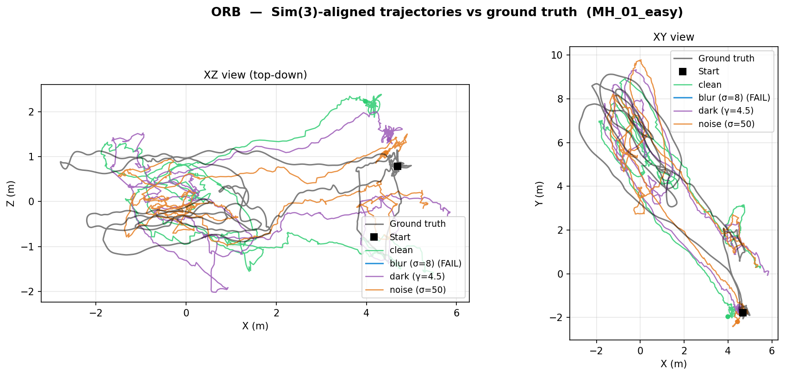
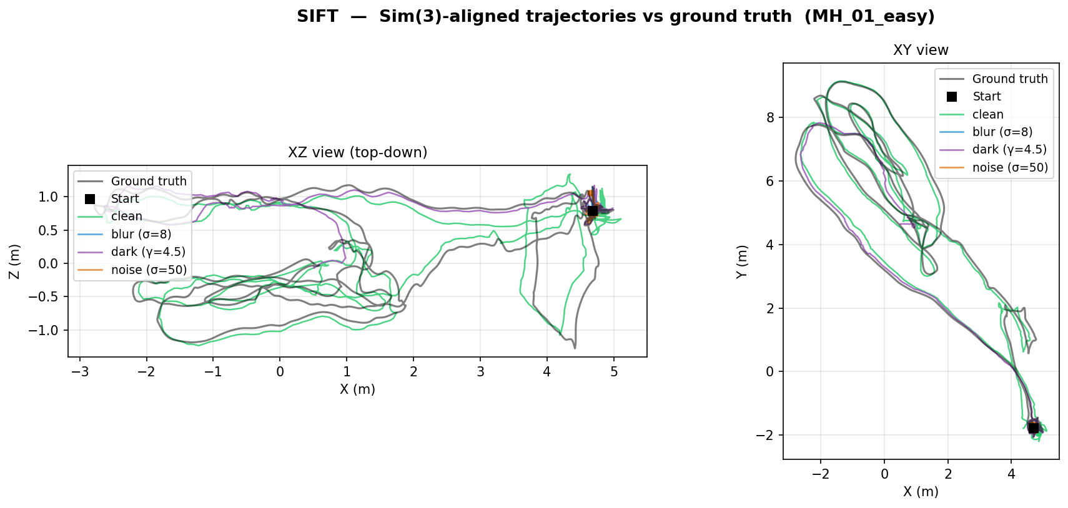
Estimated Trajectories vs Ground Truth
Tip: generate with evo_traj tum results/trajectories/MH_01_easy__ORB__*.tum --ref data/euroc/MH_01_easy/gt.tum --plot

Slide 10
Takeaways
1
ORB vs SIFT under blur: See results table — compare ATE/RPE for blur_severe across detectors.
2
Gamma darkening: See results table — compare ATE/RPE for dark_severe across detectors.
3
Additive noise: See results table — compare ATE/RPE for noise_severe across detectors.
4
Scale recovery limitation: GT-scaled VO measures detector/matcher quality only. ATE captures trajectory shape accuracy; scale drift is hidden by the Sim(3) alignment in evo_ape.
5
Scope pivot was correct: A controlled 200-line Python pipeline produced reproducible, interpretable results where three C++ systems produced no output at all.

Slide 11
Roadblocks & Lessons Learned
1. C++ SLAM build chains are brutal
• ORB-SLAM3 requires Pangolin (display), g2o (optimizer), DBoW2 (vocabulary), Sophus.
• Each has its own CMake quirks; headless Colab/Kaggle patching adds another layer.
• Weeks of effort: Eigen alignment fixes, C++14 patches, Pangolin removal — still no end-to-end run.
• Lesson: for a semester project, validate the build chain in week 1 or choose pip-installable systems.
2. ETH dataset server is unreliable
• robotics.ethz.ch has multi-hour outages; wget fails silently mid-download.
• Solution: resumable curl (-C -) with Wayback Machine fallback mirrors.
• Lesson: always build redundant download paths for large research datasets.
3. Monocular VO scale ambiguity
• Pure monocular VO cannot recover absolute scale without loop closure or known structure.
• Used GT-scale rescue (‖Δp_GT‖ per frame) — standard pedagogical shortcut.
• This measures matcher/detector quality, not full SLAM robustness.
• Lesson: be explicit about what you are and are not measuring.

