Slide 1
PROPS: Learning Stack Patterns for ROP Detection on Legacy ARM-based Devices
József Sándor, Roland Nagy, and Levente Buttyán
CrySyS Lab
Department of Networked Systems and Services
Budapest University of Technology and Economics

Slide 2
Motivation
Return-oriented programming (ROP) is still a viable attack
No ultimate defense exists, especially for legacy embedded systems
Modern hardware features on ARM architecture (PAC, BTI) are promising,
but not available on devices with ARMv7 and older architectures
In industrial and embedded systems
  hardware upgrades are impractical
  vulnerabilities cannot always be patched promptly
  devices must continue to operate despite known memory-safety issues
Notes:
Example scenario, embedded industrial environment.
widely used in industrial and embedded systems where hardware upgrades are impractical.
CVE analysis or vulnerability assessments
updates are operationally infeasible due to uptime requirements, certification constraints, or vendor support limitations.

Slide 3
Objectives
For legacy systems with 32-bit ARMv7 and older architectures
Easy to deploy and compatible with existing systems
No modification of the existing software stack
Detection vs Prevention
Using the knowledge of a potential vulnerability (e.g., from CVE databases)
Learn only the characteristics of benign stack content (anomaly detection)
Notes:
No OS change
No recompilation

Slide 4
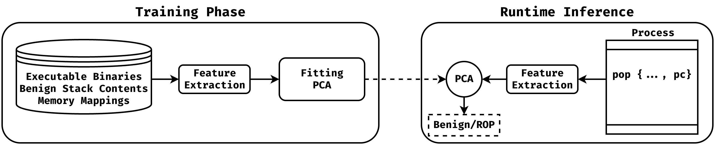
Overview of PROPS
PROPS (Precision ROP Scanner)
1
2
3
5
4
6
(on server)
(on embedded device)
Notes:
Only using benign stack content, learn benign stack pattern

Slide 5
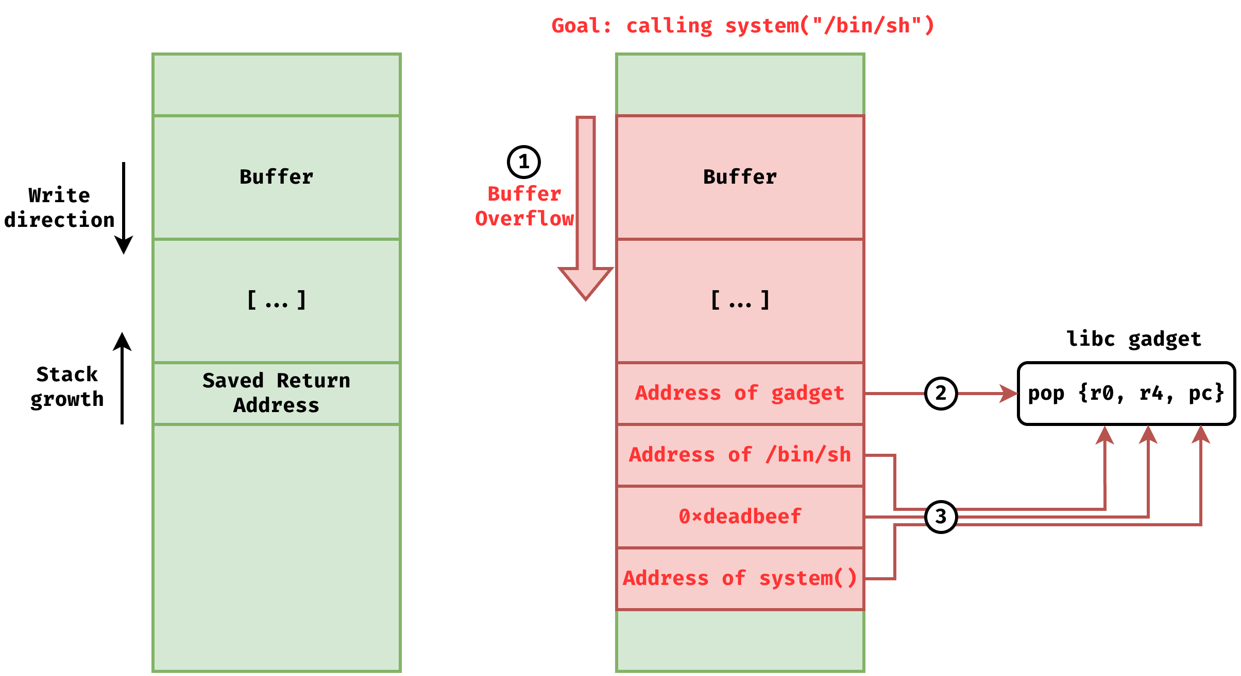
ROP on 32-bit ARM
Bypasses XN by chaining together small instruction sequences (gadgets)
32-bit ARM -> returning from function via pop {…, pc} instruction
The chain is on the top of the stack

Slide 6
Feature Extraction Heuristic
From the top of the stack, we take 32x4 bytes
Every 4-byte value is considered as an address (4-byte aligned on 32-bit ARM)
Check where it points, take 40 bytes (=10 instr.), and label it:
  F -> libc function
  S -> string
  N -> invalid instruction
  ! -> SVC instruction (supervisor call)
  G -> pop {..., pc} instruction
  J -> branch-to-register instruction
  X -> executable region
  W -> writable region
  R -> readable region
  ? -> address does not correspond to any mapped memory region
Notes:
Raw address values don’t have much meaning
We semantically encode

Slide 7
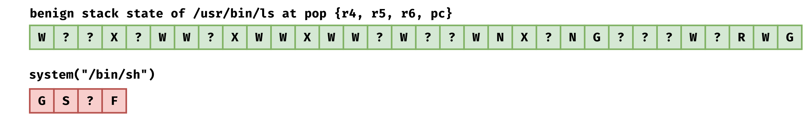
Example
Notes:
Remove the last row

Slide 8
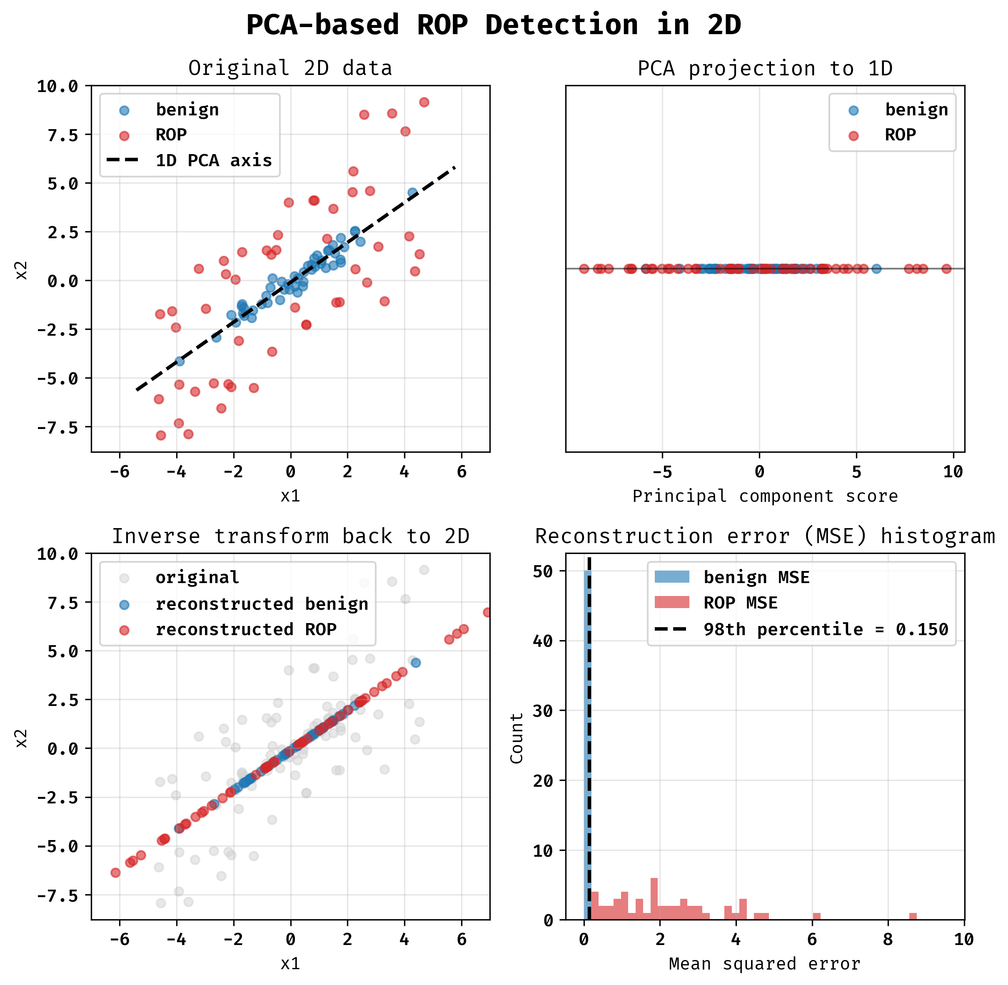
ROP as Anomaly on Stack
Semi-supervised learning approach
Using Principal Component Analysis (PCA)
One-hot encoded feature vectors (32 x 10)
Measuring reconstruction errors
  low value -> normal, benign
  high value -> anomaly, ROP
Stack that contains ROP chain produce higher reconstruction error
Threshold selection
Notes:
PCA – dimensionality reduction technique

Slide 9
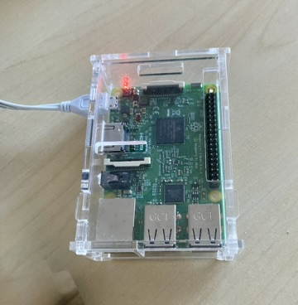
Benign Stack Collection
Raspberry Pi3 Model B running the 32-bit version of Raspberry Pi OS Lite
Run 900+ programs on RPI3 with GDB
Breakpoint at main()
  Usually, every library is loaded at this point
  We make a full memory dump
Breakpoints at every pop {…, pc} instruction
  save the top of the stack (32x4 bytes)
  not every breakpoints are reached
  same breakpoint may be hit multiple times
400K saved stack content (290K unique)
22K unique benign feature vectors
Notes:
Challenging task to collect benign data

Slide 10
ROP Chain Generation
Using angrop tool (Zeng et al., in NDSS 2026)
60 selected common ELFs (ls, grep, find, …)
3 attacker objectives
  Spawning a shell
  Creating a new executable page
  Making the stack executable
4 different methods by calling
  functions using gadgets from libc
  functions using gadgets from the target program
  system calls using gadgets from libc
  system calls using gadgets from the target program
2 modes: ARM and Thumb
1200+ ROP payloads (sometimes angrop didn’t succeed)
284 unique feature strings after feature extraction
Notes:
Angrop --> Zeng, K., Schloegel, M., Salls, C., Doupé, A., Wang, R., Shoshitaishvili, Y., Bao, T.: ropbot: Reimaging code reuse attack synthesis, NDSS 2026
Architecture agnostic
State-of-the art
Functions: system, mmap, mprotect

Slide 11
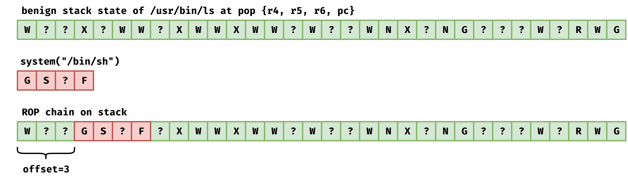
Example ROP Feature Vector
Notes:
Injecting ROP to stack, Simulating rop attacks
As realistic as possible

Slide 12
Evaluation Setup
Train on 80% of benign data (17, 600 samples)
ROP chains are NOT used for training
Test on 20% of benign data (4,400 samples)
Insert ROP chains into benign data from test set (4,400 samples)
Hyperparameter search (number of PCA components, threshold)
K-fold cross validation (5 splits, 2 repeats)
Notes:
Hard to collect real stack content with rop

Slide 13
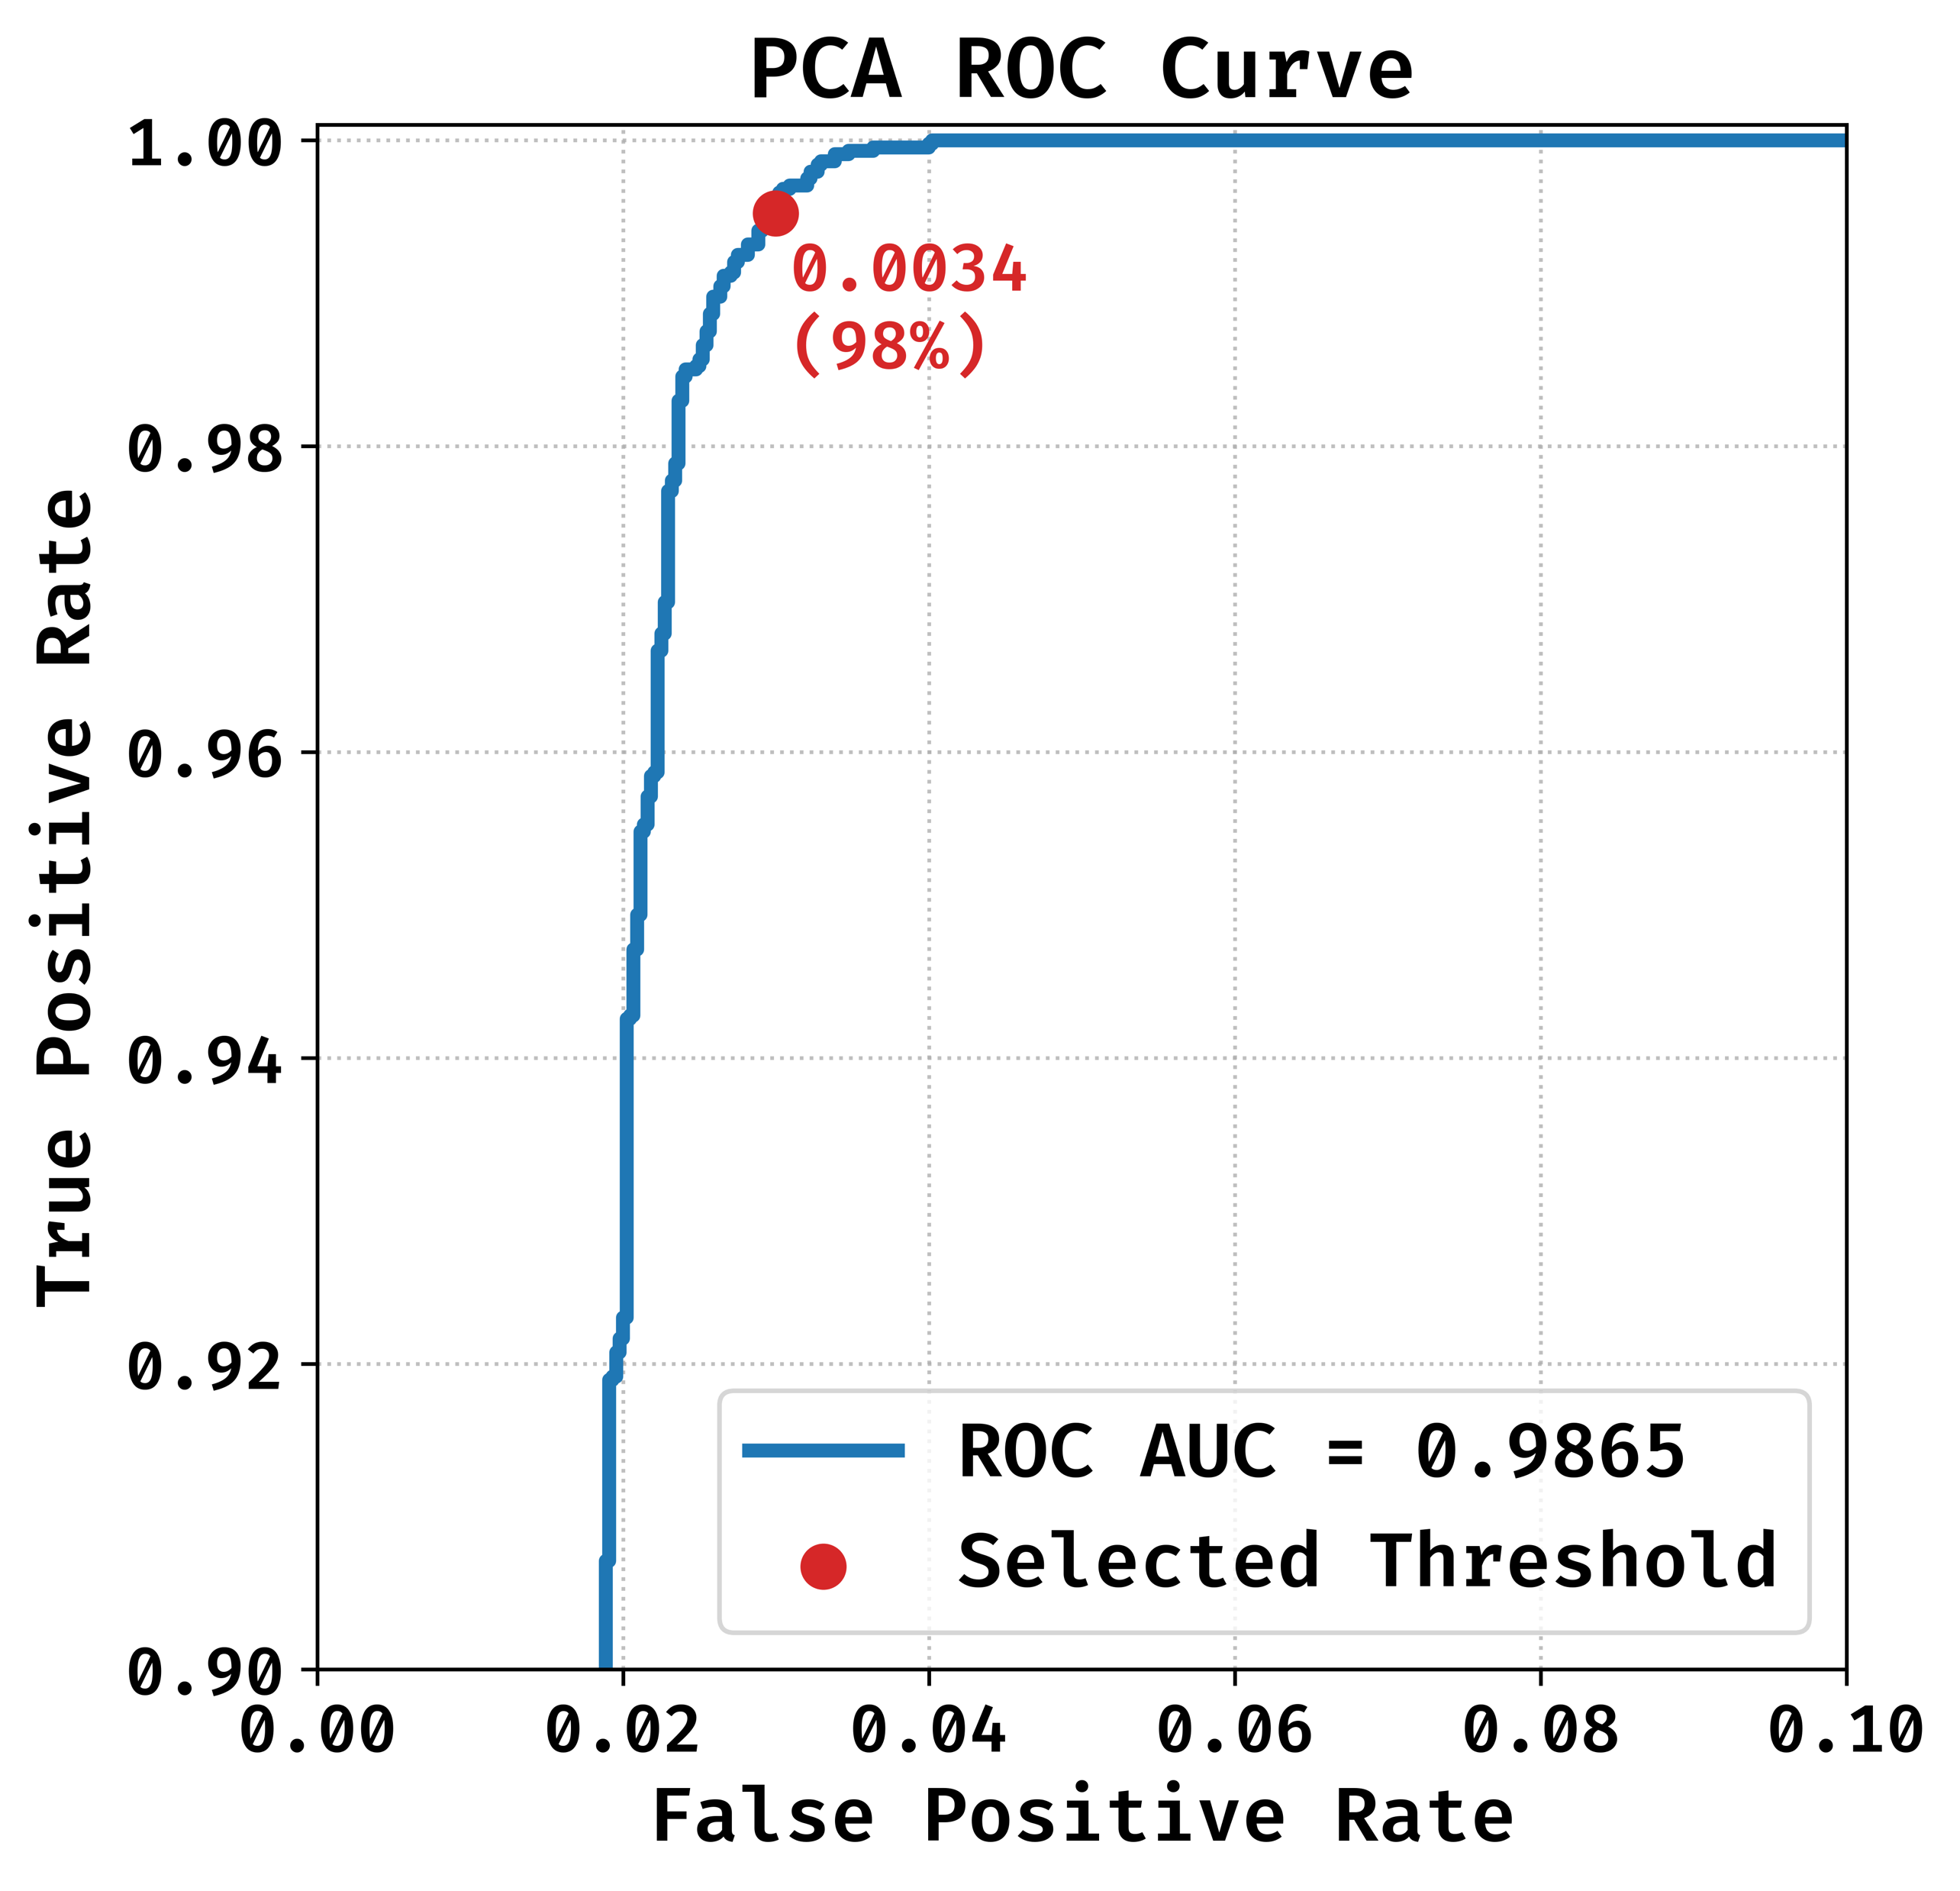
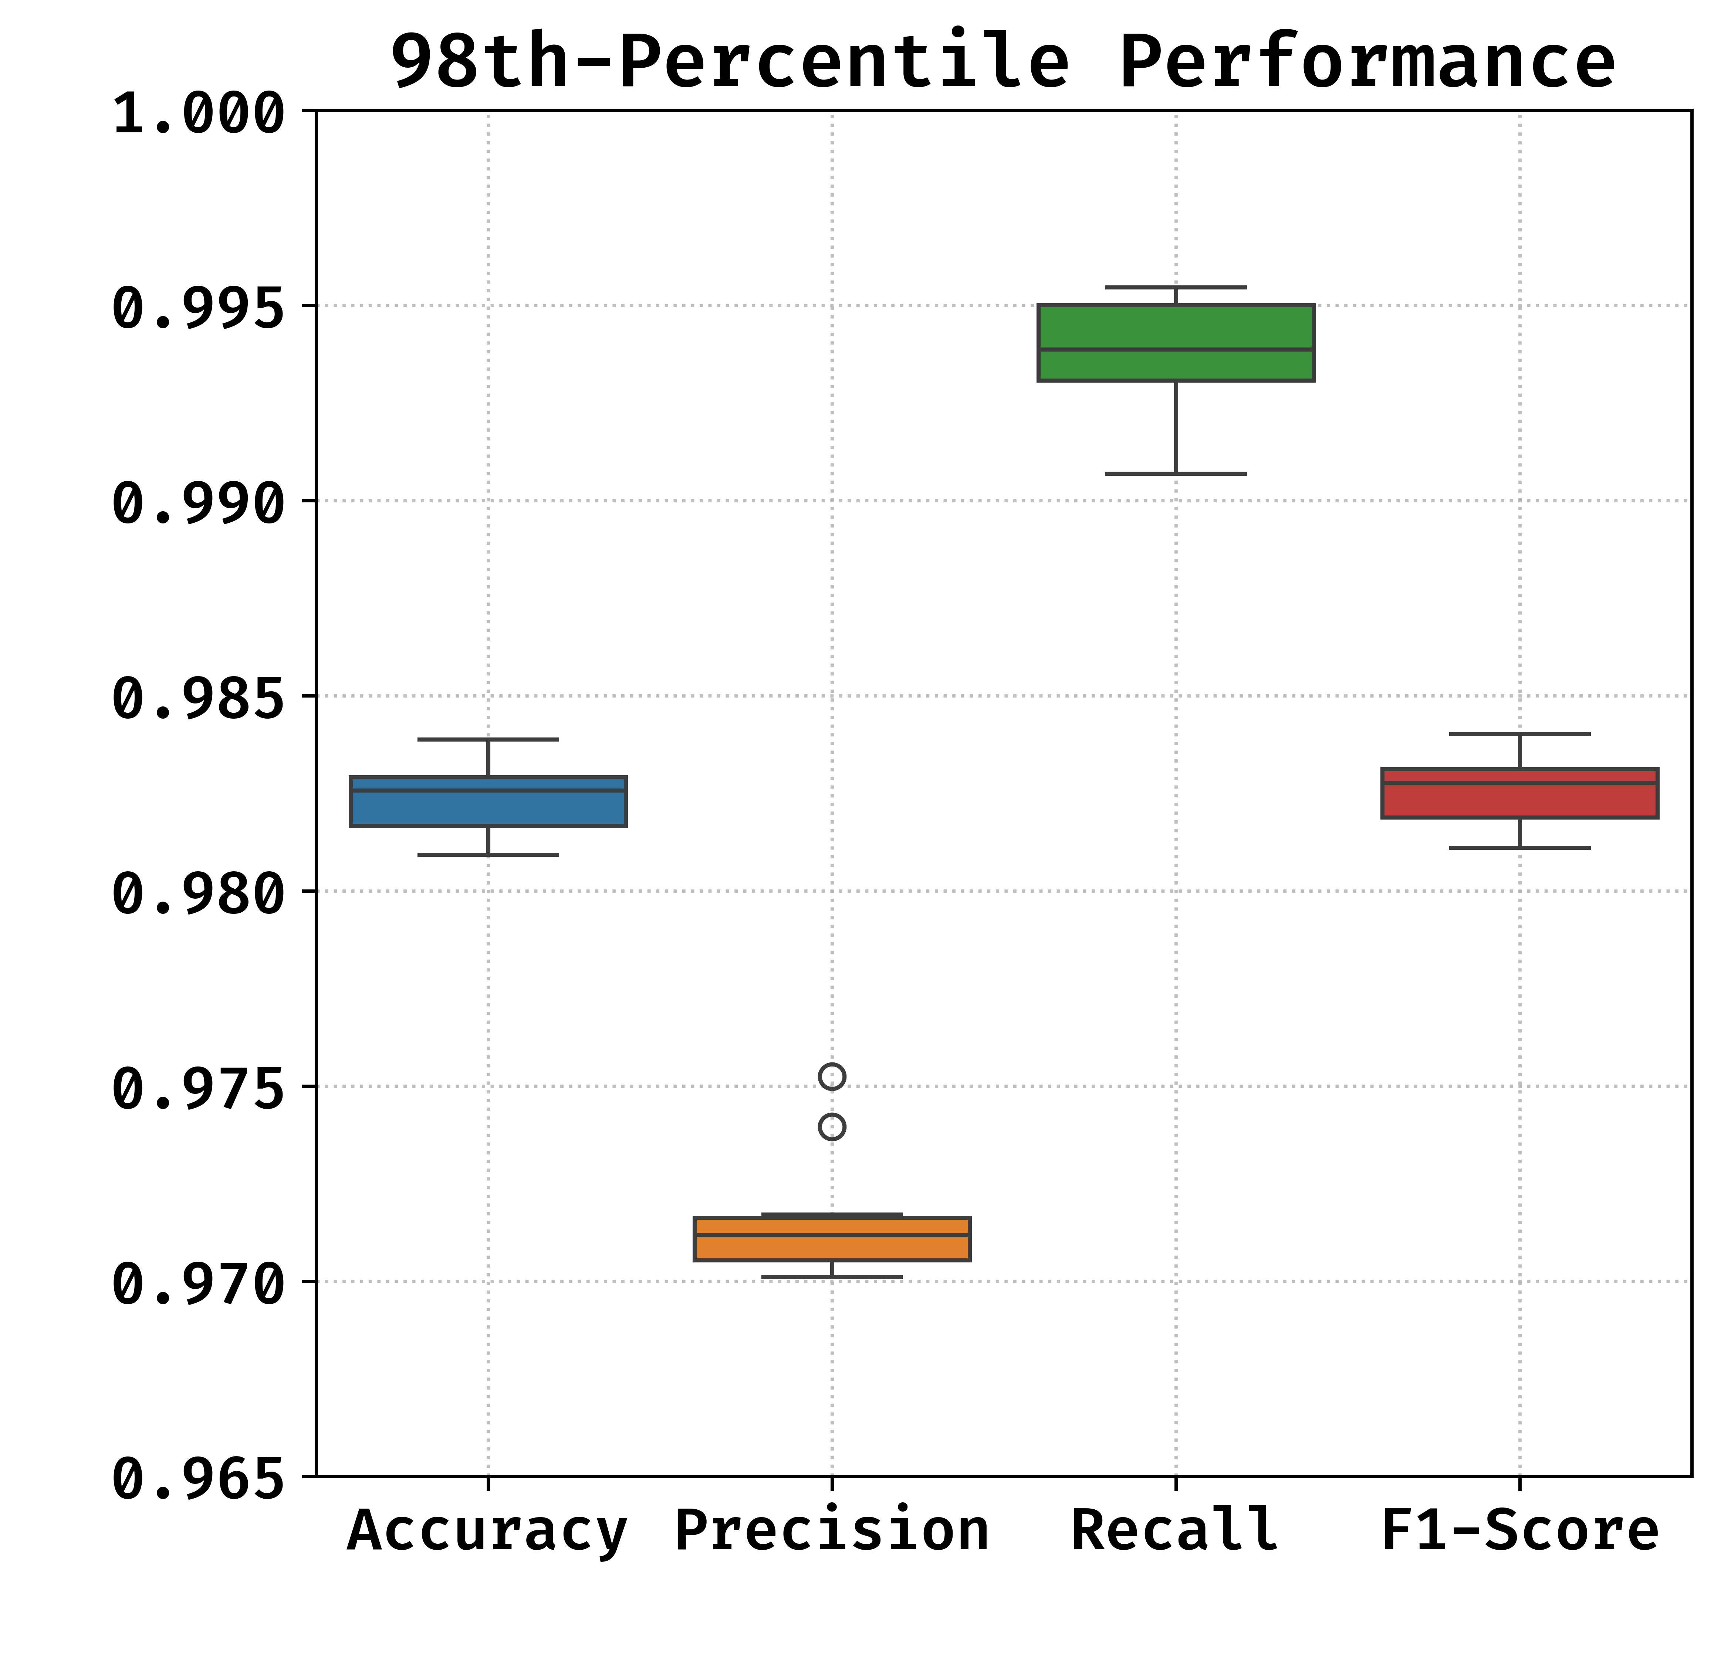
Detection Performance
Used threshold: 98th percentile of reconstruction errors observed on the training set
Notes:
Threshold selection method, trade-off for reducing FP …

Slide 14
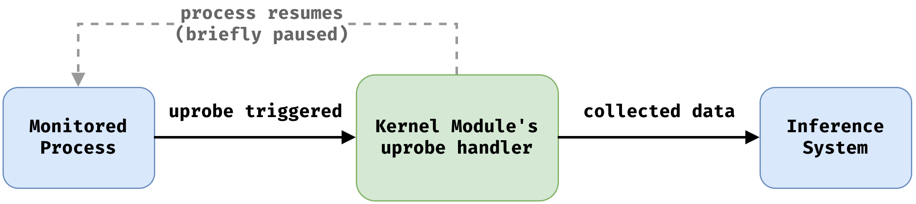
Proof-of-Concept Implementation
We place uprobes to some return instructions of the monitored process
(to the “vulnerable function”)
Loadable Kernel Module extracts the necessary data from a running process
When the execution reaches an uprobe, the Kernel Module gets the control, extracts the data and sends to the Inference System
Monitored process runs further
Notes:
Uprobes are a tracing functionality of the Linux kernel, which allows placing probes at arbitrary addresses of any userspace application
Kernel space - User space

Slide 15
Runtime Performance
Monitored process is paused while the kernel module collects the required data
Kernel module processing time is fix except for the memory mapping traversal
Low per-invocation latency
Runtime overhead measured on 60 common utility programs
A few trigger points placed at different function return points
  measurements with 1, 3, 6 and 12 trigger points
  same trigger point can be reached multiple times
  1-3 trigger points: +2% overhead on average
Significant variation in individual program performance
  depends on the target program and its arguments
  measurement noise
Notes:
Nem kell konkret szamok, nagy a variancia, miktol fugg, reszletek a cikkben
Mean: 53 µs
95th percentile: 106 µs
+ 2.02% with 1 trigger point
+ 2.04% with 3 trigger points
+ 53.06% with 6 trigger points
+ 67.07% with 12 trigger points

Slide 16
Validation
Crashmail 1.6 (CVE-2018-25223)
PMS 0.42 (CVE-2018-25224)
Using Exploit-DB ROP chains
Successful detection
Notes:
Welearegai, G.B., Hu, C., Hammer, C.: Detecting and Preventing ROP Attacks using Machine Learning on ARM. In: 2023 IEEE 47th Annual Computers, Software, and Applications Conference (COMPSAC) (2023).
Exploit-db chains convert to ARM, both opened a shell
These binaries wasn’t used for training

Slide 17
Conclusion
PROPS is a ROP detection method for legacy ARM-based devices
It is easy to deploy, compatible with existing systems
Monitors only the return points of known (or potentially) vulnerable functions
High detection rate (99% TPR)
Practical runtime overhead with 1-3 trigger points
Ongoing work
  Validation and runtime measurements on additional vulnerable programs
  Reducing FPR (2-3%) via ROP chain integrity check
Notes:
source code recompilation
firmware change
OS modification
chain integrity check without overhead

Slide 18
Acknowledgment
This work was supported by the National Research, Development and Innovation Fund of Hungary
  Doctoral Excellence Fellowship Program
  NKKP-ADVANCED_25-153325

