Slide 1
Cloud Computing
Cloud computing can be referred to as the storing and accessing of data over the internet rather than your computer's hard drive. This means you don't access the data from either your computer's hard drive or over a dedicated computer network (home or office network).
Cloud computing is a way to deliver computing as a service rather than a product. It is completely based on the Internet.
Cloud computing is the delivery of computing services over the internet.
Computing services include common IT infrastructure such as virtual machines, storage, databases, and networking.
Cloud services also include things like Internet of Things (IoT), machine learning (ML), and artificial intelligence (AI).
The term cloud refers to a network or the internet. It is a technology that uses remote servers on the internet to store, manage, and access data online rather than local drives. The data can be anything such as files, images, documents, audio, video, and more.

Slide 2
Cloud Computing
Cloud computing is a virtualization-based technology that allows us to create, configure, and customize applications and storing and accessing of data over an internet.
Cloud Computing provides on-demand hardware (like Server), storage resources, services hosting and services management environment and other devices as a utility or resource over a network.
Cloud computing removes the need to have local servers or personal devices to manage services and applications.
It is the on-demand availability of computer services like servers, data storage, networking, databases, etc.
One prominent example of cloud computing is Office 365 which allows users to store, access, edit their MS Office documents online (in browser) without installing the actual program on their device.

Slide 3
Cloud Computing
Cloud Computing with an example -
Whenever you travel through a bus, you take a ticket for your destination and hold back to your seat till you reach your destination. Likewise, other passengers also take ticket and travel in the same bus with you. When your stop comes you get off the bus. Cloud computing is just like that bus, carrying data and information for different users and allows to use its service with minimal cost.
There are the following operations that we can do using cloud computing:
Developing new applications and services
Storage, back up, and recovery of data
Hosting blogs, websites and services
Delivery of software on demand
Analysis of data
Streaming videos and audios

Slide 4
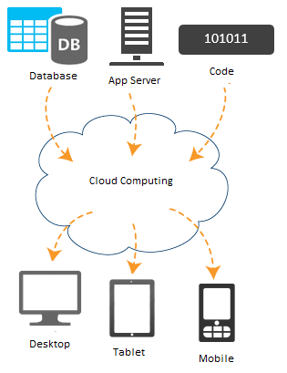
Cloud Computing
A Cloud is just a combination of hardware (computer, other devices), networks, storage, services, and interfaces that help in delivering computing as a service.

Slide 5
Why Cloud Computing?
With increase in computer and Mobile user’s, data storage has become a priority in all fields.
Large and small scale businesses today thrive on their data & they spent a huge amount of money to maintain this data.
It requires a strong IT support and a storage hub. Not all businesses can afford high cost of in-house IT infrastructure and back up support services.
For them Cloud Computing is a cheaper solution. Perhaps its efficiency in storing data, computation and less maintenance cost has succeeded to attract even bigger businesses as well.
The goal of cloud computing is to make running a business easier and more efficient, whether it's a small start-up or a large enterprise.
Every business is unique and has different needs. To meet those needs, cloud computing providers offer a wide range of services.
Cloud computing is flexible and cost-efficient, which can be beneficial to every business, whether it's a small start-up or a large enterprise.

Slide 6
Cloud Computing Benefits
There are many benefits of clouds. Some of them are listed below.
It's cost-effective: By using cloud computing, the cost will be reduced because to take the services of cloud computing, IT company need not to set its own infrastructure and pay-as-per usage of resources.
High availability: Depending on the service-level agreement (SLA) that you choose, your cloud-based apps can provide a continuous user experience with no apparent downtime, even when things go wrong.
Scalability: Apps in the cloud can scale up and scale down
Elasticity: You can configure cloud-based apps to take advantage of autoscaling, so your apps always have the resources they need.
Agility: Deploy and configure cloud-based resources quickly as your app requirements change.
Maintenance: Maintenance of cloud computing applications is easier, since they do not need to be installed on each user's computer and can be accessed from different places. So, it reduces the cost also.
Disaster recovery: By taking advantage of cloud-based backup services, data replication, and geo-distribution, you can deploy your apps with the confidence that comes from knowing that your data is safe in the event of disaster.

Slide 7
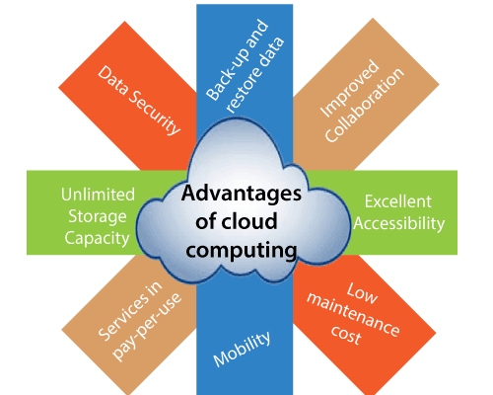
Advantages of Cloud Computing

Slide 8
Advantages of Cloud Computing
Back-up and restore data: Once the data is stored in the cloud, it is easier to get back-up and restore that data using the cloud.
Improved collaboration: Cloud applications improve collaboration by allowing groups of people to quickly and easily share information in the cloud via shared storage.
Excellent accessibility: Cloud allows us to quickly and easily access store information anywhere, anytime in the whole world, using an internet connection. An internet cloud infrastructure increases organization productivity and efficiency by ensuring that our data is always accessible.
Low maintenance cost: Cloud computing reduces both hardware and software maintenance costs for organizations.
Mobility: Cloud computing allows us to easily access all cloud data via mobile.
Services in the pay-per-use model: Cloud computing offers Application Programming Interfaces (APIs) to the users for access services on the cloud and pays the charges as per the usage of service.
Unlimited storage capacity: Cloud offers us a huge amount of storing capacity for storing our important data such as documents, images, audio, video, etc. in one place.
Data security: Data security is one of the biggest advantages of cloud computing. Cloud offers many advanced features related to security and ensures that data is securely stored and handled.

Slide 9
CapEx vs OpEx in Cloud Computing
CapEx(capital expenditure) means spending funds on infrastructure purchases such as building a data center.
CapEx funding by its nature requires upfront capital for these large purchases, which limits many organizations from building data centers.
Capital expenditures are accounted for as payments for goods and services and recorded on the balance sheet.
Capital expenditures incur depreciation as assets age.
Examples of CapEx expenditure in the cloud:
Building/premises purchase
Physical data center equipment like servers and networking infrastructure
IT equipment for IT and office staff
Patents
Installing local software or in-house applications

Slide 10
CapEx vs OpEx in Cloud Computing
Operational Expenditure (OpEx): It is like a pay-as-you-go service.
You can deduct this expense in the same year you spend it. There is no up-front cost, as you pay for a service or product as you use it.
Examples of OpEx expenses in the cloud
Items that require a subscription fee, such as software licenses or cloud-based services such as SaaS, IaaS, PaaS, and DaaS
Property leasing, such as leasing IT infrastructure on Amazon Web Services (AWS) for a monthly fee
Ongoing web hosting
Annual IT infrastructure maintenance agreements
Software support

Slide 11
CapEx vs OpEx in Cloud Computing
Context | CapEx | OpEx
The upfront cost | Significant | None
Ongoing cost | Low | Based on usage
Tax Deduction | Over-time | Same year
Early Termination | No | Anytime
Maintenance | Significant | Low
Value over time | Lowers | No change

Slide 12
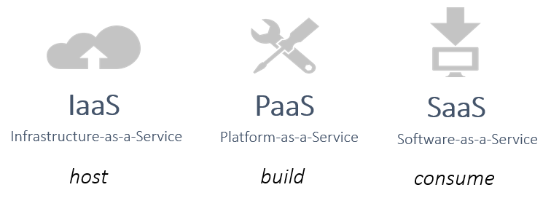
Cloud Service Models
Cloud computing service models can be classified into three categories as IaaS, PaaS and SaaS

Slide 13
Infrastructure-as-a-Service(Iaas)
IaaS is the most flexible category of cloud services. It aims to give you complete control over the hardware that runs your application. Instead of buying hardware, with IaaS, you rent it.
This cloud service model is the closest to managing physical servers; a cloud provider will keep the hardware up-to-date, but operating system maintenance and network configuration is up to you as the cloud tenant.
For example, Azure virtual machines are fully operational virtual compute devices running in Microsoft datacenters.
An advantage of this cloud service model is rapid deployment of new compute devices. Setting up a new virtual machine is considerably faster than procuring, installing, and configuring a physical server.
Advantages
Users have no up-front costs.
Applications can be made accessible quickly, and deprovisioned whenever needed.
Organizations pay only for what they use and operate under an Operational Expenditure (OpEx) model.

Slide 14
Platform-as-a-Service(Paas)
PaaS provides the same benefits and considerations as IaaS, but there are some additional benefits
This cloud service model is a managed hosting environment.
The cloud provider manages the virtual machines and networking resources, and the cloud tenant deploys their applications into the managed hosting environment.
For example, Azure App Services provides a managed hosting environment where developers can upload their web applications, without having to worry about the physical hardware and software requirements.
Advantages
Users have no up-front costs.
PaaS is more agile than IaaS, and users don't need to configure servers for running applications.
Organizations pay only for what they use and operate under an Operational Expenditure (OpEx) model.

Slide 15
Software-as-a-Service(Saas)
SaaS is software that's centrally hosted and managed for you and your users or customers. Usually one version of the application is used for all customers, and it's licensed through a monthly or annual subscription.
In this cloud service model, the cloud provider manages all aspects of the application environment, such as virtual machines, networking resources, data storage, and applications. The cloud tenant only needs to provide their data to the application managed by the cloud provider. For example, Microsoft Office 365 provides a fully working version of Microsoft Office that runs in the cloud. All you need to do is create your content, and Office 365 takes care of everything else..
Advantages
Users have no up-front costs.
Users pay for the software they use on a subscription model, typically monthly or yearly, regardless of how much they use the software.
Users can access the same application data from anywhere

Slide 16
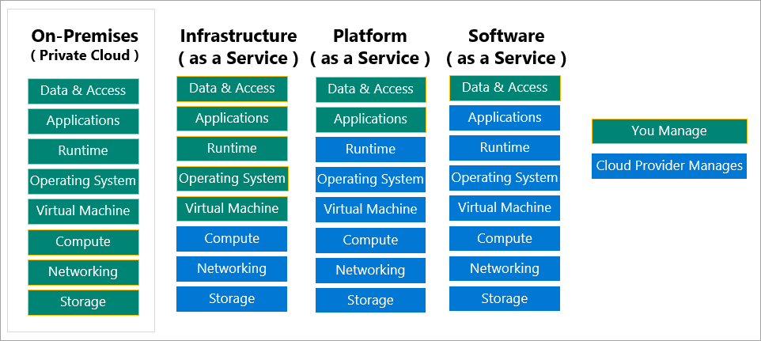
Cloud Service Models

Slide 17
Cloud Computing Service Models
IaaS | PaaS | SaaS
The most flexible cloud service. | Focus on application development. | Pay-as-you-go pricing model.
You configure and manage the hardware for your application. | Platform management is handled by the cloud provider. | Users pay for the software they use on a subscription model.

Slide 18
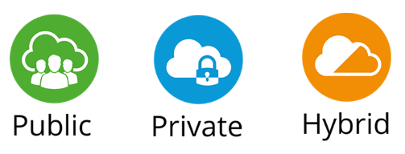
Cloud Deployment Models
There are three models to deploy your cloud computing resources.
public cloud
private cloud
hybrid cloud.

Slide 19
Cloud Deployment Models
Public cloud
A public cloud is managed by the cloud vendor and all cloud resources run in cloud vendor datacenters.
A public cloud is built, controlled, and maintained by a third-party cloud provider.
A Public cloud resources like servers and storage are accessible over the Internet.
With a public cloud, anyone that wants to purchase cloud services can access and use resources.
For Example, Microsoft Azure, AWS and Google Cloud
Private cloud
A private cloud is managed by a single business or organization and all cloud resources run in an organization on-site datacenter.
A private cloud services are accessible through a private network.
This method is more used Where the computing resources can be governed, owned and operated by the same organization.
For Example, resources running in an organization on-site datacentre

Slide 20
Cloud Deployment Models
Hybrid cloud
A hybrid cloud is a computing environment that uses both public and private clouds.
A hybrid cloud is a combination of public and private clouds. Some cloud resources run on public cloud vendor datacenters and some of them run in organization on-site datacenters.
A hybrid cloud gives greater flexibility and more deployment options to a business.
For Example, Microsoft Azure some resources running in an organization on-site datacenters and some on Microsoft datacenters.
Note: The cloud deployment model you choose depends on your budget, and on your security, scalability, and maintenance needs.

Slide 21
Cloud Deployment Models
Public cloud | Private cloud | Hybrid cloud
No capital expenditures to scale up | Organizations have complete control over resources and security | Provides the most flexibility
Applications can be quickly provisioned and deprovisioned | Data is not collocated with other organizations’ data | Organizations determine where to run their applications
Organizations pay only for what they use | Hardware must be purchased for startup and maintenance | Organizations control security, compliance, or legal requirements
Organizations don’t have complete control over resources and security | Organizations are responsible for hardware maintenance and updates

Slide 22
Cloud model comparison
Public cloud
No capital expenditures to scale up.
Applications can be quickly provisioned and deprovisioned.
Organizations pay only for what they use.
Private cloud
Hardware must be purchased for start-up and maintenance.
Organizations have complete control over resources and security.
Organizations are responsible for hardware maintenance and updates.
Hybrid cloud
Provides the most flexibility.
Organizations determine where to run their applications.
Organizations control security, compliance, or legal requirements.

Slide 23
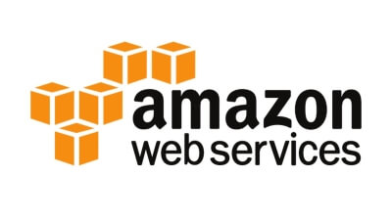
Cloud Service Providers
Cloud Service providers (CSP) offers various services such as Software as a Service, Platform as a service, Infrastructure as a service, network services, business applications, mobile applications, and infrastructure in the cloud.
The cloud service providers host these services in a data center, and users can access these services through cloud provider companies using an Internet connection.
Amazon Web Services (AWS)
AWS (Amazon Web Services) is a secure cloud service platform provided by Amazon. It offers various services such as database storage, computing power, content delivery, Relational Database, Simple Email, Simple Queue, and other functionality to increase the organization's growth.

Slide 24
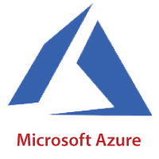
Cloud Service Providers
Microsoft Azure
Microsoft Azure is also known as Windows Azure. It supports various operating systems, databases, programming languages, frameworks that allow IT professionals to easily build, deploy, and manage applications through a worldwide network. It also allows users to create different groups for related utilities.

Slide 25
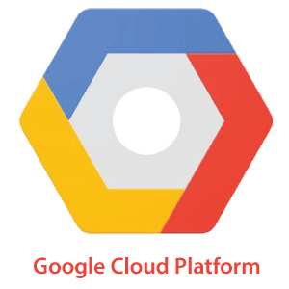
Cloud Service Providers
Google Cloud Platform
Google cloud platform is a product of Google. It consists of a set of physical devices, such as computers, hard disk drives, and virtual machines. It also helps organizations to simplify the migration process.

