Slide 1
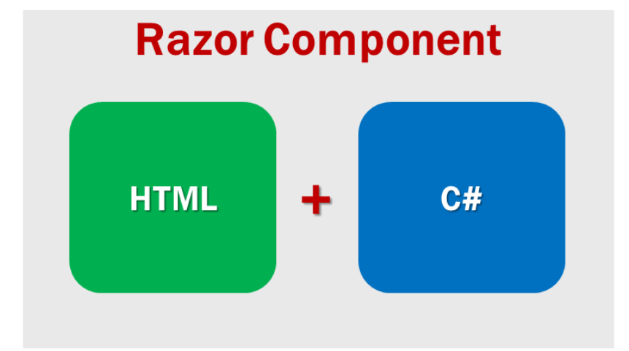
Blazor Components
Blazor is a component-driven framework
Components are the building blocks of a Blazor application.
Components can be nested, reused.
Component files have the extension .razor
Component is a combination of two things
HTML markup which defines the user interface of the component i.e the look and feel.
C# code which defines the processing logic

Slide 2
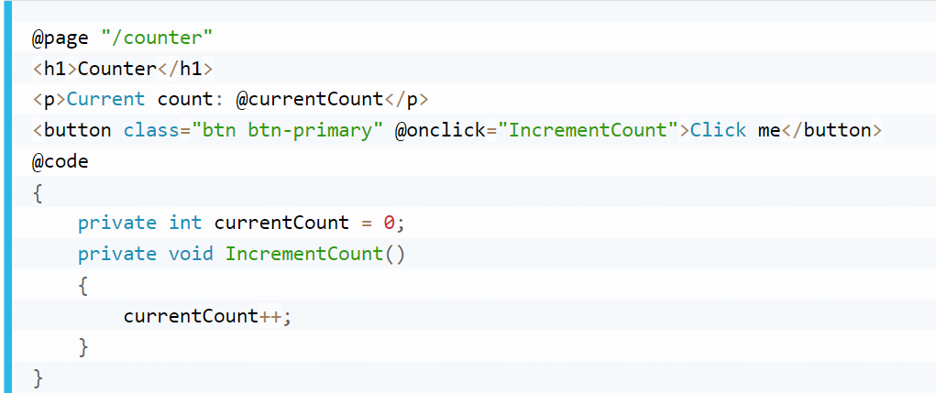
Blazor Components

Slide 3
Blazor Components
When the application is compiled, the HTML and C# code converted into a component class.
The name of the generated class matches the name of the component file. A component file name must start with an uppercase character.
If you add a component file that starts with a lower case character, the code will fail to compile and you get the following compiler error.
A component can also be nested inside another component using HTML syntax

Slide 4
Blazor Components
Where to place components??
Components can be placed anywhere within a blazor project.
It's a good practice to place components that produce webpages in the Pages folder and reusable non-page components in the Shared folder.

Slide 5
Split razor component
There are 2 approaches, to split component HTML and C# code into their own separate files.
1.Partial files approach
2.Base class approach

Slide 6
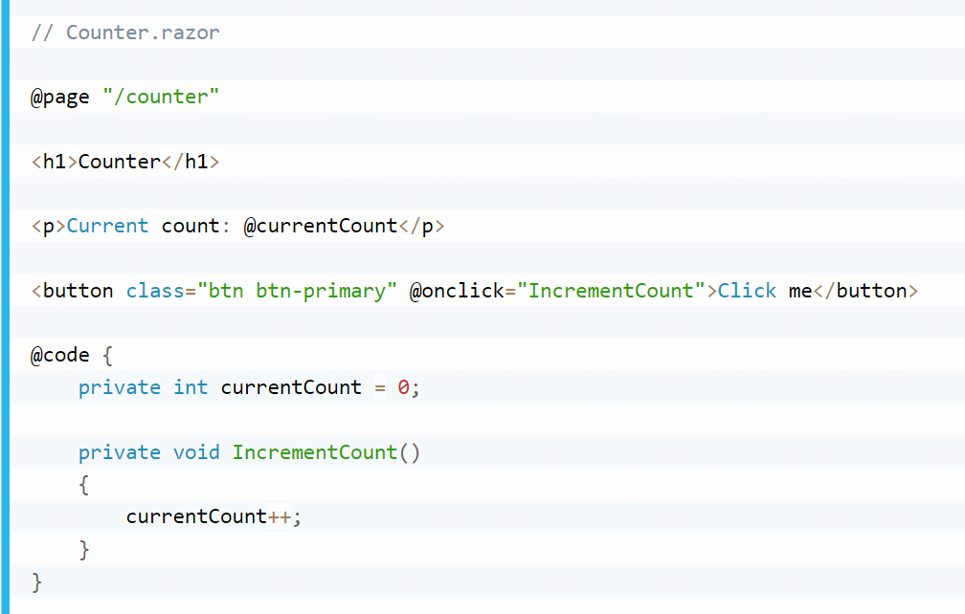
Split razor component
Single file or Mixed file approach
Both the HTML markup and C# code are in a single file.

Slide 7
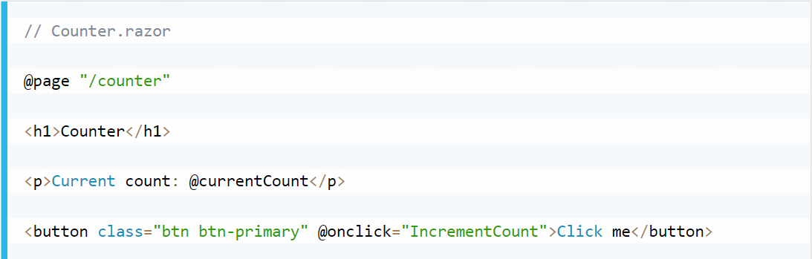
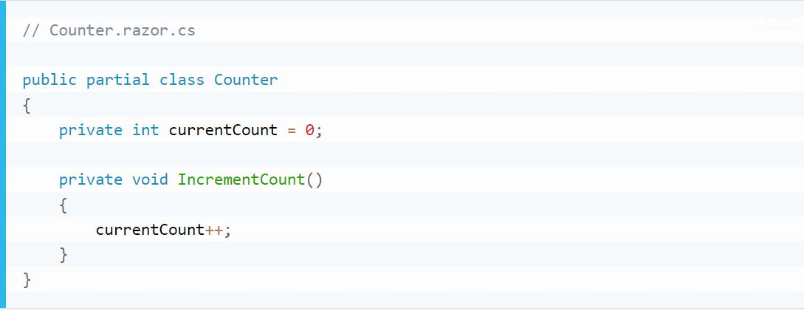
Split razor component
Partial files approach

