Slide 1
Blazor

Slide 2
What you will learn from ASP.NET Blazor Session
Blazor Introduction
Blazor Hosting Models
Blazor Project Structure
How to Develop web applications using C# and Blazor
Blazor Components
Blazor Data Binding
Blazor Hosting Models
Event Handling & Event Callback
Routing and Route Parameters
Rest API with Blazor

Slide 3
data-driven web applications
In order to develop a data-driven web application, we need two things. Server-side development as well as client-side development.
For server-side development, we generally use server-side programming languages such as C#, Java, PHP, etc.
For client-side development, we generally use JavaScript frameworks such as Angular, React, Vue, etc.
A Full-stack developer need to learn a client-side programming language (such as Angular, React, Vue, etc.) as well as a server-side programming language (such as C#, Java, PHP, etc.).

Slide 4
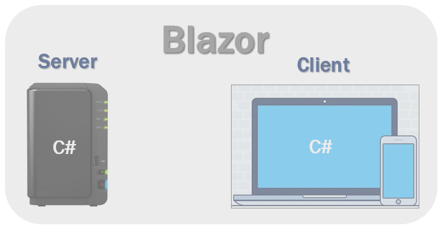
data-driven web applications
why should we learn 2 different sets of programming languages and frameworks.
Can we use C# both for server-side and client-side development?
Yes, we can use C# for both client-side as well as server-side development and this is possible because of ASP.NET Core Blazor.
With the introduction of Blazor, now you can develop client-side web user interfaces using C# instead of JavaScript. The C# code can be executed both on the server as well as in the client browser.

Slide 5
What is Blazor
Blazor is a web framework build by Microsoft.
Blazor is a Single Page Application development framework.
The name Blazor is a combination/mutation of the words Browser and Razor
Blazor is a free and open-source framework that allows us to build interactive web applications using C#.
The implication being that instead of having to execute Razor views on the server in order to present HTML to the browser, Blazor is capable of executing these views on the client.
Blazor is a free, open-source Web framework that allows us to create interactive applications in C# that will be used mainly through a web browser.
Blazor is the framework that makes it easy to write C# code in the browser using a component.
Historically, if we want to create an application that runs on a browser, we were use JavaScript. Now, thanks to blazor, we can use a programming language in the browser i.e. we can use C# language.
Blazor is a new Single Page Application (SPA) technology by Microsoft. It is a comparable technology to React, Angular, and Vue.js but uses C# instead of JavaScript.

Slide 6
What is Blazor
Blazor is a .NET frontend web framework that supports both server-side rendering and client interactivity in a single programming model
Blazor does not require any kind of plugin installed on the client in order to execute inside a browser.
Blazor either runs server-side, in which case it executes on a server and the browser acts like a dumb terminal, or it runs in the browser itself by utilizing WebAssembly.
Create rich interactive UIs using C#.

Slide 7
Advantages of Blazor framework
.NET Ecosystem for our front-end application.
C# (LINQ and asynchronous programming)
Ability to share the code between front-end and back-end
Working with components
Blazor also supports features of a SPA (Single Page Application) framework such as:
Routing
Layouts
Dependency Injection
JavaScript interop
Forms and validation
Server-side rendering

Slide 8
Blazor hosting models
Blazor offers 2 hosting models.
Blazor Server-side hosting.
Blazor WebAssembly hosting

Slide 9
Blazor server-side hosting model
in this model, the application is executed fully on the server within the ASP.NET Core application.
In this model, between the client and the server, a SignalR connection is established.
To communicate with the HTML, the server-side application uses SignalR.
With this hosting model, the application is executed on the server. Between the client and the server a SignalR connection is established.
In this model, When an event occurs on the client such as a button click, the information about the event is sent to the server over the SignalR connection.
We use the Blazor Server App template, to create a Blazor application with the server hosting model.

Slide 10
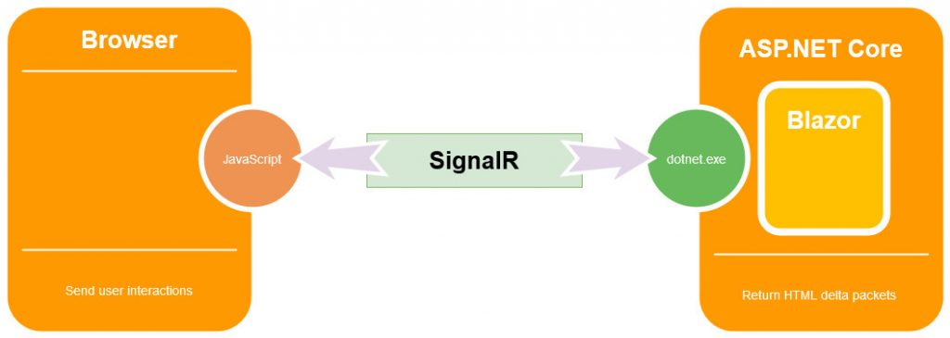
Blazor server-side

Slide 11
Benefits of Blazor Server Applications
the benefit of this type of application is that the download size is really small, significantly smaller than the Blazor WebAssembly, which means the application loads much faster.
Because it runs on the server-side, it uses all the advantages of server capabilities with all the server-side APIs available.
Blazor server-side pre-renders HTML content before it is sent to the client's browser. This makes it search-engine friendly, and there is no perceivable start-up time.
Blazor server-side apps will work on older browsers (such as Internet Explorer 11) as there is no requirement for Web Assembly, only HTML and JavaScript. As the code executes on the server, it is also possible to debug our .NET code in Visual Studio.
Additionally, we have full debugging support and our application can work on browsers that don’t support WebAssembly. This means, older browsers are supported.

Slide 12
Benefits of Blazor Server Applications
The app loads much faster as the download size is significantly smaller than a Blazor WebAssembly app
Since the app runs on the server, it can take full advantage of server capabilities, including use of any .NET Core compatible APIs.
All the client needs, to use the app is a browser. Even browsers that don't support WebAssembly can be used.
More secure because the app's .NET/C# code isn't served to clients.

Slide 13
Downsides of Blazor Server Applications
Since it runs on the server, it must be connected to the server all the time, so there’s no offline support.
Each interaction must go to the server which can cause network delays.

Slide 14
Blazor WebAssembly
It is the client-side hosting model.
This type of application runs on the client in the browser with the help of WebAssembly.
Blazor WebAssembly is a single-page app (SPA) framework for building interactive client-side web apps with . NET.
Running . NET code inside web browsers is made possible by WebAssembly (abbreviated wasm ).
As soon as the application starts it downloads everything to the browser (HTML, CSS, and JavaScript files) and it also downloads the assembly (.NET Standard DLL) files required for the application.
So, once the application starts, it can work in offline mode, meaning, it doesn’t require the server. Because this type of application is composed of static files, we can deploy it to the CDN or Server, or Azure Storage for static websites.

Slide 15
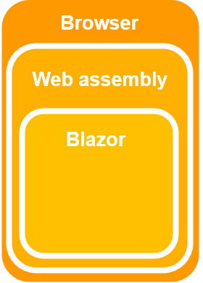
Blazor WebAssembly
We use the Blazor WebAssembly App template, to create a Blazor application with the client-side hosting model.
WebAssembly is a web standard, it is supported on all major browsers, which means also client-side Blazor apps will run inside a browser on Windows/Linux/Mac/Android and iOS.
Blazor does not require .NET to be installed on the client in order to run through WebAssembly.

Slide 16
Benefits of Blazor WebAssembly Applications
The first benefit is that this type of application is very fast, with the speed almost like the native browser applications.
As we’ve said, the Blazor WebAssembly can work in offline mode, which means it doesn’t require a connection to the server.
Additionally, serverless deployment is possible, which means you don’t need a server, just something to get the files to the browser.
Finally, this type of application can run in all modern browsers without additional plugins. This makes deployment easy on all sorts of devices.

Slide 17
Downsides of Blazor WebAssembly Applications
Since this type of application runs only in the browser, it is restricted to the browser’s capabilities.
Another thing is that everything executes in the browser. This could be a downside if the application does some heavy lifting, and our browser may not have enough resources to support that.
An additional downside is that Blazor WebAssembly downloads all the files to the client, meaning loading times are longer.
Finally, because WebAssembly is required to run this type of application, older browsers (without WebAssembly support) can’t run the Blazor WebAssembly applications. That said if our application requires running on an older browser then it is a better choice to use the Blazor server-side application.

