Slide 1
Probability and Statistical Testing
Matt Creamer

Slide 2
Discrete Probability Distributions
Probability of event A
  P(X) = # of times X occurred / # of trials
Probability of all events sums to 1
Probability is never negative

Slide 3
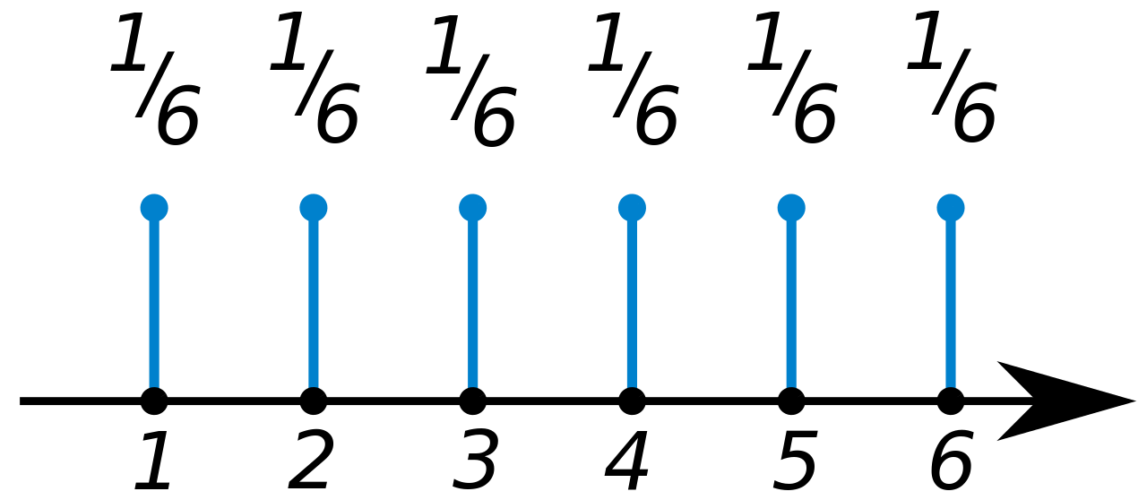
Discrete Probability Distributions
Imagine you flip a “fair” coin where each side is equally likely, whats the probability of getting heads?
Whats the probability of getting a “3” when rolling a fair dice?
See MATLAB

Slide 4
Independence
If two events are independent their probabilities can be summed
Whats the probability of getting a 1 or 2 on a dice? What about a 2 or a 3?
Whats the probability of getting a 1, 2, or 3?

Slide 5
Continuous Probability Distributions
Continuous random variables can take on any value within a range
The probability of getting an exact number is 0
Probabilities are only non zero when specified as a range
The integral of the probability distribution is 1

Slide 6
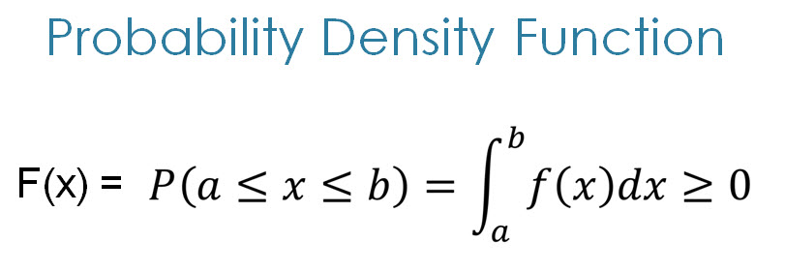
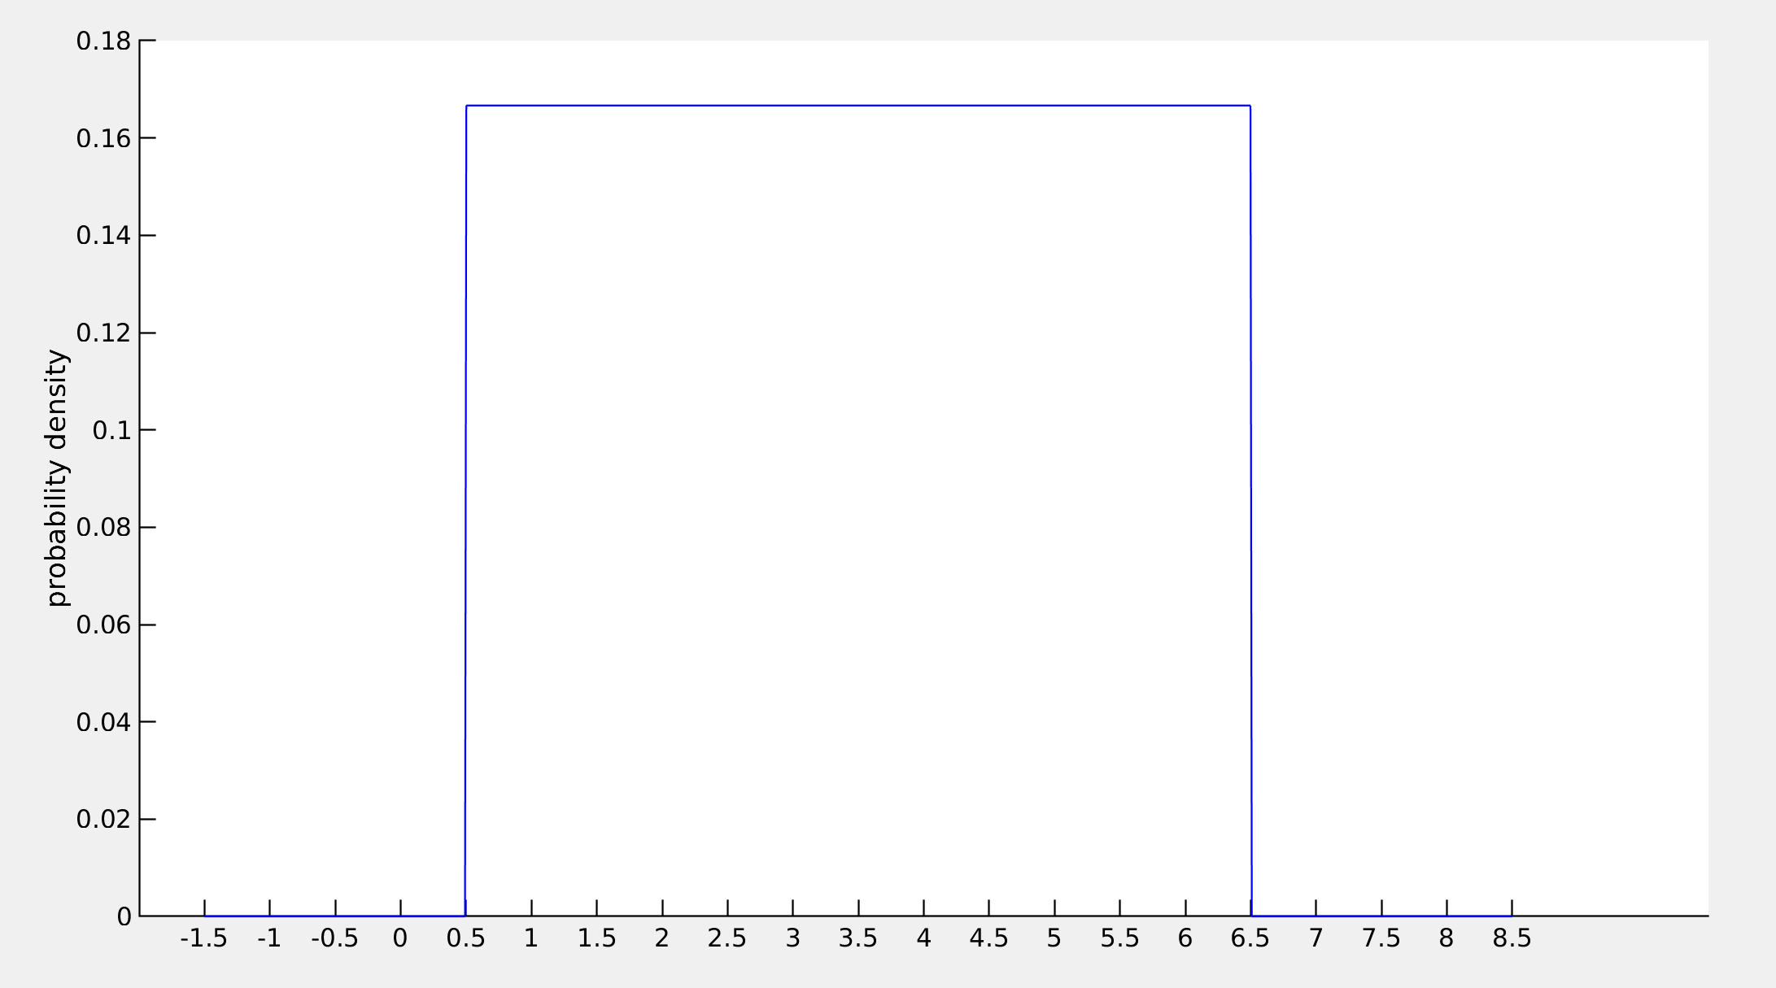
Uniform distribution

Slide 7
Gaussian / normal / bell curve
Defined by the mean and standard deviation
This is the distribution you get when many variables are combined together
68-95-99.7% of sampled values fall withing 1-2-3 standard deviations
If you sum many different random variables you get a Gaussian
Go to desmos
https://www.desmos.com/calculator/czflehe3jv
See MATLAB

Slide 8
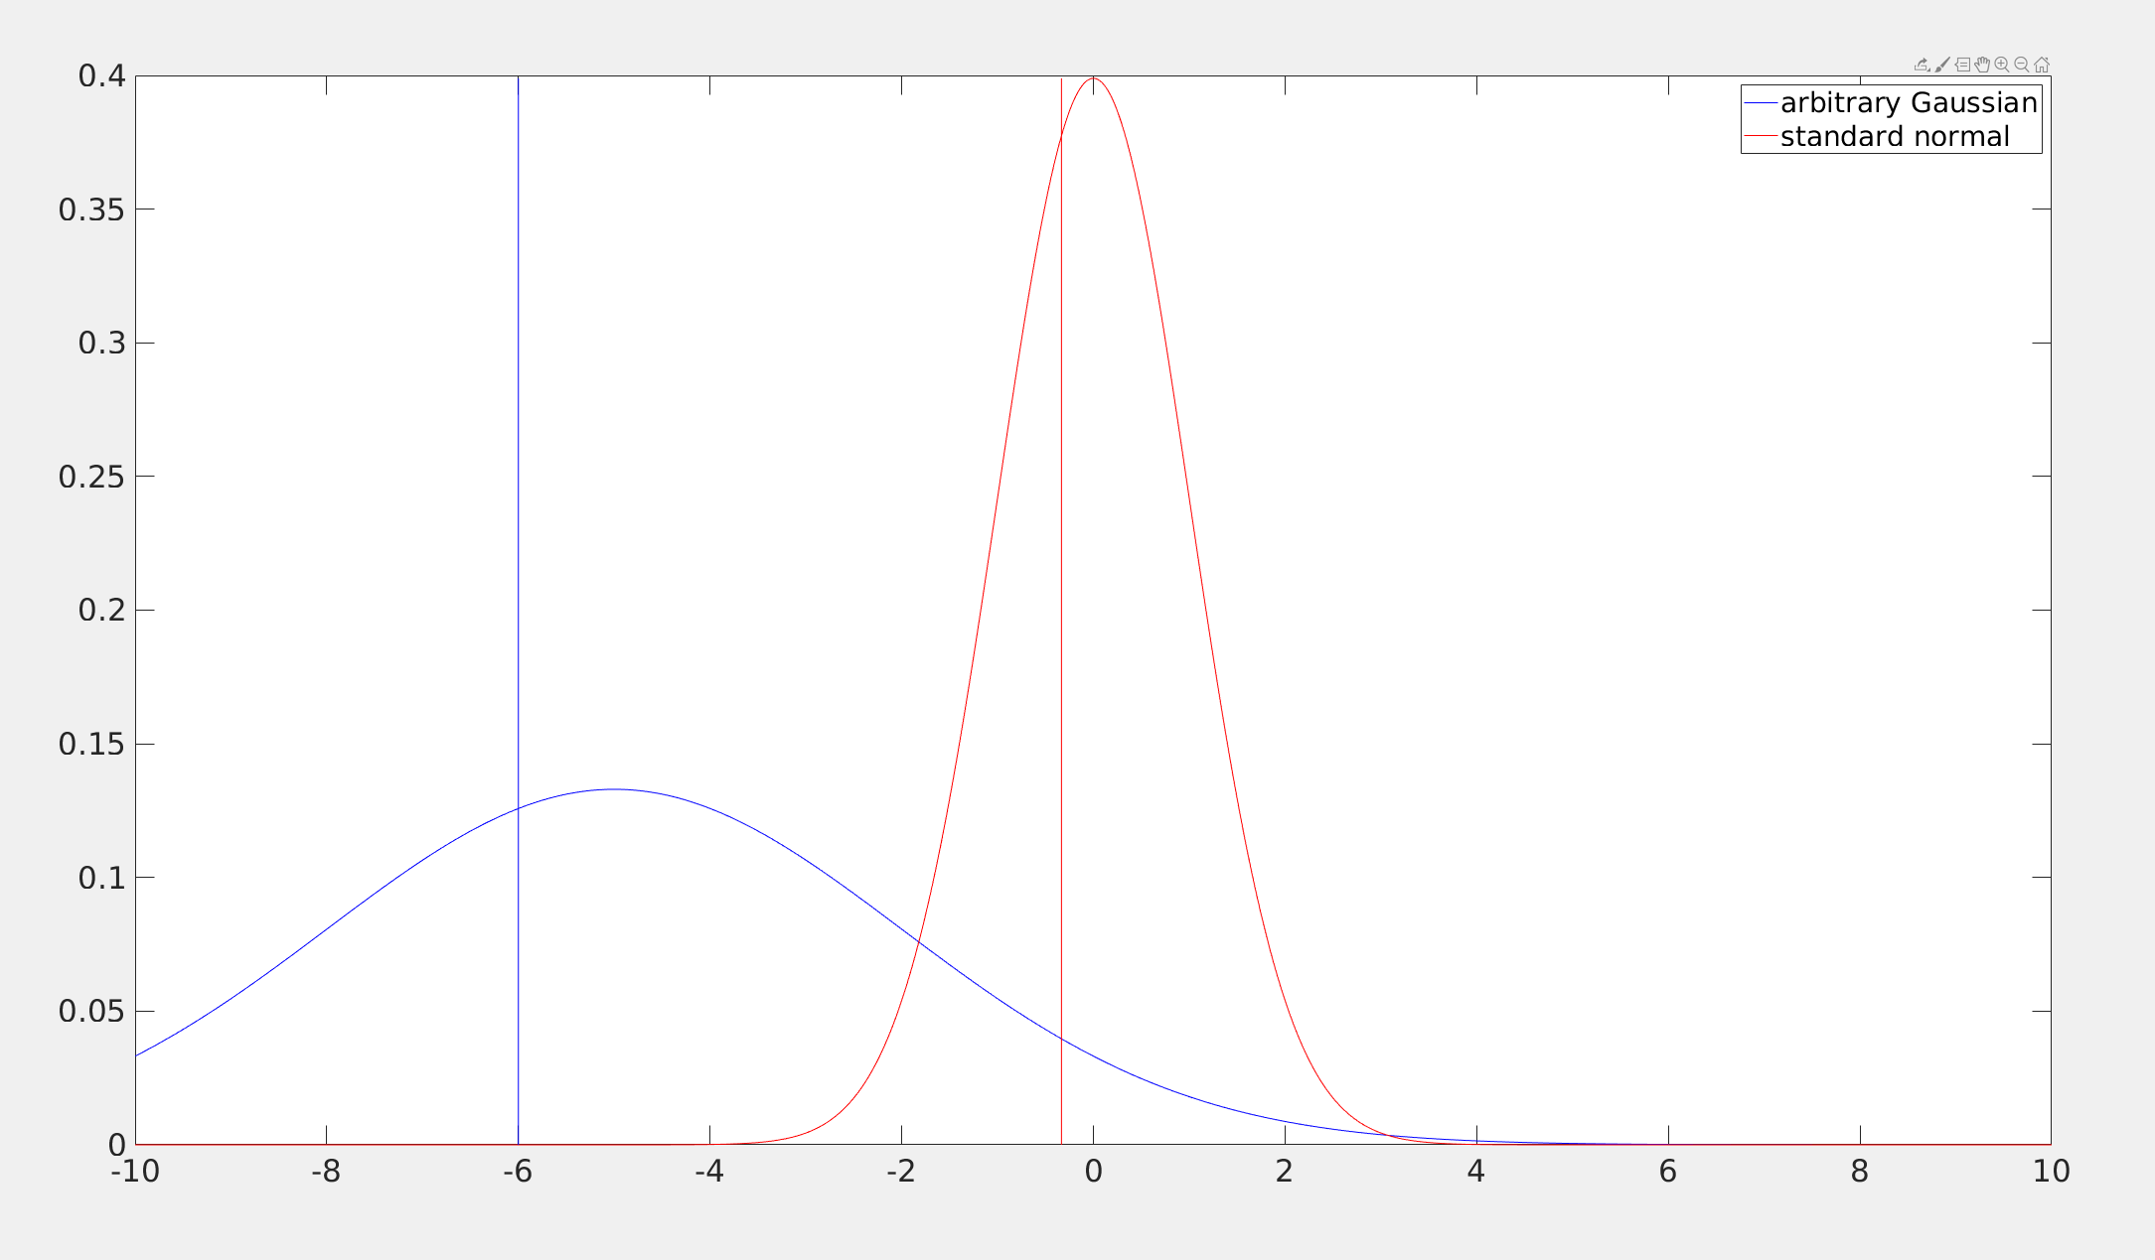
Z-scoring
Any Gaussian variable can be converted to a standard normal Gaussian by subtracting off the mean and dividing by the standard deviation
This is a convenient way to only use a single distribution – the standard normal
See MATLAB

Slide 9
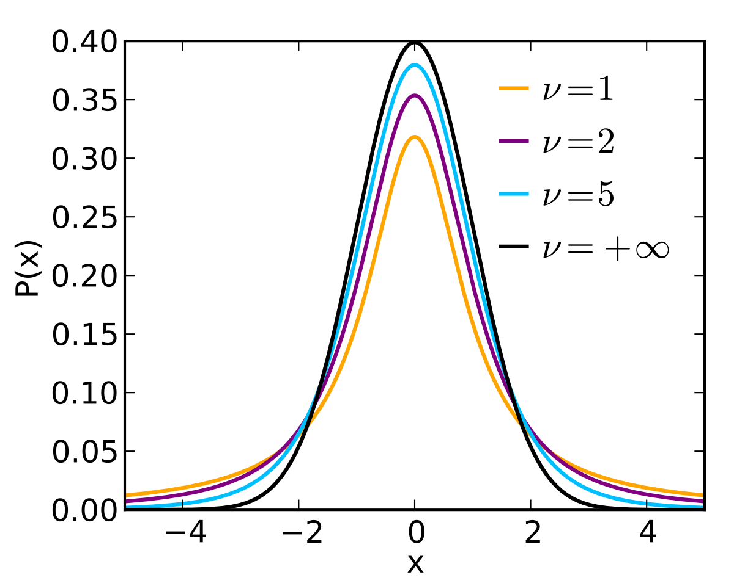
T-distribution

Slide 10
Hypothesis Testing
Consider that you are recording the activity of a neuron. You display a visual stimulus to the animal times and want to determine whether the neuron responded
On any individual trial, the neuron’s activity may go up or down, how do we make a concrete statement?

Slide 11
Hypothesis testing (cont.)
Formalize your prediction
  Null hypothesis: the mean activity is equal to 0
  Alternative hypothesis: the mean activity is different from 0
Calculate how likely the data is given your null hypothesis - p(x|H)

Slide 12
Hypothesis testing (cont.)
We cannot test the probability of the hypothesis given the data p(H|x)
We CAN test the probability of making as an extreme an observation as we did given the hypothesis p(x|H).

Slide 13
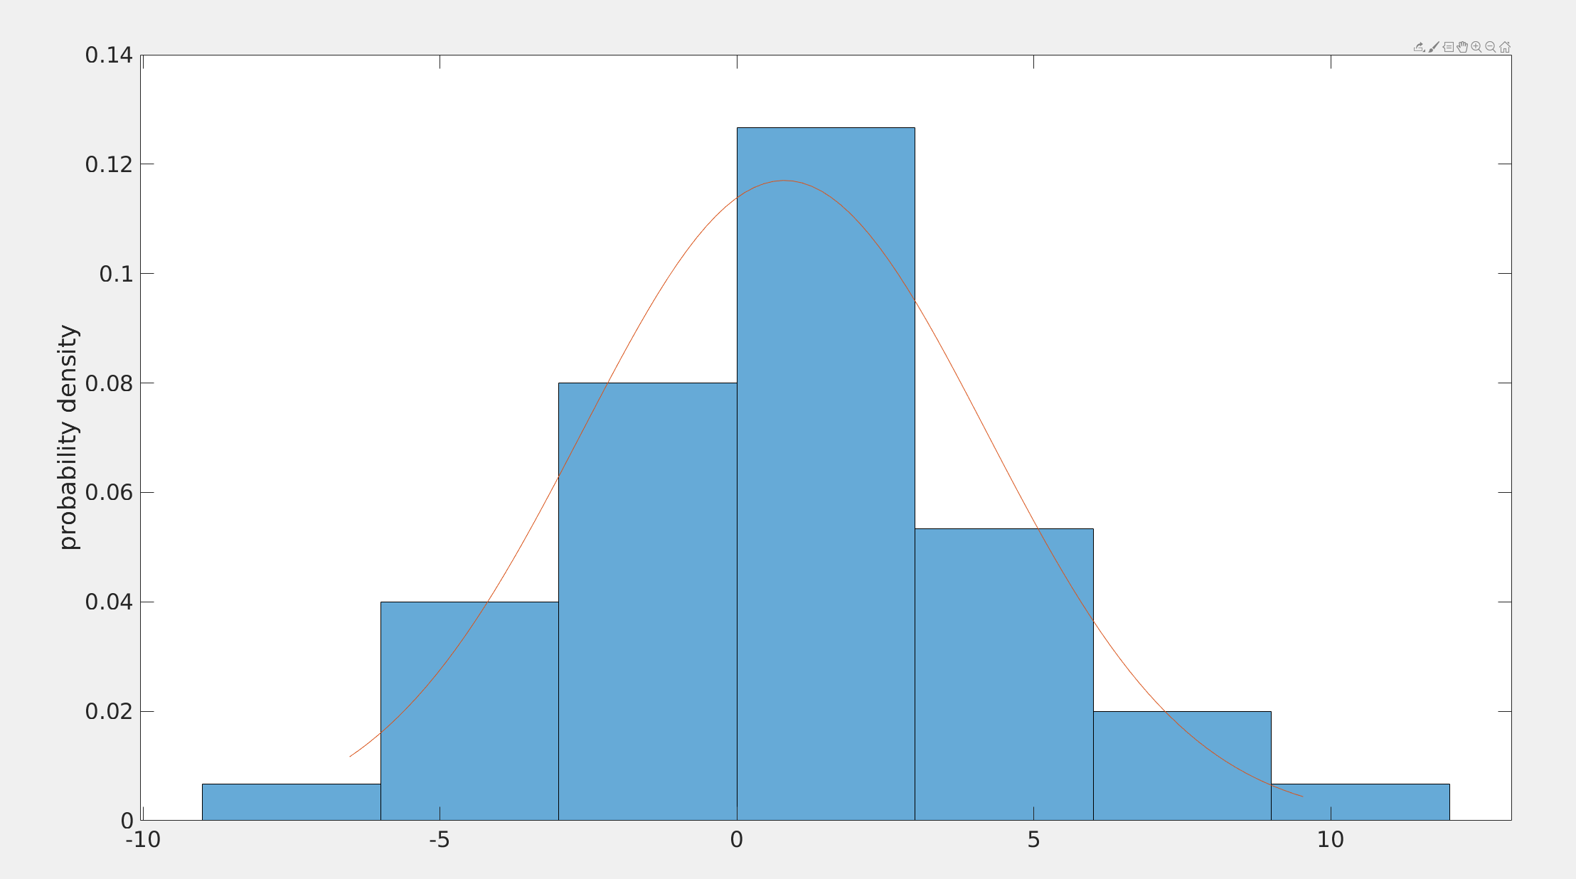
Hypothesis testing example
Assume a distribution for your data
Find out the distribution of the parameter you are testing
In our case, this is the mean of a Gaussian

Slide 14
Hypothesis testing example
The mean of a Gaussian is t-distributed
We observe a sample mean of 0.7969
We observe a sample std of 3.4089
If this data had been drawn from a normal distribution with mean 0, how likely would we be to see a sample mean as far from 0 as 0.8042?

Slide 15
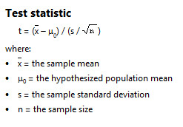
Calculate the t-statistic (z-scoring for t-distribution)
The test statistic converts our measurement (x_bar) to a the standard t-distribution

Slide 16
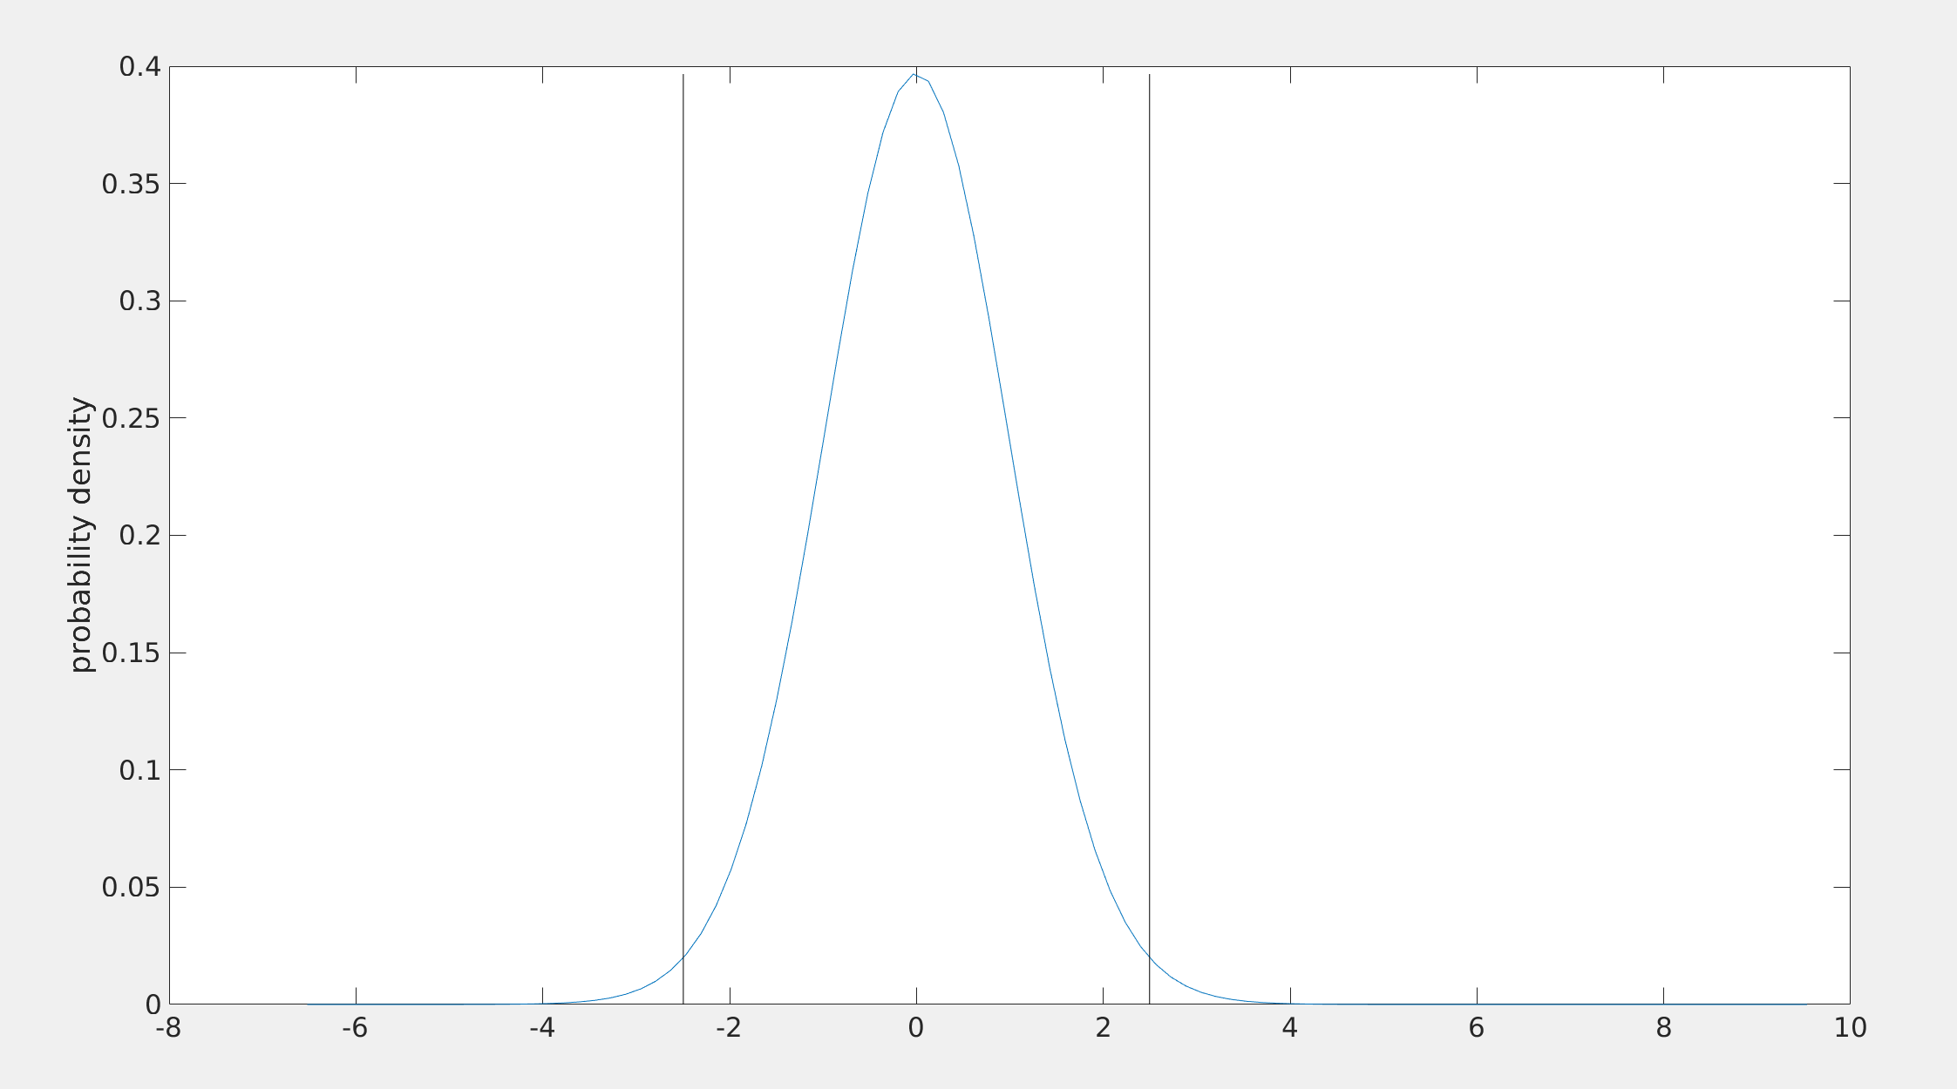
T-distribution
The area to the left of the black line plus the area to the right of the black line is p=0.016
See MATLAB

