Slide 1
Linear Regression
Matt Creamer

Slide 2
Linear Regression
Often when taking data we want to estimate a parameter of a model of the data
Image we have patched a neuron
  We set the voltage in the cell to several values
  At each voltage we record the current out of the cell
  If we model the cell as a simple resistor then
  current = conductance * voltage
We have measured current and voltage, how do we estimate conductance?

Slide 3
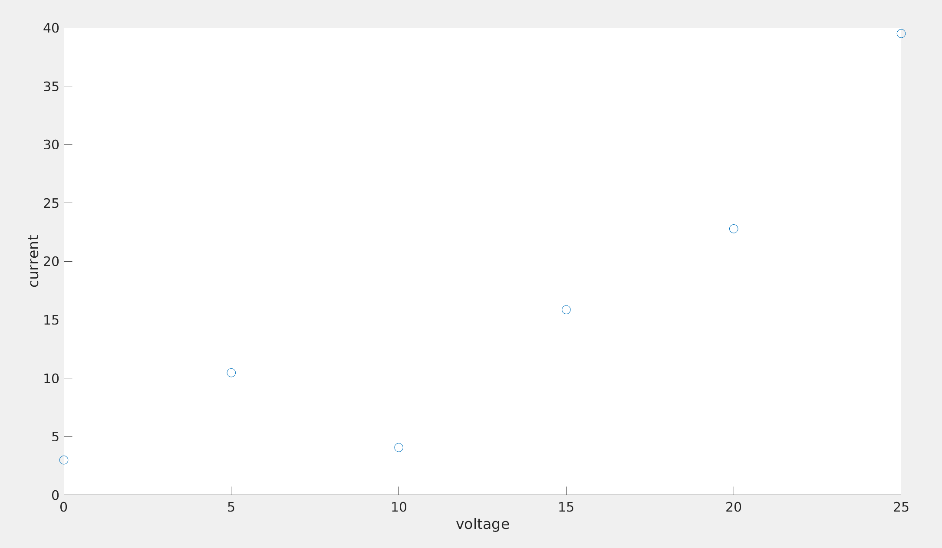
Example measurement

Slide 4
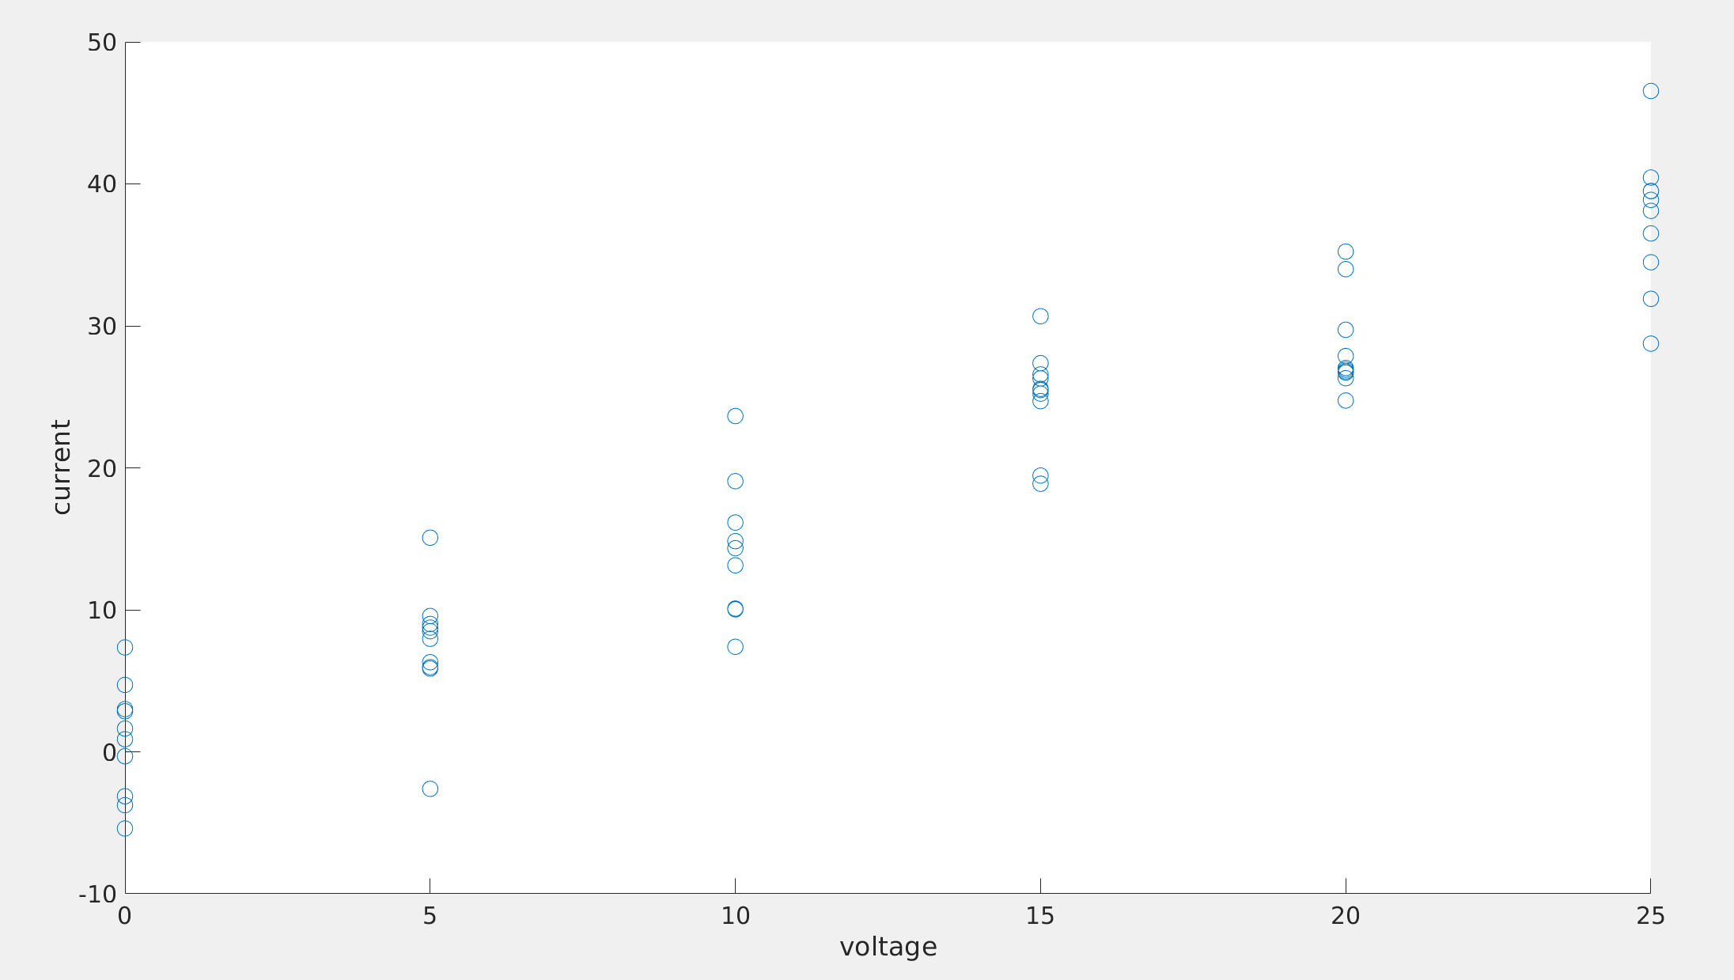
Example set of measurements

Slide 5
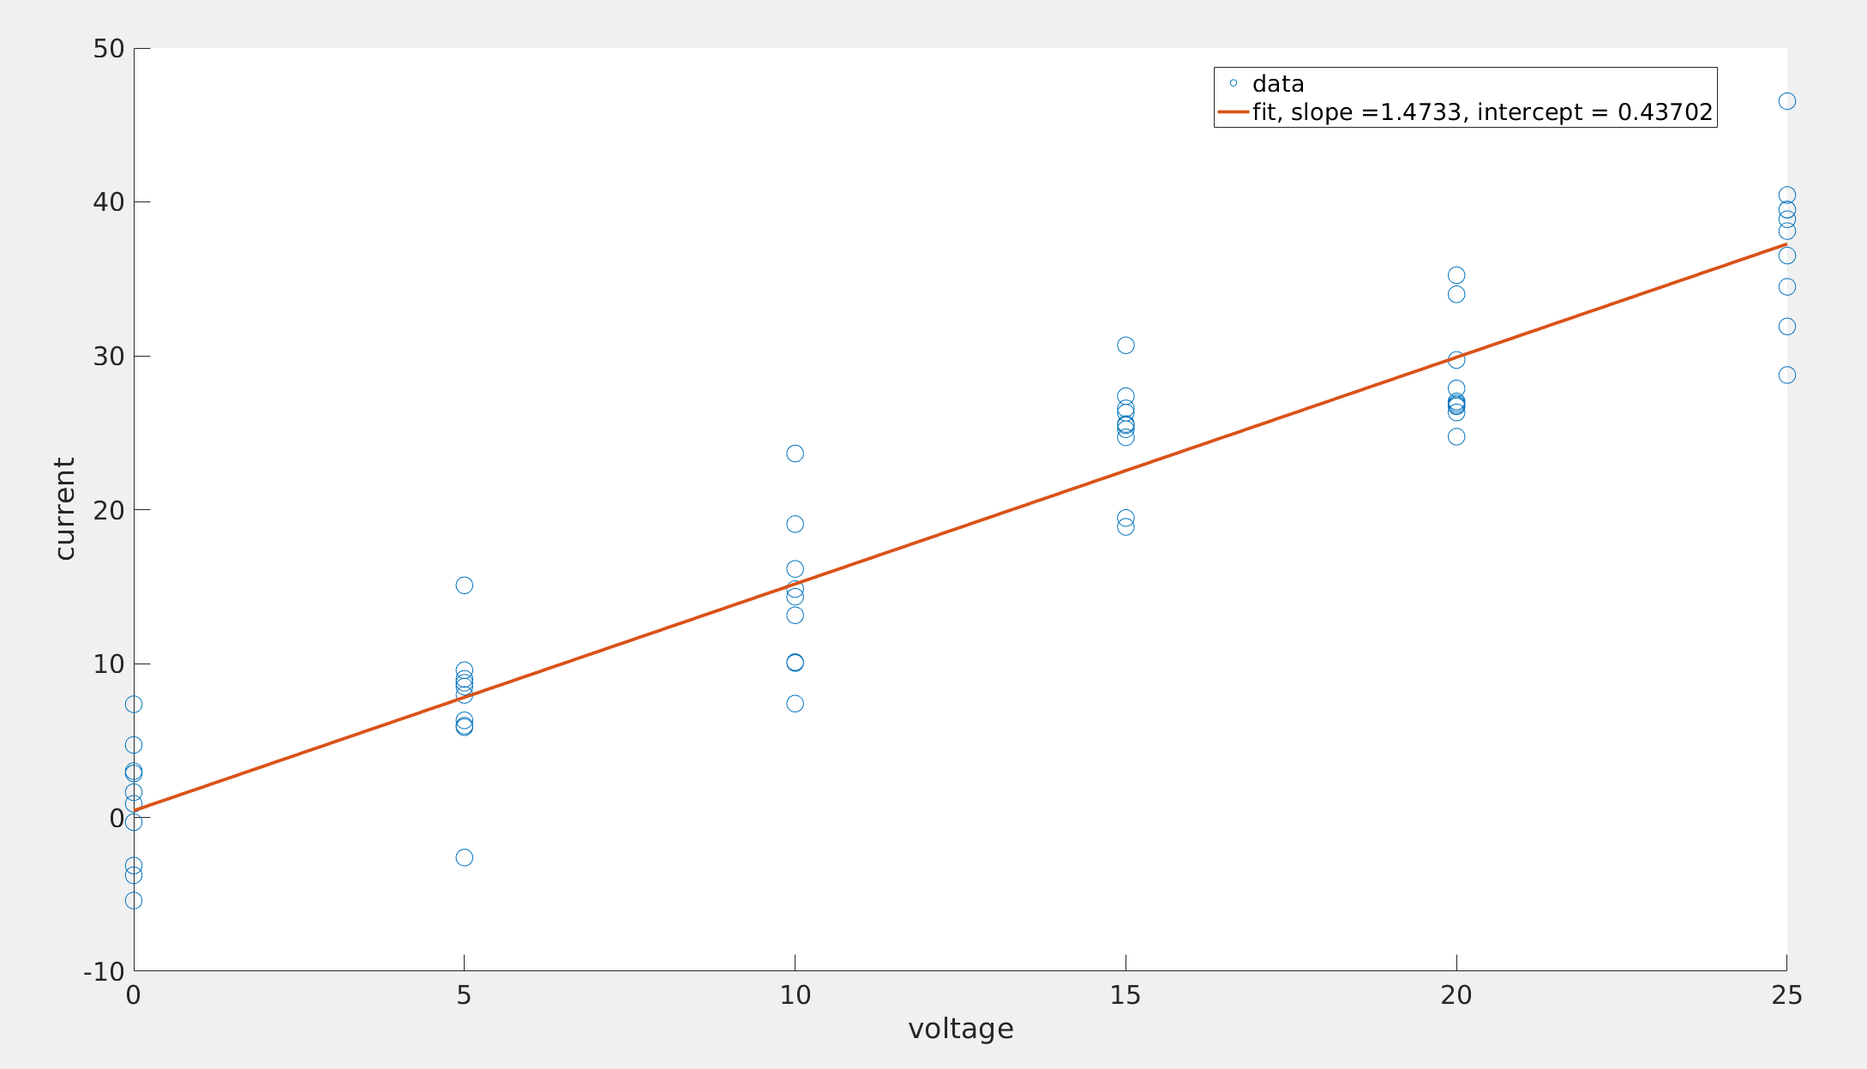
Least squares fit of a line

Slide 6
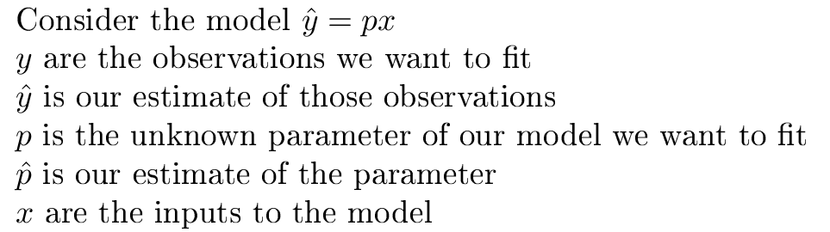
Least Squares Data Fitting

Slide 7
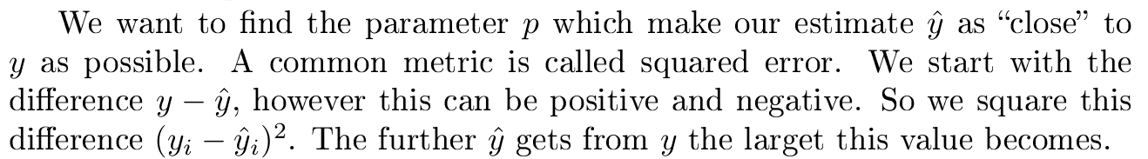
Least Squares Data Fitting

Slide 8
Brief notes
If the choice of squared error seems arbitrary: There is solid theoretical reasons to use least squares when you believe your error is gaussian distributed. Read up on “maximum likelihood estimation, linear least squares”
We will do our math using only algebra and calculus, however the math is far more succinct and general using linear algebra

Slide 9
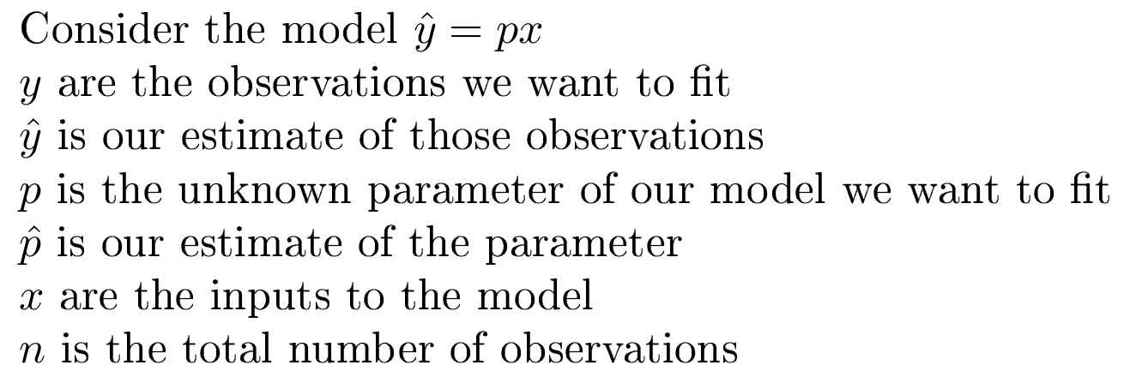
Least Squares Data Fitting

Slide 10
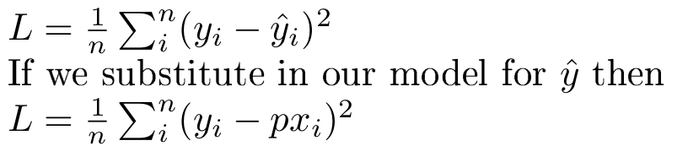
Least Squares Data Fitting

Slide 11





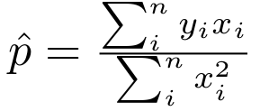

Least Squares Data Fitting

Slide 12
Exercise in MATLAB
Lets generate synthetic data of voltage stimulation and current measurements
Fit the conductance term in the model
  current = conductance * voltage

Slide 13
Combinations of functions
Linear least squares only requires linearity with respect to the parameters
These functions can be fit with linear least squares
  p1+p2*x+p3*x^2+p4*x^3
  p1*sin(x)+p2*x*exp(-x)
These functions are nonlinear with respect to x, but the parameters only interact linearly
See exercise in matlab

