Slide 1
Network Intrusion Detection and Prevention System
Team : SANDEEP & Navaneeth

Slide 2
Introduction
Cyber attacks usually follow a behavioral model, including investigation, attack and invade
Cyber attacks generally begin with targeting, followed by information gathering and then doing vulnerability to target system
Attacker can search for objects of attack through IP scanning, or a series of scanning tools.
After the attacker has obtained the information such as the service of the port and the address of the service, the attacker will lock a certain object and launch a series of attacks behavior.

Slide 3
Implementation
Built the firewall access lists(ACL) which gives black list of hosts
Setup false hosts in the initial stage of network setup
Generate suspicious source list based on the attacks on the false host IP or ports.
Based on the attacks for x amount of time, produce path rules to be added into the flow table.
Block the attacker and prevent network intrusion.

Slide 4
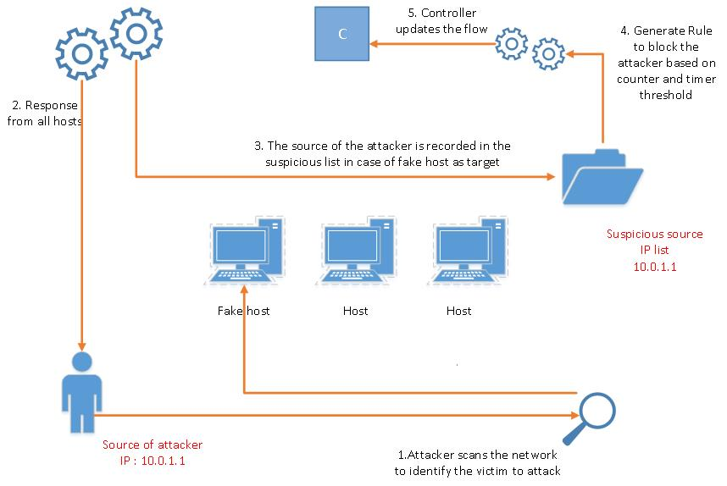
Flow-diagram

Slide 5
Algorithm in brief
used_IP = []
fake_IP = []
suspicious_IP_list = {}
suspicious_IP_time = {}
for every packetIn:
if packet.dstip in fake_IP:
suspicious_IP_list[packet.dstip]++
suspicious_IP_time[packet.dstip] = time()
if suspicious_IP_list[packet.dstip] > Ɵ:
create flow entry to block the IP
for key in suspicious_IP_list:
if suspicious_IP_time[key] > Ø
del suspicious_IP_list[key]

Slide 6
Instructions
Module stateful_firewall.py can be run in combination with any other modules that are required for the functioning of the network on top of pox controller
Eg: sudo ~/pox/pox.py forwarding.l2_learning stateful_firewall
Topology on which we tested is provided with the submission
Switch s1 is the firewall switch
Hosts h1-h4 have used_IPs (10.0.0.1-4)
Hosts h5-h20 have fake_IPs (10.0.0.5-20)
Hosts c1-c5(10.0.1.1-1.5) are used for testing the functionality of the module

Slide 7
Tools
Mininet
Pox controller
SimpleHTTPServer
Nmap (Network mapper for scanning the IP’s)
Eg: nmap –sP 10.0.0.1-15 for scanning IP’s 10.0.0.1-15

Slide 8
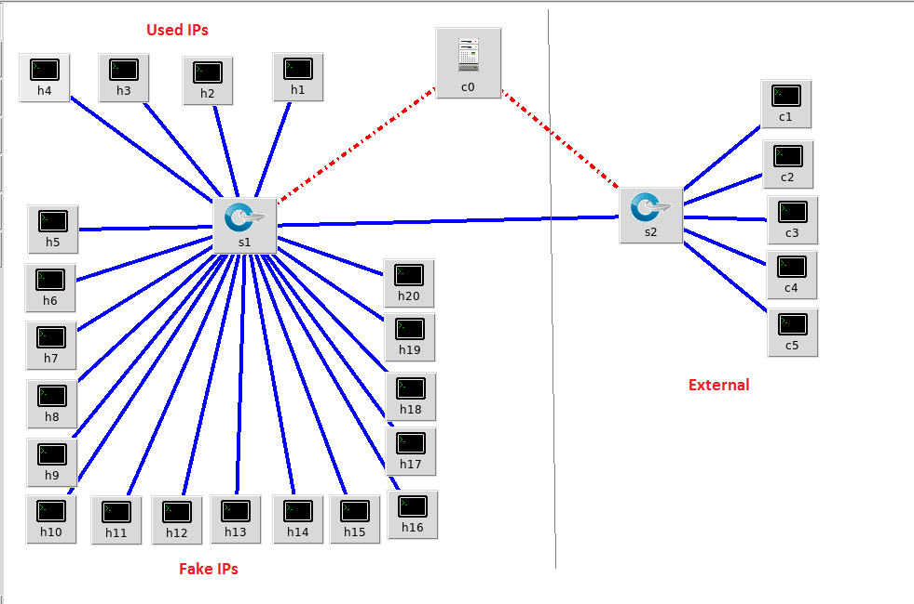
Simulation

Slide 9
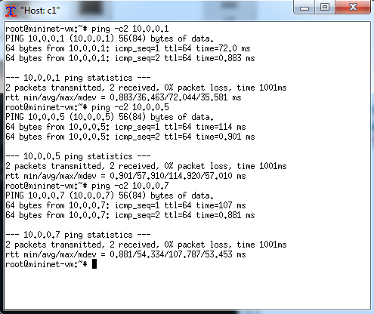
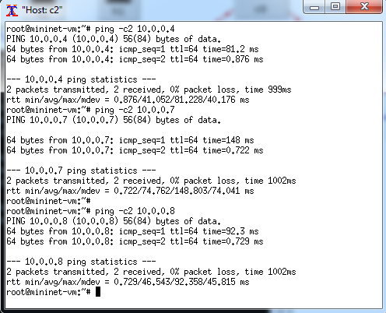
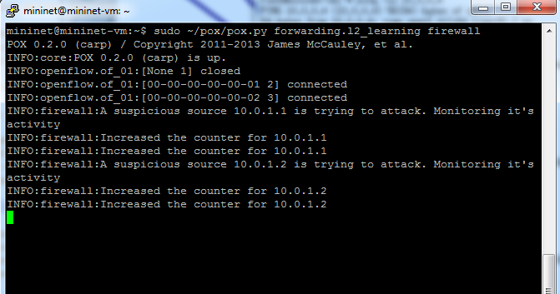
Results

Slide 10
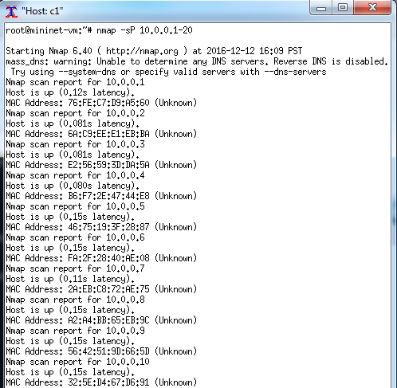
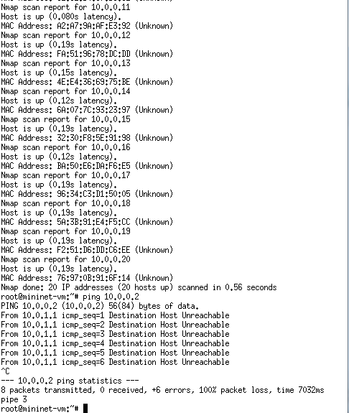
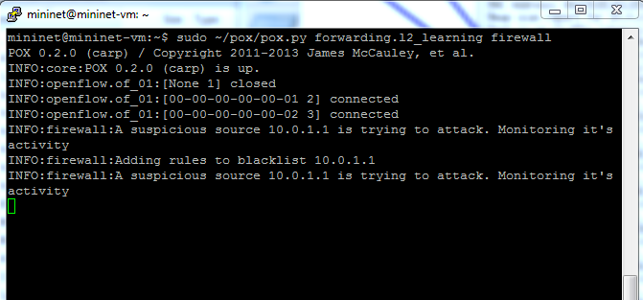
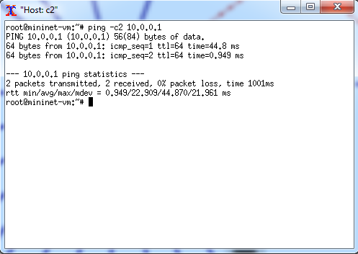
Results

Slide 11
References
P. J. Chen and Y. W. Chen, "Implementation of SDN based network intrusion detection and prevention system," 2015 International Carnahan Conference on Security Technology (ICCST), Taipei, 2015, pp. 141-146.
T. Javid, T. Riaz and A. Rasheed, "A layer2 firewall for software defined network," 2014 Conference on Information Assurance and Cyber Security (CIACS), Rawalpindi, 2014, pp. 39-42.
R. Khondoker, A. Zaalouk, R. Marx and K. Bayarou, "Feature-based comparison and selection of Software Defined Networking (SDN) controllers," 2014 World Congress on Computer Applications and Information Systems (WCCAIS), Hammamet, 2014, pp. 1-7.

