Slide 1
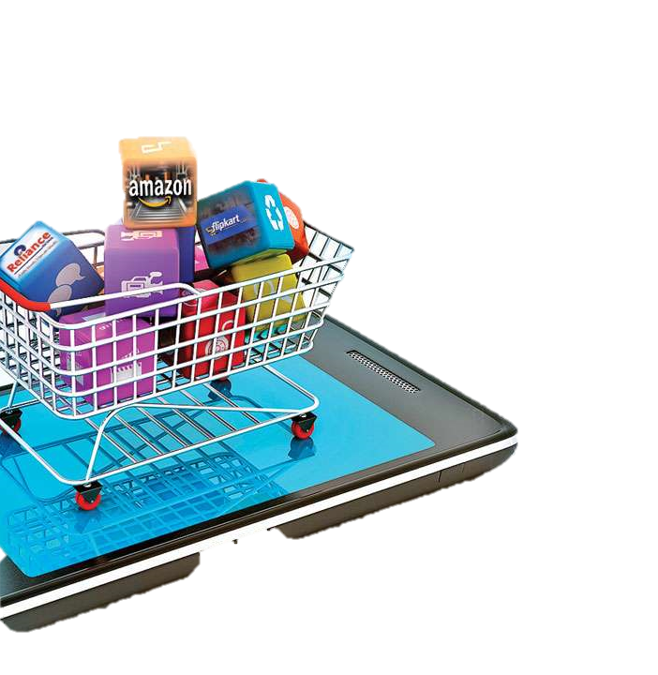
E-commerce
Customer behavior
Team 2
ITI 3 MONTHS DIPLOMA,
Data analysis track, smart village
1

Slide 2
Topics
Business Problem
Data Validation
Customer Behavior
Product Insights
Brand Analysis
Price Trends
KPI for customer Loyalty
Association Analysis
Questions
2

Slide 3

Business Problems
1- Finding the right products
2- Lacking insights in customer behavior and buying patterns
3- Not meeting customer expectation and needs

Slide 4



Data Validation
Duplications
Missing Values
Outliers
Remove View duplicated rows
User Session Category code Brand
Outliers in Price
4

Slide 5
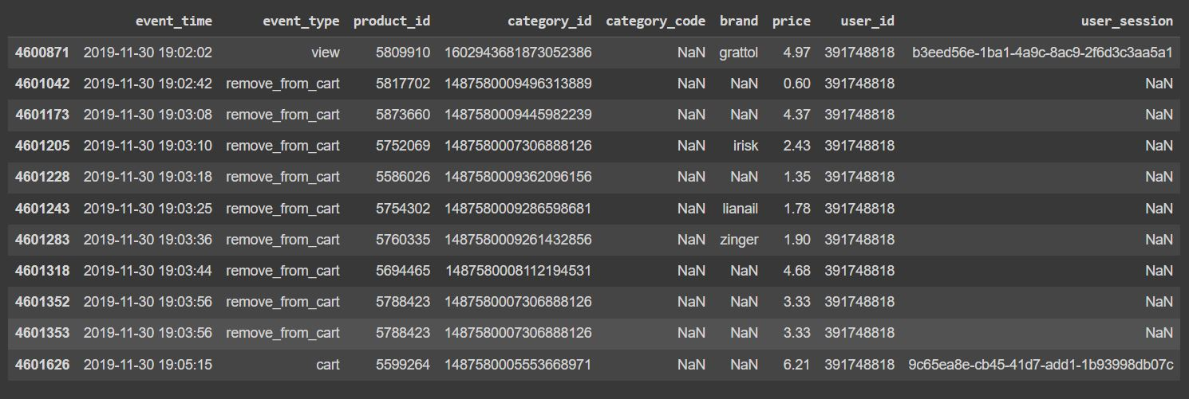
Missing values (User Session):
5

Slide 6
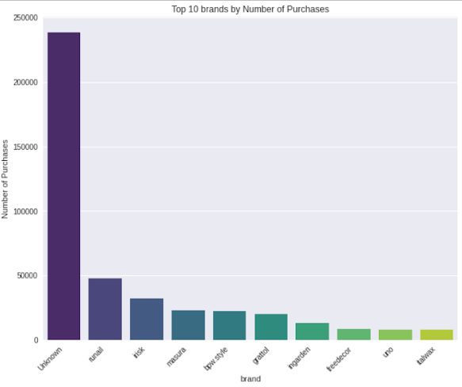
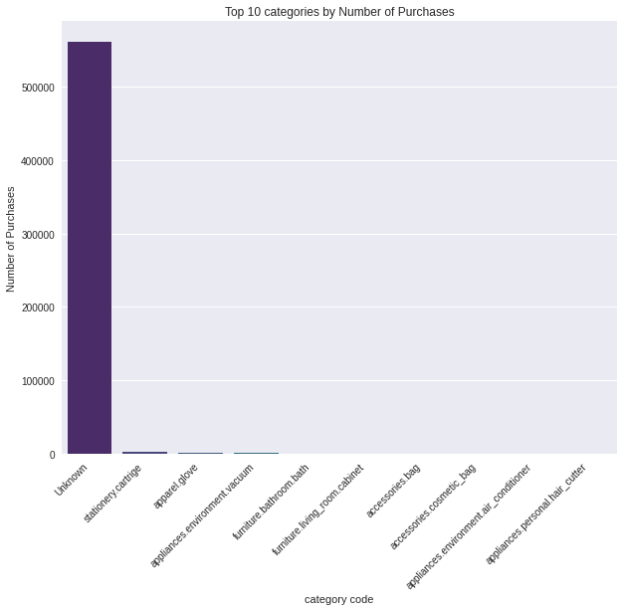
Filling missing values with unknown
6

Slide 7
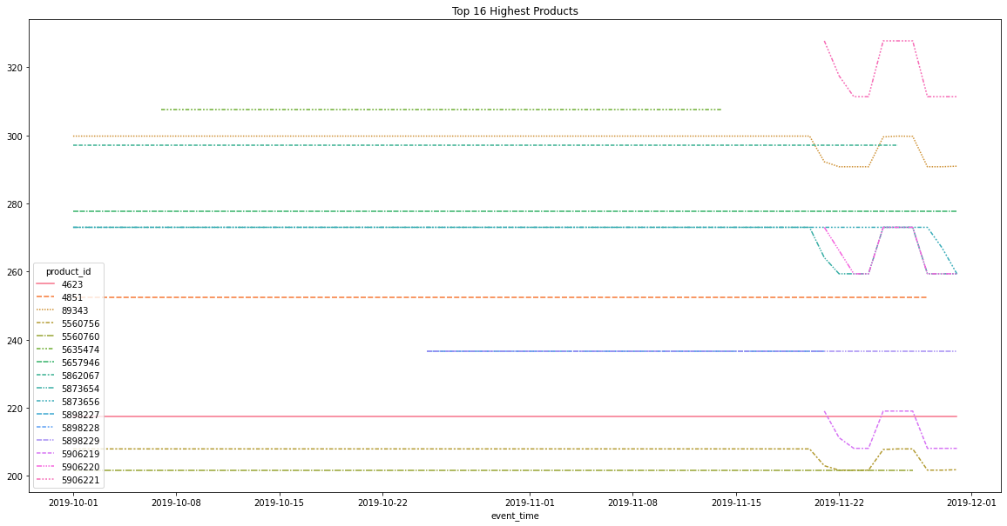
The Highest Price Validation
7

Slide 8
Customer Interactions
8

Slide 9
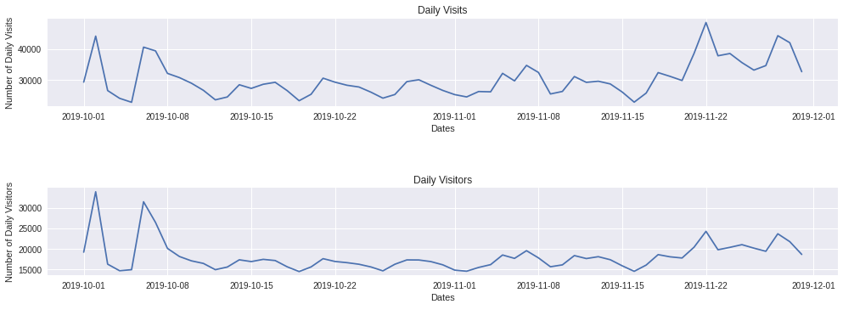
Daily Visits and Visitors
9

Slide 10
Visitor Activity Along The Day
10

Slide 11
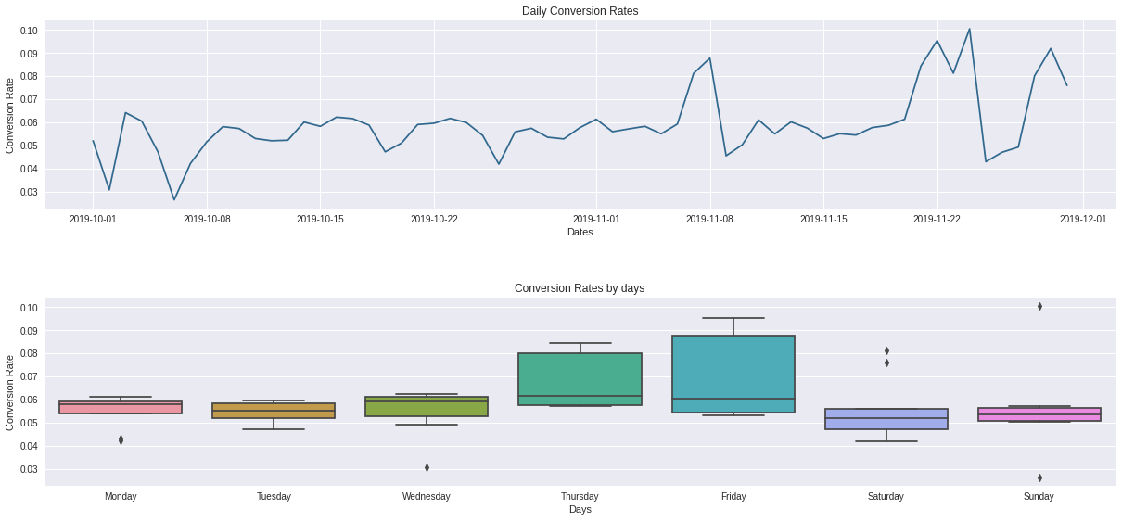
Daily Conversion Rate
11

Slide 12
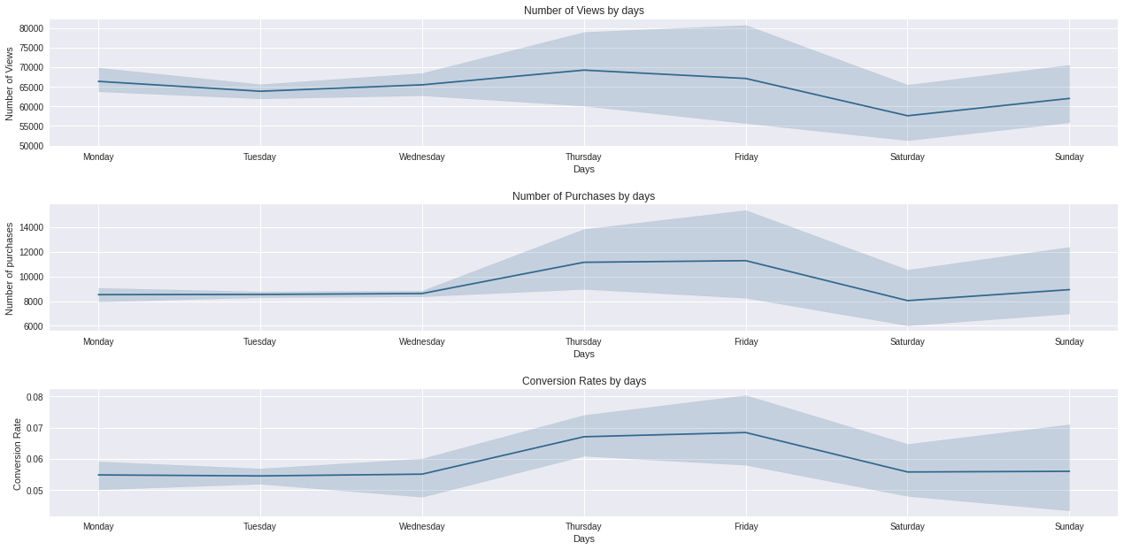
Views and Purchase per week day
12

Slide 13
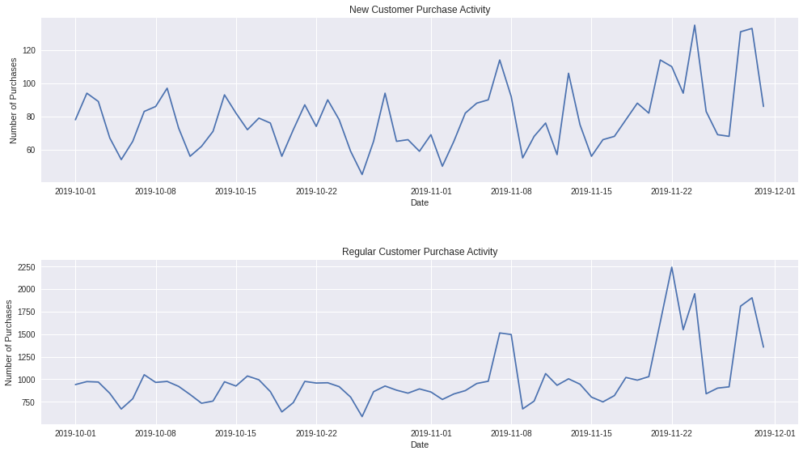
New users VS Regular users
13

Slide 14
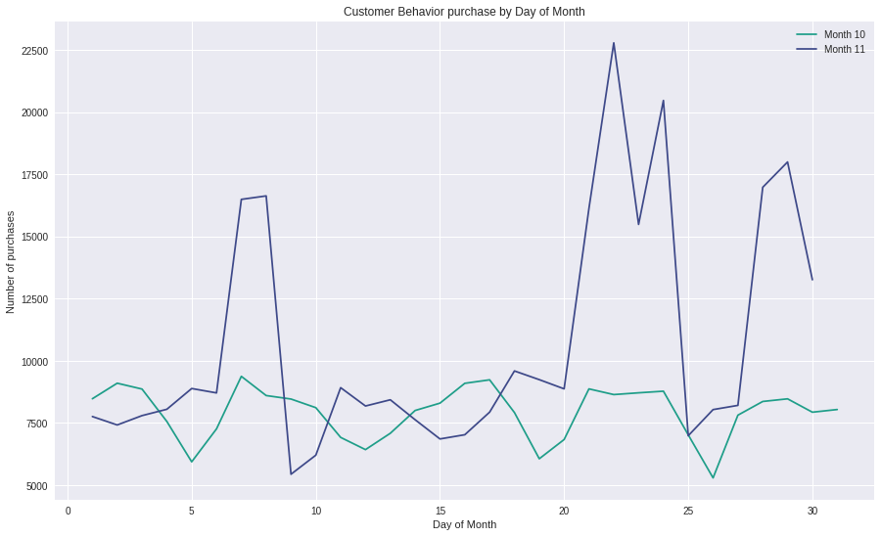
October VS November Sales
14

Slide 15
Top 10 purchased products VS on Friday (Quantity)
15

Slide 16
Fridays VS Black Friday (Quantity)
Revenue in November 22, 2019:
$102,783.33
16

Slide 17
Top 10 viewed and purchased products
17

Slide 18
Top Purchased Brands
18

Slide 19
Top 5 purchased categories (Quantity)
19

Slide 20
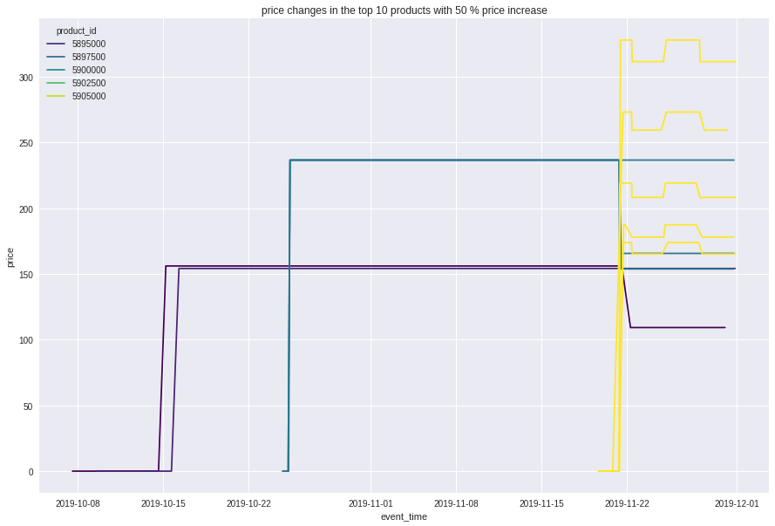
Top 10 products in price increase
20

Slide 21
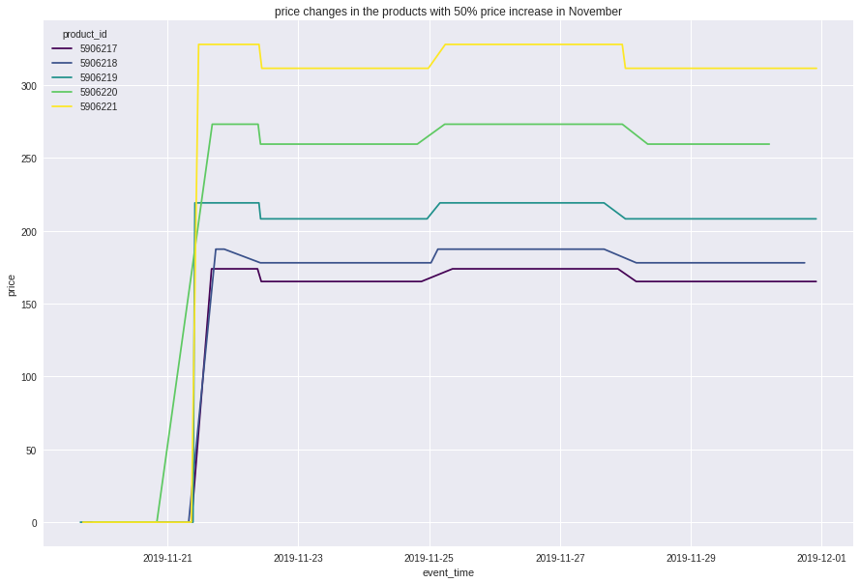
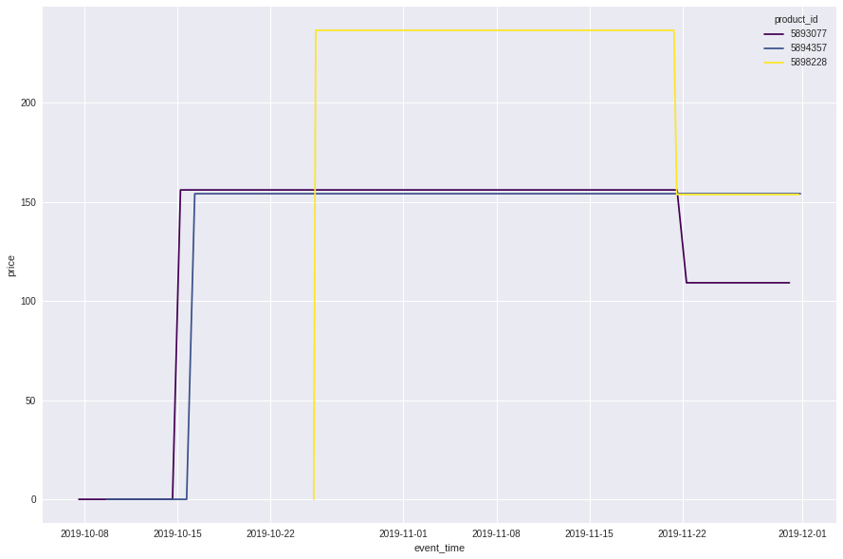
Top Price Changes
21

Slide 22
RFM Model
Top Customers
Reward them,
Will promote your brand,
Most likely to send referrals
High Value Customers
Ask for reviews,
loyalty program,
Make recommendations
Medium Value Customers
Offer coupons
personalized recommendations
Low Value Customers
Provide helpful resources on site,
Send personalized emails
22

Slide 23
Customer Lifetime Value (CLV)
CLV = Average order value * No. of repeat purchase * Customer Lifetime
Customer id | Average order value | Purchase Frequency | Customer lifespan | Customer value | clv
557790271 | 6.200616 | 438 | 0.333333 | 2715.87 | 905.29
570967715 | 8.378889 | 108 | 1 | 904.92 | 904.92
549368055 | 4.345577 | 208 | 1 | 903.88 | 903.88
563937307 | 9.736047 | 86 | 1 | 837.30 | 837.30
518278060 | 4.604128 | 172 | 1 | 791.91 | 791.91
23

Slide 24

Recommendation Analysis:
Association Rule
Apriori
FP Growth
24

Slide 25
Support Analysis
Item | Count | Percentage
5809910.0 | 700 | 0.006773
5854897.0 | 412 | 0.003986
5833330.0 | 338 | 0.003270
5751422.0 | 317 | 0.003067
5809912.0 | 308 | 0.002980
25

Slide 26
Apriori Algorithm
antecedents | consequents | Support | Confidence | Lift | Antecedents Brand | Consequents Brand
5751383.0 | 5751422.0 | 0.008555 | 0.348592 | 12.725241 | uno | uno
5833330.0 | 5833335.0 | 0.005876 | 0.201183 | 12.449704 | bpw.style | bpw.style
5833323.0 | 5833330.0 | 0.005876 | 0.361702 | 12.383482 | bpw.style | bpw.style
5816170.0 | 5809912.0 | 0.005271 | 0.317708 | 11.936756 | grattol | grattol
5833325.0 | 5833330.0 | 0.006481 | 0.337838 | 11.566448 | bpw.style | bpw.style
5849033.0 | 5751422.0 | 0.005358 | 0.248996 | 9.089532 | uno | uno
5809910.0 | 5809912.0 | 0.012357 | 0.204286 | 7.675306 | grattol | grattol
5816170.0 | 5809910.0 | 0.007000 | 0.421875 | 6.974196 | grattol | grattol
26

Slide 27
FP Growth
antecedents | consequents | antecedent support | consequent support | support | confidence | lift | conviction
5751422.0 | 5751383.0 | 0.027394 | 0.024542 | 0.008555 | 0.312303 | 12.725241 | 1.418441
5751383.0 | 5751422.0 | 0.024542 | 0.027394 | 0.008555 | 0.348592 | 12.725241 | 1.493082
5849033.0 | 5751422.0 | 0.021517 | 0.027394 | 0.005358 | 0.248996 | 9.089532 | 1.295075
5833330.0 | 5833335.0 | 0.029208 | 0.016160 | 0.005876 | 0.201183 | 12.449704 | 1.231622
5833335.0 | 5833330.0 | 0.016160 | 0.029208 | 0.005876 | 0.363636 | 12.449704 | 1.525530
5809912.0 | 5809910.0 | 0.026616 | 0.060491 | 0.012357 | 0.464286 | 7.675306 | 1.753750
5809910.0 | 5809912.0 | 0.060491 | 0.026616 | 0.012357 | 0.204286 | 7.675306 | 1.223283
5833330.0 | 5833325.0 | 0.029208 | 0.019184 | 0.006481 | 0.221893 | 11.566448 | 1.260516
5833325.0 | 5833330.0 | 0.019184 | 0.029208 | 0.006481 | 0.337838 | 11.566448 | 1.466093
5816170.0 | 5809910.0 | 0.016592 | 0.060491 | 0.007000 | 0.421875 | 6.974196 | 1.625097
5816170.0 | 5809912.0 | 0.016592 | 0.026616 | 0.005271 | 0.317708 | 11.936756 | 1.426639
5833330.0 | 5833323.0 | 0.029208 | 0.016246 | 0.005876 | 0.201183 | 12.383482 | 1.231514
5833323.0 | 5833330.0 | 0.016246 | 0.029208 | 0.005876 | 0.361702 | 12.383482 | 1.520907
27

Slide 28
Questions
28

Slide 29
Thank You
Presented by:
Esraa Mohamed
Naira Anwer
Aya Gamal
Sandra Samir
29

