Slide 1
Sets and Functions CSCI 170 Fall 2021 Lecture 2 Sandra Batista
1.1–1.2
Citation: Slides modified from slides from Harris Lewis from Harvard CS 20
https://www.seas.harvard.edu/courses/cs20/Schedule.html

Slide 2
Sets and Functions
Set Definitions
Set Operations
Sequences
Functions
Pigeonhole Principle
1.1–1.2

Slide 3
Sets
A set is an unordered collection of distinct objects.
Examples of Sets
The set of first-year college students
𝒁 = the set of integers
𝐍 = the set of nonnegative integers
R = the set of real numbers
{1, 2, 3}
{{1}, {2}, {3}}
{{Z}}
∅ = the empty set
Notes:
straight-line programs: akin to calculator

Slide 4
Set Membership, ∈
Is an object x an element of a set A? Is x in A? x ∈ A?
Example:
Let A = {apple, 10, 1.5}
10 ∈ A “10 is in A”
15 ∉ A “15 is not in A”
Elements of set must be distinct and order in which they are given does not matter.
Let B = {poppy, sunflower, rose} = {rose, poppy, sunflower} = {sunflower, rose, poppy, rose}
Notes:
straight-line programs: akin to calculator

Slide 5
Cardinality: size of set
The cardinality of set A, |A|, is the number of distinct elements in A.
Examples:
| {12,13,14,15,2*6}| =
|{1,2,3}| =
|{{1,2,3}}| =
|{N}| =
| ∅ | =
|{∅ }| =
4
3
A set is finite if it can be counted using some initial segment of the integers
|{∅, {1}, {2}, {1,2}}| = 4
1
1
1 2 3 4
0
Otherwise infinite
1
Notes:
straight-line programs: akin to calculator

Slide 6
Subset: ⊆
A ⊆ B : “A is a subset of B” or “A is contained in B”
For any element x, if x∈A, then x∈B
Examples:
N ⊆ Z
{7} ⊆ {7, “Sunday”, π}
∅ ⊆ A for any set A
Why? For any element x, if x∈∅, then x∈A.
Since no element can be in the empty set, this is vacuously true
A ⊆ A for any set A
For proper subset meaning A ⊆ B but A ≠ B,
write A ⊊ B
Notes:
straight-line programs: akin to calculator

Slide 7
Equal: =
Sets A and B are equal, A = B, if and only if A ⊆ B and B ⊆ A
If and only if is two statements:
If A = B, then A ⊆ B and B ⊆ A
2) If A ⊆ B and B ⊆ A, then A = B.
For proper subset meaning A ⊆ B but A ≠ B,
write A ⊊ B
Examples:
{1,2,3} ⊊ {1, 2,3,4}
𝐍 ⊊ 𝒁
Notes:
straight-line programs: akin to calculator

Slide 8
Powerset
The powerset of a set A, P(A), is the set of all subsets of A.
Examples:
P({1,2}) = the set of all subsets of {1,2}
= {∅, {1}, {2}, {1,2}}
P(𝒁) = the set of all sets of integers (“the power set of the integers”)
N ∈ P(Z)
Notes:
straight-line programs: akin to calculator

Slide 9
Powerset
The powerset of a set A, P(A), is the set of all subsets of A.
How do we build the powerset of a set A?
For each element in A for each subset in the powerset, let’s consider if we will include the element in the subset or not.
We must get all combinations of including and excluding all elements.
An easier way: First generate all subsets of A of size 0, then size 1, then size 2, and so forth until |A|
Let’s give it a try with the set A = { a, b , c}:
P(A) = {∅
,{a}, {b}, {c} ,
{a,b}, {b,c}, {a,c},
{ a, b , c}}
Intuition: What is the size of P(A)?
Notes:
straight-line programs: akin to calculator

Slide 10
Powerset Practice Problem
For each of the following sets, write out every member of the entire set:
P({7,8,9}) – P({7,9})
P(∅)
P(P({2}))
Notes:
Note difference between print(year) and println("leap year");

Slide 11
Set Builder
Let U be the universal set of all possible elements.
Let P(x) be a predicate or a condition that for all elements x in the universal set U is either true or false.
Set Abstraction Notation specifies the set of elements of A of which P is true:
{x ∈U: P(x)} or {x ∈U| P(x)}
Examples:
Let E be the set of even numbers:
E = {n ∈ Z : n%2 = 0}
Let O be the set of odd numbers:
O = {n ∈ Z | n % 2 = 1}
Let P be the set of prime numbers:
P = {n ∈ Z : n is prime}
P(n) is the condition n % 2 = 0, 28 ∈ E 27 ∉ E
P(n) is the condition n % 2 = 1, 31 ∈ O 30 ∉ O
P(n) is the condition n is prime, 7 ∈ P 28 ∉ P
Notes:
straight-line programs: akin to calculator

Slide 12
Sets and Functions
Set Definitions
Set Operations
Sequences
Functions
Pigeonhole Principle
1.1–1.2

Slide 13
Set Union
x∈A∪B if and only if x∈A or x∈B
Example: Let A = {1,2,3} and B = {3, 4,5}
Let’s consider the Venn Diagram of the union of A and B, A∪B = {1,2, 3, 4, 5}:
U = universe of elements
1 2
3
4 5
A
B
Notes:
straight-line programs: akin to calculator

Slide 14




Set Intersection
x∈A∩B if and only if x∈A and x∈B
Example: Let A = {1,2,3} and B = {3, 4,5}
Let’s consider the Venn Diagram of the intersection of A and B, A∩B = {3}:
U = universe of elements
1 2
3
4 5
A
B
Notes:
straight-line programs: akin to calculator

Slide 15
Set Complement
x ∈ B ̅ if and if x ∉ B
Example: Let A = {1,2,3} and B = {3, 4,5}
Let’s consider the Venn Diagram of the complement of B:
U = universe of elements
1 2
3
4 5
A
B
Notes:
straight-line programs: akin to calculator

Slide 16





Set Difference
X ∈ A\B if and only if x ∈ A and x ∉ B
Sometimes written A-B
This set is the intersection of A and the complement of B
Example: Let A = {1,2,3} and B = {3, 4,5}
Let’s consider the Venn Diagram of A\B in purple and B\A in blue:
U = universe of elements
1 2
3
4 5
A
B
Notes:
straight-line programs: akin to calculator

Slide 17
Set Laws
A distributive law for sets: A ∩(B ∪ C) = (A ∩ B) ∪(A ∩ C)
DeMorgan’s Law for sets: The complement of intersection of two sets equals the union of their complements.
U = universe of elements
U = universe of elements
B
B
A
A
C
DeMorgan’s Law
Distributive Law
Notes:
Note difference between print(year) and println("leap year");

Slide 18
Set Difference Practice Problem
Show (A-B) ∩(B-A) = ∅ using definitions and set operations. Use Venn diagram to develop intuition.
Notes:
Note difference between print(year) and println("leap year");

Slide 19
Set Equality Practice Problem
Show A -(B∩C) = (A - B) ∪(A - C) using set difference, distributive law, and DeMorgan’s law. Use Venn diagram to build intuition.
Notes:
Note difference between print(year) and println("leap year");

Slide 20
Venn Diagram Practice Problem
100 Students are enrolled in chemistry, physics, and biology. Enrollments: Physics = 45, Chemistry = 60, Biology = 30
10 Students are enrolled in all three and some students are enrolled in exactly 2 of these classes.
i) How many students are enrolled in 2 classes?
ii) Of those taking 2 classes: 9 are in physics and chemistry and 4 are in physics and biology. How many are in chemistry and biology?
U = universe of elements
B
P
C
Notes:
Note difference between print(year) and println("leap year");

Slide 21
Disjoint Sets
Sets A and B are disjoint if A∩B = ∅.
Example: Let A = {1,2,3} and B = { 4,5}
Let’s consider the Venn Diagram of disjoint A and B:
U = universe of elements
1 2
3
4 5
A
B
Notes:
straight-line programs: akin to calculator

Slide 22
Partition
A partition of a set S is a set of nonempty sets {A₁, A_{2,} A_{3,…,} A_{k}}, k greater than or equal to 1, such that
A₁ ∪ A₂ ∪ A₃ ∪… ∪ A_{k}= S
For any distinct pair of sets, A_{i} and A_{j} are disjoint (i, j ∈ {1,2,3,…,k})
Example: Let S = {1,2,3,4,5}, A₁ = {4}, A₂ = {123}, and A₃ = {5}
Let’s draw the partition of S using a Venn Diagram:
U = universe of elements
S
4 A₁
5 A₃
1 2
3
A₂
Notes:
straight-line programs: akin to calculator

Slide 23
Sets and Functions
Set Definitions
Set Operations
Sequences
Functions
Pigeonhole Principle
1.1–1.2

Slide 24
Sequences
Sequences (or lists or tuples) are ordered collections of objects.
Sequence notation may give objects using the save variables, but different subscripts: x₁, x₂, x₃,…
If two objects called an ordered pair, <a, b>.
If n-objects, called an n-tuple.
Example:
Let’s consider the ordered pairs of latitude and longitude for some locations: <latitude, longitude>
Los Angeles: <34.0522, -118.2437>
Paris: <48, 2>
Boston: <42, -71>
Antartica: <-71, 42>
Let’s consider some ordered triples or 3-tuples of <temperature, humidity, location>:
<86 F, 52%, Los Angeles>
<71 F, 84%, Boston>
Notes:
straight-line programs: akin to calculator

Slide 25
Cartesian Product
Cartesian product of sets A and B, A x B = {<a,b> : a ∈ A and b ∈ B}
That is the set of all ordered pairs such that the first element is from set A and the second from set B.
Example: Let’s consider how we may order drinks at a café. We have choice of temperature = {hot, iced} and beverage = {coffee, tea}
If we order first giving the temperature then beverage, that is temperature x beverage:
Temperature x beverage = {
<hot, coffee>,
<iced, tea>}
<iced, coffee>,
<hot,tea>,
If we order first giving the beverage then temperature, that is beverage x temperature::
<tea,iced>}
<coffee, iced>,
<coffee,hot>,
Beverage x temperature = {
<tea,hot>,
Notes:
straight-line programs: akin to calculator

Slide 26
Binary Relations
A binary relation on A x B is a subset of A x B.
Example:
Let A = {Zoe, Tommy, Jane, Noah}
B = {CS104, CS170, Math 125}
isTaking = {<Zoe, CS104>, <Zoe, Math 125>, <Tommy, CS170>,<Jane, CS170>, <Noah, CS104>}
isTaking binary relation = {<a, b> : Student a is taking course b}
isTaking is a subset of A x B (i.e. students x courses)
isTaking
Zoe
CS104
MATH125
<Tommy, Math125> ∉ isTaking
Noah
A
B
Jane
CS170
Tommy
Notes:
straight-line programs: akin to calculator

Slide 27
Sets and Functions
Set Definitions
Set Operations
Sequences
Functions
Pigeonhole Principle
1.1–1.2

Slide 28
Functions
A function, f: A → B.
A is the domain and B is the codomain
Functions are a type of binary relation.
Each element of A is associated with one element of B.
a ⟼ b f(a) = b
ONE ARROW OUT OF EACH ELEMENT OF A
f(Tommy) = CS170
<Tommy, CS170>
f
Zoe
CS104
MATH125
codomain
domain
Noah
A
B
Jane
CS170
Tommy
Notes:
straight-line programs: akin to calculator

Slide 29
Sets and Functions
Set Definitions
Set Operations
Sequences
Functions
Pigeonhole Principle
1.1–1.2

Slide 30

Pigeonhole Principle
If there are more pigeons than pigeonholes and every pigeon goes into a pigeonhole, then some pigeonhole must contain more than one pigeon in it.
A is set of 5 mice
B is set of 3 teacups
f maps mice to teacups
Image Source: http://artesanogalleria.com/charming-tails-teacup-mice/
Notes:
straight-line programs: akin to calculator

Slide 31
Pigeonhole Principle Application Example
In any group of 8 people, two were born on the same day of the week
What are the “pigeons” and what are the “pigeonholes”?
A = the set of people, B = {Sun, … Sat}, f(a) = the day of the week on which a was born
Since |A| = 8 > |B| = 7, by PHP, at least two
people in A were born on the same day of the week
Image Source: http://artesanogalleria.com/charming-tails-teacup-mice/
Notes:
straight-line programs: akin to calculator

Slide 32
Pigeonhole Principle Application Example
Suppose each pigeonhole has one bird
Every bird moves to an adjacent square (up, down, left or right).
Show that no matter how this is done, some pigeonhole winds up with at least 2 birds.
D | D | D | D | D
D | D | D | D | D
D | D | D | D | D
D | D | D | D | D
D | D | D | D | D
Since |A| = 13 > |B| = 12, by PHP, at least two birds will move to the same gray square.
Notes:
straight-line programs: akin to calculator

Slide 33

Pigeonhole Principle Practice Problem 1
N people are at a party. Show that any two guests must have the same number of friends at the party. In this example, friendship is symmetric. If Alice is friends with Bob, Bob is friends with Alice.
Photo by Glenn Han on Unsplash
Notes:
Note difference between print(year) and println("leap year");

Slide 34
Pigeonhole Principle Practice Problem 2
Let S = {3,4,5,6,7,8,9,10,11,12}. Show that any subset of six distinct integers from S must contain at least two integers whose sum is 15.
Notes:
Note difference between print(year) and println("leap year");

Slide 35
Pigeonhole Principle Practice Problem 3
Show that in any set of 9 positive integers at least two share all of their prime factors less than or equal to 5.
Notes:
Note difference between print(year) and println("leap year");

Slide 36
Extended Pigeonhole Principle
If n pigeons are placed into k pigeonholes, then there is at least one pigeonhole containing at least
pigeons.
N pigeons = 5 mice
Pigeonholes = 3 teacups
is the ceiling function: It is the smallest integer great than or equal to its argument.
Image Source: http://artesanogalleria.com/charming-tails-teacup-mice/
Notes:
straight-line programs: akin to calculator

Slide 37

Pigeonhole Principle Practice Problem 4
Twenty-five people go to daily yoga classes at the same gym, which offers 8 classes every day.
Each attendee wears either a blue, red, or green shirt to class.
Show that on a given day, there is at least one class where two people are wearing the same color shirt.
Photo by Annie Spratt on Unsplash
Notes:
Note difference between print(year) and println("leap year");

Slide 38
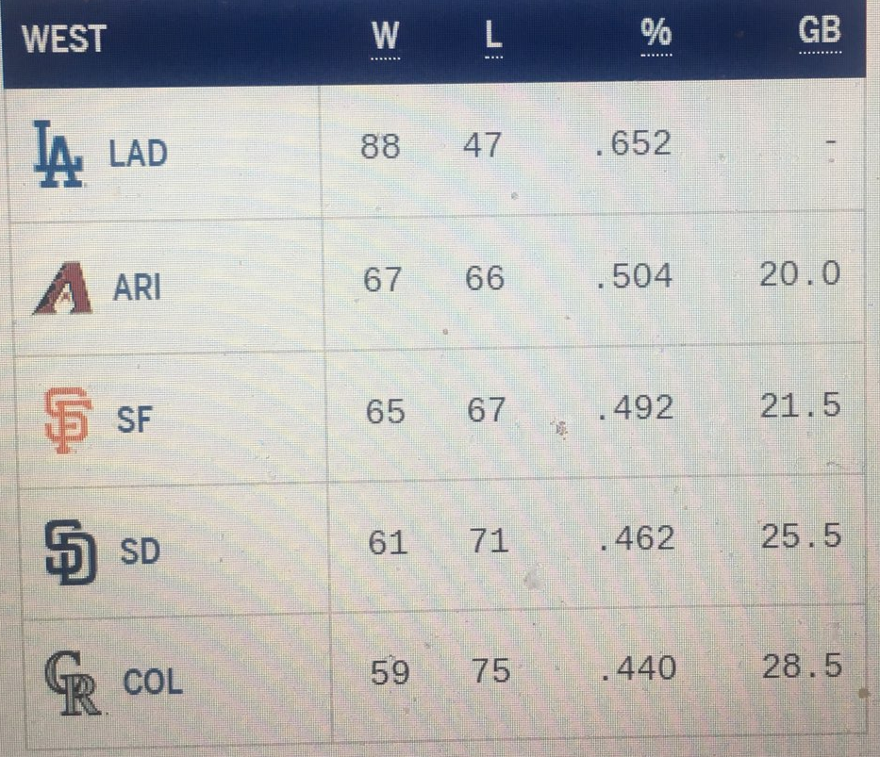
Extended Pigeonhole Principle Practice Problem
An MLB baseball card collector only collects baseball card for players from teams from the NL West. There are 5 teams in the NL West. What is the minimum number of cards that must be in the collection to guarantee that there are at least 100 cards from the same NL West team?
Notes:
Note difference between print(year) and println("leap year");

