Slide 1
Induction CSCI 170 Fall 2019 Lecture 9 Sandra Batista
1.1–1.2

Slide 2
Induction
Inference for Quantifiers
Induction
Strengthening the Inductive Hypothesis
Strong Induction
Error Checking
1.1–1.2

Slide 3
Inference for Quantifiers
Universal Instantiation: If for all x, P(x) holds, then for arbitrary value c, P(c) holds
Universal Generalization: If P(c) holds for arbitrary c, then P(x) holds for all x
Existential Instantiation: If there exists an x such that P(x) holds, then for at least one specific c, P(c) holds.
Existential Generalization: If for at least one specific c, P(c) holds, then there exists an x such that P(x) holds.
Notes:
straight-line programs: akin to calculator

Slide 4
Induction
Inference for Quantifiers
Induction
Strengthening the Inductive Hypothesis
Strong Induction
Error Checking
1.1–1.2

Slide 5
Induction
To prove claims of the form:
We apply proof technique called induction.
Examples of claims:
For any integer n, there exists a way to tile a 2xn grid with dominoes.
For any integer n, 3n+2 is odd.
Notes:
straight-line programs: akin to calculator

Slide 6
Induction
To prove claims of the form:
We apply proof technique called induction.
To prove a claim holds for any natural number:
Show the base case(s), i.e. the claim holds for n=0, P(0).
Assume the inductive hypothesis. This means to assume that the predicate holds for a specific value, e.g. Assume P(n) holds.
For the inductive step, use the inductive hypothesis to show that the predicate holds for the next value.
Notes:
straight-line programs: akin to calculator

Slide 7
Why Induction Works
Show P(0) directly.
If we then show P(0)->P(1), then by modus ponens, P(1) holds.
Now use P(1) holds and show P(1)->P(2), so by modus pones P(2) holds.
P(2) holds and show P(2)->P(3), so by modus ponens P(3) holds.
For any n, we can apply this sequence of inferences using the inductive step n times to show that P(n) holds.
Notes:
straight-line programs: akin to calculator

Slide 8
Induction Example
Exercise: For any n in the natural numbers, show
Proof by Induction:
Notes:
Note difference between print(year) and println("leap year");

Slide 9
Induction Example
Exercise: For any n in the natural numbers, show
Proof by Induction:
Notes:
Note difference between print(year) and println("leap year");

Slide 10
Induction
Inference for Quantifiers
Induction
Strengthening the Inductive Hypothesis
Strong Induction
Error Checking
1.1–1.2

Slide 11
Strengthening the Inductive Hypothesis
Sometimes, we may prove a stronger or more specific result in order to prove a statement.
This is called strengthening the inductive hypothesis.
Example: Show for any n greater than or equal to 0,
We have already shown the stronger, more specific statement:
For any n greater than or equal to 0,
The previous claim follows since
Notes:
straight-line programs: akin to calculator

Slide 12
Strengthening Inductive Hypothesis Example
Exercise: Show that for any natural number k greater than or equal to 1, the sum of the first k odd positive integers is a perfect square. A perfect square is an integer squared.
How to start?
Notes:
Note difference between print(year) and println("leap year");

Slide 13
Strengthening Inductive Hypothesis Example
Exercise: Show that for any natural number k greater than or equal to 1, the sum of the first k odd positive integers is a perfect square. A perfect square is an integer squared.
Notes:
Note difference between print(year) and println("leap year");

Slide 14
Strengthening Inductive Hypothesis Example
Prove that any 2^{n} by 2^{n} board with a middle square removed can be tiled with L-shaped tiles for any n greater than or equal to 1.
Strengthen Inductive Hypothesis: Show that any 2^{n} by 2^{n} board with any square removed can be tiled with L-shaped tiles for any n greater than or equal to 1.
Our predicate, P(n): A 2^{n} by 2^{n} board with any square removed can be tiled with L-shaped tiles
We are showing that P(n) holds for any n greater than or equal to 1.
We will show how to do so constructively in proof.
Notes:
Note difference between print(year) and println("leap year");

Slide 15
Strengthening Inductive Hypothesis Example
Strengthen Inductive Hypothesis: Show that any 2^{n} by 2^{n} board with any square removed can be tiled with L-shaped tiles for any n greater than or equal to 1.
Proof by Induction:
Base case: n =1
Assume the inductive hypothesis: Assume P(n) holds for some specific value n greater than or equal to 1.
A 2^{n} by 2^{n} board with any square removed can be tiled with L-shaped tiles.
Notes:
Note difference between print(year) and println("leap year");

Slide 16
Strengthening Inductive Hypothesis Example
Strengthen Inductive Hypothesis: Show that any 2^{n} by 2^{n} board with any square removed can be tiled with L-shaped tiles for any n greater than or equal to 1.
Before we get to the inductive step, let’s consider n = 2. How can we use the base case, n= 1, showing that we can tile a 2x2 board to tile this 4x4 board?
Notes:
Note difference between print(year) and println("leap year");

Slide 17
Strengthening Inductive Hypothesis Example
Strengthen Inductive Hypothesis: Show that any 2^{n} by 2^{n} board with any square removed can be tiled with L-shaped tiles for any n greater than or equal to 1.
Inductive Step. Assume we can tile a 2^{n} by 2^{n} board with any square removed using L-tiles. Show we can tile a 2^{n+1} by 2^{n+1}
Notes:
Note difference between print(year) and println("leap year");

Slide 18
Induction
Inference for Quantifiers
Induction
Strengthening the Inductive Hypothesis
Strong Induction
Error Checking
1.1–1.2

Slide 19
Is Weak Induction Necessary?
Given how induction works, does it matter if we show the base case
and assume for some specific value, n-1, that P(n-1)->P(n)?
We can show through many steps of inference:
P(0)->P(1)->P(2)->P(3)->P(4)->…
What if we could assume many hypotheses at once?
Notes:
straight-line programs: akin to calculator

Slide 20
Strong Induction
To prove claims of the form:
We apply proof technique called strong induction.
To prove a claim holds for any natural number:
Show the base case(s), i.e. the claim holds for n=0, P(0).
Assume the inductive hypothesis. Assume the predicate holds for predicate holds for all values from the base case to a specific value:
For the inductive step, use the inductive hypothesis to show that the predicate holds for the next value.
Notes:
straight-line programs: akin to calculator

Slide 21
Strong Induction Example
Exercise: Show that for any n greater than or equal to 12, n cents in postage can be formed using only 4-cent and 5-cent stamps.
Proof by Induction:
Notes:
Note difference between print(year) and println("leap year");

Slide 22
Strong Induction Example
Exercise: Show that for any n greater than or equal to 12, n cents in postage can be formed using only 4-cent and 5-cent stamps.
Proof by Induction:
Notes:
Note difference between print(year) and println("leap year");

Slide 23
Strong Induction Example
Recall the Fibonacci Sequence: f₀=0, f₁=1, f₂=1, f₃=2, f₄=3, f₅=5,…
What is the recursive or inductive definition for the Fibonacci sequence?
Base cases:
Recursive or inductive case: Define the sequence in terms of earlier terms in the same sequence itself
Notes:
Note difference between print(year) and println("leap year");

Slide 24
Strong Induction Example
Let’s prove the following predicate for the Fibonacci sequence where :
[Useful fact: a² = a +1.]
Proof by Induction:
Notes:
Note difference between print(year) and println("leap year");

Slide 25
Strong Induction Example
Let’s prove the following predicate for the Fibonacci sequence where :
[Useful fact: a² = a +1.]
Proof by Induction:
Notes:
Note difference between print(year) and println("leap year");

Slide 26
Strong Induction Example
Exercise: Show for any n greater than or equal to 2, n can be presented as the product of primes.
Proof by Induction:
Notes:
Note difference between print(year) and println("leap year");

Slide 27
Strong Induction Example
Exercise: Show for any n greater than or equal to 2, n can be presented as the product of primes.
Proof by Induction:
Notes:
Note difference between print(year) and println("leap year");

Slide 28
Induction
Inference for Quantifiers
Induction
Strengthening the Inductive Hypothesis
Strong Induction
Error Checking
1.1–1.2

Slide 29
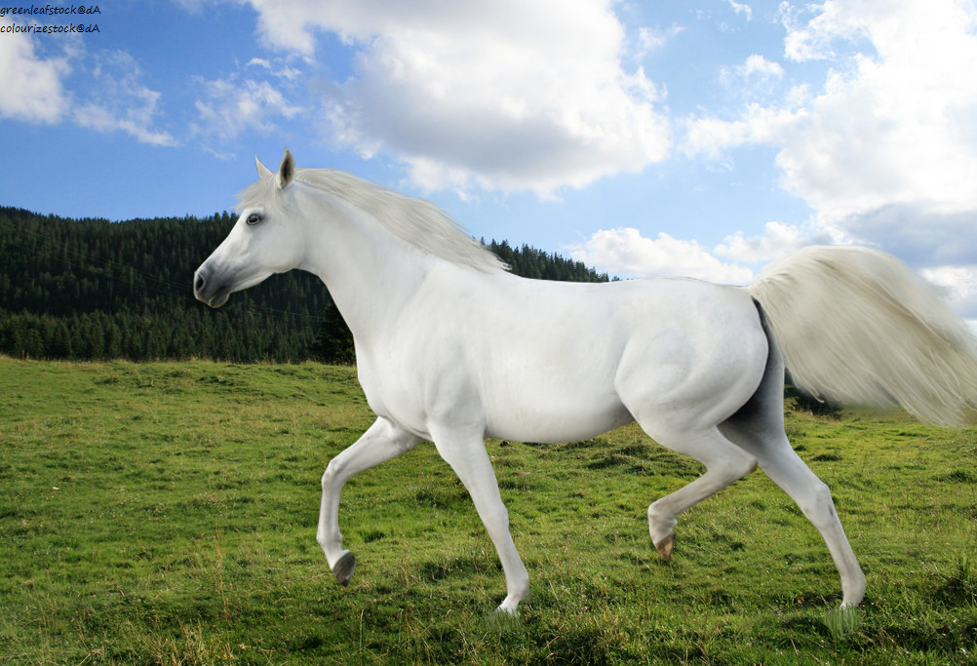
Error Checking
Bold claim: Every horse is the same color!
This Photo by Unknown Author is licensed under CC BY
Notes:
Note difference between print(year) and println("leap year");

Slide 30

Error Checking
Bold claim: Every horse is the same color!
This Photo by Unknown Author is licensed under CC BY-NC-ND
Notes:
Note difference between print(year) and println("leap year");

Slide 31
Induction
Inference for Quantifiers
Induction
Strengthening the Inductive Hypothesis
Strong Induction
Error Checking
1.1–1.2

