Slide 1
Applications of Propositions
1.1–1.2

Slide 2
Applications of Propositions
Logic Gates
Natural language to propositions
Consistent systems
puzzles

Slide 3
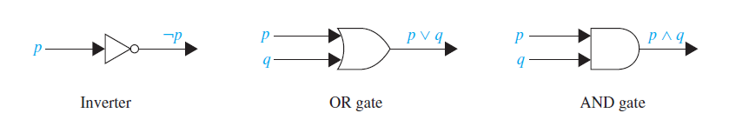
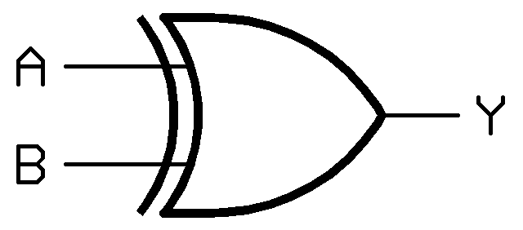
Logic gates
Logic gates are used in computer hardware design
XOR gate

Slide 4
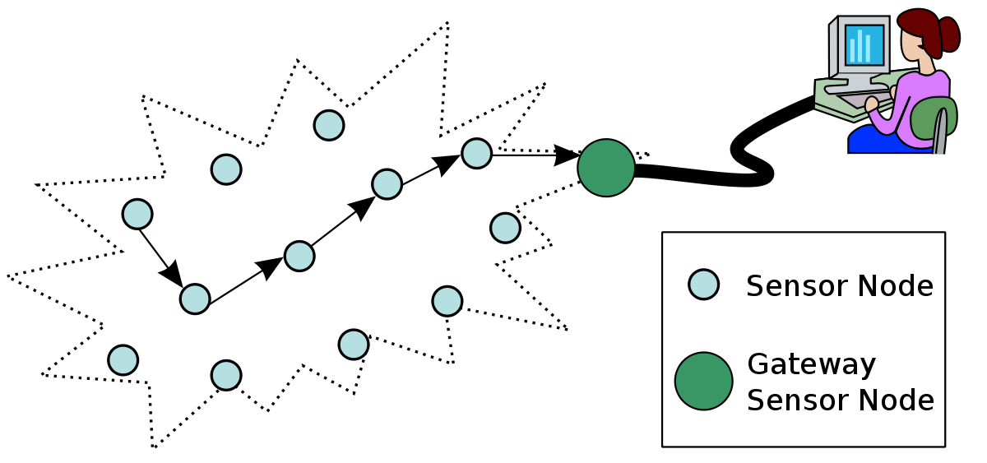
Sensor network
Requirements. Assume there is a 3-sensor network. If 2 or more sensors are true, then we must send TRUE to control station.
Design a logic circuit that meets these requirements
This Photo by Unknown Author is licensed under CC BY-SA-NC
Notes:
Key idea.
1 1 0
0 1 1
1 1 1

Slide 5
Half Adder
Design a logic circuit that adds together two bits. It should have an output bit and carry-out bit.
XOR gate
Notes:
Key idea.
1 1 0
0 1 1
1 1 1

Slide 6
introduction
Natural language to propositions
Consistent systems
puzzles

Slide 7
Many ways of saying p ➔ q
If p, then q
p implies q
p is sufficient for q
p only if q
q if p
a sufficient condition for q is p
q when p
q whenever p
a necessary condition for p is q
q is necessary for p
q follows from p

Slide 8
Examples
Convert the following statements to logical propositions
roads will be wet, if it rains
you can only pass the exam if you study tonight
It is below freezing and snowing
It is either below freezing or snowing, but not both
q if p
p only if q

Slide 9
2.1 Applications of Propositions
introduction
Natural language to propositions
Consistent systems
puzzles

Slide 10
Consistency
A set of compound propositions are consistent if there exists truth
assignment such that all propositions are satisfied at the same time.
First, we will show how two compound propositions using the atomic propositions, p and q, are consistent.
Then we will introduce a third proposition to show when they are not longer consistent.
Example: p = “There was a heatwave in Los Angeles in July 2019. ”
q = “There was a heatwave in London in July 2019.”
T
T
T
T
F
T
F
T
T
F
F
T
T
F
T
F
F
F
T
T
Notes:
straight-line programs: akin to calculator

Slide 11
workshop
Are these system specifications consistent?
Whenever the system software is being upgraded(p), users cannot access the file system(~q). (p ➔ ~q)
If users can access the file system(q), then they can save new files (r ). (q ➔ r)
If users cannot save new files(~r), then the system software is not being upgraded(~p).” (~r ➔ ~p)
Notes:
“I will pass the exam(p) if I can study tonight (q) ” ( q ➔ p)
“I will not pass the exam unless I study tonight” (~p unless q MEANS q ➔ ~(~p))
“I will pass the exam(p) if I can buy a book(q) unless the book-store is closed (R)” (p if q unless r means r ➔ ~(q➔p ) means r ➔ q^ ~p
“I know you believe you understand(p) what I said, but I am not sure you realize(q) that what you heard(r) is not what I meant!”
“she is a poor little rich girl”
P- she is poor
Q – she is rich
~p^q^p = F
“My sister is jealous of me because I'm an only child” (if I am the only child, then I have a sister and my sister is jealous of me)
I am the only child (p)
I have a sister (q)
if I am the only child, then I have a sister and my sister is jealous (r ) of me
p ➔ q ^ r but if p is true, then q cannot be true. Hence the statement is a contradiction

Slide 12
2.1 Applications of Propositions
applications
Natural language to propositions
Consistent systems
puzzles

Slide 13


Puzzle
There is an island with two kinds of inhabitants. Those who always tell the truth (knights) and those who always lie (knaves). You encounter two people A and B.
What are A and B, if A says, “B is a knight” and B says “two of us are opposite types”
Notes:
Let p and q be the statements that A is a knight and B is a knight, respectively, so that ¬p and ¬q are the statements that A is a knave and B is a knave, respectively.
Probably a good way to approach this problem (among many options) is to think of all possible scenarios. We consider all possible cases of what A and B can be. Then we interpret their statements based on their truth value. For example
If the person is a TT, then we take the statement to be always true
If the person is a liar, then we take the opposite of the statement to be true
We check out of all possibilities, which option is consistent with the two statements made
p q
T T ⬅ this is not possible since they both tell the truth and therefore both Knights(A says q; B says (p^~q) v (q^~p) and show that q ^
T F ⬅ since A tells the truth, B must be a knight, but in our assumption B is not
F T ⬅ since A lies, B must be a knave. But B is not according this case
F F ⬅ since A lies, it implies B is a knave (which is consistent). B says two of us are opposite types. But B lies. Therefore the true statement is A and B are the same type.
So we know A is a knave, and B is a knave
ALTERNATE ARGUMENTS
Assume that A is a knight. That is p is true. If A says, B is a knight, then q is true (because A always tell the truth).
But B says two of us are opposite types. then B says p ^ ~q or q ^ ~p true. But that is not possible. So either B is a knave or A is a knight. Therefore it must be But since p and q are true, we know this cannot be the case. So our assumption was wrong.
Therefore A must be a knave. Since A always lies, this implies B is a knave. This is also consistent with the statement by B (who lies), that they are opposite types.
Alternate Argument:
What if we started with an different assumption
Suppose B is a knight ➔ q = TRUE
Since B is assumed to be telling the truth, then A is a knave. ➔ p = FALSE
Since a knave lies, this implies, B is a knave. So this is a contradiction
Hence our assumption is false and B must be a knave.
Now we know B lies, B’s statement implies, A is also a knave

Slide 14



Practice problem
A tourist come to a Y junction and the city may be to the left or to the right. There is a native person standing at the junction who knows the answer. But the person may be lying or telling the truth and they only answer with YES or NO.
What question can the tourist ask, so that if the answer is “yes’ he will go left and if the answer is no, then he will go right.
Notes:
Let p and q be the statements that A is a knight and B is a knight, respectively, so that ¬p and ¬q are the statements that A is a knave and B is a knave, respectively.
Probably a good way to approach this problem (among many options) is to think of all possible scenarios. We consider all possible cases of what A and B can be. Then we interpret their statements based on their truth value. For example
If the person is a TT, then we take the statement to be always true
If the person is a liar, then we take the opposite of the statement to be true
We check out of all possibilities, which option is consistent with the two statements made
p q
T T ⬅ this is not possible since they both tell the truth and therefore both Knights(A says q; B says (p^~q) v (q^~p) and show that q ^
T F ⬅ since A tells the truth, B must be a knight, but in our assumption B is not
F T ⬅ since A lies, B must be a knave. But B is not according this case
F F ⬅ since A lies, it implies B is a knave (which is consistent). B says two of us are opposite types. But B lies. Therefore the true statement is A and B are the same type.
So we know A is a knave, and B is a knave
ALTERNATE ARGUMENTS
Assume that A is a knight. That is p is true. If A says, B is a knight, then q is true (because A always tell the truth).
But B says two of us are opposite types. then B says p ^ ~q or q ^ ~p true. But that is not possible. So either B is a knave or A is a knight. Therefore it must be But since p and q are true, we know this cannot be the case. So our assumption was wrong.
Therefore A must be a knave. Since A always lies, this implies B is a knave. This is also consistent with the statement by B (who lies), that they are opposite types.
Alternate Argument:
What if we started with an different assumption
Suppose B is a knight ➔ q = TRUE
Since B is assumed to be telling the truth, then A is a knave. ➔ p = FALSE
Since a knave lies, this implies, B is a knave. So this is a contradiction
Hence our assumption is false and B must be a knave.
Now we know B lies, B’s statement implies, A is also a knave

