Slide 1
Asymptotic Notation CSCI 170 Fall 2019 Lecture 3 Sandra Batista
1.1–1.2

Slide 2
Asymptotic Notation
Big-O Notation
Big-Omega Notation
Big-Theta Notation
Hierarchies of Functions
Properties of Asymptotic Notation
1.1–1.2

Slide 3
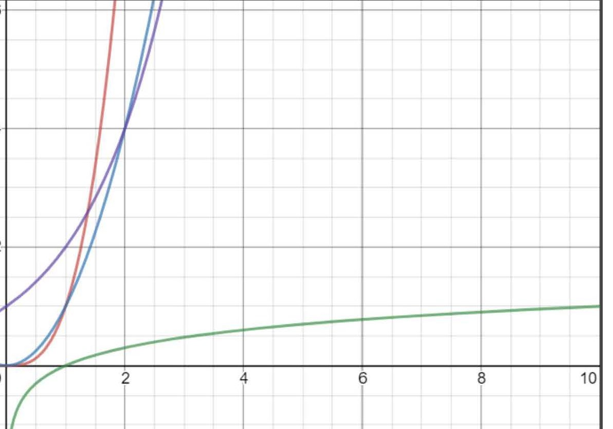
The Growth of Functions
Asymptotic Notation helps us to compare the growth rate of functions
Sometimes we only need to know what happens to function of n as n grows very large
In computer science we apply asymptotic analysis to runtime analysis to determine its scalability: How many resources in terms of time and space are needed as the input size grows?

Slide 4
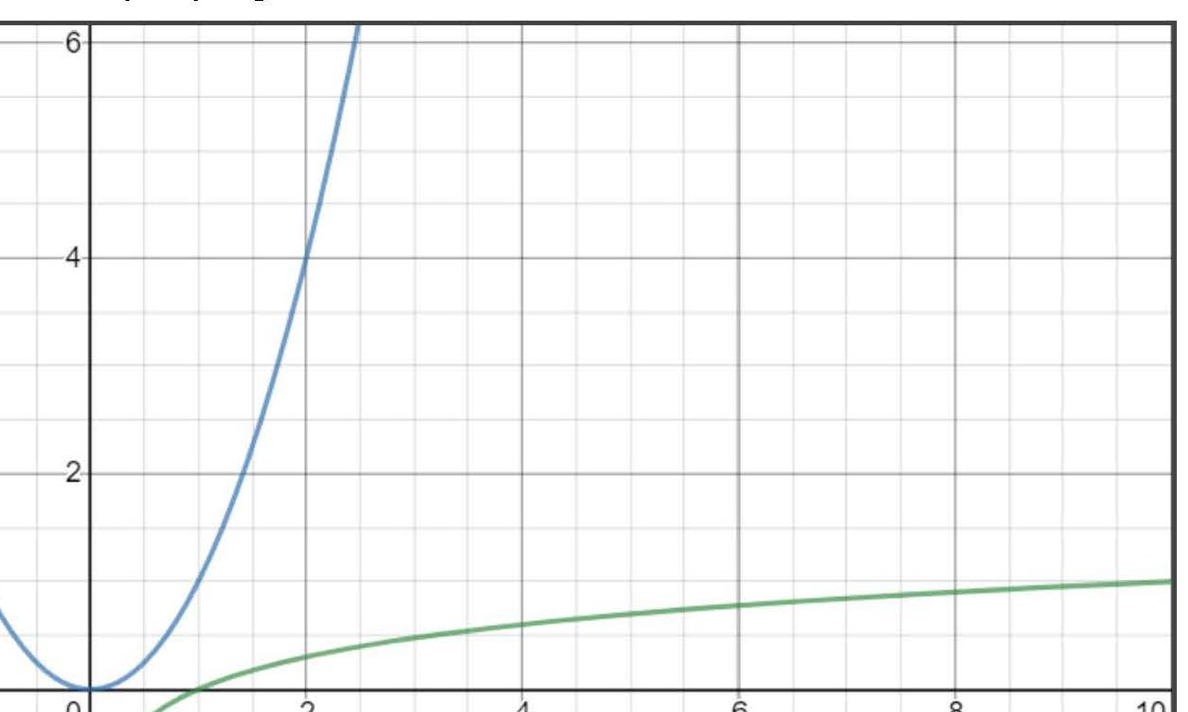
Big-O Notation
O(g(n)) = {f(n): there exists positive constants c and n₀ such that for any n greater than or equal to n₀, }
For functions, it is analogous to
.
c*g(n)
Limit Rule: f(n) ∈ O(g(n))
if and only if
f(n)
n₀
Notes:
straight-line programs: akin to calculator

Slide 5
Big-O Notation Practice Problem 1
Is 2^{n+1} in O(2^{n})?
Notes:
Note difference between print(year) and println("leap year");

Slide 6
Big-O Notation Practice Problem 2
Is 2^{2n} in O(2^{n})?
Notes:
Note difference between print(year) and println("leap year");

Slide 7
Asymptotic Notation
Big-O Notation
Big-Omega Notation
Big-Theta Notation
Hierarchies of Functions
Properties of Asymptotic Notation
1.1–1.2

Slide 8
Big-Omega Notation
(g(n)) = {f(n): there exists positive constants c and n₀ such that for any n greater than or equal to n₀, }
For functions, it is analogous to
.
Limit Rule: f(n) ∈ (g(n))
if and only if
f(n)
c*g(n)
n₀
Notes:
straight-line programs: akin to calculator

Slide 9
Asymptotic Notation
Big-O Notation
Big-Omega Notation
Big-Theta Notation
Hierarchies of Functions
Properties of Asymptotic Notation
1.1–1.2

Slide 10
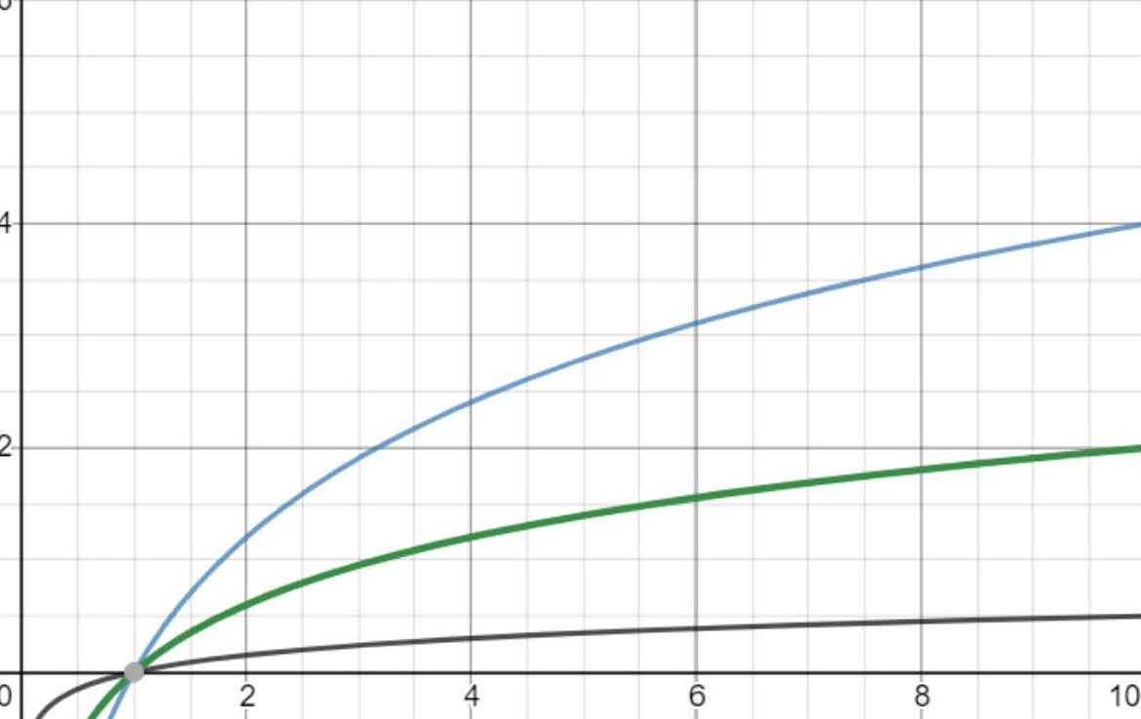
Big-Theta Notation
(g(n)) = {f(n): there exists positive constants constants c₁ , c₂ and n₀ such that for any n greater than or equal to n₀, }
For functions, it is analogous to
.
c₂*g(n)
Limit Rule: f(n) ∈ (g(n))
if and only if for some positive constant k
f(n)
c₁*g(n)
n₀
Notes:
straight-line programs: akin to calculator

Slide 11
Big-Theta Notation Practice Problem
Show log₁₀(n) is in (log₂(n)).
(Hint: Recall how to change bases. log_{b}(n) = log_{a}(n)/ log_{a}(b))
Notes:
Note difference between print(year) and println("leap year");

Slide 12
Asymptotic Notation
Big-O Notation
Big-Omega Notation
Big-Theta Notation
Hierarchies of Functions
Properties of Asymptotic Notation
1.1–1.2

Slide 13
Hierarchies of Functions
“Polynomial functions grow faster than logarithmic ones” or “Logarithmic time algorithms are better than polynomial ones”
More formally: log^{c}n is O(n^{d}) for c, d > 0
[Theorem 21.5 in Lewis, Zax textbook]
“Exponential functions grow faster than polynomial ones” or “Polynomial time algorithms are better than exponential ones”
More formally: n^{c} is O((1+d)^{n} ) for c, d > 0
[Theorem 21.7 in Lewis, Zax textbook]

Slide 14
Hierarchies of Functions
Comparing the order of growth of functions is used to compare the running times of algorithms.
To do so, create bins of the functions, that are sorted by growth by hierarchies of functions, and then sort within the bins.
e.g. “Exponential functions grow faster than polynomial ones”
When in doubt, apply limit rules! Take the ratio of two functions and check whether numerator or denominator will be larger.

Slide 15
Hierarchies of Functions Practice Problem
Rank the following functions from smallest to largest in terms of order of growth:
log n^{n}, n², n^{log n}, n log log n, 2^{log n}, log² n, n^{√2}
Notes:
Note difference between print(year) and println("leap year");

Slide 16
Asymptotic Notation
Big-O Notation
Big-Omega Notation
Big-Theta Notation
Hierarchies of Functions
Properties of Asymptotic Notation
1.1–1.2

Slide 17
Properties of Asymptotic Notation
Big-O, Big-Omega, Big-Theta are all reflexive and transitive.
e.g.
Reflexivity: f(n) is in O(f(n))
Transitivity: If f(n) is in O(g(n)) and g(n) is in O(h(n)), then
f(n) is in O(h(n))
Big-Theta is also symmetric, but Big-O and Big-Omega are not.
f(n) is in Theta(g(n)) if and only if f is in O(g(n)) and Omega(g(n))
Symmetry: If f(n) is in Theta(g(n)), then g(n) is in Theta(f(n)) [Theorem 21.2 in Lewis, Zax textbook]

Slide 18
Properties of Asymptotic Notation Practice Problem
Let f(n) and g(n) be nonnegative functions: Show that O(f(n) +g(n)) = O(max(f(n),g(n))).
Notes:
Note difference between print(year) and println("leap year");

Slide 19
Properties of Asymptotic Notation Practice Problem
Let f(n) and g(n) be nonnegative functions: Show that O(f(n) +g(n)) = O(max(f(n),g(n))).
Notes:
Note difference between print(year) and println("leap year");

Slide 20
Properties of Asymptotic Notation Practice Problem
Let f(n) and g(n) be nonnegative functions: Show that O(f(n) +g(n)) = O(max(f(n),g(n))).
Notes:
Note difference between print(year) and println("leap year");

